Slide 1
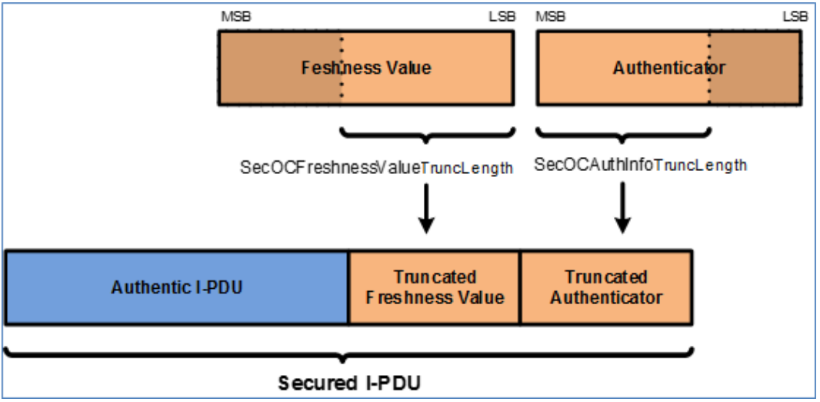
The most significant parts of an authenticator are typically harder to forge or manipulate without detection, providing a more robust defense against security threats such as replay attacks or data tampering.
Truncation to MSBs is also aligned with standard practices in cryptographic protocols.

Slide 2
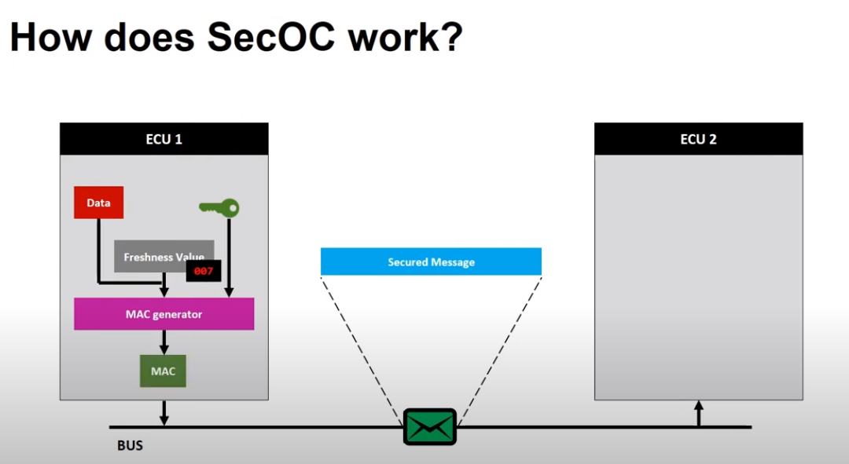

Slide 3
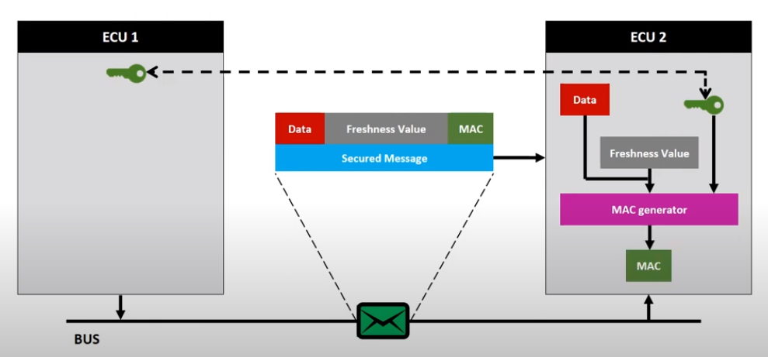

Slide 4
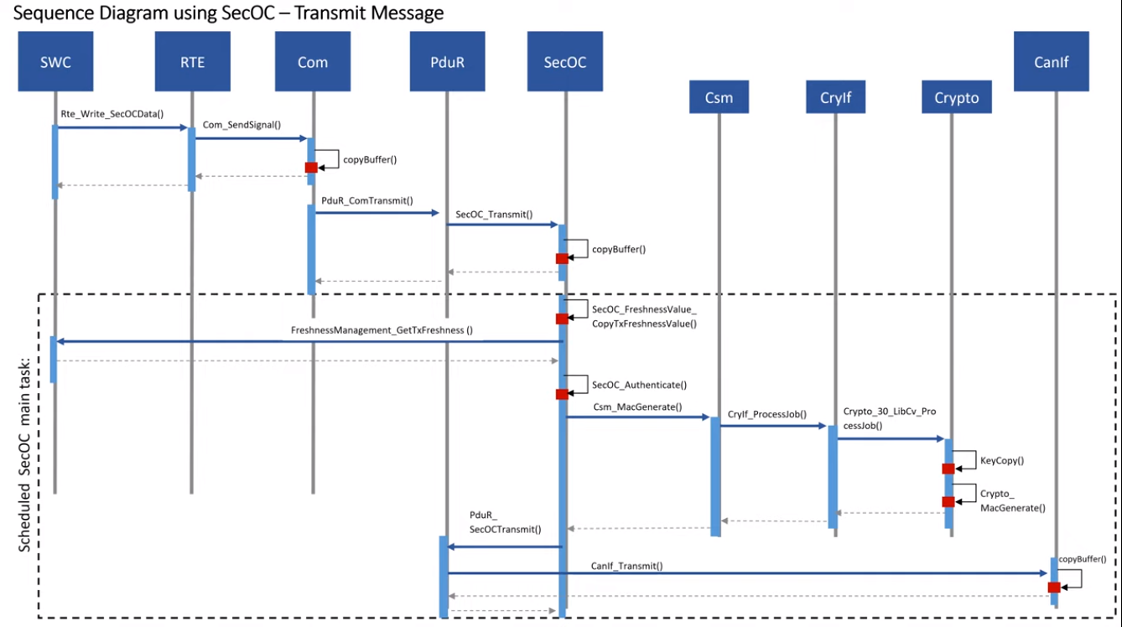

Slide 5
The creation of a Secured I-PDU
This Process consists of the following six steps:
Prepare Secured I-PDU
Construct Data for Authenticator
Generate Authenticator
Construct Secured I-PDU
Increment Freshness Counter
Broadcast Secured I-PDU

Slide 6
Calculated MAC
The data, on which the Authenticator is calculated:
the Data Identifier of the Secured I-PDU (parameter SecOCDataId)
Authentic I-PDU data
the Complete Freshness Value.
These are concatenated together respectively to make up the bit array that is passed into the authentication algorithm for Authenticator generation/verification.
Data Id = 16-bit
DataToAuthenticator = Data Identifier | secured part of the Authentic I-PDU | Complete Freshness Value.
SecuredPDU = SecuredIPDUHeader (optional) | AuthenticIPDU | FreshnessValue (optional) | Authenticator (MAC)

Slide 7
Notes
Depending on the authentication algorithm used to generate the Authenticator, it may be possible to truncate the resulting Authenticator (e.g. MAC) generated by the authentication algorithm.
Truncation may be desired when the message payload is limited in length and does not have sufficient space to include the full Authenticator.
In case a MAC is used, it is possible to transmit and compare only parts of the MAC.
This is known as MAC truncation.
However, this results in a lower security level at least for forgery of single MACs.
While we propose to always use a key length of at least 128 bits, a MAC truncation can be beneficial.

