Slide 1
Comparing data plane & control plane for Docker Containers, QEMU/KVM and Xen VM
Neda Farahmandi NetID:nfara011
Hunter Adomitis NetID: hadom001

Slide 2
Outline
Goal: To gain an understanding of Docker containers vs QEMU/kvm and Xen VMs and to compare their data plane and control plane.
Design
Selected Sock Shop, a Microservices Demo Application for testing on Docker containers, QEMU/ kvm VMs and Xen VMs.
Implementation on Cloud Labs
Deployment on Docker Containers
Deployment on QEMU/KVM
Deployment on Xen
Demo
Problems faced
Q&A

Slide 3
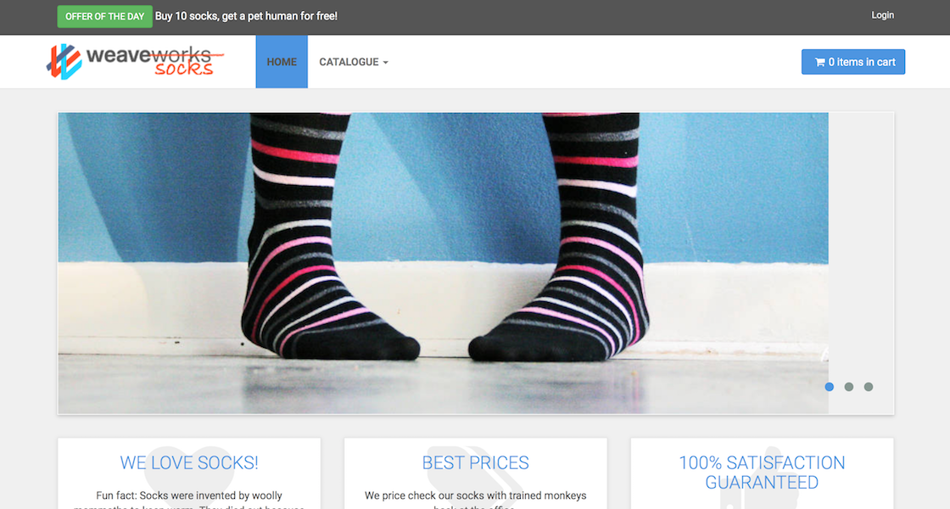
Design
Running a Microservices Application, sock shop on
Docker Containers
Docker containerization engine
Docker-compose container orchestration
Used WeaveScope for monitoring
QEMU/ KVM
3 VMs
1 master node: control plane
2 worker nodes: data plane
Kubernetes orchestration
Xen
Virtual Box
Kubernetes orchestration
Used WeaveScope for monitoring

Slide 4
Docker Containers
Cloud lab Experiment
Ubuntu-22.04
Dependencies
curl -sSL https://get.docker.com/ | sh
apt-get install -yq jq python-pip curl unzip build-essential python-dev
curl -o /tmp/terraform.zip https://releases.hashicorp.com/terraform/0.7.11/terraform_0.7.11_linux_amd64.zip
Clone the microservices repo
git clone https://github.com/microservices-demo/microservices-demo
cd microservices-demo
Set up WeaveScope
sudo curl -L git.io/scope -o /usr/local/bin/scope
sudo chmod a+x /usr/local/bin/scope
scope launch
provision the infrastructure
docker-compose -f deploy/docker-compose/docker-compose.yml up -d
provision the infrastructure & simulate user traffic
docker run --net=host weaveworksdemos/load-test -h $frontend-ip[:$port] -r 100 -c 2
docker run --net=host weaveworksdemos/load-test -h $frontend-ip[:$port] -r 100 -c 2

Slide 5

Demo

Slide 6
QEMU/KVM
Cloud lab Experiment
Created 3 VMs with kvm small-lan profile: Ubuntu-22.04
ubuntu-vm0: master node
ubuntu-vm1: worker-1
ubuntu -vm2: worker-2
Created 3 VMs with kvm small-lan profile: Ubuntu-22.04
Set up the master node and worker nodes
Install Kubernetes Components
Install kubelet, kubeadm, and kubectl
Initialize Kubernetes Master Node. Set up the kubeconfig
Deploy a Pod Network
Join the Worker Nodes

Slide 9
Xen
Every vm had the same microservice installed and tested to ensure correctness and to learn the strengths and weaknesses of each one
We used the sock-shop demo microservice application
We changed as little as possible in of the demo for 2 reason
We wanted to focus setting up the vm environments rather than developing our own application
We want as much consistency between vms
Github repo link:
https://github.com/microservices-demo/microservices-demo

Slide 11
What didn’t work
Majority of time spent on researching and understanding the problem statement.
Selected a microservice that was deprecated and not supported.
So many trials and errors for QEMU/kvm since there is no available guide.
Slight difference in different releases cause trouble, so we learned what does not work very well.
The main problem faced through the project was primarily setting up the vm since we had to create our own profiles in order to run each vm
Also, given the security with cloud labs we could not access the front end to test to see if that was working properly. As a result, we chose to use virtual box for the XEN vm to test accessing the microservice through the internet.

Slide 12
References
https://github.com/microservices-demo/microservices-demo?tab=readme-ov-file
https://github.com/weaveworks
https://gloryyusuf20.medium.com/using-the-cloud-to-deploy-a-microservices-application-786d51830815
https://www.n0derunner.com/create-a-linux-vm-with-kvm-in-6-easy-steps/
https://medium.com/@kvihanga/how-to-set-up-a-kubernetes-cluster-on-ubuntu-22-04-lts-433548d9a7d0
https://uthy.hashnode.dev/mastering-kubernetes-setting-up-a-cluster-and-deploying-a-demo-app-with-weaveworks-socks-shop-on-ubuntu-2004

Slide 13
Q&A

