Slide 1


Industrial Practice (CoSc3122) Presentation
Design and Development of a Dynamic Website and Content Management System for Oda Bultum University (OBU-CMS)
Nedi Usman Hussen
Student ID: 2184/16 | Department of Computer Science, Haramaya University
Advisor: Mr. Kibru G. | Host: ICT Directorate, Oda Bultum University
Monday, October 26, 2026
Notes:
Good morning. I am Nedi Usman Hussen. My industrial practice was at the ICT Directorate of Oda Bultum University, where I designed and built OBU-CMS, a dynamic website with a content management system. I follow the department presentation template: organization background, the project, problem and objectives, literature review, requirements, system model, methodology, benefits of the internship, conclusion and recommendations, and a demonstration.

Slide 2




1.1 Organization Background
Template 1.1
Why this company?
Which section, and why?
A real client with a real need: the university website had to be modernized, and the result is used by staff and students
ICT Directorate: it owns the servers, network and the website, so a web system belongs there
Work flow of the section
Tasks I executed
Support requests by tickets; infrastructure changes need written approval of the ICT Director; progress meetings every Monday and Thursday
Requirements, database design, backend and frontend, Admin CMS, testing, documentation
Notes:
Oda Bultum University is a public university founded in 2015 in Chiro, West Hararghe. I worked in the ICT Directorate because it is the technical owner of the university website. The Directorate works with a ticket system for support and written approval for infrastructure changes, and I met the ICT Director every Monday and Thursday to demonstrate progress. My tasks covered the full life cycle: requirements, database design, backend, frontend, the admin panel, testing and documentation.

Slide 3



Skills and Tools from Coursework
Template 1.1
Course knowledge that helped
Languages and techniques
Tools and methods
Database systems: normalization, keys, SQL
Software engineering: requirements, UML
Web development: HTTP, rendering, REST
Information security: least privilege, CSRF, SQL injection
TypeScript, JavaScript, SQL
HTML and CSS (Tailwind)
UML modeling, ER design, migrations
Row Level Security and role-based access
React 19, TanStack Start, Supabase
Git, VS Code, Postman, ESLint
Agile Scrum with sprint reviews
curl scripts and SQL inspection
Notes:
Database systems gave me normalization, keys and SQL for the 27-table design. Software engineering gave me requirements and UML. Web development and security courses helped with server-side rendering, authentication, Row Level Security, CSRF and SQL injection prevention. The languages and tools are TypeScript, SQL, React with TanStack Start, Supabase, Tailwind, Git and Postman, with an Agile Scrum method.

Slide 4
Challenges and Measures
Template 1.1
Challenge
Measure taken
Public reads vs admin writes
Row Level Security as the main rule; Supabase client for pages, few server functions
Clean, unique URLs
generate_slug() SQL function, unique constraints, -2/-3 check in hooks
Images used by many modules
One central media table and the AdminImageUpload component
Scope growth from every office
Agile backlog: core modules first, extra requests postponed
Notes:
Main challenges and measures: public reading versus admin writing was solved with Row Level Security; clean and unique URLs with a SQL slug function and unique constraints; image reuse with one central media table; and scope growth with a prioritized Agile backlog. At work I also had to fit review cycles into the Directorate formal approval process.

Slide 5
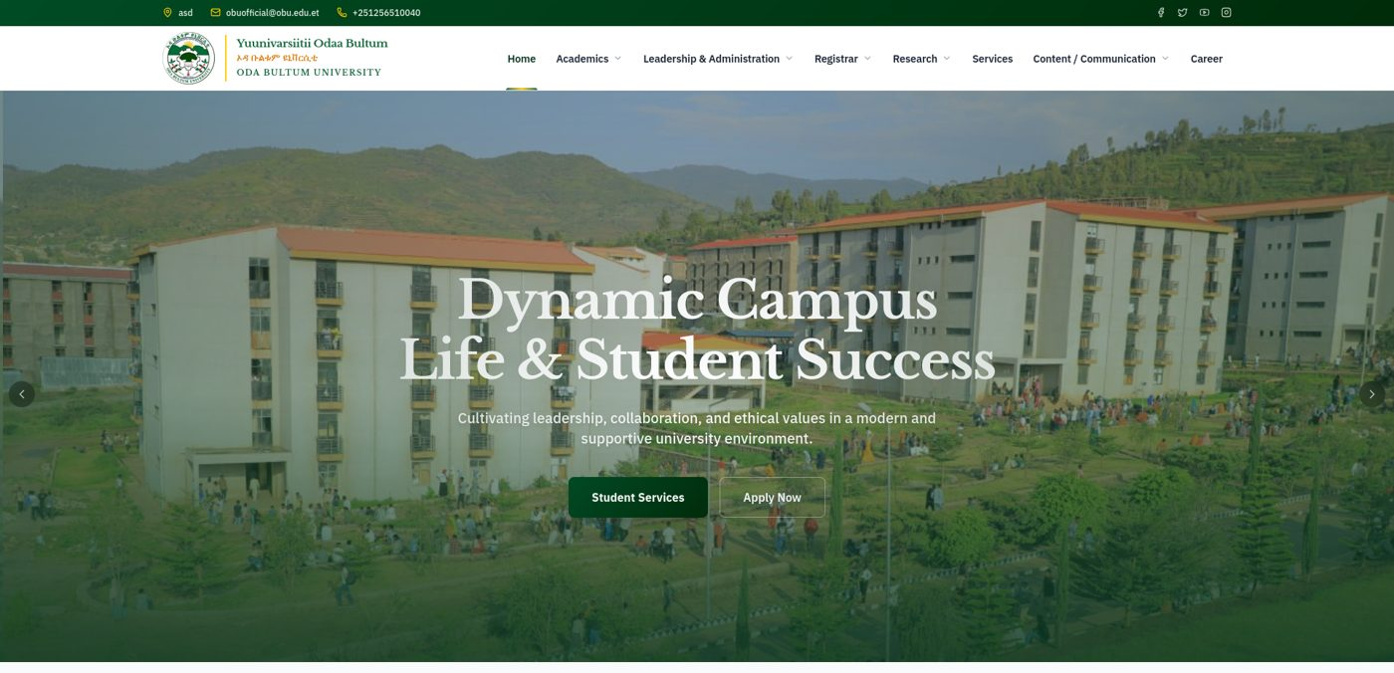
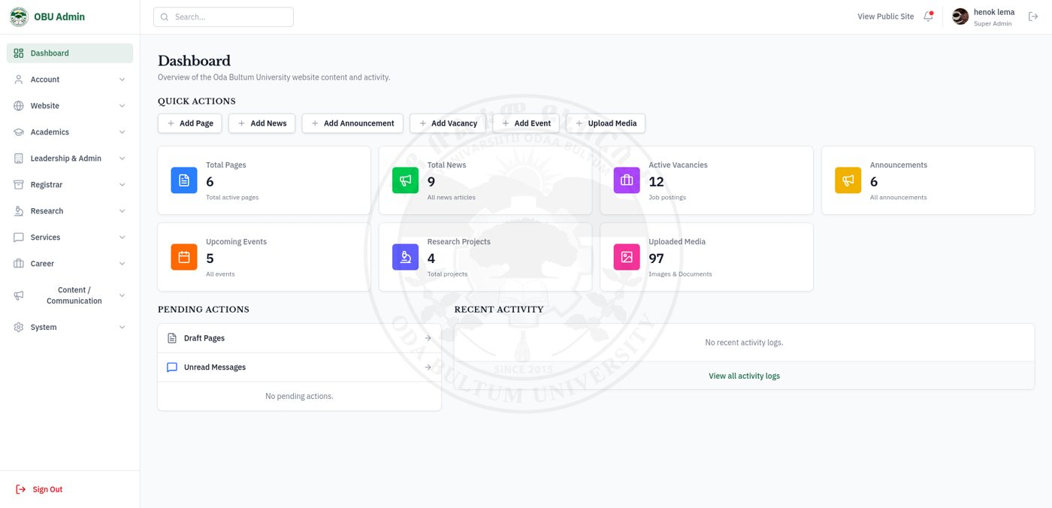
1.2 Introduction of the Project
Template 1.2
OBU-CMS: a dynamic university website with a secure Admin CMS, so that staff publish news, events, programs, research and vacancies without writing code.
27
database tables
73
route files
30
functional requirements
React 19 + TanStack Start | TypeScript | Tailwind CSS | Supabase (PostgreSQL, Auth, Storage)
Notes:
This is the project in one slide. OBU-CMS is a dynamic website for Oda Bultum University with a secure Admin CMS. It has 27 database tables, 73 route files (38 public and 35 admin) and 30 functional requirements, built with React, TanStack Start, TypeScript, Tailwind and Supabase. On the right: the new public site and the admin dashboard.

Slide 6




2. Problem and Justification
Template 2
Content depends on technical staff
Urgent notices are delayed
Why it is justified
Registration and exam notices are time-sensitive
Many offices must publish independently and safely
Students mostly use phones
Accountability: who changed what, and when
One reusable system lowers maintenance work
No structured content or clean links
News, events, vacancies are not managed records
No media library, roles or audit trail
Nobody can tell who changed what
Hard to read on phones
Deep menus, low contrast, fixed 2023 footer
Notes:
The old website was template-based. Content updates needed technical help, content had no structure, there was no media library, roles or audit trail, and some pages were hard to read on phones, with a fixed copyright year of 2023. Justification: registration and exam notices are time-sensitive, many offices must publish on their own, students mostly use phones, and the university needs accountability.

Slide 7



3. Objectives of the Project
Template 3
General objective Build a secure, responsive, database-driven website and CMS so that non-technical staff publish university information themselves.
Dynamic website
Slug-based pages for news, events, programs, research, leadership
Secure Admin CMS
Login, Row Level Security, role-based System menu
Media library
Upload once, reuse everywhere; type and 10 MB checks
Audit log
Every create, update, delete and upload is recorded
Notes:
The general objective is a secure, responsive, database-driven website and CMS. Four specific objectives are shown; the report lists eight measurable ones.

Slide 8
4. Literature Review
Template 4
Approach
Strength
Limitation
Decision
Traditional CMS (e.g. WordPress, Drupal)
Mature; themes and plugins; fast to start
Plugin upkeep and security; generic content model
Not chosen
Headless CMS (e.g. Strapi, Contentful)
API-first, structured content
Extra service to host; the website is still to be built
Not chosen
Custom app on Supabase (this project)
Typed code, database-level security, one codebase
More development effort
Chosen
Role-Based Access Control
Permissions belong to roles (Sandhu et al., 1996)
PostgreSQL Row Level Security
The database applies per-row policies
OWASP Top 10
Broken access control is a top web risk
Scrum Guide (2020)
Short sprints with reviews
Notes:
Related work: traditional CMSs such as WordPress and Drupal are mature but depend on plugins and a generic content model. Headless CMSs are API-first but still need a separate website and extra hosting. I chose a custom application on Supabase because the content is structured academic data and I wanted type safety and database-level security. The ideas behind it: role-based access control by Sandhu and colleagues, PostgreSQL Row Level Security, the OWASP Top 10 warning on broken access control, and the Scrum Guide. The full references are in the report.

Slide 9
5. Functional Requirements
Template 5
Public website (16)
Admin CMS (14)
Dynamic home page with hero slides
News, events, announcements with slugs
Colleges, departments, programs
Leadership, services, vacancies
Registrar documents and notices
Contact form, galleries, pages
Secure login and route guard
Dashboard with live statistics
CRUD for the content modules
Media library and unique slugs
Users, roles, navigation, settings
Activity log and contact messages
Notes:
There are 30 functional requirements: 16 for the public website and 14 for the Admin CMS. Non-functional requirements include usability, performance, reliability, security, scalability, responsiveness, maintainability and legal compliance.

Slide 10
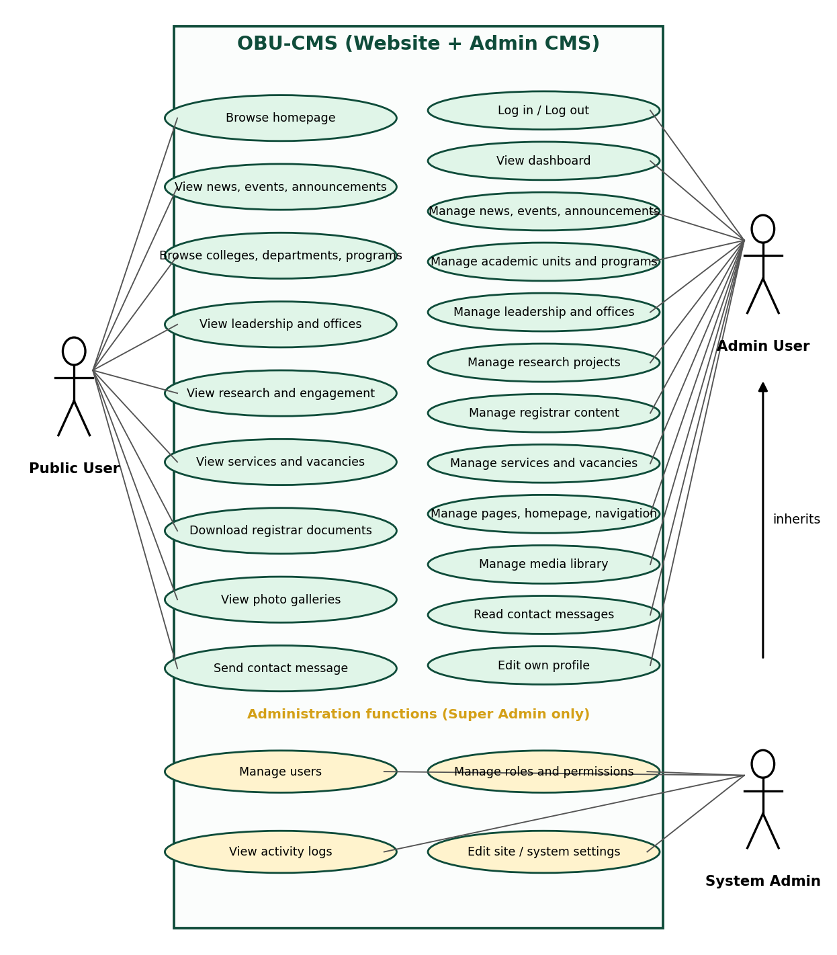



6.i System Model: Use Cases
Template 6
Public User
Reads published content, downloads Registrar documents, sends a contact message
Admin User
Logs in; manages content, media, pages and navigation
System Admin
Also manages users, roles, activity logs and settings
Notes:
A use case diagram shows actors and what they do with the system. Actors are external users: the public user who only reads, the admin user who manages content, and the system administrator who also manages users, roles and logs. The full diagram with all use cases is in the report.

Slide 11
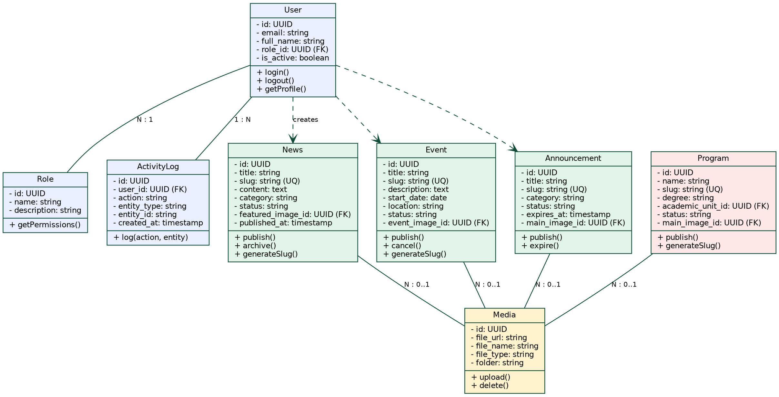
6.ii System Model: Class Diagram
Template 6
Notes:
A class describes a group of similar objects. This is the core domain: User with a Role, ActivityLog entries written by users, and the content classes News, Event, Announcement and Program, each referencing the central Media class. The attributes are the real columns of the database tables. A second class diagram of the application modules is in the report.

Slide 12



7. Methodology
Template 7
Data collection
Technologies
Interviews with the ICT Director, Content Officer, Communications and Registrar staff; study of the old website obu.edu.et
React 19, TanStack Start, Tailwind CSS v4, Radix UI, Supabase (PostgreSQL, Auth, Storage), Vite
Languages, tools, techniques
Development methodology
TypeScript, SQL; Git, VS Code, Postman; UML, ER design, migrations, Row Level Security
Agile Scrum: 4 sprints in 45 days, each ending with a demo to the ICT Director
Notes:
Data collection: interviews with the ICT Director, the Senior Web and Content Officer, the Communications office and the Registrar, plus study of the existing website. Technologies and tools are listed. The development methodology was Agile Scrum: four sprints over 45 days: authentication and database, public website, admin core modules, and extended modules, then testing, user acceptance testing and handover.

Slide 13
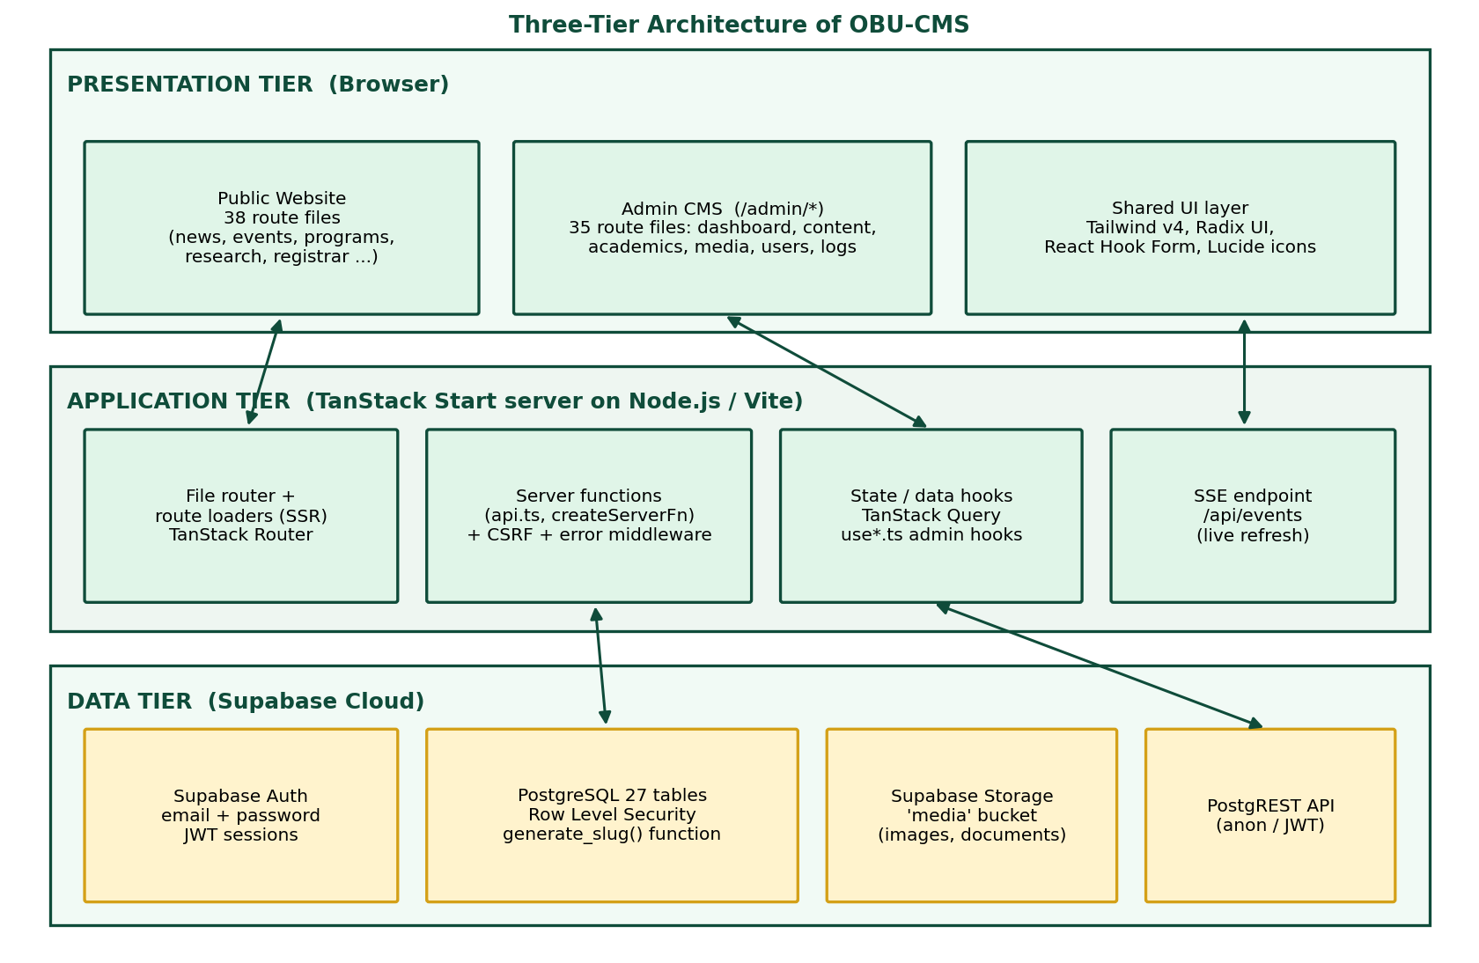
System Design Overview
Three tiers
Browser UI, TanStack Start server, Supabase data tier
27 tables
One central media table; slugs, status, foreign keys
Layered security
Supabase Auth, Row Level Security, CSRF, upload checks, audit log
Notes:
A three-tier design: browser interface, TanStack Start server with loaders and server functions, and Supabase for data. The database has 27 tables with one central media table. Security works in layers: Supabase Auth login, Row Level Security so the public reads only published rows, a role check for the System menu, CSRF middleware, upload validation and an audit log.

Slide 14





8. Benefit of the Internship (1/3)
Template 8
Practical skills
Built a full-stack system from database to UI
Theoretical knowledge
Applied normalization, UML, architecture patterns, security principles
Industrial problem-solving
Turned vague office needs into requirements and working modules
Team playing
Worked with ICT, Registrar, Communications; acted on sprint feedback
Leadership
Owned the project: planning, demos, decisions, priorities
Notes:
Practical skills: I built a full-stack system from database to interface. Theoretical knowledge: normalization, UML, architecture patterns and security principles became concrete. Problem-solving: I turned vague office needs into requirements and working modules. Team playing: I worked with the ICT Directorate, Registrar and Communications, and used sprint feedback. Leadership: I owned the planning, demonstrations and priority decisions.

Slide 15




8. Benefit of the Internship (2/3)
Template 8
Work ethics, industrial psychology
Entrepreneurship
Formal approvals, no credentials in shared code, honest reporting of my own code weaknesses; stakeholders need patience and clear communication
Product thinking: find a real need, build a first version, iterate with users; OBU-CMS can be adapted to other institutions
Interpersonal communication
Challenges faced
Explained technical choices to non-technical staff; ran interviews and demos; wrote progress summaries
Formal approval cycles, growing scope, moving from sample data to a real database, working alone as developer and tester
Notes:
Work ethics: I followed the formal approval process, kept credentials out of the code, and reported the weaknesses of my own code honestly. Entrepreneurship: I found a real need, built a working first version, and improved it with user feedback; the system can be adapted for other institutions. Communication: interviews, demos, and weekly summaries to my advisor. Challenges: approval cycles, growing scope, moving from sample data to a real database, and working alone.

Slide 16
8. Benefit of the Internship (3/3)
Template 8
Career fit
Software development is my goal; this was a real full-stack project
Strengths
Database design, learning new tools fast, security awareness, finishing what I start
Did my goals change?
They became clearer: full-stack web development and secure systems
Areas to improve
Automated testing, earlier time estimates, working in a larger team
Value of the internship
Very high: real users, real deadlines, real consequences
Notes:
Career: the internship fit my goal of working in software development because it was a real full-stack project. My goals became clearer: full-stack web development and secure systems. I value the internship very highly because it had real users and real consequences. Self-evaluation: my strengths are database design, learning tools quickly and security awareness; I want to improve automated testing, time estimation and teamwork in a larger group.

Slide 17
9. Conclusion and Recommendations
Template 9
Overall conclusion
The host company
Improving the internship
OBU-CMS replaces a content process that depended on technical staff
27 tables, 73 routes, RLS, media library, audit log
Remaining work is listed: legacy functions, role-aware policies, Zod
Recommended for future placement
Real projects and supportive staff
Needs a named supervisor and early server access
Extend from 45 to 90 days
Mid-internship review with advisor and host
Database design unit before the internship
Keep an archive of project repositories
Notes:
Overall conclusion: OBU-CMS replaces a content process that depended on technical staff with one where each office publishes its own information. Remaining work is listed honestly in the report. Recommendation on the host: I recommend the ICT Directorate for future placements, provided a named supervisor and early server access are arranged. To improve the internship: extend it to 90 days, add a mid-internship review, teach database design earlier, and keep an archive of project repositories.

Slide 18
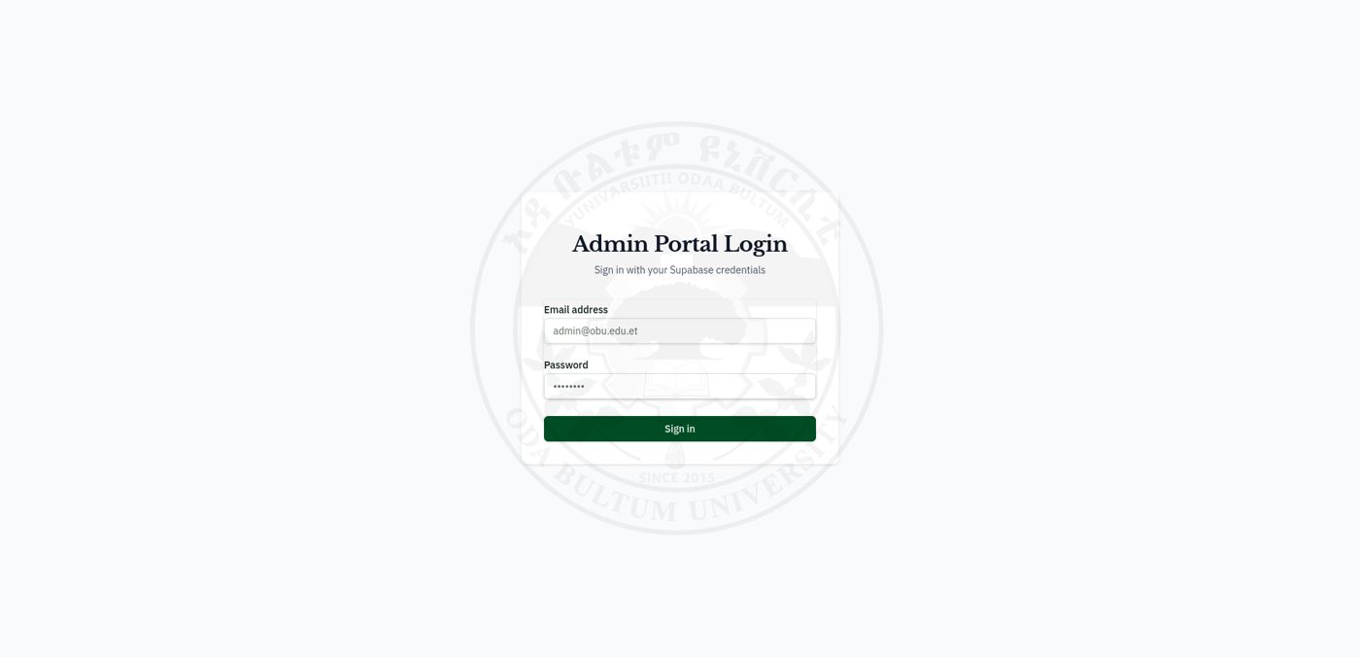
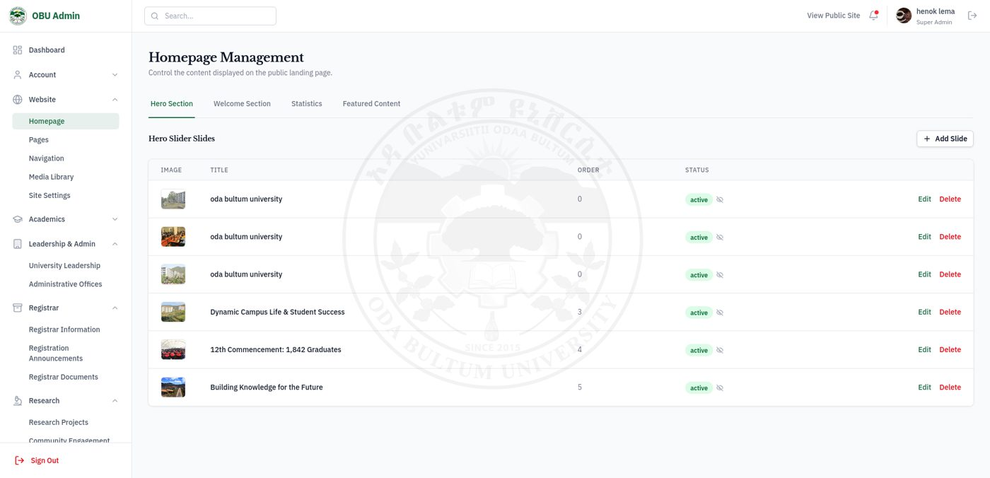
10. Prototype Demonstration
Template 10
Public site
Admin login
Dashboard
Homepage manager
Live demo on my machine
1. Open the public site and show the news page
2. Log in to /admin as an administrator
3. Create a news article with a cover image and publish it
4. Refresh the public site and show the new article
5. Show the activity log and the role-restricted System menu
Notes:
Now I will demonstrate the prototype on my machine. If the live demo fails, these screenshots are my backup. Steps: open the public site, log in to the admin, create and publish a news article with an image, refresh the public site to see it, and show the activity log and the role-restricted System menu.

Slide 19
Thank you
Questions and discussion
Nedi Usman Hussen | 2184/16
Advisor: Mr. Kibru G. | ICT Directorate, Oda Bultum University
Notes:
Thank you for listening. I thank my advisor Mr. Kibru, the ICT Directorate, and the Registrar office. I am ready for your questions.

