Slide 1


INDUSTRIAL INTERNSHIP PROJECT
ESS Internal News &
Announcement Portal
Haramaya University
College of CCI
Department of Computer Science
Rediet Belay · ID 2282/16
Academic Advisor: Mr. Kibru G
Notes:
Good morning, respected advisor and evaluators. My name is Rediet Belay, ID 2282/16, from the Department of Computer Science, College of CCI, Haramaya University. Today I will present my industrial internship project: the ESS Internal News and Announcement Portal. I carried out this work at the Ethiopian Statistical Service, in the Software Development Unit of the IT Directorate. In this presentation I will take you from the problem, through the design, to what was built and what I learned.

Slide 2






Presentation outline
Context & problem
Objectives & plan
Organization, structure, why this project
Scope, schedule, methodology, risks
Requirements
Analysis & design
Existing vs proposed system
Actors, workflows, architecture, UI, security
Implementation & testing
Reflection & Q&A
Tools, challenges, honest status
Learning, recommendations, conclusion
Notes:
Here is how the presentation is organized. I start with the organization and the problem. Then I explain the objectives, the plan and the requirements. The middle part covers the analysis and design: actors, workflows, architecture, database, user interface and security. After that I describe the implementation, the challenges and the testing, and I finish with my learning outcomes, recommendations and conclusion.

Slide 3



The organization: Ethiopian Statistical Service
1963
1989
2021
Central Statistical Office (CSO)
Central Statistical Agency (CSA)
Renamed ESS · Proclamation 1263/2021
Official statistics
National Statistical System
25 regional branches
Designs national surveys and runs the Population & Housing Census
Coordinates statistics across government and stores national data
Headquarters on Churchill Road, Addis Ababa; hubs in Adama, Mekele, Jimma and more
Notes:
The Ethiopian Statistical Service, or ESS, is the federal authority responsible for collecting, analyzing and publishing official statistics in Ethiopia. It began in 1963 as the Central Statistical Office, became the Central Statistical Agency in 1989, and was renamed ESS in August 2021 under Proclamation 1263 of 2021. Its mandate includes national surveys, the population and housing census, and coordinating the national statistical system. The headquarters is on Churchill Road in Addis Ababa, and the work is spread over 25 regional branch offices. That geography is the root of our problem: staff are scattered, so communication has to reach everyone equally.

Slide 4
Structure and where the project fits
Director General
Project relevance
Connects IT (hosts) and PR (writes) to all employees
Built in the Software Development Unit by intern developers
Git + GitHub with feature branches and review before merge
Deputy Director General
IT Directorate
system hosting & development
Public Relations
content & announcements
25 regional branch offices (readers)
Notes:
This diagram shows the structure. The Director General leads, the Deputy Director Generals oversee the directorates, and two of them matter for this project. The IT Directorate hosts and develops the systems, and the Public Relations and Communications Directorate creates the content: news, announcements and circulars. The consumers are the employees in the 25 regional branches. My project connects these three groups. I worked inside the Software Development Unit, as part of a team of intern developers, using Git and GitHub with separate feature branches and review before merging.

Slide 5




The problem we set out to solve
Fragmented channels
No central archive
7–14
Memos, email lists and word of mouth give inconsistent information
Past notices and criteria cannot be found or referenced
days of delay before regional offices receive updates
Regional disadvantage
Manual workload
Paper memos and scattered email lists
Staff outside Addis Ababa are the last to know
Staff format, photocopy and distribute paper notices
Notes:
Now the problem. Today ESS shares internal news through physical memos on bulletin boards, scattered email lists and word of mouth. For regional offices this creates a delay of seven to fourteen days. Updates arrive late or not at all, there is no central archive, and staff in the regions are at a structural disadvantage compared with headquarters. HR and communication staff also spend time formatting, photocopying and distributing paper. The result is an information gap that lowers engagement, trust and organizational agility.

Slide 6
Objectives and scope
1
Responsive, read-only public interface with search
General objective
Build a web-based portal where ESS publishes, manages and distributes news centrally, with equal access for all employees nationwide.
2
Admin dashboard with encrypted login
3
Full CRUD for news listings
4
Image upload (e.g. event posters)
5
Correct English and Amharic rendering
Out of scope: external internet access · user comments · individual employee accounts
Notes:
The general objective is to design and develop a web-based internal news portal so that ESS can publish, manage and distribute announcements centrally, with equal access for all employees. The specific objectives are: a responsive, read-only public interface with search; a secure administrator dashboard with encrypted login; full create, read, update and delete for news; image upload, for example event posters; and correct display of both English and Amharic text. The scope is deliberately focused. The portal does not include external internet access, comment sections or individual employee accounts.

Slide 7



Plan, methodology and risk management
4–5 week schedule
Agile prototyping
Risks and mitigation
Wk 1
Requirements, DB design
Short iterative cycles
Components reviewed and adjusted early
Waterfall rejected: it freezes requirements too soon
Amharic sorting
→ utf8mb4_unicode_ci
Wk 2
React frontend
Malicious uploads
→ Multer type checks
Wk 3–4
Express API, uploads
Admin URL bypass
→ Server route guard
Wk 5
QA and documentation
Notes:
The project ran over a four to five week plan: week one for requirements and database design, week two for the React frontend, weeks three and four for the Express backend, middleware and uploads, and week five for quality assurance and documentation. We used an Agile prototyping approach rather than Waterfall, because requirements around search and filtering needed to change with feedback. We also identified three main risks, and each had a mitigation: Amharic sorting problems, solved with utf8mb4 unicode collation; malicious file uploads, solved with file type validation in Multer; and unauthorized access to admin URLs, solved with route protection on the server.

Slide 8


Existing system vs proposed system
Today: manual and fragmented
Proposed: ESS-INAP portal
Memos, email lists, word of mouth
One official web portal
No central, searchable archive
Searchable archive, newest first
Unclear, unequal visibility of notices
Same content for everyone, posts attributed
Manual formatting and photocopying
Admin publishes from a dashboard
Regional offices hear last
Instant access from every branch
Notes:
This slide compares the old and new situation. In the existing system, information moves by memo, email and word of mouth, so it is inconsistent. There is no central archive, so past notices cannot be found. Transparency is weak because staff cannot be sure every opportunity was advertised equally. And regional staff are the last to know. The proposed portal replaces this with one official, searchable, always-available channel, which is accessible without login for reading, and managed only by authorized administrators.

Slide 9






System requirements
Functional
Non-functional
Public viewing, no login
Usability Clean for all skill levels
Text search
Reliability High uptime, data integrity
Password-protected admin
Performance Fast search, thousands of users
CRUD with expiry date
Security Hashed passwords, intranet only
Secure image upload
Maintainability Modular code, documentation
Responsive on desktop and mobile
Legal compliance ESS data-handling policies
Notes:
The requirements are grouped in two parts. The functional requirements are: public viewing of announcements without login, a search bar, a password-protected administrator dashboard, create, read, update and delete of news with title, content and expiry date, image upload through a secure backend, and a responsive interface. The non-functional requirements are usability, reliability, performance, security, maintainability and legal compliance. For security specifically, the requirements say passwords must be hashed, database access must use parameterized queries, uploads must be type-restricted, and the system should be reachable only through the internal ESS intranet.

Slide 10


Actors and use cases
Public User
Any ESS employee · no login
Administrator
Authenticated · protected routes
View Home
Login / Logout
View dashboard
View About
Create, update, delete news
View News list
Manage profile
Change password
View News details
Note: DB roles (ADMIN, CONTENT_MANAGER …) exist but are not enforced per route yet
Notes:
We identified two actors. The Public User, which is any ESS employee, can view Home, About, the News list and News Details, without authentication. The Administrator can log in, view the dashboard, manage news by creating, updating and deleting, manage the profile, change the password and log out. This use case diagram shows exactly that. One point I want to be precise about: the database has a role field with values such as ADMIN and CONTENT_MANAGER, but the active routes currently use general authentication, not role-specific permissions. So roles are prepared for future expansion.

Slide 11
Key workflows
Administrator login
Enter credentials
POST /auth/login
Find admin in MySQL
bcrypt check, issue JWT
Token stored, dashboard opens
Create news article
Authenticated admin
Fill form, attach image
Validate fields and file
Store file, insert record
Success message shown
Notes:
Two workflows show how the system behaves. First, login: the administrator enters credentials, the React page sends them to the login endpoint, the backend finds the user in MySQL, compares the password with the stored bcrypt hash, and returns a signed JWT. The frontend stores it and opens the dashboard. Second, creating news: after authentication the administrator fills the form and attaches an image. The request goes as multipart form data, the server verifies the token, validates the input and the file, stores the file, inserts the record, and returns success. Invalid input is returned to the form with an error before anything is saved.

Slide 12
Software architecture
Presentation layer
React 18 · React Router · Context · Axios
Why layers?
Page changes need no database code
Queries stay in backend models
Admin pages are lazy-loaded
Files stored apart; only paths in DB
HTTP / JSON + multipart
Application / API layer
Node.js 20 · Express · middleware · controllers
Data layer
MySQL 8 · parameterized SQL
File storage
uploads/news · quarantine
Notes:
The system uses a layered full-stack architecture with four responsibilities. The presentation layer is React 18 with React Router and context. The application layer is Node.js and Express with routes, middleware, controllers and services. The data layer is MySQL 8. And the file storage holds uploaded images separately, with only the path saved in the database. Communication is HTTP with JSON and multipart. This separation helps maintainability: changing a page does not touch database code, and database queries stay inside backend models. Administrator pages are also lazy-loaded in React for faster initial loading.

Slide 13

API and database design
Method | Endpoint | Access
POST | /api/auth/login | Public
GET | /api/news | Public
GET | /api/news/latest | Public
GET | /api/news/:id | Public
POST | /api/news | Protected
PUT | /api/news/:id | Protected
DELETE | /api/news/:id | Protected
PUT | /api/auth/changepassword | Protected
MySQL 8 (InnoDB)
utf8mb4: Ethiopic script support
Unique username and email
Indexes and full-text indexes
FK: news.posted_by → admins
Image paths stored as JSON
Notes:
The REST API has two groups. Authentication endpoints handle login, logout, profile and password change. News endpoints are public for reading: list with search and pagination, latest news, and single article; and protected for writing: create, update and delete. The database is relational, MySQL with InnoDB and utf8mb4. It has unique username and email, indexes for lookup and sorting, full-text indexes prepared for search, and a foreign key from news to the administrator who posted it. Image paths are stored as JSON in the news table.

Slide 14
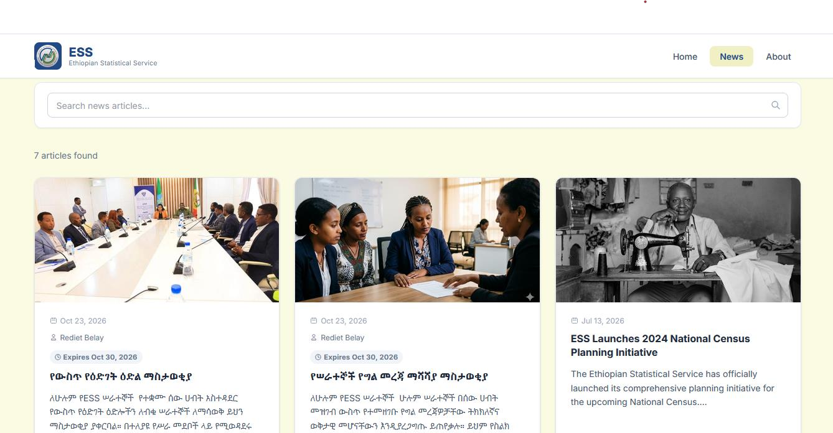
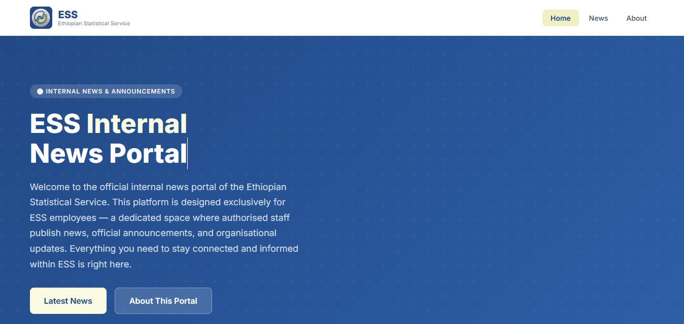
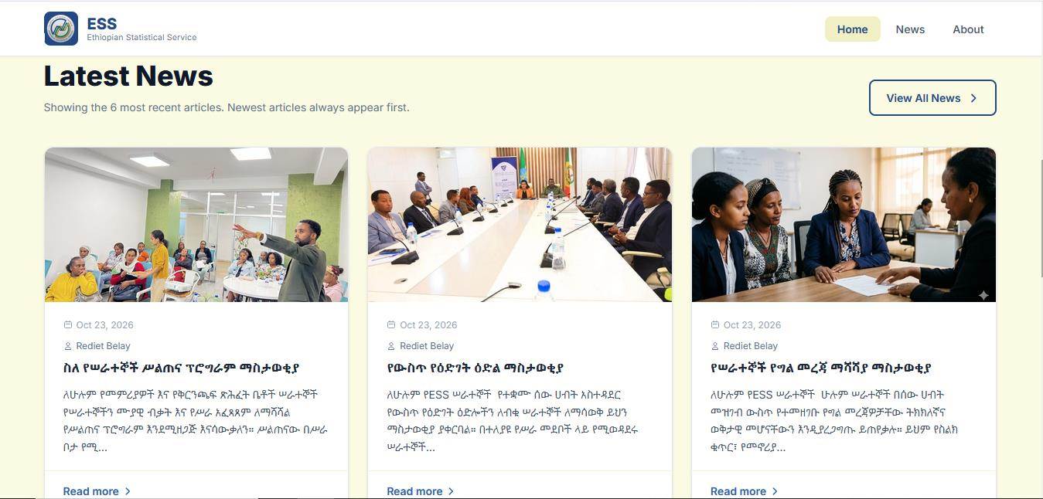
User interface: public portal
News: search + pagination
Amharic and English cards
Home → News → Details
Notes:
This is the public interface. Employees see a hero page with the portal name, then the latest news cards, with the newest first. The News page has a search bar, pagination and article cards with image, date, author and expiry. Here you can see Amharic and English articles displayed correctly side by side, which was one of our objectives. The About page explains the purpose of the portal. The path is short, Home to News to News Details, so a user finds information quickly. The colors come from the ESS brand: navy and cream.

Slide 15
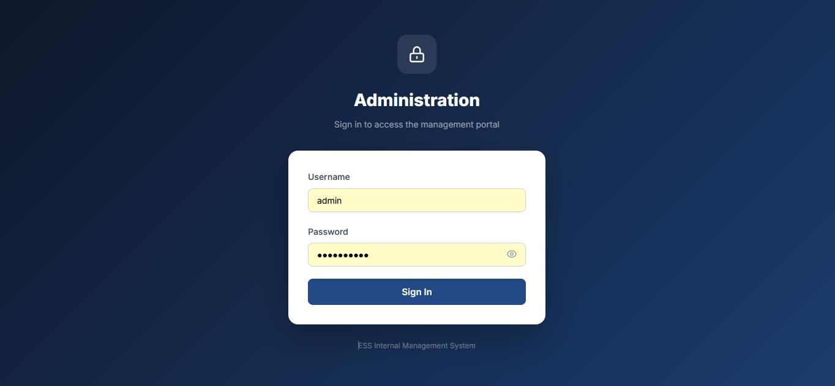
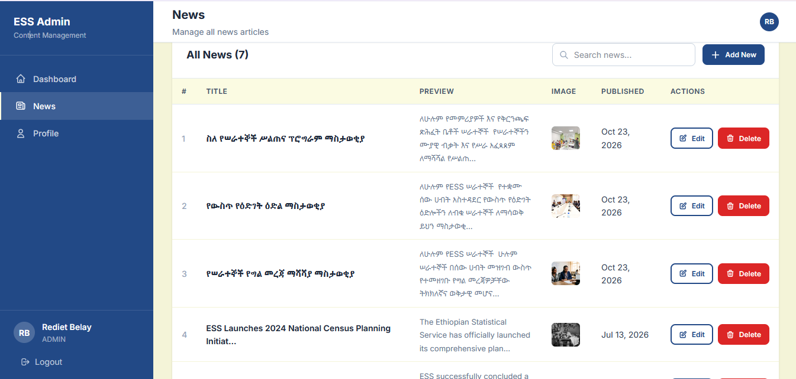
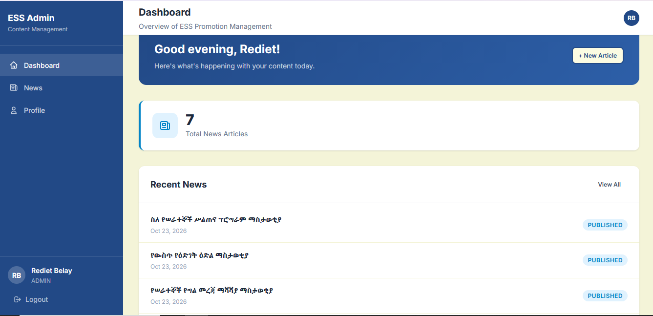
User interface: administrator console
Login with validation
Dashboard overview
Edit / Delete with confirmation
Notes:
The administrator area is separate from the public site. After login, the admin sees a dashboard with a greeting, the total number of news articles and the recent news with their status. The sidebar has Dashboard, News and Profile, and it collapses on mobile. In News Management, the administrator sees a table with preview, image, publish date and Edit and Delete buttons, plus search and an Add New button. Deleting asks for confirmation first. Profile lets the administrator update their information and change their password.

Slide 16



Security design
Authentication
Authorization
SQL injection
JWT after bcrypt check; hash cost factor 12
authenticate middleware on every protected route
Parameterized queries with mysql2
Safe uploads
Hardening
Password policy
jpeg/jpg/png only, sanitized names, outside web root
Helmet headers, CORS limits, rate limiting
8+ chars with upper, lower and digit
Notes:
Security is built in layers. Authentication uses a JWT after the password is checked against a bcrypt hash; we use cost factor 12 when changing passwords, and passwords must have at least eight characters with upper case, lower case and numbers. Authorization uses a middleware on every protected route, checking the Bearer token or the cookie. All database access uses parameterized queries to prevent SQL injection. Uploads are restricted by type, sanitized and kept outside the public web root. In addition, we use CORS restrictions, rate limiting and Helmet security headers, and the frontend has a ProtectedRoute, though the real protection is always on the server.

Slide 17
Implementation and challenges
Technology stack
Frontend and backend out of sync
→ API contract defined first
Frontend
React 18, Vite, Axios, React Router
Unsafe file uploads
→ Type and size checks, sanitized names
Backend
Node 20, Express, mysql2, Multer, JWT
Layout on any screen
→ Tested with Chrome DevTools
Database
MySQL 8, Workbench
Tools
VS Code, Git, GitHub
SQL injection
→ Prepared statements for all input
Notes:
For implementation, we used React with Vite, Axios for requests, Node.js and Express, mysql2, Multer for uploads, bcrypt and JWT, MySQL Workbench for the database, and Git with GitHub. Four challenges stand out. First, keeping frontend and backend in agreement, solved by defining the API contract early. Second, safe file upload, solved by validating type and size and sanitizing filenames. Third, responsive design, checked in different screen sizes with Chrome DevTools. Fourth, SQL injection, handled with a rule that every query with user input uses prepared statements.

Slide 18
Testing and honest project status
Testing approach
Done
Public pages, admin login, news CRUD, image upload, security layers
Unit
Jest, React Testing Library
Integration
Supertest: API and auth
Prepared
Role-based auth, promotions table, full-text indexes
End-to-end
Cypress: login → publish → view
Cross-browser
Chrome, Firefox, Safari, Edge
Pending
Executed test report, production deployment, load test
Security
Login bypass, SQLi, bad uploads
Notes:
Testing was planned at several levels: unit, integration, end-to-end, cross-browser and security testing. For integration, the focus was on whether the API returns the right data and whether authentication blocks unauthenticated requests. For security, we tried to bypass login, inject SQL and upload dangerous files. I want to be honest about one point: a formal executed test-results report was not part of the submitted materials, so I present the testing as a plan with the checks we carried out, not as a table of pass or fail results. Also, the architecture here is the development setup, localhost ports 3000 and 5000, not a production deployment.

Slide 19

Learning outcomes and recommendations
What I learned
Recommendations
How frontend, backend, database and security work as one system
Tracing a problem layer by layer
Applying web, database and software engineering theory
Documenting honestly: designed vs built vs tested
For ESS
Enforce role-based authorization
Backups, monitoring, error logging
Automated tests; finish or drop promotions
For future interns
Clear scope, weekly notes, keep test evidence
Notes:
My main learning outcomes are practical and professional. I saw how frontend, backend, database and security work together in a real system, and I learned to trace a problem step by step through the layers. I applied web programming, database and software engineering theory, and I learned to describe a project honestly, separating what is designed from what is implemented and what is tested. My recommendations for ESS are: complete promotion management if it stays in scope, enforce role-based authorization, set up backups, monitoring and logging, and add automated tests. For future interns: clear scope at the start, weekly notes, and exposure to testing, deployment and documentation.

Slide 20

Thank you
Rediet Belay · ID 2282/16 · Advisor: Mr. Kibru G
Notes:
In conclusion, the ESS Internal News and Announcement Portal gives ESS a central, secure and searchable channel that reaches all 25 regional offices at the same time, replacing slow paper and scattered email. It also gave me real experience of building a full-stack system. I thank my academic advisor, Mr. Kibru G, my supervisors at ESS, and the evaluators for your time. I am now happy to answer your questions.

