Slide 1


Industrial Practice Presentation
Design and Development of a Dynamic Website and Content Management System for Oda Bultum University (OBU-CMS)
Nedi Usman Hussen
Student ID: 2184/16 | Department of Computer Science, Haramaya University
Advisor: Mr. Kibru G. | Host: ICT Directorate, Oda Bultum University
Monday, October 26, 2026
Notes:
Good morning. I am Nedi Usman Hussen. My industrial practice was at the ICT Directorate of Oda Bultum University, where I designed and built a new dynamic website with a content management system, called OBU-CMS. In the next 12 to 15 minutes I will show the problem, the design, the result, and what I learned.

Slide 2



Host Organization
Oda Bultum University
Public university founded in 2015, in Chiro, West Hararghe, Oromia
University President
President Offices
Administrative and Development VP
Academic, Research and Community Service VP
ICT Directorate
Manages servers, network and systems; technical owner of OBU-CMS
ICT Directorate (host)
Other President Offices: Audit, Planning, Legal, Public Relations, Security
Registrar, Colleges, Research
Who uses the website
Students, applicants, staff, Registrar, communications office, the public
OBU-CMS
Simplified from the university hierarchy (report Figure 1.1)
Notes:
Oda Bultum University was founded in 2015 in Chiro. The ICT Directorate is directly attached to the President, and it owns the university website. My users are the content staff of the offices, the Registrar, and of course students and the public.

Slide 3
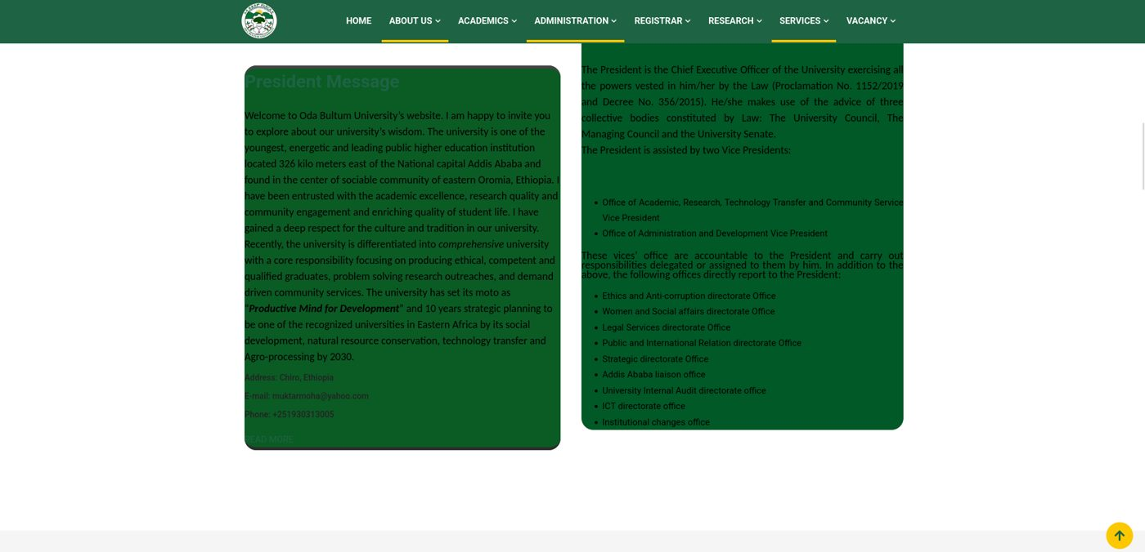


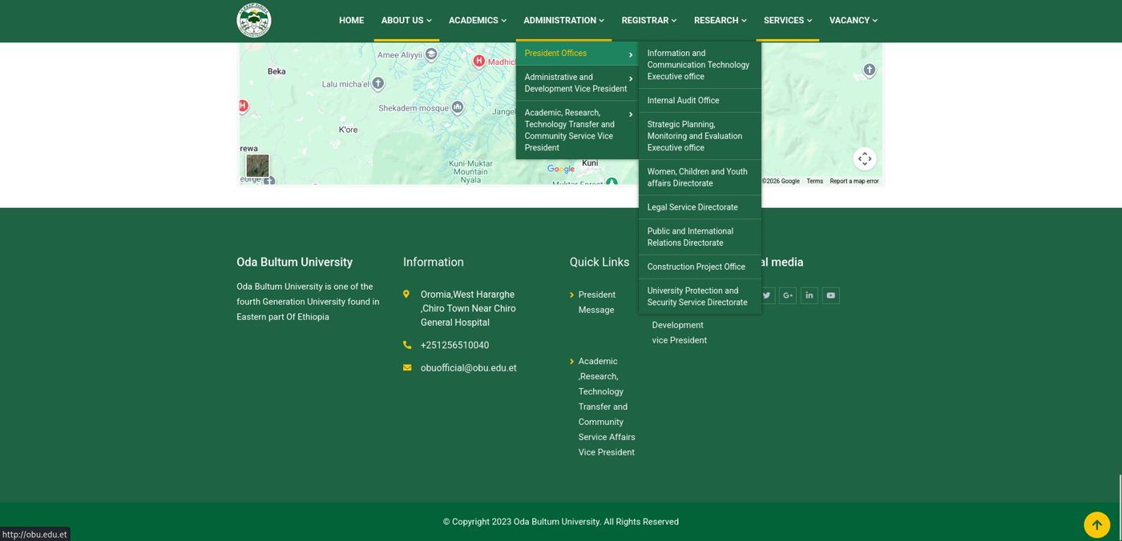


The Problem
Content depends on technical staff
Urgent notices (registration, exams) are delayed
No structured content
News, events, vacancies have no managed records or clean links
No media library, no roles, no audit trail
Nobody can tell who changed what
Hard to read and use on phones
Deep menus, low-contrast pages, fixed 2023 footer
Existing website obu.edu.et
Notes:
The old site worked, but every update needed technical help, content had no structure, there was no media library, no separation of roles and no audit trail. On the right you can see two screens: a low-contrast, overflowing President message page and a deep drop-down menu with a fixed copyright year of 2023.

Slide 4



Objectives
General objective Build a secure, responsive, database-driven website and CMS so that non-technical staff publish university information themselves.
Dynamic website
Slug-based pages for news, events, programs, research, leadership
Secure Admin CMS
Login, Row Level Security, role-based System menu
Media library
Upload once, reuse everywhere; type and 10 MB checks
Audit log
Every create, update, delete and upload is recorded
Notes:
The general objective is to give the university a secure and responsive dynamic website that staff can manage without writing code. The four main specific objectives: a dynamic website, a secure admin CMS, a media library, and an audit log. The report lists eight measurable objectives.

Slide 5
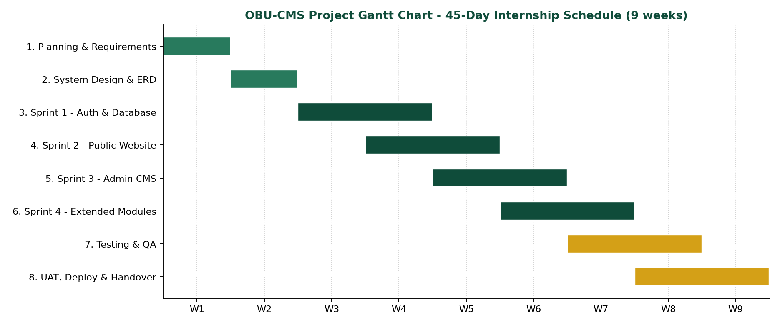
Method and Schedule
Agile Scrum
4 sprints, each ending with a demo to the ICT Director
45 days
9 weeks, 8 phases from planning to handover
Why Scrum
Requirements grew as offices saw the screens
Gantt chart: planning, design, four sprints, testing, UAT and handover
Notes:
I used Agile Scrum because the requirements were not complete at the start: every office had different needs. Four sprints, each ending with a demonstration to the ICT Director and the content officer. The 45 days are shown as nine weeks and eight phases.

Slide 6






Technology Stack
TanStack Start + React 19
SSR, file-based routing, server functions
TypeScript
Typed code from database to UI
Tailwind CSS v4 + Radix UI
Responsive and accessible interface
Supabase
PostgreSQL, Auth, Storage, Row Level Security
Vite + node-postgres
Fast builds, parameterized SQL
Git, Postman, ESLint, Prettier
Version control, testing, code quality
Notes:
The stack is modern and typed end to end. TanStack Start gives server-side rendering and routing, Supabase gives the PostgreSQL database, authentication and storage, and Tailwind gives a responsive interface. Supabase also gives Row Level Security, which is the base of the access control.

Slide 7
Requirements
30
functional requirements
16 for the public site, 14 for the Admin CMS
Key features
Dynamic home page, news, events, announcements
Colleges, departments and programs hierarchy
Registrar documents and vacancies
Role-protected Admin CMS with dashboard
Media library and unique slugs
User, role, navigation and settings management
Activity log and contact messages
8
non-functional areas
usability, performance, reliability, security, scalability, responsiveness, maintainability, legal
73
route files
38 public pages and 35 admin pages
Notes:
There are 30 functional requirements: 16 for the public website and 14 for the admin panel. Non-functional requirements cover usability, performance, reliability, security, scalability, responsiveness, maintainability and legal compliance. The code has 38 public and 35 admin route files.

Slide 8
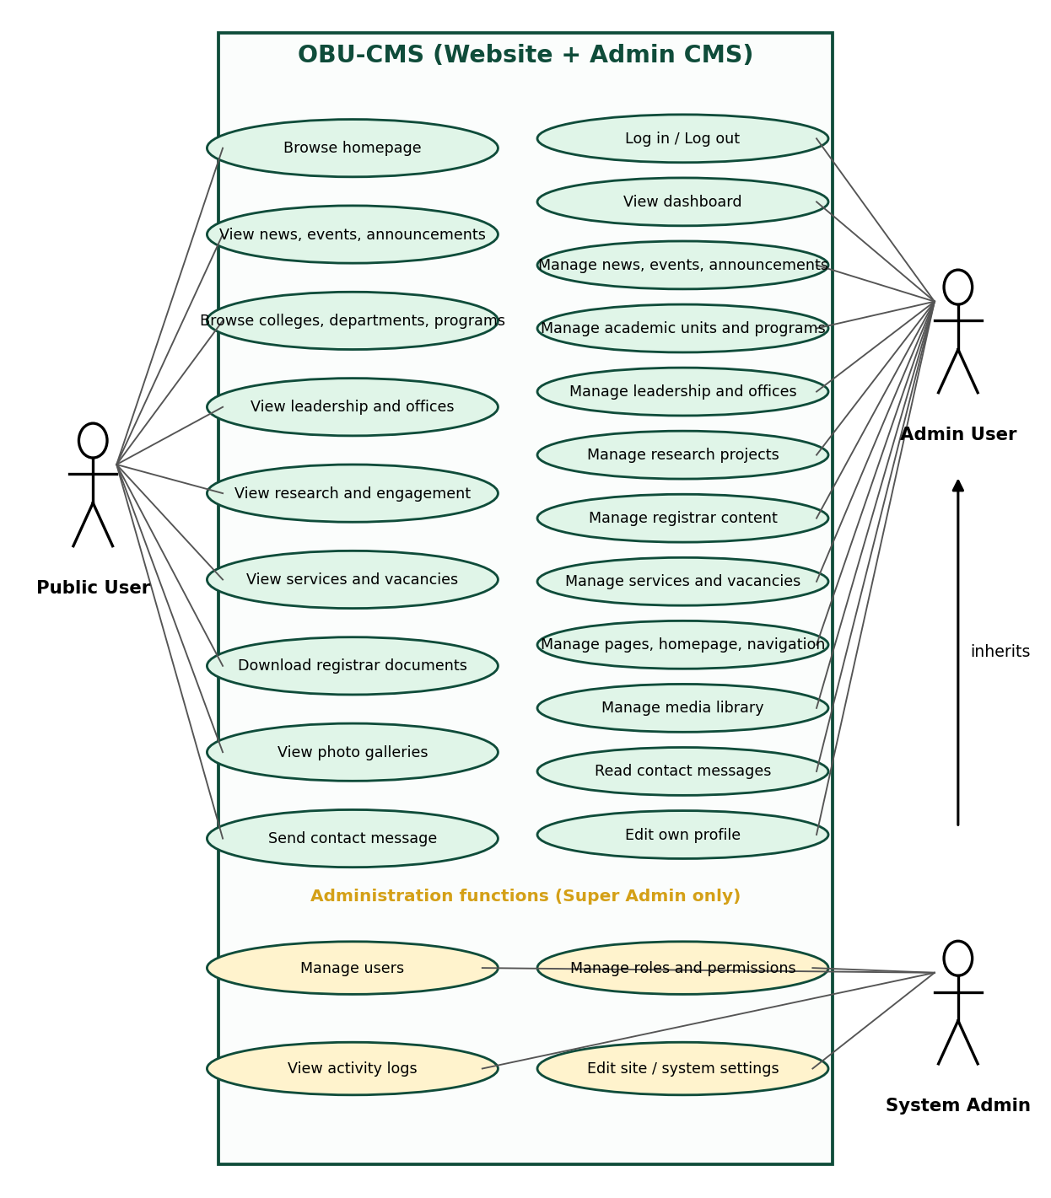



System Model: Use Cases
Public User
Reads published content, downloads Registrar documents, sends a contact message
Admin User
Logs in and manages content modules, media, pages, navigation
System Admin
Also manages users, roles, activity logs and site settings
Notes:
There are three actors: the public user who only reads, the admin user who manages content, and the system administrator who also manages users, roles and logs. The full UML set is in the report: use case, class, object, sequence, state chart and activity diagrams.

Slide 9
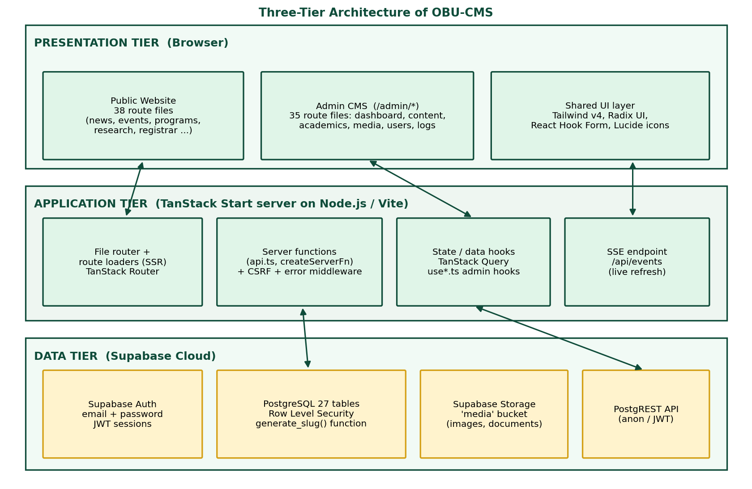
Software Architecture
Tier 1: Presentation
React 19 pages rendered on the server, then hydrated
Tier 2: Application
TanStack Start: route loaders, server functions, CSRF middleware
Tier 3: Data
Supabase: PostgreSQL with RLS, Auth, Storage
Notes:
A three-tier design: the browser interface, the TanStack Start server with loaders and server functions, and Supabase for data. Public pages mostly read through the Supabase client with the public key, so Row Level Security decides what is visible. A small set of server functions uses a direct PostgreSQL connection.

Slide 10





Database Design
27
PostgreSQL tables
One central media table; slugs, status and foreign keys everywhere
Security and audit
users, roles, permissions, activity_logs
Site and web content
pages, navigation, homepage, settings, media
Communication
news, announcements, events, galleries
Academics
academic_units, programs (college > department > program)
Administration and Registrar
leadership, offices, Registrar notices
Research and services
projects, facilities, engagement, services, vacancies
Notes:
The database has 27 tables in six groups. All content tables reference one central media table, so an image is uploaded once and reused. Hierarchies use a parent id, for example college to department. The ER diagrams are in Chapter 4 of the report.

Slide 11



Security and Access Control
Authentication
Supabase Auth, JWT session, /admin route guard
Row Level Security
Public reads only published rows; writes need a registered admin
Role check
System menu only for Super Admin
CSRF and SQL safety
CSRF middleware, parameterized queries, upload limits
Audit trail
activity_logs for every admin action
Notes:
Security works in layers: login with Supabase Auth, a route guard on every admin page, Row Level Security in the database so the public can only read published rows, a role check for the System menu, CSRF middleware, parameterized SQL, upload validation, and an audit log. I also reviewed my own code and listed remaining improvements honestly in the report.

Slide 12





How Publishing Works
1. Log in
Session checked on every /admin page
>
2. Fill the form
Title, content, status, cover image
>
3. Upload media
Type and size validated, saved to Storage
>
4. Unique slug
-2, -3 added if the title exists
>
5. Save and log
RLS check, activity log, visible on the site
Draft items stay hidden from visitors. Sequence and activity diagrams: report Figures 4.4 to 4.6.
Notes:
This is the publishing workflow in the Admin CMS. The editor logs in, fills the form, optionally uploads an image, the system makes the slug unique, saves the record under Row Level Security, and writes an activity log entry. Draft items are not visible to the public.

Slide 13
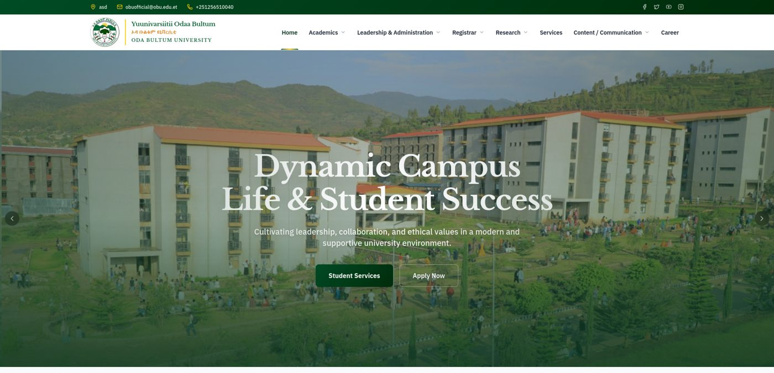
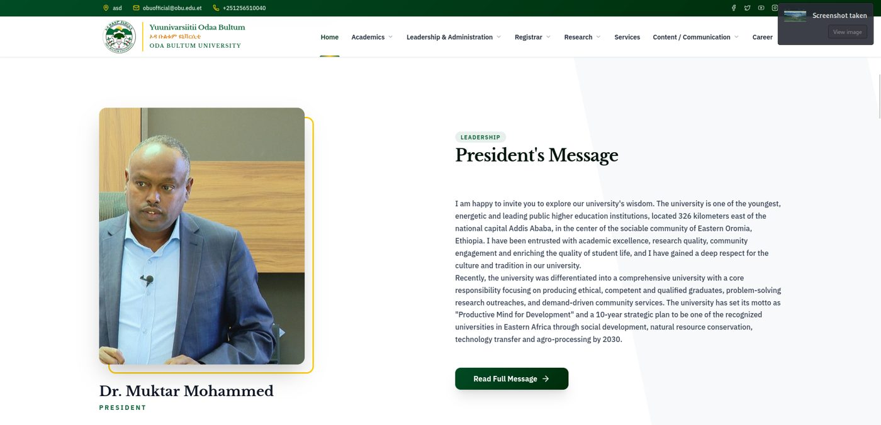

The New Public Website
Home page with hero slider and grouped menu
President's message with photo and biography
Responsive on phones, tablets, desktops
Clean slug URLs for every item
SEO titles and descriptions per page
All content loaded from the database
Notes:
Here is the new public website. The menu follows the university structure, the hero slider and the President message come from the database, and every content page has a clean address and a proper page title.

Slide 14
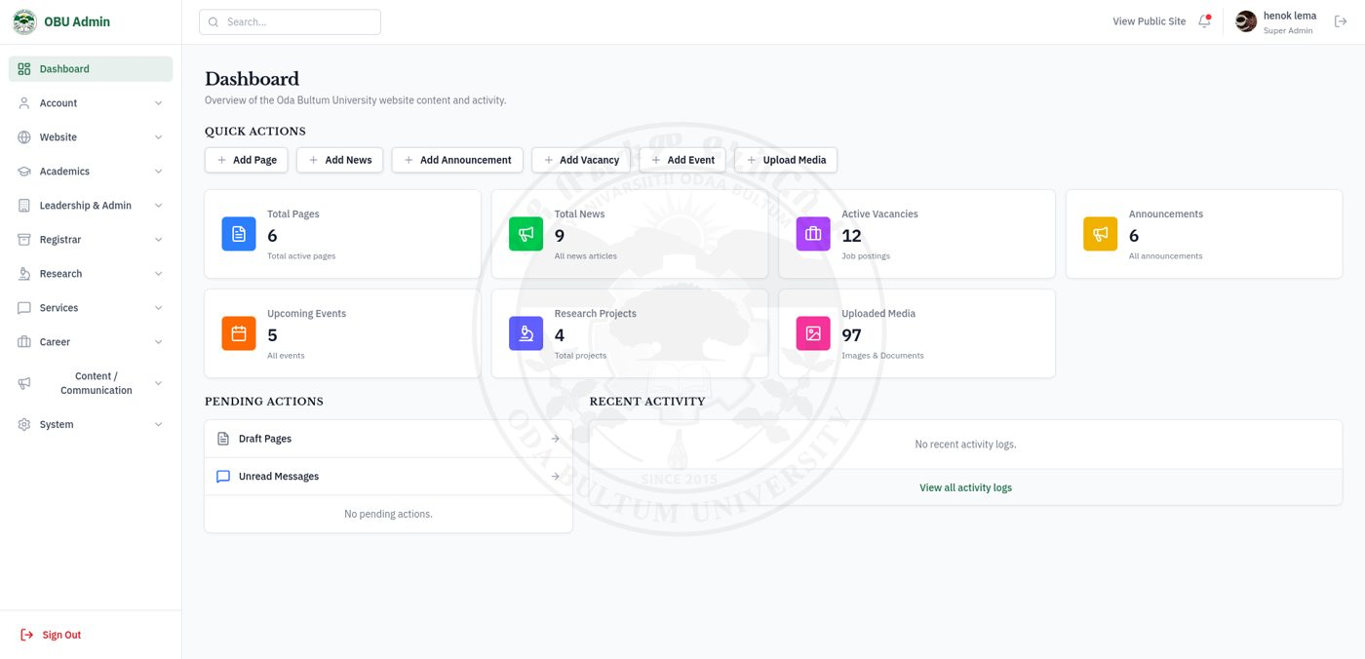
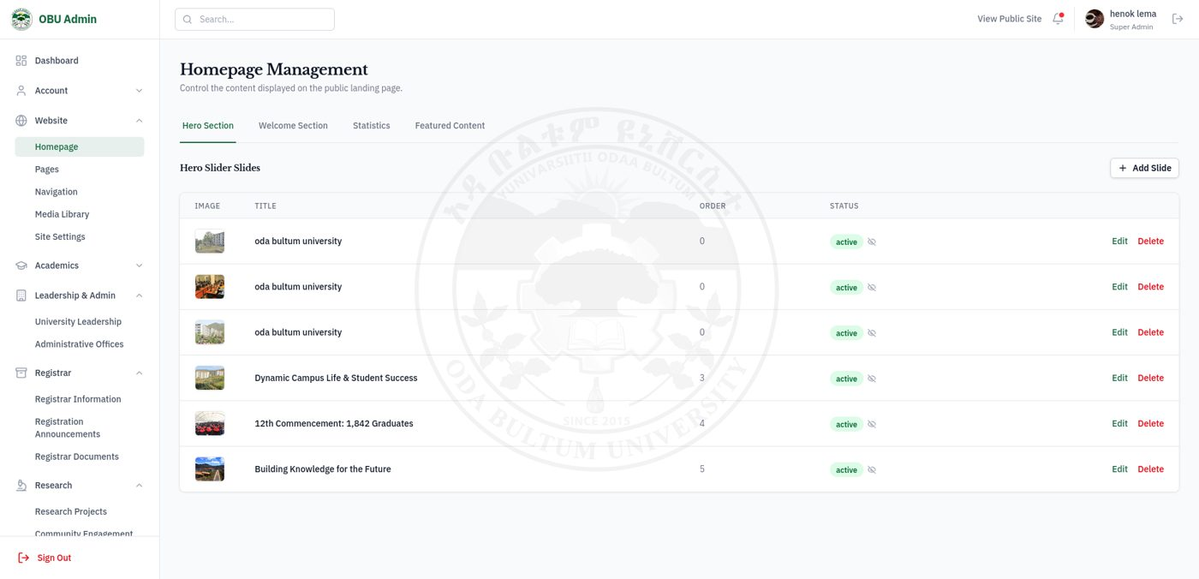
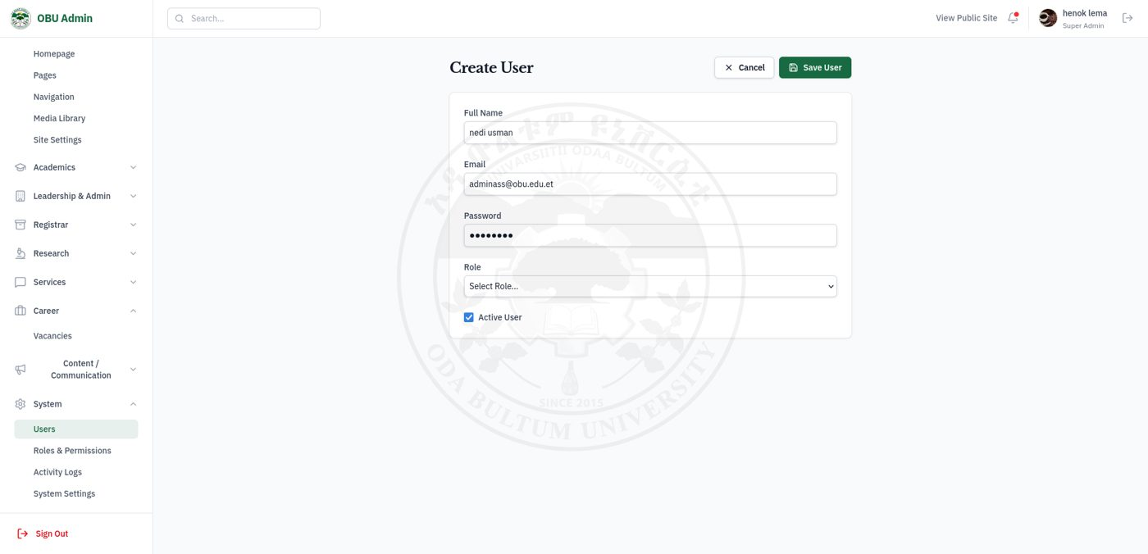
The Admin CMS
Homepage manager
Dashboard: live counts, quick actions, activity
Live data: 9 news, 12 vacancies, 6 announcements, 5 events, 97 media
Create user with role
Notes:
This is the admin panel. The dashboard shows live content counts: 9 news articles, 12 active vacancies, 6 announcements, 5 events, and 97 media files. The homepage manager controls the hero slides, and a Super Admin creates users and assigns roles.

Slide 15
Testing and Results
45 / 45
Postman integration tests
News, events, programs, media, auth, settings
6 / 6
RLS security scenarios
Unauthenticated access denied; published rows visible
6 / 6
browser and device checks
Chrome, Firefox, Safari: 1280, 768 and 375 px
7 / 7
UAT scenarios passed
ICT Directorate and Registrar's Office users
Scripts also check that data created in the Admin CMS appears on the public college, department and program pages.
Notes:
Testing had four parts: 45 Postman integration tests, six Row Level Security scenarios with unauthenticated requests, cross-browser and responsive checks at 1280, 768 and 375 pixels, and seven user acceptance scenarios with ICT and Registrar staff. Curl scripts also verify that content created in the admin appears on the public pages.

Slide 16
Challenges and Solutions
Challenge
Solution
Public reads vs admin writes
Row Level Security as the main rule; Supabase client for pages, a few server functions only
Clean, unique URLs
generate_slug() SQL function, unique constraints, -2/-3 check in the hooks
Images reused by many modules
One central media table and the AdminImageUpload component
Types out of sync with the schema
Extended database.types.ts updated after each migration
Notes:
Four main challenges. First, public pages and admin writes need different access, so Row Level Security became the main protection. Second, clean unique slugs through a SQL function and unique constraints. Third, a central media table so images are reused. Fourth, keeping TypeScript types in sync with the schema after every migration.

Slide 17
Impact for the University
Before
After: OBU-CMS
Technical staff update every page
Offices publish their own notices
No control over who changes what
Login, roles, Row Level Security, activity log
Scattered images and documents
Central media library, reuse everywhere
Fixed texts and menus
Settings, navigation and homepage stored in the database
Hard to use on phones
Responsive layout for students on mobile
Notes:
This table summarizes the real problems the project solves: offices can publish their own notices, access is controlled and recorded, media is managed centrally, menus and texts are data and not code, and the site works on phones.

Slide 18
Lessons and Next Steps
What I learned
Before wider production use
Full-stack TypeScript with SSR
Relational design: 27 tables, migrations, RLS
Defense in depth, and reviewing my own code
Agile work with real stakeholders
Remove old server functions and dev credentials
Role-aware database policies, Zod validation
Build 3 missing Research admin pages
Editorial review step and regular backups
Student portal as Phase 2
Notes:
I learned full-stack TypeScript, relational design with Row Level Security, defense in depth, and agile work with real users. My code review also found points to fix before wider production use: remove legacy server functions and development credentials, add role-aware database policies and input validation, build three missing admin pages, and add an editorial review step. The next phase could be a student portal.

Slide 19
Thank you
Questions and discussion
Nedi Usman Hussen | 2184/16
Advisor: Mr. Kibru G. | ICT Directorate, Oda Bultum University
Notes:
Thank you for listening. I thank my advisor Mr. Kibru, the ICT Directorate, and the Registrar's Office. I am ready for your questions.

