Slide 2
marp: true
theme: default
paginate: true
style: |
/* ── Base ── */
@import url('https://fonts.googleapis.com/css2?
family=Inter:wght@400;600;700;900&family=JetBrains+Mono:wght@400;700&display=
swap');
section {
font-family: 'Inter', 'Segoe UI', sans-serif;
font-size: 26px;
background: #0d1117;
color: #e6edf3;
padding: 48px 64px;
}

Slide 3
The setup
The hardware
2 vCPU · 2 GB RAM · 20 GB SSD
~$12/month (Hetzner CX22)
Docker Compose (same constraints, same demo)
The WordPress site
2,500 posts · 500 WooCommerce products
~6,000 revisions in DB
Realistic bloat: transients, orphaned meta
WooCommerce + Yoast SEO active
The load generator

Slide 4
The journey
p95
DB
Level
Stack
requests/s
CPU
New layer
Latency
Threads
Apache +
crash
~140 →
0
100% 20+
—
mod_php
@ ~50 VU
collapse
+ Nginx · FPM
OPcache ·
1
· OPcache ·
133 ms
65
25%
12.5
Redis
Redis
+ FastCGI
cache ·
FastCGI
2
79 ms
70
18%
3
MariaDB
page cache
tuning
+ Cloudflare
~15 ms
origin sees
Edge cache

Slide 5
Key concept: what is a Virtual User?
NOT this:
50 VUs = 50 people who visited today
50 VUs = 50 page loads total
1 VU = 1 unique session
THIS:
1 VU = 1 browser-like loop running continuously
VU #1: GET / → sleep 1-2s
→ GET /?p=1 → sleep 1-2s
→ GET / → repeat forever
50 VUs = 50 concurrent loops
=
50 simultaneous open connections

Slide 6
Key metric definitions
Term
What it actually means
Concurrent browser-like loops running continuously — not
Virtual Users
unique visitors
requests/s
Total HTTP responses served per second across all VUs
p95 latency
95% of requests were faster than this — 5% were slower
p99 latency
The near-worst case — 1% of requests were slower than this
FPM workers
PHP processes currently executing code right now
Requests waiting for a free PHP worker — 0 = healthy, >0 =
FPM queue depth
trouble
DB threads
MySQL queries actively executing — not just connected
running

Slide 7
Observability stack
k6 ──remote-write──
Prometheus
── node-exporter (CPU, RAM, disk)
│
── cadvisor (container metrics)
│
── mysqld-exporter (threads, buffer pool)
│
── php-fpm-exporter (workers, queue)
│
── nginx-exporter (connections, requests/s)
│
── redis-exporter (hit rate, memory)
▼
Grafana ←── Loki (container logs)
7 dashboards
(live during demo)
Every number you see on screen is a real metric from a real process.
No synthetic benchmarks. No cherry-picked results.

Slide 8
💥
ACT I
The Crash
Level 0 — Apache + mod_php

Slide 9
Level 0 — How Apache prefork works
Each connection = one OS process
Browser connects
→ Apache forks a worker process
→ worker loads PHP + WordPress into RAM
→ PHP runs, queries MySQL
→ response sent
→ worker stays alive, waiting
(idle, ~32 MB RAM held)
The problem:
60 idle workers = 1.9 GB RAM consumed
Browser #61 gets: queue
Browser #200 gets: 503
The process model was designed for static files in 1996.

Slide 10
The Apache math
Workers busy
What happens
1 – 40
Fast responses
41 – 47
Slow — swapping begins
48
Queue forms — new requests wait
100+
503 Service Unavailable

Slide 11
Level 0 — The Crash (Black Friday ramp: 0 → 500 Virtual
Users)

Slide 12
Level 0 — reading the crash
Panel
Metric
Value
What it means
VU &
Peak
~140 →
Server buckled — req/s fell while VUs
req/s
requests/s
collapse
kept climbing
VU &
req/s at 500
24.5
83% of requests failing or queued
req/s
VU
Latency
p95
2.9 s
15× worse than Level 1
Latency
p99
6 s flat
Hard ceiling — connections timing out
Latency
p50
~1 s
Even the median is unusable
Catastrophic backlog — workers
PHP-FPM Queue depth
~250
exhausted
Active
maxed →
PHP FPM
W k
i
i
d
l
d

Slide 13
🩹
ACT II
Stop the Bleeding
Level 1 — Nginx + PHP-FPM + OPcache + Redis

Slide 14
Level 1 — Three changes, zero cost
1. Nginx (event-driven)
One thread, 10,000+ concurrent connections.
Zero RAM per idle connection.
2. PHP-FPM (decoupled pool)
Workers handle PHP execution only.
Nginx queues connections externally.
pm.max_children = 20
— hard limit, never OOM.
3. OPcache + Redis object cache
OPcache: compiled PHP bytecode in shared memory — zero disk reads
Redis: DB query results in RAM — 82% of DB calls served from memory

Slide 15
OPcache — the biggest free win
Without OPcache (Level 0)
Every single request:
disk read → parse → lex
→ AST → compile → opcodes
→ execute → response
Repeat for 300+ PHP files.
wp-settings.php alone
includes 100+ files.
With OPcache (Level 1+)
First request only:
compile → store in shared RAM
Every request after:
read opcodes from RAM

Slide 16
Level 1 — Demo Dashboard (50 Virtual Users)

Slide 17
Level 1 — reading the dashboard
50
Peak Virtual Users
65
Peak requests/s
133 ms
p95 Latency
FPM Workers chart — top right:
Active Workers peaked at 14 / 20
Queue Depth: 0 throughout ← the stack did not crash
Idle workers always available → Nginx never queued
MariaDB Threads — bottom right:

Slide 18
L0 → L1: the jump
Metric
Level 0
Level 1
Δ
Crash at 50 Virtual Users
server buckles
stable
crash eliminated
Peak requests/s
~140 → collapse
65
stable throughput
p95 Latency
~3 s
133 ms
−95%
p99 Latency
6 s flat ceiling
~350 ms
−94%
CPU @ 50 Virtual Users
~100%
25%
−75%
FPM queue depth
~250 backlog
0
DB Threads peak
20+
12.5
−37%
Redis hit ratio
—
82.3%
new layer added

Slide 19
Level 1 — PHP-FPM Workers & Request Rate

Slide 20
Level 1 — Redis: 82% Hit Rate, 6K ops/s

Slide 21
Level 1 — what Redis is actually doing
46,000 cached keys · 14.5 MB · 6,000 ops/s at peak
WordPress makes 300+ DB calls per page request.
Redis intercepts most of them:
wp_get_option('siteurl') → Redis HIT → 0.1 ms
wp_get_option('blogname') → Redis HIT → 0.1 ms
WP_Query (recent posts) → Redis HIT → 0.1 ms
get_post_meta(post_id, '_price')→ Redis HIT → 0.1 ms
WC product lookup → Redis MISS → MySQL → 4 ms → cached
After warmup: ~82% of DB calls answered from memory.
MySQL sees ~54 queries/request instead of 300+.
Redis did not prevent the crash at Level 0 because we never got there.
It would delay the crash significantly — but doesn't eliminate it.
That requires removing PHP from the hot path entirely.

Slide 22
🚀
ACT III
Cache Everything
Level 2 — FastCGI page cache + MariaDB tuning

Slide 23
The key insight
Most WordPress page requests return identical HTML for every anonymous
visitor.
Home page. Category. Blog post. Shop.
PHP runs. MySQL queries. OPcache helps. Redis helps.
The output is still the same HTML every time.
FastCGI page cache — the logical conclusion:
First anonymous visitor → PHP runs → nginx stores response on disk
Every visitor after → nginx reads cached file → 8ms TTFB
PHP never runs
MySQL never runs
Redis never asked
Cached (anonymous visitors)
Homepage · Category pages · Posts · Shop

Slide 24
Level 2 — nginx config
fastcgi_cache_path /var/cache/nginx
levels=1:2
keys_zone=WORDPRESS:100m
inactive=60m
max_size=1g;
# Bypass rule — logged-in users and WooCommerce sessions
set $skip_cache 0;
if ($http_cookie ~* "wordpress_logged_in|woocommerce_cart|woocommerce_session") {
set $skip_cache 1;
}
location ~ \.php$ {
fastcgi_cache WORDPRESS;
fastcgi_cache_key "$scheme$request_method$host$request_uri";
fastcgi_cache_valid 200 60m;
fastcgi_cache_bypass $skip_cache;
fastcgi_no_cache $skip_cache;
add_header X-Cache-Status $upstream_cache_status; # HIT / MISS / BYPASS
}

Slide 25
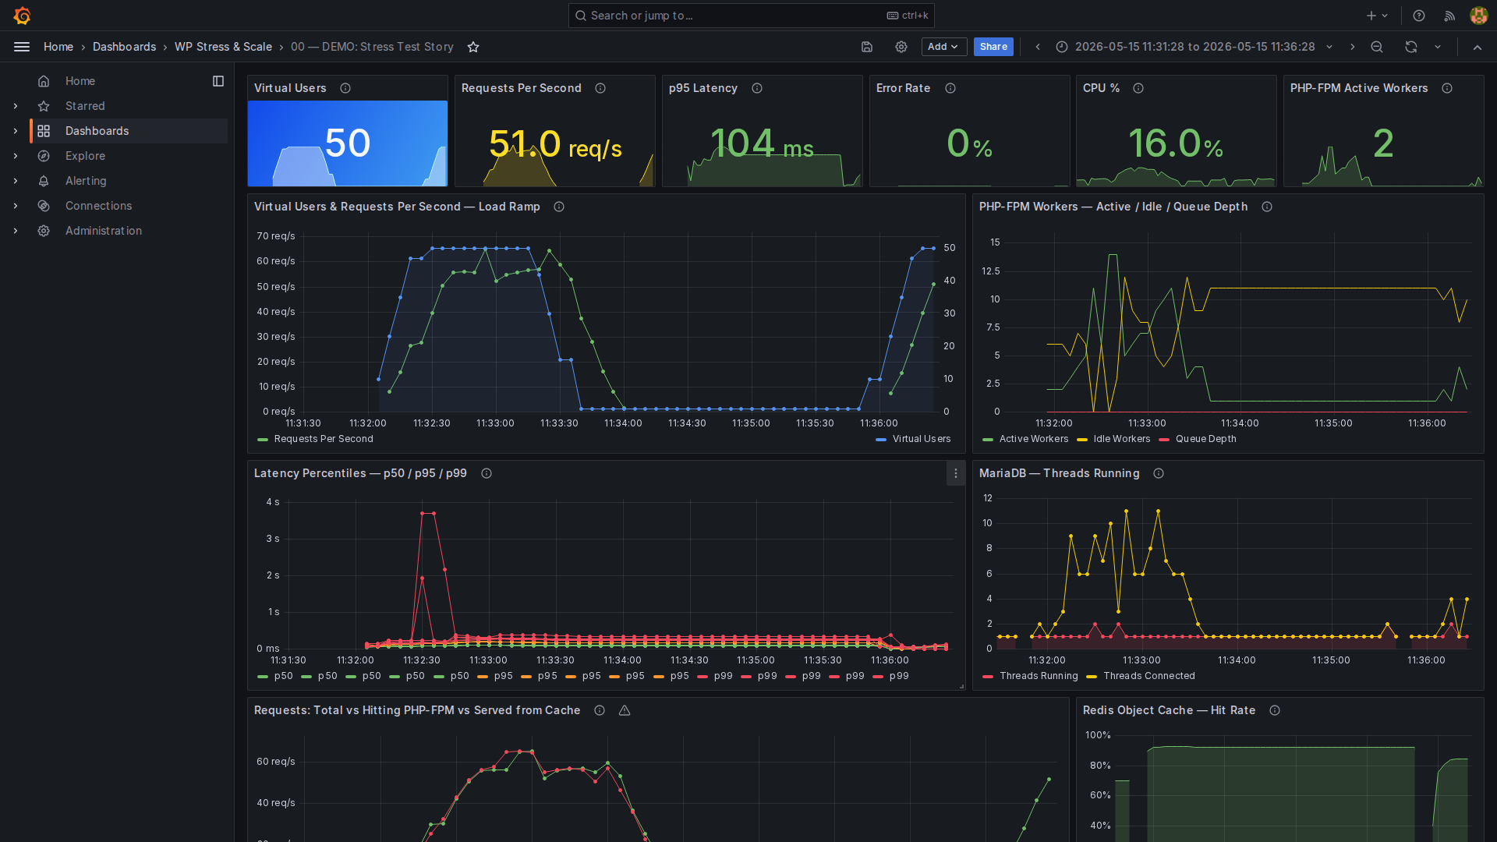
Level 2 — Demo Dashboard (50 Virtual Users)

Slide 26
Level 2 — reading the dashboard
70
Peak requests/s (+8%)
79 ms
p95 Latency (was 133ms)
18%
CPU (was 25%)
FPM Workers — top right:
Active Workers peaked at 11 / 20 (was 14)
Queue Depth: 0 — same as L1 but with less work
FPM Request Rate: only ~20 requests/s (vs 70 requests/s from Nginx)
50 requests/s served from cache — PHP never ran

Slide 27
L0 → L1 → L2: the progression
Metric
Level 0
Level 1
Level 2
Peak requests/s
~140 →
65
70
p95 Latency
~3 s
133 ms
79 ms
CPU @ 50 Virtual Users
~100%
25%
18%
FPM workers (peak)
—
14 / 20
11 / 20
FPM queue depth
~250
0
0
DB Threads peak
20+
12.5
3
FastCGI cache offload
0%
0%
~70%
Redis hit ratio
—
82.3%
~80%+

Slide 28
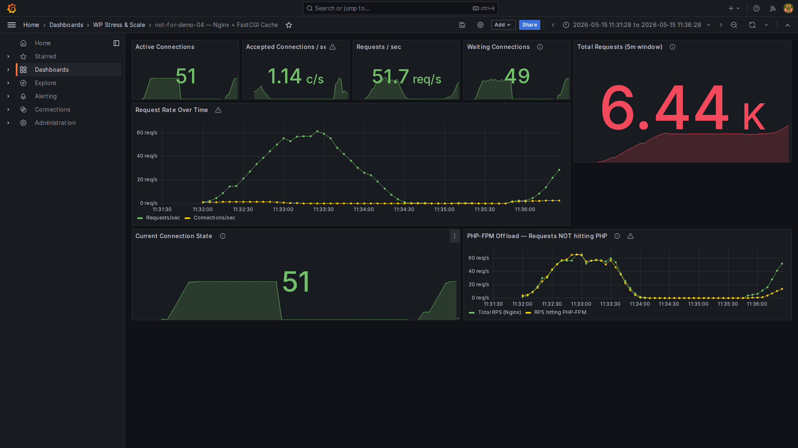
Level 2 — Nginx Cache: 9.94K requests, FPM Offload

Slide 29
Level 2 — the FPM offload panel explained
Bottom-right panel: PHP-FPM Offload — Requests NOT hitting PHP
Total requests/s (Nginx) ████████████████████████ ~70 ← everything
Requests/s hitting PHP-FPM ████████ ~20 ← only cache misses
Gap ████████████████ ~50 ← served from cache
PHP never ran
MySQL never queried
In 5 minutes of the test:
9,940 total requests
~7,000 served from nginx cache (disk read, <10ms)
~2,940 required PHP execution (cold cache, logged in, dynamic pages)
This is the money slide.

Slide 30
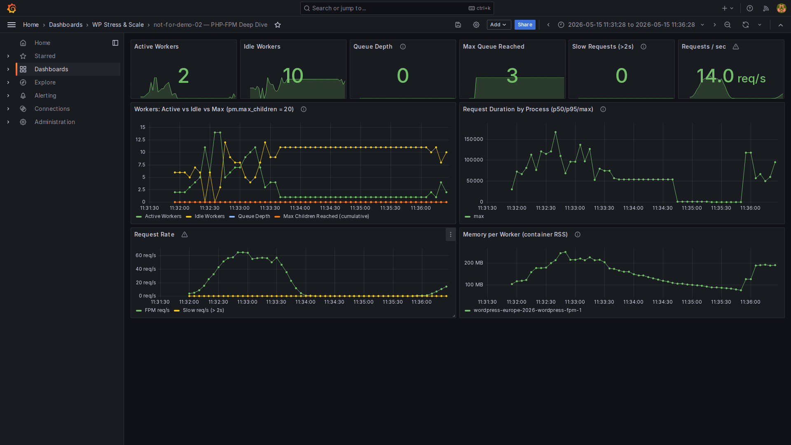
Level 2 — PHP-FPM: Steady at 10-11 Workers

Slide 31
MariaDB tuning — Level 2
Level 0 baseline config:
# 00-baseline.cnf
innodb_buffer_pool_size = 128M
# (default — fits almost nothing)
max_connections = 151
With 128M buffer pool:
WordPress DB ≈ 500MB
Every query reads from disk
Buffer pool full → constant disk I/O
Slow queries undetected
Level 2 tuned config:

Slide 32
Level 1 vs Level 2 — the real numbers
Metric
Level 1
Level 2
Change
Peak requests/s @ 50 Virtual Users
65
70
+8%
p95 Latency
133 ms
79 ms
−41%
CPU usage
25.4%
18.1%
−29%
FPM workers (peak)
14 / 20
11 / 20
−21%
FPM queue depth
0
0
—
MariaDB threads (peak)
12.5
3
−76%
Cache offload
0%
~70%
50 requests/s saved
Requests in 5 min
~8K
9.94K
+24%
Redis hit ratio
82.3%
~80%+
similar

Slide 33
⚡
What's Next?
The Static Leap
Level 4 — Simply Static: WordPress as a CMS, not a runtime

Slide 34
Level 4 — the concept
Build time (once per publish cycle, after content is seeded):
# Setup — install the Simply Static plugin:
wp plugin install simply-static --activate
# Export — trigger once after content is ready:
wp simply-static run
# Crawls every published URL → flat HTML + assets
# Output: static/export/ → served by Nginx, zero PHP
Simply Static is a WordPress plugin — no external tooling needed.
Run once after seeding 2,500 posts + 500 products. Re-run after any publish.
Takes ~2–5 min. Output directory is the same
static/export/
Nginx already
serves.
Runtime (every anonymous request):

Slide 35
Level 4 — Simply Static: expected numbers
Metric
Level 2
Level 4 (estimated)
requests/s @ 50 Virtual Users
70
500–1,500+
p95 Latency
79 ms
~3–5 ms
CPU @ 50 Virtual Users
18%
<3%
DB Threads
3
~0
PHP workers needed
11
0
The math:
Level 2 bottleneck: PHP executing 300+ DB queries per page
→ Redis saves 82%, FastCGI saves another 70%
→ PHP still runs for cache misses

Slide 36
Level 3 — Cloudflare CDN
The concept:
Browser (anywhere in the world)
↓
Cloudflare Edge (300+ PoPs — nearest data center, <30ms away)
├── CACHE HIT → response from edge (0ms origin, ~10–20ms to browser)
└── CACHE MISS → fetch from your VPS (once per TTL, then cached at edge)
Your $12 VPS only sees cache misses — ~10–20% of total traffic during a spike.
Metric
Level 2 (direct)
Level 3 (+ Cloudflare)
Δ
TTFB for cached pages
79 ms
10–20 ms
−75%
Origin requests at peak
100%
~15–20%
−80%
Bandwidth from VPS
100%
~20–30%
−75%
DDoS protection
none
unlimited
—

Slide 37
Cloudflare Free Plan — what you get
Performance (free)
Global CDN — 300+ PoPs worldwide
Full page caching via Cache Rules
Polish — automatic image compression
Rocket Loader — async JS loading
Free SSL/TLS — automatic HTTPS
HTTP/2 + HTTP/3 (QUIC) — automatic
Security (free)
DDoS mitigation — unlimited, unmetered
Bot Fight Mode — basic bot blocking
WAF — 5 custom rules

Slide 38
The full picture
CPU @ 50
DB
Level
Stack
p95 Latency
Virtual Users
Threads
crash ~50
0
Apache + mod_php
100%
20–30
Virtual Users
Nginx + FPM +
1
133 ms
25%
12.5
OPcache + Redis
Level 1 + FastCGI
2
79 ms
18%
3
cache + MariaDB
Level 2 + Cloudflare
3
~20 ms (edge)
<5%
<1
CDN
4
Level 2 + Simply Static
~4 ms
<5%
<1

Slide 39
The full cache hierarchy
Request from browser
│
▼
[Cloudflare CDN] ← Level 3 (edge cache, global PoP)
│ miss
▼
[Nginx FastCGI Cache] ← Level 2 (disk cache, 60-min TTL)
│ miss
▼
[PHP-FPM] ← always running, pool of 20 workers
├── [OPcache] ← Level 1 (compiled bytecode in RAM)
└── [Redis Object Cache] ← Level 1 (DB query results in RAM)
│ miss (first time only)
▼
[MariaDB] ← tuned at Level 2: 512MB buffer pool
Each layer absorbed ~70–95% of what reached it.
MariaDB only sees the requests Redis couldn't answer.

Slide 40
Lessons learned
1. Measure before you fix
Set up Prometheus + Grafana
before you need it.
You cannot fix what you cannot see.
make obs-up
— 30 seconds.
2. The three WP cache layers
OPcache → PHP bytecode → always on
Redis → DB queries → wp redis enable
FastCGI → Full pages → nginx.conf
Most sites use 0 of these 3.
All three: completely different machine

Slide 41
The tools — all free, all open source
Tool
Role
k6
Load generator — scriptable, Prometheus remote-write
Prometheus
Metrics collection + storage
Grafana
7 dashboards, auto-provisioned
Loki + Promtail
Container log aggregation
Tool
Role
Nginx FastCGI
Full-page cache (built-in)
PHP OPcache
Bytecode cache (built-in)
Redis
Object cache
MariaDB 11
Tuned DB config

Slide 42
Thank you!
Nedko Hristov
Senior DevOps Engineer @ Nemetschek Bulgaria
github.com/NedkoHristov/WordPress-Europe-2026
Questions?
"The best time to add monitoring was before the crash.
The second best time is right now."

