Slide 1
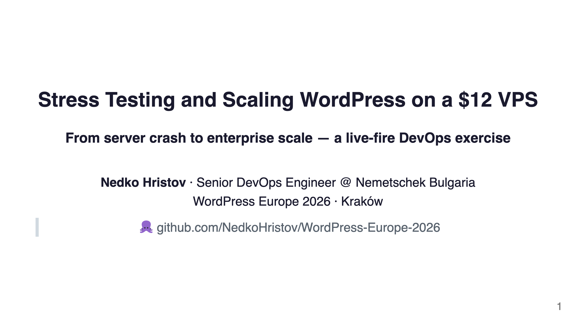
Notes:
Speaker notes: Welcome everyone. Today we're going to crash a WordPress server — on purpose — and then fix it, layer by layer, while watching everything in real time on Grafana dashboards. Every command I run is in the GitHub repo. You can reproduce every number I show you.

Slide 2
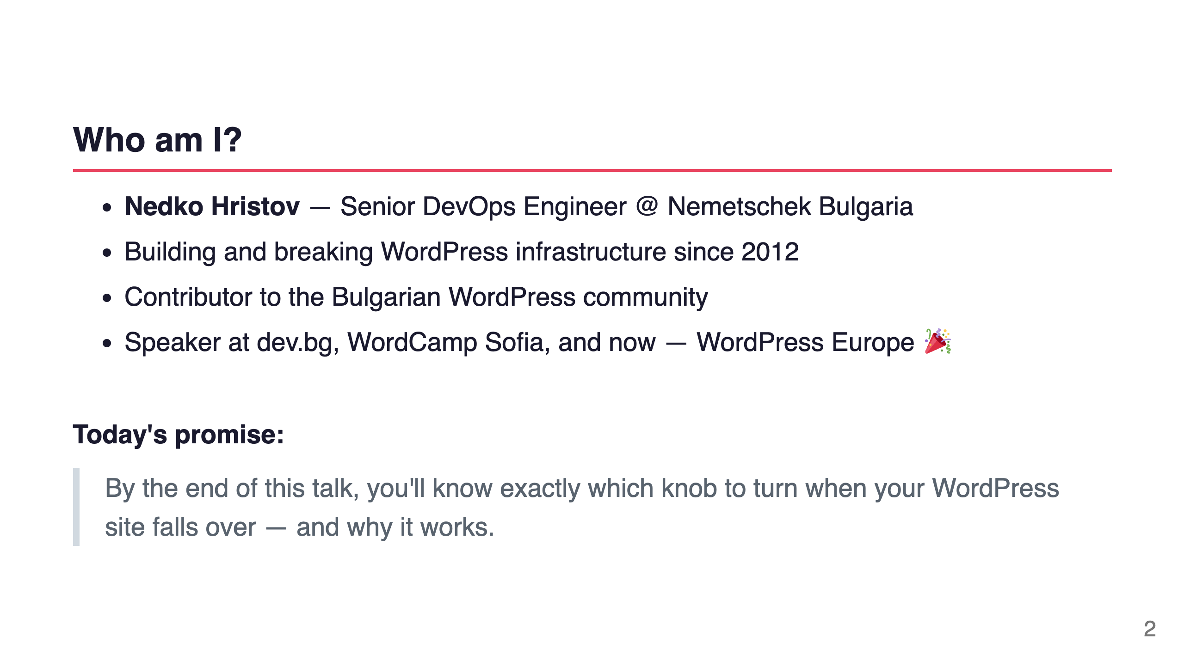
Notes:
Speaker notes: Quick intro. I've been running WordPress at scale for over a decade. I've seen every failure mode. Today I want to share the playbook I wish I had early on.

Slide 3
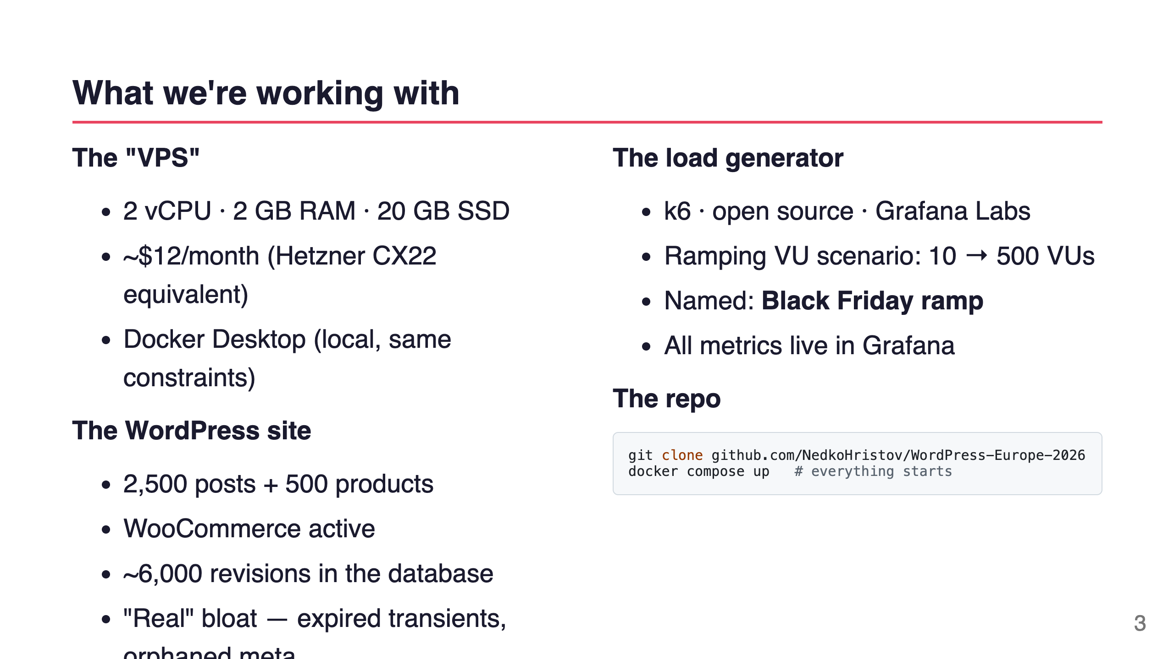
Notes:
Speaker notes: We're simulating a real $12 VPS by running Docker with constrained resources. The WordPress database has realistic bloat — not just empty tables. k6 handles the load and pushes metrics to Prometheus in real time.

Slide 4
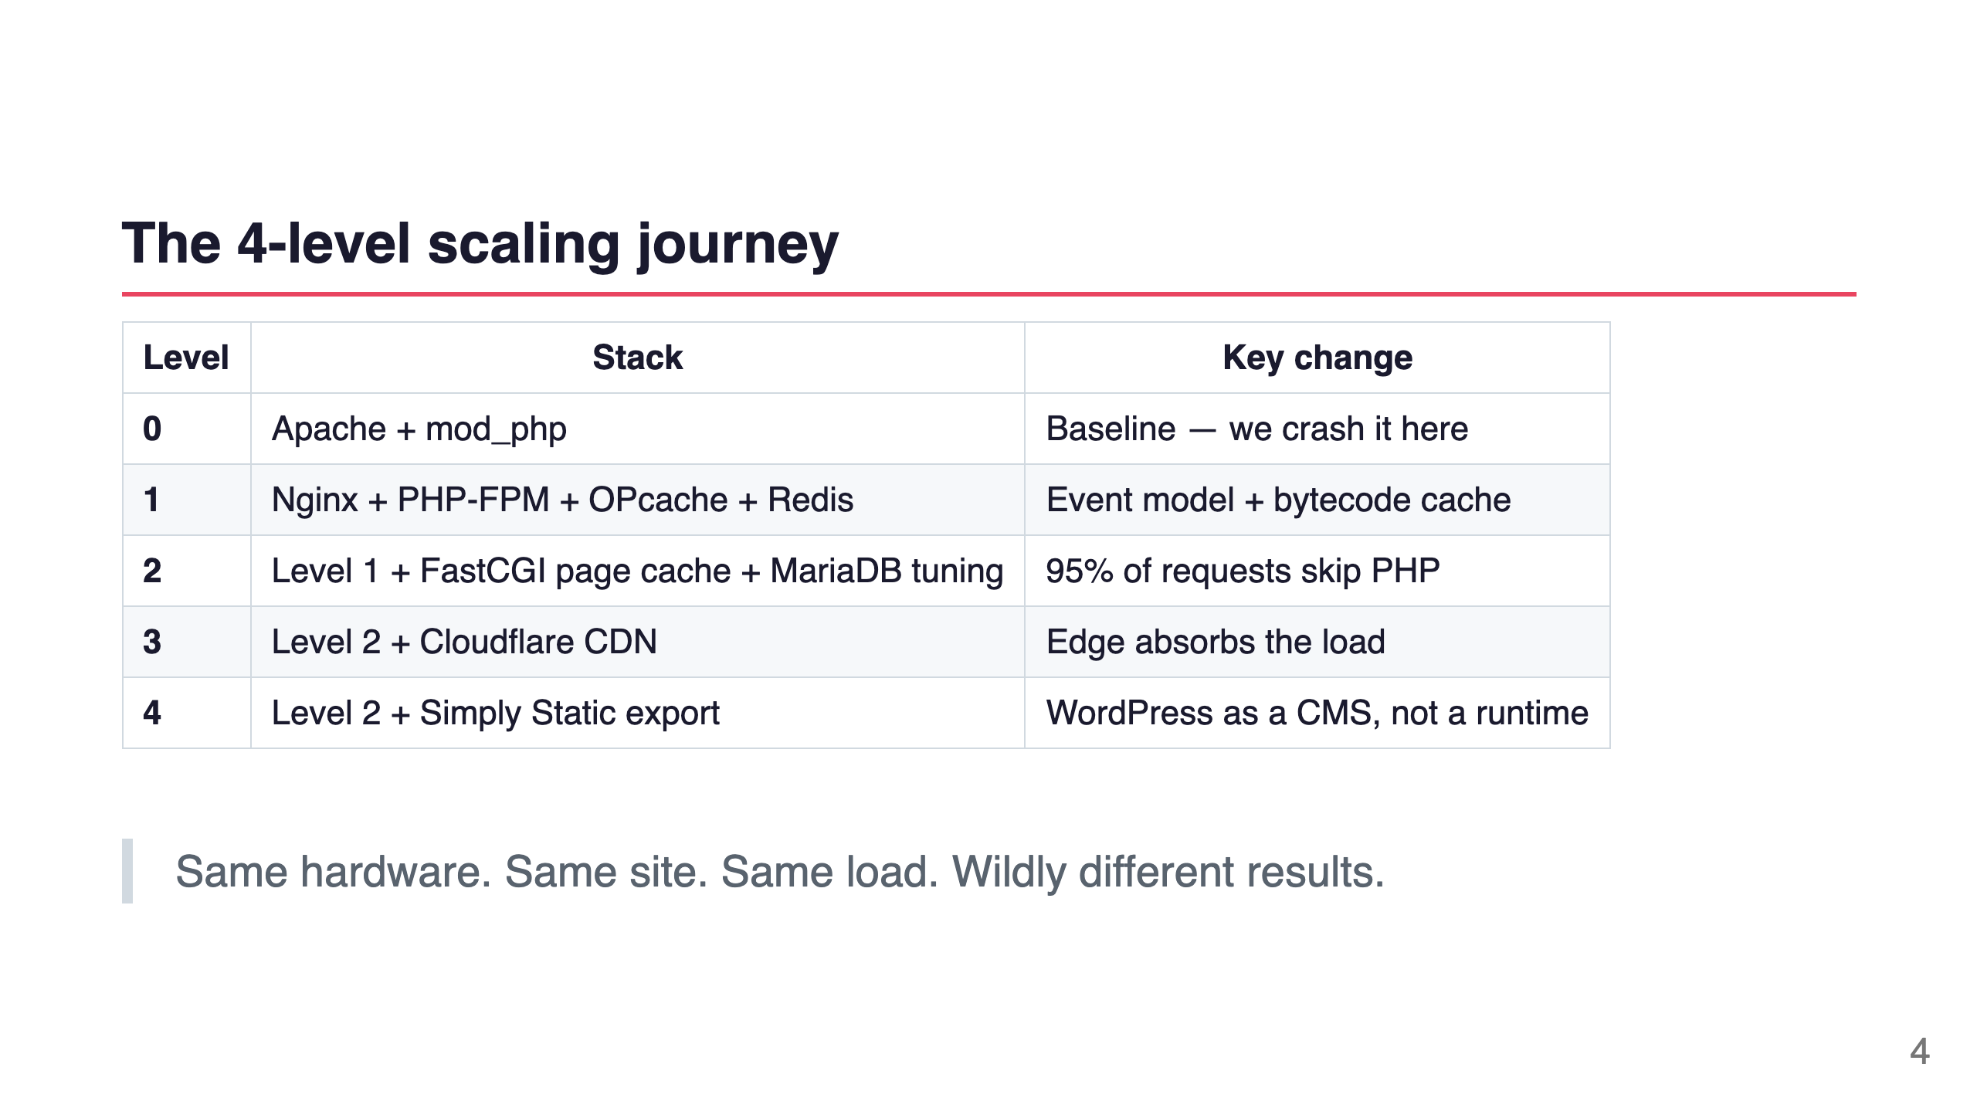
Notes:
Speaker notes: Every level is a real, actionable change you can make to a production site. We go from "it crashes at 50 users" to "500 users, 0% errors, CPU barely moving."

Slide 5
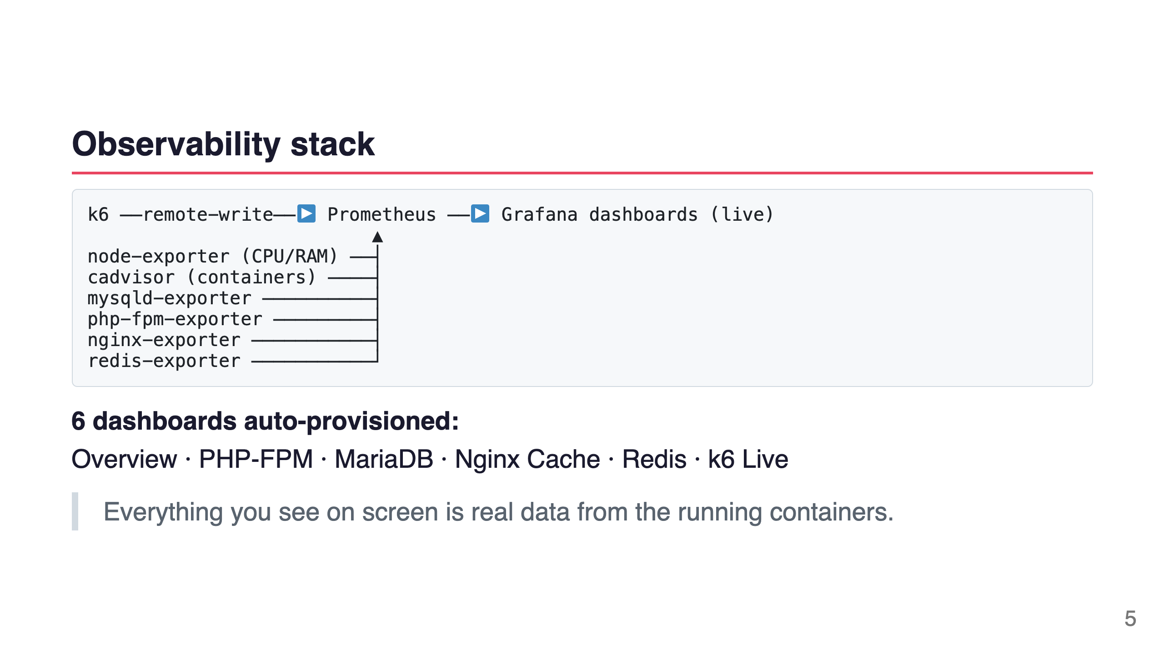
Notes:
Speaker notes: I want you to trust the numbers. Every metric is from an actual exporter scraping the real process. The k6 results go directly into Prometheus via remote write — the same Prometheus that's graphing the server health. One source of truth.

Slide 6
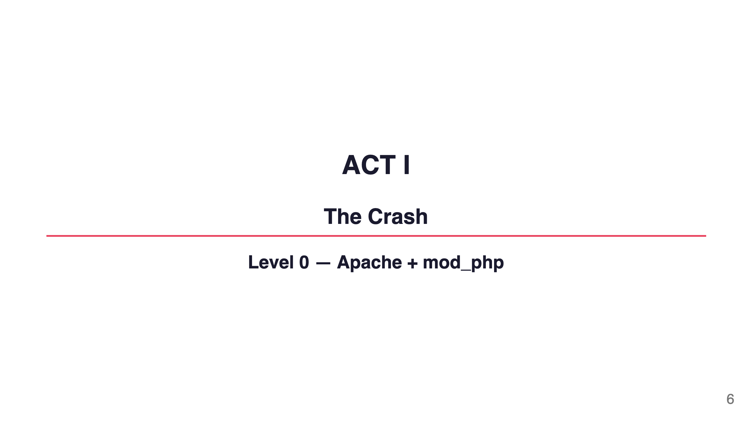
Notes:
Speaker notes: Let's start where most WordPress sites start. The default. The thing your hosting provider sets up for you. Apache prefork with mod_php.

Slide 7
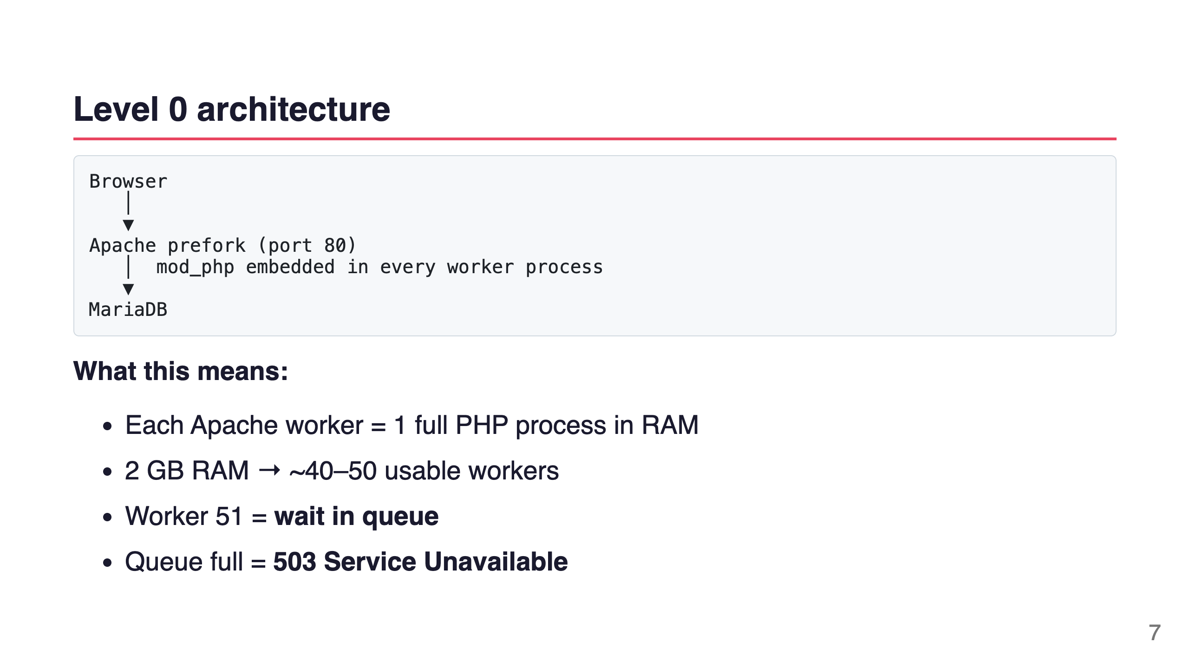
Notes:
Speaker notes: Apache prefork was designed in 1995. Each connection gets its own process. Each process loads PHP into memory. On a 2GB VPS with a WordPress site, you realistically get about 40-50 slots. The 51st visitor waits. And the 100th visitor gets a 503.

Slide 8
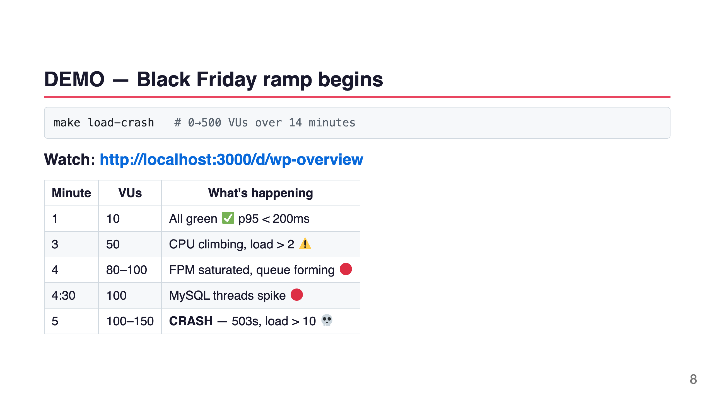
Notes:
Speaker notes: [Run make load-crash, switch to Grafana Overview]. Watch the load average. The moment it crosses 2.0 on a 2-core machine, we're in trouble. When it hits 10, the machine is effectively frozen from the web server's perspective.

Slide 9
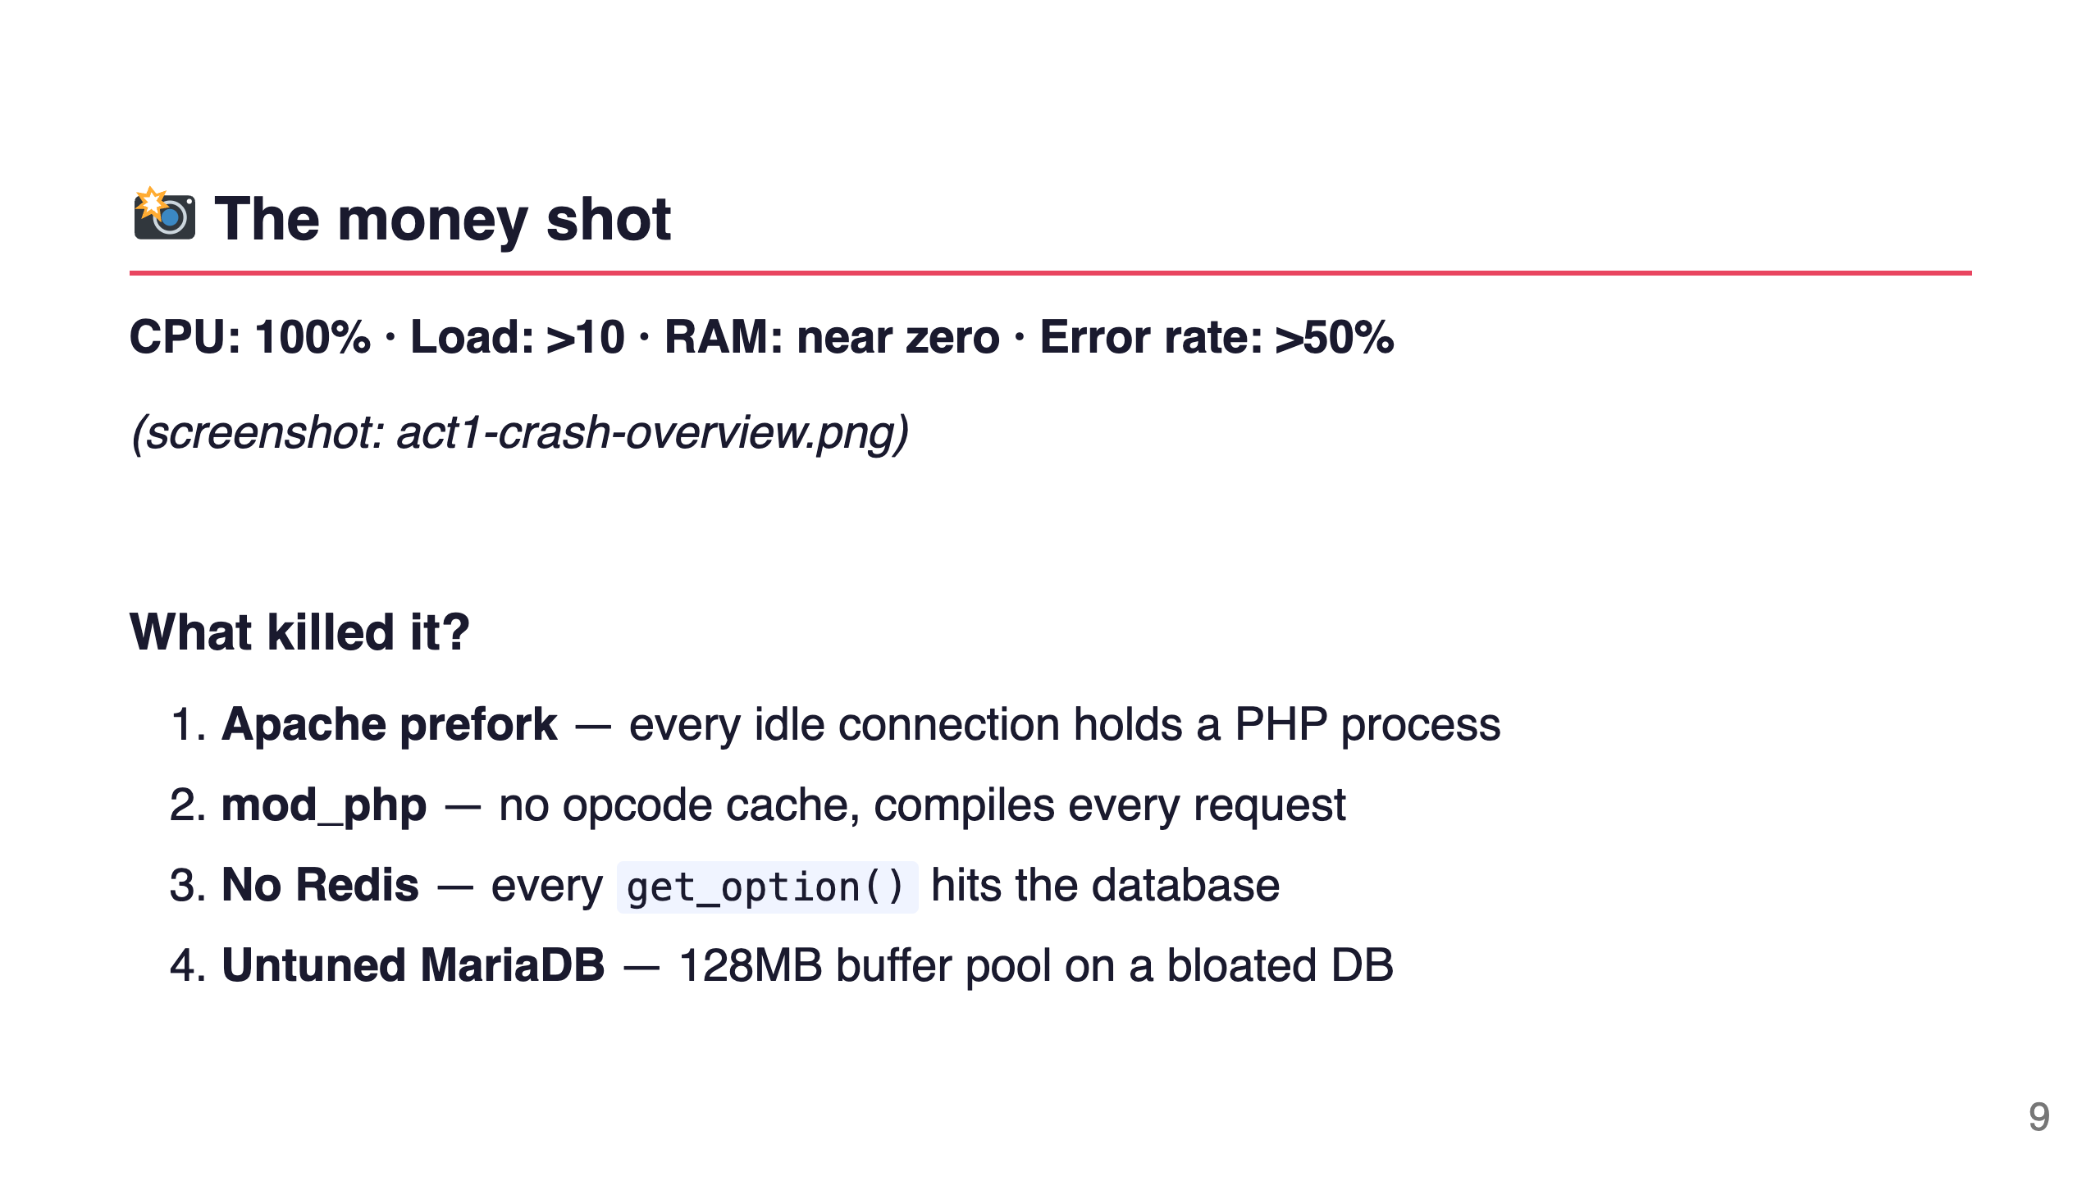
Notes:
Speaker notes: [Point to the dashboard]. This is what a crash looks like in Grafana. CPU pegged at 100%. Load average of 10 on a 2-core machine — that means 8 processes in the queue for every 2 running. RAM near zero because the OS is desperately trying to free memory for the next Apache worker.

Slide 10
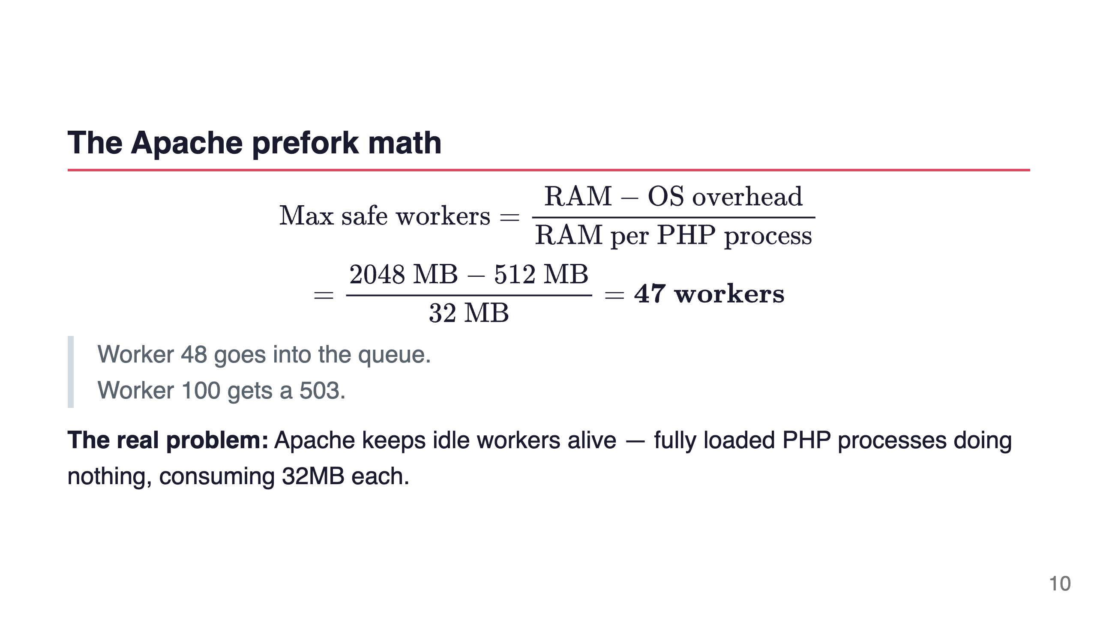
Notes:
Speaker notes: This is the core issue. Apache prefork is a process-per-connection model. Even a visitor who's just reading a page, with their browser open and coffee in hand — that's 32MB of RAM doing nothing but waiting for them to click. 47 visitors. That's your limit.

Slide 11
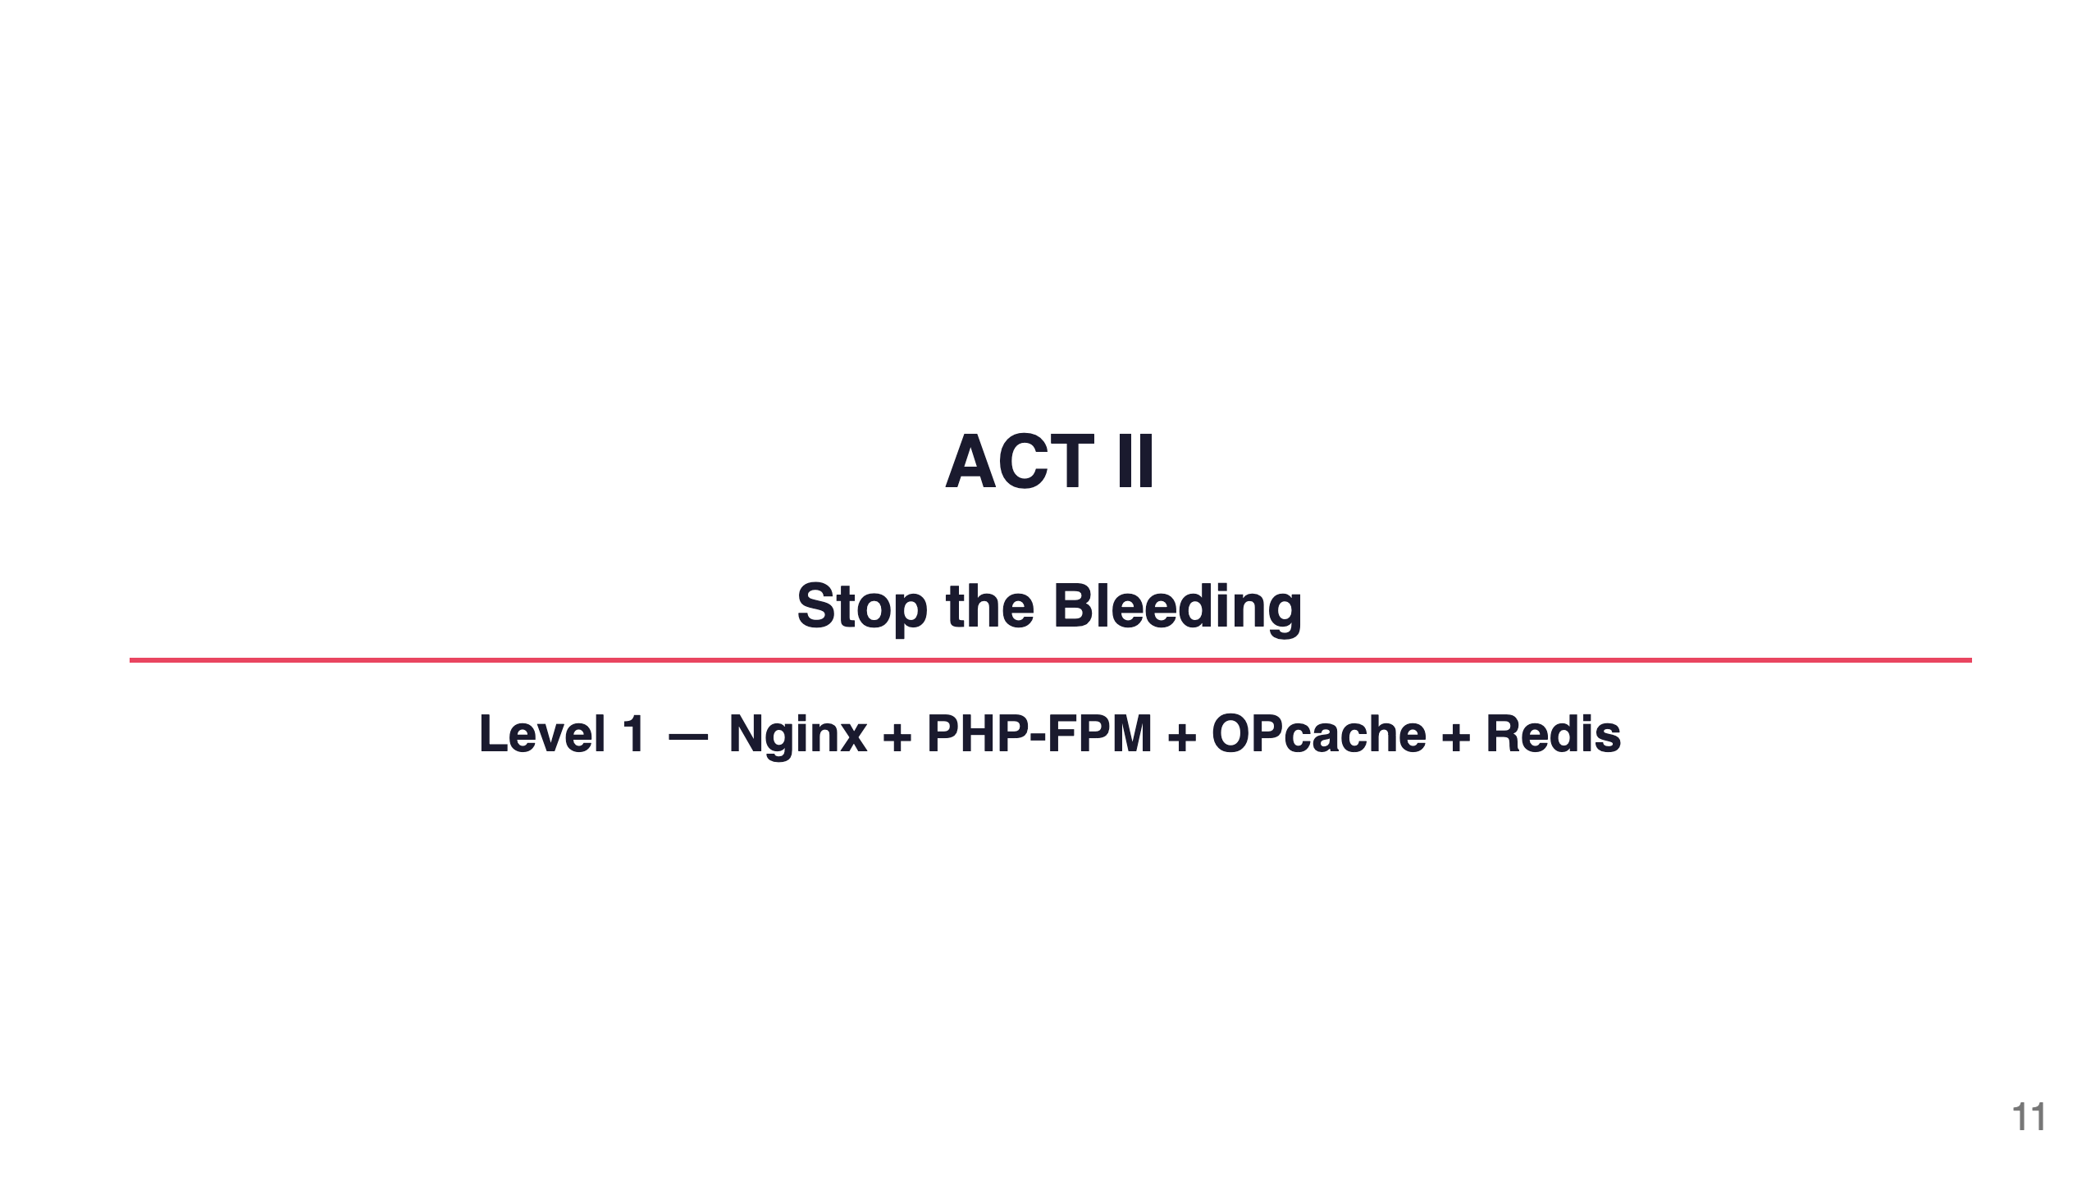
Notes:
Speaker notes: The fixes aren't exotic. They're well-known. They're just not the default. Let's apply them one by one and watch the dashboard react in real time.

Slide 12
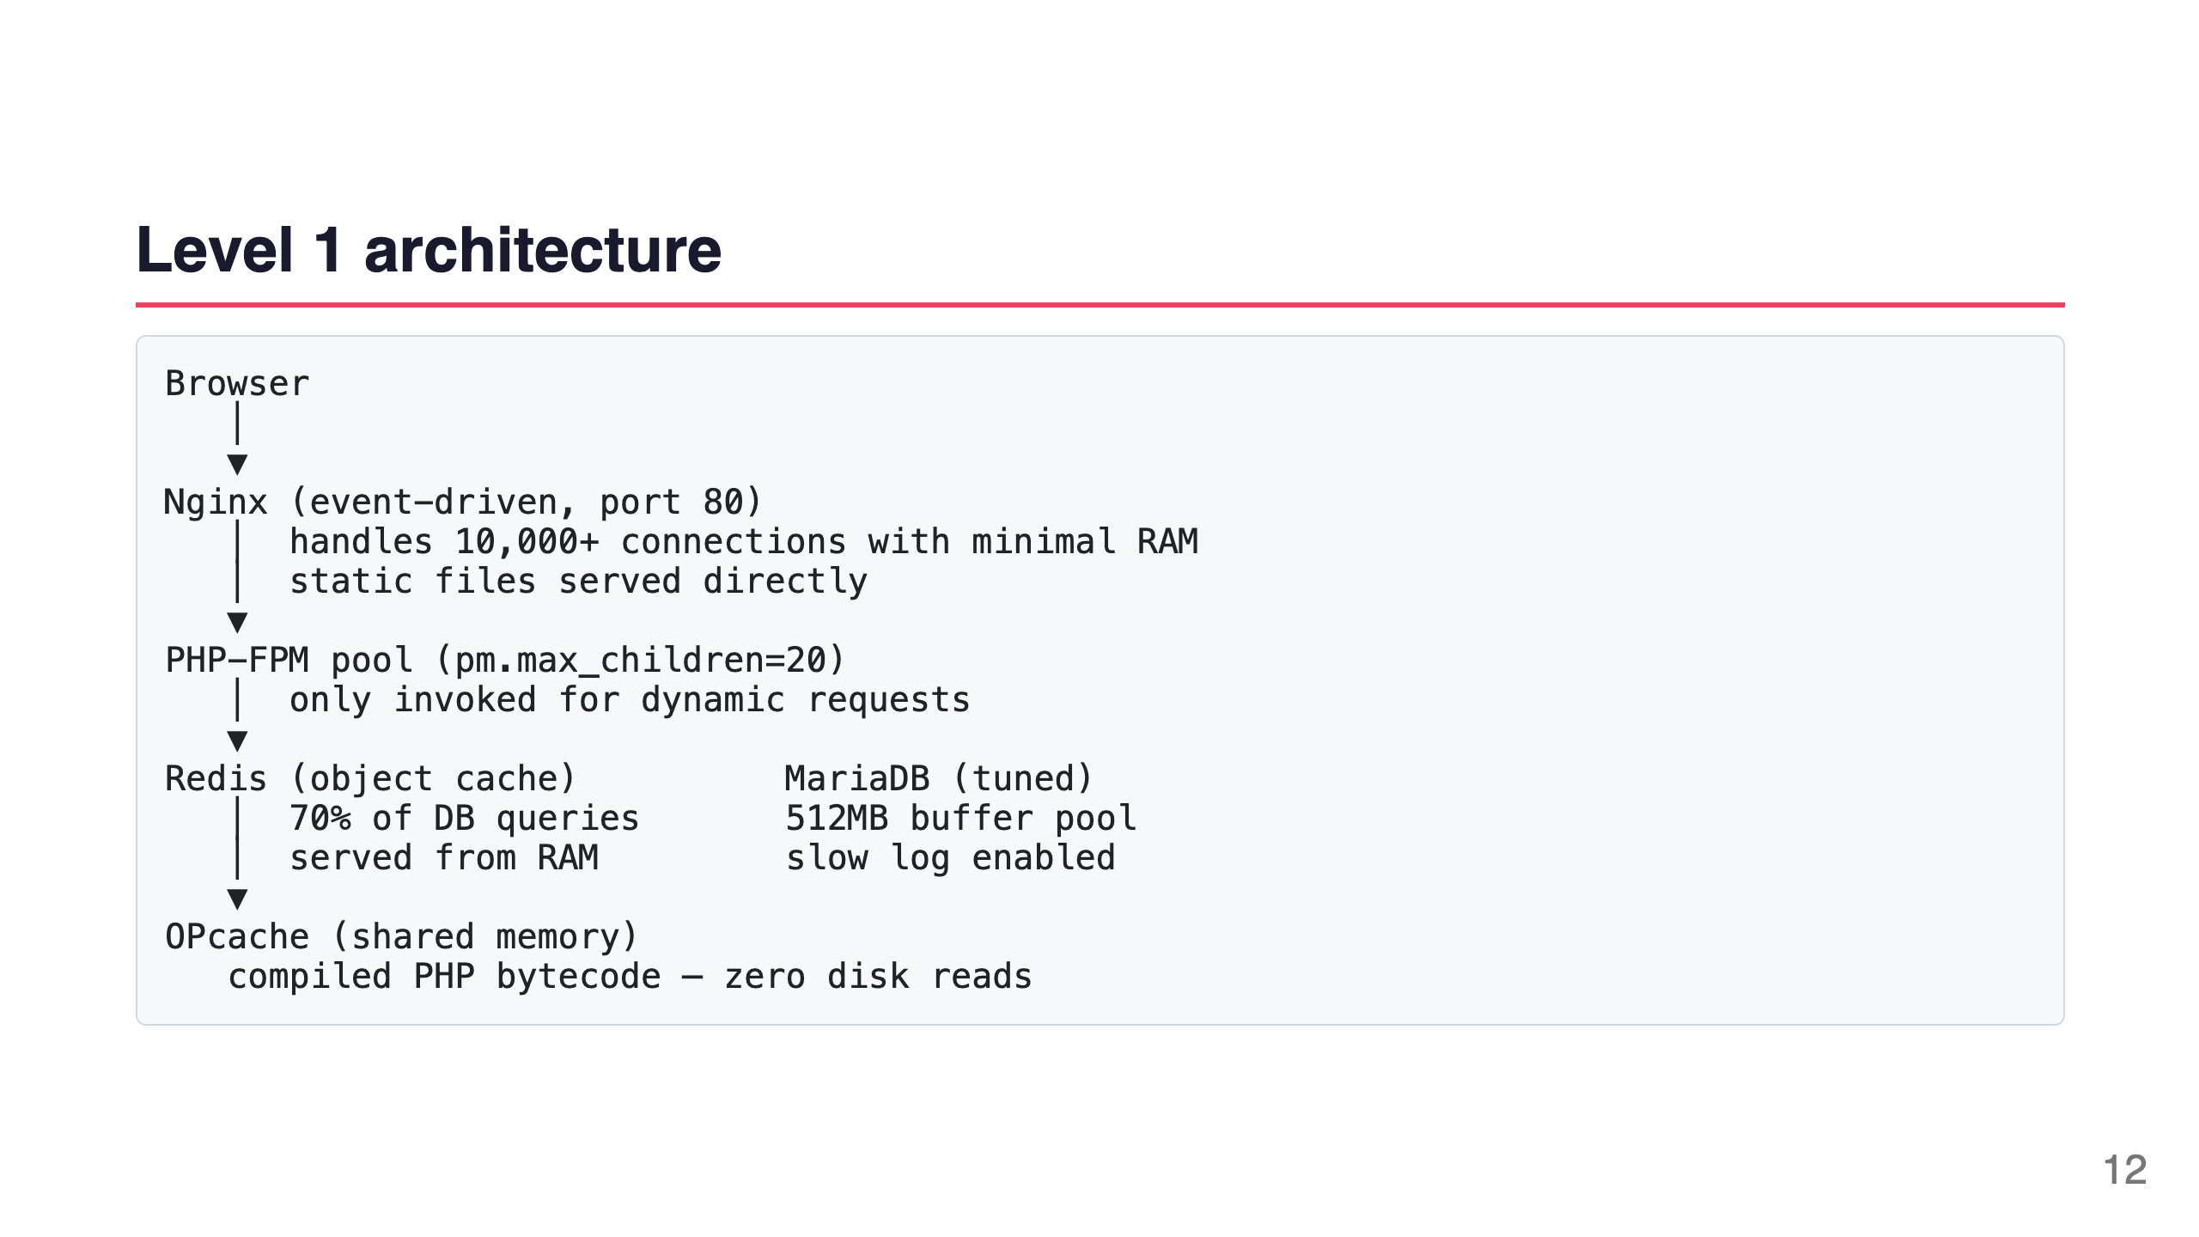
Notes:
Speaker notes: Three changes. Nginx replaces Apache. PHP-FPM decouples PHP from the web server. OPcache keeps compiled bytecode in shared memory. Redis caches DB queries. All four work together.

Slide 13
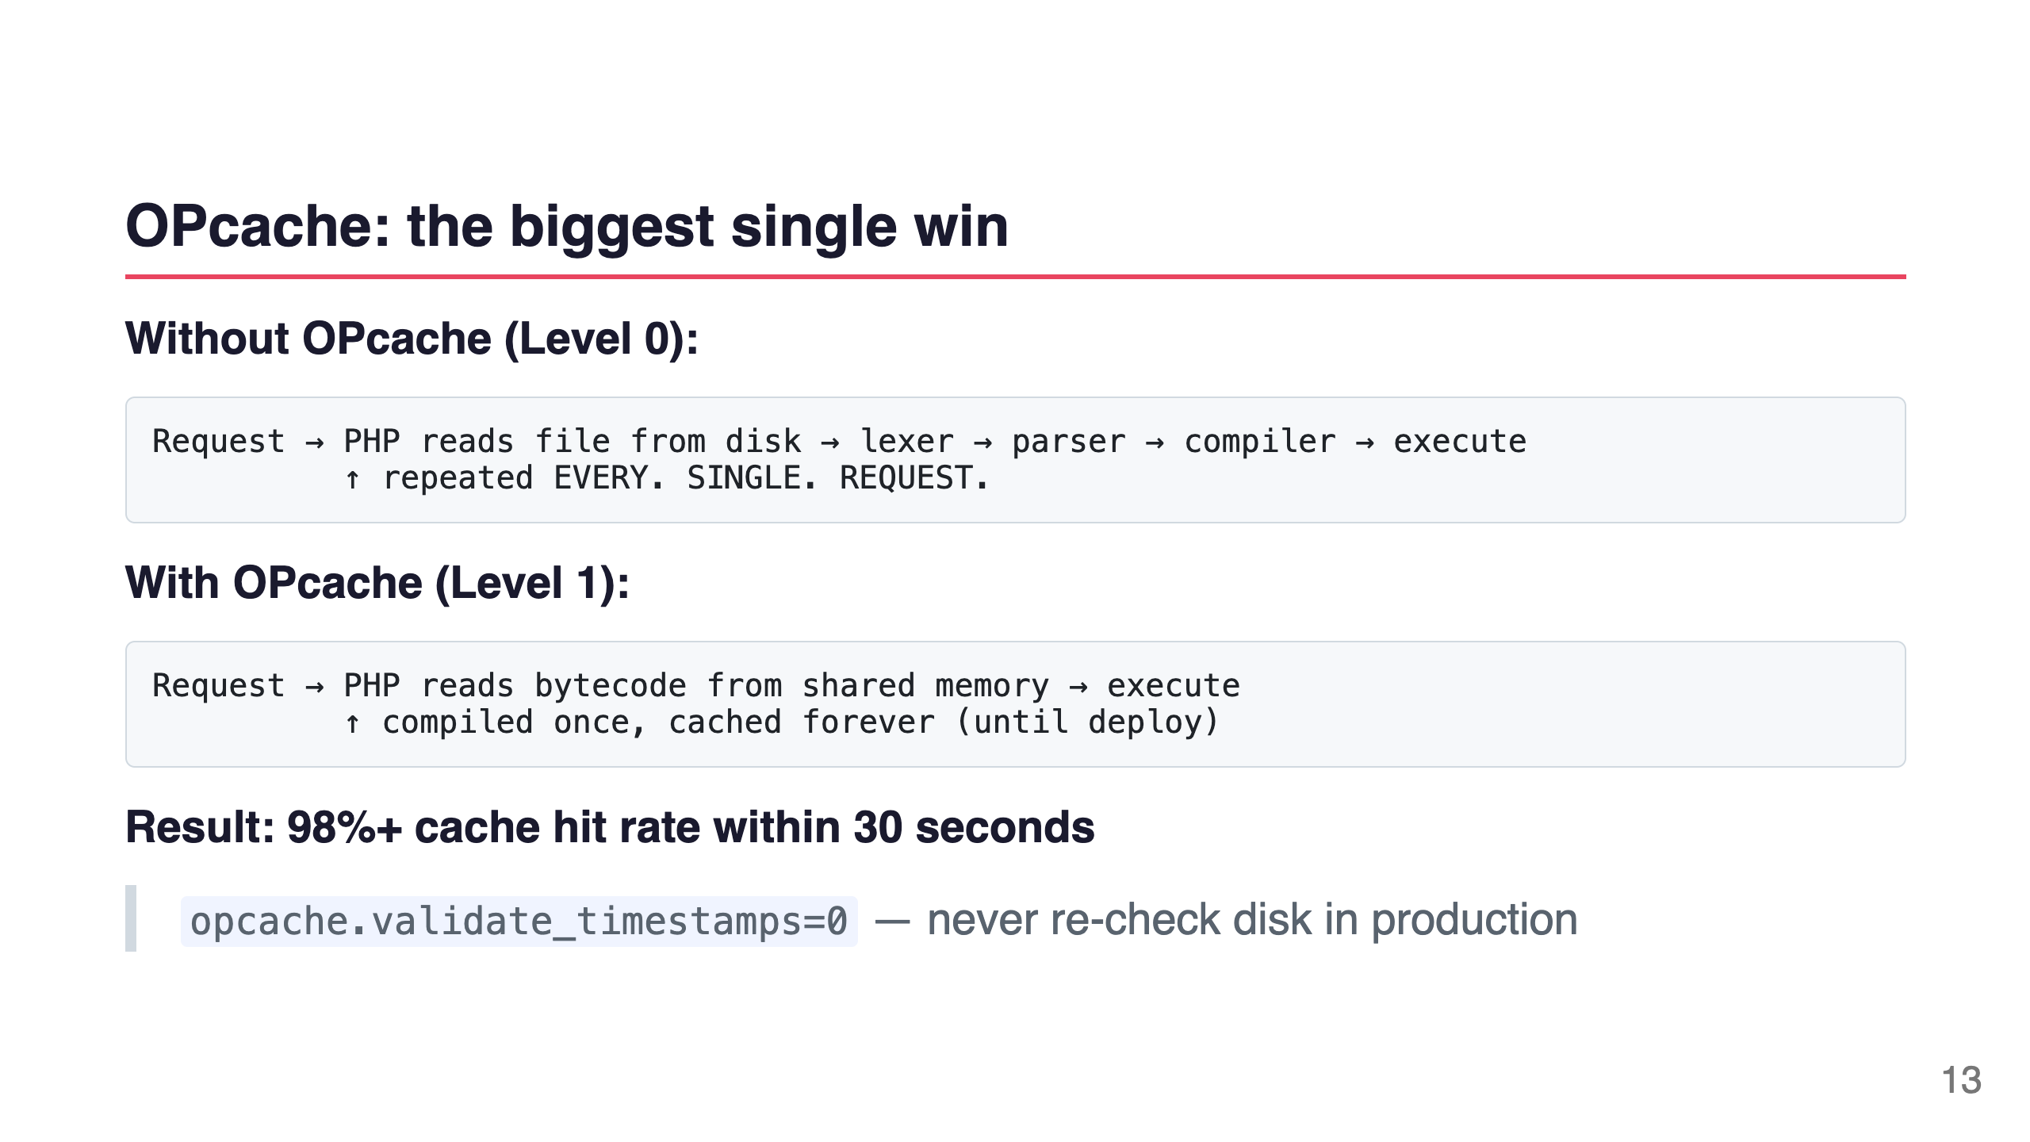
Notes:
Speaker notes: OPcache is free, ships with PHP 5.5+, and is probably already installed on your server. If it's not enabled — enable it right now. Your server will immediately feel like you upgraded the CPU.

Slide 14
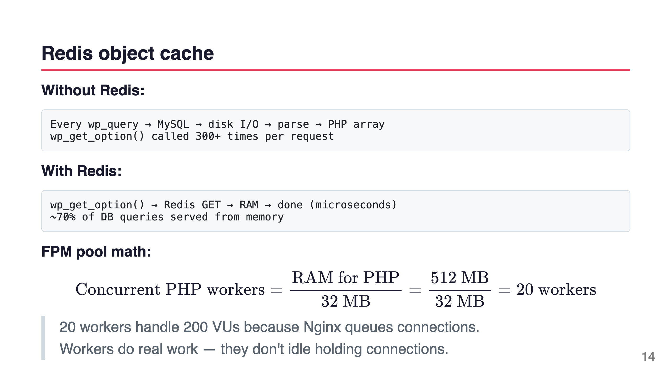
Notes:
Speaker notes: Redis-Cache plugin, wp redis enable, done. The object cache stores the result of every database query in Redis. The next request gets it from RAM. On a typical WordPress site with WooCommerce, about 70% of DB calls are cache-able.

Slide 15
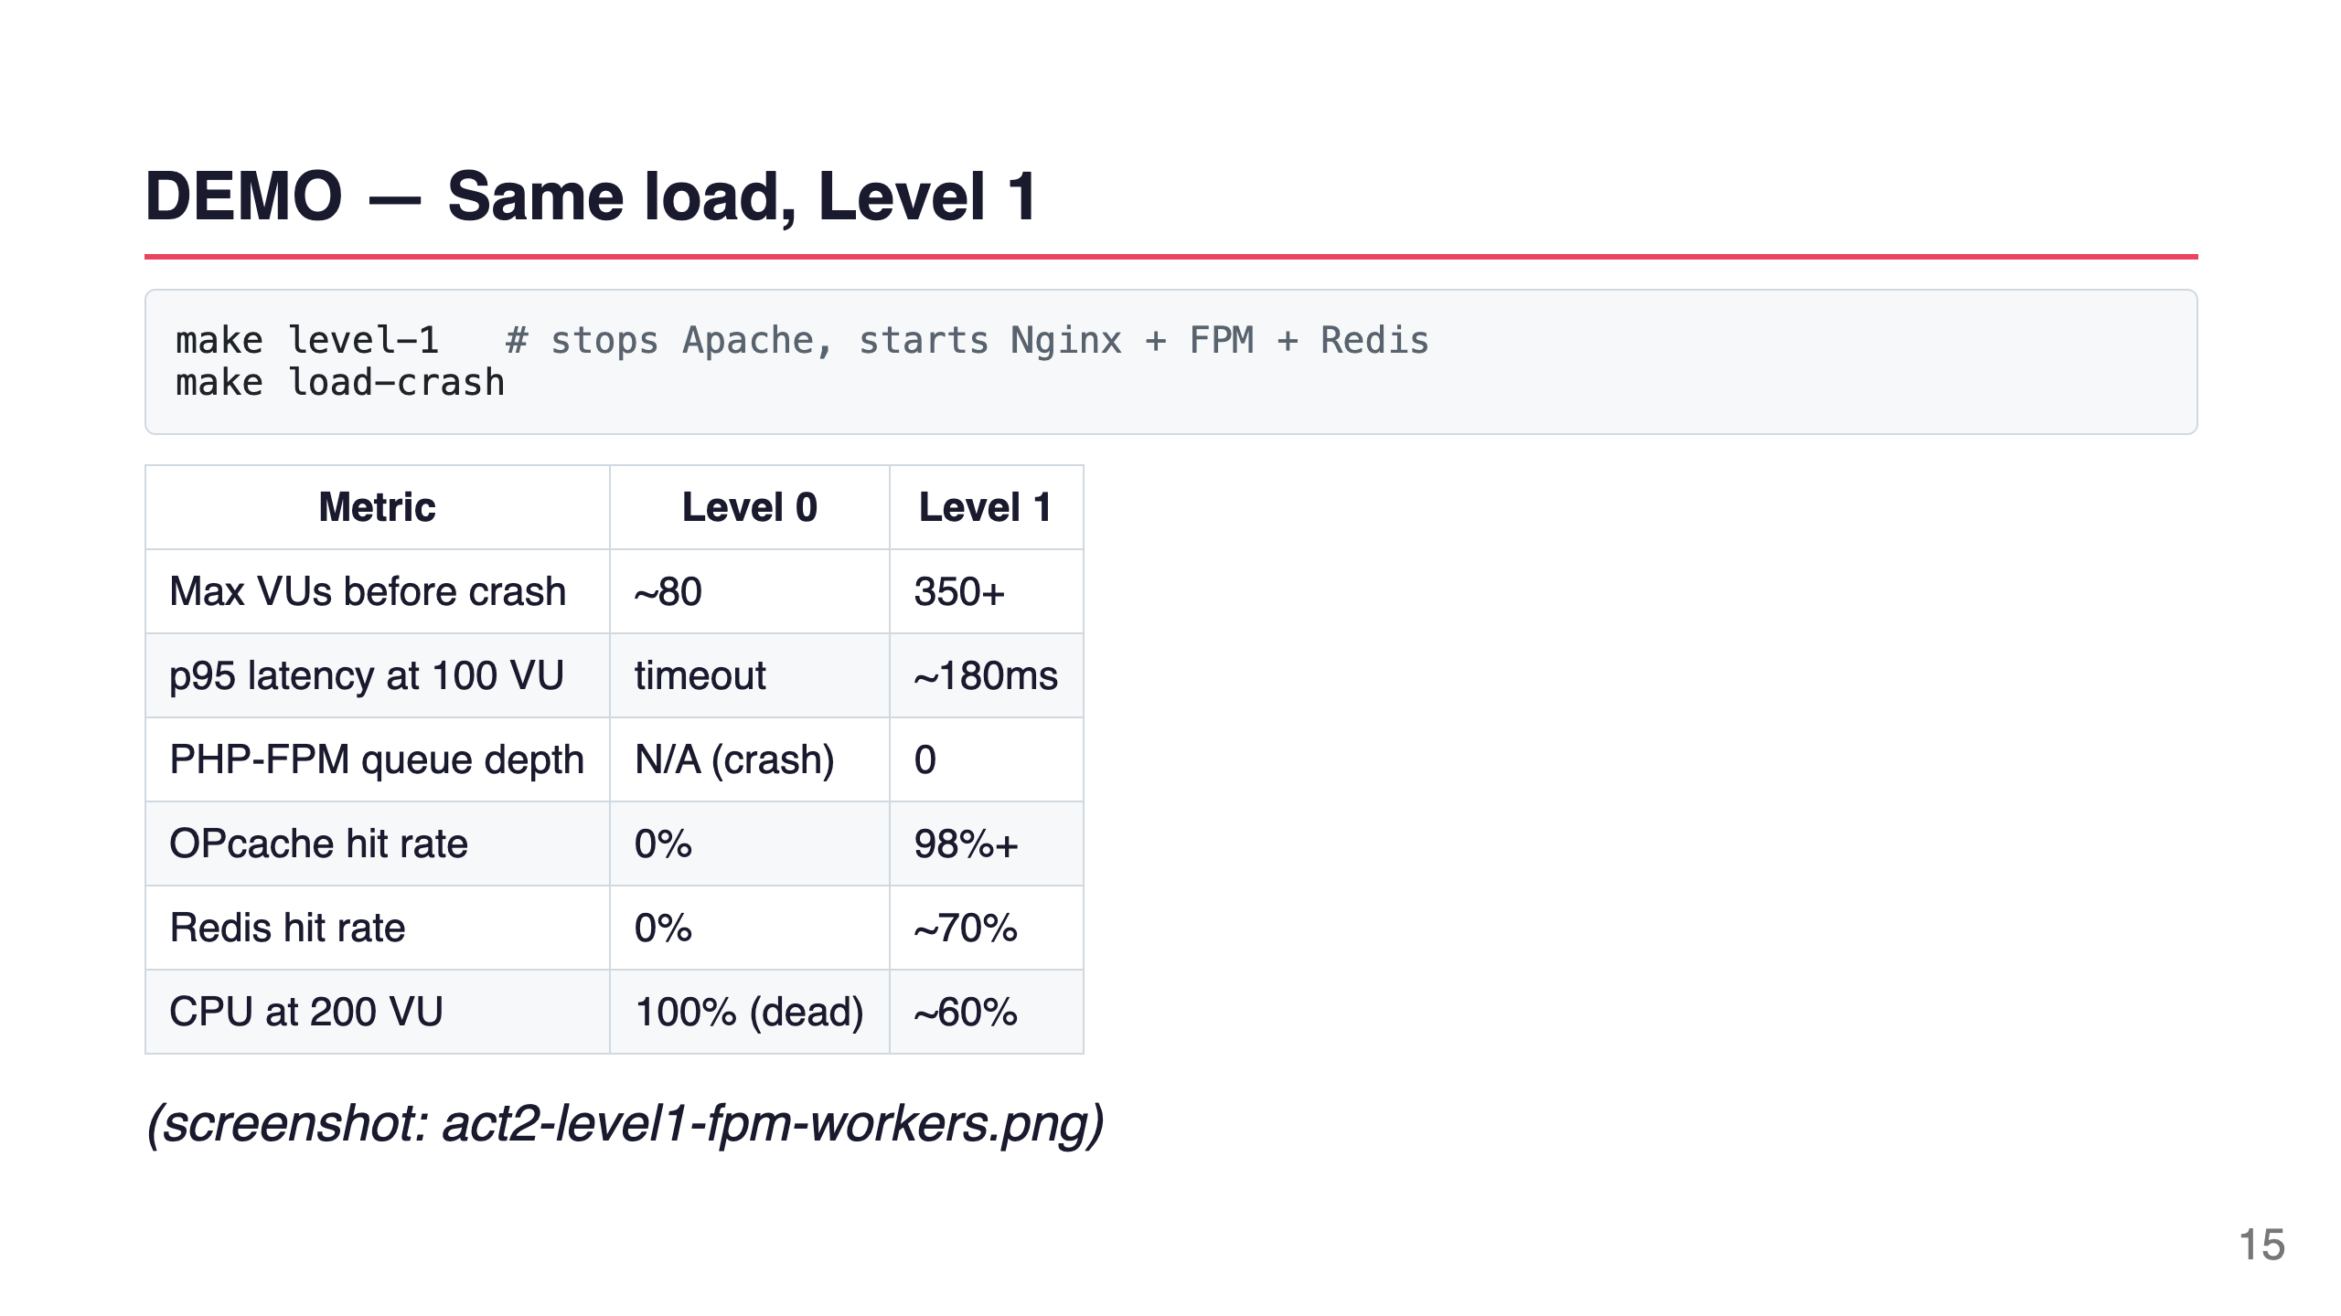
Notes:
Speaker notes: [Switch to PHP-FPM dashboard]. See the Active Workers line — it's staying below 15 even at 200 VUs. Queue Depth is zero. That zero is the whole story. Nginx is absorbing the connections; FPM workers are only busy when there's real PHP work to do.

Slide 16
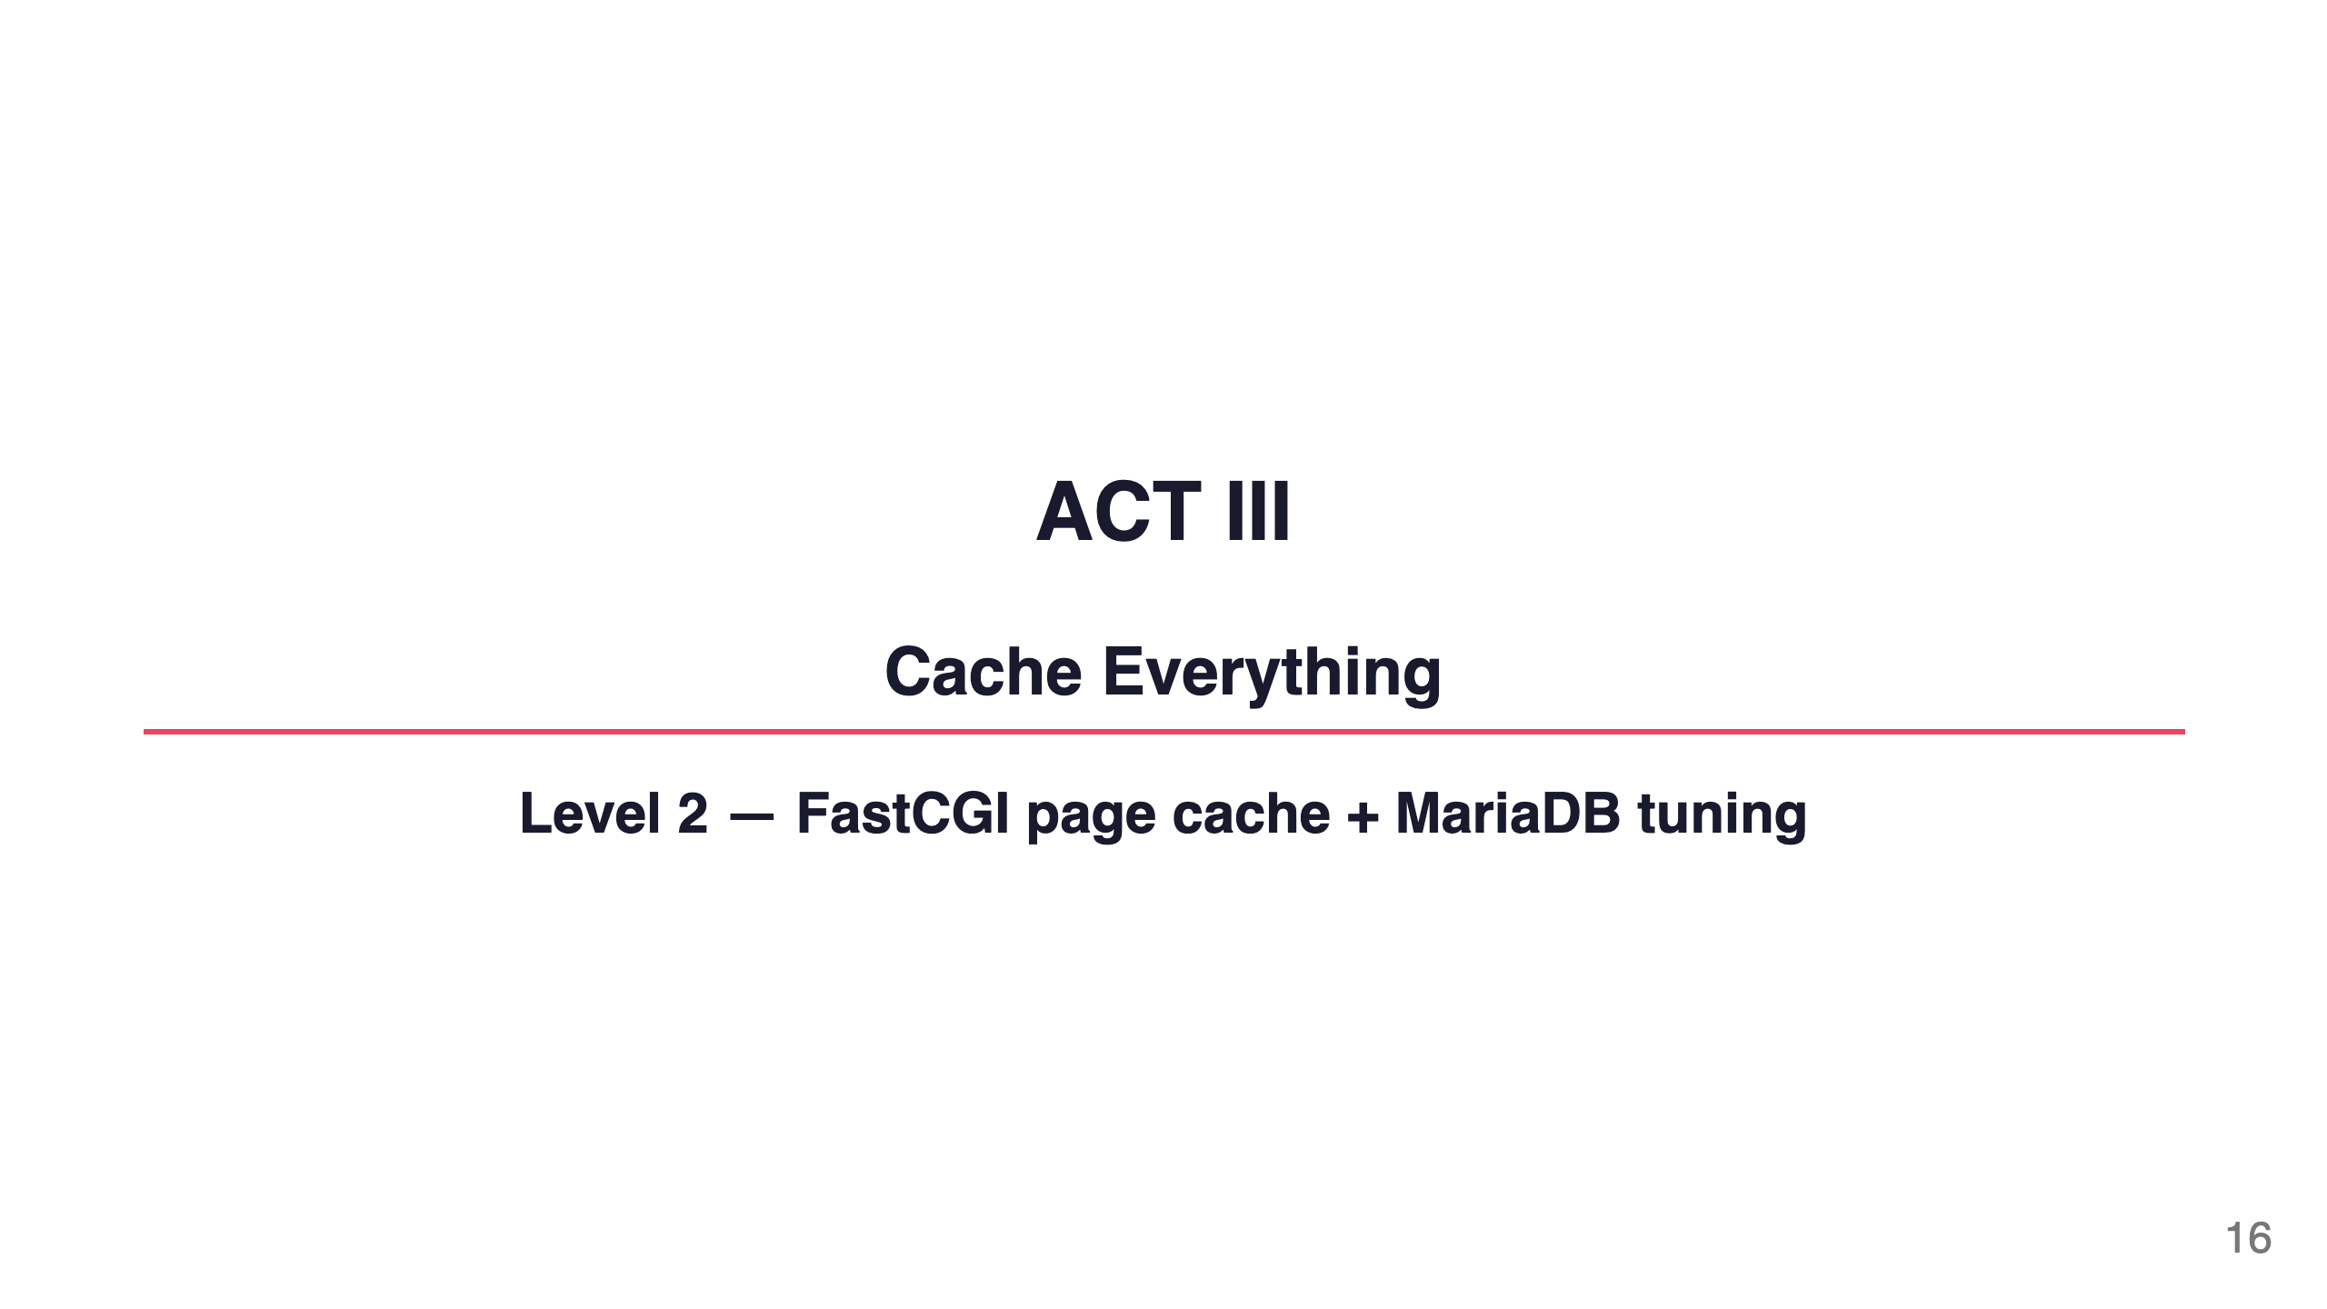
Notes:
Speaker notes: We've stopped the crash. Now let's make the server "bored" — so bored that 95% of requests never wake up PHP at all.

Slide 17
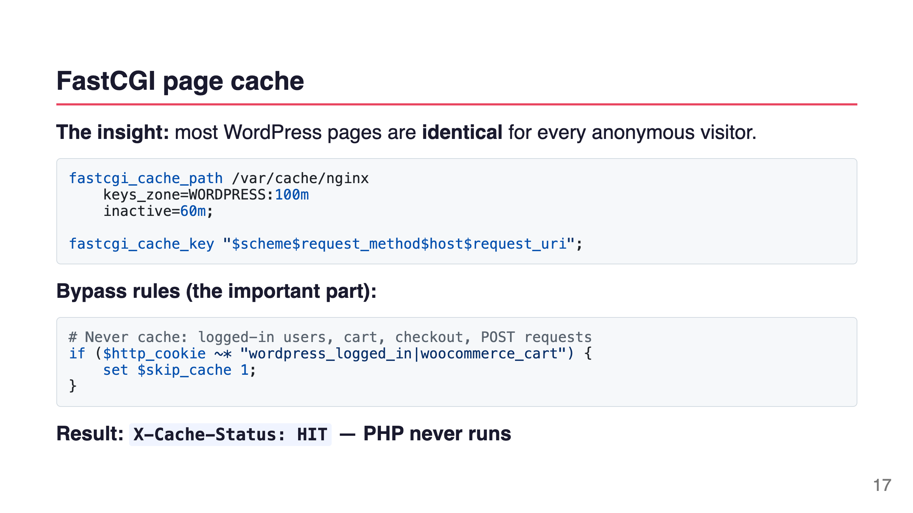
Notes:
Speaker notes: The cache lives on disk (or tmpfs). First visitor generates the page — FPM runs, PHP executes, MySQL queries, page rendered, stored in cache. Every visitor after that for the next hour: Nginx reads from disk, returns in 8ms. PHP is completely bypassed.

Slide 18
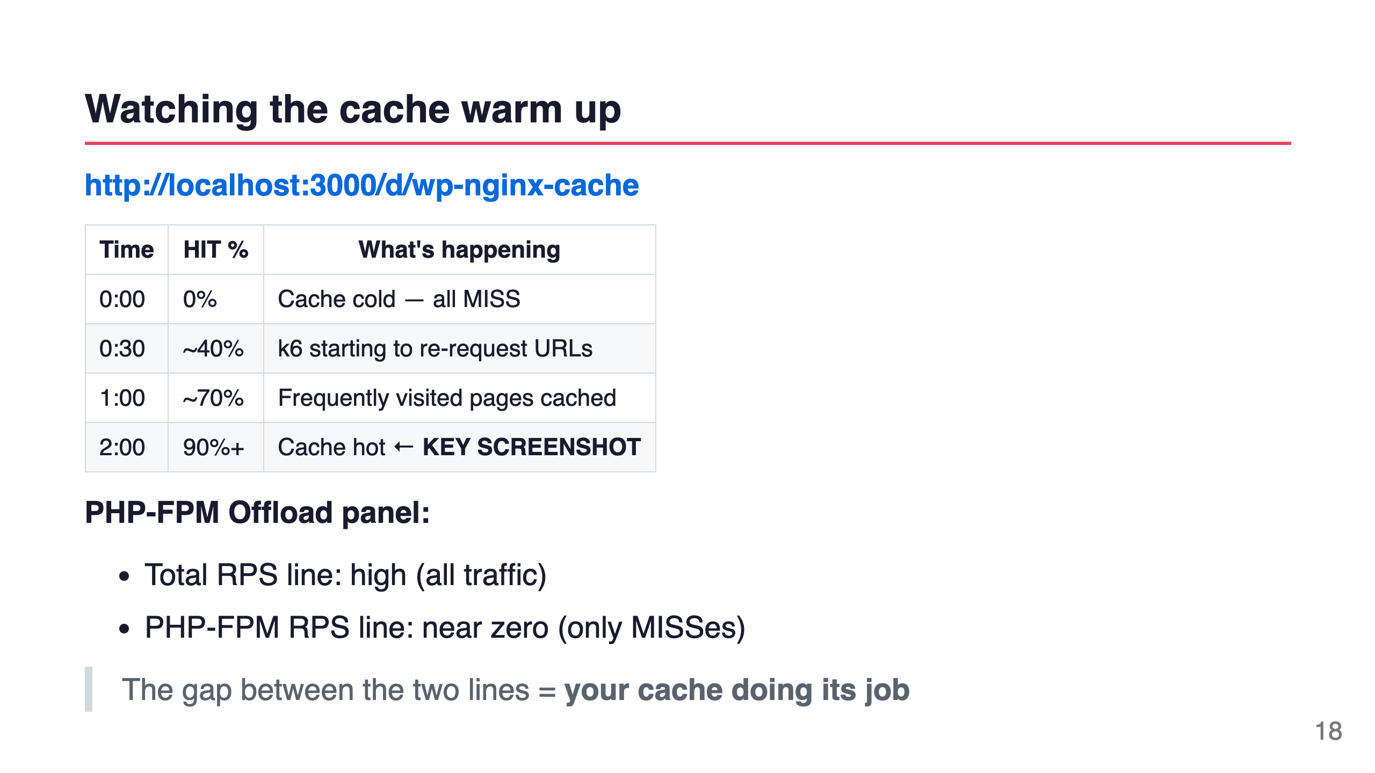
Notes:
Speaker notes: [Open Nginx Cache dashboard]. Watch the donut chart. It starts solid red — all MISS. As k6 keeps hitting the same URLs, the green HIT slice grows. Within 2 minutes you'll see 90%+ HIT. The PHP-FPM workers drop to near idle. The server is practically bored.

Slide 19
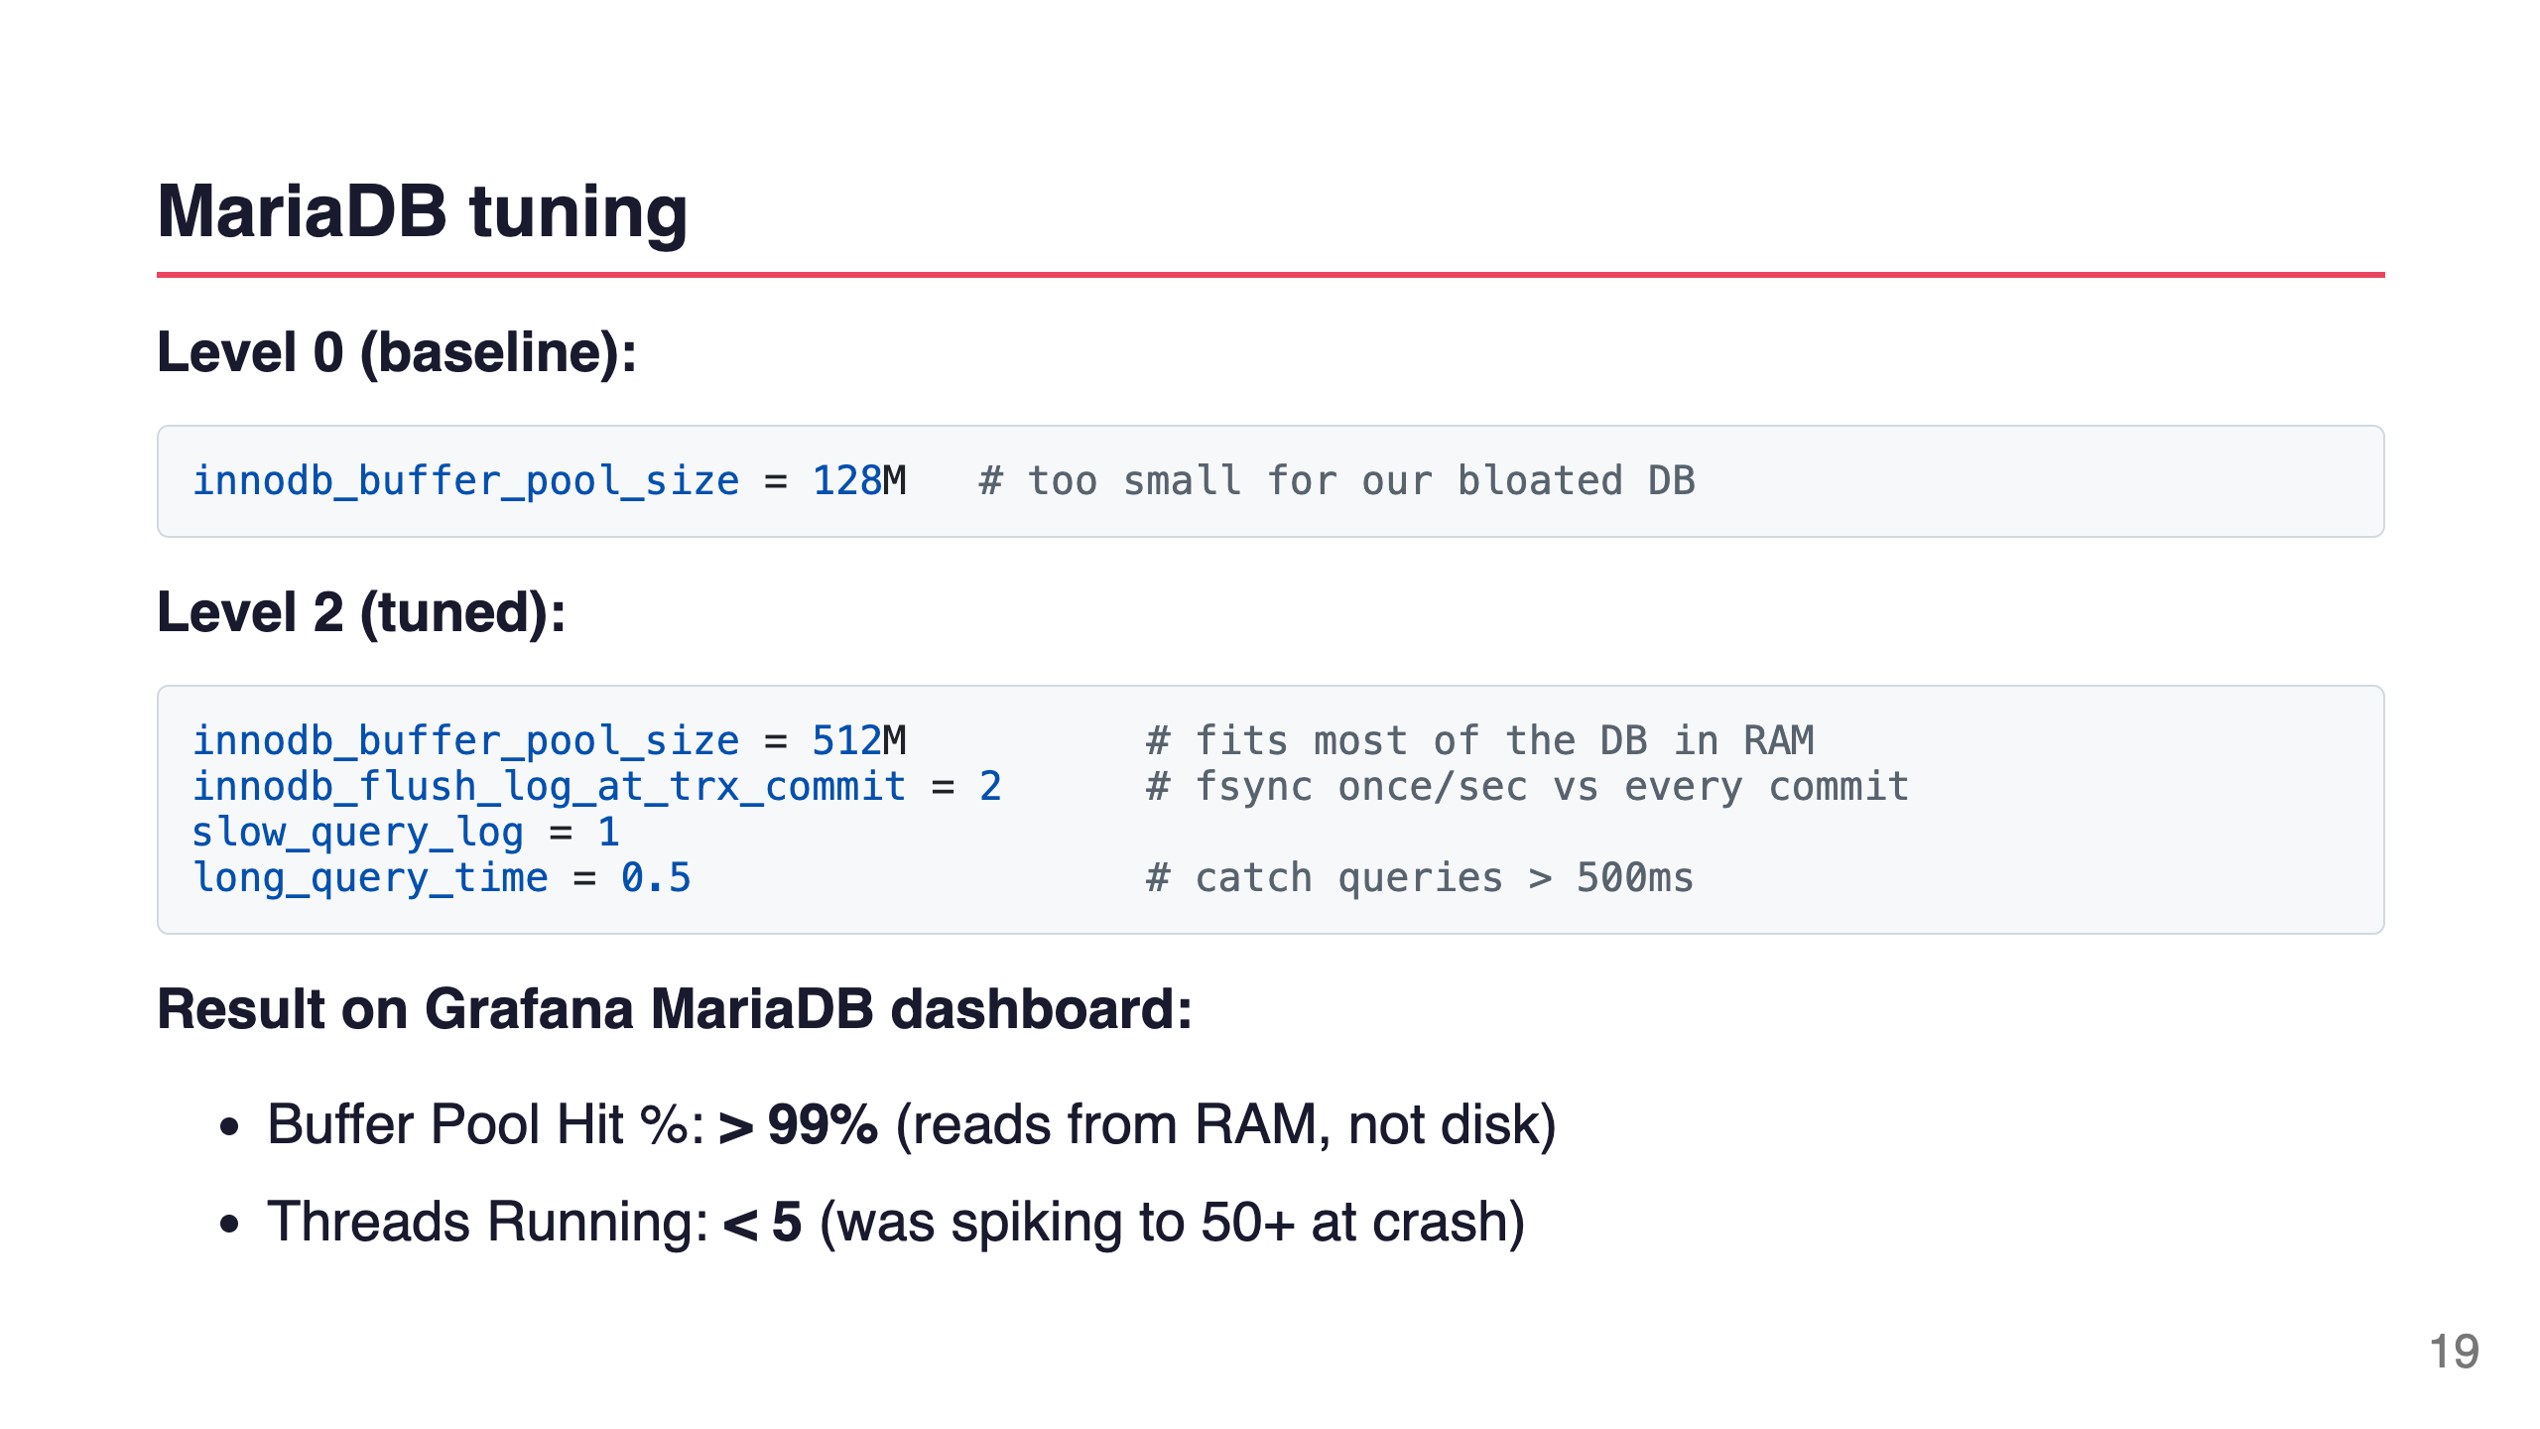
Notes:
Speaker notes: The buffer pool is MySQL's RAM cache for table data and indexes. If it's too small, every query triggers a disk read. 512MB fits most of our 2500-post, 500-product database in RAM. Threads Running is the crash indicator — when it spikes, the DB is overwhelmed.

Slide 20
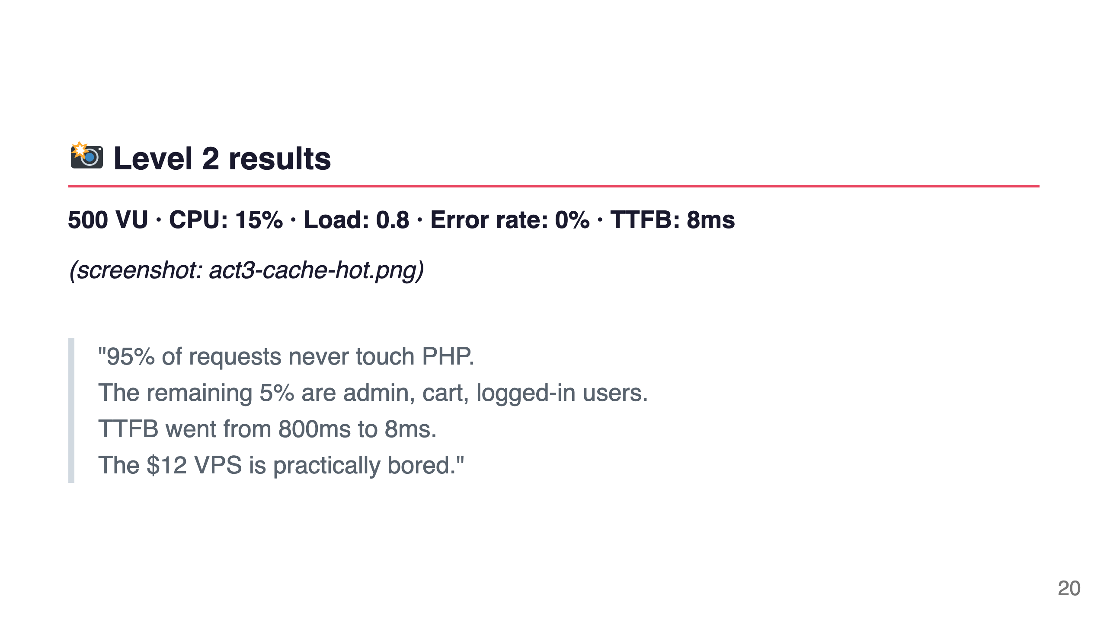
Notes:
Speaker notes: Same hardware. Same site. Same load — actually MORE load than what crashed Level 0. The difference is architectural. We're not asking PHP to do work it doesn't need to do.

Slide 21
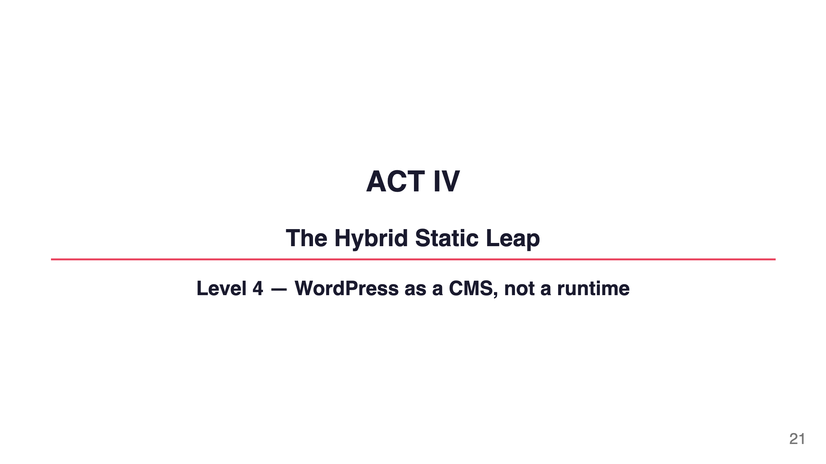
Notes:
Speaker notes: For some content sites — blogs, documentation, marketing pages — we can go even further. What if WordPress never served a single page at all?

Slide 22
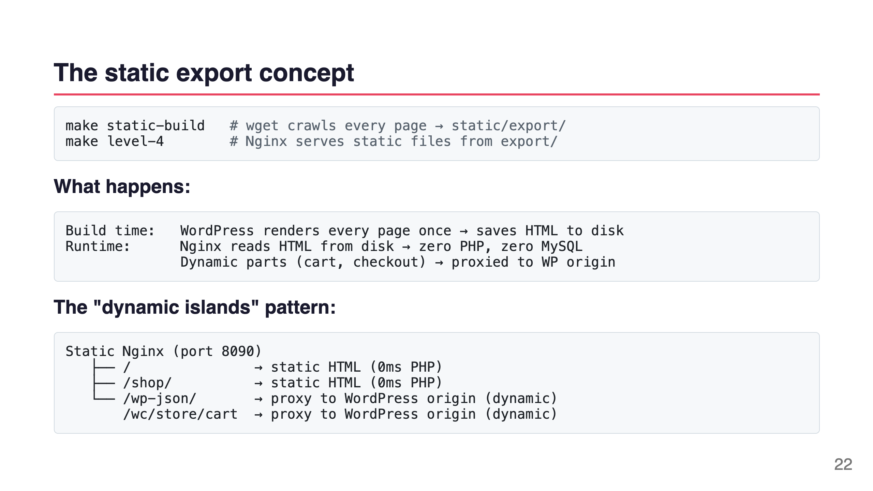
Notes:
Speaker notes: Simply Static plugin crawls your WordPress site at build time — just like a search engine would — and saves every page as a static HTML file. Then you serve those files with Nginx. WordPress only runs when someone actually adds something to their cart.

Slide 23
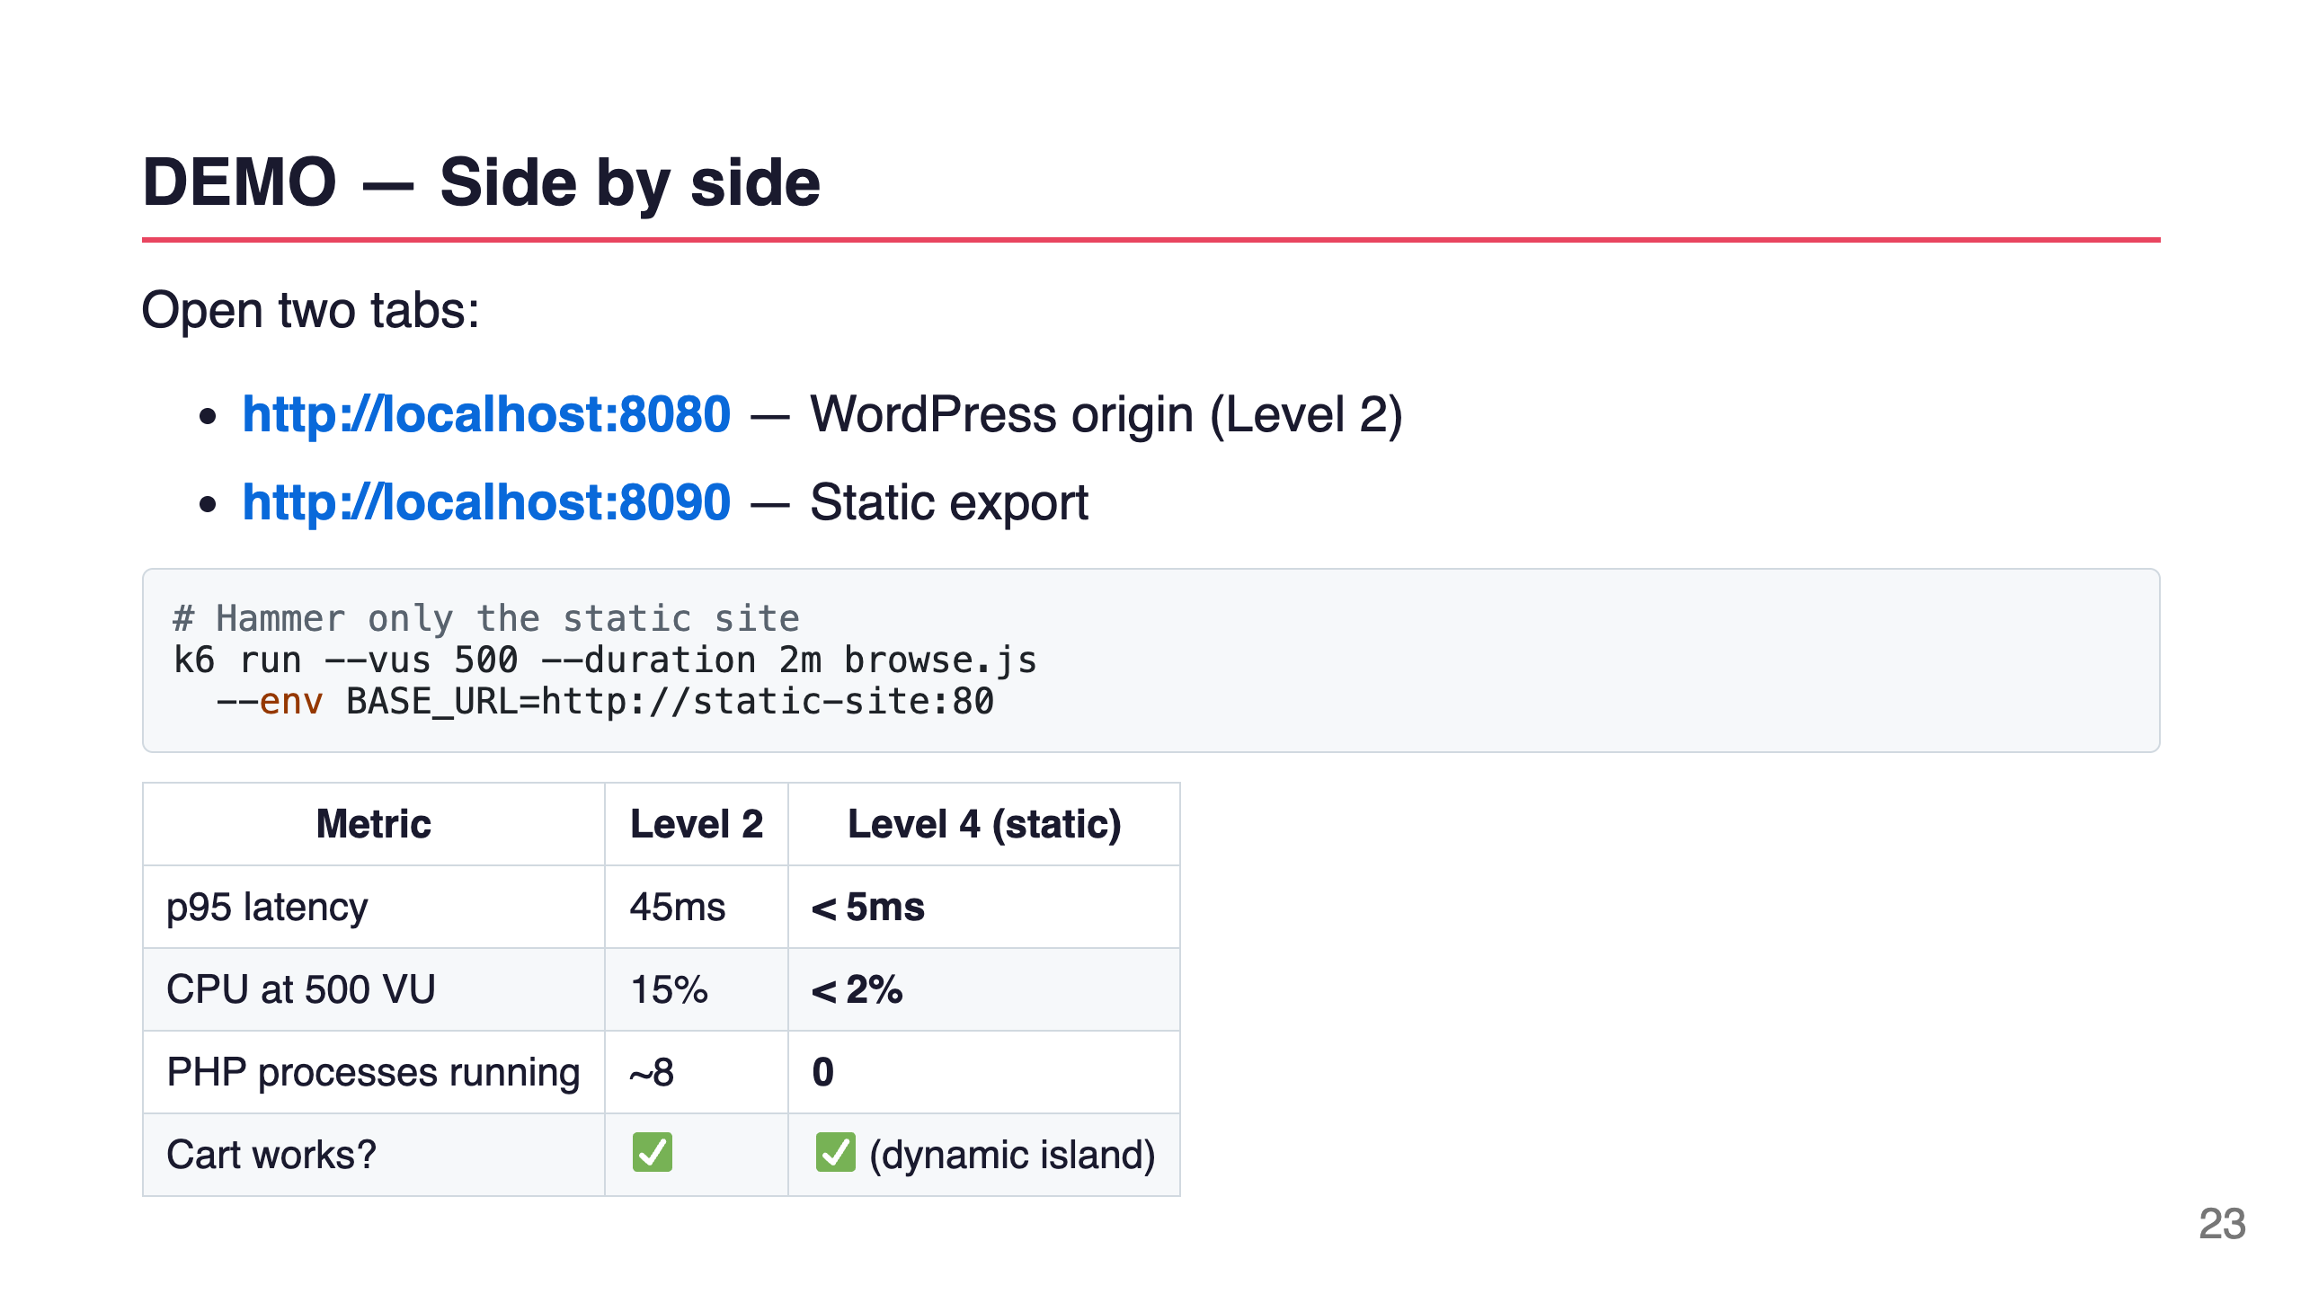
Notes:
Speaker notes: [Open both tabs]. You can see the static site loads before the spinner even starts on the WordPress tab. And the cart still works — because checkout and cart pages are proxied to the live WordPress instance. You get the best of both worlds.

Slide 24
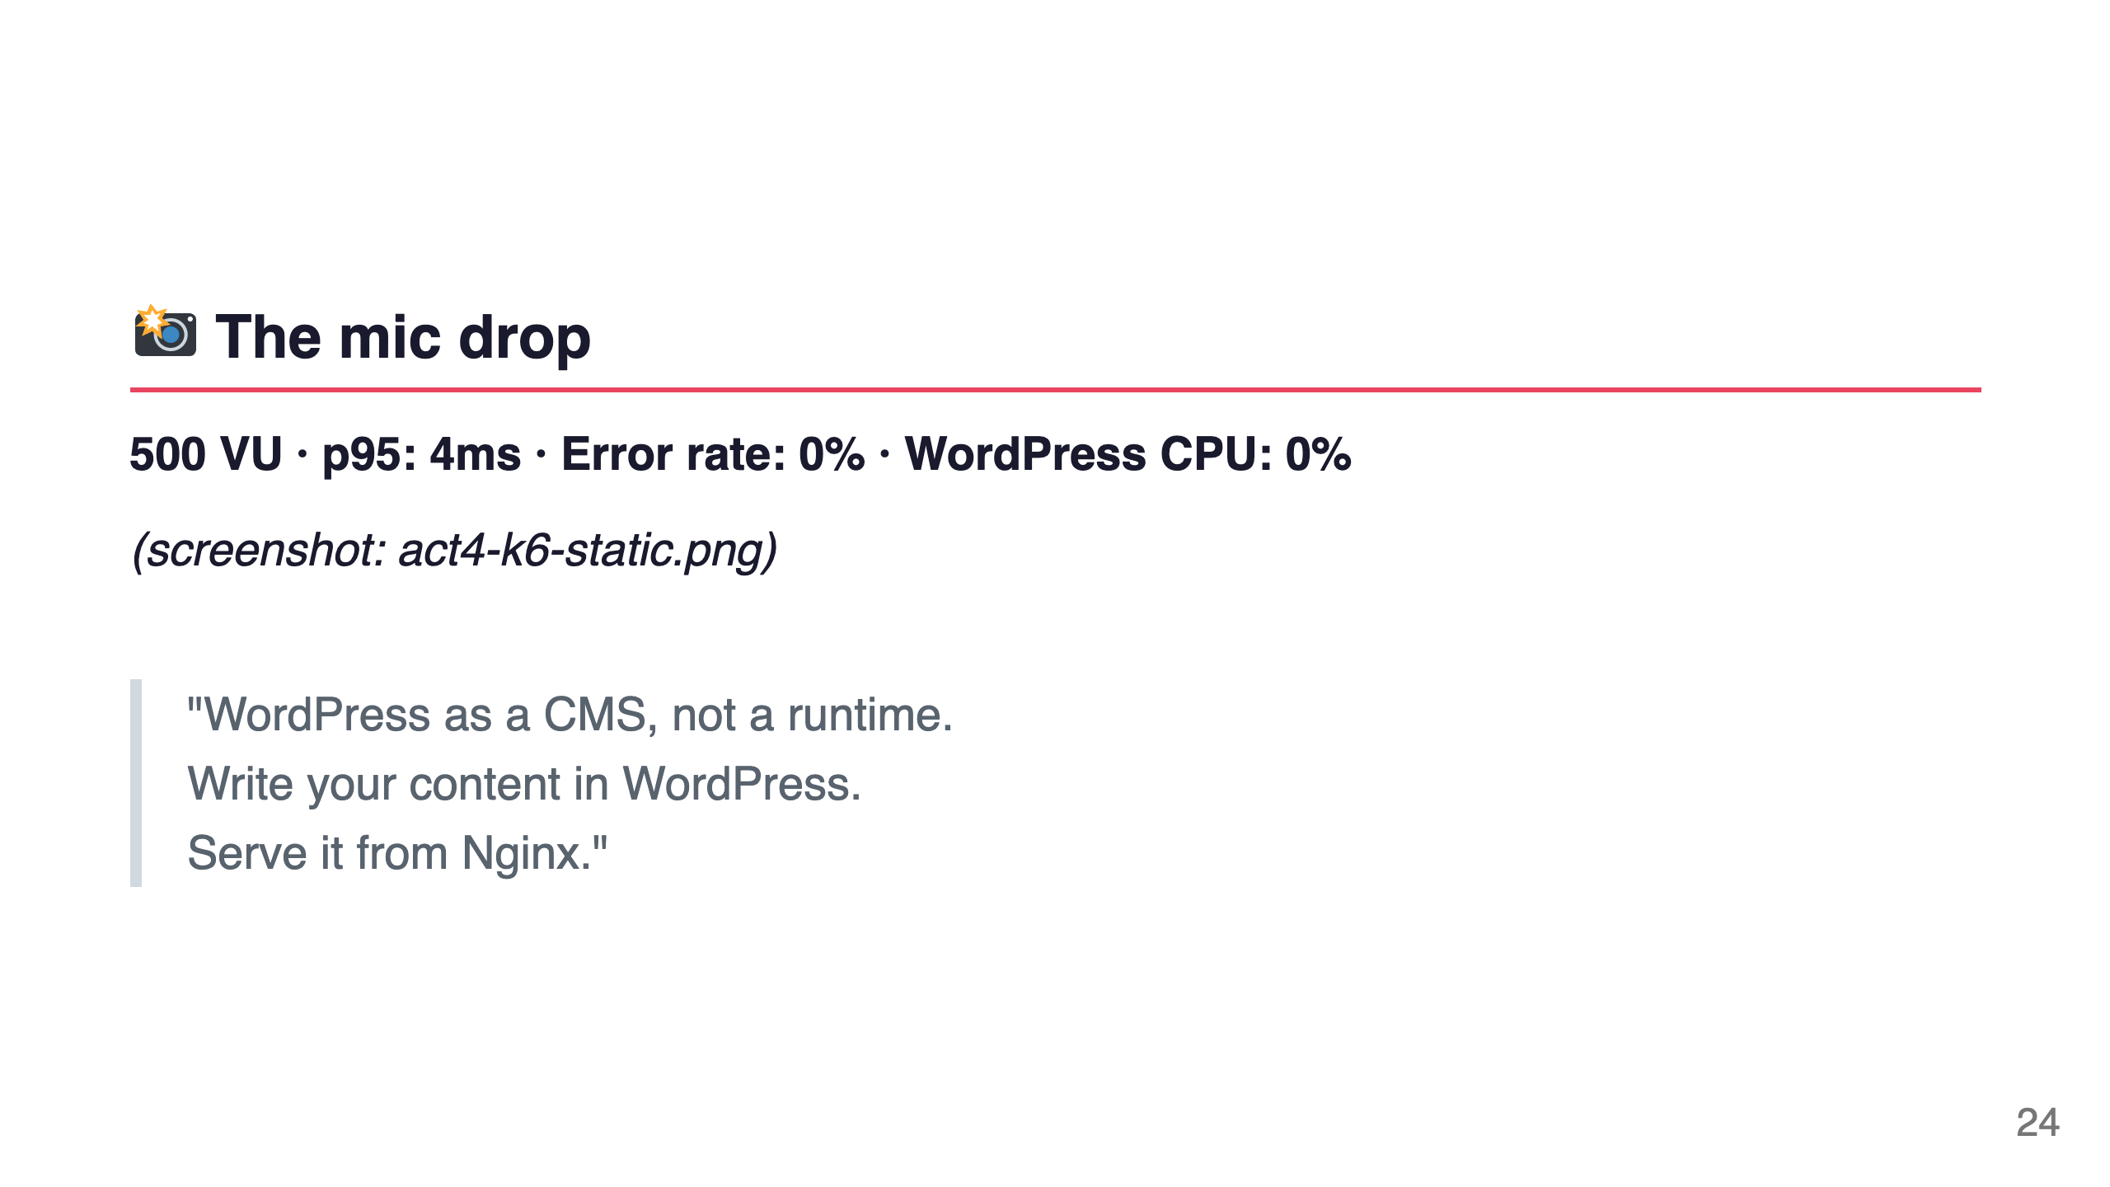
Notes:
Speaker notes: 500 virtual users. 4ms p95 latency. Zero errors. The WordPress container is completely idle. This is the maximum you can get from a $12 VPS — and it's genuinely indistinguishable from a $5,000/month CDN setup for static content.

Slide 25
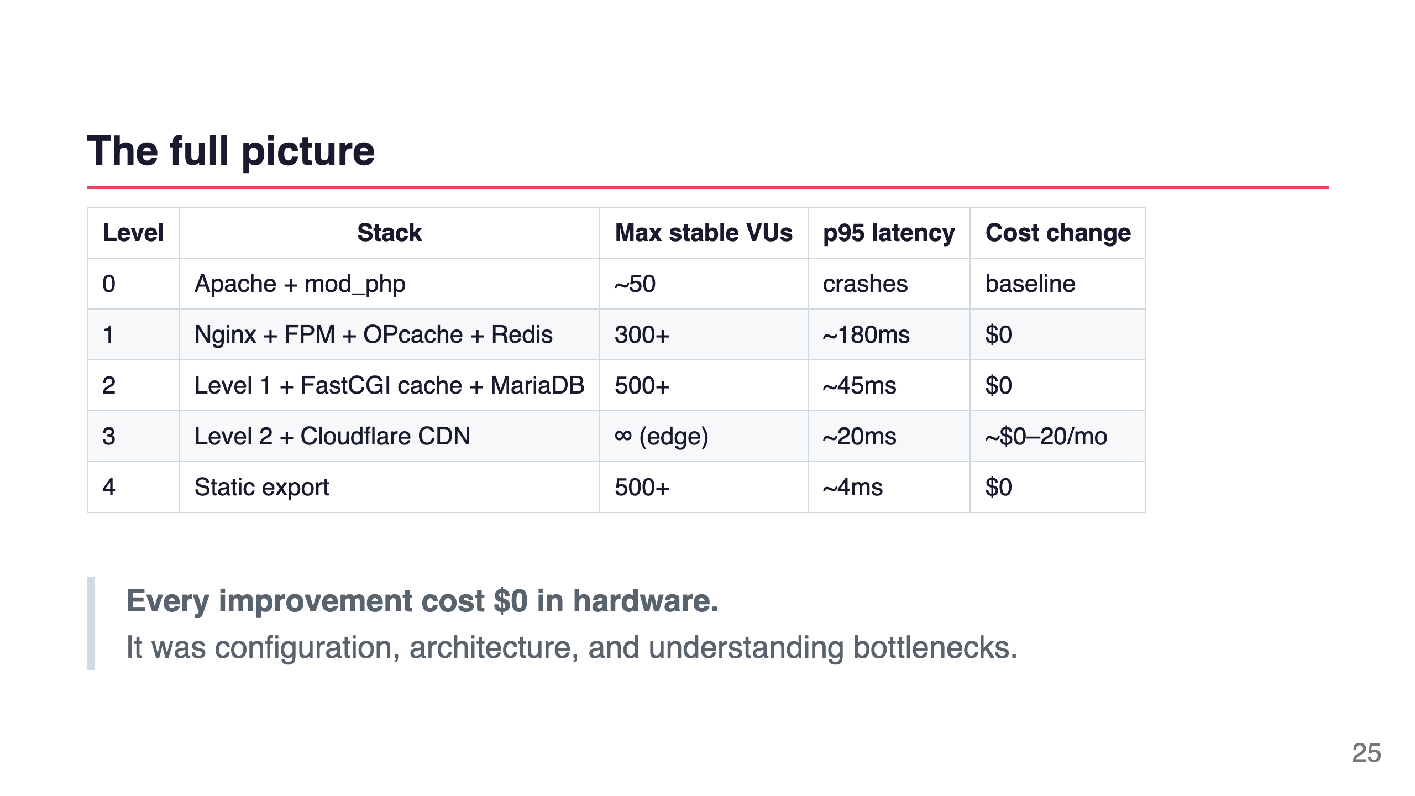
Notes:
Speaker notes: Let's recap. We went from crashing at 50 users to serving 500 users with sub-5ms response times. On the same $12 VPS. Without touching the hardware. Every single change was software — configuration, architecture, understanding where the bottleneck actually was.

Slide 26
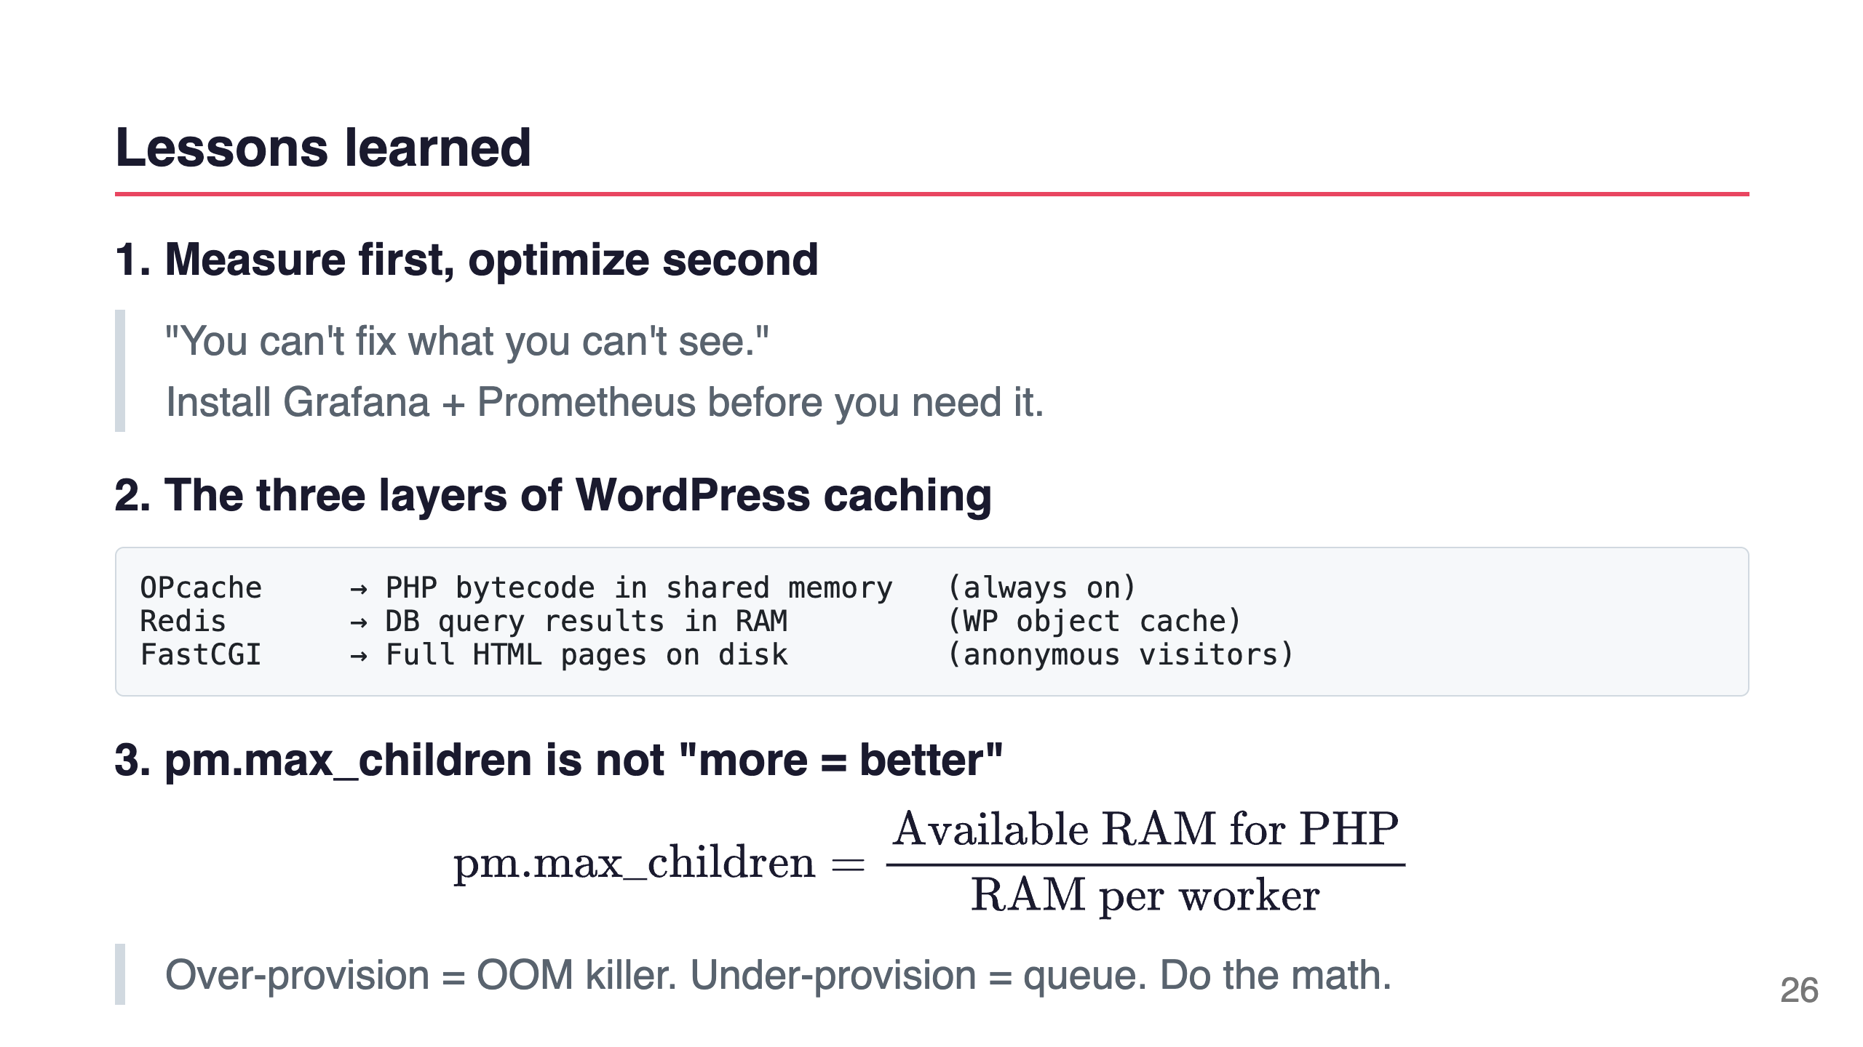
Notes:
Speaker notes: Three things I want you to remember. First: you need dashboards before you need them — set up monitoring before Black Friday, not during. Second: WordPress has three distinct caching layers — most sites only use one. Third: FPM pool size is a math problem, not a guess.

Slide 27
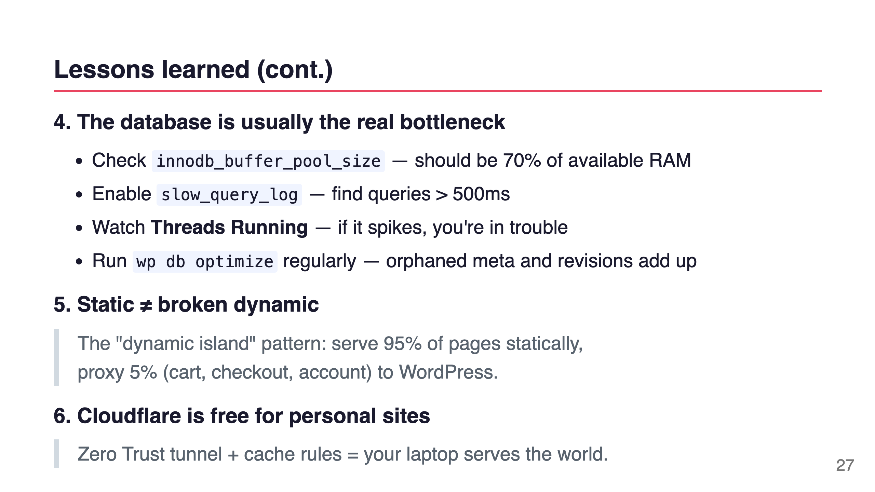
Notes:
Speaker notes: The database is almost always where WordPress falls over at scale. Not PHP. Not Nginx. MySQL. If you only do one thing after this talk: set your innodb_buffer_pool_size to 70% of available RAM and enable the slow query log.

Slide 28
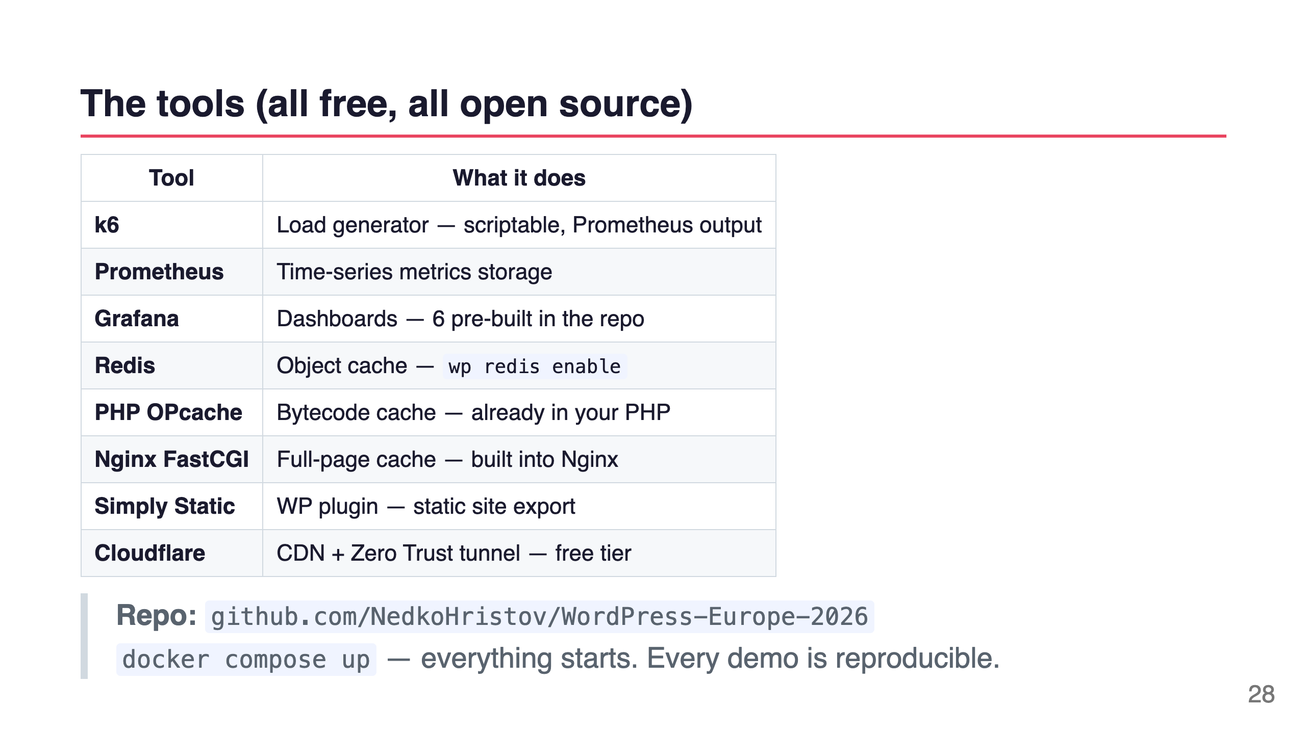
Notes:
Speaker notes: Everything I used today is free and open source. The repo has the full setup — docker compose up and you have WordPress, Grafana, Prometheus, k6, Redis, all 6 dashboards, all load test scripts. Clone it, run the demos, show your team.

Slide 29
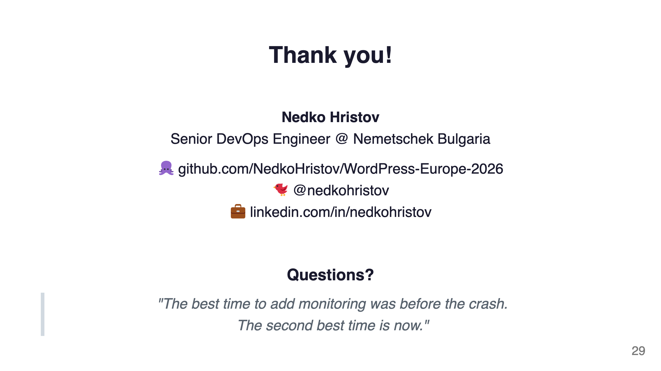
Notes:
Speaker notes: That's it. The repo is public, every file is documented, every command is in the Makefile. If you want to reproduce any of these numbers on your own machine, clone the repo and run make level-0. Thank you for being here!

