Slide 2
marp: true
theme: default
paginate: true
style: |
/* ── Base ── */
@import url('https://fonts.googleapis.com/css2?
family=Inter:wght@400;600;700;900&family=JetBrains+Mono:wght@400;700&display=
swap');
section {
font-family: 'Inter', 'Segoe UI', sans-serif;
font-size: 20px;
background: #0d1117;
color: #e6edf3;
padding: 48px 64px;
}

Slide 3
The setup
The hardware
2 vCPU · 2 GB RAM · 20 GB SSD
~$12/month (Hetzner CX22)
Docker Compose (same constraints, same demo)
The WordPress site
2,500 posts · 500 WooCommerce products
~6,000 revisions in DB
Realistic bloat: transients, orphaned meta
WooCommerce + Yoast SEO active
The load generator

Slide 4
The journey
p95
DB
Level
Stack
requests/s
CPU
New layer
Latency
Threads
crash
Apache +
~40+ →
0
@ ~200
100% 20+
—
mod_php
collapse
VU
+ Nginx · FPM
~100–130
OPcache ·
1
· OPcache ·
~50–60
~25% ~15–20
ms
Redis
Redis
+ FastCGI
cache ·
~70–90
FastCGI
2
~65
~18% ~0–3
MariaDB
ms
page cache
tuning

Slide 5
Key concept: what is a Virtual User?
1 VU = 1 browser-like loop, running forever
VU #1: GET / → wait 1s → GET /?p=1 → wait 1s → repeat …
VU #2: GET / → wait 1s → GET /?p=2 → wait 1s → repeat …
⋮
VU #50: GET / → wait 1s → GET /?p=5 → wait 1s → repeat …
50 VUs = 50 open connections = ~50 req/s sustained
Real-world equivalent (think time = 15–30× longer in real life)
k6 VUs
≈ Real simultaneous visitors
10
~150 – 300
50
~750 – 1,500
100
~1,500 – 3,000

Slide 6
Key metric definitions
Term
What it actually means
Concurrent browser-like loops running continuously — not
Virtual Users
unique visitors
requests/s
Total HTTP responses served per second across all VUs
p95 latency
95% of requests were faster than this — 5% were slower
p99 latency
The near-worst case — 1% of requests were slower than this
FPM workers
PHP processes currently executing code right now
Requests waiting for a free PHP worker — 0 = healthy, >0 =
FPM queue depth
trouble
DB threads
MySQL queries actively executing — not just connected
running

Slide 7
The two load test scripts
Why does one screenshot say 50 VU and another say 500 VU?
snapshot.js
— 50 Virtual Users
Purpose: measure and compare levels
0 → 50 VU in 20s
hold 50 VU for 50s ← screenshot fires here
ramp down in 20s
Total: 90 seconds
Used for:
make snapshot-l1
,
make snapshot-l2
All three levels visible and comparable
L0 struggles, L1 stable, L2 stays clean
black-friday.js
— 0 → 500 Virtual Users

Slide 8
Observability stack
k6 ──remote-write──
Prometheus
── node-exporter (CPU, RAM, disk)
│
── cadvisor (container metrics)
│
── mysqld-exporter (threads, buffer pool)
│
── php-fpm-exporter (workers, queue)
│
── nginx-exporter (connections, requests/s)
│
── redis-exporter (hit rate, memory)
▼
Grafana ←── Loki (container logs)
7 dashboards
(live during demo)
Every number you see on screen is a real metric from a real process.
No synthetic benchmarks. No cherry-picked results.

Slide 9
💥
ACT I
The Crash
Level 0 — Apache + mod_php

Slide 10
Level 0 — How Apache prefork works
Each connection = one OS process
Browser connects
→ Apache forks a worker process
→ worker loads PHP + WordPress into RAM
→ PHP runs, queries MySQL
→ response sent
→ worker stays alive, waiting
(idle, ~32 MB RAM held)
The problem:
60 idle workers = 1.9 GB RAM consumed
Browser #61 gets: queue
Browser #200 gets: 503
The process model was designed for static files in 1996.

Slide 11
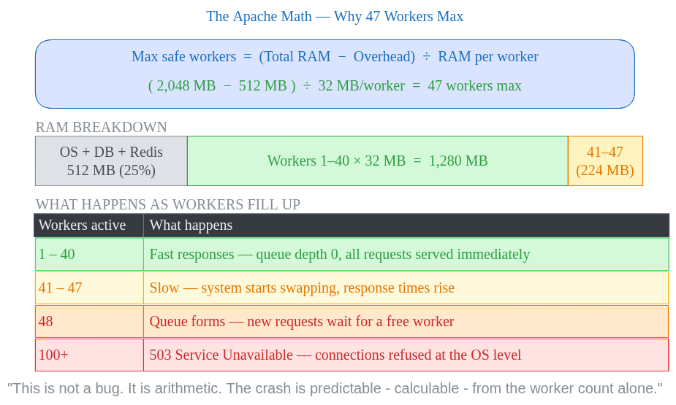
The Apache math

Slide 12
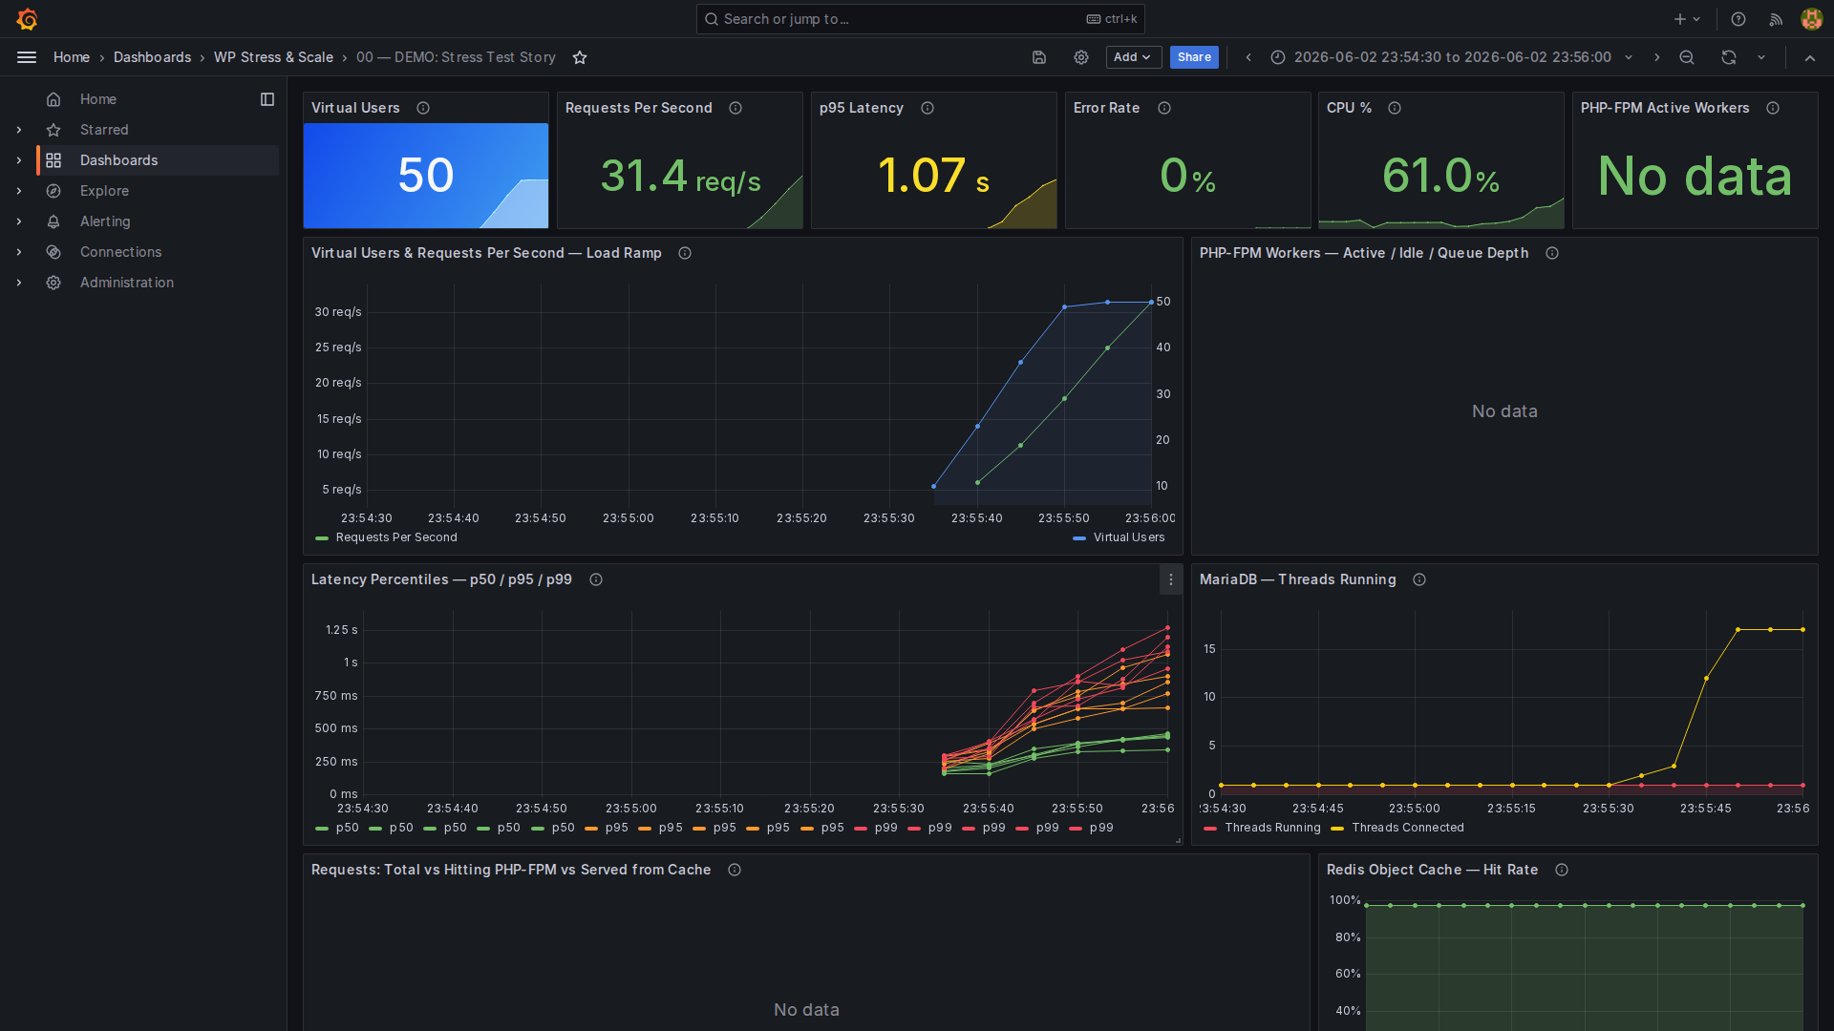
Level 0 — Baseline (50 Virtual Users — before the storm)

Slide 13
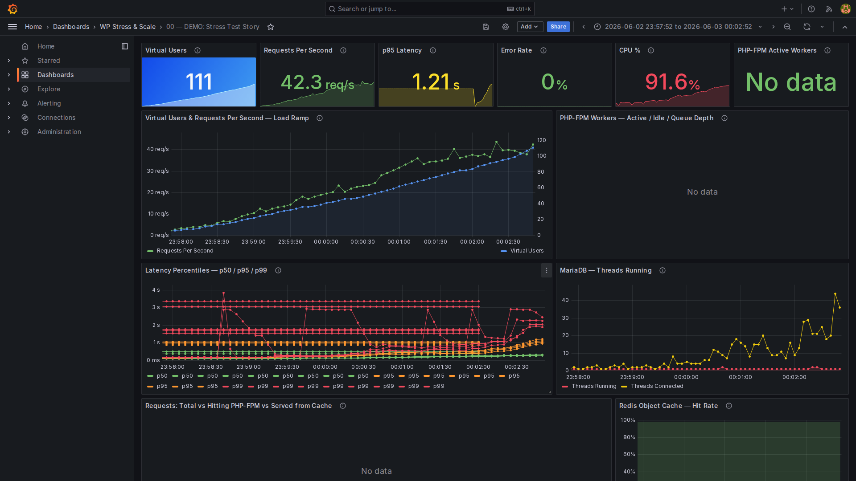
Level 0 — The Crash (Black Friday ramp: 0 → 500 VU —
Apache dies at ~50)

Slide 14
Level 0 — reading the crash
Panel
Metric
Value
What it means
VU &
req/s at 107 VU
Still serving — collapse happens
~40 req/s
req/s
(screenshot)
past ~200 VU
VU &
~40+ →
Screenshot captured mid-ramp;
req/s trend
req/s
collapse
peak-then-drop happens off-screen
Latency
p95
~3–6 s
Many × worse than Level 1
~6 s (hard
Latency
p99
Connections timing out at OS level
ceiling)
Latency
p50
~1–2 s
Even the median is unusable
Connection
OS listen queue overflowing — new
Apache
~250+
backlog
connections refused

Slide 15
🩹
ACT II
Stop the Bleeding
Level 1 — Nginx + PHP-FPM + OPcache + Redis

Slide 16
Level 1 — Three changes, zero cost
1. Nginx (event-driven)
One thread, 10,000+ concurrent connections.
Zero RAM per idle connection.
2. PHP-FPM (decoupled pool)
Workers handle PHP execution only.
Nginx queues connections externally.
pm.max_children = 20
— hard limit, never OOM.
3. OPcache + Redis object cache
OPcache: compiled PHP bytecode in shared memory — zero disk reads
Redis: DB query results in RAM — 82% of DB calls served from memory

Slide 17
OPcache — the biggest free win
Without OPcache (Level 0)
Every single request:
disk read → parse → lex
→ AST → compile → opcodes
→ execute → response
Repeat for 300+ PHP files.
wp-settings.php alone
includes 100+ files.
With OPcache (Level 1+)
First request only:
compile → store in shared RAM
Every request after:
read opcodes from RAM

Slide 18
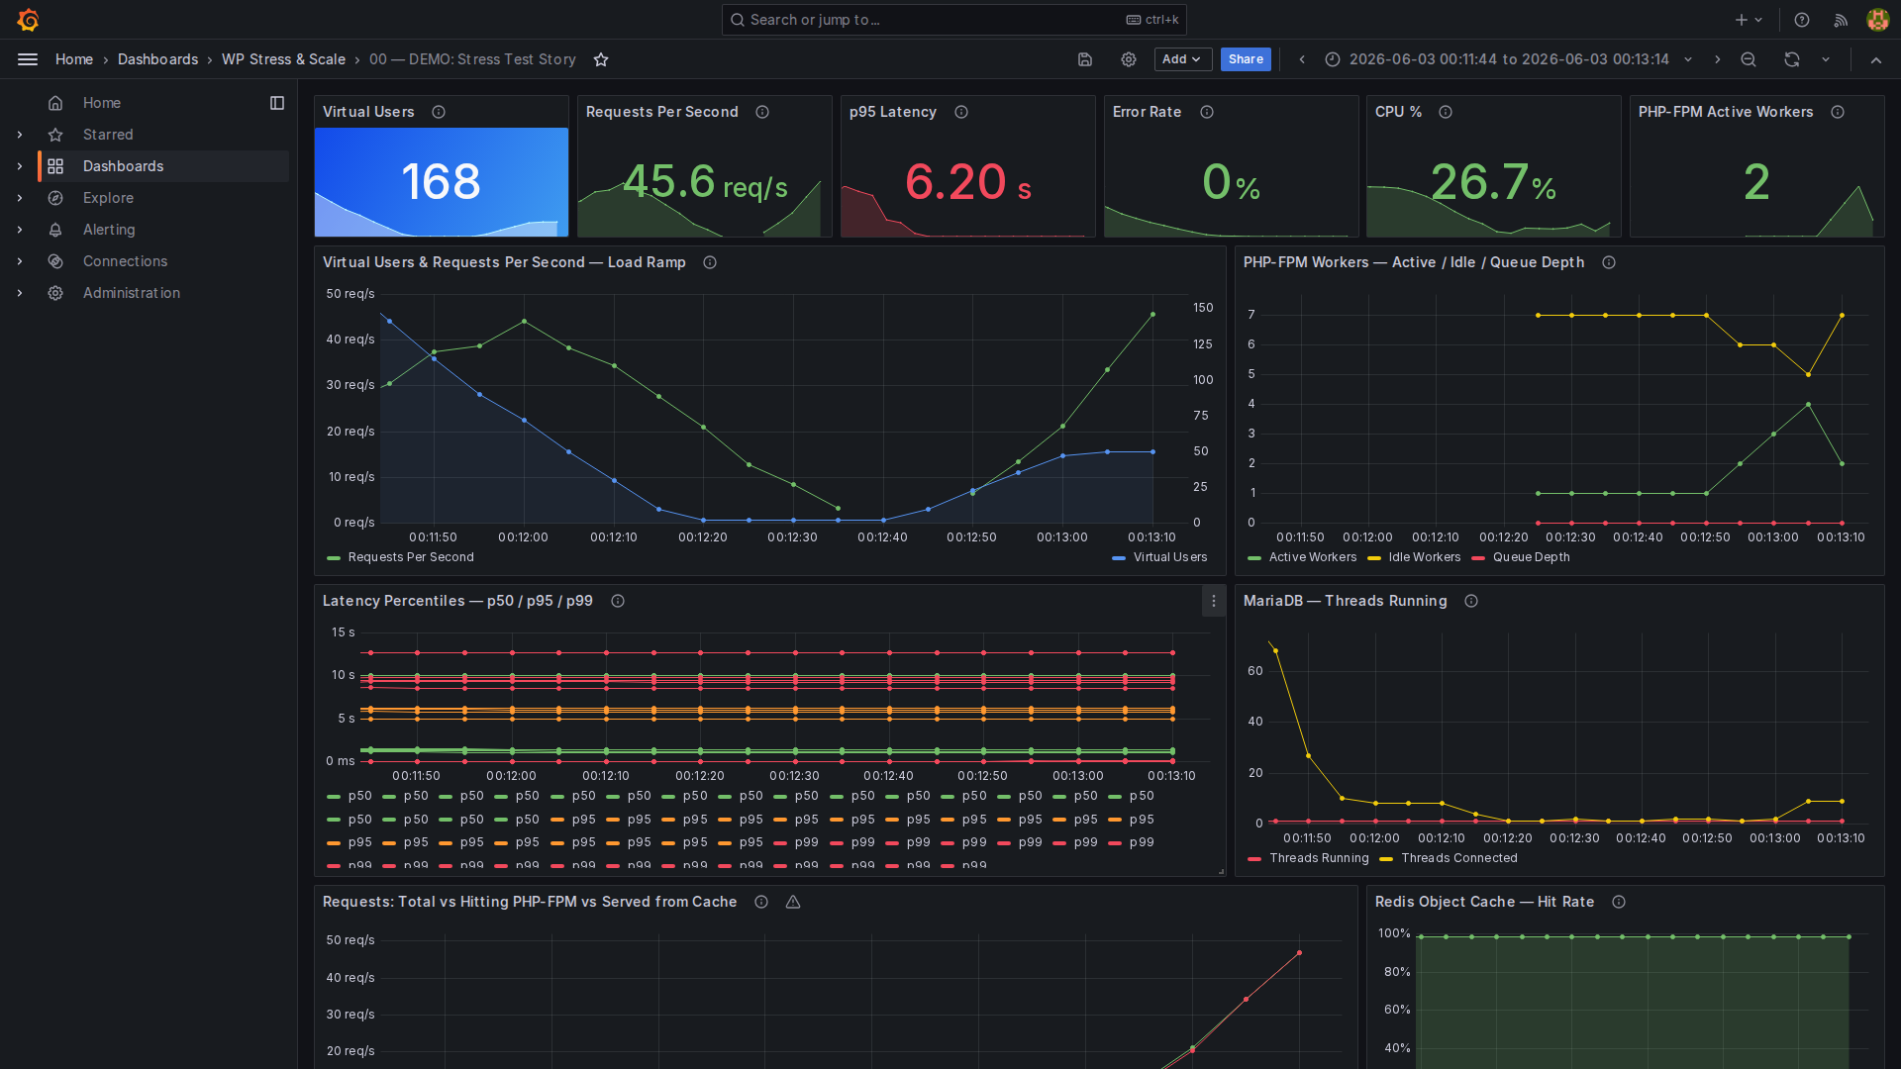
Level 1 — Demo Dashboard (50 Virtual Users)

Slide 19
Level 1 — reading the dashboard
Panel
Metric
Value
What it means
Virtual Users
Peak
50
Steady-state load
Requests/s
Peak
~50–55 req/s
Stable — no collapse
Was 3+ s — now human-
Latency
p95
~130 ms
perceptible
FPM Workers
Peak active
~8 / 20
Headroom left
Crash eliminated — was
FPM Queue
Depth
0
~250
~15–20 threads
Every request still hitting
MariaDB
Peak threads
MySQL
Requests vs
No page cache yet — all to
G

Slide 20
L0 → L1: the jump
Metric
Level 0
Level 1
Δ
Crash at 50 Virtual
crash
server buckles
stable
Users
eliminated
Peak requests/s
~40+ → collapse
~50–55 req/s
stable throughput
p95 Latency
~3 s
~130 ms
−96%
p99 Latency
~6 s flat ceiling
~350 ms
−94%
CPU @ 50 Virtual
~100%
~25%
−75%
Users
~250 (Apache listen
0 (FPM
Request backlog
queue gone
queue)
absorbs)
DB Threads peak
30+
~15–20
still MySQL-heavy

Slide 21
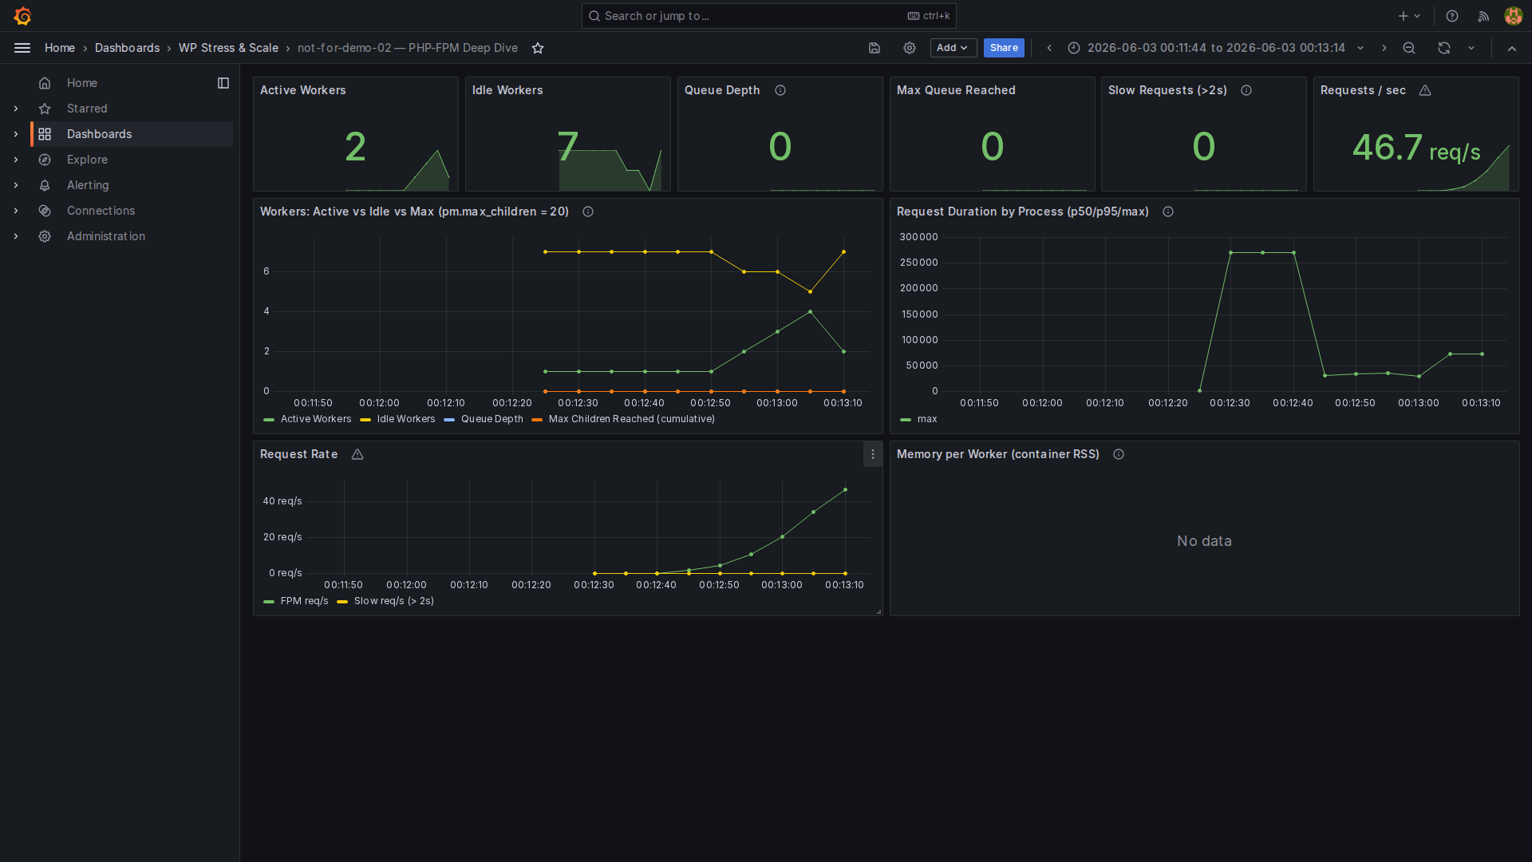
Level 1 — PHP-FPM Workers & Request Rate

Slide 22
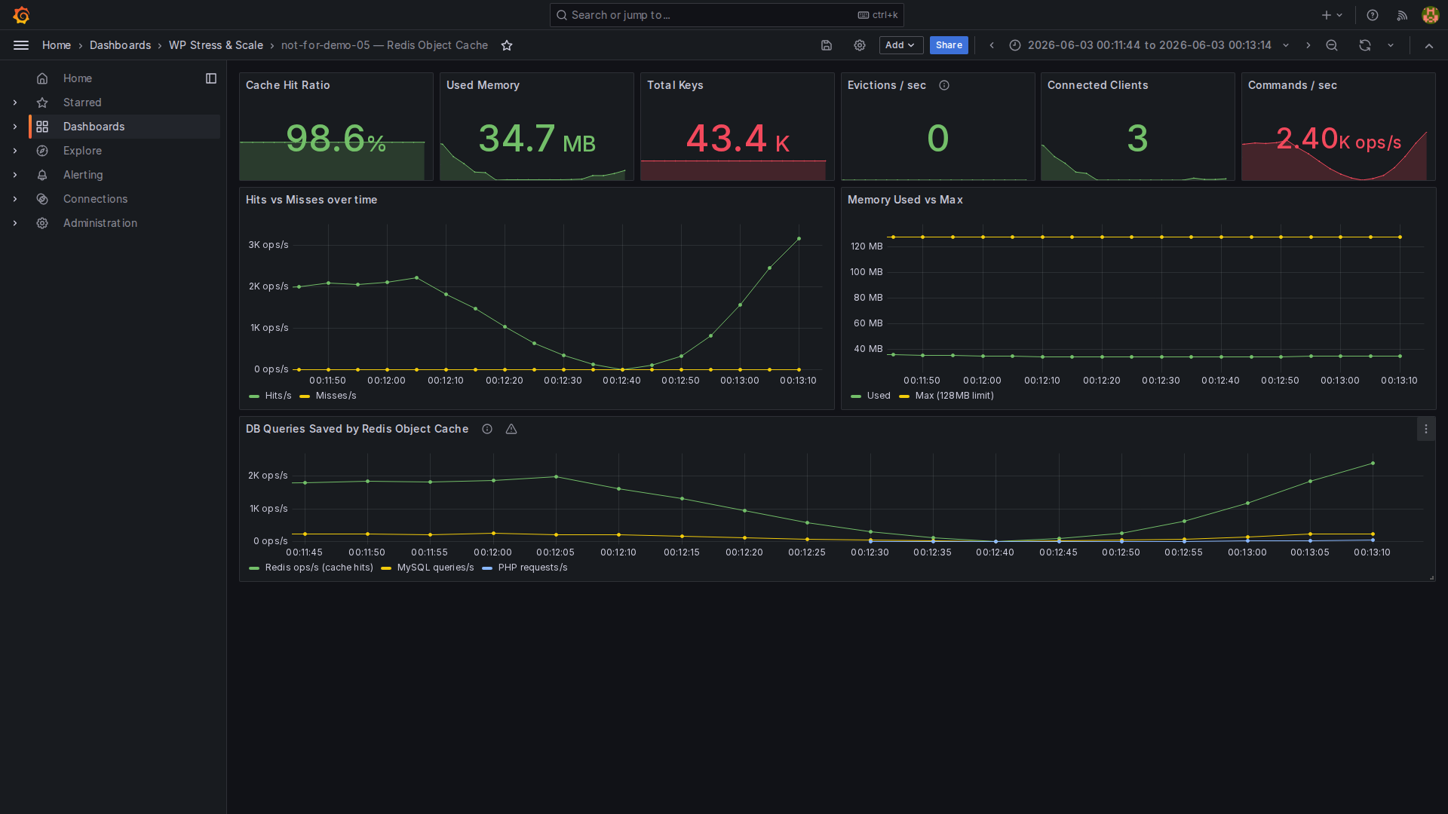
Level 1 — Redis: 97% Hit Rate, ~2.5K ops/s

Slide 23
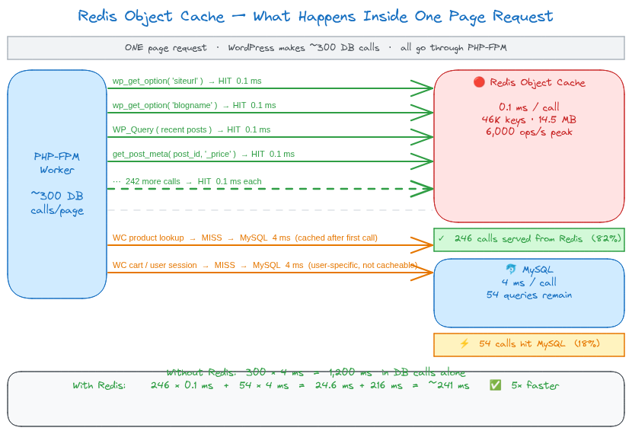
Level 1 — what Redis is actually doing
~43,000 cached keys · 23 MB · ~2,500 ops/s at peak

Slide 24
🚀
ACT III
Cache Everything
Level 2 — FastCGI page cache + MariaDB tuning

Slide 25
The key insight
Most WordPress page requests return identical HTML for every anonymous
visitor.
Home page. Category. Blog post. Shop.
PHP runs. MySQL queries. OPcache helps. Redis helps.
The output is still the same HTML every time.
FastCGI page cache — the logical conclusion:
First anonymous visitor → PHP runs → nginx stores response on disk
Every visitor after → nginx reads cached file → 8ms TTFB
PHP never runs
MySQL never runs
Redis never asked
Cached (anonymous visitors)
Homepage · Category pages · Posts · Shop

Slide 26
Level 2 — nginx config
fastcgi_cache_path /var/cache/nginx
levels=1:2
keys_zone=WORDPRESS:100m
inactive=60m
max_size=1g;
# Bypass rule — logged-in users and WooCommerce sessions
set $skip_cache 0;
if ($http_cookie ~* "wordpress_logged_in|woocommerce_cart|woocommerce_session") {
set $skip_cache 1;
}
location ~ \.php$ {
fastcgi_cache WORDPRESS;
fastcgi_cache_key "$scheme$request_method$host$request_uri";
fastcgi_cache_valid 200 60m;
fastcgi_cache_bypass $skip_cache;
fastcgi_no_cache $skip_cache;
add_header X-Cache-Status $upstream_cache_status; # HIT / MISS / BYPASS
}

Slide 27
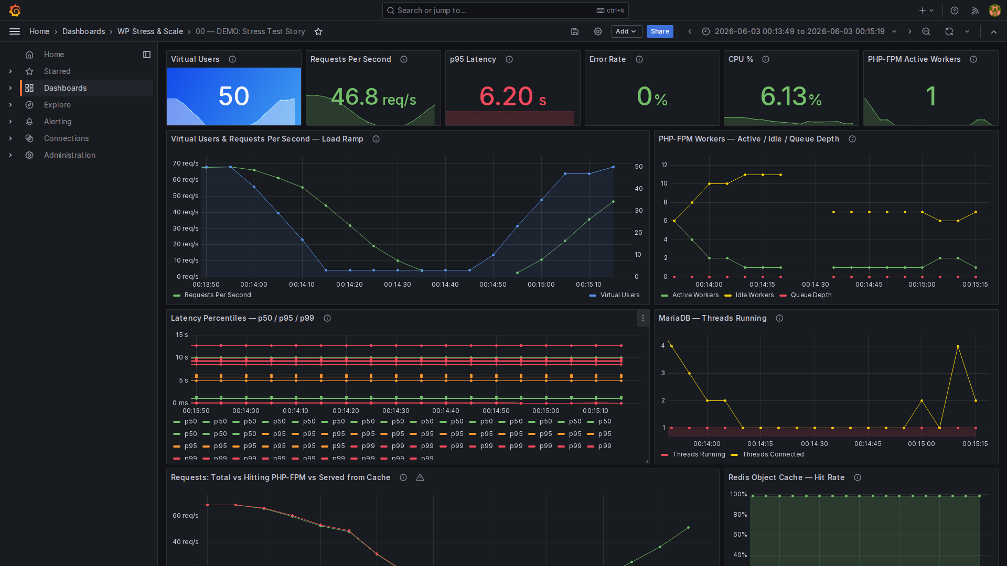
Level 2 — Demo Dashboard (50 Virtual Users)

Slide 28
Level 2 — reading the dashboard
Panel
Metric
Value
What it means
Virtual Users
Peak
50
Same load as L1
~65 req/s
~+15–20% vs L1 — nginx serving
Requests/s
Peak
from disk
~70–80 ms
~−40% vs L1 — most requests never
Latency
p95
hit PHP
CPU
@ 50 VU
~18%
Was ~25% at L1 — less PHP work
FPM Workers
Peak active
~10–12 / 20
Was ~8 — cache absorbed the burst
Stays clean — cache absorbs the
FPM Queue
Depth
0
burst
FPM Request
~20–30%
N i
O l
h
i
h PHP

Slide 29
L0 → L1 → L2: the progression
Metric
Level 0
Level 1
Level 2
Peak requests/s
~40+ →
~50–55 req/s
~65 req/s
p95 Latency
~3 s
~130 ms
~70–80 ms
CPU @ 50 Virtual Users
~100%
~25%
~18%
FPM workers (peak)
—
~8 / 20
~10–12 / 20
Request queue
~250 (Apache backlog)
0 (FPM absorbs)
0
DB Threads peak
30+
~15–20
~0–3
FastCGI cache offload
0%
0%
~70%
Redis hit ratio
—
~80–97%
~80–97%

Slide 30
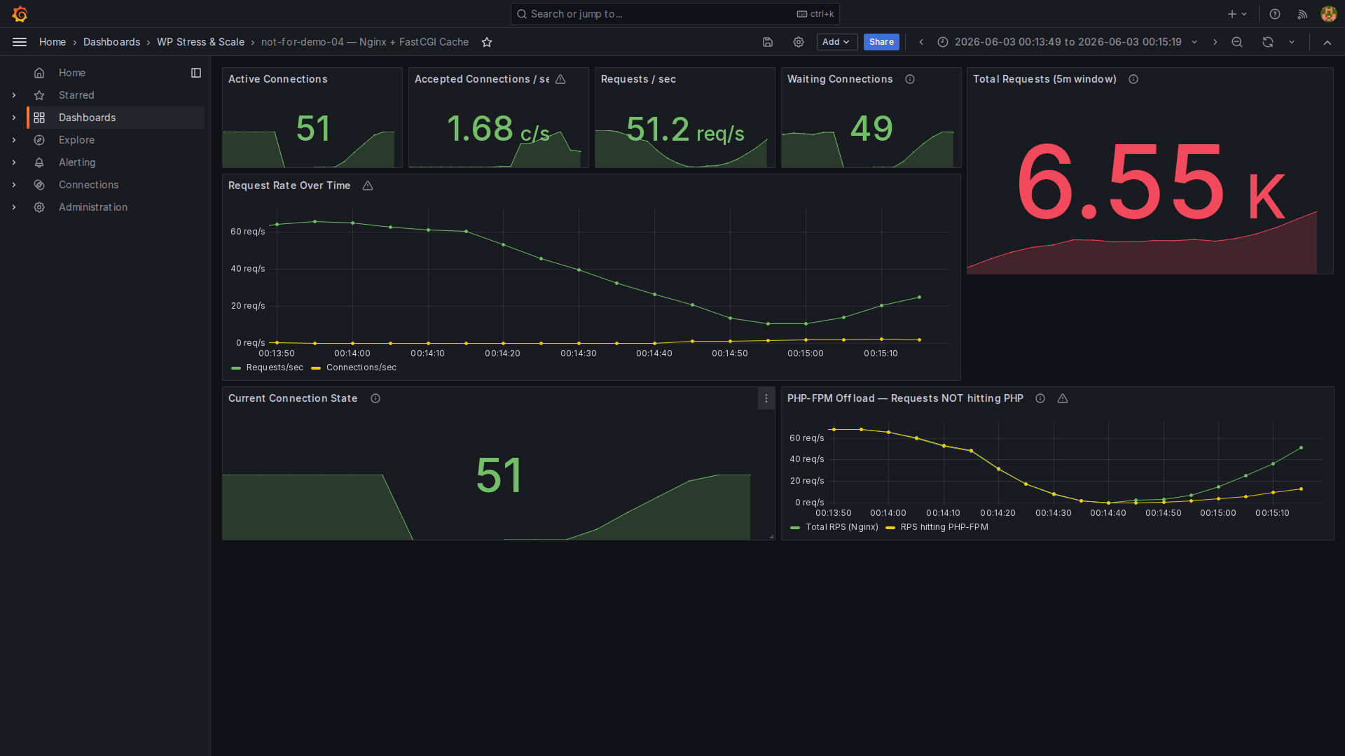
Level 2 — Nginx Cache: FPM Offload in action

Slide 31
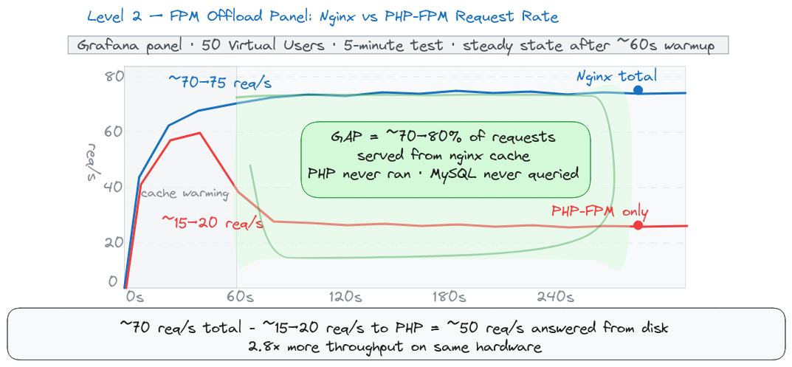
Level 2 — the FPM offload panel explained
~70–75 req/s total · only ~20–30% reach PHP · ~70% gap = cache
This is the money slide.
The gap between the two lines is PHP execution that never happened

Slide 32
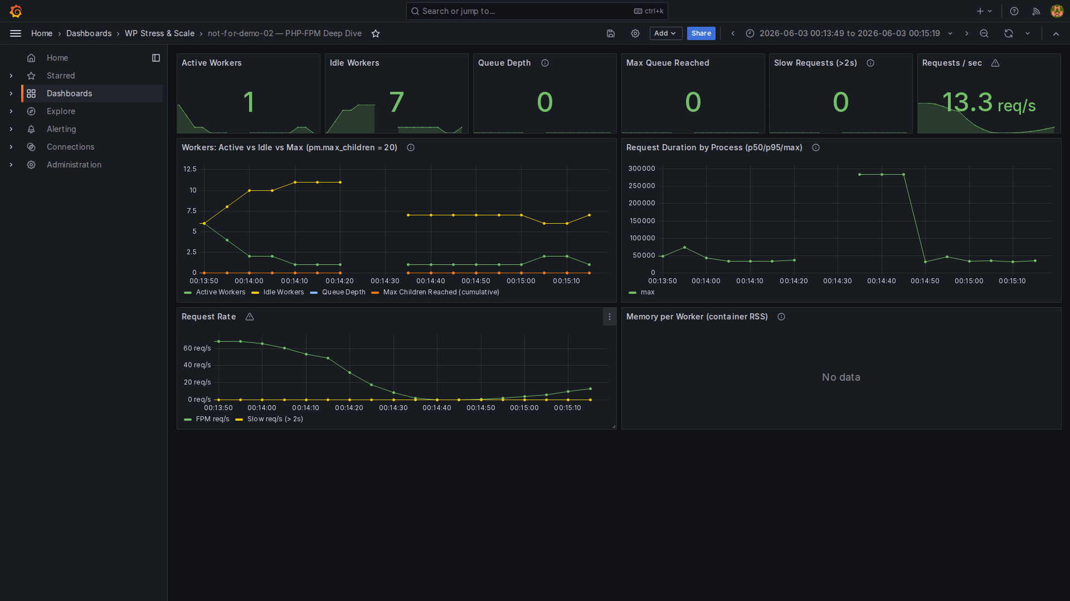
Level 2 — PHP-FPM: Peak ~10 Workers During Cache-Miss
Burst

Slide 33
MariaDB tuning — Level 2
Level 0 baseline config:
# 00-baseline.cnf
innodb_buffer_pool_size = 128M
# (default — fits almost nothing)
max_connections = 151
With 128M buffer pool:
WordPress DB ≈ 500MB
Every query reads from disk
Buffer pool full → constant disk I/O
Slow queries undetected
Level 2 tuned config:

Slide 34
Level 1 vs Level 2 — the real numbers
Metric
Level 1
Level 2
Change
Peak requests/s @ 50 Virtual
~50–55
~65 req/s
~+15–20%
Users
req/s
~70–80
p95 Latency
~130 ms
~−40%
ms
CPU usage
~25%
~18%
~−30%
~10–12 /
FPM workers (peak)
~8 / 20
cache absorbs the burst
20
FPM queue depth
0
0
—
MariaDB threads (peak)
~15–20
~0–3
~−85–90%
majority served from
C
h
ffl
d
0%
70%

Slide 35
⚡
What's Next?
The Static Leap
Level 4 — Simply Static: WordPress as a CMS, not a runtime

Slide 36
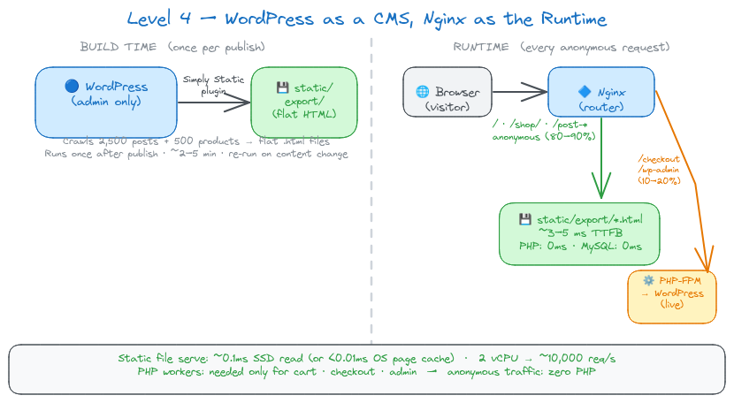
Level 4 — the concept
wp plugin install simply-static --activate

Slide 37
Level 4 — Simply Static: expected numbers
Level 4
Metric
Level 2
Why
(estimated)
requests/s @ 50 Virtual
SSD read vs PHP
~70–75
500–1,500+
Users
execution
~70–80
p95 Latency
~3–5 ms
file serve vs 300 DB calls
ms
CPU @ 50 Virtual Users
~18%
<3%
no PHP, no MySQL
anonymous traffic never
DB Threads
~3
~0
hits DB
static files bypass FPM
PHP workers needed
~11
~0
entirely

Slide 38
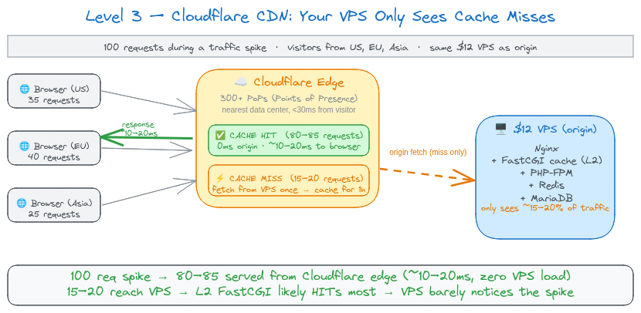
Level 3 — Cloudflare CDN
Metric
Level 2 (direct)
Level 3 (+ Cloudflare)
Δ
TTFB for cached pages
~70–80 ms
~10–20 ms
~−75–80%

Slide 39
Cloudflare Free Plan — what you get
PoP = Point of Presence — a physical Cloudflare data center. 300+ worldwide
means a server is always <30ms from your visitor.
Performance (free)
Global CDN — 300+ PoPs worldwide
Full page caching via Cache Rules
Polish — automatic image compression
Free SSL/TLS — automatic HTTPS
HTTP/2 + HTTP/3 (QUIC) — automatic
Security (free)
DDoS mitigation — unlimited, unmetered
Bot Fight Mode — basic bot blocking

Slide 40
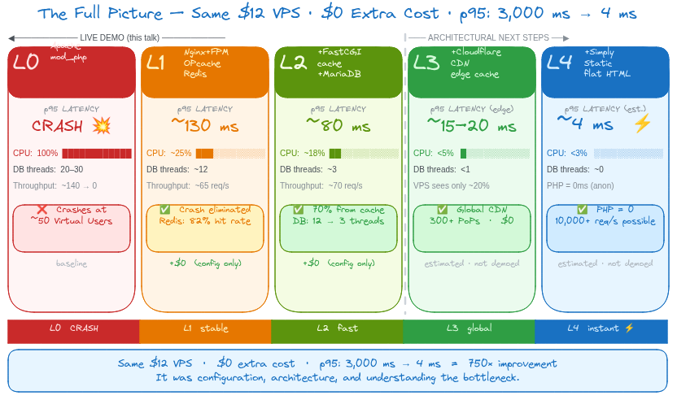
The full picture

Slide 41
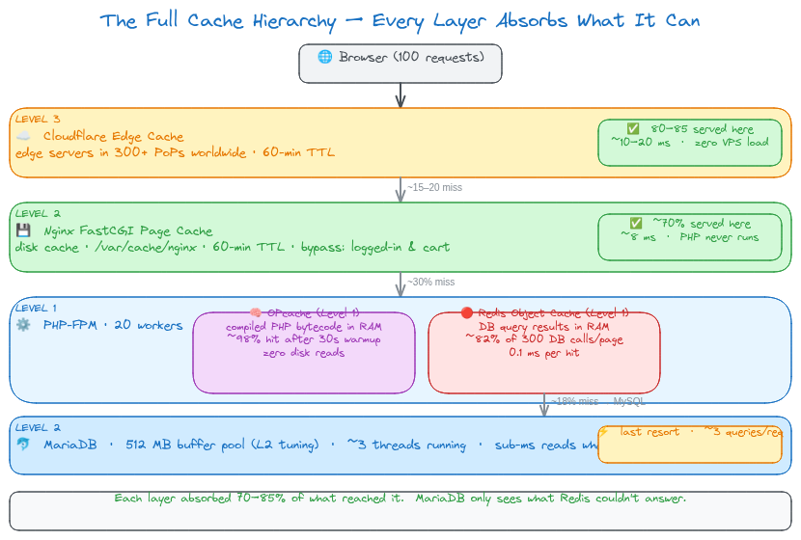
The full cache hierarchy

Slide 42
Lessons learned
1. Measure before you fix
Set up Prometheus + Grafana
before you need it.
You cannot fix what you cannot see.
make obs-up
— 30 seconds.
2. The three WP cache layers
OPcache → PHP bytecode → always on
Redis → DB queries → wp redis enable
FastCGI → Full pages → nginx.conf
Most sites use 0 of these 3.
All three: completely different machine

Slide 43
The tools — all free, all open source
Tool
Role
k6
Load generator — scriptable, Prometheus remote-write
Prometheus
Metrics collection + storage
Grafana
7 dashboards, auto-provisioned
Loki + Promtail
Container log aggregation
Tool
Role
Nginx FastCGI
Full-page cache (built-in)
PHP OPcache
Bytecode cache (built-in)
Redis
Object cache
MariaDB 11
Tuned DB config

Slide 44
Thank you!
Nedko Hristov
Senior DevOps Engineer @ Nemetschek Bulgaria
github.com/NedkoHristov/WordPress-Europe-2026
Questions?
"The best time to add monitoring was before the crash.
The second best time is right now."

