Slide 1
CaseStudy2DDS
Neddy Nyatome

Slide 2

Objectives
General approach
Findings
Models

Slide 3
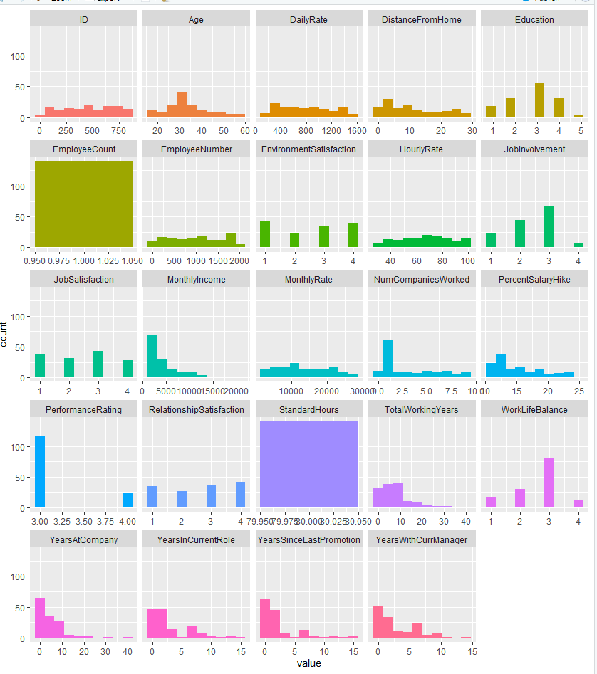
The dataset
n = 870 , var = 36
Data tidying
Attrition = 16% of employees

Slide 4

Findings
1. Job role = Highest attrition
2. New employees
3. Promotion
4. Stock Option level
5. More Education
Top 3 factors:
1. Job level
2. Stock Option Level
3. YearsAtCompany

Slide 5

Models
KNN Model
Regression Model -> To predict Monthly income

