Slide 1



Network programming
Topic 6
File-sharing application
Members:
Phạm Thành Biên 20194731
Phạm Hải Đăng 20194736
Hoàng Thanh Lâm 20194786

Slide 2




Table of content
I
Introduction
Member's contribution
II
III
System architecture
IV
System design
Protocol design
VI
Demo
V

Slide 3




I. Introduction
A file-sharing application allows users to share and access files and folders from their devices.
The main functionalities of our project:
Use TCP/IP protocol with multi-thread
Project uses Winsock and gtk library for UI
- Allow users to create groups. The group creator has the role of - group leader.
- Each group has its own folder, containing shared files within that group.
- Any member of the group can upload files and create subfolders within the group's folder.
Only the group leader has the authority to delete files and subfolders.
- The client has the following functionalities:
+ Create a shared group.
+ Request to join a group.
+ Upload file.
+ Download file.

Slide 4
II. Member's contribution
Team member | Contribution
Phạm Thành Biên – leader (20194731) | Design program architecture Program user interface Program functionalities: Create, delete, join group View, accept join request(admin) View group list, files/folder list
Phạm Hải Đăng (20194736) | Design user interface Document preparation Program functionalities: Upload, download file Create, delete folder
Hoàng Thanh Lâm (20194786) | Document preparation Design user interface Program functionalities: Sign in Sign up

Slide 5



III. System architecture
Let's begin

Slide 6

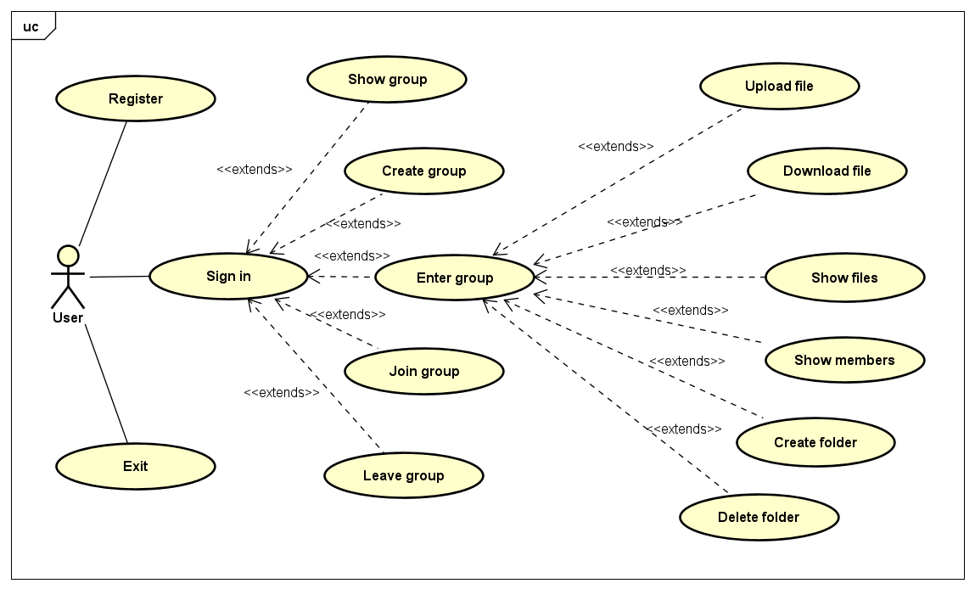
Use case diagram

Slide 7
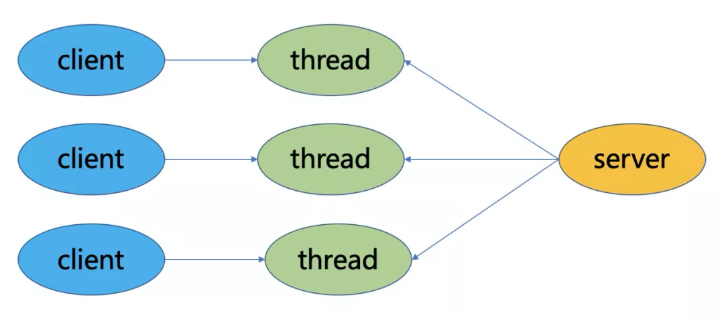
III. System architecture
TCP client-server model with multithreaded server

Slide 8
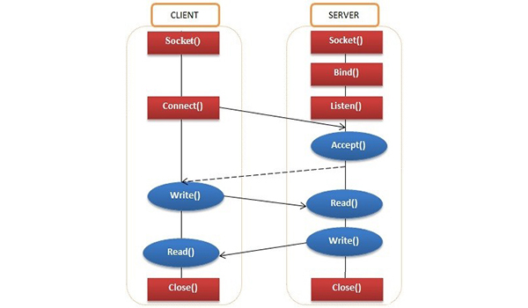
III. System architecture

Slide 9


III. System architecture
Start
Client flows
Welcome screen
End
Exit
Sign in
Sign up
Check input
No
Yes
Menu
File functions
Group functions
Back

Slide 10
III. System architecture
Start
Initializing
Server flows
Load from database
Receive Message
Handing Error
Group functions
Sign in
File functions
Sign up
Back
Exit

Slide 11
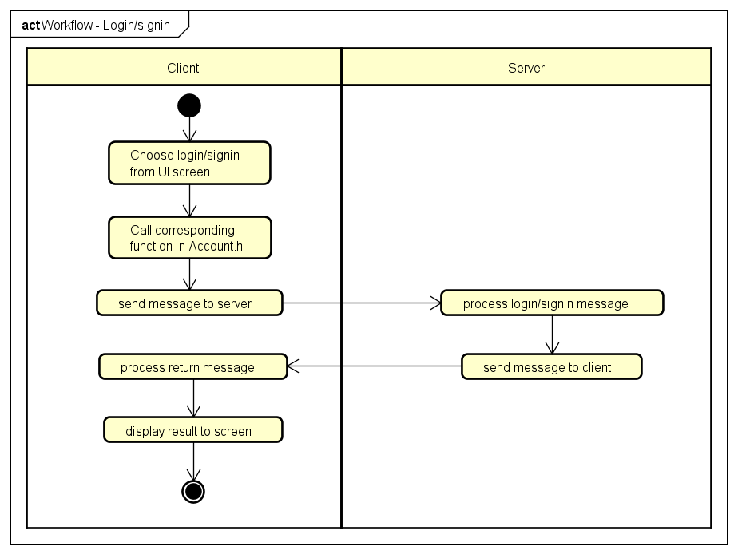
IV. System design
Login/Signin workflow

Slide 12
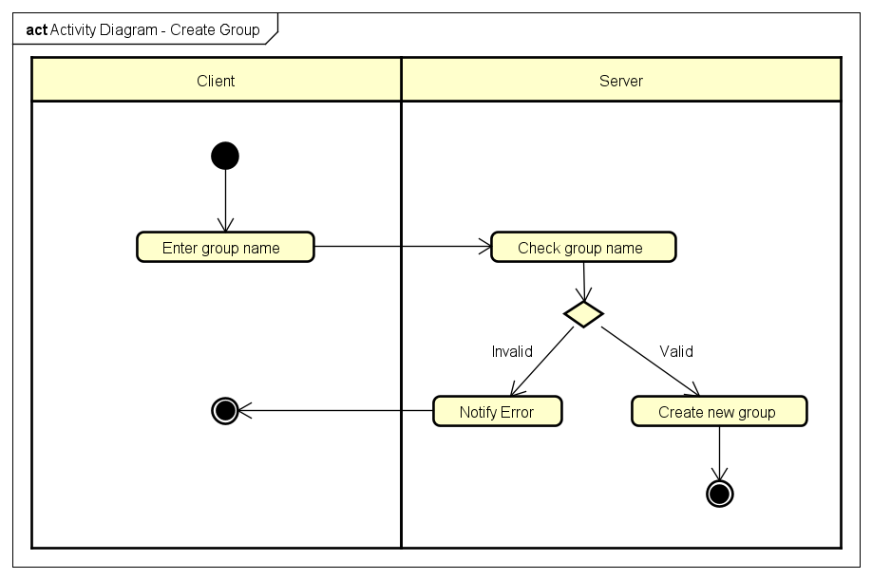
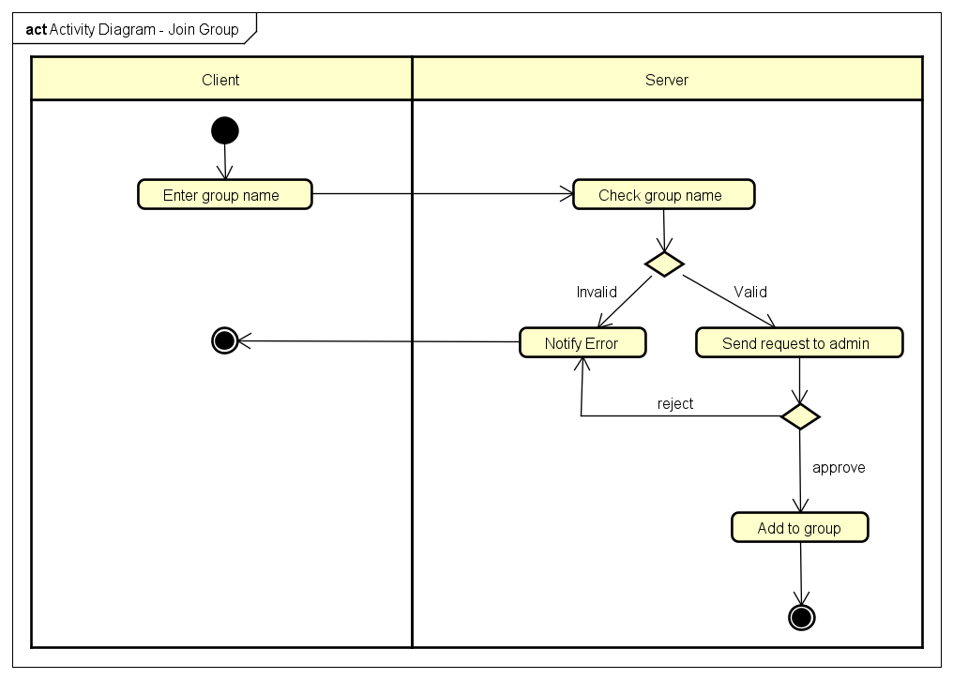
IV. System design
Create group
Join group

Slide 13
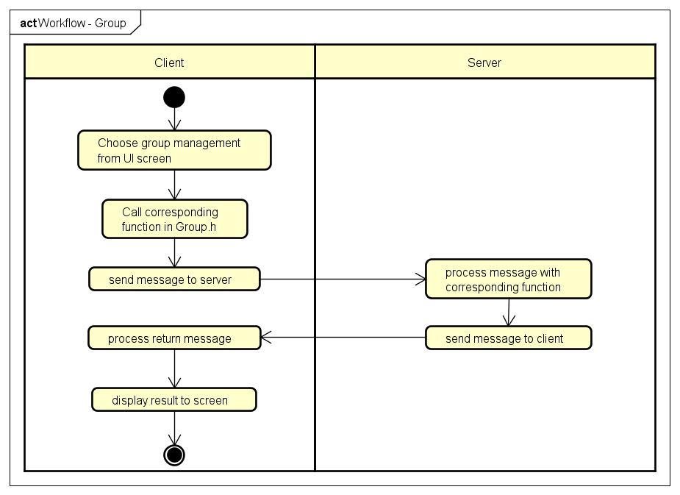
IV. System design
Group management workflow

Slide 14
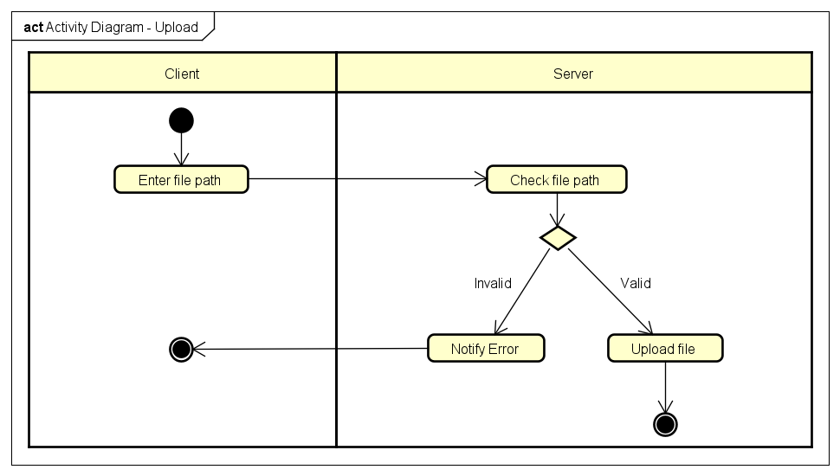
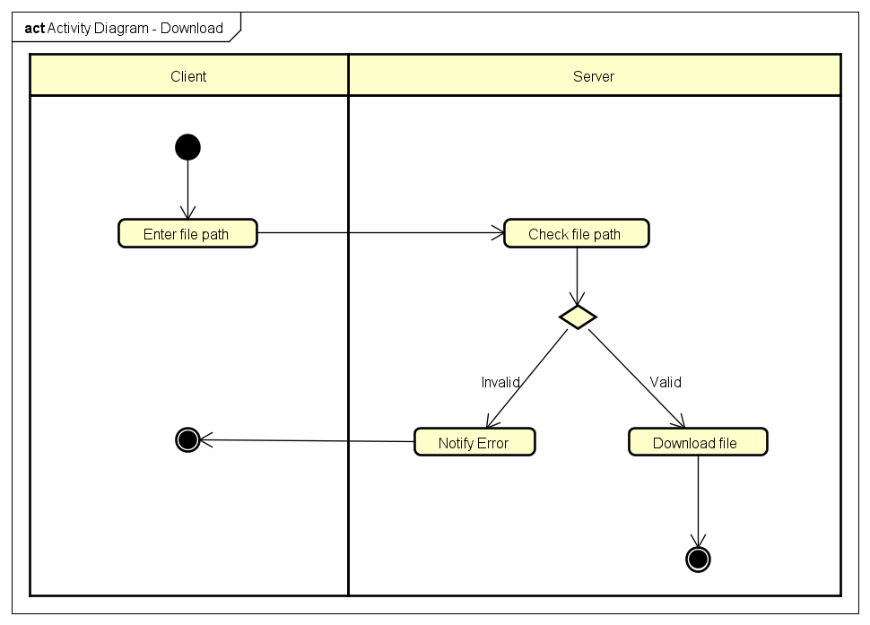
IV. System design
Upload file
Download file

Slide 15
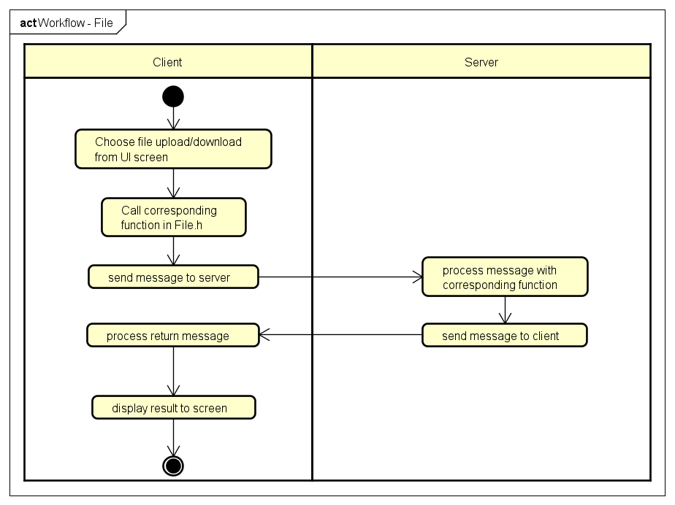
IV. System design
File management workflow

Slide 16
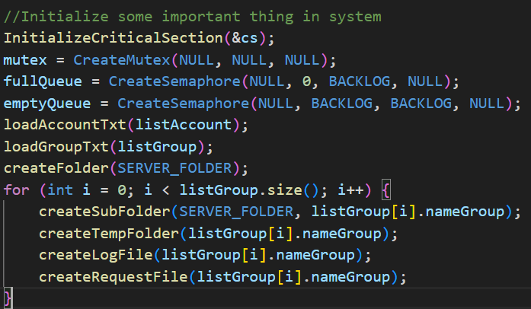
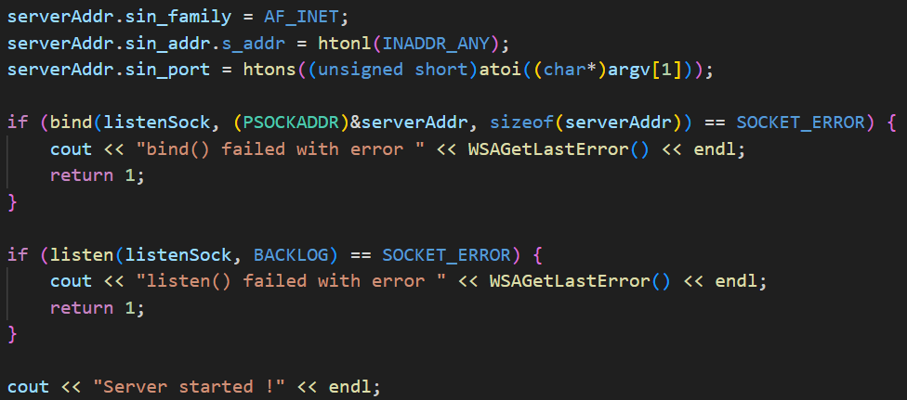
Server workflow
Initial data
Bind and listen request

Slide 17
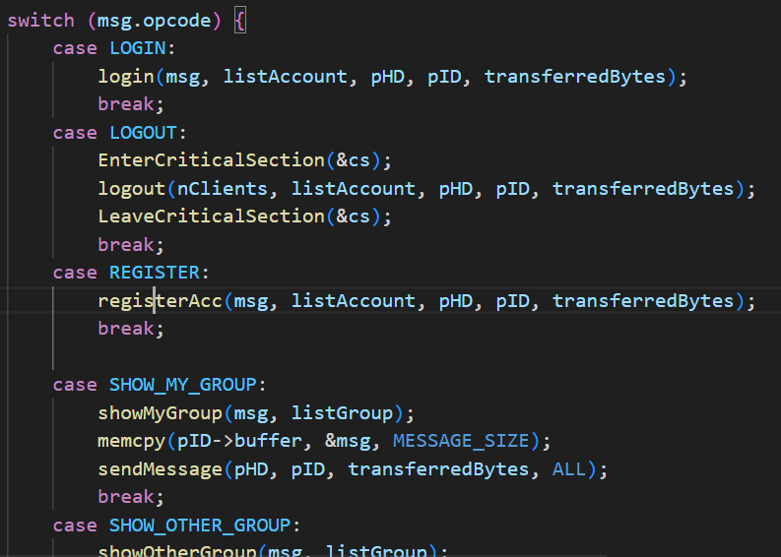
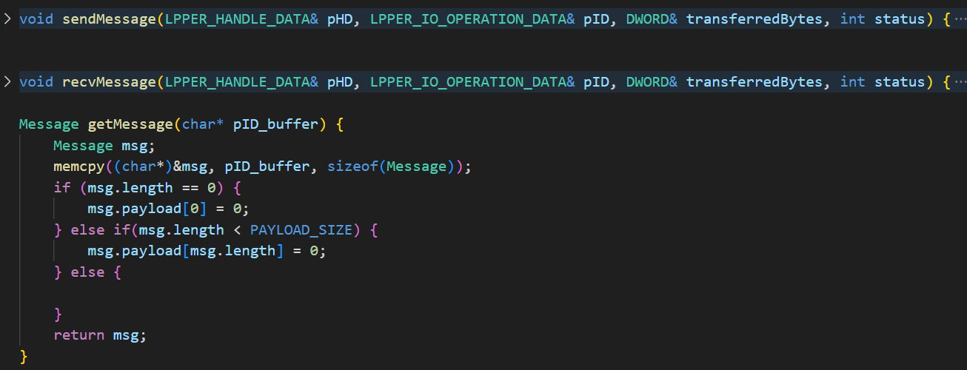
Server workflow
Process with corresponding function
Return message to client

Slide 18
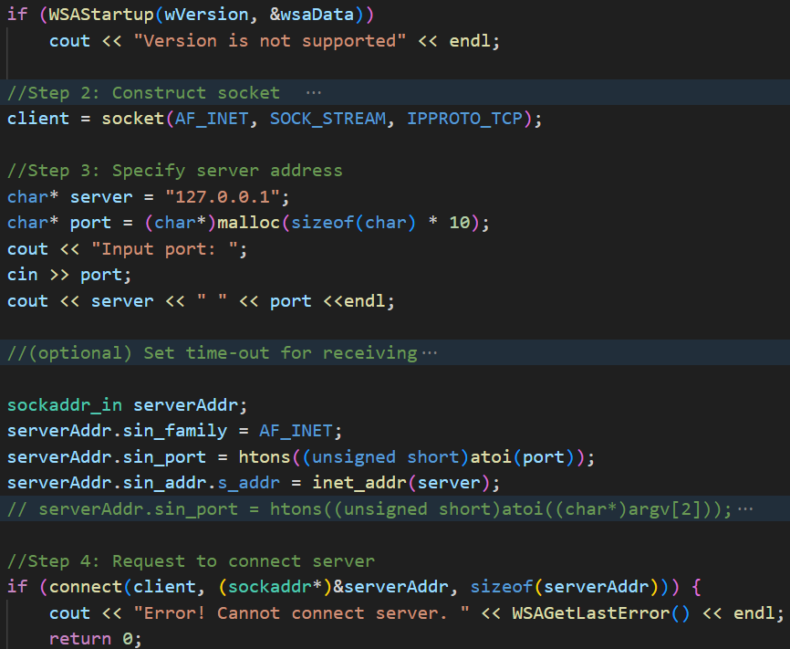
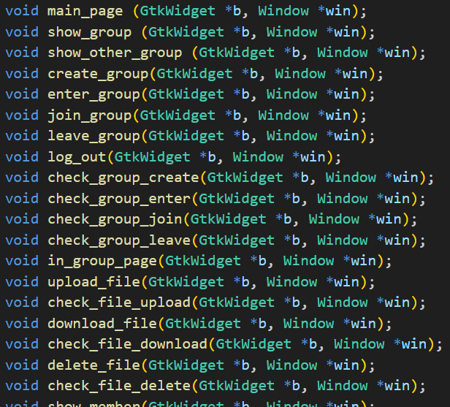
Client workflow
Client initial and connect to server
Client choose function from UI screen

Slide 19
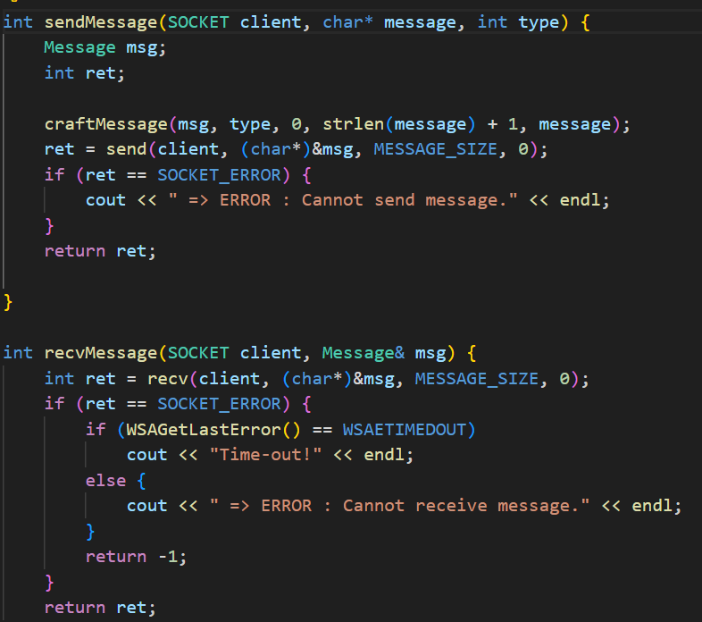
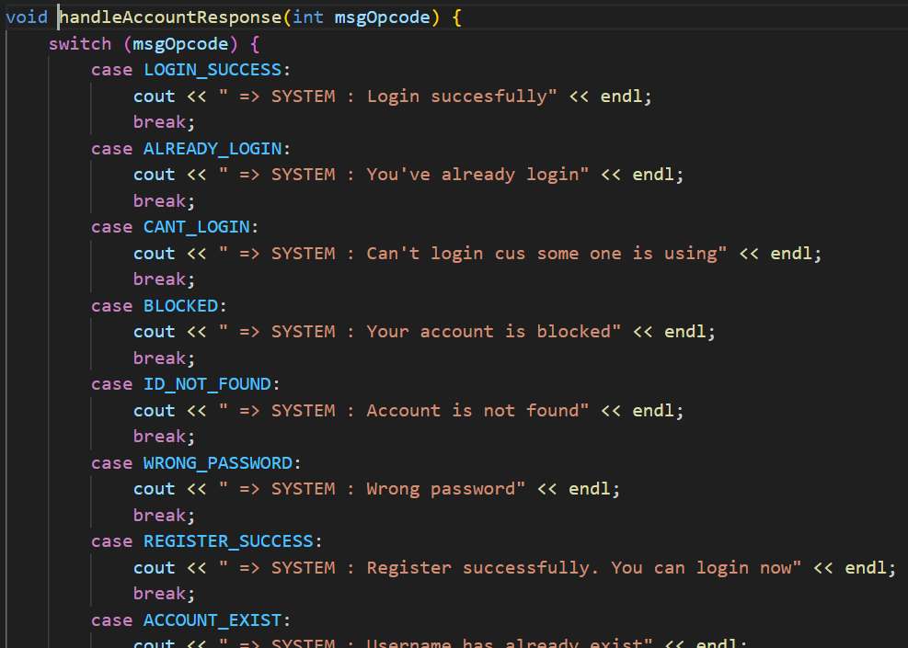
Client workflow
Process and send message to server
Receive, process return message and display

Slide 20
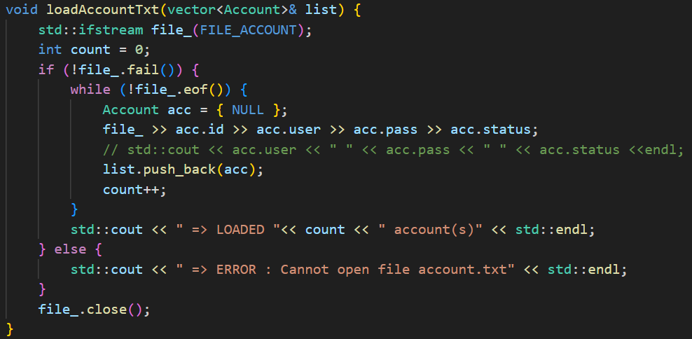
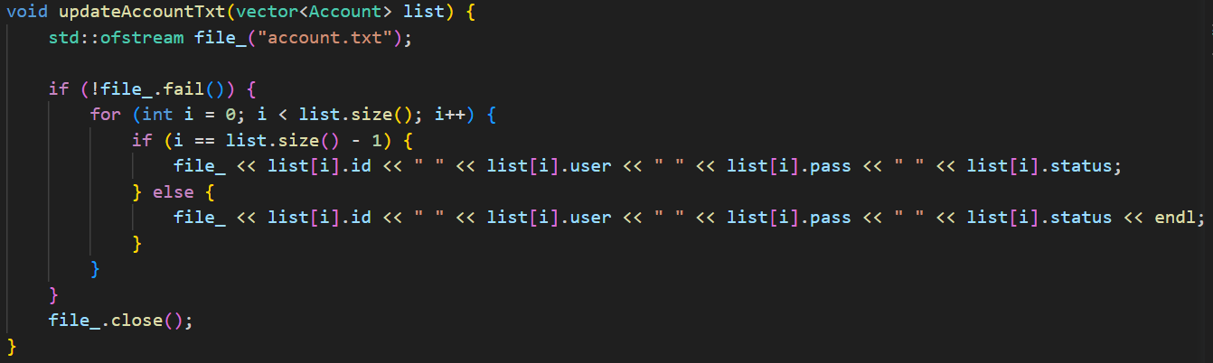
Manage entities
Manage user account

Slide 21
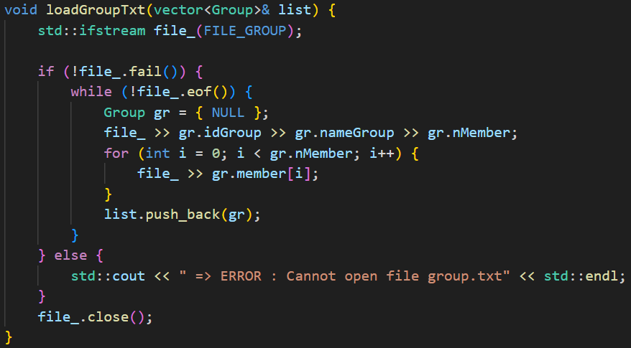
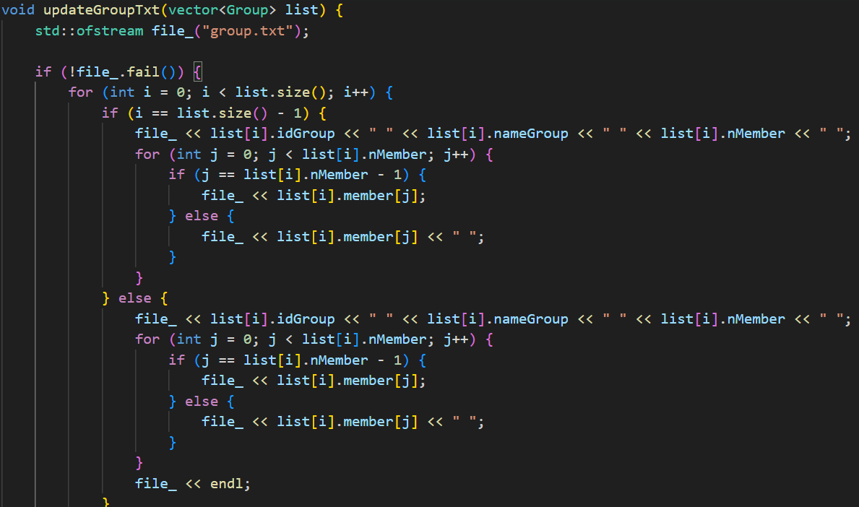
Manage entities
Manage group

Slide 22

V. Protocol design
Message:
opcode | length | payload
Opcode: message code
Length: message length
Payload: data in message
typedef struct Message {
int opcode;
int length;
char payload[PAYLOAD_SIZE];
}Message;

Slide 23
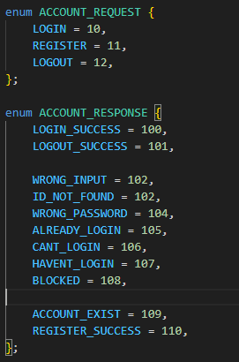
V. Protocol design
Message opcode for account Request: LOGIN REGISTER LOGOUT
Response: LOGIN_SUCCESS LOGOUT_SUCCESS WRONG_INPUT ID_NOT_FOUND WRONG_PASSWORD ALREADY_LOGIN CANT_LOGIN HAVENT_LOGIN BLOCKED ACCOUNT_EXIST RESISTER_SUCCESS

Slide 24
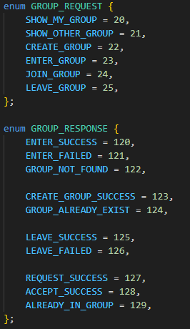
V. Protocol design
Message opcode for group Request: SHOW_MY_GROUP SHOW_OTHER_GROUP CREATE_GROUP ENTER_GROUP JOIN_GROUP LEAVE_GROUP
Response: ENTER_SUCCESS ENTER_FAILED GROUP_NOT_FOUND CREATE_GROUP_SUCCESS GROUP_ALREADY_EXIST LEAVE_SUCCESS LEAVE_FAILED REQUEST_SUCCESS ACCEPT_SUCCESS ALREADY_IN_GROUP

Slide 25
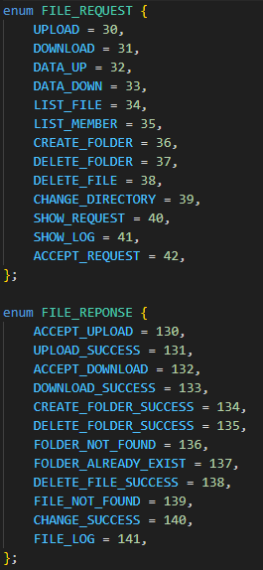
V. Protocol design
Message opcode for file Request: UPLOAD DOWNLOAD DATA_UP DATA_DOWN LIST_FILE LIST_MEMBER CREATE_FOLDER DELETE_FOLDER DELETE_FILE CHANGE_DIRECTORY SHOW_REQUEST SHOW_LOG ACCEPT_REQUEST
Response: ACCEPT_UPLOAD UPLOAD_SUCCESS ACCEPT_DOWNLOAD DOWNLOAD_SUCCESS CREATE_FOLDER_SUCCESS DELETE_FOLDER_SUCCESS FOLDER_NOT_FOUND FOLDER_ALREADY_EXIST DELETE_FILE_SUCCESS FILE_NOT_FOUND CHANGE_SUCCESS FILE_LOG

Slide 26
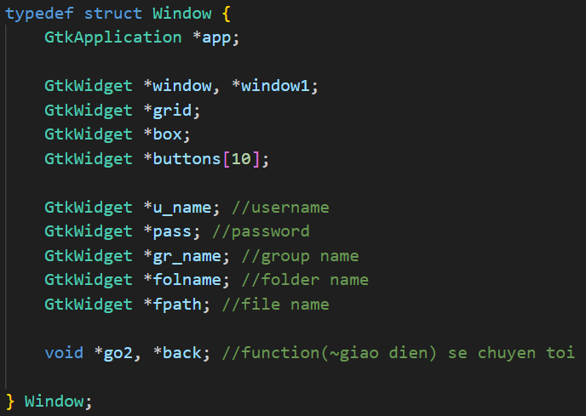
V. Protocol design
Define UI screen app Window, window1 grid box Buttons[10] U_name pass Gr_name folname fpath Go, back

Slide 27
V. Protocol design
Message transfer diagram
Login
Client
Server
Send username, password
LOGIN
Check account
username + password
Invoice error
ID_NOT_FOUND
wrong ID
WRONG_PASSWORD
wrong pass
Next menu
LOGIN_SUCCESS
true

Slide 28
V. Protocol design
Create group
Client
Server
Send group’s name
CREATE_GROUP
Check group
group name
false
Invoice error
GROUP_ALREADY_EXIST
Group existed
Back to menu
CREATE_GROUP_SUCCESS
true

Slide 29
V. Protocol design
Join group
Client
Server
Send group’s name
JOIN_GROUP
Check group
group name
false
Invoice error
GROUP_NOT_FOUND
Group not found
Back to menu
REQUEST_SUCCESS
true

Slide 30
V. Protocol design
Download file
Client
Server
Send file’s name
DOWNLOAD
Check file
File name
true
Invoice error
FILE_NOT_FOUND
false
File not found
ACCEPT_DOWNLOAD
Received data then write to file
DATA_DOWN
Read file
!feof(file)
Stop receive data and close file
feof(file)
DOWNLOAD_SUCCESS

Slide 31
V. Protocol design
Upload file
Client
Server
Send file’s name
UPLOAD
Locate file path to database
Filepath
Read file
!feof(file)
DATA_UP
Received data then write to file
feof(file)
Read file complete
UPLOAD_SUCCESS
Stop receive data and close file

Slide 32
VI. Demo

Slide 33



THANK YOU FOR LISTENING

