Slide 1
REAL-TIME
Veterinary Clinic
Queue Management
A003
A001
WebSocket and Socket.IO
A002
A live queue that keeps pet owners and clinic staff in sync
10-minute presentation and live demo
Notes:
Good morning. Today I will present PawEver's real-time veterinary clinic queue management feature. The goal is to let pet owners see their place in the queue while clinic staff manage the next patient. I will explain why the clinic needs this feature, how WebSocket and Socket.IO support it, how the system is implemented, and then show the feature in a short live demonstration.

Slide 2
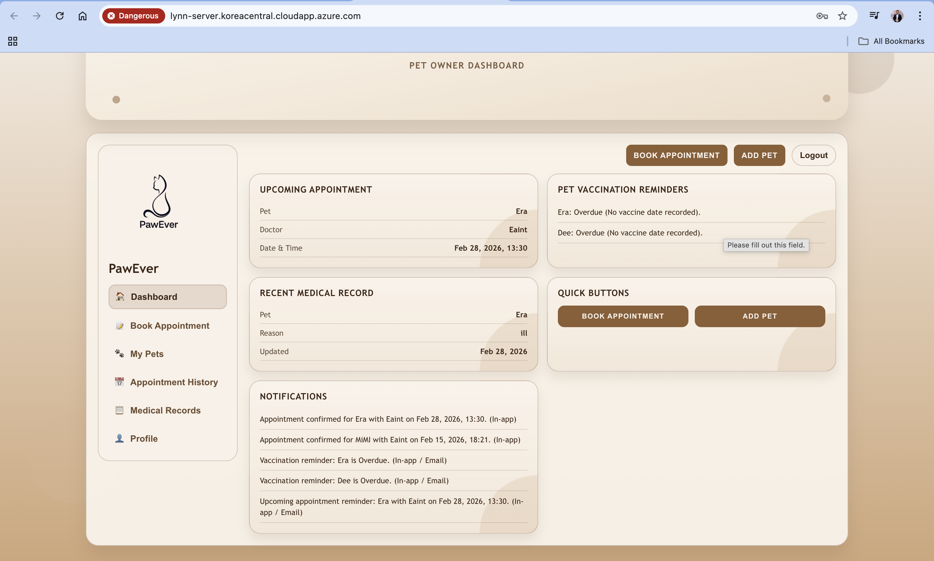
02
Clinic queue problem
Owners and staff work from different views of the same waiting room
Pet owners
• Cannot see when their pet will be called
• Ask staff for repeated updates
• Experience uncertainty while waiting
Clinic staff
• Track the queue manually
• Announce changes one person at a time
• Risk showing stale information
Core issue: the queue changes faster than manual communication
PawEver queue management
2
Notes:
The clinic queue creates problems for both sides. Pet owners do not know when their pet will be called, so they repeatedly ask staff for updates. Staff may keep a waiting list, but they must communicate each change manually. If a page only loads data once, it becomes stale as soon as staff call the next patient. The core problem is that the queue changes faster than manual communication.

Slide 3
03
Proposed solution
A shared queue with automatic updates after every accepted action
1
2
3
4
Check in pet
Join queue
Call next
Update screens
Owner selects a registered pet
System assigns a queue number
Staff advances the waiting list
Owner and staff see the new state
Owner view
Live shared state
Staff view
Queue number · status · patients ahead
Waiting list · current patient · call next
PawEver queue management
3
Notes:
The proposed solution creates one shared queue. First, the owner checks in a registered pet. The server assigns a queue number. Staff view the waiting list and call the next patient. Every accepted action updates the owner and staff screens. The owner sees the queue number, current status, and patients ahead. Staff see the current patient and the ordered waiting list.

Slide 4
04
Technology of interest
Socket.IO manages a persistent real-time channel between browser and server
WebSocket
Socket.IO
A persistent, full-duplex connection
uses
The real-time library used by PawEver
Named events
Automatic reconnection
Rooms for broadcasting
Polling fallback
Browser and server can exchange messages without creating a new HTTP request for every update.
PawEver queue management
4
Notes:
WebSocket is the underlying communication technology. It keeps a full-duplex connection open so the browser and server can exchange messages immediately. PawEver uses Socket.IO on top of that connection. Socket.IO provides named events, reconnection, rooms, and a fallback to HTTP long polling. A raw WebSocket client cannot connect directly to this Socket.IO server because Socket.IO adds its own protocol and handshake.

Slide 5
05
Queue update flow
The database commits the change before Socket.IO announces it
Owner or staff
REST endpoint
PostgreSQL
Socket.IO
Queue pages
1
Check in, call next, or cancel
User sends an HTTP request
2
Validate and update
Server checks role, ownership, and queue status
3
Commit queue state
Transaction saves the authoritative result
4
Emit queue:updated
Event carries change type, entry ID, and time
5
Fetch a fresh snapshot
Each page reloads only the data it may see
PawEver queue management
5
Notes:
Here is the complete update flow. The owner or staff first sends a normal REST request. The server validates the request and starts a database transaction. PostgreSQL saves the new queue state. Only after the successful commit does the server emit queue updated through Socket.IO. Connected pages receive the signal and fetch a fresh REST snapshot. This design keeps PostgreSQL as the source of truth and avoids sending private pet or owner data inside the live event.

Slide 6
06
System architecture
REST handles data operations while Socket.IO carries change notifications
Pet owner
Queue Status
HTTP JSON
Application server
read / write
PostgreSQL
REST API
check-in · list · next · cancel
Socket.IO server
queue room · queue:updated
Authoritative queue entries
Clinic staff
Queue Management
emit event
Live notification path
Small change signal only
Socket.IO returns to both queue pages
Scale-out note: multiple server instances would need a shared Socket.IO adapter
PawEver queue management
6
Notes:
The architecture has two client views: Queue Status for owners and Queue Management for staff. Both use REST for reads and queue actions. The application server contains the REST routes and the Socket.IO server on the same HTTP server. PostgreSQL stores the authoritative state. Socket.IO broadcasts only a change signal to the queue room, and both clients then fetch their permitted data. If this system later runs on multiple backend instances, a shared adapter such as Redis would be required for cross-instance broadcasts.

Slide 7
07
Socket.IO event design
One event announces change; REST returns the role-scoped queue data
Design decisions
queue:updated
1
Privacy
{
"change": "checked-in",
"entryId": "...",
"changedAt": "2026-09-22T...Z"
}
No owner or pet details in the event
2
Authorization
REST response stays scoped by role and user ID
3
Resilience
Socket reconnects and the page refreshes every 30 seconds
Other change values: next-called, cancelled
Simplicity
4
One event triggers the same refresh behavior
Current limitation: userId identifies the caller; production needs secure sessions or tokens
PawEver queue management
7
Notes:
The server emits one named event: queue updated. Its payload includes the type of change, the affected entry ID, and a timestamp. It does not include the owner's name or pet information. This protects data during broadcast. Each client reacts by calling the REST API, where role and owner rules determine the response. Socket.IO reconnects automatically, and the page has a 30-second safety refresh. The current application uses a user ID parameter rather than secure server sessions, so production authentication remains a future improvement.

Slide 8
08
Implementation plan and runnable proof
Four layers turn queue actions into reliable live updates
01
Database
Queue table, status constraint, ordering indexes
RUNNABLE PROOF
Backend
02
REST API
Check in, list, current, next, and cancel
npm run db:migrate
npm run dev
03
Socket.IO
Join queue room and emit after success
Frontend
npm run dev
04
React client
Listen, reconnect, refresh, and clean up
Verification
npm run build
queue integration test
Database rules prevent two active entries for one pet and more than one SERVING patient
PawEver queue management
8
Notes:
The implementation has four layers. The database defines queue statuses and ordering rules. The REST API exposes check-in, list, current, next, and cancellation operations. Socket.IO places clients in a queue room and emits only after a successful change. The React page listens for the event, refreshes, reconnects, and removes its listeners when the page unmounts. The project includes migration commands, a frontend build, and an integration test for the queue behavior.

Slide 9
09
Live demonstration and testing
Two browser windows show the same queue changing in real time
PET OWNER WINDOW
STAFF WINDOW
1 Select a registered pet
2 Click Check In
3 Read queue number and patients ahead
4 Watch the status change without refresh
1 Confirm the waiting entry appears
2 Click Call Next Patient
3 Confirm WAITING becomes SERVING
4 Call next again and test cancellation
Proof point: the owner page changes while no one presses Refresh
PawEver queue management
9
Notes:
For the live demo, I will use two browser windows. On the owner page, I select a registered pet and click Check In. The page shows a queue number and the number of patients ahead. In the staff window, the new entry appears in the waiting table. I click Call Next Patient. Then I return to the owner window without pressing Refresh. The status has changed to Serving because Socket.IO delivered queue updated and the page fetched fresh data. I call next again to show the first visit as Completed and the next visit as Serving. Finally, I check in another pet and cancel it while waiting. This proves check-in, ordering, status transitions, cancellation, and the live notification path.

Slide 10
THANK YOU
Real-time queue visibility for pet owners and clinic staff
1
2
3
PostgreSQL
REST API
Socket.IO
stores the queue state
applies each queue action
announces every accepted change
Questions?
Notes:
To conclude, PostgreSQL stores the authoritative queue state, the REST API applies each action, and Socket.IO announces accepted changes in real time. This gives clinic staff a simple workflow and gives pet owners immediate visibility into their turn. Thank you. I am happy to answer any questions.

