Slide 1
REAL-TIME
Veterinary Clinic
Queue Management
A003
A001
WebSocket and Socket.IO
A002
A live queue that keeps pet owners and clinic staff in sync
10-minute presentation and live demo
Notes:
Good morning. Today I will present our proposal for a real-time veterinary clinic queue management system. In the current queue experience, pet owners must refresh the page or ask staff for updates. Our proposed change uses WebSocket and Socket.IO so queue changes reach connected owner screens immediately. I will explain the problem, the proposed solution, the technical design, the implementation plan, and then show a short live demonstration.

Slide 2
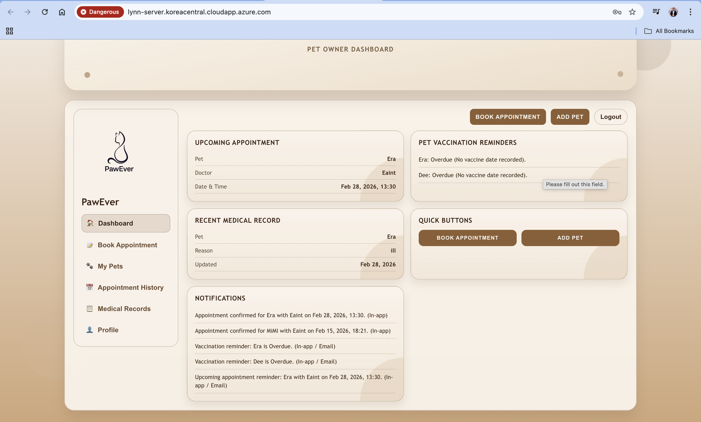
02
Clinic queue problem
The current queue page does not update automatically
Owners need four answers
• Which number is being served?
• How many patients are ahead?
• Is their turn approaching?
• Has their appointment been called?
Current workaround
Refresh the page repeatedly or ask clinic staff for an update.
Result: uncertainty, unnecessary waiting, and repeated questions for staff
PawEver queue management
2
Notes:
The current queue gives pet owners a number after check-in, but the information does not update automatically. Owners need to know which number staff are serving, how many patients are ahead, whether their turn is approaching, and whether staff have called their appointment. Today they must repeatedly refresh or ask clinic staff. This creates uncertainty, unnecessary waiting, and repeated questions that interrupt clinic work.

Slide 3
03
Proposed solution
Staff action triggers an immediate update on every connected owner screen
1
2
3
4
Owner checks in
Staff calls next
Server broadcasts
Screen changes
System assigns a queue number
Queue state changes on the server
Socket.IO sends the update
Owners see the new state instantly
Before
No manual refresh
After
Refresh page or ask staff
Current number, patients ahead, and call status update automatically
PawEver queue management
3
Notes:
Our proposed solution adds a continuous real-time channel. The owner checks in and receives a queue number. When staff click Call Next Patient, the application updates the queue on the server. Socket.IO immediately broadcasts the new queue state to connected owner screens. The interface then shows the current number, patients ahead, and whether the pet has been called. The owner does not press Refresh.

Slide 4
04
Technology of interest
Socket.IO manages a persistent real-time channel between browser and server
WebSocket
Socket.IO
A persistent, full-duplex connection
uses
The real-time library used by PawEver
Real-time event communication
Automatic connection handling
Broadcasting to many users
Rooms for clinic departments
Reconnection support
Browser and server can exchange messages without creating a new HTTP request for every update.
PawEver queue management
4
Notes:
WebSocket provides continuous two-way communication between a client and server. The connection stays open, so the server can send a queue change as soon as it happens. Socket.IO simplifies this work. It provides real-time events, automatic connection handling, broadcasting to multiple users, rooms that can separate clinic departments, and reconnection support. Our first proof can use one shared queue room. Department-specific rooms are part of the proposed extension.

Slide 5
05
Queue update flow
One staff action reaches every connected pet-owner screen
Clinic staff
Application API
PostgreSQL
Socket.IO
Owner screens
1
Click Call Next Patient
Staff sends an HTTP request
2
Validate and advance
Server completes the old turn and calls the next
3
Save new queue state
Database stores current number and statuses
4
Broadcast queue update
Socket.IO sends an event to connected clients
5
Update the interface
Each owner screen displays the new information
PawEver queue management
5
Notes:
The key flow begins when staff click Call Next Patient. The browser sends the action to the application API. The server validates the staff account, completes the previous turn, and advances the next waiting entry. PostgreSQL saves the new state. Socket.IO then broadcasts a queue update. Every connected owner screen handles that event and updates the displayed current number, patient count, and status without a manual refresh.

Slide 6
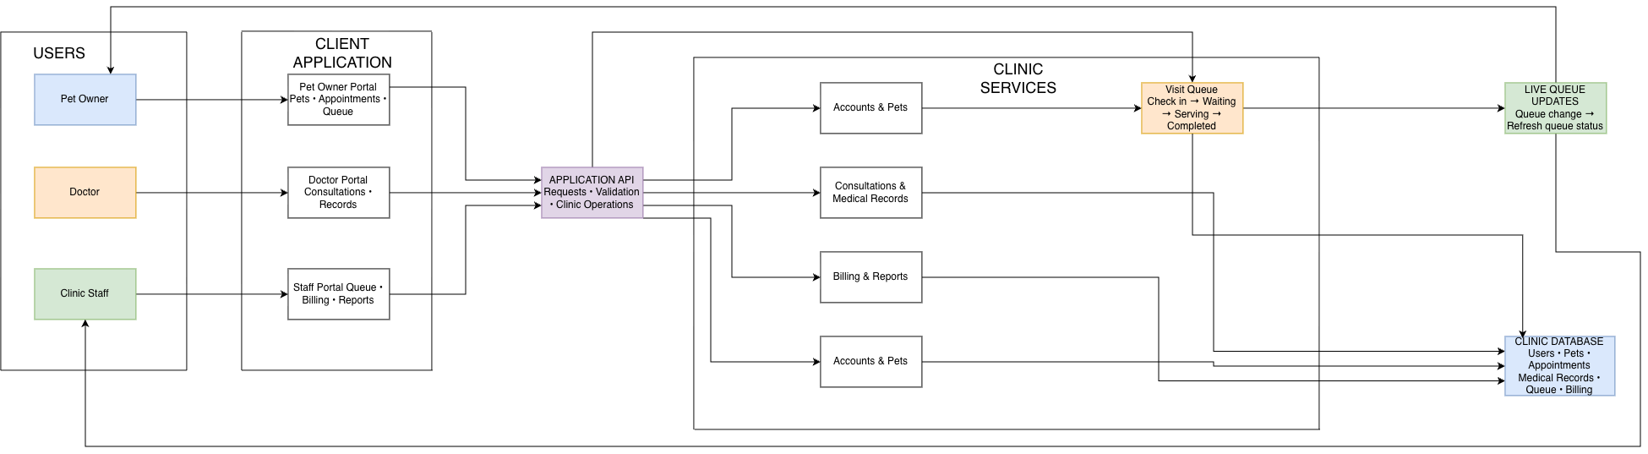
06
System architecture
Users, client portals, clinic services, live queue updates, and persistent storage
Pet owners, doctors, and clinic staff use dedicated portals connected to one application API.
Queue changes pass through clinic services, update the database, and reach connected owner screens through the live queue channel.
PawEver queue management
6
Notes:
This architecture begins with three users: pet owners, doctors, and clinic staff. Each role uses a dedicated client portal. The portals send requests to one application API, which validates the request and coordinates clinic operations. Accounts and pet data, consultations and medical records, billing, and the visit queue sit inside the clinic services layer. When clinic staff change the visit queue, the server saves the new state in the clinic database. The live queue update channel then notifies connected pet-owner screens so their queue status changes without a manual refresh. Socket.IO provides that persistent channel and can broadcast each queue event to every client in the relevant clinic or department room.

Slide 7
07
Socket.IO event design
The proposed event carries the queue information needed by the owner screen
Design decisions
queue:update
{
"department": "general",
"currentQueueNumber": "A014",
"patientsAhead": 2,
"status": "WAITING",
"updatedAt": "..."
}
1
Broadcast
Send to all clients in the correct room
2
Privacy
Exclude unnecessary owner and pet details
3
Recovery
Reconnect and resynchronize after disconnection
Sent after check-in, call-next, or cancellation
4
Consistency
Emit only after the database update succeeds
Prototype today: queue:updated signal followed by a fresh REST snapshot
PawEver queue management
7
Notes:
This slide shows the proposed event contract. The event can include the department, current queue number, patients ahead, status, and update time. The server sends it after check-in, call-next, or cancellation. It broadcasts to the appropriate room, excludes unnecessary personal details, reconnects after network loss, and emits only after the database update succeeds. Our runnable prototype currently sends a smaller queue updated signal and then fetches a fresh REST snapshot. That prototype proves the live channel while the proposal defines the richer final event.

Slide 8
08
Implementation plan and runnable proof
The prototype proves live delivery; the proposal adds richer events and department rooms
01
Queue state
Keep ordered WAITING, SERVING, and COMPLETED entries
RUNNABLE PROOF
Backend
02
Socket server
Attach Socket.IO and create queue rooms
npm run db:migrate
npm run dev
03
Event contract
Broadcast current number, count, and status
Frontend
npm run dev
04
Owner screen
Update immediately and resync after reconnect
Verification
npm run build
queue integration test
Runnable proof demonstrates check-in, call-next, cancellation, reconnection, and live screen refresh
PawEver queue management
8
Notes:
The implementation plan starts with reliable queue states, then attaches Socket.IO, defines the event contract, and updates the owner interface. The current runnable proof already demonstrates the key behavior: check-in, call-next, cancellation, automatic reconnection, and screen updates without a manual refresh. The next proposal step is to include the richer queue payload and introduce rooms for separate clinics or departments.

Slide 9
09
Live demonstration and testing
Two browser windows show the same queue changing in real time
PET OWNER WINDOW
STAFF WINDOW
1 Select a registered pet
2 Click Check In
3 Read queue number and patients ahead
4 Keep this screen open without refreshing
1 Confirm the waiting entry appears
2 Click Call Next Patient
3 Watch the owner screen change automatically
4 Test reconnection and cancellation
Proof point: the owner page changes while no one presses Refresh
PawEver queue management
9
Notes:
For the live demonstration, I will open the pet-owner and staff pages in separate windows. The owner checks in a registered pet and receives a queue number. I leave that screen open without pressing Refresh. On the staff page, I confirm the waiting entry and click Call Next Patient. The owner screen changes automatically to show the new current number and status. I can briefly disconnect and reconnect to show Socket.IO recovery, then check in another pet and cancel it. The main proof is visible: a staff action changes every connected owner screen without manual refresh.

Slide 10
THANK YOU
Real-time queue visibility for pet owners and clinic staff
1
2
3
Staff action
Socket.IO
Owner screen
changes the queue
broadcasts the update
changes without refresh
Questions?
Notes:
To conclude, our proposal connects one staff action to every relevant pet-owner screen. The server updates the queue, Socket.IO broadcasts the change, and the owner interface changes without a refresh. This reduces uncertainty for owners and repeated questions for clinic staff. Thank you. I am happy to answer any questions.

