Slide 1
Life Improvisation System
* Aravind Mandapaka(001277353)
* Bala Krishna Chandana(001279253)
* Mahesh Tiruveedhula(001811508)

Slide 2
Problem Statement
Health, Education and safety are the essentials of mankind in the modern society.
Health conditions of citizens should be improved, especially for those who are underprivileged.
Prominence of education should be acknowledged to parents who are deprived and their children shall be enrolled in any nearby school.
Safety is more a right of every citizen which can be improved and information on critical incidents are to be immediately notified to people.
Future living conditions of any place should be determined for helping citizens live a better life.

Slide 3
Solution
A powerful ecosystem based application that collects data of citizens on the below aspects.
Improper health conditions of underprivileged people are treated by doctors in a local hospital being funded by private firms or privileged ones.
Children are enrolled in a high school by campaigning about the importance of education, conducted by higher standard students of same school. This process can again be funded by any private firms.
Acknowledging any critical incident to all the people in any region before it becomes a news and improving safety measures by collection of reported incidents.
perform data analysis of accumulated data over a period to derive inferences.

Slide 4
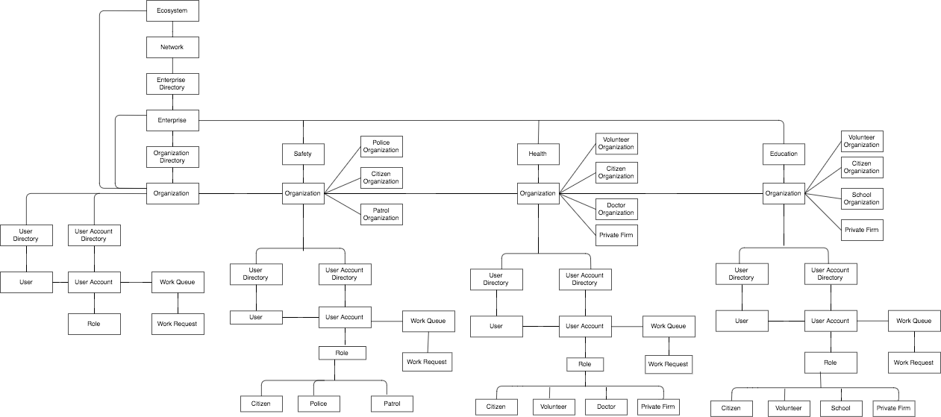
Object Model

Slide 5
Use cases
Citizen reporting a critical situation to the police for authentication and approval.
After approval, message being delivered to all users of application in that region.
Increase of patrol and safety measures based on the accumulated data of the activities reported dynamically.
Safety Enterprise

Slide 6
Use cases(cont)
Health Enterprise
Volunteers reports information on ill health of people in a community to doctors.
A doctor then suggests the treatment required and the tests that should be undergone and forward the same request to CSR heads of private firms.
A CSR head can either fund the request or can even reject the it.
Unique feature here is to provide a platform for every citizen to help other needful citizens(patients).

Slide 7
Use cases(cont)
Education Enterprise
Volunteers collect details of educational background of children in a region and sends it to schools in that region.
Higher standard students of school conduct camps and register students based on volunteer report.
Vacancies are created in school based on registrations done in the camps and funds need to accommodate those vacancies are generated.
Principal then requests CSR Head for the funds and gets children enrolled.

Slide 8
Actors
Citizen
Police
Patrol
Volunteer
Doctor
School
CSR Head

Slide 9
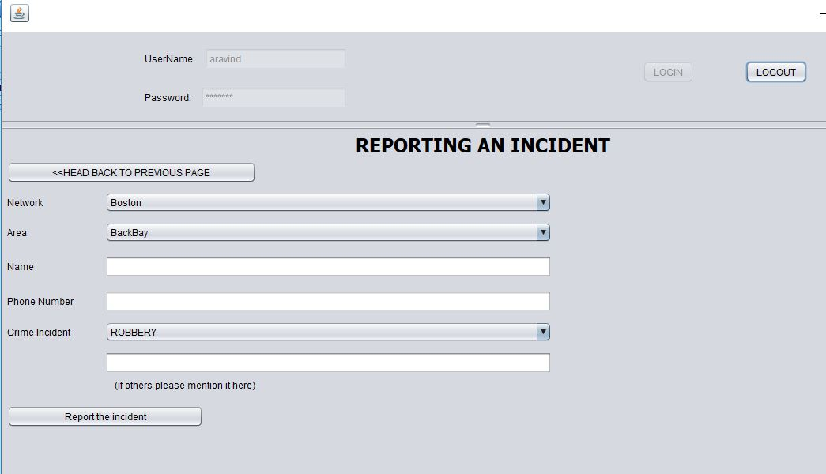
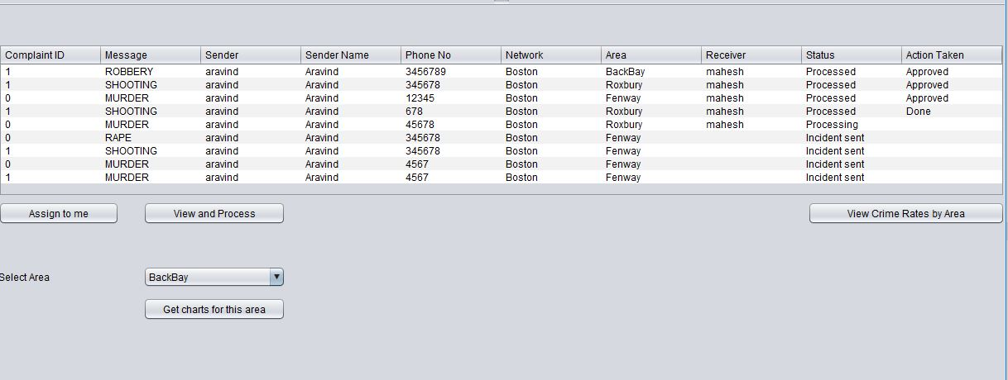
Screenshots
Citizen Reporting a Critical situation:
Police work Area and work requests:

Slide 10
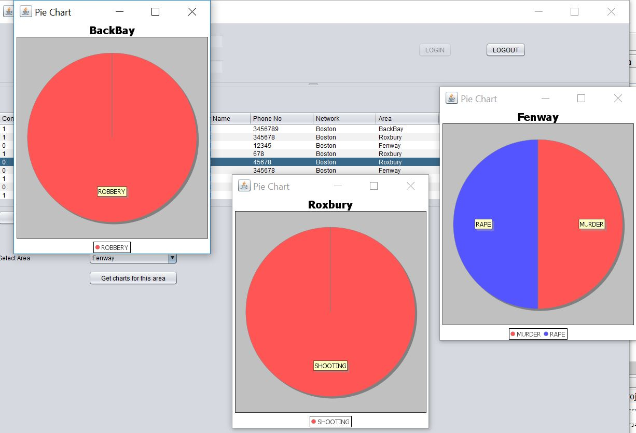
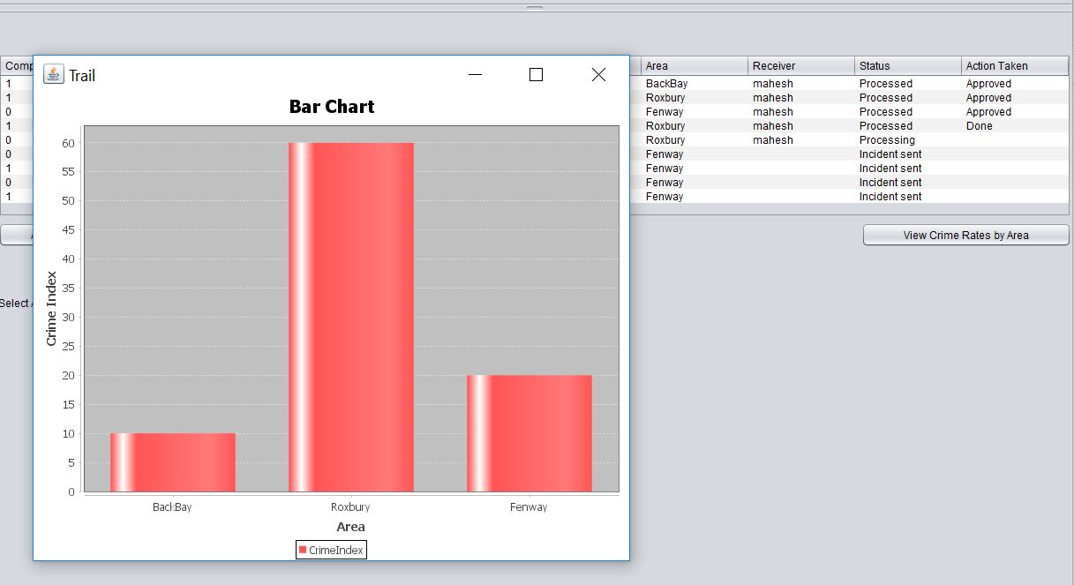
Screenshots(cont)
Types of crimes in each Area:
Over all crime indexes of all the Areas:

Slide 11
Unique features
Ecosystem model that enables communication between networks.
Common access to all the enterprises for Citizen which is realistic.
Email alerts, message for users.
Bar charts and Pie charts which analyze data for deriving decisions.
Citizen role having multiple features i.e funding others for education and ill health conditions.

Slide 12
Thank You

