Slide 1
Differential Privacy in Virtual Worlds: Anonymizing User Behavior in Video Games
Saravan Pravallika Neeharika Gaurav

Slide 2
Introduction
Virtual worlds and video games have become an integral part of our daily lives.
As these platforms collect massive amounts of user data, concerns about user privacy and security have arisen.
Surveillance in video games can compromise data privacy by monitoring in-game communications, tracking player behavior, sharing data with third parties, and exposing players to cybersecurity risks.
Differential privacy is a technique that provides a mathematical guarantee of privacy protection while still allowing useful analysis of data.
Applying differential privacy to anonymize user behavior in video games can provide benefits for both game developers and players.
In this we will explore the concept of differential privacy and its application to virtual worlds and video games, including challenges, real-world examples, and potential future impact.

Slide 3
Motivation
The increasing amount of user data being collected by video game companies, combined with the growing concerns over privacy and data protection, make it an important area of research.
Differential privacy provides a promising solution to balance the need for data analysis and the protection of individual privacy, and this project aims to explore its application in the context of virtual worlds and video games.
The collection and use of user data in video games raise ethical concerns regarding privacy, data protection, and consent.
Differential privacy can provide a privacy-preserving approach to data collection and analysis, thus reducing the risk of data misuse or exposure.
Anonymizing user behavior in virtual worlds can help to mitigate potential harms such as discrimination, or loss of reputation resulting from the misuse of personal information.
Applying differential privacy can also help to address power imbalances between game developers and players, promoting transparency, accountability, and user control over personal data.
Implementing robust privacy protections and ethical guidelines can help to build trust and foster a positive relationship between game developers and players, ultimately leading to a more responsible and sustainable gaming industry.

Slide 4
The psychological impact of in-game data prediction on users
Loss of Autonomy
Anxiety
Frustration
Suspicion
Self-Doubt

Slide 5
Privacy Concerns with In-Game Data Analysis
Profiling
Surveillance
Security
Transparency

Slide 6
Why surveillance is big issue??
In-game data collection can track players' behaviors, movements, and preferences, leading to concerns about privacy and surveillance.
Profiling can be created using in-game data, leading to targeted advertising and content, but also raising concerns about discrimination.
Collecting and storing large amounts of personal data for online games can create security risks, such as data breaches and cyber attacks.
The lack of transparency surrounding in-game data collection and usage can lead to concerns about how players' personal information is being used.
There is a need for clear guidelines and regulations around in-game data collection and usage to address privacy concerns and protect players' personal information.

Slide 7
Third-party use of predicted user behavior in games
Targeted Advertising
Data Analysis Services
Credit Scoring
Research
Fraud Detection

Slide 8
Targeted advertising
Gaming companies create detailed player profiles by analyzing data such as demographics, location, gameplay behavior, and interests.
Targeted ads can be placed within the game to promote relevant products or services to players.
In-game data can be used to offer personalized deals and promotions to players based on their behavior and preferences.
Cross-promotion of other games or products within the company's portfolio can be done based on the player's in-game behavior.
Sponsorship deals with influencers can be offered based on the player's in-game data and social media presence.

Slide 9
How differential privacy is used
Differential privacy is a technique used to protect the privacy of players' data by adding random noise to the data. This makes it difficult for an attacker to identify an individual's personal information.
Differential privacy is applied to sensitive data collected by video game companies, such as privacy of player chat logs, username, choosing to share only certain type of data, protecting demographic information.
The use of differential privacy in video games allows game developers to collect and analyze data while protecting the privacy of individual players.
Differential privacy can help prevent potential harm caused by the misuse of player data, such as discrimination or loss of reputation.
By implementing differential privacy techniques in video games, game developers can build trust with their player base by demonstrating a commitment to protecting player privacy and promoting responsible data practices.

Slide 10
Why differential privacy is used
Differential privacy provides a privacy-preserving approach to data collection and analysis, thus reducing the risk of data misuse or exposure.
Many countries have regulations that require companies to protect the personal information of their users. Differential privacy can help video game companies comply with these regulations.
Anonymizing user behavior in virtual worlds can help to mitigate potential harms such as discrimination or loss of reputation resulting from the misuse of personal information.
Applying differential privacy can help to address power imbalances between game developers and players, promoting transparency, accountability, and user control over personal data.
Implementing robust privacy protections and ethical guidelines can help to build trust and foster a positive relationship between game developers and players, ultimately leading to a more responsible and sustainable gaming industry.

Slide 11
Enhancing techniques
Laplace mechanism: The technique used in differential privacy to add random noise to query responses. In video games, this can be used to protect the privacy of player data by adding noise to the results of queries about player behaviour. The amount of noise added can be adjusted based on the sensitivity of the data being queried, with more sensitive data requiring more noise to protect it.
Exponential mechanism: The technique used in differential privacy that selects a response from a set of possible outcomes based on their relative privacy cost. This can be used in video games to provide players with choices that protect their privacy, such as opting out of data collection or choosing to share only certain types of data.
k-anonymity techniques: The technique is a data de-identification technique that groups individuals into clusters based on shared attributes. In video games, this can be used to group players together based on similar behaviour, such as similar play styles or preferences, to protect their privacy.

Slide 12
Enhancing techniques
Bag-of-words differential privacy: The technique used to protect the privacy of text data, such as chat logs or player names, by creating a randomized bag of words that still preserves the overall statistical characteristics of the original data. This can be used in video games to protect the privacy of player communication.
Word-based differential privacy: The technique used to protect the privacy of text data by adding random noise to individual words. This can be used in video games to protect the privacy of player chat logs, usernames, and other text-based data. The amount of noise added can be adjusted based on the sensitivity of the data being protected.

Slide 13
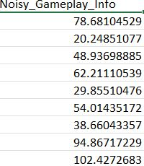
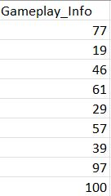
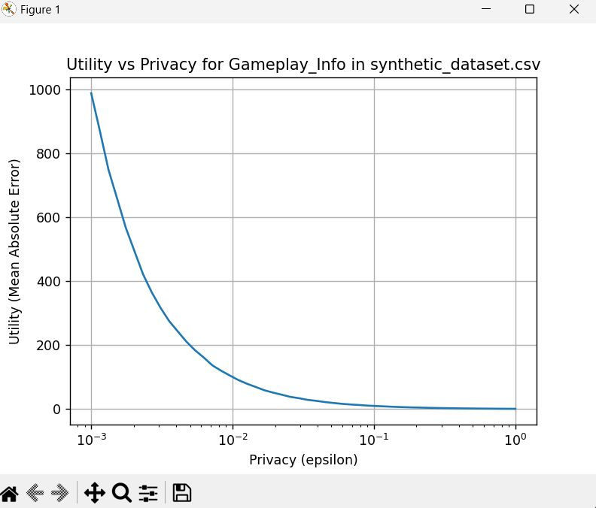
Gameplay info
noise added gameplay info original gameplay info calculate the Mean Absolute Error (MAE) between the original values and the noisy values for a range of epsilon values

Slide 14
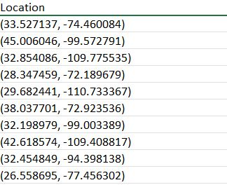
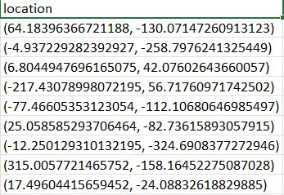
location
Original location Noise added location

Slide 15
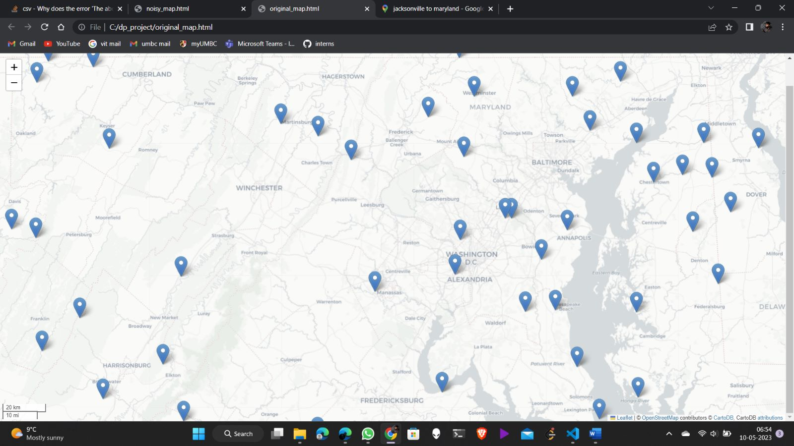
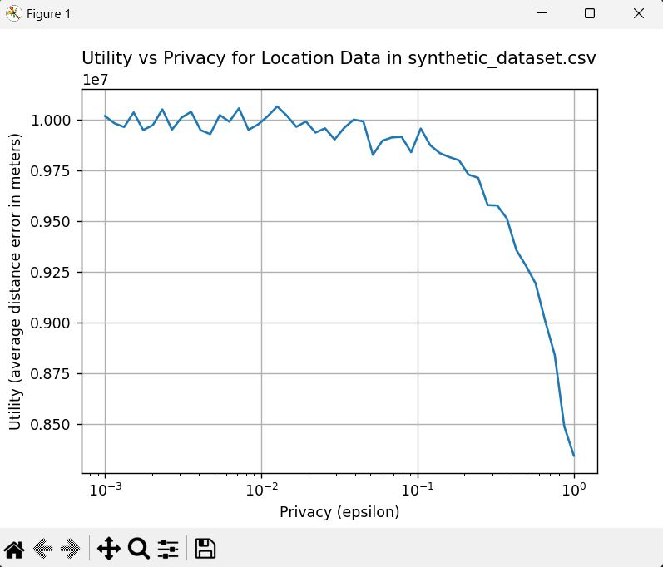
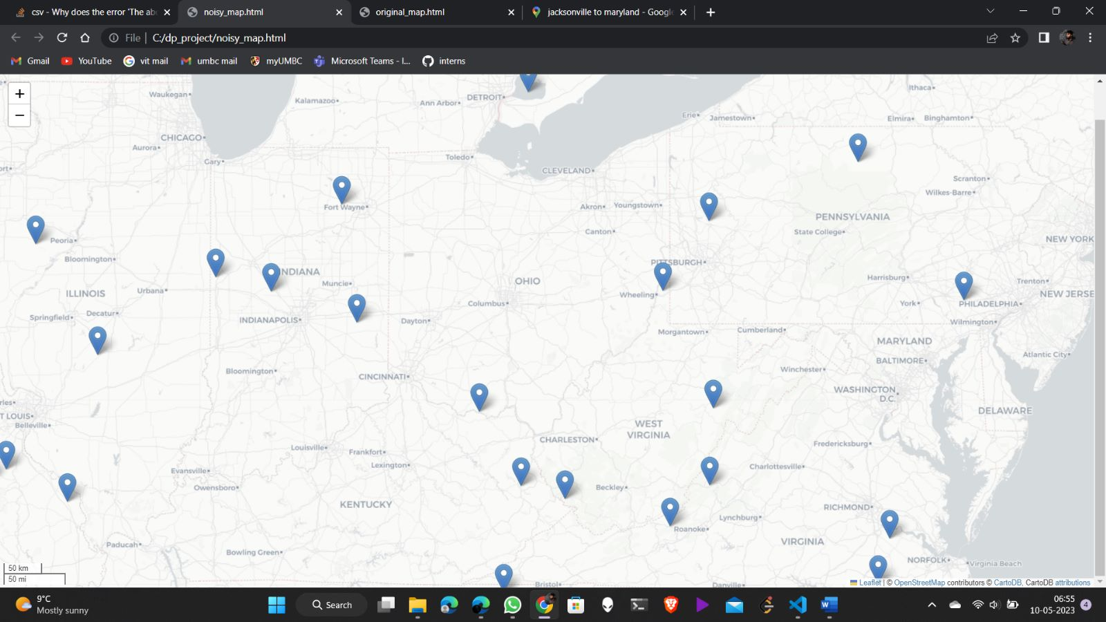

Slide 16
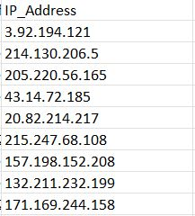
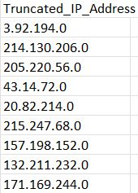
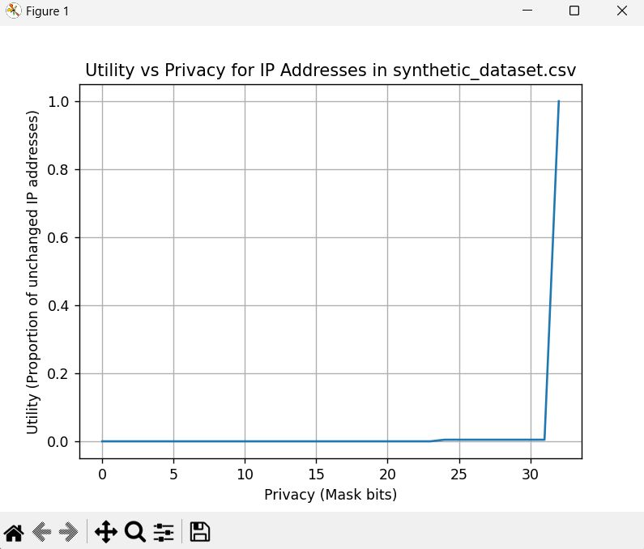
IP Address

Slide 17
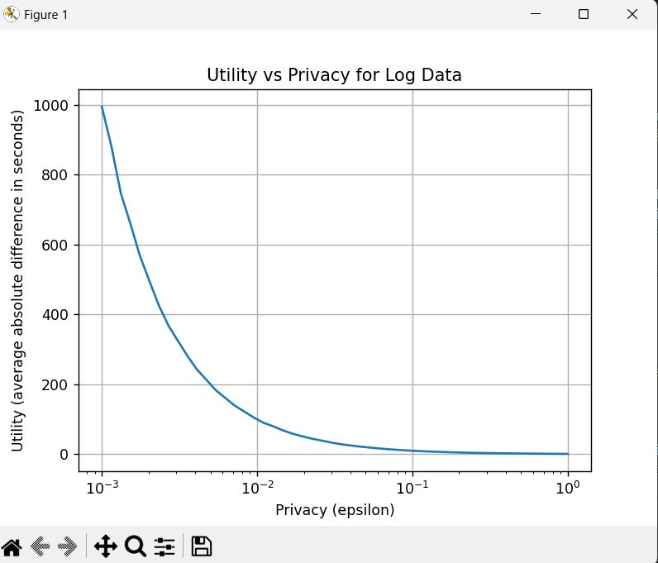
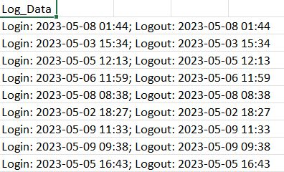
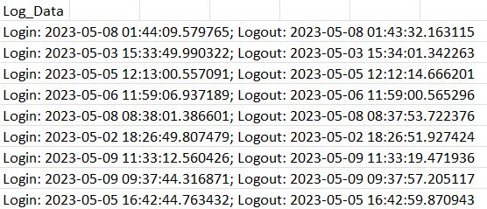
Log data

Slide 18
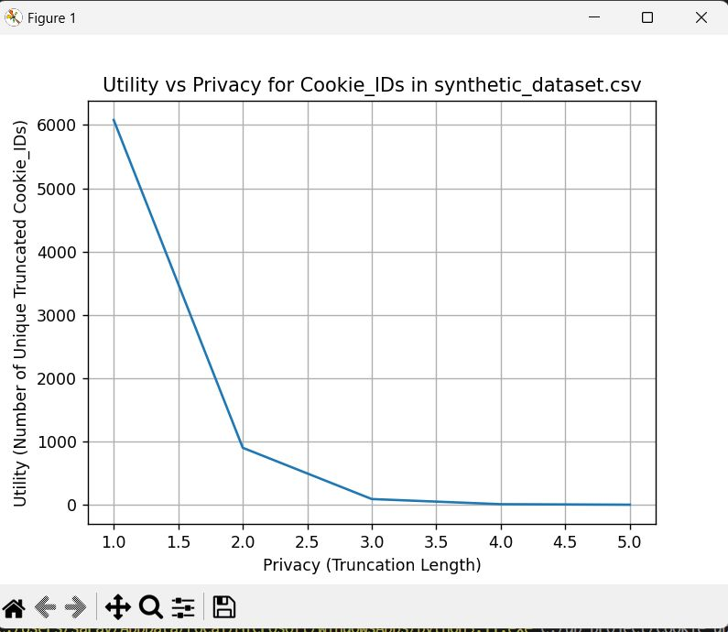
cookies
Exponential mechanism differential privacy is not suitable for anonymizing unique identifiers like Cookie_IDs, as it is designed for categorical data where data points can be mapped to a finite set of categories.
truncate the Cookie_IDs and calculate the utility loss for different truncation lengths.
As you increase the truncation length, the privacy level increases, and the utility decreases

Slide 19
THANK YOU

