Slide 1
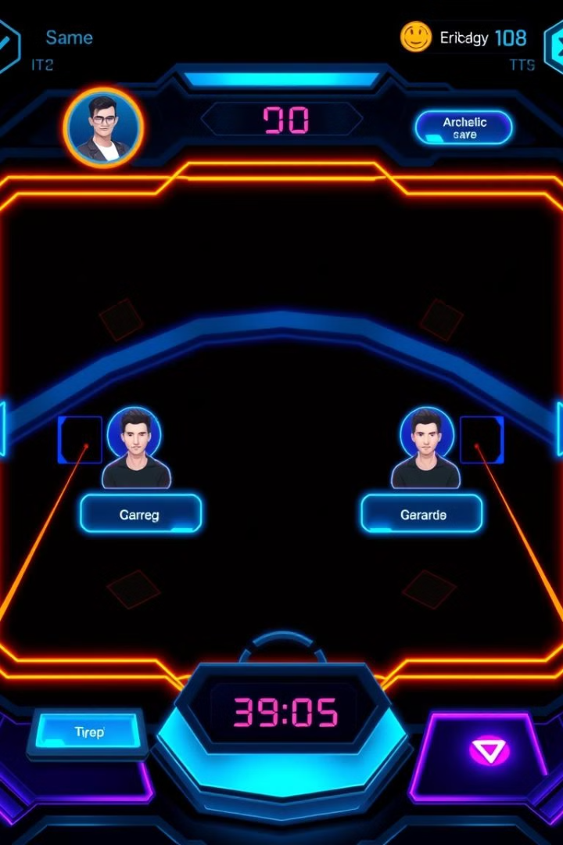
Rock-Paper-Scissors Multiplayer Game
This presentation will guide you through the creation of a rock-paper-scissors multiplayer game using Python, Pygame, and socket programming. The goal is to build a fun and interactive experience that allows two players to compete online.

Slide 2

About Rock-Paper-Scissors
Introduction
Rules
Rock-Paper-Scissors is a simple hand game where two players simultaneously choose one of three options: Rock, Paper, or Scissors.
Rock beats Scissors,
Scissors beats Paper,
Paper beats Rock.
Objective
Players try to outsmart their opponent by selecting the winning option.

Slide 3
About Socket Programming
What is Socket Programming?
Key Concepts
Socket programming enables communication between devices (client and server) over a network using sockets.
Socket: Endpoint of a communication channel.
IP Address: Identifies a device on the network.
Port Number: Specifies the application or service.

Slide 4
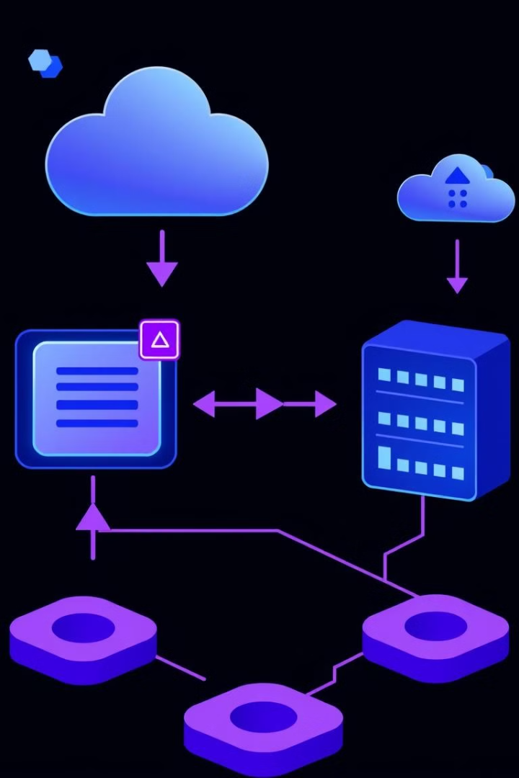
Socket Programming in Rock-Paper-Scissors
1
Client sends player actions to the server and receives game updates
2
Server hosts the game logic and manages client connections.
3
Uses TCP protocol for reliable data transfer, allowing players to interact with the server to fetch the game state and submit their moves.

Slide 5



What Happens in client.py
Network Connection
User Interface
Game State Update
Connects to the server using the Network class.
Provides a graphical interface using Pygame for players to select moves.
Continuously updates the game state by fetching data from the server.

Slide 6

What Happens in server.py
Client Connections
Game State Management
Handles client connections and assigns each client as Player 0 or Player 1.
Manages the game state, including players' moves, results, and reset conditions.
Communication
Listens on a specified port for client messages and responds with updated game data.

Slide 7



What Happens in network.py
TCP Connection
Establishes a TCP connection between the client and server.
Data Serialization/Deserialization
Serializes and deserializes data using the pickle module.
Player ID Retrieval
Retrieves the player ID assigned by the server.

Slide 8
What Happens in game.py
Connected
1
The game.py module checks if both players are connected by calling the connected() function. This ensures that the game can proceed with two active participants.
2
Both Went
Once both players have made their moves, the bothWent() function is called to verify that the game can move on to the winner determination stage.
Winner/Tie match
3
The winner() function is responsible for calculating the winner based on the moves made by the two players. It can identify a winner or a tie, and updates the game state accordingly.

Slide 9
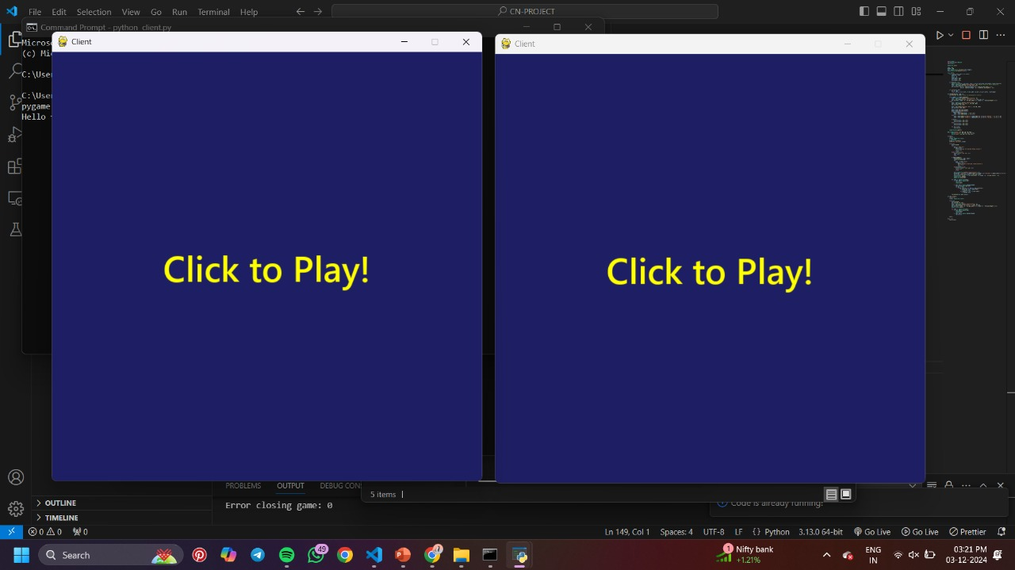
Output for This Project

Slide 10
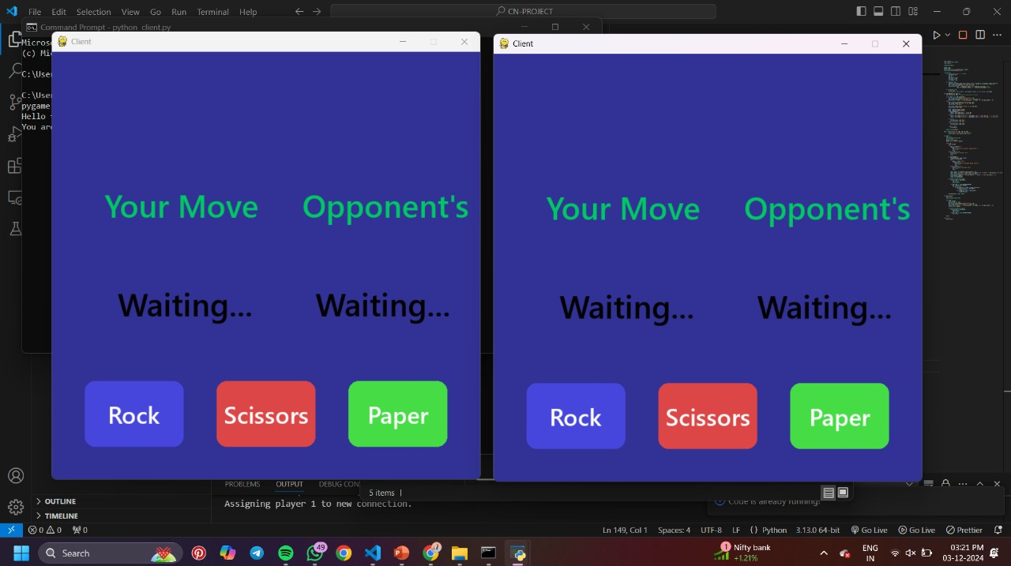

Slide 11
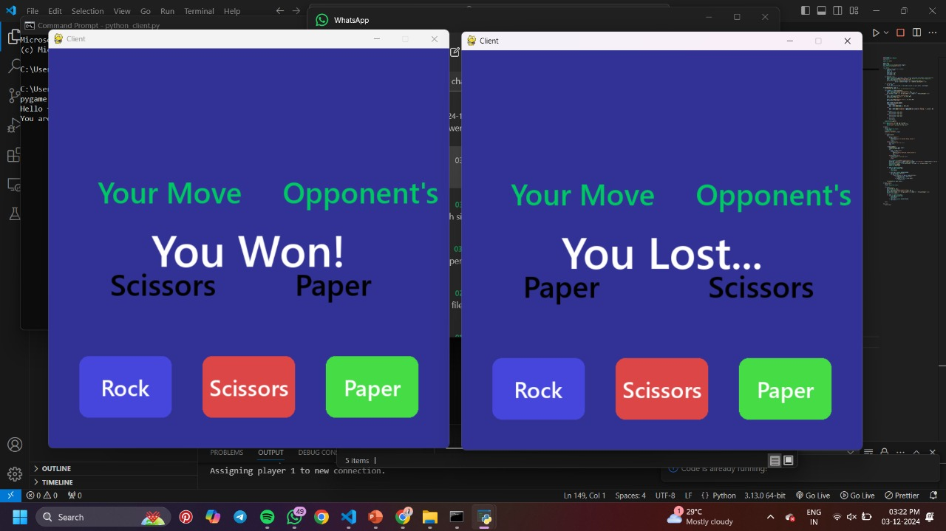

Slide 12
Improving the project
1
Enhanced User Interface
2
Multiplayer Features
Implement a visually appealing interface using Pygame.
Add support for more players for larger games.
3
Statistics & Leaderboards
4
Cross-Platform Compatibility
Track player stats and encourage competition.
Make the game playable on all major platforms.

Slide 13
Conclusion
This project showcases the power of socket programming and network synchronization for building a real-time multiplayer game. The key learnings include client-server communication and game development techniques. This lays the foundation for future complex multiplayer games and innovative applications.

