Slide 1

Presentation on automatic caption generator
Presented by :
BHAVIK DARji(160303108016)
Hemil pansuria(160303108069)
JAY PATEL(160303108081)
NEEL PATEL(160303108086)
Under guidance of :
Prashant sahatiya
Assistant Professor
(IT Department)

Slide 2
Outline
Introduction
Motivation
Aim & Objectives
Literature Survey
Methodology
Existing Work Flow
Proposed Work Flow
Implementation
Future Scope
Conclusion

Slide 3
INTRODUCTION

Slide 4
automatic caption generator
Nowadays its being easier to find subtitle for any movies or web-series but sometimes its hard to find or impossible for particular video.( i.e speech ).
To solve this problem we have built a software which will automatically generate subtitle for the videos.

Slide 5
motivation

Slide 6
motivation
We got motivated from the lecture videos, movies and some talks that does not have subtitles. Sometimes we don’t get subtitle from internet for specific video.
There are many online “ speech to text ” generator but they are not providing video to subtitle generator.
Some deaf people and Some people who are having hearing problem so it will help them.

Slide 7
Aim & objectives

Slide 8
Aim & objectives
To generate subtitles automatically with speech and voice recognition techniques.
To generate subtitles for those videos who’s subtitles are not available online and also for any homemade videos.
It helps to generate subtitle on offline basis. It does not required internet connection.

Slide 9
Literature survey

Slide 10
Paper 1: Bengali consonants-voice to text conversion using machine learning tool
Publication and Year | Author name | Approach (Methodology) | Advantages | Limitations
IJRCEE,2017 | Shikhor Kumar Roy,Abinash Kanti Ghosh,Aysa Siddika Asa, Md. Palash Uddin,Md.Rashedul Islam,Masud Ibn Afjal | (1)Phonemics and Phonemes (2)Linear Prediction Coding(LPC) (3)Mel Frequency Campestral Coefficient(MFCC) (4)Hidden Markov Model(HMM) (5)Speech Segmentation | Using the STT(Speech to text) conversion people with listening disability to communication alternative way to understand voice commincation. | Automatic Speech Recognition(ASR) techniques can’t be direct conversion so speech signal into sequence of phoneme.

Slide 11
Paper 2: Speech Recognition system for English language
Publication and Year | Author name | Approach (Methodology) | Advantages | Limitations
IJARCCE,2013 | Ms.Vrinda,Mr.Chander Shekhar | (1)Continuous Speech (2)Discrete Speech (3)HMM (4)Speaker Dependence (5)Sound Phonemes (6)Speech Interface | encourages natural, human-like conversations that create more satisfying self-service interactions with customers. | The limitation on speech technology is based on the frustration of the user at errors. Even if a program is 99.7% accurate, you'll still have three errors in 1,000 words.

Slide 12
Paper 3: automatic subtitle generation for video
Publication and Year | Author name | Approach (Methodology) | Advantages | Limitations
IJERGS,2015 | Akhil Kanade, Sourabh Gune, Shubham Dharamkar, Rohan Gokhale | 1)Speech Extraction 2) Speech API 3) Speech Recognition 4) Audio extraction 5) how to convert to srt files 6)Natural language Processing | Learn new language faster and follow along easily. Easier to translate to other language. | It will take more time to generate subtitle for large file..

Slide 13
Paper 4: Using Automatic speech recognition to enhance education for all students : turning a vision into reality
Publication and Year | Author name | Approach (Methodology) | Advantages | Limitations
IEEE,2004 | Mike Wald | 1) ASR(Automatic Speech Recognition) 2) Real Time Editing/Transcription 3) Re-Voice 4) Feasibility Trials 5) Speech Synchronized | Eliminates Handwriting, spelling problems. Easy to understand the user. | physical problems include fatigue from speaking continuously and the disruption in an office filled with people speaking

Slide 14
Paper 5: minimum classification error rate methods for speech recognition
Publication and Year | Author name | Approach (Methodology) | Advantages | Limitations
IEEE,1997 | Biing-hwang Juang, Wu Chou, Chin-Hui Lee | 1) HMM 2) MCE (Minimum Classification Error) 3) MAP(Maximum a Posteriori) 4) Statistical Method 5) Speech Characteristics 6) MCE Training | There is MCE and HMM method used superiority over the distribution estimation method by speech recognition, they provides error rate. | The MCE Approach to recognizer design aims at optimizing the recognizer parameter to minimize the error rate

Slide 15
Paper 6: Implementation of Speech to Text Conversion
Publication and Year | Author name | Approach (Methodology) | Advantages | Limitations
7,july,2015, IJIRSET | Prachi Khilari, Poffessor. Bhope V.P | 1)Types of speech 2) Speech production and speech production 3) speech recognition techniques: Analysis,Feature Extraction, Modeling , Testing. |  | Difficult to generate text for some non adaptive word

Slide 16
Paper 7: Real-time Subtitle Synchronization in Live Television Programs
Publication and Year | Author name | Approach (Methodology) | Advantages | Limitations
IEEE, 2011 | Mercedes de Castro, Diego Carrero, Luis Puente | 1.AUTOMATIC SPEECH RECOGNITION 2.AUTOMATIC SPEECH RECOGNITION APPLIED TO TV LIVE PROGRAMS | 1.Makes Easy to understand the visually 2.Helpful for Deaf person

Slide 17
Paper 8: multimodel human emotion recognition
Publication and Year | Author name | Approach (Methodology) | Advantages | Limitations
-ATR Media Integration and Communication Laboratories -1998 | Lawerence chen, Thomas Hunang | 1.Audio processing 2.Video processing 3.Bimodal data | 1.Increase the rate of recognition 2.More accurate

Slide 18
Paper 9: Generating Subtitles Automatically using Audio Extraction and Speech Recognition
Publication and Year | Author name | Approach (Methodology) | Advantages | Limitations
-IEEE -2015 | 1.Abhinav mathur 2.Tanya saxena | 1.Audio extraction 2. speech reorganization 3. subtitle generation | - | Accuracy problem

Slide 19
Paper 10: Introduction to Various Algorithms of Speech Recognition: HMM, DTW and ANN
Publication and Year | Author name | Approach (Methodology) | Advantages | Limitations
-IJEDR -2014 | Pahini A. Trivedi | 1) RAW speech 2) Signal analysis 3) Perceptual Linear prediction(PLP) 4)linear predictive coding(LPC) | Algorithm makes easy to implement speech recognition | Limitations of HMM  Constant observation of frames  The Markov assumption  Lack of formal methods for choosing a model topology

Slide 20
Paper 11: Speech-To-Text Conversion (STT) System Using Hidden Markov Model (HMM)
Publication and Year | Author name | Approach (Methodology) | Advantages | Limitations
IJSTR, JUNE-2015 | Su Myat Mon, Hla Myo Tun | Mel Frequency Cepstral Coefficients (MFCC), Hidden Markov Model | The performance of the system is more accurate and reliable. | Not use for large audio file.

Slide 21
Paper 12: A Review on Speech Recognition Challenges and Approaches
Publication and Year | Author name | Approach (Methodology) | Advantages | Limitations
WCSIT, 2012 | Vimala.C, Dr.V.Radha | Types of speech, Speech recognition extraction techniques | HMM with MFCC give more accuracy than others. | Continues speech will decreased the accuracy

Slide 22
Paper 13: AUTOMATIC LECTURE SUBTITLE GENERATION AND HOW IT HELPS
Publication and Year | Author name | Approach (Methodology) | Advantages | Limitations
IEEE, 2017 | Xiaoyin che, Sheng Luo, Haojin Yang, Christoph Meinel | Automatic Speech Recognition Sentence Boundary Detection Lexical Model Acoustic Model and Joint Decision Scheme | Give one more functionality to generate subtitle in target language. | The difference in original language and targeted language is more.

Slide 23
Paper 14: A Comparative Study of Noise Reduction Techniques for Automatic Speech Recognition Systems
Publication and Year | Author name | Approach (Methodology) | Advantages | Limitations
IEEE, 2016 | Kanika Garg, Goonjan Jain | Adaptive Weiner Filtering, Adaptive Line Enhancer, A Multiple Microphone Technique, Gamma tone Filter | Unwanted sound, additive noise, Multiplicative noise can be remove. | The given methods have not been tested on real time environments having real components of noise in speech

Slide 24
Paper 15: Design and Implementation of Java Media Player
Publication and Year | Author name | Approach (Methodology) | Advantages | Limitations
Journal of kerbala university, 2010 | Muhanad hayder | Java media framework, AWT, Swing, All the diagrams for media player | It give functionality like open URL, changing speed of video etc, support all file format.

Slide 25
Paper 16: A Novel Model for Speech to Text Conversion
Publication and Year | Author name | Approach (Methodology) | Advantages | Limitations
January 2014 | Deepa V. Jose, Alfateh Mustafa, Sharma R. | Speech synthesizer Speech potential extraction Mapping of words into dictionary | Cryptography Smart recognition MCQ and Test Confluence of separate modules | Error in listening Not complete accurate

Slide 26
Paper 17: VOICE RECOGNITION SYSTEM: SPEECH-TO-TEXT
Publication and Year | Author name | Approach (Methodology) | Advantages | Limitations
November 2015 | Prerana Das, Kakali Acharjee, Pranab Das, Vijay Prasad | Spectral subband centroids Concept sequence modelling Hidden Markov model | Improved quality matrices Speech enhancement using filter | Noisy speech signal Sensitive to any noise Overlapping of resolution

Slide 27
Paper 18: a review on speech recognition technique
Publication and Year | Author name | Approach (Methodology) | Advantages | Limitations
November 2010 | Santosh K. Gaikwad, Bharti W. Gawali, Pravin Yannawar | Principle component analysis Linear discriminate analysis Indepemdent component analysis | Fast Eigenvector based Linear mapping Better time resolution Robust | Filter tuned required Noisy data

Slide 28
Paper 19: recent advances in deep learning for speech research at Microsoft
Publication and Year | Author name | Approach (Methodology) | Advantages | Limitations
IEEE, 2013 | Li Deng, Jinyu Li, Jui-Ting Huang, Kaisheng Yao, Dong Yu, Frank Seide, Michael Seltzer, GeojjZweig | DNN training/testing FRA training data Batch implementation using SGD | Stable Noise robustness Less word error rate | Word error rate are there Variation in voices

Slide 29
Paper 20: Speech recognition by machine : a review
Publication and Year | Author name | Approach (Methodology) | Advantages | Limitations
IJARIIT, 2018 | Dhanush Kumar S, Lavanya S, Madhumita G, Mercy Rajaselvi V | Digitization Conversion using Google speech API Command recognition Question detection Google text to speech | Helpful for student Answering student’s questions | Error in word detection Accuracy minimized Internet connection always required

Slide 30
METHODOLOGY

Slide 31
methodology
Separate audio file from video file.
Using speech recognition techniques covert that audio file into text file.
Make a srt file for subtitle.
Add srt file to video file.

Slide 32
Existing work flow

Slide 33
existing work flow
Currently if we want subtitle for particular video than we have to download subtitle file using internet and add that subtitle in media player while playing the video.

Slide 34
Proposed work flow

Slide 35
proposed work flow
We have made software in that we have to give video as input and the software will automatically generate subtitle for that video and play the video with subtitle.

Slide 36
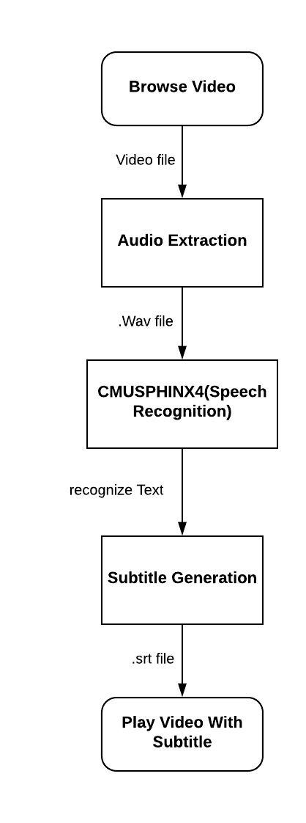

Slide 37
Implementation

Slide 38
Implementation
PROJECT | AUTOMATIC CAPTION GENERATOR
GUI | Jframe(GUI)
Audio Extraction | JAVE library(converToWave())
Subtitle Generation | JAVA library CMUSphinx4

Slide 39
Programming Language : JAVA
Sphinx4:
Sphinx4 is a pure Java speech recognition library.
It provides a quick and easy API to convert the speech recordings into text with the help of CMUSphinx acoustic models.
It can be used on servers and in desktop applications.
Sphinx4 supports US English and many other languages.

Slide 40
Speech recognition

Slide 41
Acoustic Model
An acoustic model is used in automatic speech recognition to represent the relationship between an audio signal and the phonemes that make up speech.
The model is learning from a set of audio recordings and their corresponding transcripts.

Slide 42
Language model
A language model is a grammar file for an entire language.
It defines which word could follow previously recognized words and helps to significantly restrict the matching process by stripping words that are not probable.

Slide 43
Dictionary
A phonetic dictionary provides the system with a mapping of vocabulary words to sequences of phonemes.
It contains the list of all words in the language along with their pronunciations. It might look like this:
hello H EH L OW
world W ER L D
the TH IH
the(2) TH AH

Slide 44
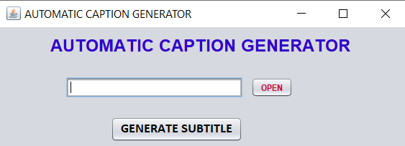
Software gui

Slide 45
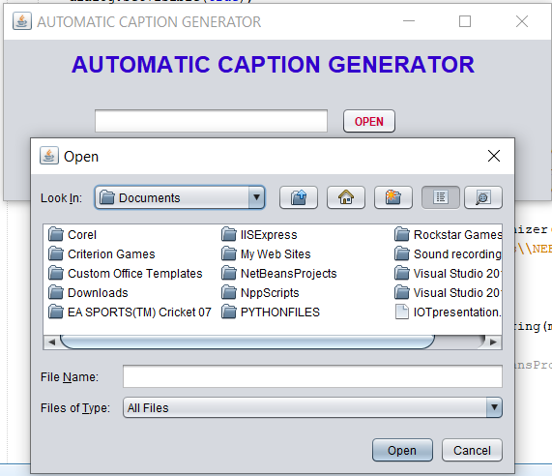
For choosing video file

Slide 46
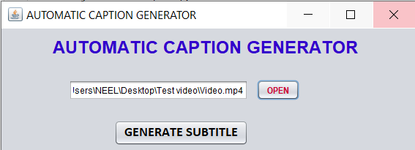
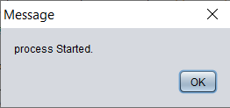
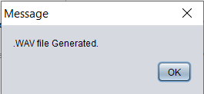
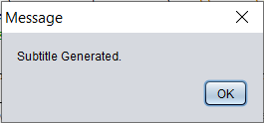
Step by step process

Slide 47
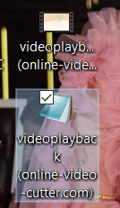
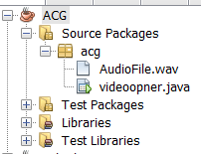
Generated audio and subtitle file

Slide 48
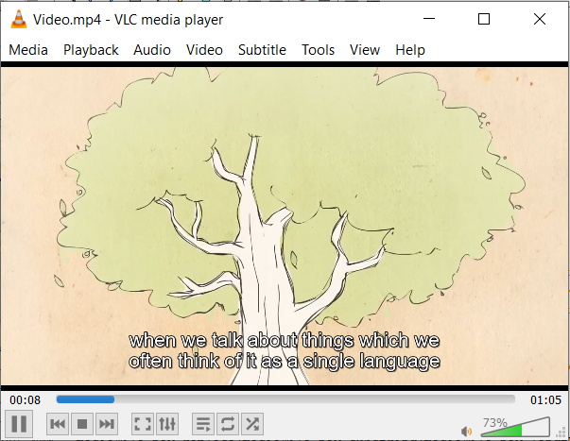
Playing video with subtitle

Slide 49
Future scope

Slide 50
Future scope
In future, we can generate subtitle for other language by training the model with sufficient dataset of particular language.
Another thing we can do is one language subtitles can also be translated into other languages.
We can also do for mix language video by training model with multi language dataset.

Slide 51
conclusion

Slide 52
conclusion
We have modified the manual typing part in conventional subtitle generation and made it automatic by use of speech recognition.
This method can save a lot of time and increase productivity.
In addition, It is Helpful for people who are not very good at English and also facing difficulties to understand proper pronunciation of language, so it will help them to enjoy the video without any queries related to language.
It will also help deaf people to understand the video.

Slide 53
THANK YOU…

