Slide 1



NILOY
ROY
ASPIRING SOFTWARE ENGINEER

Slide 2






PROFILE
niloyroy1715@gmail.com
linkedin.com/in/niloyroy55/
+880-170-581-4064
Sylhet, Bangladesh

Slide 3

ABOUT ME
A Computer Science student at SUST passionate about software development, ML, and Bangla NLP. I enjoy solving problems, building projects, and exploring the intersection of AI and language. Always eager to learn, collaborate, and grow.

Slide 4

EDUCATION
Rangpur Zilla School, Rangpur
Carmichael College, Rangpur
Secondary School Certificate Examination (Result GPA 5.00)
Higher Secondary Certificate Examination (Result GPA 5.00)
Shahjalal University of Science & Technology, Sylhet
Bachelor of Science in Computer Science & Engineering

Slide 5

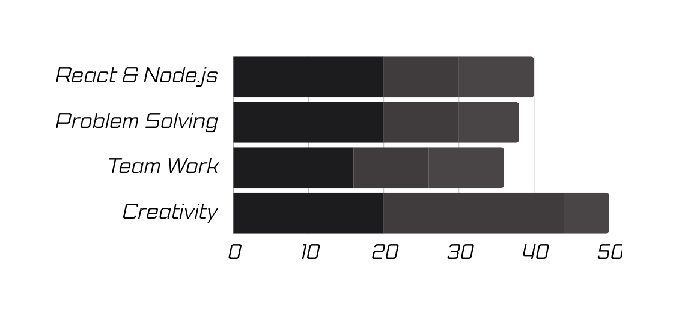
PERSONAL SKILLS
Adaptable and analytical, with strong problem-solving, teamwork, and communication skills.

Slide 6
CERTIFICATION
AWS Academy Cloud Web Application Builder
Supervised Machine Learning: Regression and Classification, Coursera
Completed hands-on training in designing and deploying full-stack web applications using AWS services and cloud-native architecture.
Learned the fundamentals of supervised learning, including linear and logistic regression, model evaluation, and implementation using real-world data.

Slide 7

THANK YOU
That was my short journey through the world of web development. From simple codes to complex projects, I have seen how important a programmer's role is in creating innovative technological solutions. Let's keep expanding our knowledge, keep learning, and keep creating something amazing. Thank you for your attention.

Slide 8

LET’S WORK TOGETHER

