Slide 1
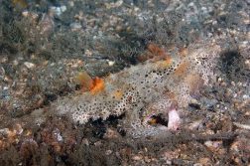
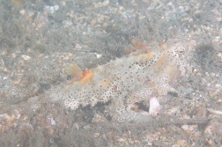
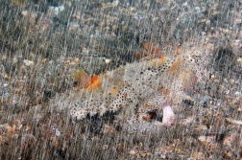
Robust Camouflaged Object Detection on a Laptop GPU
COMPUTER VISION · MINI PROJECT
clean
A corruption benchmark of specialist and SAM-based detectors, and a lightweight robust SAM adapter
fog, severity 5
Ronak Daniel
Roll no. I015
Neel Jaiswal
Roll no. I032
rain, severity 5
Notes:
Introduce the project and the team. The pictures on the right show the same camouflaged flatfish (a COD10K test image) clean, in fog and in rain: our detector has to find the animal in all three.

Slide 2
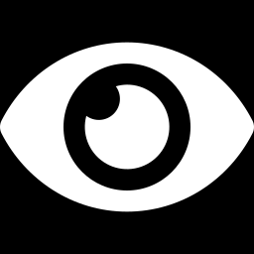
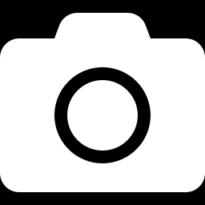
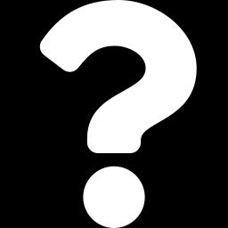
The problem: hidden animals, imperfect cameras
Camouflaged object detection (COD)
8 × 5
Find the animal whose colour and texture match its background, and output a pixel mask of it.
corruption types × severity levels
Real cameras degrade images
6,473
Camera traps, drones and phones add blur, noise, JPEG compression, fog and rain.
test images in 4 datasets
Open question
4 GB
SAM-based detectors are the most accurate on clean images. How robust are they to these corruptions, and can a small model stay robust on a 4 GB laptop GPU?
laptop GPU (RTX 3050 Laptop GPU)
Notes:
COD is segmentation, not boxes. Cameras in the field rarely give clean images. Nobody had measured how SAM-based COD models behave under corruption, and all the strongest models are too large for a student laptop. These two gaps define the project.

Slide 3
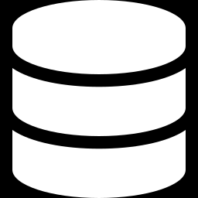
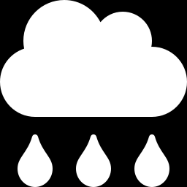
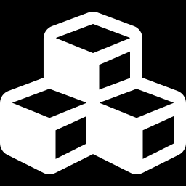
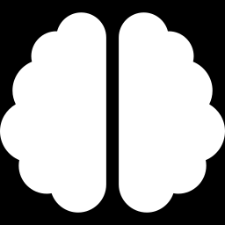
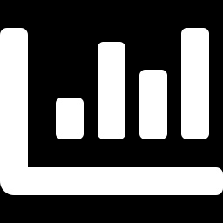
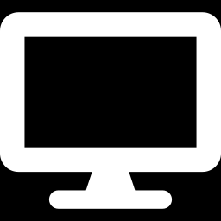
Implementation pipeline
1 Data
2 Corruptions
3 Baselines
COD10K + CAMO train (4,040 images). Test: CHAMELEON, CAMO, COD10K, NC4K
8 types × 5 severities with fixed seeds. 4 seen in training, 4 held out (unseen)
6 published models ported to one interface: predict(image) → mask
4 Our model
5 Evaluation
6 Analysis + demo
Frozen MobileSAM encoder + adapters + learned prompts, trained on the laptop GPU
Every model × dataset × 41 conditions (clean + 40). Sα, Eφ, Fβw, MAE, Dice, IoU
Retention, unseen corruptions, bootstrap tests, speed and memory. Gradio demo
Python 3.11 · PyTorch 2.6 (CUDA 12.4) · PySODMetrics · Gradio · every number read from results/*.csv
Notes:
Walk through the six stages. The rows read left to right; step 4 (orange) is our own model. Stress that all models go through one common interface, so they are compared under identical conditions, and that corruptions use fixed seeds, so every model sees exactly the same corrupted images.

Slide 4
Models and algorithms used
Specialist COD models
SAM-based COD models
Ours: robust SAM adapter
SINet-V2 (TPAMI 2022)
PFNet (CVPR 2021)
ZoomNet (CVPR 2022)
FEDER (CVPR 2023, clean only)
SAM2-UNet (216.5 M)
SAM-Adapter, ViT-H (641.3 M)
Oracle-box MobileSAM (analysis only)
MobileSAM TinyViT encoder (frozen)
Bottleneck adapters in 10 blocks
Learned prompt tokens
SAM mask decoder (trained)
Algorithms
Bottleneck adapters
Learned prompt tokens
Structure loss (wBCE + wIoU)
Corruption augmentation
Clean/corrupted consistency loss
AdamW + cosine learning rate
fp16 + gradient checkpointing
Paired bootstrap (95% CI)
Notes:
Three families of models: CNN specialists designed for COD, large SAM-based detectors, and our small SAM-based adapter. FEDER released only prediction maps, so it appears in the clean results only. The oracle-box MobileSAM is given the ground-truth box, so it is an analysis probe, not a competitor. The algorithm row lists the training and evaluation techniques; the next two slides explain their roles.

Slide 5
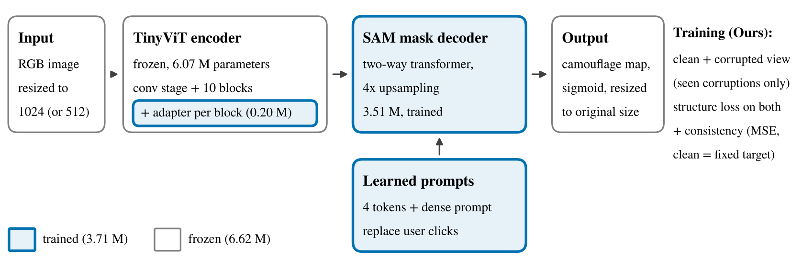
Our model: a prompt-free MobileSAM adapter
10.3 M
3.7 M
0 clicks
parameters in total
trained: adapters, prompts, decoder
prompts are learned, fully automatic
Notes:
The image goes through MobileSAM's TinyViT encoder, which stays frozen. Small bottleneck adapters, added beside each block's MLP, learn what camouflage looks like. SAM normally needs a click or a box; we replace those with learned prompt tokens, so the detector needs no user input. The SAM mask decoder is fine-tuned and outputs the camouflage map. During training each image is shown clean and corrupted; the consistency loss pushes the two predictions to agree.

Slide 6
Role of models and algorithms used
Component | Role in the project
SINet-V2, PFNet, ZoomNet | Specialist baselines: how well do CNNs built for COD survive corruption? SINet-V2 is the reference for mCE.
SAM2-UNet, SAM-Adapter | Foundation-model baselines: the most accurate on clean images; we measure their robustness for the first time.
MobileSAM TinyViT (frozen) | General visual features learnt from 11 M images, small enough for a 4 GB GPU.
Bottleneck adapters | Teach the frozen encoder about camouflage with 0.2 M parameters; start at zero, so training begins from SAM.
Learned prompt tokens | Replace user clicks and boxes, so detection is fully automatic.
Structure loss | Weighted BCE + weighted IoU: focuses training on hard pixels near object boundaries.
Augmentation + consistency | Train on 4 seen corruptions; make the corrupted-view prediction match the clean one.
Metrics + bootstrap | Six standard COD metrics; 95% confidence intervals show whether a difference is real.
Notes:
One line per component. The baselines answer the benchmark question; the frozen encoder, adapters and prompts make the model small and automatic; augmentation and the consistency loss target robustness; the bootstrap tells us which differences are statistically real.

Slide 7
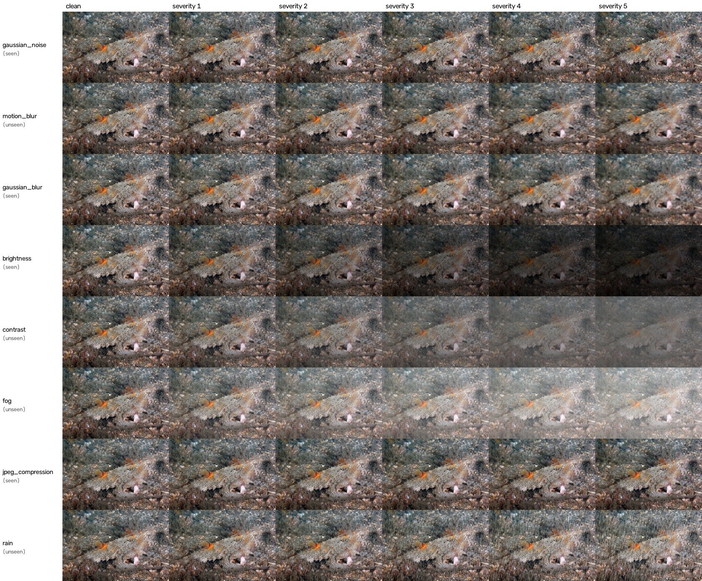
Inputs: test images under eight corruptions
Test sets
CHAMELEON | 76 images
CAMO | 250 images
COD10K | 2,026 images
NC4K | 4,121 images
Seen in training
Gaussian noise, Gaussian blur, brightness, JPEG
Held out (unseen)
motion blur, contrast, fog, rain
Severity 1 to 5 follows the COD10K-C definitions; rain is our own addition.
Notes:
Each test image is evaluated clean and under 8 corruptions at 5 severities: 41 versions per image. Four corruptions are used during training (seen); the other four, including rain, are never seen in training, which tests real generalisation rather than memorised augmentation.

Slide 8
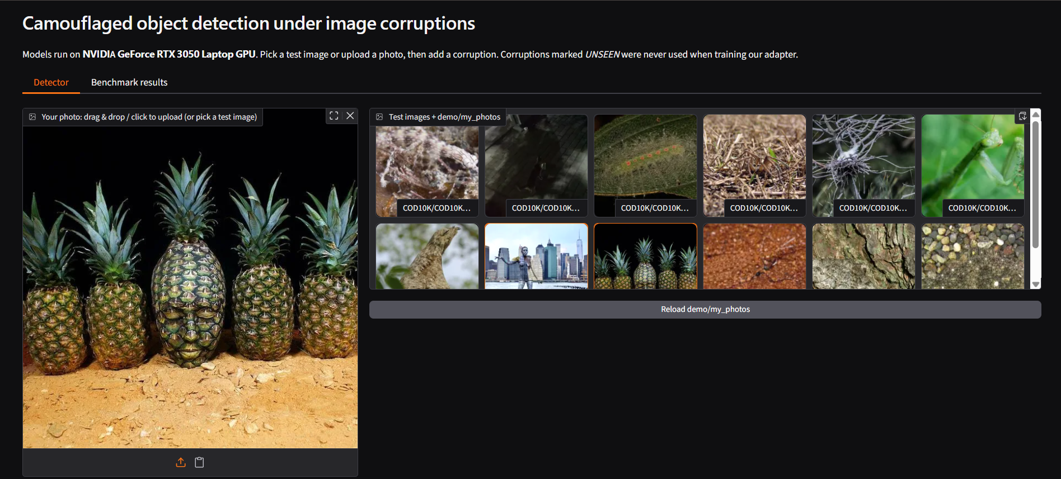
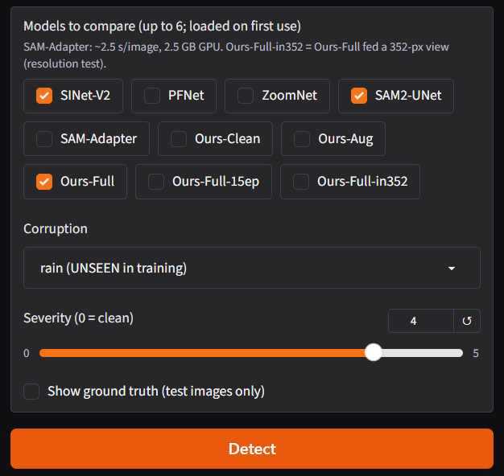
Inputs in the demo app
Upload any photo, or pick one of 12 test images (COD10K, CAMO, CHAMELEON) or a photo from demo/my_photos.
Tick up to 6 models, choose a corruption (UNSEEN ones were never used in training) and a severity from 0 to 5.
Notes:
Run with: python demo/app.py. Left: the photo input and the test-image gallery (the pineapple photo is a CAMO test image). Right: the controls. Every model runs on the same corrupted image, so the comparison is fair.

Slide 9
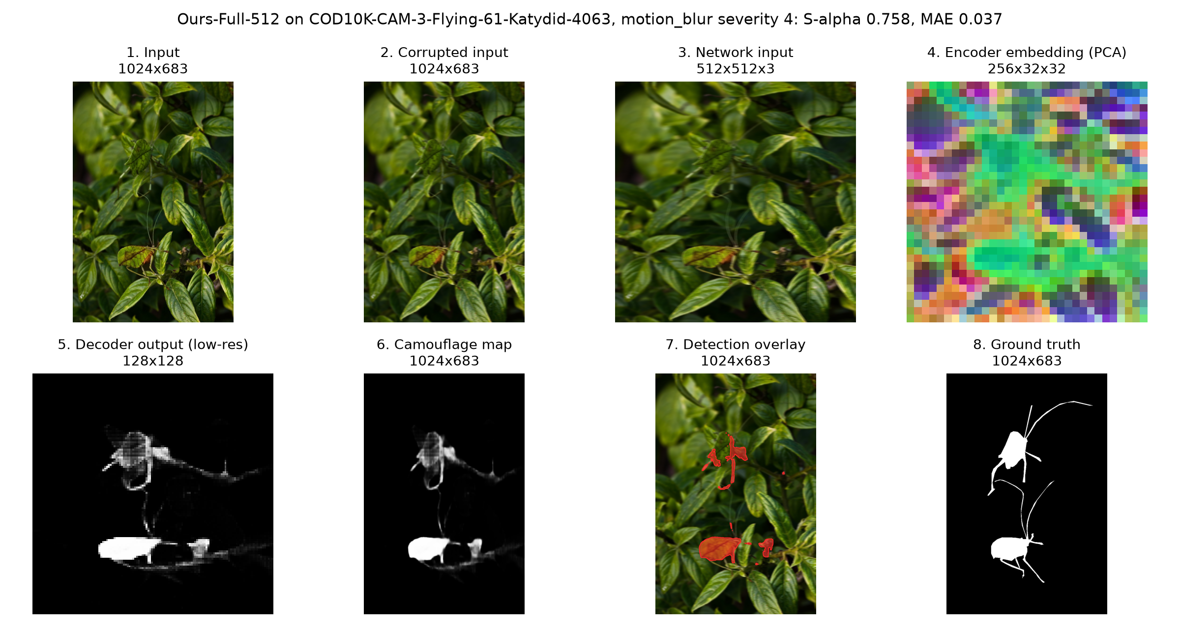
Intermediate outputs of our model
Ours (512) on the slide-10 katydid under motion blur, severity 4 (unseen in training). Stages 3–5 are inside the network; sizes are height × width.
Notes:
Stages inside our model for one test image: the corrupted input, the square network input, the encoder embedding (256 channels on a coarse grid, shown with its first three principal components as colours), the decoder's low-resolution mask, and the final map resized to the original image, then thresholded into the overlay.

Slide 10
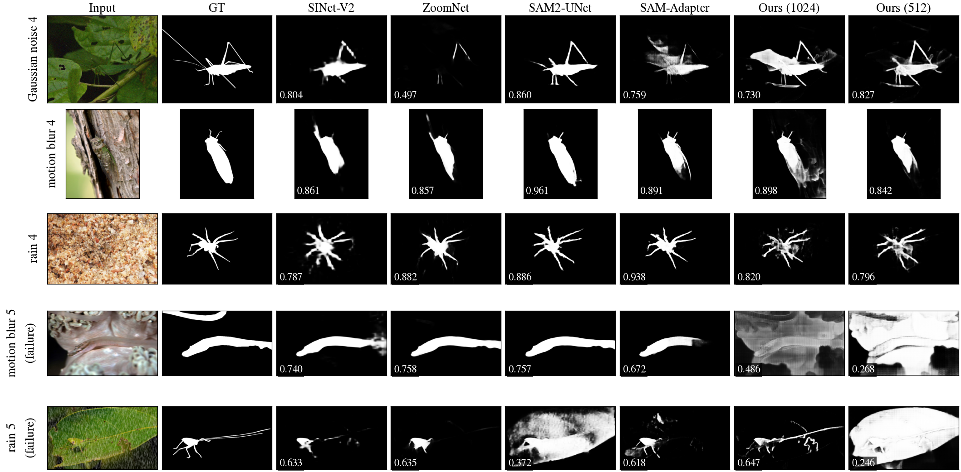
Outputs: predicted masks under corruption
Rows 1–3: images where Ours (512) has its median Sα. Rows 4–5: its lowest-scoring images (failure cases). Numbers: per-image Sα.
Notes:
Each row is one corrupted COD10K image; columns are the input, the ground truth and six models. Images were chosen by fixed rules (median and worst case for our 512 model), not hand-picked; the selection is logged in results/qualitative_selection.csv. The last two rows show where our model fails: heavy motion blur and heavy rain.

Slide 11
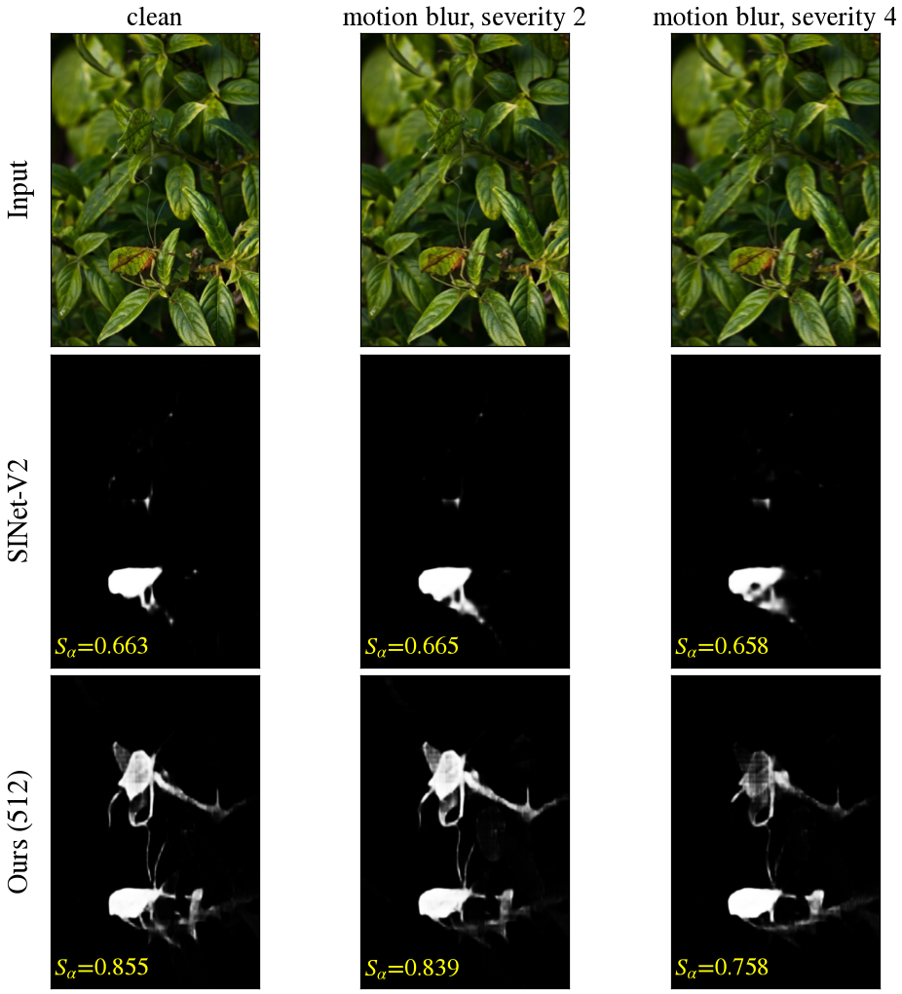
Outputs: one image under increasing motion blur
Motion blur is an unseen corruption: our model never saw it in training.
SINet-V2 finds only part of the katydid at every severity (Sα 0.663 → 0.658).
Ours (512) recovers its legs and wings (Sα 0.855 clean, 0.758 at severity 4).
Chosen by a fixed rule: the image at the 90th percentile of our gain over SINet-V2 under motion blur, a clear example but not the best one.
Notes:
Top row: input; middle: SINet-V2; bottom: our 512-pixel model. Our model's score drops as blur grows, but it keeps far more of the object than SINet-V2. Say clearly that this example was picked by a rule and is better than average.

Slide 12
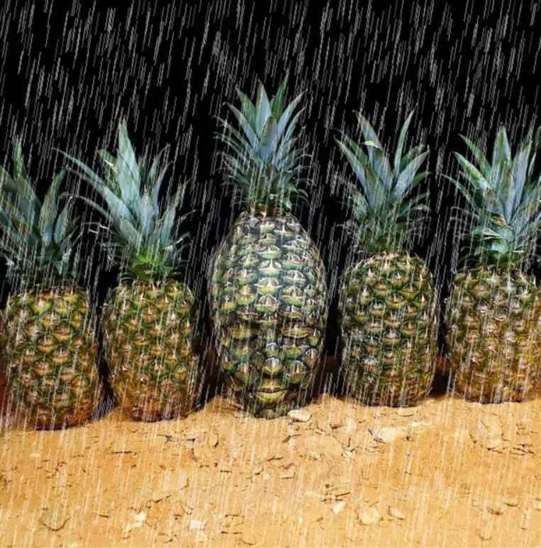
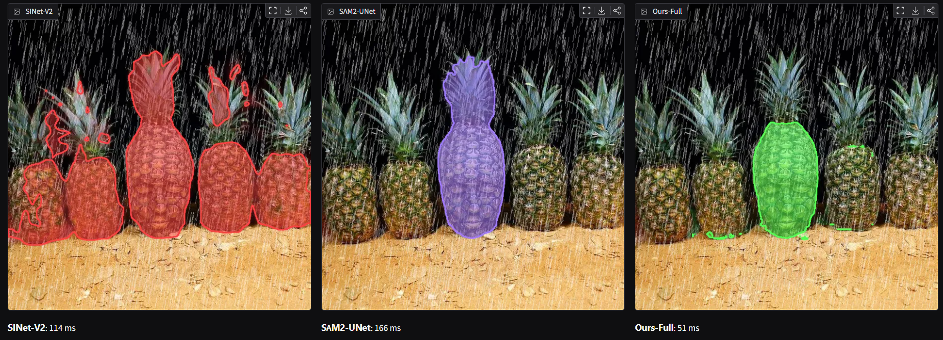
Outputs in the demo app: rain, severity 4
A CAMO test image: a face painted to look like a pineapple.
SINet-V2 marks almost every pineapple; SAM2-UNet and Ours-Full pick out the painted face.
Latency shown by the app: SINet-V2 114 ms, SAM2-UNet 166 ms, Ours-Full 51 ms. It includes pre- and post-processing, so it is higher than the benchmark timing.
Input after the corruption (rain is unseen in training)
Notes:
Each selected model's mask is drawn as a coloured overlay on the corrupted image, with its latency underneath.

Slide 13
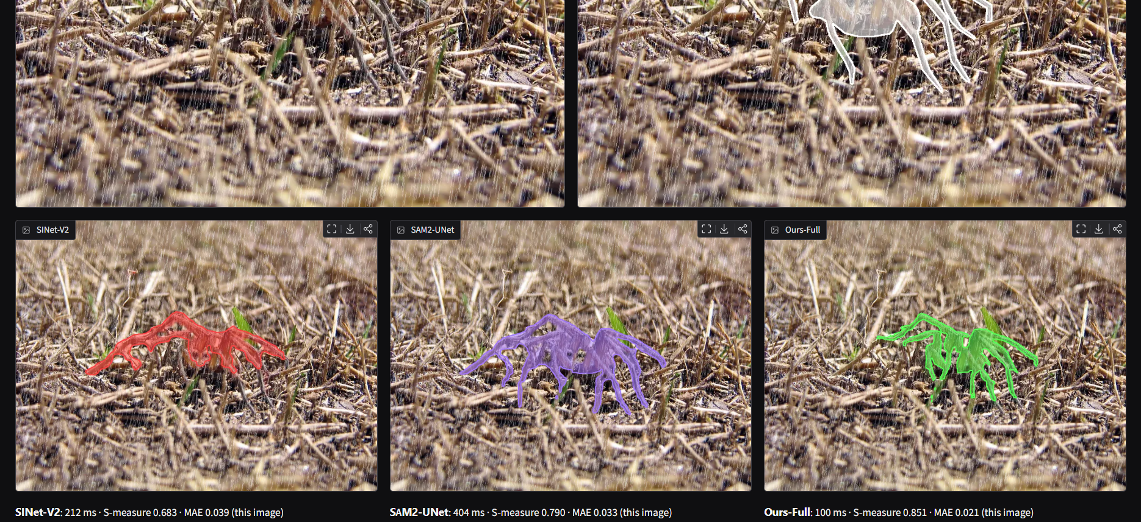
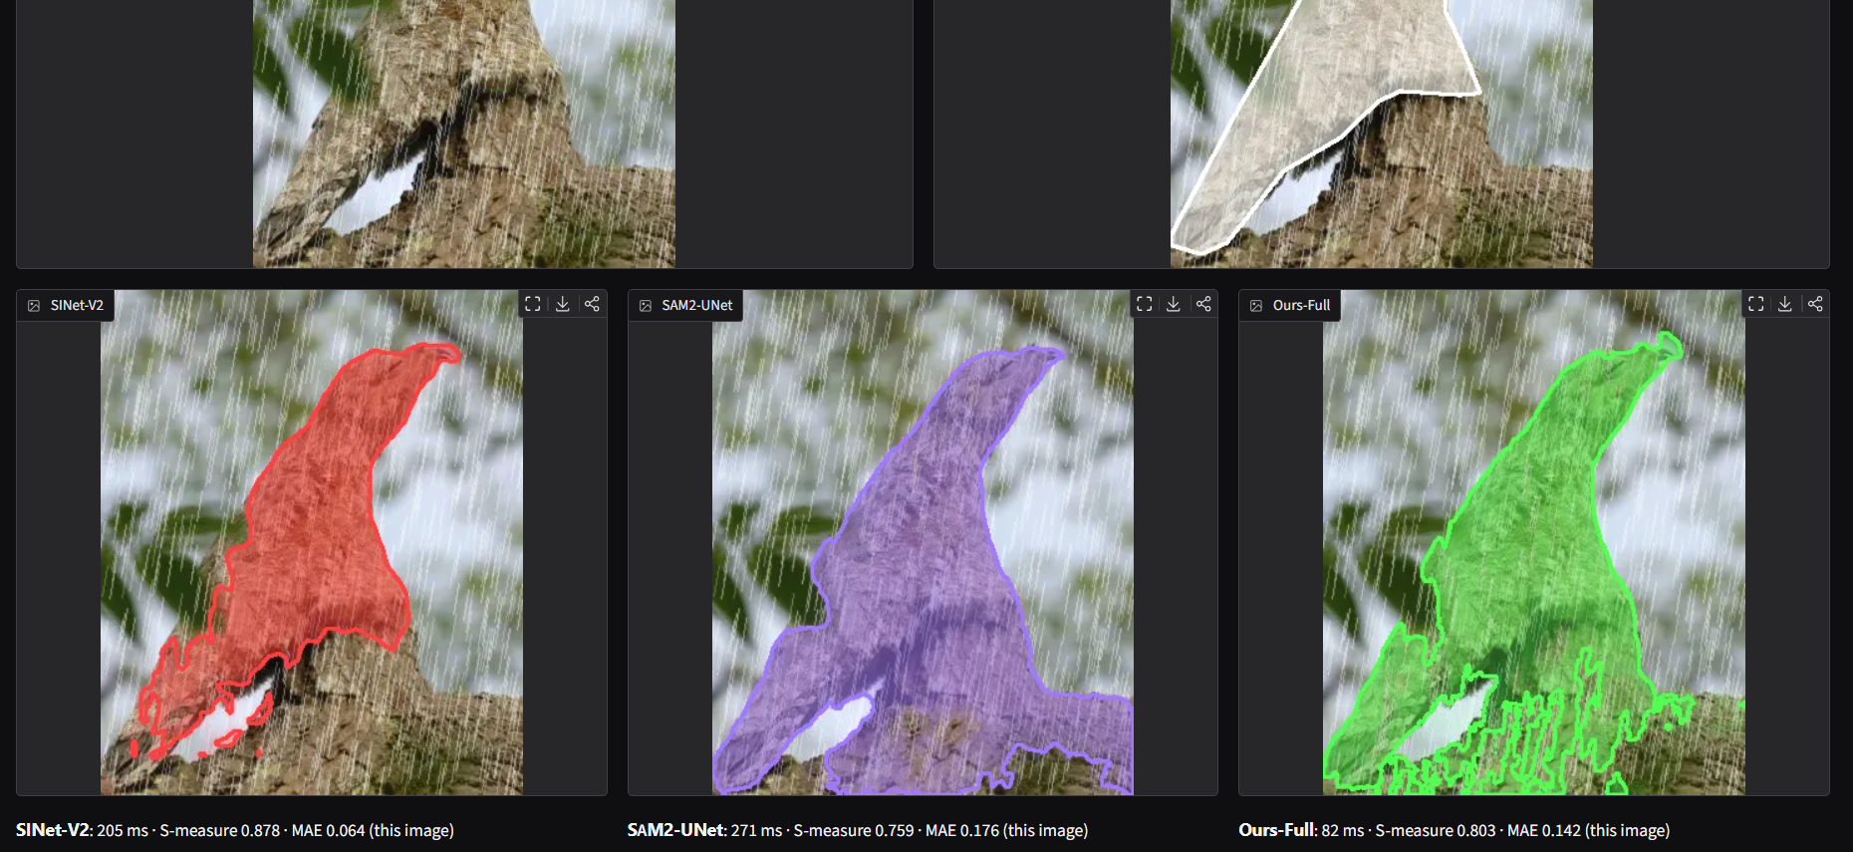
Outputs in the demo app, with ground truth
Top: a spider in dry grass
Ours-Full scores highest on this image (S-measure 0.851, against 0.790 for SAM2-UNet and 0.683 for SINet-V2).
Bottom: an animal on a branch
Here SINet-V2 is best (0.878; Ours-Full 0.803, SAM2-UNet 0.759). Single images go either way; the benchmark averages thousands.
Notes:
With 'Show ground truth' ticked for a test image, the app draws the ground truth in white and prints each model's per-image S-measure and MAE. Scores on this slide are the ones printed by the app. We show one image where our model wins and one where it does not, to be honest about single examples.

Slide 14
Performance: accuracy under corruption (COD10K)
+0.017
Ours (1024) vs SINet-V2 under corruption (95% CI +0.013 to +0.021)
−0.054
Ours (1024) vs SAM2-UNet (216.5 M params): still behind
+0.005
on unseen corruptions, from augmentation + consistency loss
Notes:
Light bars are clean scores, dark bars the mean over all 40 corrupted conditions. Ours (1024) beats every specialist model under corruption on COD10K, and the paired bootstrap confirms it (+0.017 over SINet-V2). It stays below SAM2-UNet, which is 20 times larger; we report that honestly. Training on four corruptions also helps on the four unseen ones, by a small but significant amount (95% CI +0.003 to +0.007).

Slide 15
Performance: speed and memory on the laptop GPU
Model | Params (M) | Latency (ms) | FPS | Peak VRAM (MB) | Sα under corruption
SINet-V2 | 27.0 | 28.6 | 35.0 | 134 | 0.795
PFNet | 46.5 | 37.8 | 26.4 | 258 | 0.773
ZoomNet | 32.4 | 94.4 | 10.6 | 410 | 0.803
SAM2-UNet | 216.5 | 71.3 | 14.0 | 879 | 0.866
SAM-Adapter | 641.3 | 3840.6 | 0.3 | 2477 | 0.853
Ours (1024) | 10.3 | 45.6 | 21.9 | 181 | 0.812
Ours (512) | 10.3 | 23.1 | 43.2 | 87 | 0.805
23.1 ms
per image for Ours (512): 43 FPS
87 MB
peak GPU memory for Ours (512)
2.6 h
Batch size 1, image 768×1024, NVIDIA GeForce RTX 3050 Laptop GPU. SAM-based models and ours in fp16, CNNs in fp32.
to train Ours (512) on the 4 GB GPU (1024: 8.5 h)
Notes:
All timings were measured on our own RTX 3050 laptop GPU. Ours (512) is the fastest model in the table and uses the least memory, while beating SINet-V2 under corruption (+0.010). SAM-Adapter is the most accurate on clean images but takes about 3.8 s per image.

Slide 16
Performance on all four test sets
Sα under corruption | CHAMELEON | CAMO | COD10K | NC4K
SINet-V2 | 0.870 | 0.791 | 0.795 | 0.826
PFNet | 0.849 | 0.746 | 0.773 | 0.801
ZoomNet | 0.867 | 0.771 | 0.803 | 0.822
SAM2-UNet | 0.896 | 0.860 | 0.866 | 0.887
SAM-Adapter | 0.857 | 0.811 | 0.853 | —
Ours (1024) | 0.847 | 0.785 | 0.812 | 0.836
Ours (512) | 0.833 | 0.799 | 0.805 | 0.844
What the table says
Ours (1024) is ahead of all specialists on COD10K and NC4K, the two large test sets.
Level with SINet-V2 on CAMO, behind it on CHAMELEON (76 images).
SAM2-UNet is best everywhere, at 20× our size.
Bold: best per dataset. Orange: our model scores higher than every specialist model. SAM-Adapter was not run on NC4K (≈4 s per image × 4,121 images × 41 conditions).
Notes:
Mean Sα over the 40 corrupted conditions on each dataset. On NC4K, Ours (512) beats SINet-V2 by +0.018 (95% CI +0.016 to +0.021). CHAMELEON has only 76 images, so its differences are less certain.

Slide 17
Contribution: what is new compared with the literature
1
First corruption benchmark with SAM-based COD models
2
Held-out (unseen) corruption protocol
The only earlier COD corruption benchmark (COD10K-C, 2026) tested CNN specialists only. We add SAM2-UNet and SAM-Adapter: 7 models, 4 datasets, 41 conditions each.
Train on 4 corruptions, test on 4 never seen, including a new rain corruption. Gain on unseen: +0.005 Sα (95% CI +0.003 to +0.007); rain +0.015.
3
Input resolution explains robustness
4
A robust adapter that trains on a 4 GB laptop
The 1024-px models lose the most under local corruptions. Training at 512 px keeps accuracy there (+0.000, 95% CI −0.003 to +0.002) at twice the speed.
Prompt-free MobileSAM adapter with a clean/corrupted consistency loss and 3.7 M trained parameters. Ours (1024) is ahead of all specialists under corruption on COD10K and NC4K; Ours (512) trains in 2.6 h.
Notes:
These four points are not in the literature. COD10K-C (Sayem, arXiv 2606.02603) is the closest work; it has no SAM-based models, no unseen-corruption split and no resolution analysis. Our model is not the most accurate overall, so the claim is robustness per unit of compute, not state of the art.

Slide 18
Summary
1
SAM2-UNet is the most accurate model, also under corruption
at 216.5 M parameters; SAM-Adapter takes 3.8 s per image on a laptop GPU.
2
Our 512-px adapter is the fastest model tested
23.1 ms and 87 MB, and ahead of SINet-V2 under corruption (+0.010).
3
Robustness partly transfers to unseen corruptions
+0.005 Sα from training on four corruption types.
Limitations: synthetic corruptions are not real camera degradation; SAM2-UNet remains more accurate; one GPU class tested.
Notes:
Close with the three takeaways and the limitations. Offer to run the live demo: python demo/app.py.

