Slide 1


Business Transformation with
Hi-Tech Automation Solutions

Slide 2






The HiTech’s Specialization in
Aftermarket
Softwares
DMS
Dealer Management System
eCatalogue
Online Spare Parts Catalogue
SCMS
Service Call Management System
DSIP
Digital Service Information Portal
GUI, Catalo Structuring
Link Service Bulletin
Link part MOQ/ MRP
FFMS
Field Force Management System
IETM
Interactive Electronic Technical Manuals

Slide 3



DMS Modules Key Features – Customize the Product as per OEM Business Need
Pre Sales & Sales Module
Service & Warranty Module
Enquiry Management
Quotation Management
Marketing Activity Mgmt.
Product Purchase Transaction
Product Inventory Transaction
Sales & Marketing Claims
Service Appointments & CRM
Service Job Cards Management
Warranty Management
Free Service & Warranty Claims
Service Activity Management
Service Dashboard
01
03
DMS
Spare Purchase Transaction
Spare Inventory Transaction
Spare Parts Dashboard
Spare Order Quotations
Spare Parts Discrepancy Claims
Parts Catalog Integration
02
04
Integration with ERP Systems
Integration with 3rd Party Apps
Web + Mobile Applications
Customized / Scalable Solution
High Information Security
Application Hosting at OEMs
Spares Module
Advanced Value Added Features

Slide 4
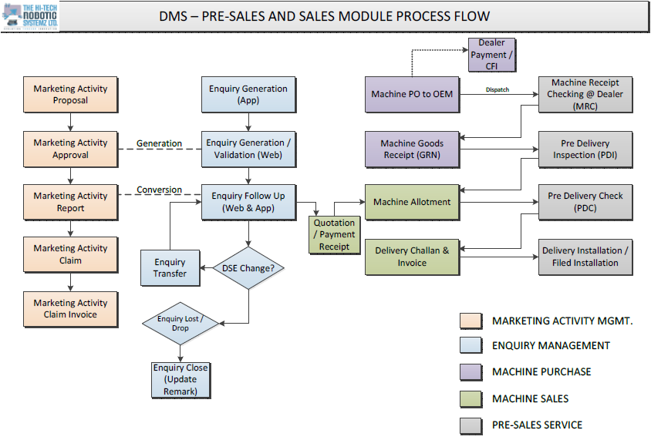

Slide 5
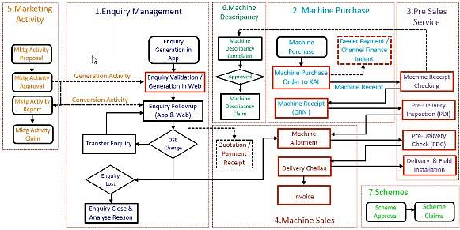
Pre-Sales & Sales Module Process Flow

Slide 6
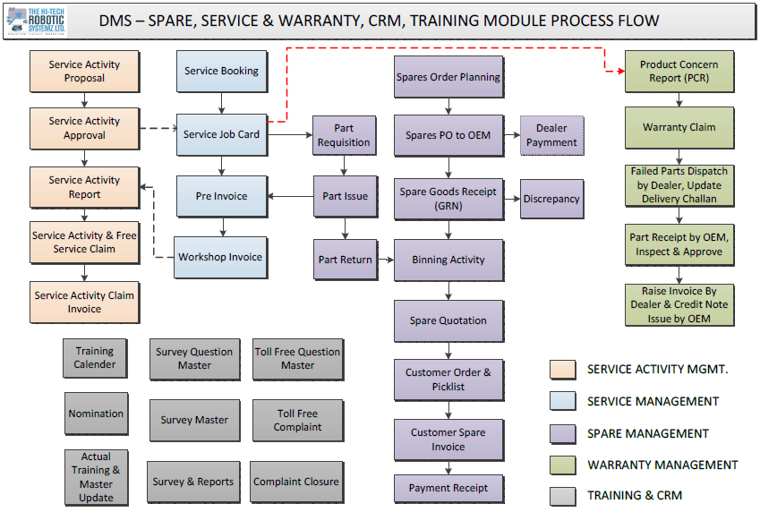

Slide 7
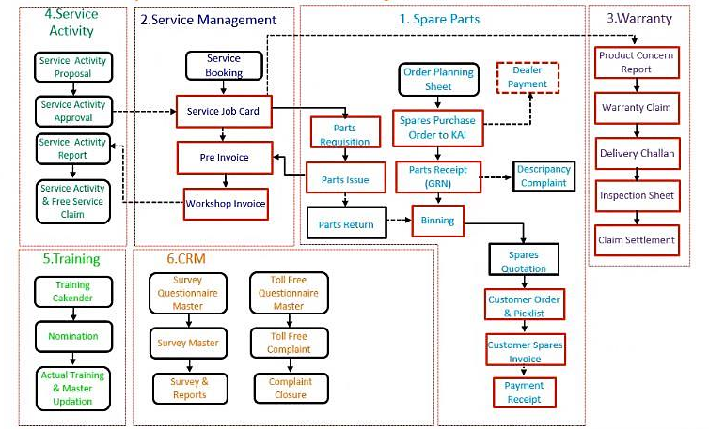
Spare & Service Module Process Flow

Slide 8
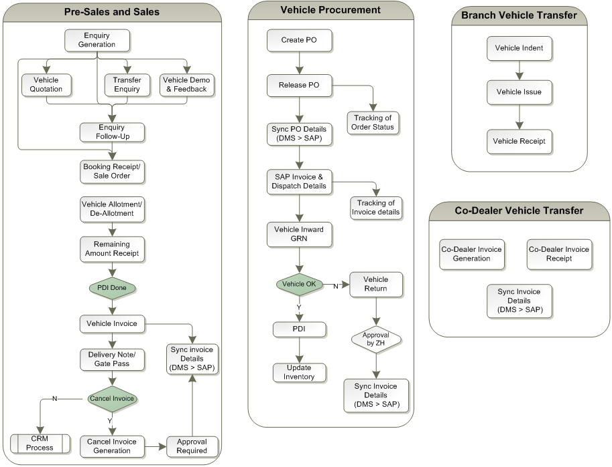
Pre-Sales & Sales Module Process Flow

Slide 9
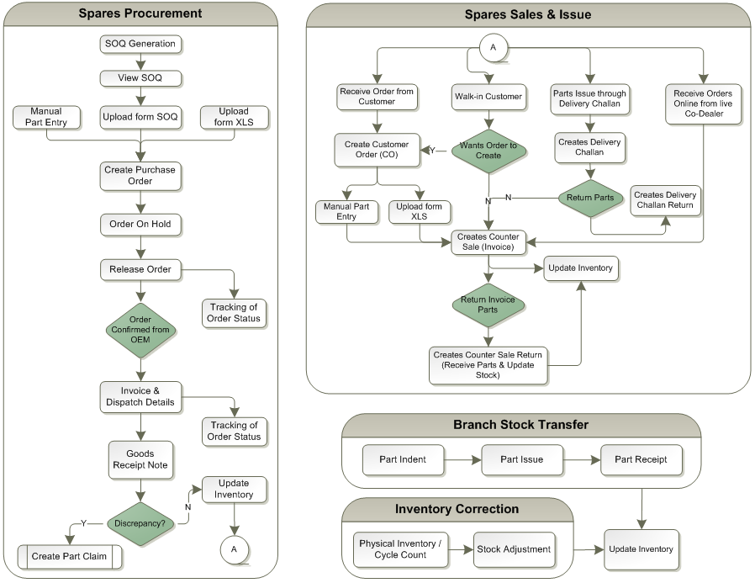
Spares Module Process Flow

Slide 10
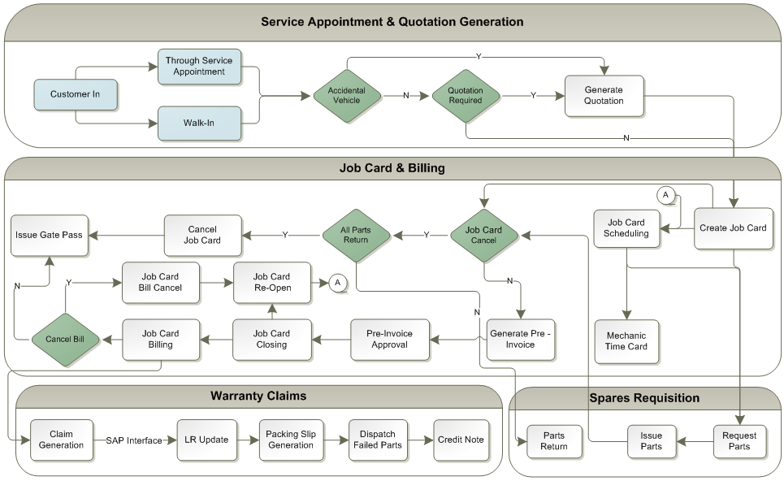
Service Module Process Flow

Slide 11
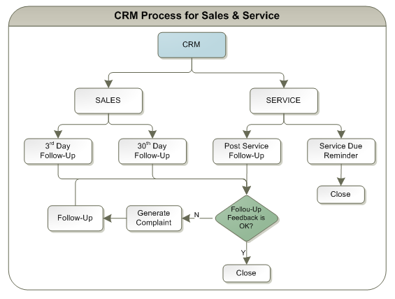
CRM Process Flow

Slide 12
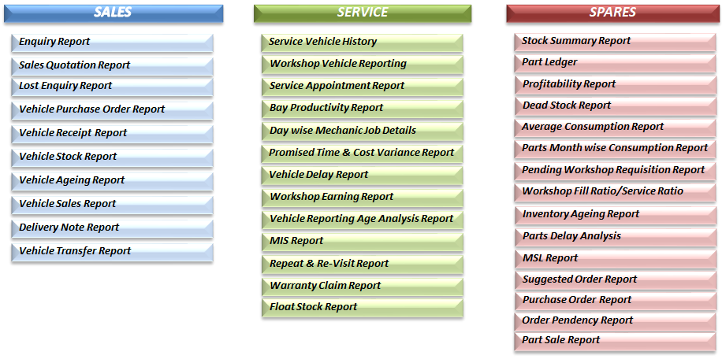
MIS Reports

Slide 13
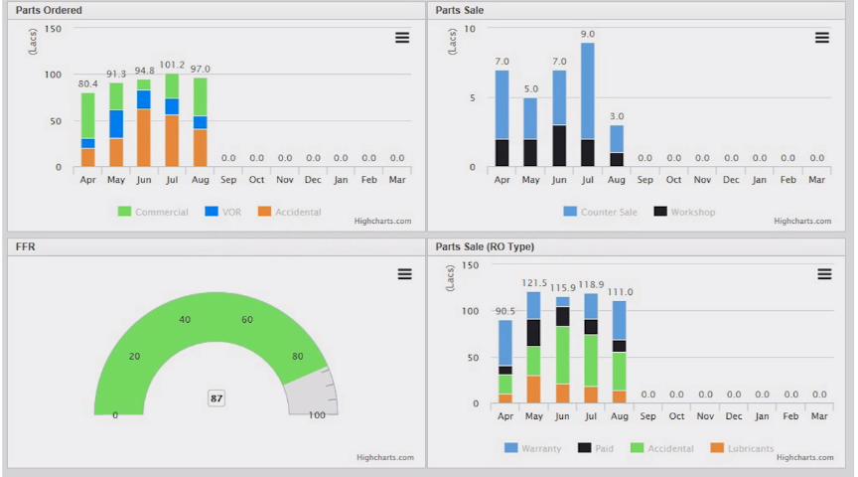
MIS Reports - Dashboard

Slide 14
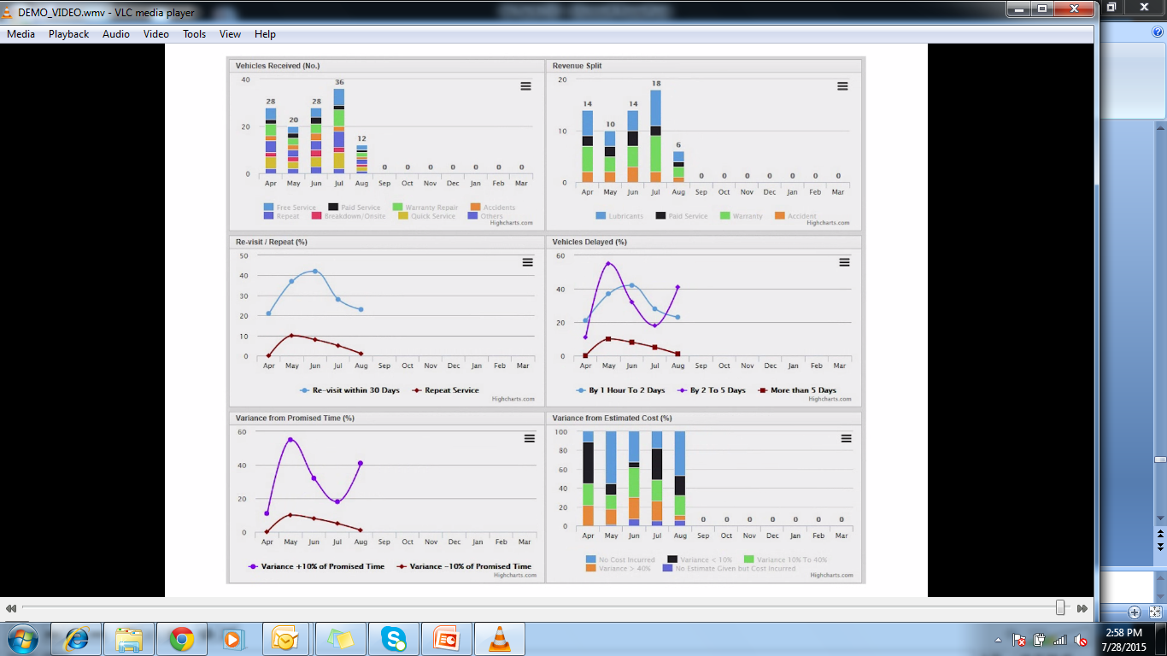
MIS Reports - Dashboard

Slide 15
DMS Project Execution Process
Requirement Gathering
Functional Requirement Document (FRD) Preparation
Sign-off on FRD
Prototype Design (PD)
Sign-off on PD
Offsite Development & Unit Testing
Onsite Development & ERP Integration
User Acceptance Testing with Business Users
Pilot Rollout at 5 Dealership by THRSL & OEM DMS Team
Training to OEM DMS Team
Rollout by OEM DMS Team at all Dealer Locations
Configuration of Production Environment and Uploading of Master Data

Slide 16



THANK YOU
Pune - India
3rd floor, Nyati Millennium, Near Datta Mandir Chowk, Viman Nagar, Pune, Maharashtra 411014
Gurgaon - India
A-18, Infocity, Sector-34,
Gurgaon – 122001
Haryana, India
ritesh.kachhadiya
@hitechroboticsystemz.com

Slide 17
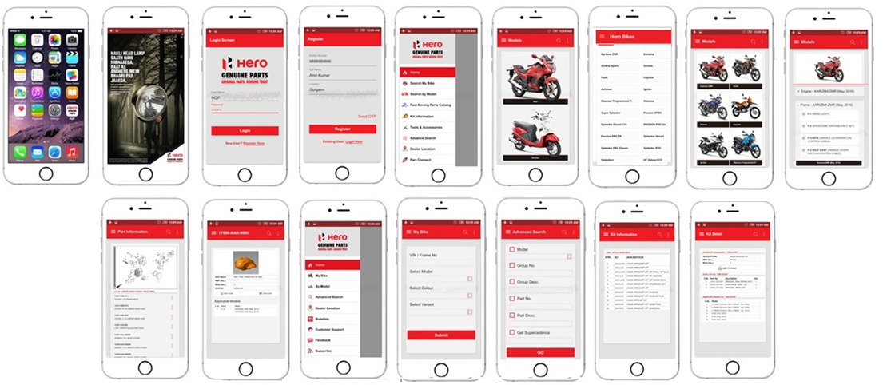
mCatalog Screens – Extension of eCatalog on Mobile Apps

Slide 18
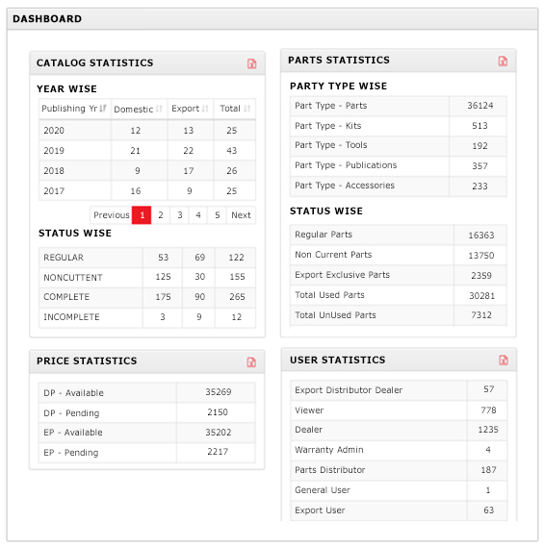
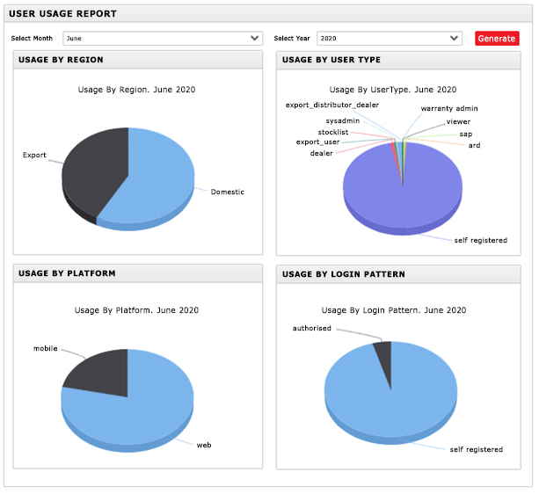
eCatalog Analytics for Admin User – Dashboard & Chart Form

Slide 19





















Many OEM’s Trust in eCatalog Solution Proves Best in Class Product
2004
2008
2012
2016
2020

