Slide 1

Dimentionality Reduction
22ETAI410029 – Neel Narayan Shetty 22ETAI410038 – Shamanth Patel 22ETAI410002 – Adhya D
Delivered to:
Ms. Nidhi Soni
nidhisoni.cs.et@msruas.ac.in

Slide 2
INDEX
Introduction
Dataset (Details)
Dataset Parameters(Details)
Platform Description
Comparison of Methods (Explanation)
Plot
Results
Conclusion
References

Slide 3
Introduction
Dimentionality reduction on pokemon data!
Pokémon is a globally popular franchise that began as a video game series in 1996. It revolves around capturing, training, and battling creatures called Pokémon, each with unique attributes, abilities, and types. With over 1,000 Pokémon species today, the franchise has expanded into trading card games, TV shows, movies, and more.

Slide 4
Introduction
From a machine learning perspective, Pokémon offers a fascinating dataset. Each Pokémon is defined by structured attributes such as:
Types (e.g., Fire, Water, Electric)
Base Stats (e.g., Attack, Defense, Speed)
Abilities (special powers)
Evolutionary Stages (how they grow and change)
Move Sets (actions they can perform in battle)

Slide 5
Introduction
From a machine learning perspective, Pokémon offers a fascinating dataset. Each Pokémon is defined by structured attributes such as:
Types (e.g., Fire, Water, Electric)
Base Stats (e.g., Attack, Defense, Speed)
Abilities (special powers)
Evolutionary Stages (how they grow and change)
Move Sets (actions they can perform in battle)

Slide 6


Introduction

Slide 7
Dataset (Details)
This dataset contains information on all 802 Pokemon from all Seven Generations of Pokemon. The information contained in this dataset include Base Stats, Performance against Other Types, Height, Weight, Classification, Egg Steps, Experience Points, Abilities, etc.

Slide 8
Dataset Parameters(Details)
name: The English name of the Pokemon
japanese_name: The Original Japanese name of the Pokemon
pokedex_number: The entry number of the Pokemon in the National Pokedex
percentage_male: The percentage of the species that are male. Blank if the Pokemon is genderless.
type1: The Primary Type of the Pokemon
type2: The Secondary Type of the Pokemon
classification: The Classification of the Pokemon as described by the Sun and Moon Pokedex
height_m: Height of the Pokemon in metres
weight_kg: The Weight of the Pokemon in kilograms
capture_rate: Capture Rate of the Pokemon
base_egg_steps: The number of steps required to hatch an egg of the Pokemon
abilities: A stringified list of abilities that the Pokemon is capable of having
experience_growth: The Experience Growth of the Pokemon
base_happiness: Base Happiness of the Pokemon
against_?: Eighteen features that denote the amount of damage taken against an attack of a particular type
hp: The Base HP of the Pokemon
attack: The Base Attack of the Pokemon
defense: The Base Defense of the Pokemon
sp_attack: The Base Special Attack of the Pokemon
sp_defense: The Base Special Defense of the Pokemon
speed: The Base Speed of the Pokemon
generation: The numbered generation which the Pokemon was first introduced
is_legendary: Denotes if the Pokemon is legendary.

Slide 9
Platform Description
matplotlib: A library used for creating graphs and visualizations, such as line charts, bar charts, and scatter plots.
numpy: A library for working with arrays and performing mathematical operations efficiently.
pandas: A library for handling and analyzing structured data, like tables or spreadsheets.
plotly: A library for creating interactive and visually appealing charts and dashboards.
scikit-learn: A machine learning library with tools for building models like classifiers, regressors, and clustering algorithms.
Jupyter Notebook

Slide 10
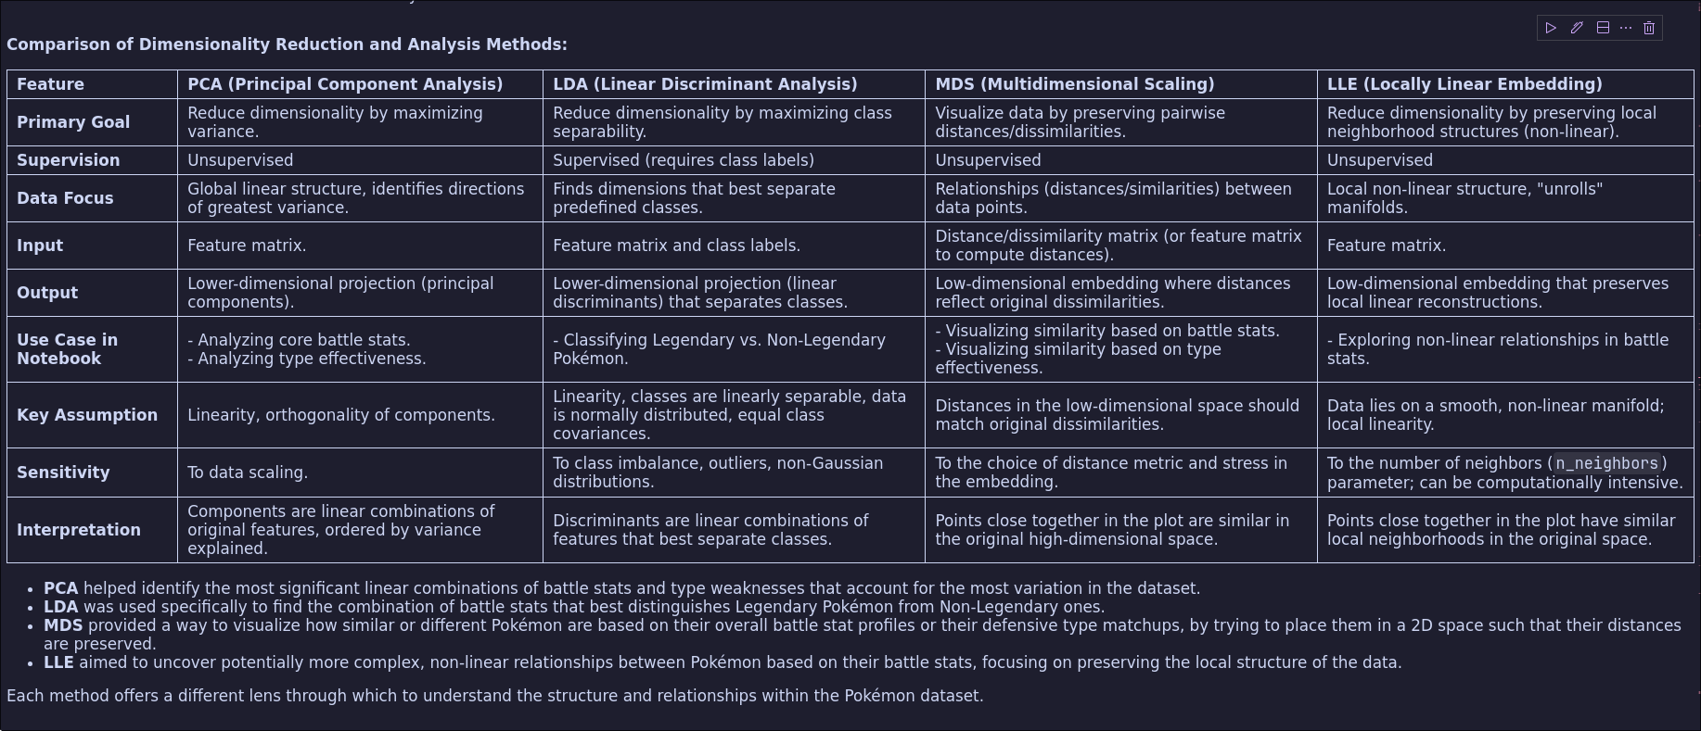
Comparison of Methods

Slide 11
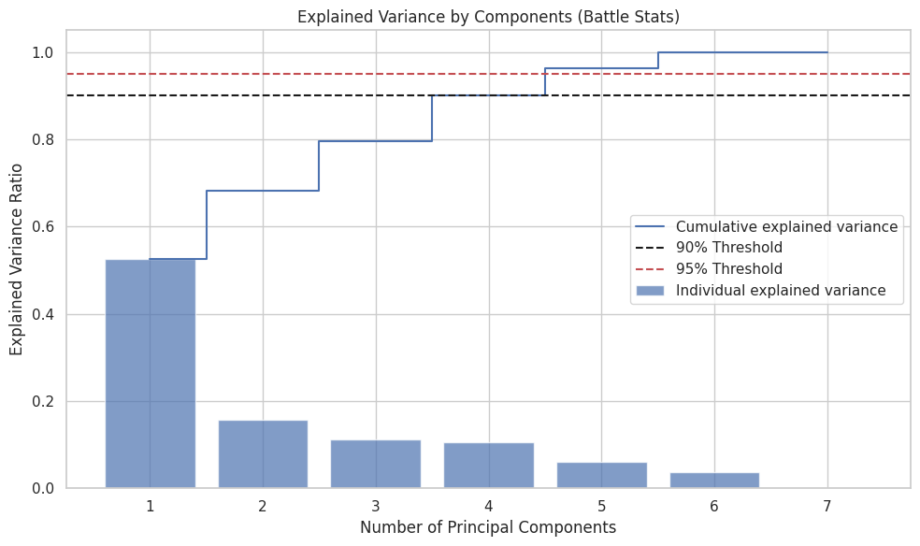
PCA on battle stats

Slide 12
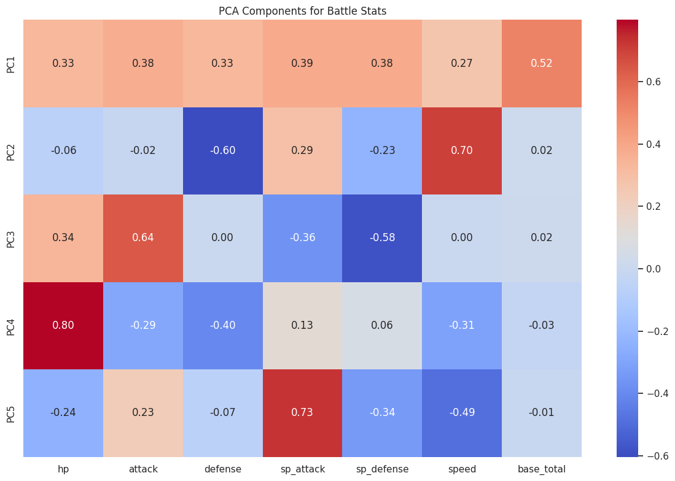

Slide 13
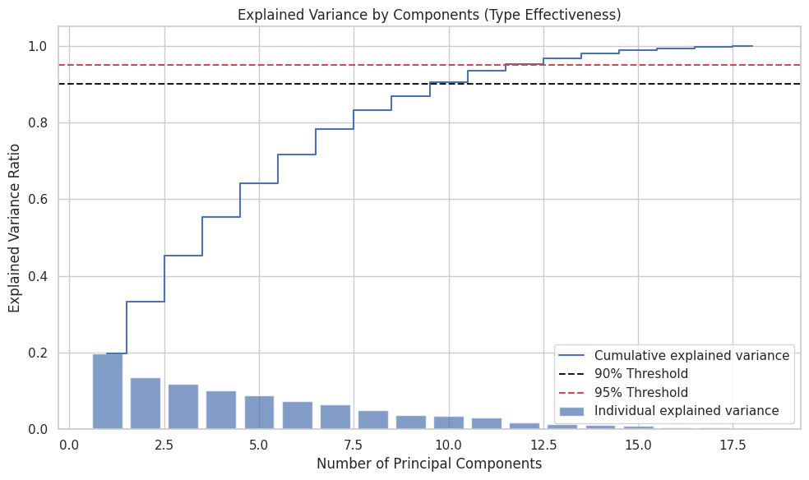
PCA on type effectiveness

Slide 14
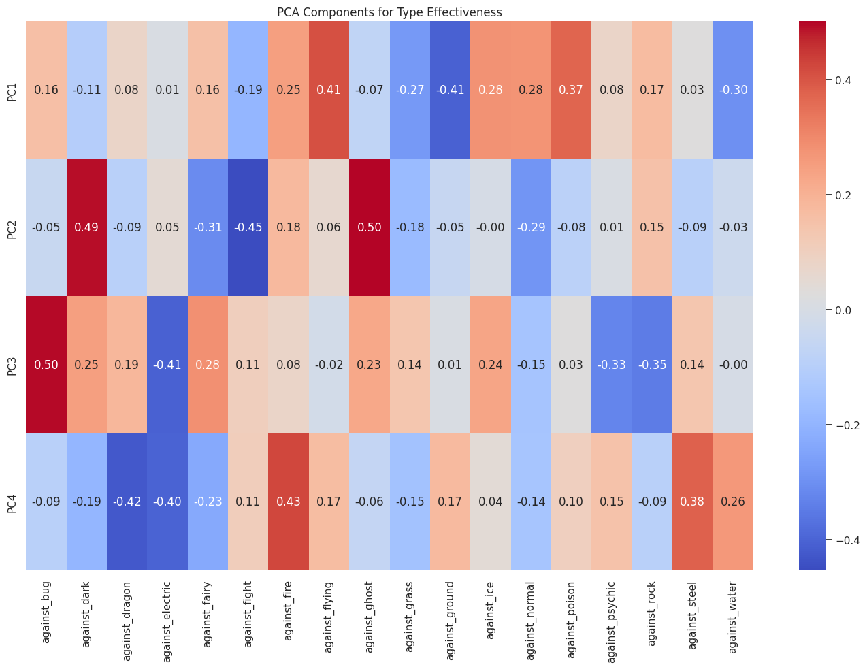

Slide 15


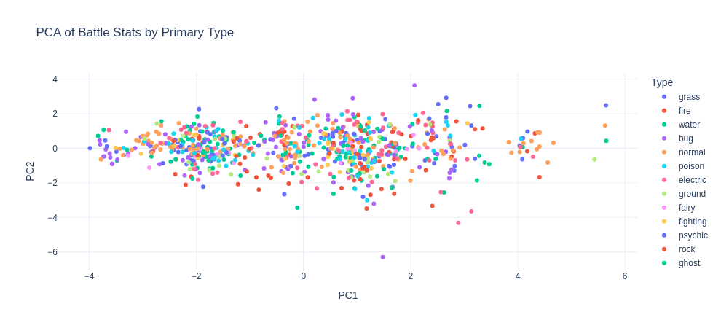



Slide 16
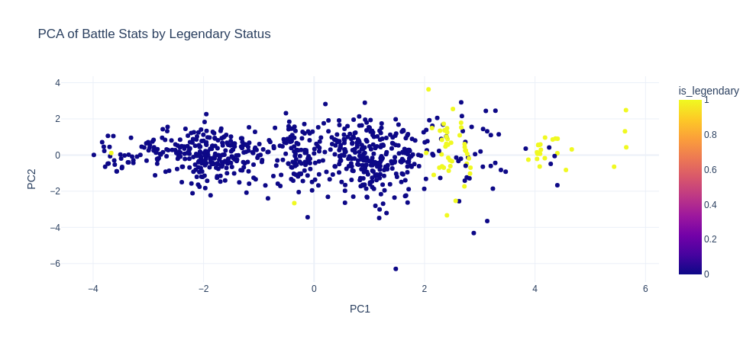

Slide 17
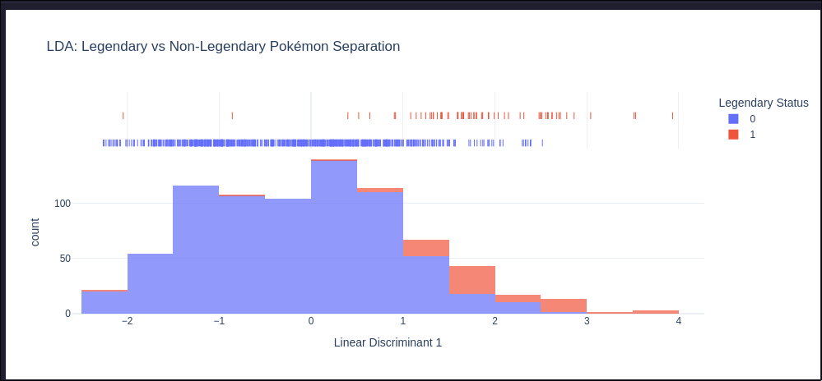
LDA, battle stats to legendary

Slide 18
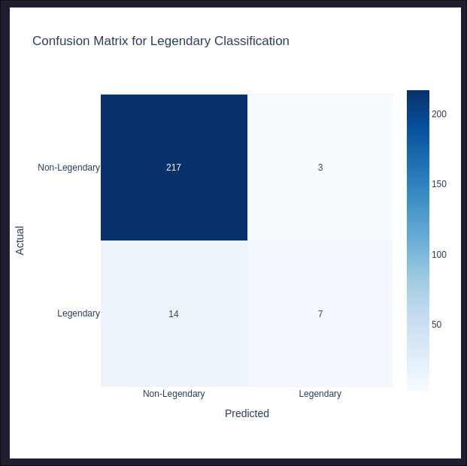
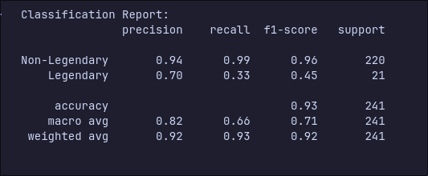

Slide 19
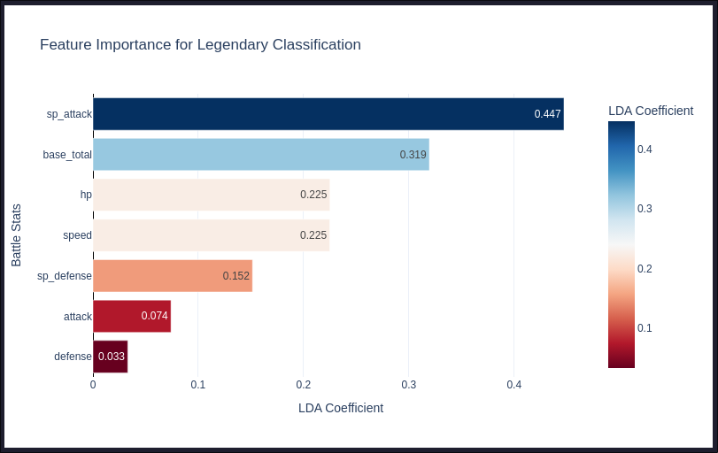

Slide 20
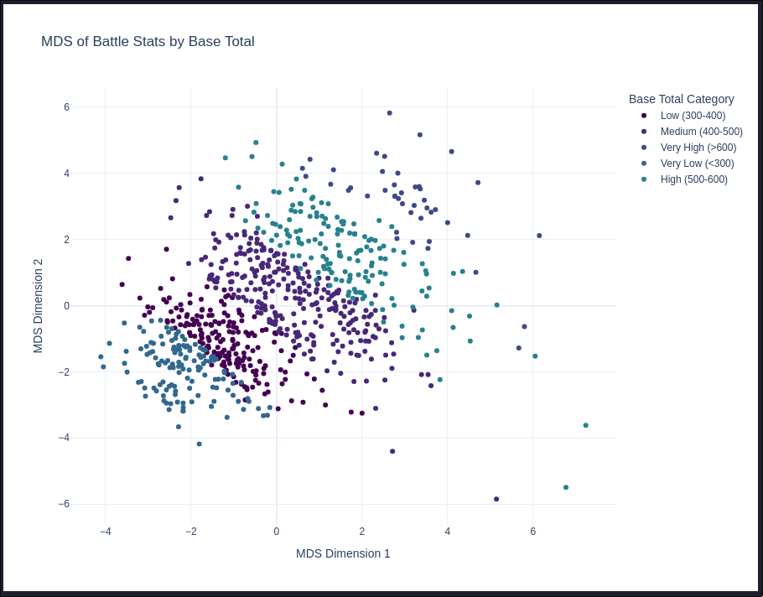
MDS, stat based similarity

Slide 21
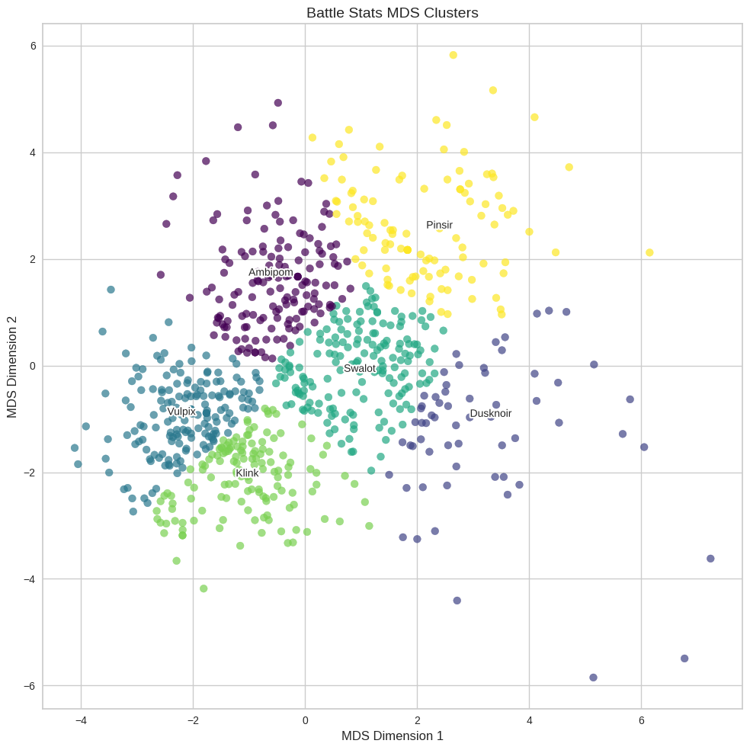

Slide 22
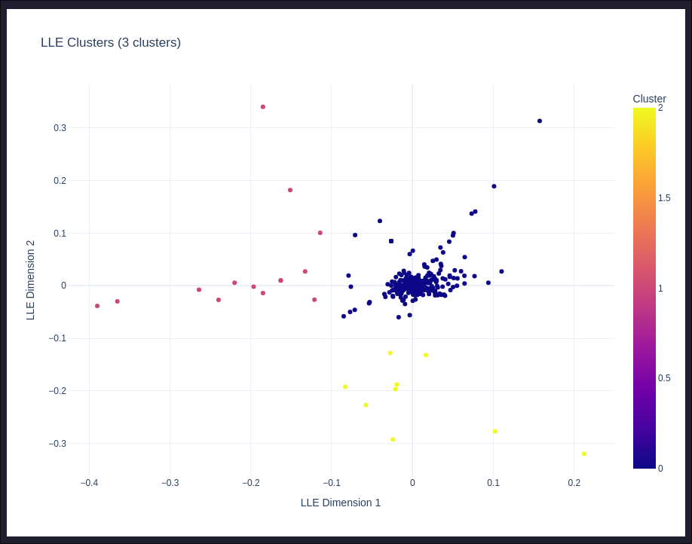
LLE on battle stats

Slide 23
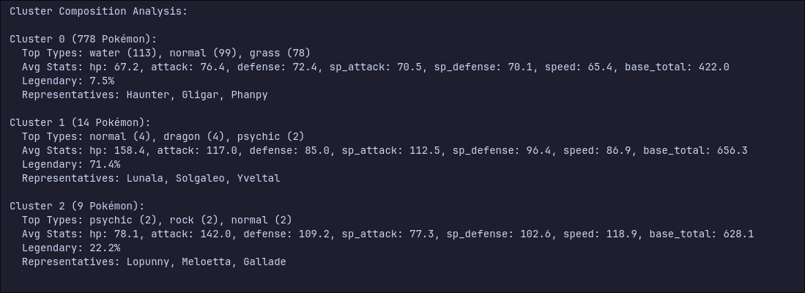

Slide 24
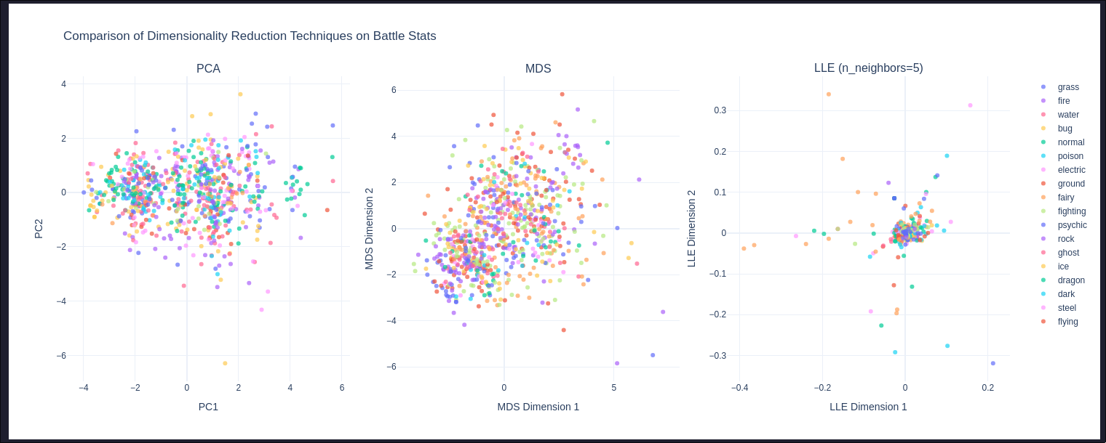

Slide 25
Results
Principal Component Analysis (PCA)
Battle Stats: PCA was applied to the core battle statistics of Pokémon. The dimensionality was effectively reduced, with the analysis indicating that 4 principal components were sufficient to retain approximately 90% of the variance from the original stat features. These principal components typically captured aspects like overall Pokémon power, offensive capabilities, defensive strengths, and speed.
Type Effectiveness: For the 18 features representing type effectiveness (i.e., against_* columns), PCA reduced the dimensionality to 10 principal components while still preserving 90% of the original variance. This suggests that underlying patterns in Pokémon defensive profiles can be described by a smaller set of consolidated type interaction factors.

Slide 26
Results
Linear Discriminant Analysis (LDA)
LDA was successfully used to classify Pokémon as either Legendary or Non-Legendary based on their battle statistics.
The model demonstrated good predictive performance in distinguishing between these two classes, with the linear discriminant(s) highlighting specific stats (e.g., higher base totals, special attack/defense) as key differentiators. The model achieved a notable accuracy on this classification task.

Slide 27
Results
Multidimensional Scaling (MDS)
MDS was employed to visualize Pokémon in a lower-dimensional space (typically 2D) while attempting to preserve the pairwise distances or dissimilarities based on their battle stats and type effectiveness profiles.
The resulting visualizations effectively grouped Pokémon with similar characteristics. For instance, Pokémon with comparable overall stat distributions or similar defensive matchups (weaknesses/resistances) were observed to cluster together in the MDS plots, allowing for an intuitive exploration of these relationships.

Slide 28
Results
Locally Linear Embedding (LLE)
LLE, a non-linear dimensionality reduction technique, was applied to the battle stats to uncover underlying manifold structures.
The LLE embeddings successfully preserved local neighborhood information. This resulted in visualizations where:
Legendary Pokémon often appeared as distinct outliers or formed small, separate clusters, highlighting their unique stat profiles.
Groups of Pokémon with similar characteristics (e.g., very low or very high stats, specialized roles) clustered together, revealing non-linear relationships that might not be as apparent with linear methods like PCA.

Slide 29
Conclusion
Dimensionality reduction and analysis techniques like PCA, LDA, MDS, and LLE each provide unique insights into the Pokémon dataset by highlighting different structural aspects.
PCA excelled at reducing feature dimensions (4 for battle stats, 10 for type effectiveness, both retaining ~90% variance), revealing key linear patterns in Pokémon characteristics.
LDA effectively classified Legendary vs. Non-Legendary Pokémon, identifying the battle stats most crucial for this distinction.
MDS created intuitive 2D visualizations, grouping Pokémon with similar battle stats or type effectiveness profiles, thus preserving their pairwise dissimilarities.
LLE uncovered non-linear relationships by preserving local neighborhoods, often isolating Legendary Pokémon as outliers and clustering Pokémon with similar niche stat profiles.
In essence, the optimal technique depends on the specific analytical objective:
Use PCA for general variance-based feature reduction.
Employ LDA for supervised classification and identifying class-separating features.
Choose MDS for visualizing data based on inter-point dissimilarities.
Opt for LLE to explore local, non-linear data structures.
Understanding these distinct strengths allows for their appropriate and complementary application, leading to a richer understanding of complex datasets.

Slide 30
References
Pokemon dataset on kaggle - https://www.kaggle.com/datasets/rounakbanik/pokemon

Slide 31
Thank you

