Slide 1
Breast Tumor Classification with Random Forest + Pattern Segmentation
UCI Breast Cancer Wisconsin (Diagnostic)
Individual Capstone Project
Presented by: Nilesh Shirke
Model: Random Forest Classifier

Slide 2
Problem Statement & Objective
Problem Statement
Classify tumor observations as Malignant (M) or Benign (B)
Use 30 diagnostic measurements from the UCI WDBC dataset
Build a reproducible Random Forest Classifier
Objectives
Perform data validation and preprocessing
Tune the Random Forest using GridSearchCV
Evaluate using ROC-AUC, Recall, Precision and F1
Analyze false positives and false negatives
Perform K-Means and Hierarchical Clustering

Slide 3
Dataset Overview
UCI Breast Cancer Wisconsin (Diagnostic)
569 observations
30 real-valued diagnostic features
Target: Diagnosis — Malignant (M) / Benign (B)
No missing values
ID column excluded from model training
357 Benign (62.74%)
212 Malignant (37.26%)

Slide 4
Data Preparation & EDA
Data Preparation
Preprocessing
Removed the ID column
Encoded B = 0, M = 1
Stratified 80% / 10% / 10% Train/Validation/Test split
Random seed: 42
StandardScaler used for clustering
No observations removed as statistical outliers
EDA Findings
Key EDA Findings
No missing values
No duplicate observations
Class distribution: 357 B / 212 M
Strong correlations among several size-related features
All 30 diagnostic features retained

Slide 5
Random Forest Model & Hyperparameter Tuning
Model
Single Random Forest Classifier
random_state = 42
class_weight = "balanced"
Hyperparameter Tuning
GridSearchCV
5-fold cross-validation
648 parameter combinations
Selection criterion: ROC-AUC
Malignant recall considered during model selection
Parameter | Final Value
n_estimators | 200
max_depth | 5
min_samples_split | 2
min_samples_leaf | 1
max_features | sqrt
class_weight | balanced

Slide 6
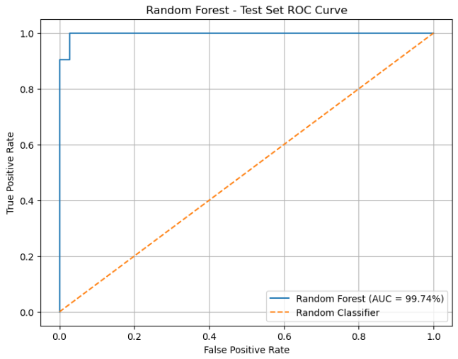
Final Model Evaluation — Test Set
Performance
Accuracy: 96.49%
Precision: 100.00%
Malignant Recall: 90.48%
F1 Score: 95.00%
ROC-AUC: 99.74%
Confusion Matrix
True Negatives: 36
False Positives: 0
False Negatives: 2
True Positives: 19

Slide 7
Threshold Decision & Error Analysis
Decision Threshold
Selected threshold: 0.50
Lower thresholds did not improve malignant recall
Higher thresholds reduced malignant recall
Test-Set Errors
False Positives: 0
False Negatives: 2
Hard cases: 2 malignant observations predicted as benign
Size-related features were closer to the benign pattern in these cases
Mitigation
Continue threshold analysis using validation data
Investigate false-negative feature patterns
Use repeated stratified validation to assess robustness

Slide 8
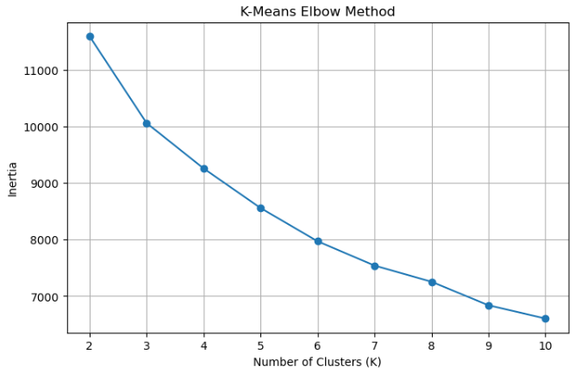
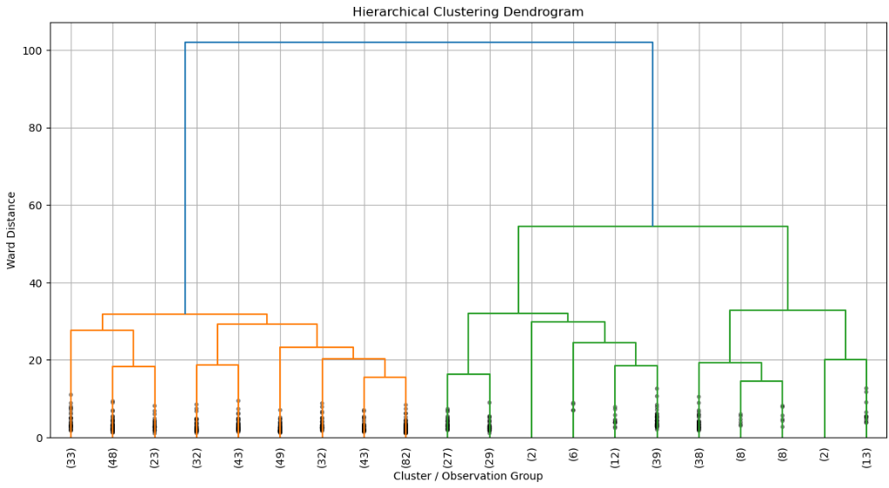
Clustering & Pattern Segmentation
K-Means
Standardized 30 diagnostic features
Evaluated K = 2 to 10
Elbow method → K = 5
n_init = 10
random_state = 42
Hierarchical
Ward linkage
Dendrogram used to examine grouping structure
Dendrogram cut to obtain 5 clusters
Used as an exploratory pattern-analysis method

Slide 9
Key Findings & Recommendations
Key Findings
Random Forest achieved 96.49% test accuracy
99.74% ROC-AUC
90.48% malignant recall
0 false positives and 2 false negatives
Clustering identified 5 exploratory pattern groups
Recommendations
Continue threshold analysis using validation data
Investigate the two false-negative cases
Use repeated stratified validation to assess robustness

Slide 10
Conclusion & Limitations
Conclusion
Built a reproducible Random Forest classification pipeline
Achieved 96.49% test accuracy and 99.74% ROC-AUC
Identified 2 false-negative cases for further analysis
Performed K-Means and hierarchical clustering for exploratory pattern analysis
Limitations
Dataset contains only 569 observations
Results may not generalize to other datasets or populations
Clustering results are exploratory
Project is for learning and demonstration, not clinical deployment
Future Work
Evaluate on additional datasets
Assess model calibration and threshold stability
Explore additional feature-analysis and clustering techniques

Slide 11
Thank You…

