Slide 1
Automation Society Security Task
AutoSecure

Slide 2
TEAM DETAILS
Team Number: ASST2
Team Mentor : Mr. Umesh Pulliwar
Group Members : Archana Bhatia
Mohini Bhave
Ria Dharmani
Neelam Somai
College: Vivekanand Education Society’s Institute Of Technology, Chembur, Maharashtra.

Slide 3
Problem Statement
Make housing societies more secure.
Visitors ➡ Regular and Irregular
Registered Regular Visitors ➡ Automatic recording using continuous camera feed ➡ timestamp and temperature
Accurate face recognition by considering visual changes
Daily report generation
Assumptions:
Visitors arriving one-by-one
Continuous power supply and WiFi available to Raspberry Pi
Any mobile like device is available with watchman

Slide 4
Our solution
Hierarchy of users with different access rights
Camera module and contactless temperature sensor mounted on a single device(Raspberry Pi) ➡ ensures automatic synchronization
Efficient face recognition using AWS Face Rekognition API
Increases incident response and resolution time.
Temperature data analysis to trace any Covid-19 cases.
Handling irregular visitors seamlessly

Slide 5
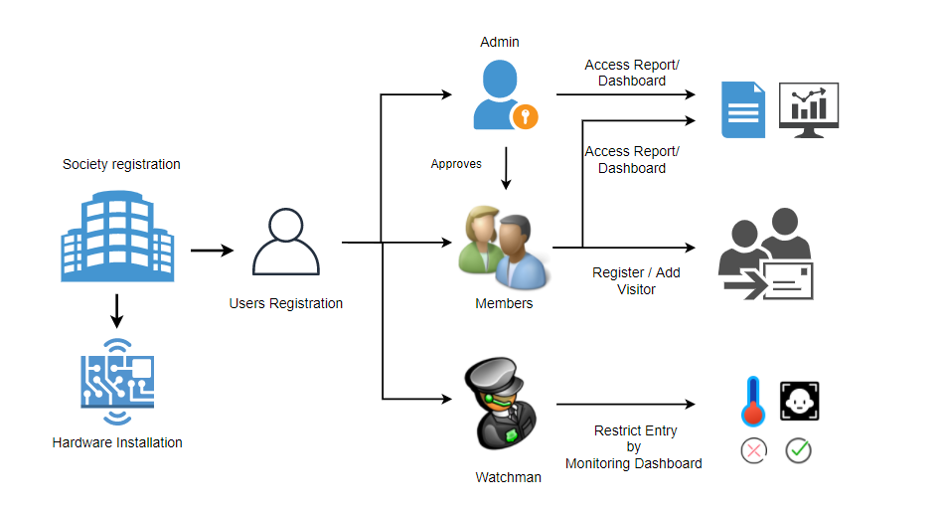
Flow diagram

Slide 6
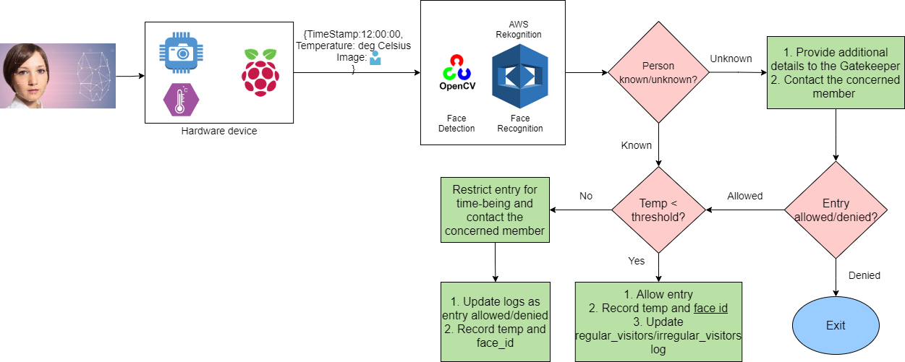
Block diagram

Slide 7
SWOT Analysis
Efficient logs
Easy to use User Interface
Fast face recognition- 10-15 sec.
Recognition of faces with masks, spectacles, and other accessories.
Temperature Guns are more accurate compared to sensor
Have to train gatekeepers to use it
Manual intervention of gatekeeper required to restrict specific entries.
Strengths
Weaknesses
Connectivity issues
Hardware failure
Improper handling of system
Integration with QR code
Tracing back is possible when Covid +ve patient found
Integration of speech recognition for complete contactless system
Threats
Opportunities

Slide 8
Basic pricing
Sr. no. | Item | Cost (Rs.)
 | Raspberry Pi 4 Model B (1 GB RAM) | ~ 2950/-
2. | MLX90614 contactless temperature sensor | 1090/-
3. | Camera module for raspberry pi 4 (or night vision camera) | 365/- (or 1240/-)
4. | AWS Rekognition (APIs: index_faces, search_faces_by_image) | 146/- (each API price per 1000 images for the first month = $1.00)
5. | AWS RDS Only Day ( 6am - 12pm ) 24 hours | (1.24 Rs per hour ) 692 (18 hrs for 31 days) 923 (24 hrs for 31 days)
 | Total | 4405 (Installation) + 838 (Monthly) = 5243/- 5280( Installation) + 1069 (Monthly) = 6349/-

Slide 9
Demo

Slide 10
Thank You!

