Slide 1


A Probabilistic Object Detection in Computer Vision Using Deep Learning Approach
TEAM MEMBERS: MENTOR NAME:
Neelam Somai Ms. Archana Das
Jaymeet Manishkumar Mehta
Faizan Ahmed Sayyad
Kona Sireesha

Slide 2
Introduction
To safely operate in the real world, robots need to evaluate how confident they are about what they see around . A new challenge in computer vision algorithms to not just detect and localize objects, but also report how certain they are.
Object detection is often an important part of the perception system of robots or autonomous systems such as driverless cars. It provides crucial information about the robot’s surroundings and has significant influence on the performance of the robot in its environment.
For example, driverless cars need object detection to be aware of other cars, pedestrians, cyclists and other obstacles on the road. Future domestic service robots and robots in healthcare will have to be able to detect a large range of household objects in order to properly fulfill their tasks.

Slide 3
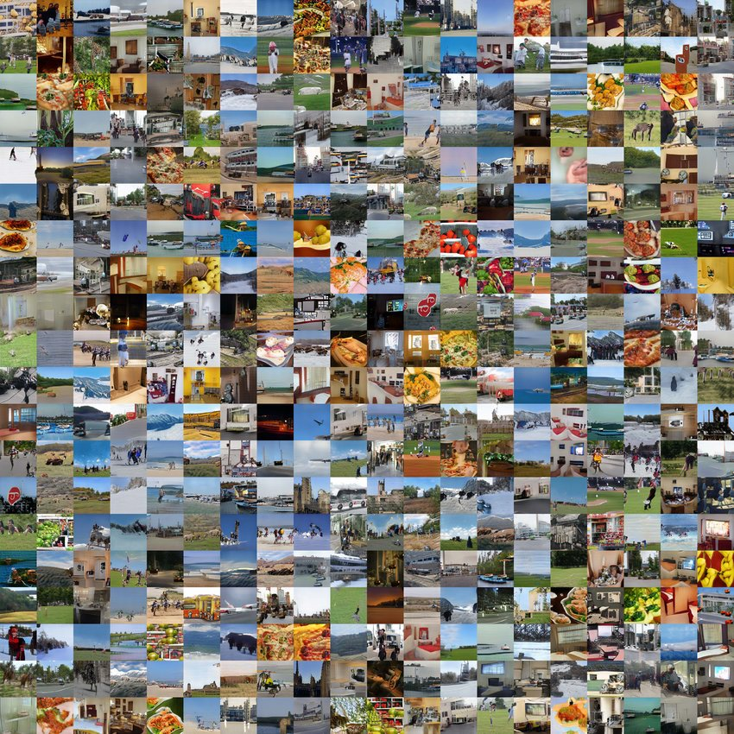
Dataset Used
The dataset used for training the models is Microsoft Common Objects in Context (MS COCO). COCO dataset is an excellent object detection dataset that has 80 different classes, 80,000 training images and 40,000 validation images available.

Slide 4
Methodology
The project is implemented using Single Shot Detection(SSD) and You Look Only Once (YOLOv3) Algorithms.
SSD object detection is made up of two components: 1. Extracting features maps 2.Convolution filters to detect objects. SSD uses VGG16 to extract features.
YOLOv3 is much faster than SSD while achieving very comparable accuracy. Lets see how YOLO detects the objects in a given image. First, it divides the image into a 13×13 grid of cells. The size of these 169 cells vary depending on the size of the input. For a 416×416 input size that we used in our experiment , the cell size was 32×32. Each cell is then responsible for predicting a number of boxes in the image.

Slide 5
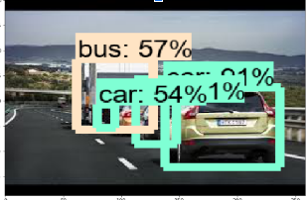
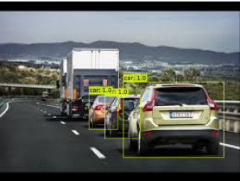
Results Achieved
OBJECT DETECTION WITH SSD
OBJECT DETECTION WITH YOLO

Slide 6
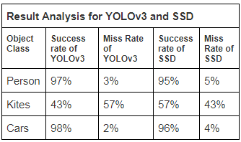
Conclusion
YOLOv3 has better results for our test images than SSD. The certainty of objects in the image obtained with YOLOv3 are higher. In terms of speed also YOLOv3 performed better than SSD. It took less than 12 seconds to detect 12 objects in a image.

Slide 7
References
[1] T. Lin, M. Maire, S. Belongie,L. Bourdev, R. Girshick, J. Hays, D. Ramanan, C. Zitnick and P. Dollar, "Microsoft COCO: Common Objects in Context”,arXiv:1405.0312v3 , Feb 2015.
[2] J. Redmon and A. Farhadi, “YOLOv3: An Incremental Improvement”, arXiv:1804.02767v1, Apr 2018.
[3] P. Viola & M. Jones. “Rapid Object Detection using a Boosted Cascade of Simple Features,” Conference on Computer Vision and pattern recognition, 2001.
[4] Krizhevsky, Alex, I. Sutskever, and G. Hinton. “Image net classification with deep convolution neural networks”,NIPS Conference ,2012.

Slide 8
Thank You

