Slide 1


Provide Post surgery care by analysing the medical background of the patient
Vivekananda Education Society’s Institute of Technology, Computer Department
TEAM:
Neelam Somai Class:D12B
Gayatri Patil Class:D12B
Anmol Vaswani Class:D12B
06 March 2020

Slide 2
Abstract.
Medical Details like blood pressure, Glucose Level, surgeries in the past etc will be taken and based on their analysis various suggestions will be given in fields like Ayurveda, Homeopathy, Allopath etc based on user preference.
An option for Consultancy is also provided for taking second opinions from the available doctors.
A facility for renting or buying new or second hand various medical accessories like wheelchairs, hospital stretchers, anesthesia machines, sterilizers etc is also provided to the patients.
Contact of nurses and Emergency services will also be provided.
06 March 2020

Slide 3
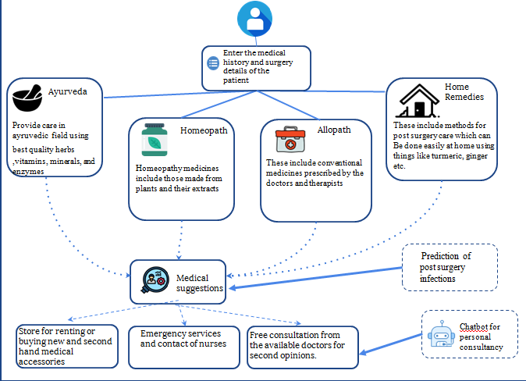
Proposed Architecture/Diagram

Slide 4
Technology Stack
Laravel Framework
Machine Learning
Front End Technologies : HTML, CSS , Bootstrap, JavaScript
Back End Technologies : PHP My Admin, MySQL
06 March 2020

Slide 5
Conclusion
Using our Website we aim to provide help to the patients in taking proper measures for post surgery care.
We also provide them services of the store to buy or rent medical accessories.
This is thus an efficient way to provide facility of free consultation by making best use of the technology available.

