Slide 1


ORB-SLAM 3
EECE 5554: Robot Sensing and Navigation
Anuj Patel (002874710)
Neel Adke (002203150)
Shubhankar Katekari (002459924)
Arun Srinivasan (002839500)

Slide 2
What is orb-slam 3
SLAM (simultaneous localization and mapping) is a mapping method that allows robots and other autonomous vehicles to build a map and localize itself on that map at the same time.
Core Features:
Multi-Camera Systems: ORB-SLAM 3 supports multiple camera systems, including monocular, stereo, and RGB-D setups. It can even handle fisheye lenses, which are common in robotics and augmented reality applications.
Versatility: It's designed to work in a wide range of environments, from small indoor spaces to large-scale outdoor settings. When it is test on public dataset (Euroc) is shows the error of +-3 cm.
Real-Time Operation: Like its predecessors, ORB-SLAM 3 operates in real time, which is crucial for applications in robotics and autonomous systems.
Types of Slams:
Visual SLAM (V-SLAM)
LIDAR-Based SLAM
2D SLAM
3D SLAM
Graph-Based SLAM
EKF (Extended Kalman Filter) SLAM

Slide 3
Requirements for Orb slam 3
1. Operating System
Linux: ORB-SLAM 3 is typically run on a Linux-based operating system, with Ubuntu being the most common choice.
2. Programming Language and Compiler
C++: ORB-SLAM 3 is written in C++, so a compatible C++ compiler is necessary.
GCC/G++: A version compatible with C++11 (or later) standards is usually required.
3. Dependencies and Libraries
Eigen3: used for linear algebra.
Pangolin: Pangolin helps in rendering the SLAM output, such as the trajectory and the map.
OpenCV: Essential for image processing and computer vision tasks
DBoW2 or g2o: For loop closure detection and graph optimization, respectively. ORB-SLAM 3 may use DBoW2 (or a similar library) for bag-of-words based place recognition and g2o (or Ceres Solver) for optimizing the pose graph.

Slide 4
Applications of SLAM
1.Autonomous Vehicles: For navigation in environments without GPS, like indoor spaces or other planets.
2.Domestic Robots: Like robotic vacuum cleaners, to navigate and clean homes efficiently.
3.Industrial Automation: In warehouses and manufacturing facilities for autonomous material handling and transportation.
4.Exploration: In areas where human access is difficult or dangerous, like deep-sea exploration or space missions.
Notes:
The significance of SLAM cannot be overstated. It is a foundational technology that supports the operation of autonomous vehicles, drones, underwater exploration devices, and even planetary rovers. It also plays a crucial role in augmented reality, enabling devices to superimpose virtual objects onto the real world in a way that they appear to coexist within the same space.
SLAM is an ongoing area of research that addresses a fundamental question in robotics and artificial intelligence: How can an agent understand and navigate an unknown environment without any prior knowledge? It’s a question that continues to drive innovation in the field of autonomous systems.
In the field of robotics slam is important for 2 reasons:
Autonomous Navigation:
Spatial Awareness: SLAM provides robots with the ability to understand and interact with their surroundings. This spatial awareness is critical for navigating through environments, especially those that are complex or previously unknown.
Obstacle Avoidance: With SLAM, robots can identify and avoid obstacles, making their movement safer and more efficient.
Dynamic Environment Mapping:
Real-Time Updates: Environments often change, and SLAM allows robots to adapt by updating their internal maps in real-time. This adaptability is crucial for tasks in dynamic settings like homes, offices, or outdoor terrains.
Interaction with the Environment: Robots equipped with SLAM can interact more effectively with their environment, such as picking up objects, avoiding moving obstacles, or performing tasks that require precise spatial positioning.

Slide 5
Difference between Orb slam2 and Orb slam3
Feature | ORB-SLAM 2 | ORB-SLAM 3
Algorithm and Features | Uses ORB features for localization and mapping. Supports monocular, stereo, and RGB-D cameras. | Builds upon ORB-SLAM2 with enhancements. Adds multi-map support and map merging capabilities.
Performance and Efficiency | Efficient with the supported camera setups. May face challenges in large-scale environments or long-term SLAM. | Enhanced performance in large environments and over extended periods. More robust in relocalization and tracking.
Camera Support and Versatility | Supports monocular, stereo, and RGB-D cameras. No native IMU data integration. | Extends support to Visual-Inertial SLAM by combining camera data with IMU data, improving robustness and accuracy.
Applications and Use Cases | Suitable for robotics, augmented reality, and similar applications. Limited in dynamic or large-scale environments. | Ideal for demanding applications like autonomous vehicles, drones, requiring high precision and robustness in large or complex environments.

Slide 6
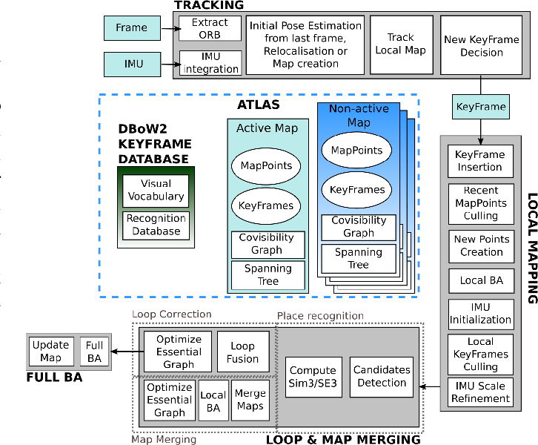

Slide 7
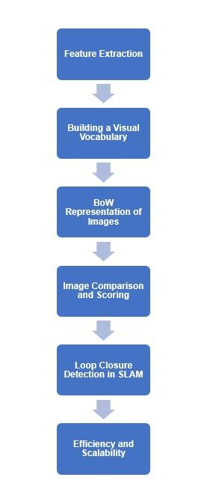
DBOW2: Place recognition and loop closure detection
Enhanced Library: DBoW2 is an improved version of the DBow library, serving as a C++ library for image indexing and bag-of-words representation.
Templated Classes: DBoW2 introduces templated classes, enabling compatibility with a wide range of descriptor types.
Direct Descriptor Support: The library comes with built-in support for working directly with ORB or BRIEF descriptors.
Efficient Feature Comparison: Implementation of a direct file in the image database allows for fast and efficient feature comparison, especially beneficial for applications like DLoopDetector.
Storage Format: Unlike its predecessor, DBoW2 moves away from binary format and adopts the OpenCV storage system. This enables files to be stored as plain text in YAML format for improved compatibility or in compressed gunzip format (.gz) to reduce disk usage.
Code Optimization: Several code optimizations have been introduced to enhance speed, and the overall interface of DBoW2 has been simplified for user convenience.
No Stop Words: For performance considerations, DBoW2 does not support the use of stop words in its operations.

Slide 8
Bundle Adjustment
1. Local Bundle Adjustment:
- This is performed frequently and focuses on a local subset of the map, typically involving the recently viewed keypoints and camera poses (keyframes).
- The objective is to adjust the 3D positions of these key points and the poses of the relevant keyframes to minimize the reprojection error, improving the local accuracy of the map and the trajectory.
2. Global Bundle Adjustment:
- Less frequent than local BA, global BA optimizes the entire map and all keyframes' poses.
- This is crucial for maintaining global consistency in the map, especially important in large-scale or long-duration mapping tasks.
3. Integration with ORB-SLAM Features:
- In ORB-SLAM 3, BA is integrated with other advanced features like loop closure detection, multimap support, and Visual-Inertial SLAM.
- These integrations enhance the robustness and accuracy of the SLAM process.
4. Computational Considerations:
- Due to its computational intensity, ORB-SLAM 3 employs strategies to efficiently manage the BA process, such as prioritizing local BA and performing global BA under specific conditions or at lower frequencies.
5. Impact on Performance:
- The accuracy and robustness of BA directly impact the overall performance of ORB-SLAM3 in terms of map quality and trajectory estimation.

Slide 9
ORB Feature Detection
1. Feature Detection with FAST
FAST (Features from Accelerated Segment Test): ORB uses the FAST algorithm for keypoint detection. FAST is efficient at identifying corners in an image, which are useful for tracking across multiple frames.
Adaptive and Non-maximal Suppression: The detection threshold for FAST is adaptively set to select a uniform distribution of keypoints throughout the image. Non-maximal suppression is applied to ensure that the keypoints are well-distributed and not clustered.
2. Orientation Assignment for Rotation Invariance
Intensity Centroid Method: Each keypoint orientation is determined by computing the intensity centroid of its surrounding pixel patch. This step is crucial for achieving rotation invariance, a property that allows the system to recognize the same feature from different angles.
Consistency Across Rotations: Assigning an orientation to each keypoint ensures that the feature descriptor can be matched consistently, regardless of the image rotation.
3. Descriptor Generation with Rotated BRIEF
BRIEF (Binary Robust Independent Elementary Features): After detecting keypoints, ORB uses a modified version of the BRIEF descriptor to describe the key points. BRIEF creates a binary string representation for each keypoint, based on a set of intensity difference tests between pairs of pixels in the key point’s neighborhood.
Rotation Invariance: The standard BRIEF descriptor is not rotation-invariant. Therefore, ORB rotates the BRIEF descriptor according to the previously computed keypoint orientation. This results in the 'Rotated BRIEF' descriptor, which is robust to image rotation.
4. Efficient Matching and Tracking
Binary Nature of Descriptors: The binary nature of ORB descriptors allows for fast computation of Hamming distances during feature matching, a critical aspect for real-time applications like SLAM.
Feature Matching Across Frames: ORB descriptors are matched across successive frames using techniques like the Hamming distance. These matched features enable the system to track the camera's movement and build a 3D map of the environment.

Slide 10
ATLAS
ATLAS is a framework within ORB-SLAM 3 designed for large-scale and long-term SLAM. It allows the SLAM system to handle multiple maps simultaneously, which is particularly useful in scenarios where the environment is extensive or the SLAM process is expected to run for a long duration.
Key Features of ATLAS in ORB-SLAM 3
Multimap Support:
Purpose: ATLAS can maintain and switch between multiple maps. This is useful when the system explores different areas that are not connected or when it loses and then regains tracking in a new location.
Advantage: It allows ORB-SLAM 3 to operate effectively in larger environments than previous versions, which were more limited in their spatial scope.
Map Merging and Relocalization:
Map Merging: If the system recognizes that it has re-entered a previously mapped area, ATLAS can merge the current map with the corresponding existing map. This feature ensures continuity and consistency in the mapping process.
Relocalization: In cases where tracking is lost, ATLAS aids in relocalizing in any of the existing maps, enhancing the robustness of the system.
Handling Long-Term SLAM Tasks:
In long-duration SLAM tasks, the ability to handle multiple maps and merge them as needed helps in maintaining an accurate and comprehensive representation of the environment over time.
Visual-Inertial SLAM (VI-SLAM):
ORB-SLAM3, with ATLAS, supports Visual-Inertial SLAM, which integrates visual data from cameras with inertial measurements. This integration further improves the system's performance, especially in environments where visual features are insufficient or temporary losses of visual information occur.

Slide 11
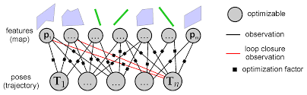
Factor Graphs
Map Representation:
ORB-SLAM 3 utilizes factor graphs to represent the map of the environment. This includes the camera poses (as variable nodes) and the observed features or landmarks (also as variable nodes).
The relationships between camera poses and landmarks, derived from observations, are modeled as factors.
Optimization:
Factor graphs in ORB-SLAM 3 are used for optimizing the map and trajectory. This is done using optimization techniques like Bundle Adjustment and pose graph optimization.
These optimizations aim to reduce the overall error in the system (e.g., the difference between observed and predicted landmark positions).
Handling Large-Scale Environments:
In large-scale environments, factor graphs enable efficient and effective management of a large number of variables and measurements. This is crucial for the performance of ORB-SLAM3 in extensive or complex settings.
Visual-Inertial SLAM (VI-SLAM):
In the case of Visual-Inertial SLAM, factor graphs in ORB-SLAM3 can also incorporate inertial measurements, further enriching the data used for optimization and enhancing the robustness and accuracy of the system.

Slide 12
Issues faced
Multiple Versions of Python and OpenCV Installed: Navigating the complexities arising from having various versions of Python and OpenCV installed on the system.
Accurate Camera Parameters Required for .yaml Files: The necessity for precise camera parameters in the .yaml configuration files, extending beyond the parameters for the phone camera.
Dependency Mismatch: Addressing issues related to mismatches in software dependencies.
C11 to C14 Migration: Transitioning from the C11 standard to the C14 standard in the coding environment.
OpenCV 3.2.0 to OpenCV 4.8.0 Migration: Upgrading from OpenCV version 3.2.0 to version 4.8.0, and managing the associated challenges.
Missing Files in the Repository: Dealing with the absence of several critical files in the repository.
Challenges Executing build_ros.sh: Difficulties encountered while attempting to execute the build_ros.sh script, often requiring multiple attempts.
ORB-SLAM 3's Limited Feature Detection: ORB-SLAM 3 struggles to detect features in scenarios involving rapid turns and dimly lit areas.
Inconsistent Loop Closure: The loop closure in ORB-SLAM 3 does not occur flawlessly in every iteration, indicating room for improvement in algorithm consistency.

Slide 13
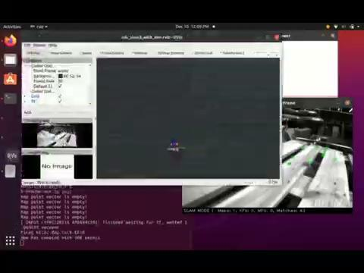
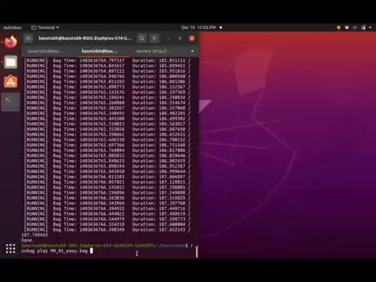
Results for euroc easy dataset
Monocular 2) Monocular+Inertial
Euroc dataset MH_01_easy.bag

Slide 14
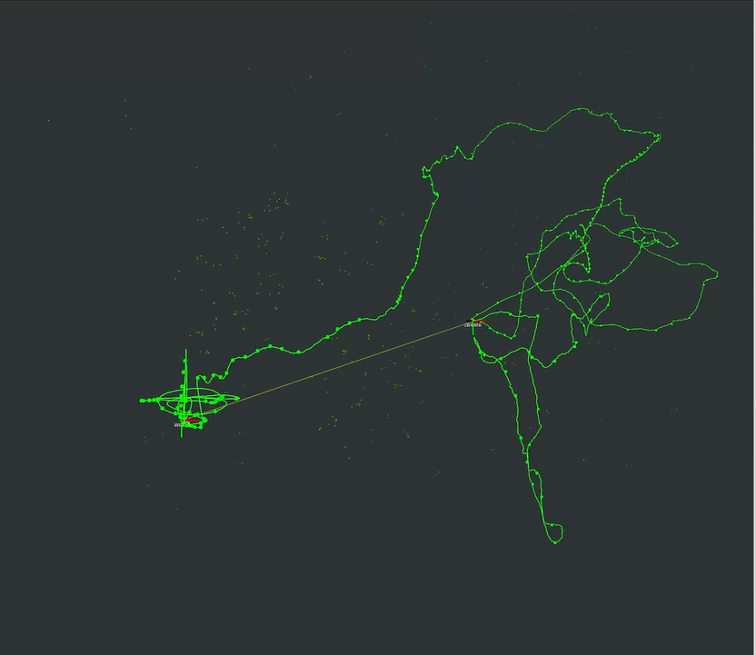
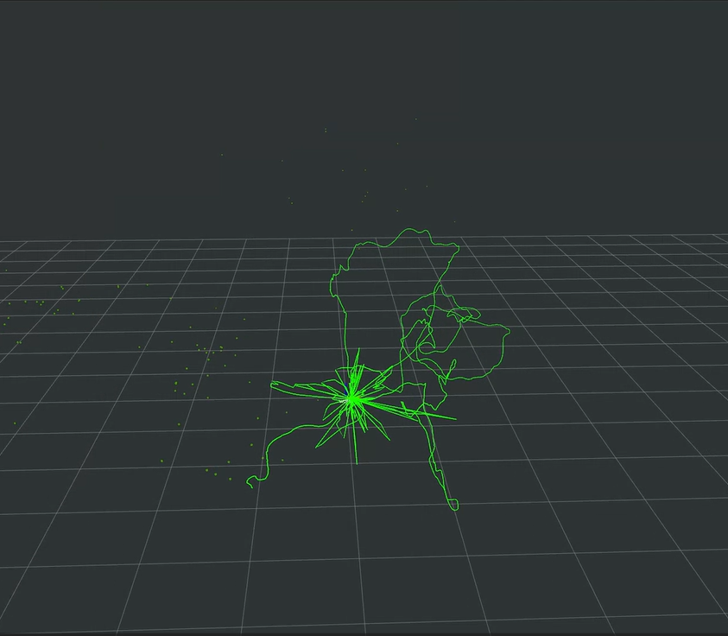
Results
Monocular 2) Monocular+Inertial
Analysis
In an evaluation of ORB SLAM 3's performance with different datasets, the system demonstrated notable compatibility and consistency. Using both a monocular camera dataset and an IMU dataset processed with the same ROS bag, the generated maps were almost identical, underscoring ORB SLAM 3's reliability in varied data handling.This test highlights ORB SLAM 3's robustness in 3D mapping and its potential applicability in diverse navigation and mapping scenarios.

Slide 15

Results for euroc difficult dataset
Monocular 2) Monocular+Inertial
Euroc dataset MH_05_difficult.bag

Slide 16
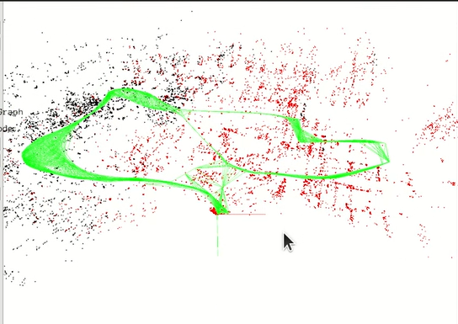
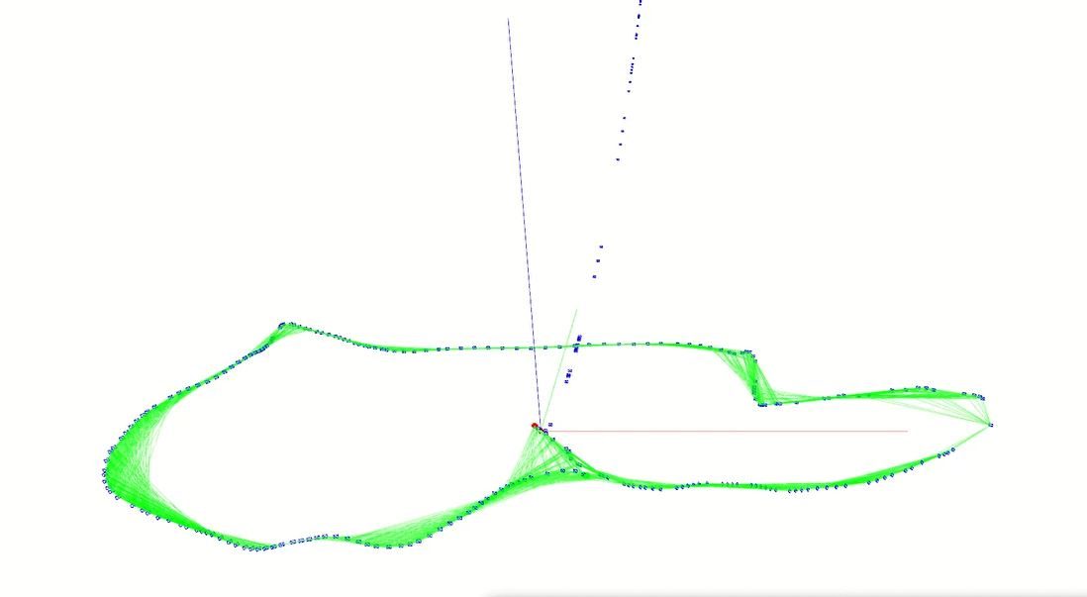
Results
Monocular 2) Monocular+Inertial
In a comparative analysis of ORB SLAM 3's performance using a challenging dataset (MH_05_DIFFICULT.BAG), notable differences emerged between the monocular data set and the combined mono-inertial dataset. Specifically, the monocular dataset alone did not yield a graph as accurate or detailed as the one produced with the mono-inertial dataset. This discrepancy highlights the enhanced performance and feature detection capabilities when inertial data is integrated. Additionally, the analysis revealed limitations in ORB SLAM 3's ability to detect features on certain surfaces, such as planes or in dark environments, indicating areas for potential improvement in its feature detection algorithms.

Slide 17
Results
Snell library

Slide 18
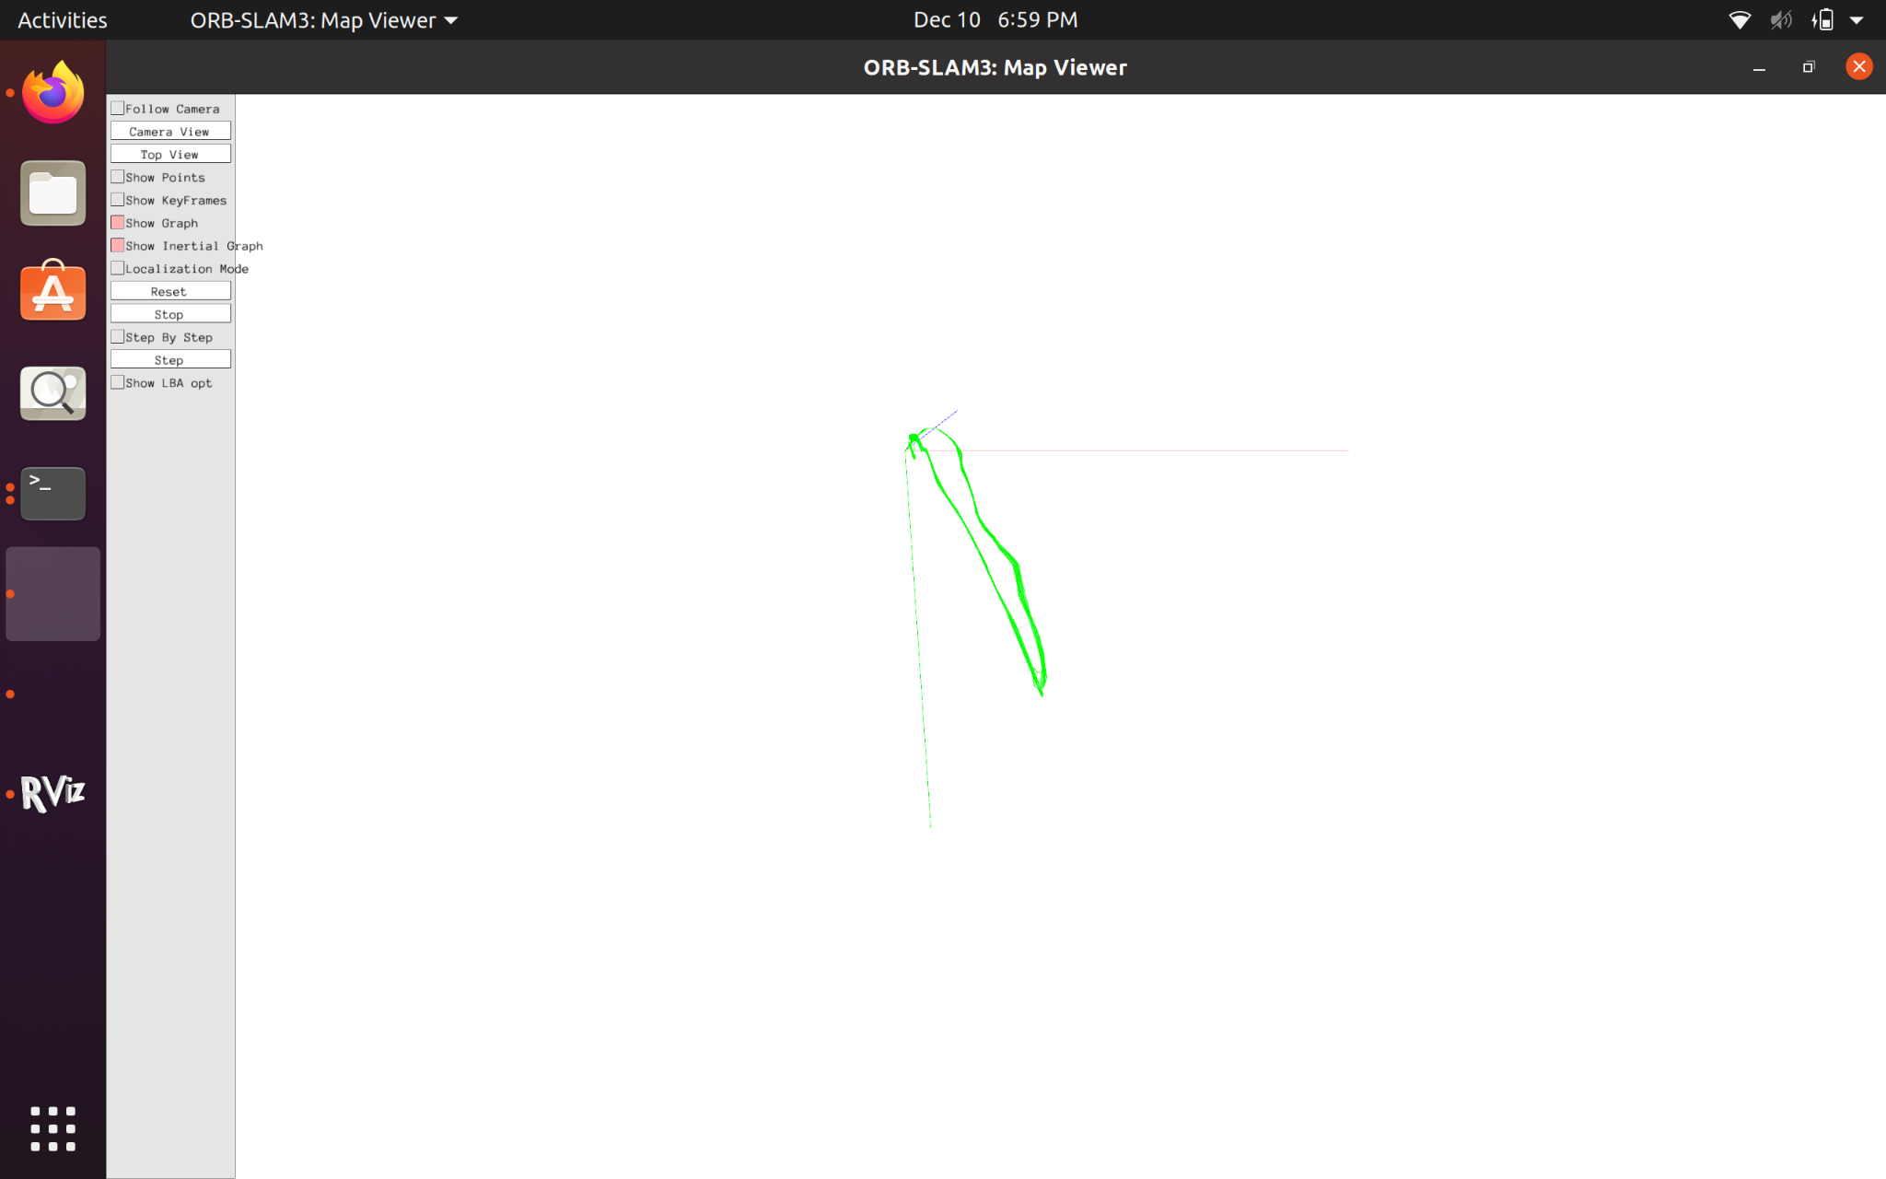
Results
Snell library
In testing ORB SLAM 3 with an indoor dataset featuring numerous moving people, the system performed well, successfully managing dynamic conditions and achieving loop closure, as evidenced in the video. However, challenges arose in the basement with plain surfaces, where the system consistently lost features during turns, highlighting an area for improvement in environments with fewer detectable features.

Slide 19
Results
Northeastern campus

Slide 20
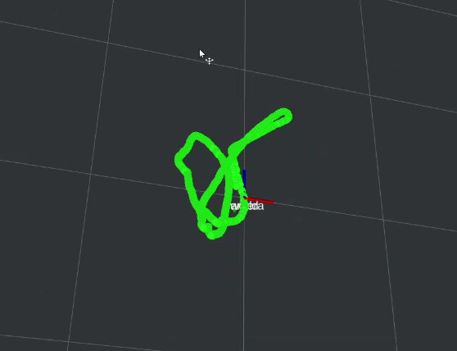
Results
Northeastern campus
This data was collected outdoor around the northeastern campus with comparatively fewer features as the upper part of the video consists of uniform coloured sky. The straight paths in this analysis were accurately plotted whereas the orb slam3 got a bit confused at the turns, and couldn’t estimate the exact angle of turn. Loop closure was successful in this case as well.

Slide 21
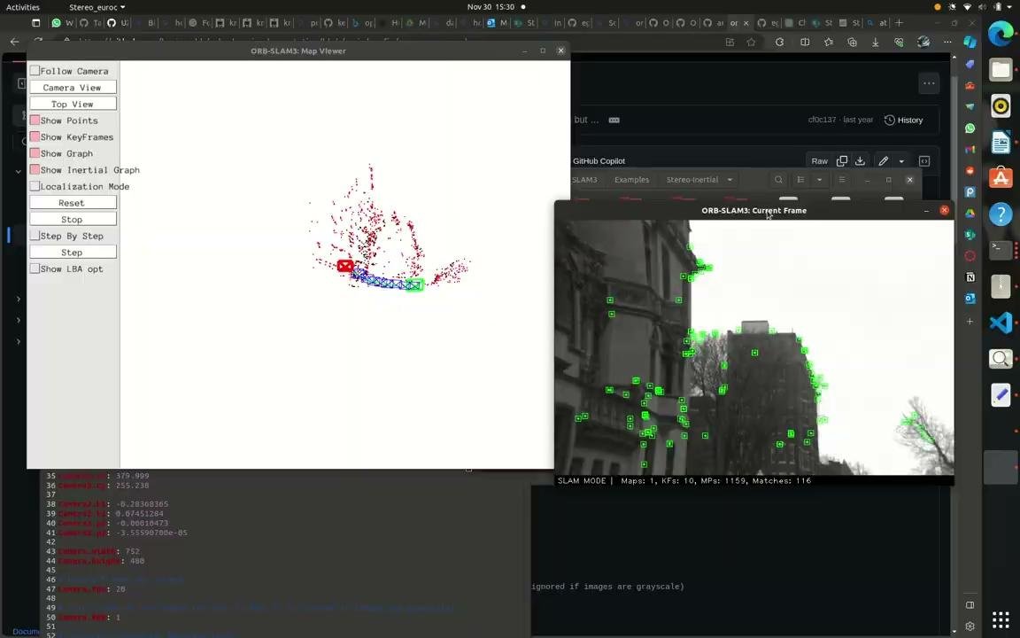
NUance car dataset
This dataset, provided by our professor, presented several challenges. The YAML configuration file provided with the dataset proved to be inaccurate as it did not give the expected output. This was evident as the output video received in the orb slam3 was warped at the edges, or sometimes, did not run at all . After multiple iterations of the values of camera parameters, we successfully achieved our best results with the dataset.

Slide 22
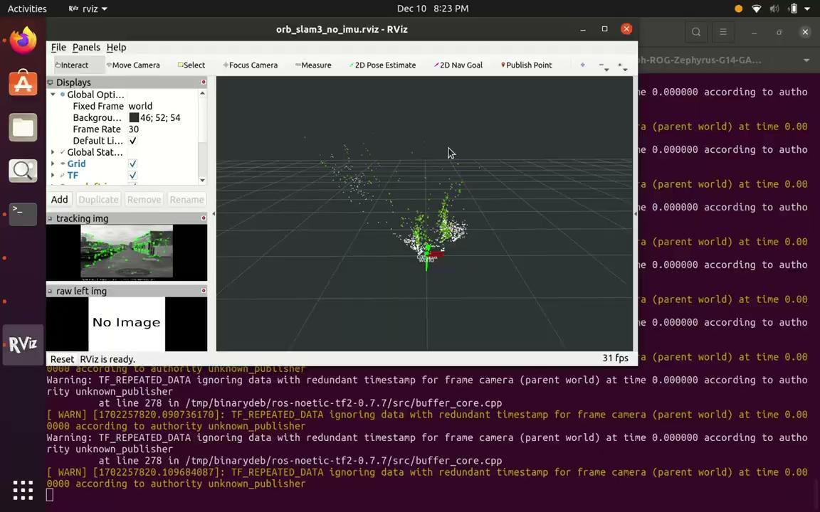
Results
Outdoor dataset with phone camera

Slide 23
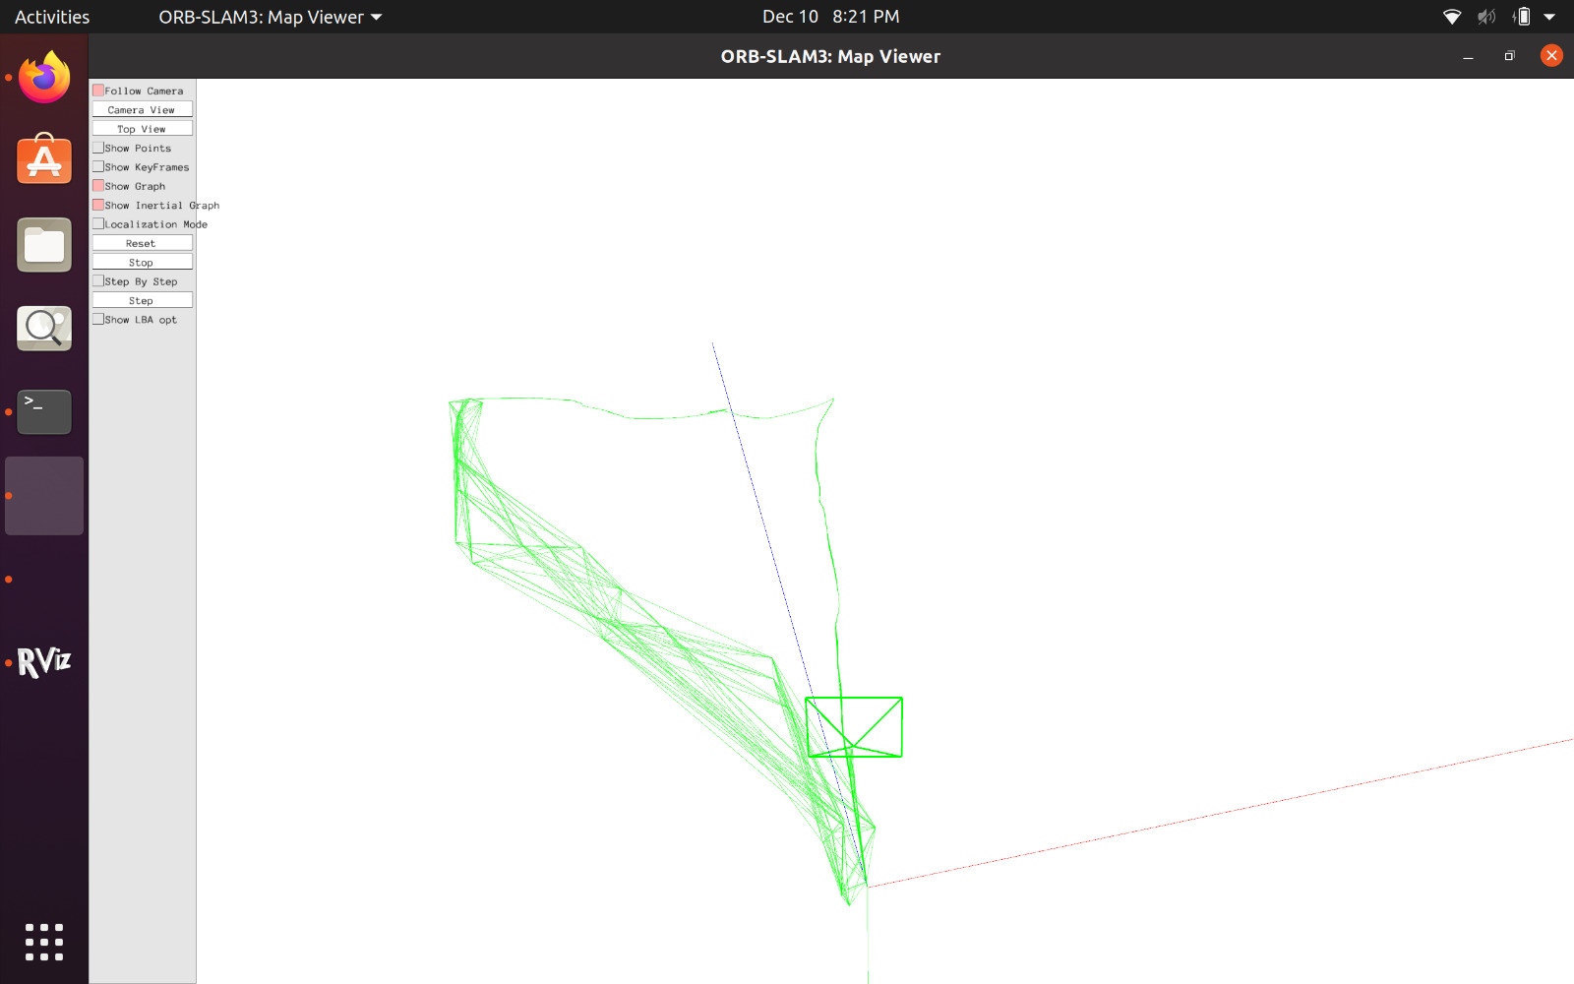
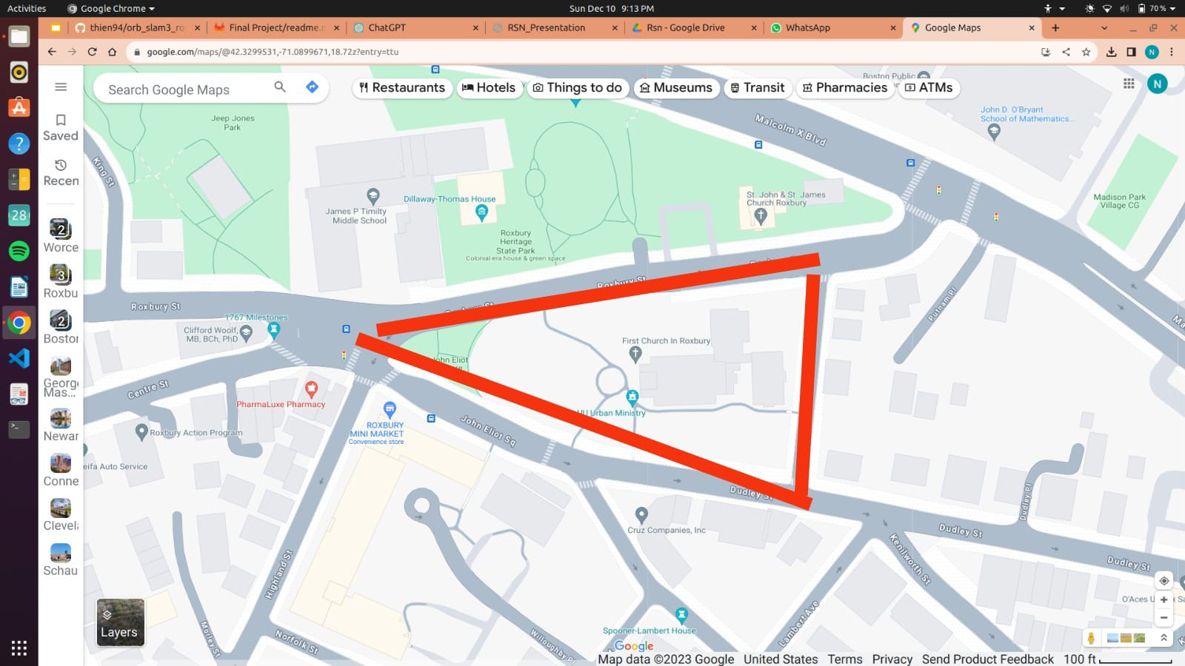
Results
Outdoor dataset with Phone camera
The ORB SLAM 3 system effectively mapped the outdoor dataset, demonstrating its capability in diverse environments. To ensure accuracy, particularly around turns and specific frames, we carefully maintained the camera's stability to prevent feature loss. Despite these precautions, multiple data retakes were necessary due to feature loss at various points. In the final analysis, it was observed that ORB SLAM 3 occasionally struggled to detect sufficient points in some areas, leading to deviations from a straight line in the mapped output. This highlights an area for potential improvement in feature detection in certain outdoor conditions.

Slide 24
Thank you!

