Slide 1

Detecting Manipulated Facial Images
Biometric Security (IT499)
Winter 2025
Dhirubhai Ambani Institute of Information
and Communication Technology (DA-IICT)
Darpan Lunagariya (202201462)
Neel Patel (202201494)

Slide 2

The Problem: DeepFakes
With the rapid advancement of AI tools, creating hyper-realistic fake images and videos has become incredibly quick and easy. This leads to severe consequences:
Spread of misinformation and fake news.
Defamation and privacy violations.
Loss of trust in digital content.
As fake images and videos become more realistic and common, we need systems that can detect these manipulations, even when the content is compressed. Social media platforms often compress images and videos, making it harder to spot fakes.

Slide 3
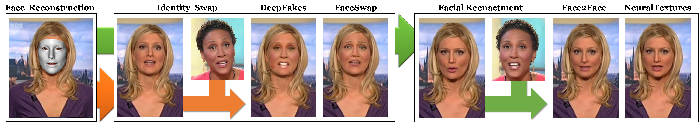
Types of Facial Manipulations
Identity Manipulation:
Replacing one person’s face with another’s.
(Available Tools: Deepfakes, FaceSwap)
Example: A celebrity’s face swapped onto someone else’s body.
Expresseion Manipulation:
Changing a person’s facial movements or expression.
(Available Tools: Face2Face, NeuralArchitectures)
Example: Make someone laugh or talk from normal image.

Slide 4
FaceForensics++ Dataset
The authors created a large-scale dataset called FaceForensics++ to effectively train detection models.
This dataset includes over 1.8 million images generated from 1,000 YouTube videos using four manipulation methods: DeepFakes, Face2Face, FaceSwap, and NeuralTextures. Among these, Face2Face and FaceSwap rely on computer graphics, while DeepFakes and NeuralTextures use learning-based approaches.
They applied real-world compression (High Quality (HQ) and Low Quality (LQ)) to mimic how images are processed on social media platforms.

Slide 5
Image Manipulation Methods
FaceSwap
DeepFakes
This method uses facial landmarks to fit a 3D template model on the source image. The model is then projected onto the target image by aligning it with the target’s landmarks and using the source image’s textures. Finally, the rendered model is blended into the target image, and color correction is applied to create a manipulated image.
This method uses two autoencoders with a shared encoder. The autoencoders are trained to reconstruct images of the source and target faces separately. A face detector crops and aligns the images. To create a fake image, the trained encoder and decoder of the source face are applied to the target face. The output is then blended into the target image using Poisson image editing for a seamless result.

Slide 6
Image Manipulation Methods
Face2Face
NeuralTextures
The original Face2Face method uses two video streams and manual keyframe selection to create a detailed 3D face model. The first few frames were used to build a 3D face model and to track expressions across the video. Keyframes were automatically selected based on the face’s left and right angles. The method then transferred the source video’s facial expressions (using 76 Blendshape coefficients) to the target video, generating realistic reenactments.
It uses the original video data to learn a neural texture of the target person, combined with a rendering network. The model is trained using a photometric reconstruction loss and an adversarial loss. The method relies on tracked facial geometry In this implementation, only the mouth region’s expressions are modified, leaving the eye region unchanged for realistic results.

Slide 7
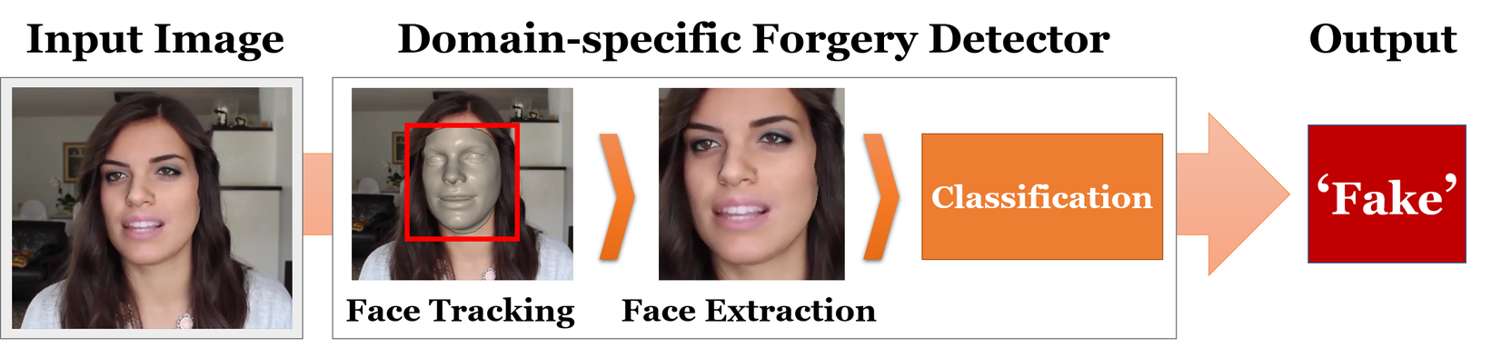
Forgery Detection
Forgery detection is treated as a binary classification task, where each frame of the video is classified as either real or manipulated.
To detect facial forgery, we use a face tracking method to locate and extract the face region from each video frame. This extracted region is then passed into a trained classification network, which predicts whether the face is real or manipulated.

Slide 8
Forgery Detection
Predictions based on Steganalysis Features
This method uses handcrafted features, specifically patterns of 4 pixels along horizontal and vertical directions in high-pass images, resulting in 162 features. These features are then used to train a linear Support Vector Machine (SVM) classifier.
Predictions based on Learned Features
Five different CNN-based networks were used to perform the classification task.
Cozzolino Method
Bayar and Stamm Method
Rahmouni Method
MesoInception-4 Network (Inspired by InceptionNet)
XceptionNet Network

Slide 9
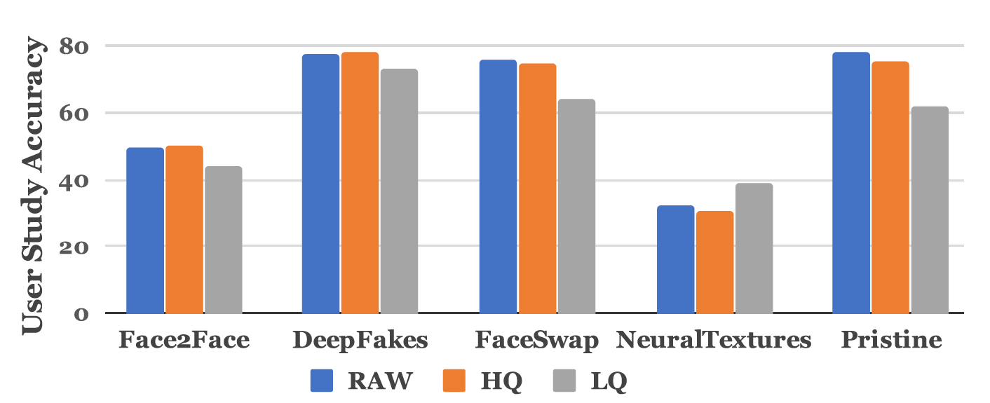
Forgery Detection Results
Forgery Detection of Human Observers:

Slide 10
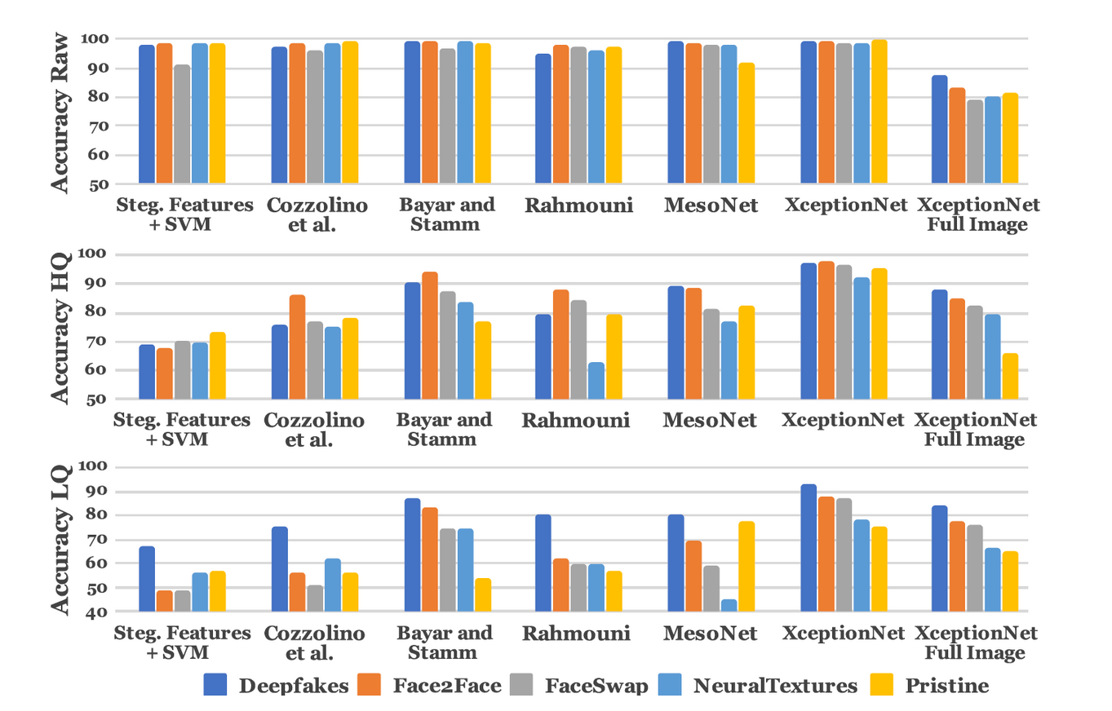
Forgery Detection Results
Automatic Forgery Detection Methods:

Slide 11
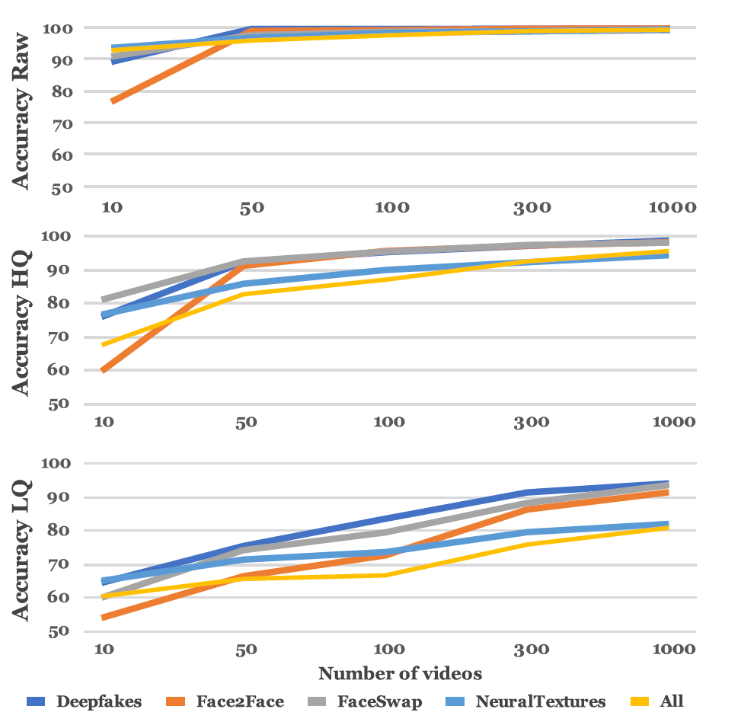
Size of Training Dataset
This graph shows how the accuracy of the XceptionNet model improves as the number of videos in the training dataset increases.
It highlights that a large amount of data is essential for better accuracy, particularly for low-quality videos.

Slide 12
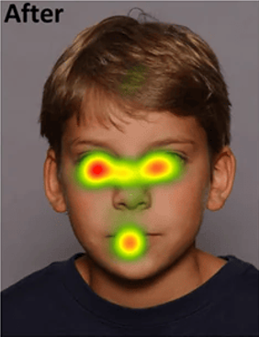
Further Work
Identifying critical regions that model uses to detect manipulations using the heatmaps.
Visualization Approaches:
GradCAM: Highlight class-specific regions using gradients from the final convolutional layer.
SHAP: Quantify pixel-level contributions to predictions.

Slide 13
Conclusion
While the latest facial manipulation methods produce highly realistic forged images, this work demonstrates that trained forgery detectors can effectively identify these fake images, even in challenging low-quality scenarios.
A large-scale dataset like FaceForensics++ enables more effective training of networks by leveraging domain-specific knowledge.
As new manipulation techniques emerge, tools like transfer learning will be crucial for detecting fakes with minimal training data.

Slide 14
Thank you

