Slide 1


A.D.PATEL INSTITUTE OF TECHNOLOGY
Department: Information Technology
Subject: Design Engineering 2A
Topic: Vehicle tracking station
Name & Enrollment: Neel Shah(170010116050)
Vijul Patel(170010116040)
Guided by: Prof. Jayandrath R Mangrolia

Slide 2
Key concepts
Introduction
Flow
Features
Technology
Elements
Prototype
Reference

Slide 3
Introduction
As a one report suggest in Motor vehicles, About $6 billion was lost to motor vehicle theft in 2018. The average dollar loss per theft was $8,407.
Motor vehicles were stolen at a rate of 228.9 per 100,000 people in 2018, down from 237.7 in 2017.
In 2018, 748,841 vehicles were stolen, down 3.1 percent from 772,943 vehicles in 2017.

Slide 4
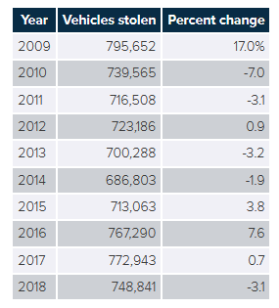
Fig shows the change of percentage in every year

Slide 5
So, there are need of system that would be helpful for people which will help to find their stolen vehicle in sometime.
There are some systems are available today.
But, there are some problem in each system.
So, we are going to make some efficient system.

Slide 6
Intent
Our key concept is to use e-memo system for the people
We can take all frames that will be captured by CCTV and make one data base that will store details of vehicles pass from that CCTV.
We process that frames to find object and number plates and store it in database.

Slide 7
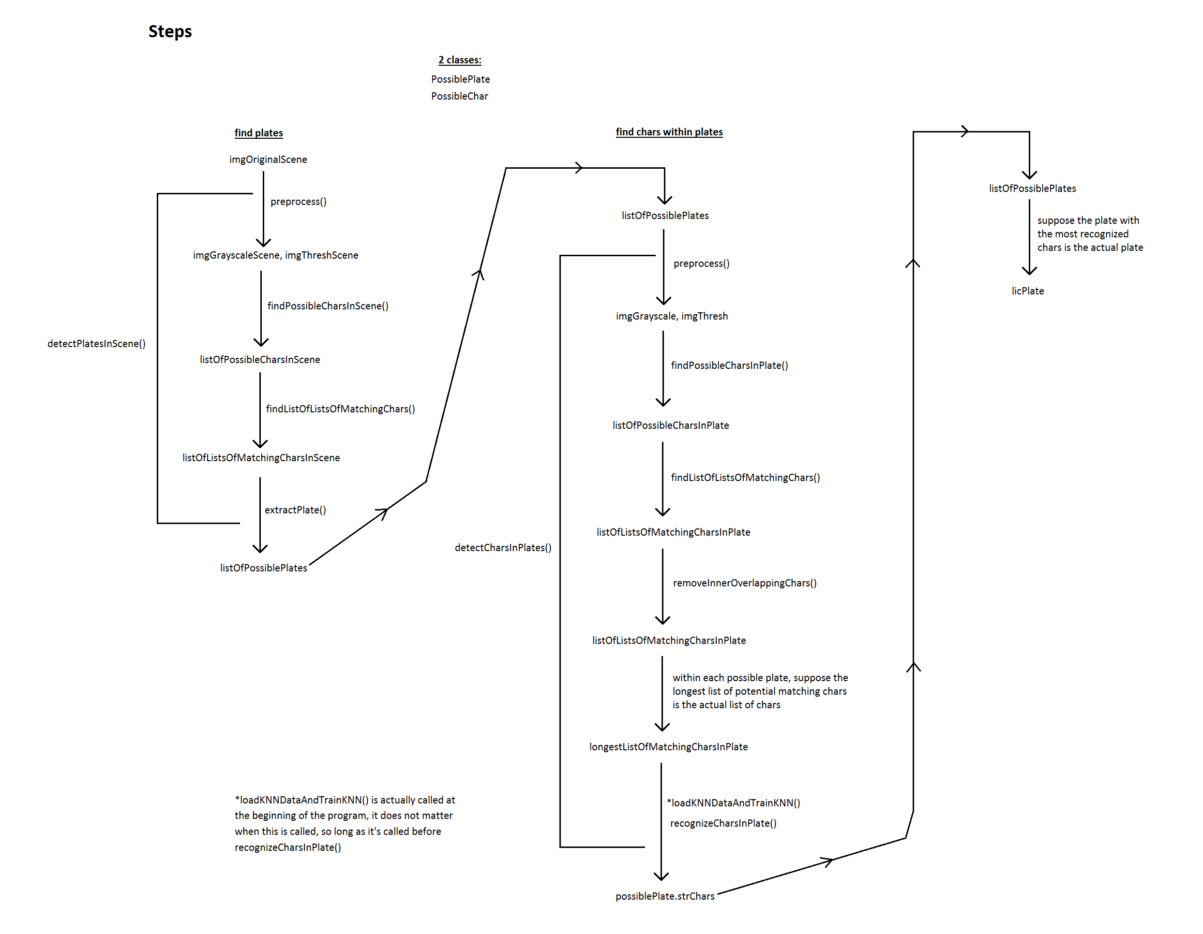
Flow

Slide 8
Features
There are mainly four features of this Smart Tracker
Object Detection (Vehicle Recognition)
Number-Plate Recognition
Store Vehicle Details In Database
Search given number plate in database
It can be implemented using Image Processing.

Slide 9
Vehicle Recognition
Vehicle recognition system in which the basic components of road vehicles are first located in the frames based on background subtraction and then Harris corner(Algorithm) of moving vehicles are abstracted.
At last, we calculate the Hausdorff distance(Algorithm) between the Harris corner of which need to be recognized and that of standard samples of car, bus, truck and other vehicle.
The two whose Hausdorff distance is the smallest could be judged as the same type.

Slide 10
Because of vehicle detection and recognition in frames, cluttered road images, a new vehicle recognition approach is proposed in order to better deal with vehicle variability, illumination conditions, partial occlusions and rotations.
The experimental results show that the system can accurately detect and recognize the vehicles on the urban multi-traffic road, while satisfying the real-time requirement.

Slide 11
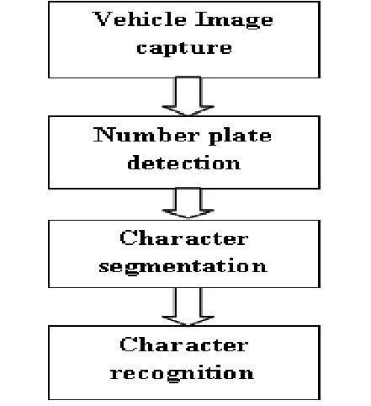
Number Plate Recognition
The first step i.e. to capture image of vehicle looks very easy but it is quite difficult task to capture image of moving vehicle in such a manner that none of the component of vehicle especially the vehicle number plate should be missed.
Presently number plate detection and Recognition processing time is less than 50ms in many systems.
The success of fourth step depends on how second and third step are able to locate vehicle number plate and separate each character.

Slide 12
Object Detection Algorithm
For Object Detection there are two algorithm :
Horn-Schunk Algorithm
Lucas-Kanade Algorithm
For speed calculation form object detection algorithm first of all we first detect our object than we find its centroid point , using two consecutive frame we find difference of pixel using centroid point.

Slide 13
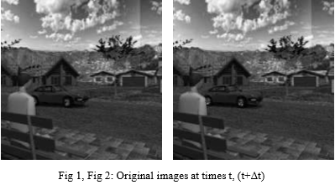
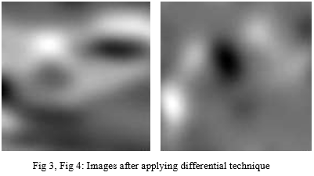
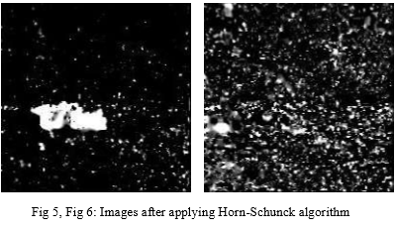
Horn-Schunk Algorithm

Slide 14
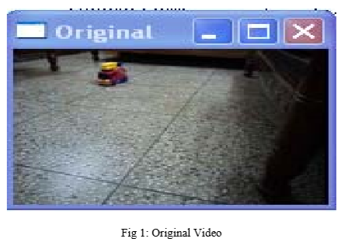
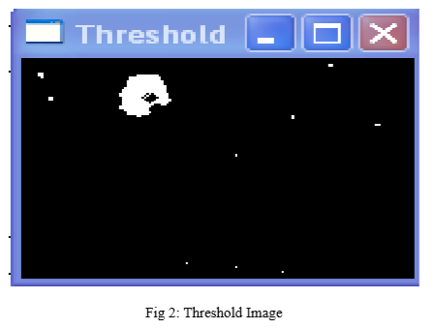
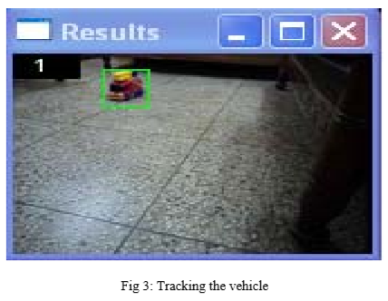
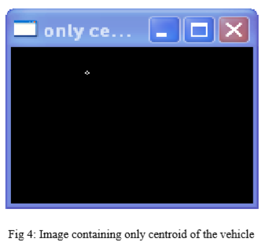

Slide 15
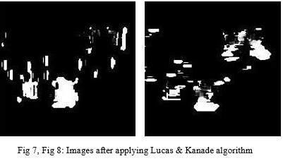
Lucas-Kanade Algorithm

Slide 16
Differences
Horn Schunk Algorithm
Lucas kanade Algorithm
Horn Schunk algorithm takes more computation time
Mathematically complex
Optimize the function based on residuals from the brightness constancy
It uses gradient constraints equations using global smoothness constraints.
It takes less computational time than horn-Schunk algorithm.
Uses image patches and windowing methods
Using least square methods
Improves the signal strength & reduces noise giving more accurate & relative speed results.

Slide 17
Searching
Searching is dependent on which database we use in our project
Here we use mysql so there are two features of it for searching
Full-text search function.
SQL like operator

Slide 18
Elements
Camera - That take the images of the vehicles (front or rear side). We use the CCTV cameras which will be located at circles or any other places.
Computer & Software - Normally a PC running Windows or Linux. It runs the application which controls the system, get and reads the frames, find number plates from frames , stores data in database and interact with other applications and systems.

Slide 19
Database - The data stored here. The data includes the recognition results and (optionally) the vehicle or driver-face.
Device – This is the device like laptop or smart phones to view web or app of our idea.

Slide 20
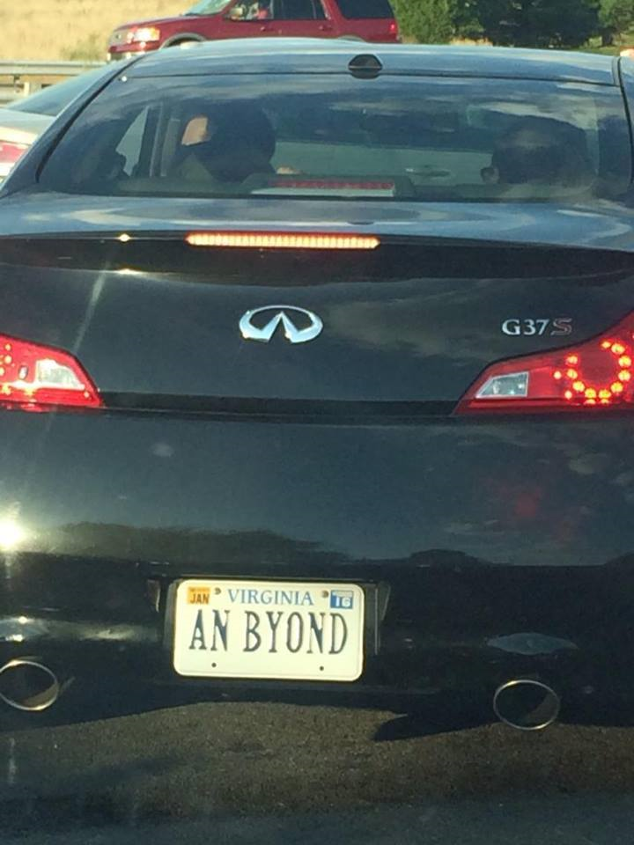
Prototype
Fig shows the original picture of the object which will be processed and from that we will found the number plate .

Slide 21
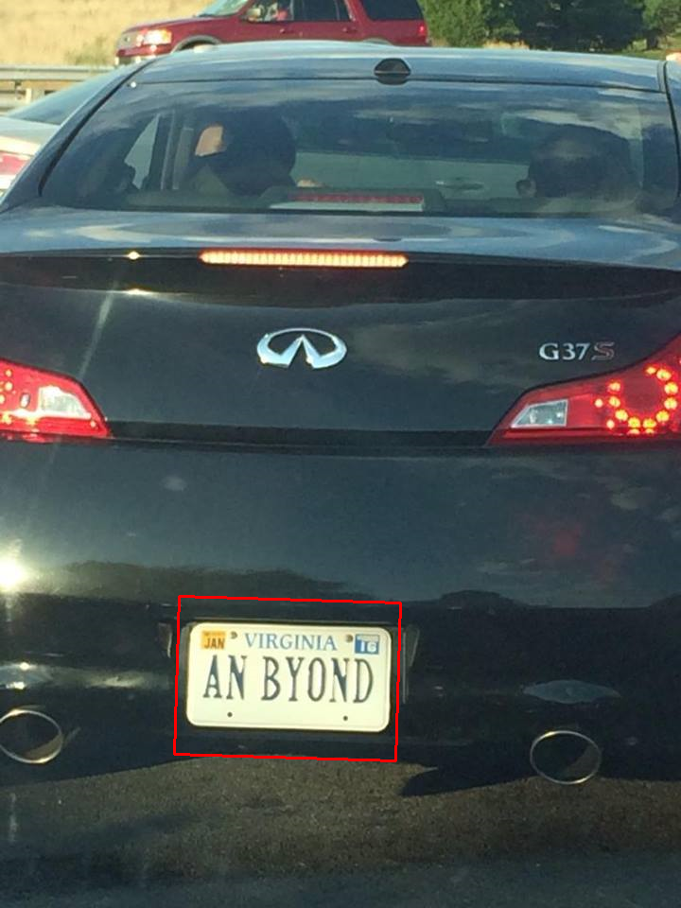
Picture shows the processed image of given frame (photo).
In the photo we can see the red box which will be drawn on number plate.

Slide 22
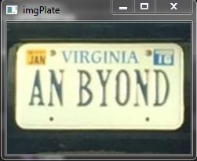
Picture shows the extracted number plate from the image which will be further used for number plate recognition.

Slide 23

After completing process it will give total number of possible number plates that would be found in picture and from that which would optimal that will be extracted

Slide 24
References
https://en.wikipedia.org/wiki/Automatic_number-plate_recognition.
https://www.researchgate.net/publication/236888959_Automatic_Number_Plate_Recognition_System_ANPR_A_Survey
https://www.researchgate.net/publication/230846430_Speed_Detection_Camera_System_using_Image_Processing_Techniques_on_Video_Streams
https://ieeexplore.ieee.org/document/5274034

Slide 25


