Slide 1
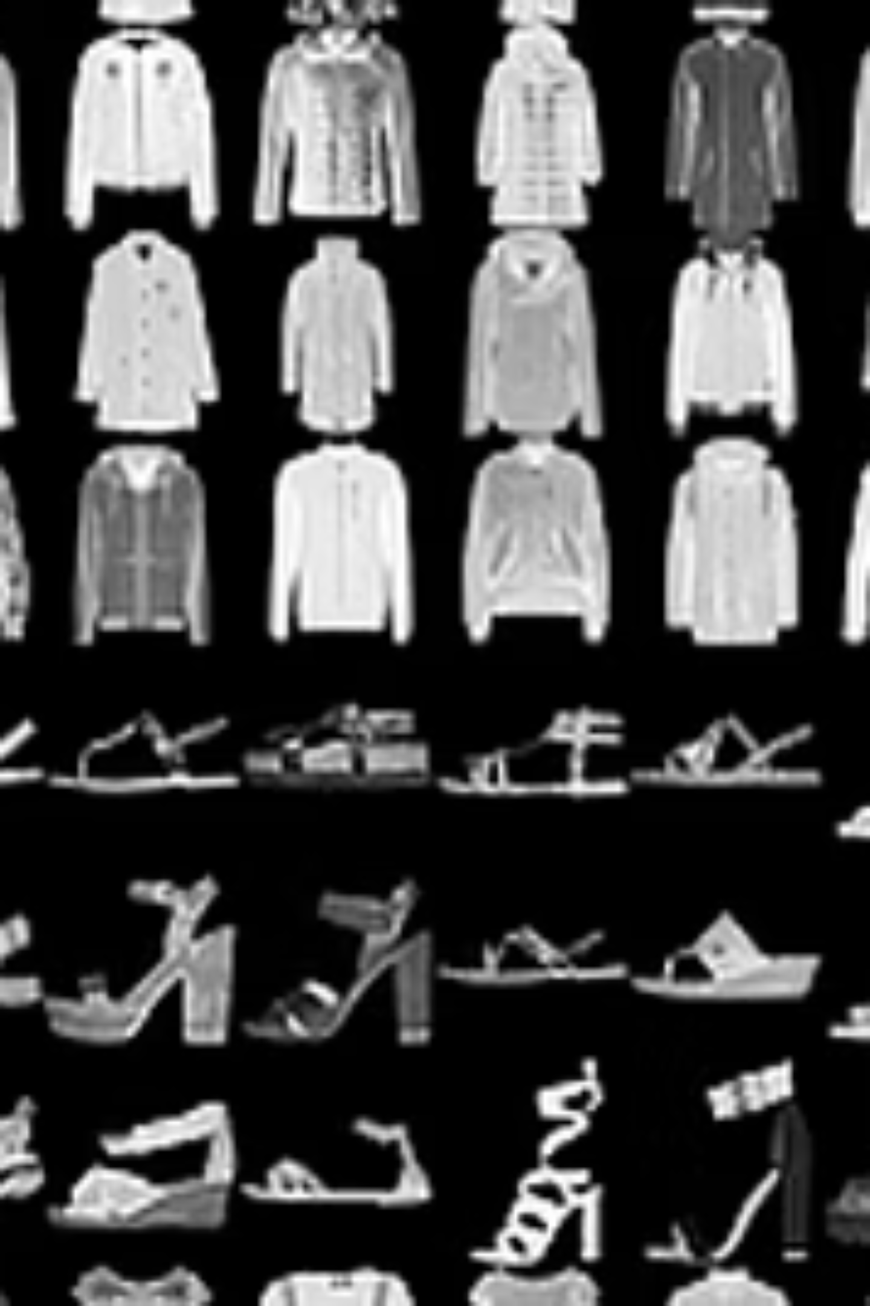
Project Title: Fashion-MNIST Classification ANN vs CNN Comparative Analysis
Presenter’s Name (NEEL ANADKAT – P2943206):
ARTIFICIAL INTELLIGENCE (MSC)
Date of Presentation : 17 NOV 2025

Slide 2
Introduction
Why Fashion-MNIST?
Modern benchmark for image classification with 70,000 grayscale images across 10 clothing categories. More challenging than traditional MNIST digits, providing real-world application for automated clothing categorization in e-commerce.
Research Question
Do Convolutional Neural Networks significantly outperform traditional ANNs for clothing image classification?
Key Challenge
Dataset Scale
Distinguishing visually similar garments like shirts vs t-shirts, coats vs pullovers
60,000 training images, 10,000 test images, 28×28 pixel resolution

Slide 3
Objectives & Goals
01
02
Implement ANN Architecture
Implement CNN Architecture
Build Multi-Layer Perceptron with dropout regularization
Create convolutional network with batch normalization and modern techniques
03
04
Compare Performance
Error Analysis
Identify failure cases and confusion patterns between classes
Analyze metrics, training dynamics, and architectural trade-offs
85%
10
2
Target Accuracy
Classes
Models
Minimum threshold for both models
Clothing categories to classify
ANN and CNN for comparison

Slide 4
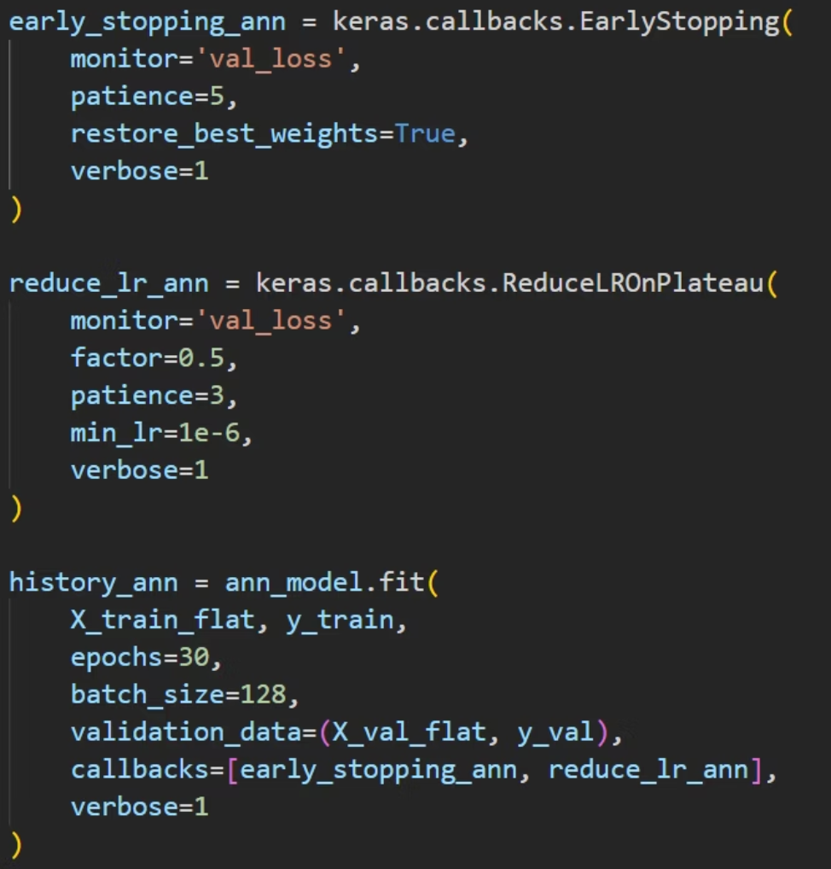
Methodology & Approach
Data Loading
Preprocessing
Split Data
Train Models
Evaluate
Fashion-MNIST dataset with 70K images
Normalize pixels [0,255] → [0,1]
48K train / 12K val / 10K test
ANN and CNN with callbacks
Compare performance metrics
Training Strategy
Optimizer: Adam (learning rate 0.001)
Loss: Sparse Categorical Crossentropy
Regularization: Dropout, Early Stopping, LR Reduction
CNN Enhancement: Data augmentation (rotation, shift, zoom)

Slide 5

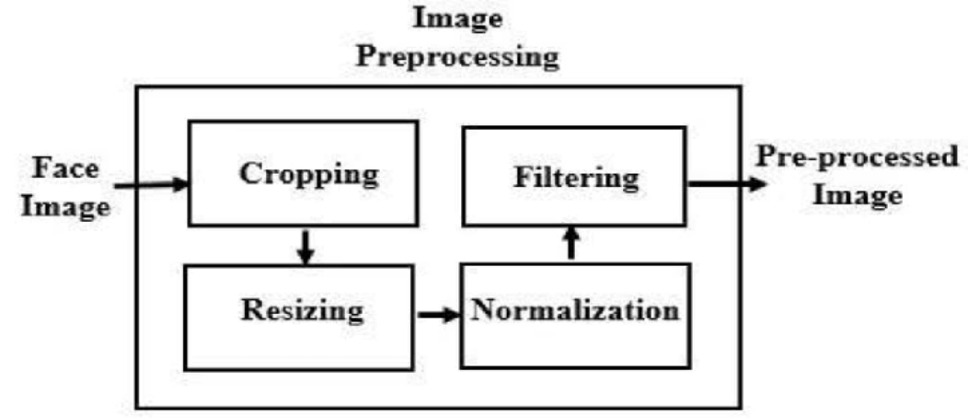
Data Preparation
Dataset Split
Validation Set
Test Set
48,000 training samples with stratified distribution across all 10 classes
12,000 samples for monitoring training and preventing overfitting
10,000 samples for final evaluation and performance comparison
Data Transformations
Data-preprocessing: Normalize pixels [0,255] → [0,1].
ANN Format: Images flattened to 784-dimensional vectors, destroying spatial structure but enabling fully-connected processing.
CNN Format: Preserved 28×28×1 spatial structure with added channel dimension for convolutional operations.
Augmentation (CNN only): Rotation ±10°, width/height shift ±10%, zoom ±10% applied during training to improve generalization.
Dataset Link: https://github.com/zalandoresearch/fashion-mnist

Slide 6


Model Architectures
ANN (Multi-Layer Perceptron)
CNN (Convolutional Network)
Input Layer
Input
784 neurons (flattened 28×28)
28×28×1 images
Dense 512 + Dropout 0.3
Conv Block 1
ReLU activation
Conv32→BN→Conv32→BN→MaxPool→Dropout
Dense 256 + Dropout 0.3
Conv Block 2
ReLU activation
Conv64→BN→Conv64→BN→MaxPool→Dropout
Dense 128 + Dropout 0.2
Classifier
ReLU activation
Flatten→Dense256→BN→Dropout
Output Layer
Output
10 neurons, Softmax
10 neurons, Softmax
Parameters: 567,434 total trainable parameters
Parameters: 872,426 (1.54× more than ANN)
Key Difference: ANN destroys spatial structure; CNN preserves and exploits it through convolutional filters

Slide 7
Results & Findings
89%
93%
+4.2%
ANN Accuracy
CNN Accuracy
Improvement
Test performance
Test performance
CNN over ANN
Metric
ANN
CNN
Change
Test Accuracy
88.98%
92.67%
+4.15%
Test Loss
0.3168
0.1979
-39.6%
Training Epochs
22
42
+91%
Inference Speed
0.126s
0.141s
1.12× slower
Easiest Classes
Hardest Class
Trouser (99%), Bag (99%), Sandal (99%) - distinctive shapes
Shirt: ANN 65.8% → CNN 85.0% (+19.2% improvement!)

Slide 8
Discussion & Interpretation
Why CNN Outperforms ANN
Spatial Feature Preservation
Parameter Efficiency
Convolutions respect image structure, detecting edges, textures, and shapes hierarchically rather than treating pixels independently.
Weight sharing across spatial locations means a 3×3 filter applies everywhere, versus unique weights for every pixel in ANN.
Translation Invariance
Augmentation Synergy
Max pooling provides robustness, recognizing garments regardless of slight position shifts in the image.
CNNs benefit more from augmented variations, learning robust spatial features from rotated and shifted images.
Most Confused Pairs
CNN Advantage
Shirt ↔ T-shirt/top (145 errors), Pullover ↔ Coat (104 errors) - visual similarity challenges both models
Coat↔Pullover errors reduced 46% (98→53), demonstrating better spatial feature learning

Slide 9
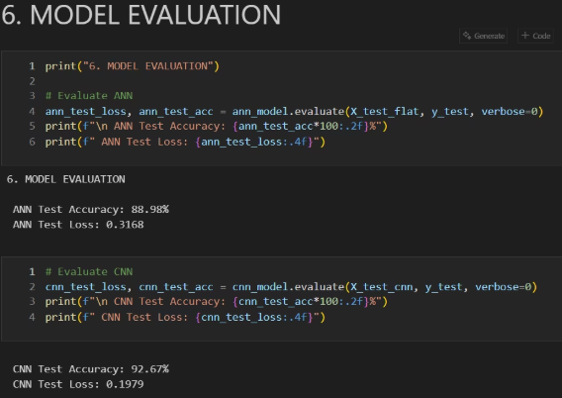
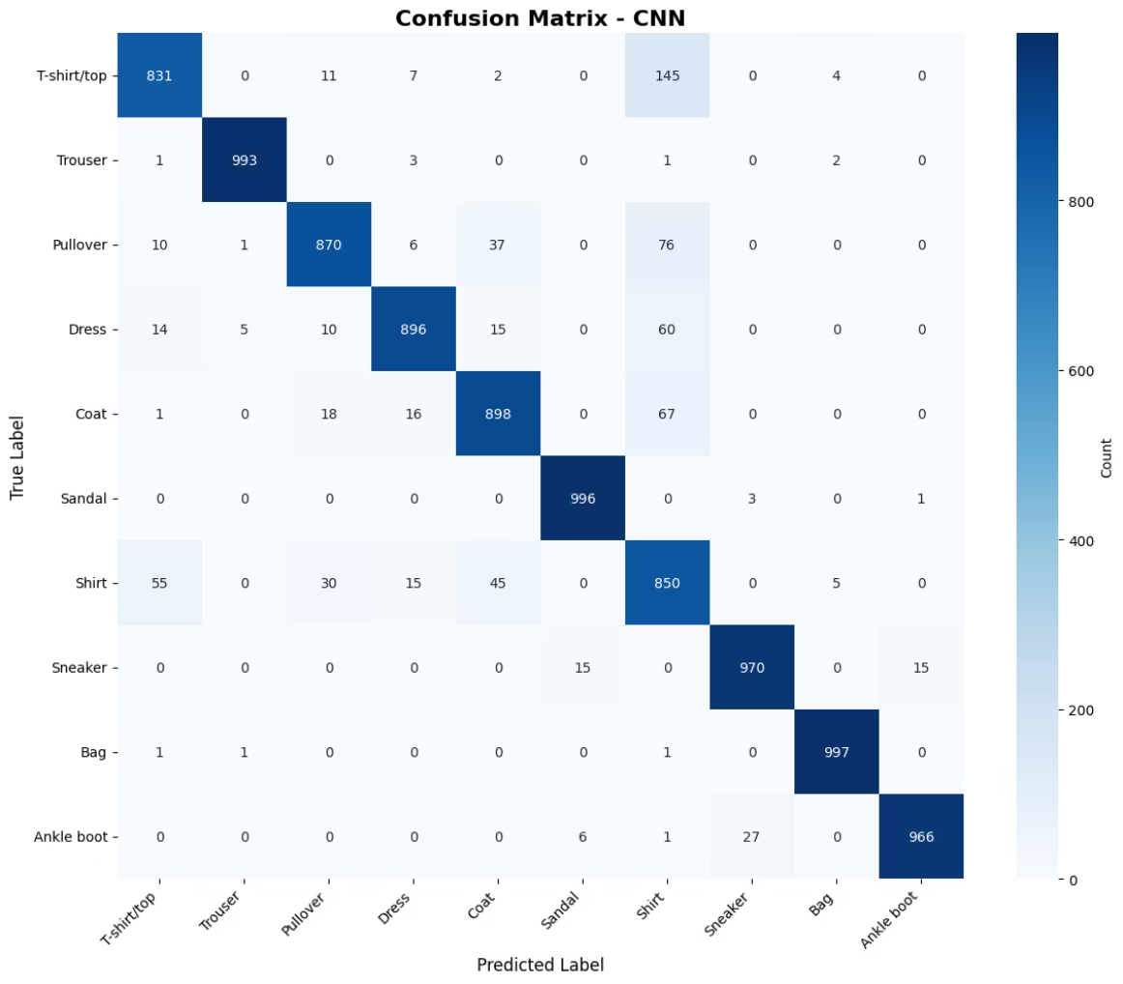
Conclusion & Summary
CNN achieves 92.67% accuracy
1
2
3
Key Achievement
Persistent Challenges
Modern Techniques
CNN outperforms ANN by 4.15%, validating spatial inductive biases for image classification tasks
Identified visual similarity issues (Shirt classification, Coat vs Pullover) that challenge even advanced models
Demonstrated impact of batch normalization, data augmentation, and regularization on model performance
Lessons Learned
Trade-offs
Architecture must match data structure (spatial → convolutional)
CNN: Better accuracy, slower inference
Regularization crucial for generalization
ANN: Faster predictions, lower accuracy
Trade-off: 53.7% more parameters for meaningful accuracy gain
Parameter efficiency ≠ computational efficiency

Slide 10
Future Work & Acknowledgments
Short-term
Long-term
Stratified splitting, ensemble methods, attention mechanisms for focusing on discriminative regions
Vision Transformers, explainability with Grad-CAM, model quantization for mobile deployment
1
2
3
Medium-term
Transfer learning with ResNet, hyperparameter optimization using Optuna, deeper CNN architectures
Deployment Considerations
Acknowledgments
Model quantization (INT8) for speed optimization
TensorFlow and Keras frameworks for implementation. Fashion-MNIST dataset creators for providing benchmark data. Deep Learning course instructors for guidance.
TensorFlow Lite for mobile applications
Batch inference for server deployment
Confidence thresholding to reject uncertain predictions
Tools Used: Python, TensorFlow 2.19, NumPy, Matplotlib, Seaborn, Scikit-learn
Continuous monitoring for distribution drift

