Slide 1
Visualising Solid Shapes
Mathematics (CBSE)
Standard 7
Textbook: (Chapter 15 NCERT)
Slides:https://github.com/NeelChoksi/visualising-solid-shapes
Neel Choksi
19BCE0990
VIT-Vellore

Slide 2
Topics
Plane Figures and Solid Shapes
Faces , Edges Vertices
Building 3-D Shapes
Drawing Solids on a flat surface and Visualizing them.
Viewing Different Sections of a Solid

Slide 3



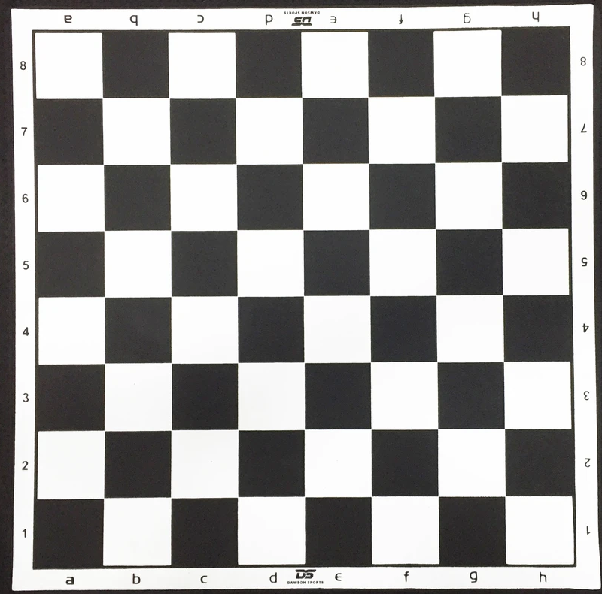
Plane Figures(2-D)
Traffic Sign(Triangle)
Clock(Circle)
Paper(Rectangle)
Chessboard(Squares)

Slide 4
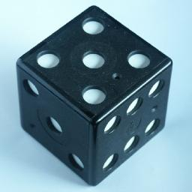
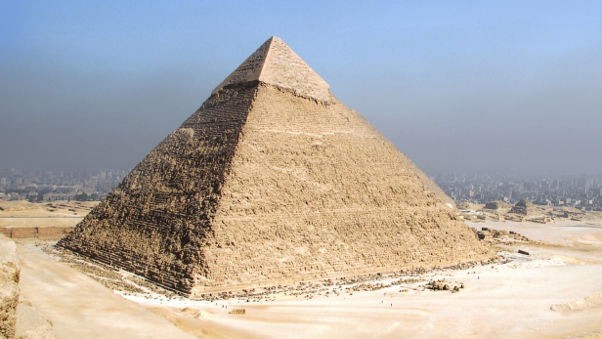
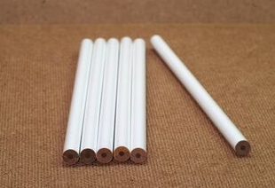

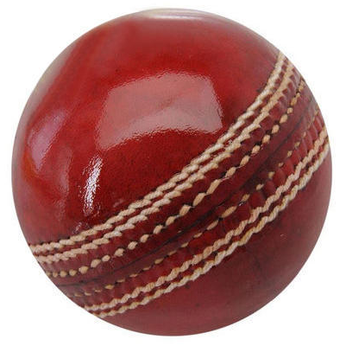
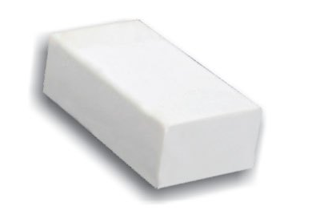
Solid Shapes(3-D)
Dice(Cube)
Pencil (Cylinder)
Pyramid
Cone
Ball(Sphere)
Eraser(Cuboid)

Slide 5
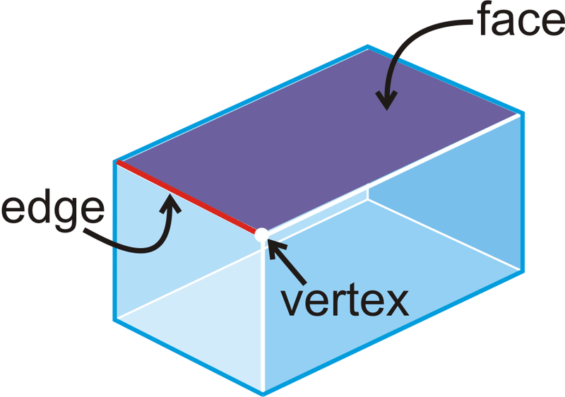
Faces , Edges Vertices

Slide 6
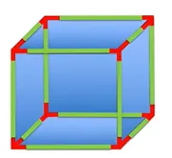
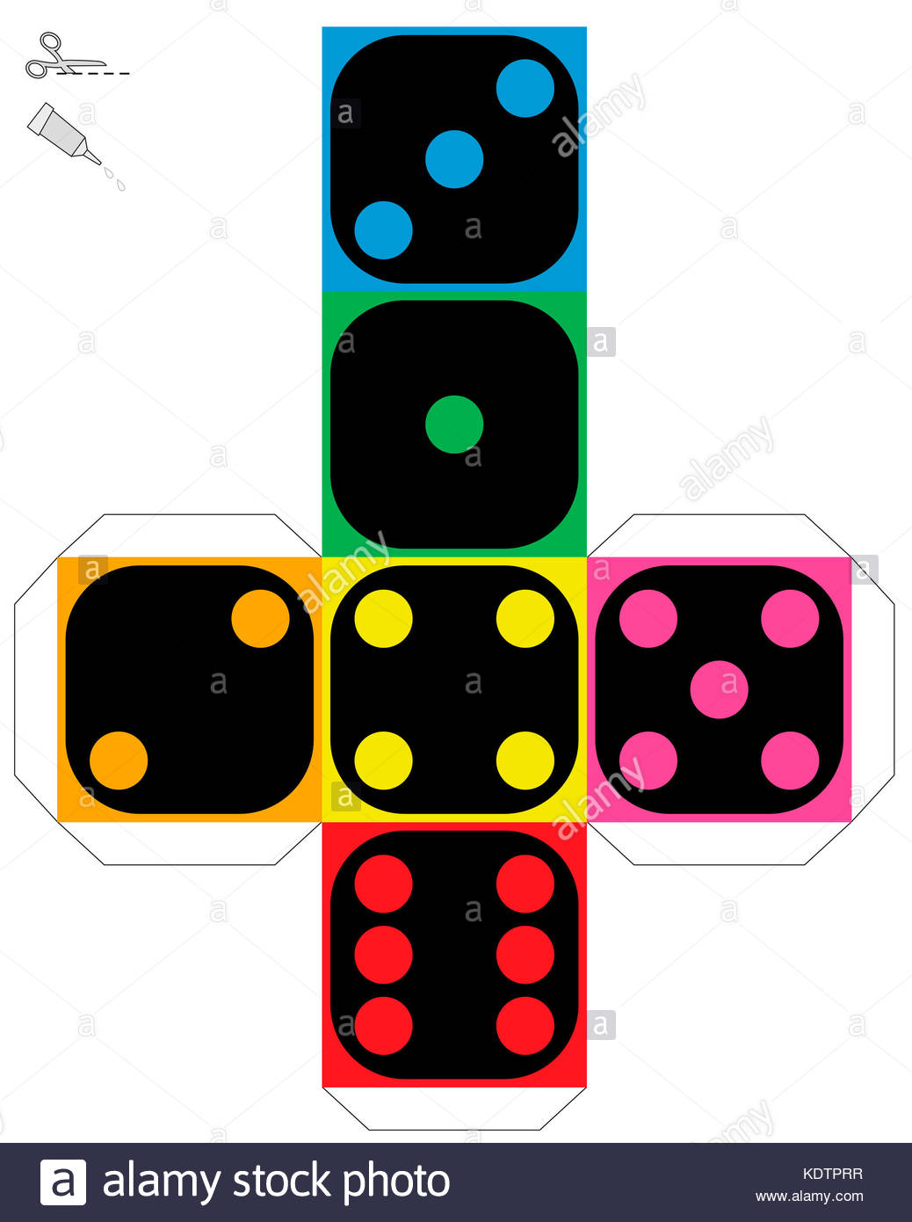
Building 3-D Shapes
Cube
Faces | 6
Edges | 12
Vertices | 8

Slide 7
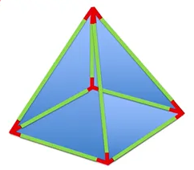
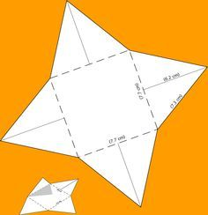
Building 3-D Shapes
Pyramid
Faces | 5
Edges | 8
Vertices | 5

Slide 8
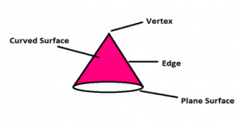
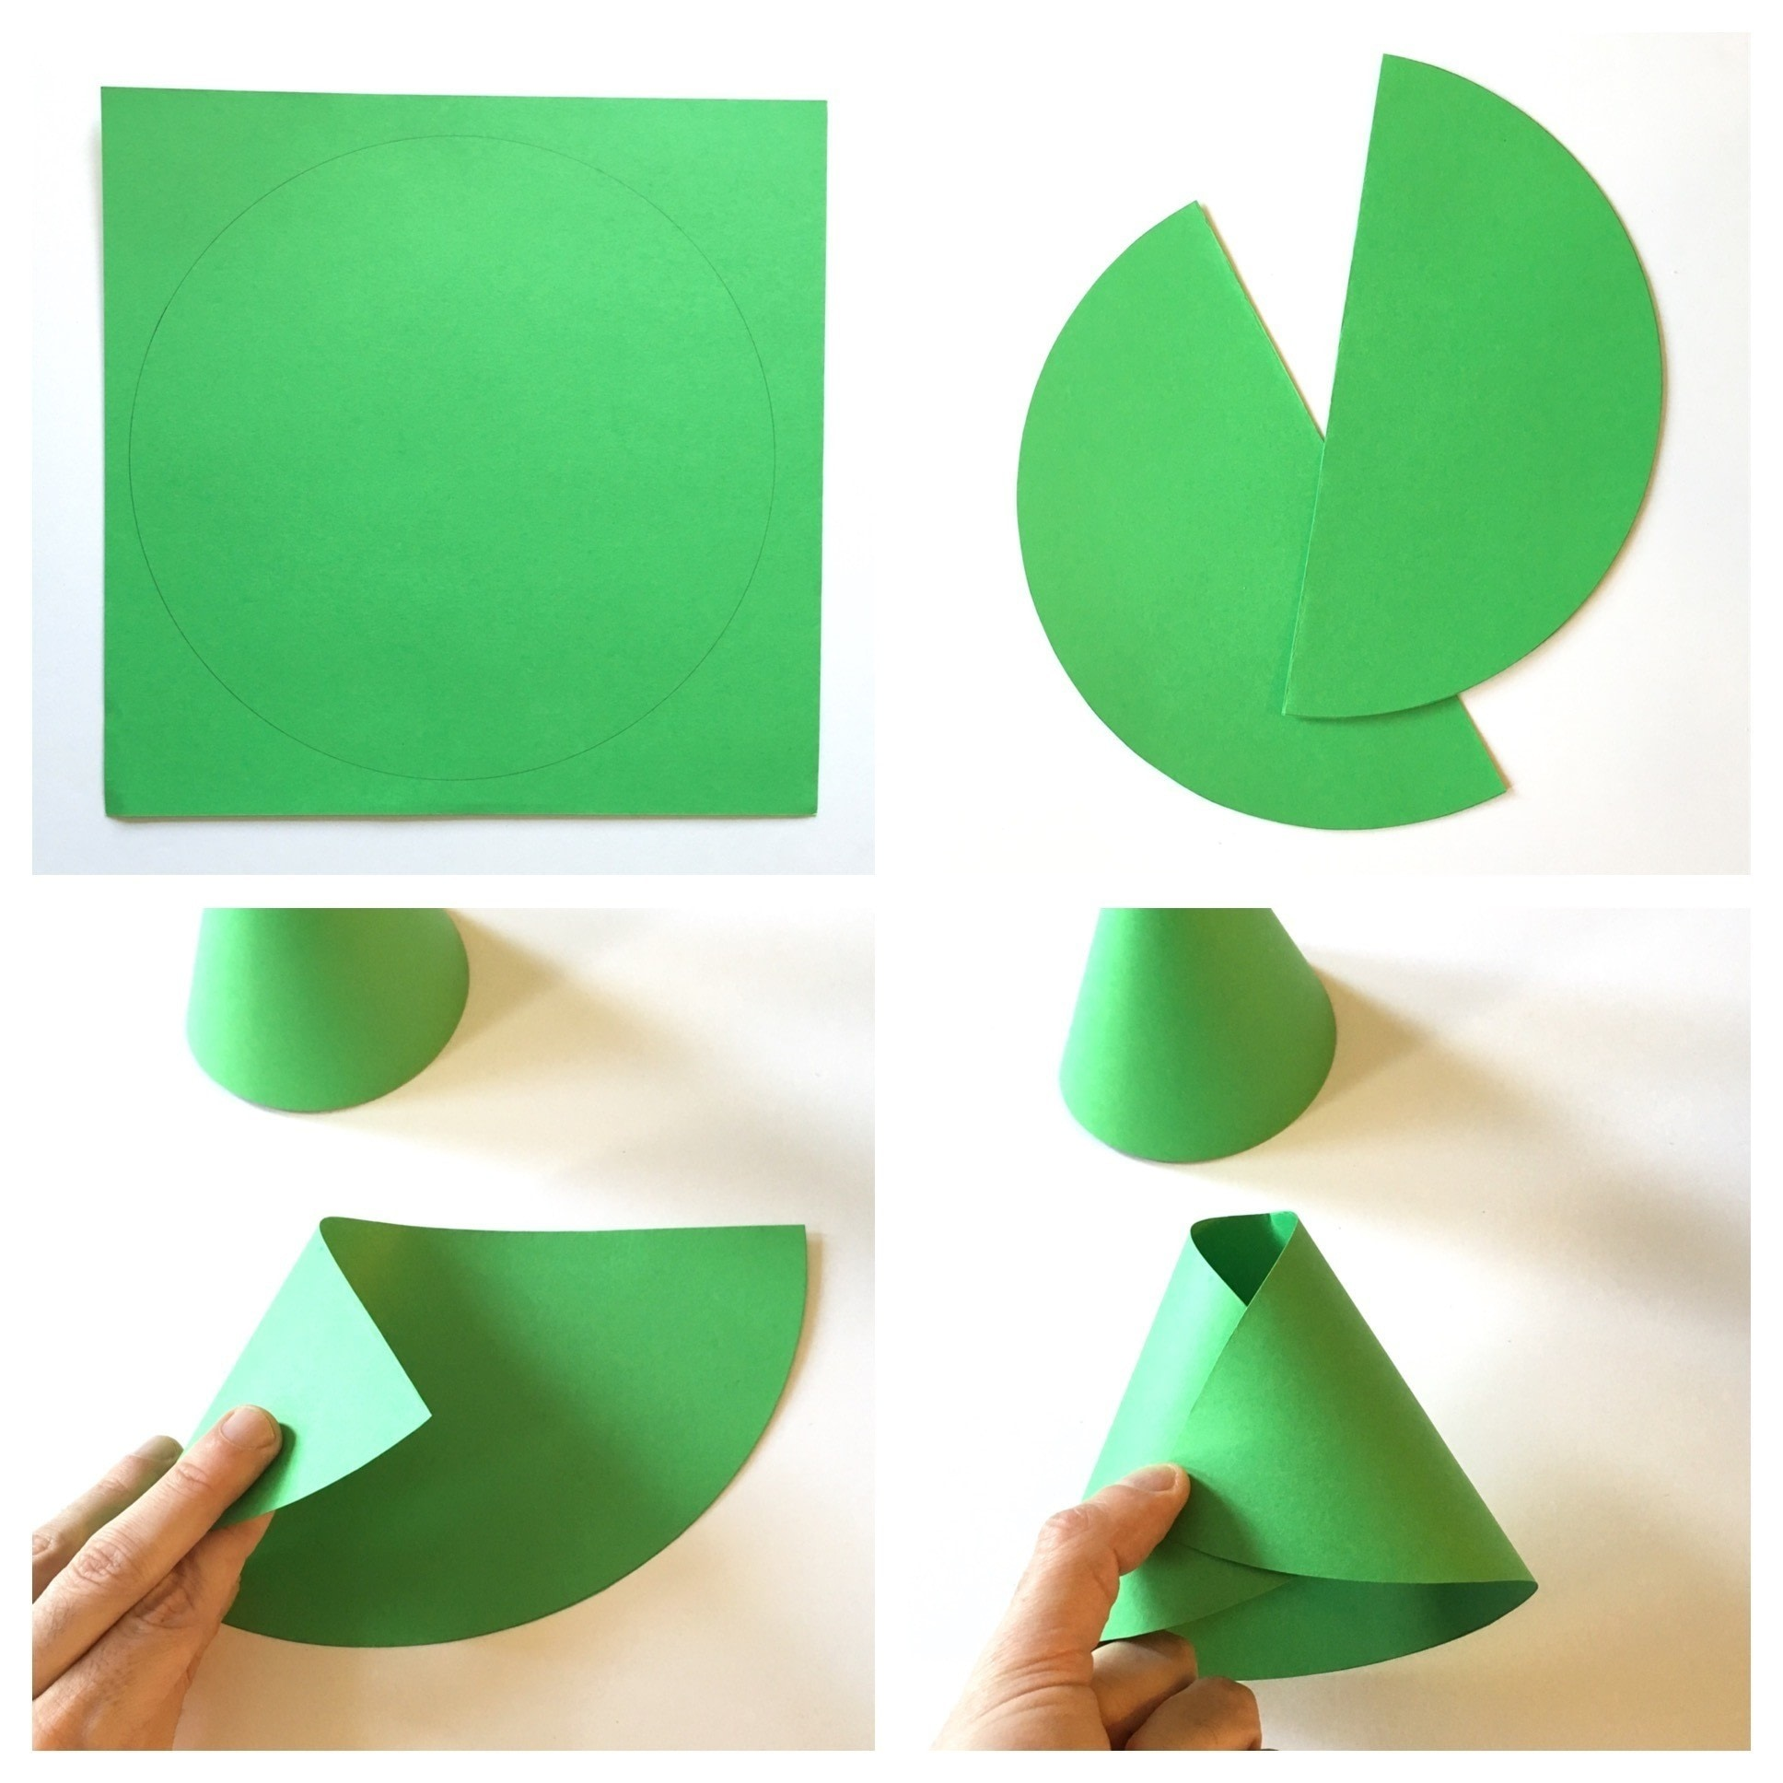
Building 3-D Shapes
Cone
Faces | 2
Curved Edge | 1
Vertex | 1

Slide 9
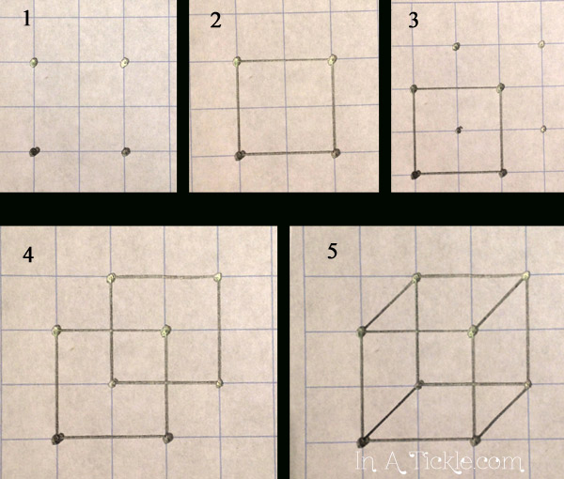
Drawing Solids on a flat surface
Cube

Slide 10
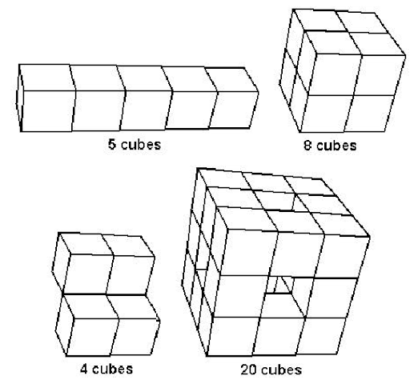
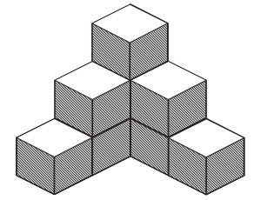
Guess the number of cubes

Slide 11
Yes you all were correct!!
5 Cubes
4 Cubes
9 Cubes

Slide 12
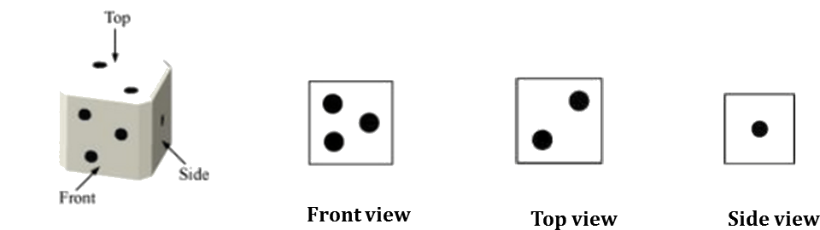
Viewing Different Sections of a Solid
Remember the dice from before?
Dice has 6 sides but we can only see 3 at a time!

Slide 13
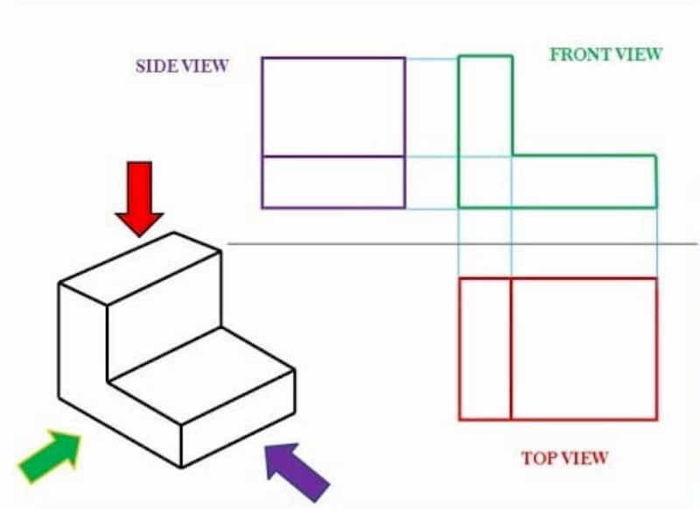

Slide 14
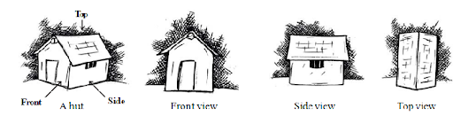

Slide 15
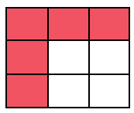
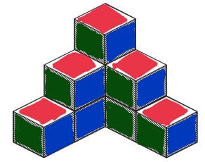
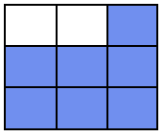
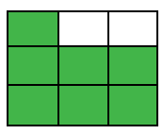
Top
Front
Side

Slide 16
Thank You

