Slide 1


CE143: COMPUTER CONCEPTS & PROGRAMMING
July – November 2019
UNIT – 12
File Management in ‘C’

Slide 2


Objectives
To be able to create, update and close files using C programming.
To be able to read & write integer and character in the file.
To be able to work with Error handling functions.
To be able to understand command line arguments.
To be able to do File handling Programming in C.
Chapter – 12 : File Management in C

Slide 3
Introduction
In this chapter, we will discuss
    Need of File Handling
    Create and close file
    Modes of file
    Read & write single character and integer to file
    Use of fprintf and fscanf functions
    Error handling functions
    Random access of files using ftell
    rewind
    fseek
    command line argument
Chapter – 12 : File Management in C

Slide 4
Introduction to File
File is a collection of related data that a computers treats as a single unit.
File is a sequence of bits, bytes, lines or records whose meaning is defined by its creator and user.
When a computer reads a file, it copies the file from the storage device to memory.
When it writes to a file, it transfers data from memory to the storage devices.
C uses a structure called FILE (defined in stdio.h) to store the attributes of a file.
Chapter – 12 : File Management in C

Slide 5
Need of File Management
As in programming language we store variable and array in program but after program ends these variable and array also get vanished as it is non permanent storage medium.
In case of file which is known as permanent storage medium, it contains data even after program exits.
If we want some data in program and file contain that data then instead of entering data manually you can access data directly from file.
File makes easy to transfer data from one computer to another.
File makes handling data easy .
Chapter – 12 : File Management in C

Slide 6
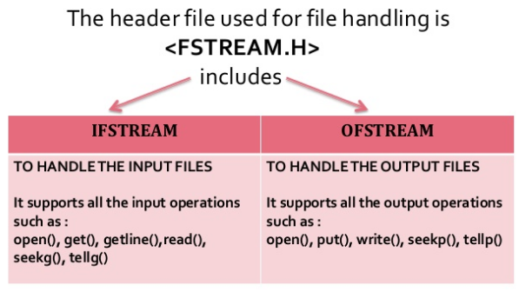
File streams in C Programming
Chapter – 12 : File Management in C

Slide 7
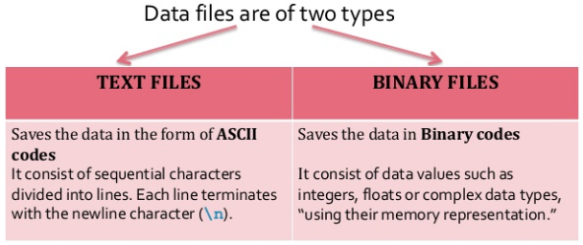
File streams in C Programming
Can be created, Updated and processed by C Programs.
Storage of data in variables and arrays is only temporary.
Chapter – 12 : File Management in C

Slide 8
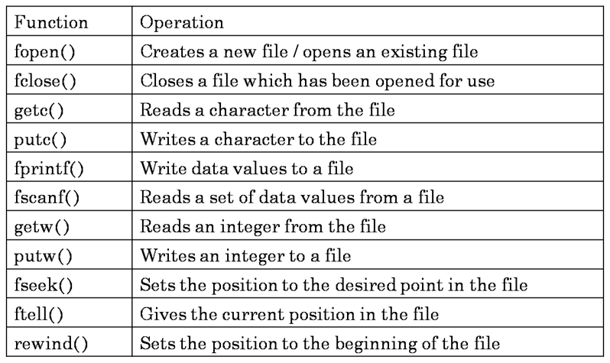
File Handling Functions
Chapter – 12 : File Management in C

Slide 9
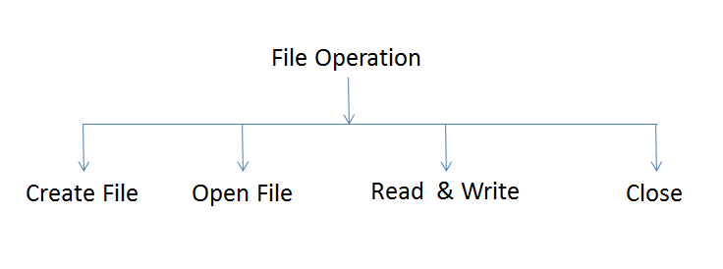
Basic File Operations
Chapter – 12 : File Management in C

Slide 10
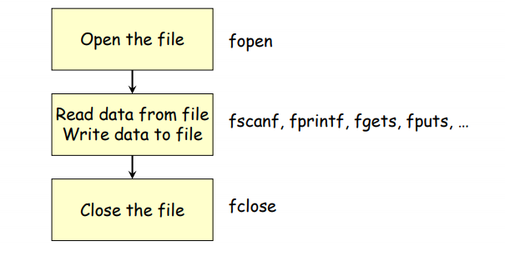
Steps in Processing a File
Chapter – 12 : File Management in C

Slide 11
Opening File or Creating File
The fopen() function is used to create a new file or to open an existing file.
It makes the connection between the physical file and the stream.
General Syntax :
FILE *fp;
fp =fopen(“filename”, “mode”);
Here,
  filename is the name of the file to be opened
  mode specifies the purpose of opening the file
  *fp is the FILE pointer (FILE *fp), which will hold the reference to the opened (or created) file.
  fopen returns a pointer to the file which is used in all subsequent file operations.
Chapter – 12 : File Management in C

Slide 12
Opening File or Creating File
Chapter – 12 : File Management in C

Slide 13
Example- Opening File or Creating File
fopen("E:\\cprogram\\newprogram.txt","w");
fopen("E:\\cprogram\\oldprogram.bin","rb");
Let's suppose the file newprogram.txt doesn't exist in the location E:\cprogram.
The first function creates a new file named newprogram.txt and opens it for writing as per the mode 'w'.
The writing mode allows you to create and edit (overwrite) the contents of the file.
Now let's suppose the second binary file oldprogram.bin exists in the location E:\cprogram.
The second function opens the existing file for reading in binary mode 'rb'.
The reading mode only allows you to read the file, you cannot write into the file.
Chapter – 12 : File Management in C

Slide 14
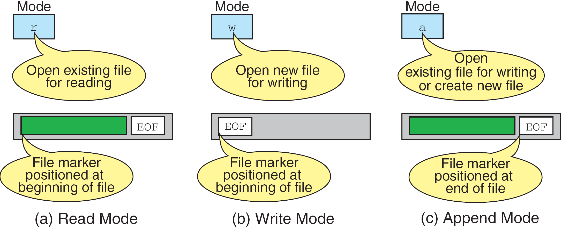
File open modes
Chapter – 12 : File Management in C

Slide 15
More on file open modes
File Mode | Meaning of Mode | During Inexistence of file
r | Open for reading. | If the file does not exist, fopen() returns NULL.
w | Open for writing. | If the file exists, its contents are overwritten. If the file does not exist, it will be created.
a | Open for append. i.e, Data is added to end of file. | If the file does not exists, it will be created.
rb | Open for reading in binary mode. | If the file does not exist, fopen() returns NULL.
wb | Open for writing in binary mode. | If the file exists, its contents are overwritten. If the file does not exist, it will be created.
ab | Open for append in binary mode. i.e, Data is added to end of file. | If the file does not exists, it will be created.
r+ | Open for both reading and writing. | If the file does not exist, fopen() returns NULL.
w+ | Open for both reading and writing. | If the file exists, its contents are overwritten. If the file does not exist, it will be created.
a+ | Open for both reading and appending. | If the file does not exists, it will be created.
rb+ | Open for both reading and writing in binary mode. | If the file does not exist, fopen() returns NULL.
wb+ | Open for both reading and writing in binary mode. | If the file exists, its contents are overwritten. If the file does not exist, it will be created.
ab+ | Open for both reading and appending in binary mode. | If the file does not exists, it will be created.
Chapter – 12 : File Management in C

Slide 16
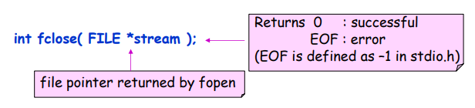
Closing a file
When we finish with a mode, we need to close the file before ending the program or beginning another mode with that same file.
To close a file, we use fclose and the pointer variable:
fclose(filepointer);
Example:
    FILE *xyz;
    xyz = fopen("test","w");
    ----
    ----
    fclose(xyz);
Chapter – 12 : File Management in C

Slide 17

Example- Open, close, read
int main()
{
FILE *fr;
char c;
fr = fopen("prog.txt", "r");
while( c != EOF)
{
c = fgetc(fr); /* read from file*/
printf("%c",c); /* display on screen*/
}
fclose(fr);
return 0;
}
Chapter – 12 : File Management in C

Slide 18

Input/output operations on file
Reading File :
fgetc() function: The fgetc() function returns a single character from the file. It gets a character from the stream. It returns EOF at the end of file.
Example:
  void main()
  {
    FILE *fp;
    char c;
    fp=fopen("myfile.txt","r");
    while((c=fgetc(fp))!=EOF){
    printf("%c",c);
    }
    fclose(fp);
    getch();
  }
Chapter – 12 : File Management in C

Slide 19

Input/output operations on file
Writing File :
fputc() function: The fputc() function is used to write a single character into file. It outputs a character to a stream.
Example:
  #include <stdio.h>
  void main()
  {
    FILE *fp;
    fp = fopen("file1.txt", "w");//opening file
    fputc('a',fp);//writing single character into file
    fclose(fp);//closing file
  }
Chapter – 12 : File Management in C

Slide 20
Input/output operations on file
Reading File :
fgets() function: The fgets() function reads a line of characters from file. It gets string from a stream.
Example:
  void main()
  {
    FILE *fp;
    char text[300];
    fp=fopen("myfile2.txt","r");
    printf("%s",fgets(text,200,fp));
    fclose(fp);
    getch();
  }
Chapter – 12 : File Management in C

Slide 21
Input/output operations on file
Writing File :
fputs() function: The fputs() function writes a line of characters into file. It outputs string to a stream.
Example:
    void main()
    {
      FILE *fp;
      clrscr();
      fp=fopen("myfile2.txt","w");
      fputs("hello c programming",fp);
      fclose(fp);
      getch();
    }
Chapter – 12 : File Management in C

Slide 22
Input/output operations on file
Reading File :
fscanf() function: The fscanf() function is used to read set of characters from file. It reads a word from the file and returns EOF at the end of file.
Writing File :
fprintf() function: The fprintf() function is used to write set of characters into file. It sends formatted output to a stream.
Chapter – 12 : File Management in C

Slide 23

fscanf() , fprintf() example
#include <stdio.h>
void main() {
int i, j, k ;
FILE *ifp, *ofp ;
ifp = fopen("abc.txt", "r" ) ;
ofp = fopen("cal.txt", "w" ) ;
fscanf( ifp, "%d %d %d", &i, &j, &k ) ;
fprintf( ofp, "sum: %d\n", i + j + k ) ;
fclose( ifp ) ;
fclose( ofp ) ;
}
Chapter – 12 : File Management in C

Slide 24
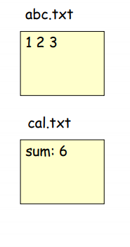
fscanf() , fprintf() example
#include <stdio.h>
void main() {
int i, j, k ;
FILE *ifp, *ofp ;
ifp = fopen("abc.txt", "r" ) ;
ofp = fopen("cal.txt", "w" ) ;
fscanf( ifp, "%d %d %d", &i, &j, &k ) ;
fprintf( ofp, "sum: %d\n", i + j + k ) ;
fclose( ifp ) ;
fclose( ofp ) ;
}
Chapter – 12 : File Management in C

Slide 25
Read & Write integer to file
File operation | Declaration & Description
putw() | Declaration: int putw(int number, FILE *fp); putw function is used to write an integer into a file. In a C program, we can write integer value in a file as below. putw(i, fp); where i – integer value fp – file pointer
getw() | Declaration: int getw(FILE *fp); getw function reads an integer value from a file pointed by fp. In a C program, we can read integer value from a file as below. getw(fp);
Chapter – 12 : File Management in C

Slide 26
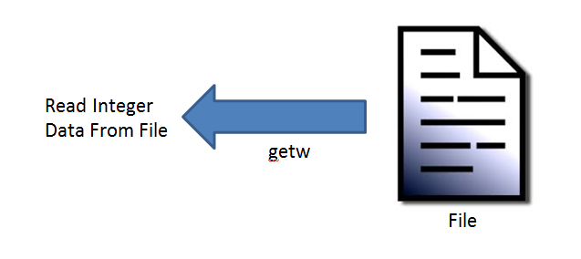
Example- getw() and putw()
void main()
{
FILE *fp;
int n;
fp=fopen("c.dat", "wb+");
printf("Enter the integer data");
scanf("%d",&n);
while(n!=0)
{
putw(n,fp);
scanf("%d",&n);
}
rewind(fp);
printf("Reading data from file");
while((n=getw(fp))!=EOF)
{
printf("%d\n",n);
}
fclose(fp);
getch();
}
Chapter – 12 : File Management in C

Slide 27
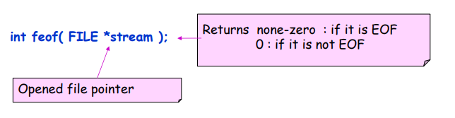
feof() Function
Check whether the file pointer is at the end of file or not.
Chapter – 12 : File Management in C

Slide 28

Error Handling functions in C
C language does not provide any direct support for error handling.
However a few methods and variables defined in error.h header file can be used to point out error using the return statement in a function.
In C language, a function returns -1 or NULL value in case of any error and a global variable errno is set with the error code.
Chapter – 12 : File Management in C

Slide 29
What is errno?
errno value | Error
1 | Operation not permitted
2 | No such file or directory
3 | No such process
4 | Interrupted system call
5 | I/O error
6 | No such device or address
7 | Argument list too long
8 | Exec format error
9 | Bad file number
10 | No child processes
11 | Try again
12 | Out of memory
13 | Permission denied
Whenever a function call is made in C language, a variable named errno is associated with it.
It is a global variable, which can be used to identify which type of error was encountered while function execution, based on its value.
Below we have the list of Error numbers and what does they mean.
Chapter – 12 : File Management in C

Slide 30
perror() and strerror() function
C language uses the following functions to represent error messages associated with errno:
  perror(): returns the string passed to it along with the textual representation of the current errno value.
  strerror() is defined in string.h library. This method returns a pointer to the string representation of the current errno value.
Chapter – 12 : File Management in C

Slide 31
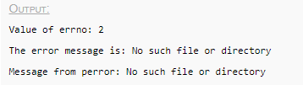
Example- Error Handling
#include <stdio.h>
#include <error.h>
#include <string.h>
int main ()
{
FILE *fp;
//If a file, which does not exists, is opened, we will get an error
fp = fopen("IWillReturnError.txt", "r");
printf("Value of errno: %d\n ", errno);
printf("The error message is : %s\n", strerror(errno));
perror("Message from perror");
return 0;
}
Chapter – 12 : File Management in C

Slide 32
Random access of file using ftell
The ftell() function returns the current file position of the specified stream.
We can use ftell() function to get the total size of a file after moving file pointer at the end of file.
We can use SEEK_END constant to move the file pointer at the end of file.
Syntax:
long int ftell(FILE *stream)
Chapter – 12 : File Management in C

Slide 33

Example- ftell
#include <stdio.h>
#include <conio.h>
void main ()
{
  FILE *fp;
  int length;
  clrscr();
  fp = fopen("file.txt", "r");
  fseek(fp, 0, SEEK_END);
  length = ftell(fp);
  fclose(fp);
  printf("Size of file: %d bytes", length);
  getch();
}
Chapter – 12 : File Management in C

Slide 34
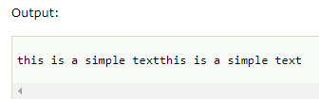
rewind
The rewind() function sets the file pointer at the beginning of the stream.
It is useful if you have to use stream many times.
Syntax:
rewind(FILE *stream);
Example:
void main()
{
  FILE *fp;
  char c;
  fp=fopen("file.txt","r");
  while((c=fgetc(fp))!=EOF)
  {
  printf("%c",c);
  }
  rewind(fp);
  //moves the file pointer at beginning of the file
  while((c=fgetc(fp))!=EOF)
  {
  printf("%c",c);
  }
  fclose(fp);
  getch();
}
Chapter – 12 : File Management in C

Slide 35
fseek
fseek() is used to move file pointer associated with a given file to a specific position.
Syntax:
int fseek(FILE *pointer, long int offset, int position)
Where,
  pointer: pointer to a FILE object that identifies the stream.
  offset: number of bytes to offset from position
  position: position from where offset is added.
returns:
  zero if successful, or else it returns a non-zero value
Position defines the point with respect to which the file pointer needs to be moved. It has three values:
  SEEK_END : It denotes end of the file.
  SEEK_SET : It denotes starting of the file.
  SEEK_CUR : It denotes file pointer’s current position.
Chapter – 12 : File Management in C

Slide 36
Example- fseek
// C Program to demonstrate the use of fseek()
#include <stdio.h>
int main()
{
FILE *fp;
fp = fopen("test.txt", "r");
// Moving pointer to end
fseek(fp, 0, SEEK_END);
// Printing position of pointer
printf("%ld", ftell(fp));
return 0;
}
Chapter – 12 : File Management in C

Slide 37
Command line arguments
It is possible to pass some values from the command line to your C programs when they are executed.
These values are called command line arguments.
It is required when you want to control your program from outside instead of hard coding those values inside the code.
The command line arguments are handled using main() function arguments where..
  argc refers to the number of arguments passed. (ARGument Count)
  argv[] is a pointer array which points to each argument passed to the program. (ARGument Vector)
Chapter – 12 : File Management in C

Slide 38


Example- Command line arguments
#include <stdio.h>
void main( int argc, char *argv[] )
{
if( argc == 2 )
printf("The argument supplied is %s\n", argv[1]);
else if( argc > 2 )
printf("Too many arguments supplied.\n");
else
printf("One argument expected.\n");
}
  When the above code is compiled and executed with single argument, it produces the following result.
  $./a.out testing
  The argument supplied is testing
  When the above code is compiled and executed with a two arguments, it produces the following result.
  $./a.out testing1 testing2
  Too many arguments supplied.
Chapter – 12 : File Management in C

Slide 39
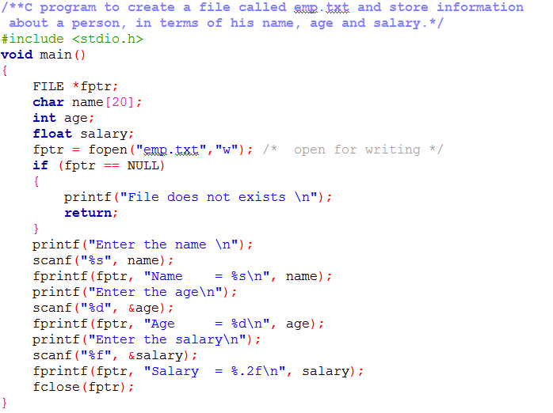
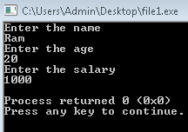

Programming Examples
Chapter – 12 : File Management in C

Slide 40
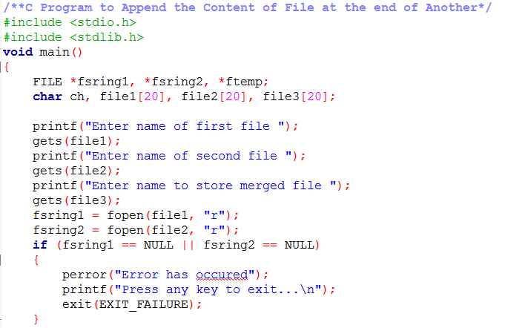
Programming Examples-Cont
Chapter – 12 : File Management in C

Slide 41
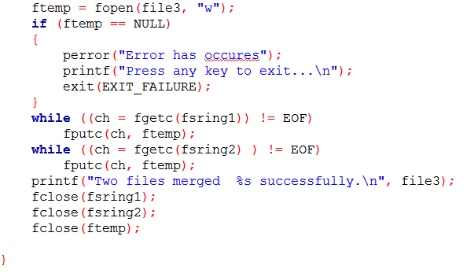
Programming Examples-Cont
Chapter – 12 : File Management in C

Slide 42
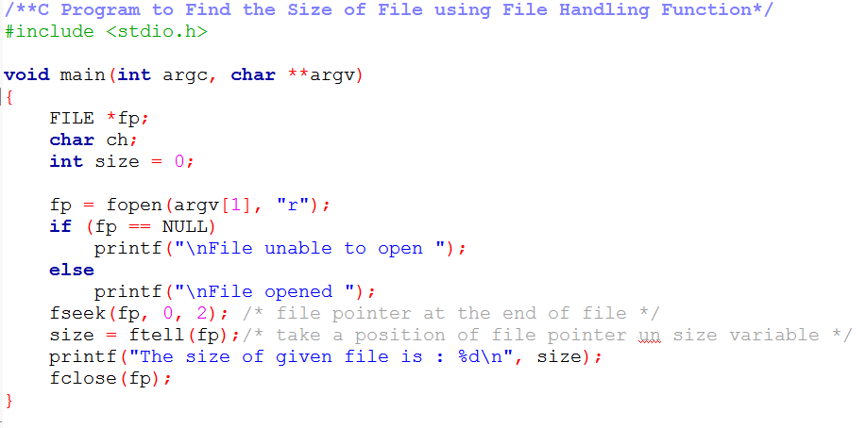
Programming Examples
Chapter – 12 : File Management in C

Slide 43
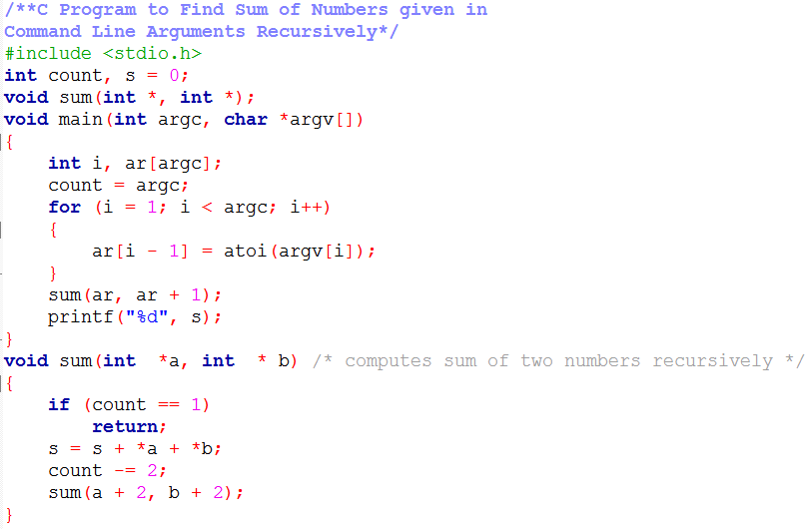
Programming Examples
Chapter – 12 : File Management in C

Slide 44
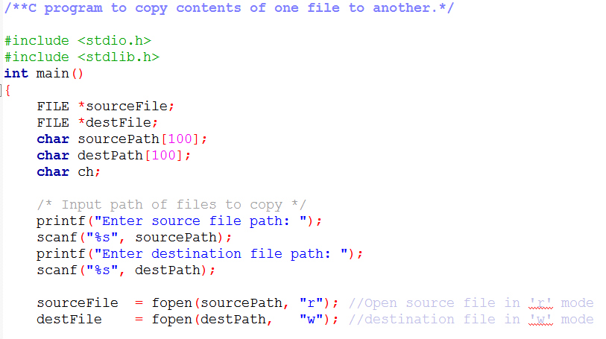
Programming Examples-Cont
Chapter – 12 : File Management in C

Slide 45
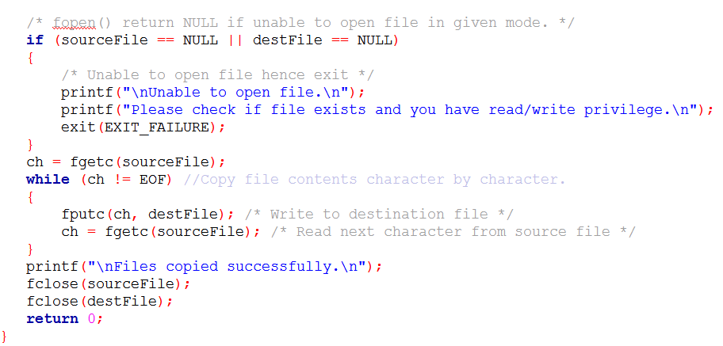
Programming Examples-Cont
Chapter – 12 : File Management in C

Slide 46
Previous Year Questions
A file abc.txt is opened in write mode. Enter data into that file. Copy the data from abc.txt into another filexyz.txt which is opened in write mode.
Explain fseek() and ftell() functions related to file.
Which are the various operations that can be performed on file? Also explain fopen(), fclose() and fseek() functions.
Which are the modes of file? Why the file should be closed in a Program?
Which are the modes supported by fopen() for file? What are the reasons to close a file using fclose()?
Chapter – 12 : File Management in C

Slide 47
Previous Year Questions
Write a program that reads a file containing integers and append at its end the sum of all the integers.
Write a Program to read a file that contains characters. Encrypt the data in this file while writing it into another file. For example while writing the data in another file you can use the formula ch=ch-2, i.e., if the data contains character 'red' the encrypted data becomes 'pcb'.
Chapter – 12 : File Management in C

