Slide 1

Machine Learning Hackathon CG 2022
Team Name- IceBox
Team Leader Name- Saikat Dey
Team Leader Email Address- jahar2dey@gmail.com

Slide 2
Brief description of the problem at hand:
In this problem we are dealing with Phishing Detection. We to read the data and create a model based on the data analysis to identify if the website is legitimate or a phishing website. The Result will be determined by the two values [1, -1] where 1 represent the legitimate and -1 represents phishing
1 represents the legitimate
0 represents suspicious
-1 represents phishing

Slide 3
Solution proposed and description:
We are solving the given problem using data-science. The solution involves the implementation of feature engineering. We used KNN Classifier, Linear Regression, Ridge Classifier and Random Forest Classifier. Finally we have achieved the most accurate result i.e., above 97% using the Random Forest Classifier.

Slide 4
Technology/Tool Stack Used
Python
pandas
NumPy
scikit learn
Jupyter notebook environment

Slide 5
Approach:
check for empty cells in dataset.
find relevant correlations.
split train data into train and validation set.
selected multiple suitable ml models:
StratifiedKFold
Random Forrest Classifier
KNN Classifer
Linear Regressor
Ridge Classifier
trained each one of them with parameter tuning.
found out the best model
then trained the train set with 97.01% accuracy
then used this model to generate the final classification results

Slide 6
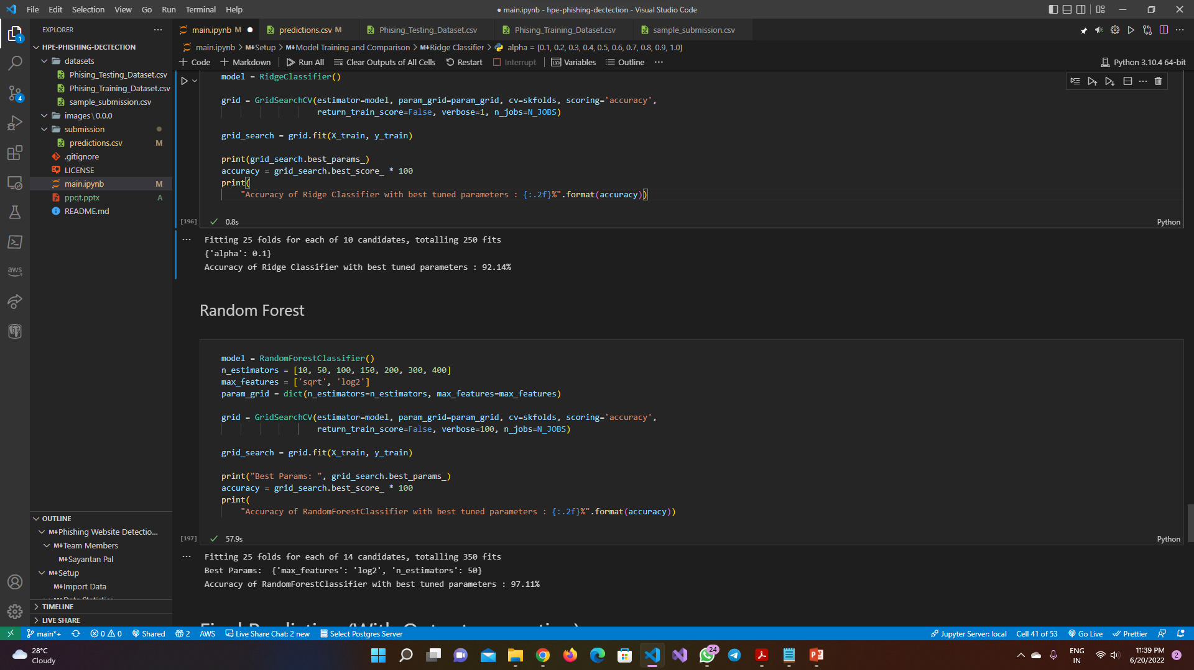
Execution Demo(Video/Screenshots) of the solution:

Slide 7
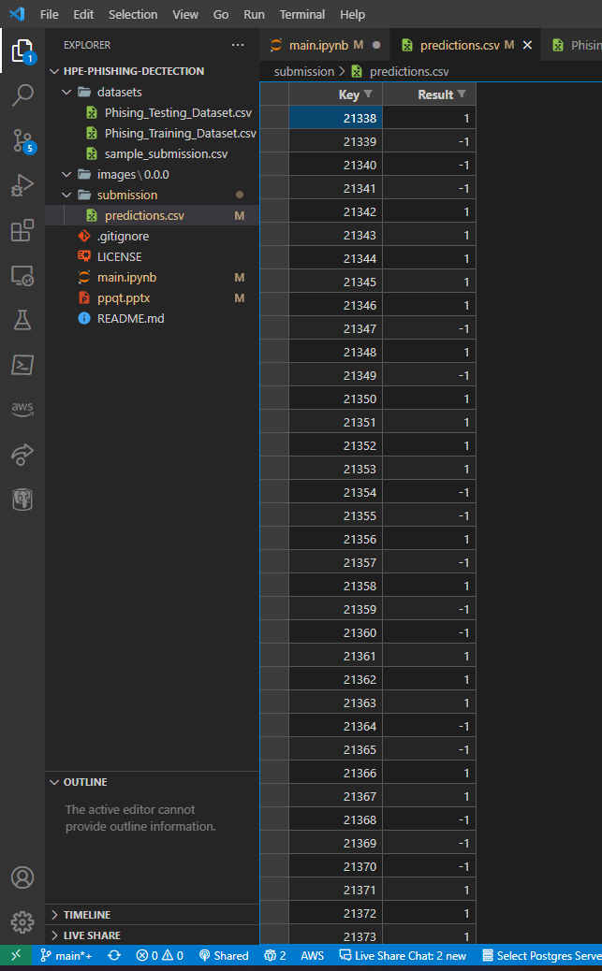
Execution Demo(Video/Screenshots) of the solution:

Slide 8
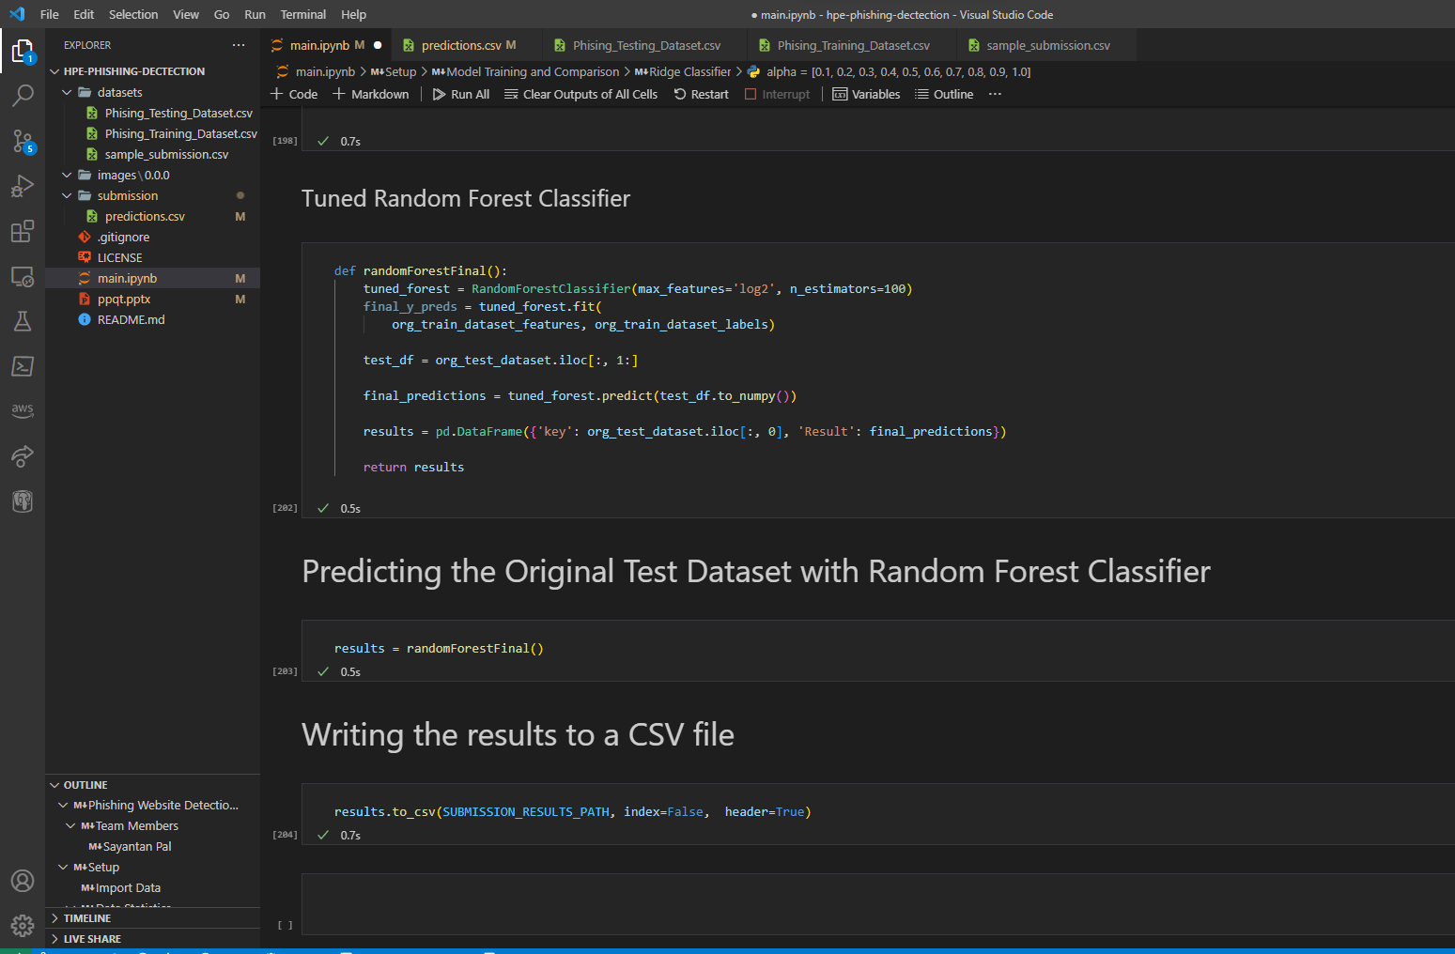
Execution Demo(Video/Screenshots) of the solution:

Slide 9
Source code as ZIP or GitHub URL:
https://github.com/notfathomless/hpe-phishing-dectection.git

Slide 10
THANK YOU

