Slide 1
NRTF / JUSTICETREE AI
The Problem → Our Solution
Introducing a legislative bill explorer for North Carolina
THE PROBLEM
THE SOLUTION
Bills include dense language, multiple versions, amendments, and procedural histories.
A summary alone may omit evidence or confuse proposed and enacted law.
A web application where users can examine a bill, its full text, and legislative history.
Evidence-linked evaluations make claims easier to verify and challenge.
DESIGN GOAL • Do not just summarize legislation. Show the evidence.
ATO 2026 • CONCEPT / PROPOSED INTEGRATION 1 / 3

Slide 2
NRTF / JUSTICETREE AI
How a User Explores a Bill
Illustrative user experience — confirm live features with the development team
01 FIND A BILL
02 EXAMINE RECORDS
Search or select a North Carolina bill.
Read the full text, versions, and legislative actions.
03 CHECK A CLAIM
04 REVIEW FINDINGS
Compare a specific claim with cited passages.
See supporting evidence, contradictions, and uncertainties.
ATO 2026 • CONCEPT / PROPOSED INTEGRATION 2 / 3

Slide 3
NRTF / JUSTICETREE AI
JusticeTree Frameworks in NRTF
Example: North Carolina HB 318 — proposed evaluation architecture
PMF • EVIDENCE
ITMOST • AUTHORITY
VBE • EXECUTION
Tests claims against supporting and contradictory evidence; records gaps and limitations.
Examines provenance and the evidence for claimed information authority.
Separates analysis from authorization before consequential external actions.
INPUT Full bill text + versions + legislative history + official sources
OUTPUT Evidence-linked findings + contradictions + uncertainty + audit trail
Framework roles are proposed; do not represent them as deployed or independently validated.
ATO 2026 • CONCEPT / PROPOSED INTEGRATION 3 / 3

Slide 4
NRTF / JUSTICETREE AI
Technologies
Python
Snowflake API
LegiScan API – Bill data
Gemini API– fallback for
ATO 2026 • CONCEPT / PROPOSED INTEGRATION 3 / 3

Slide 5
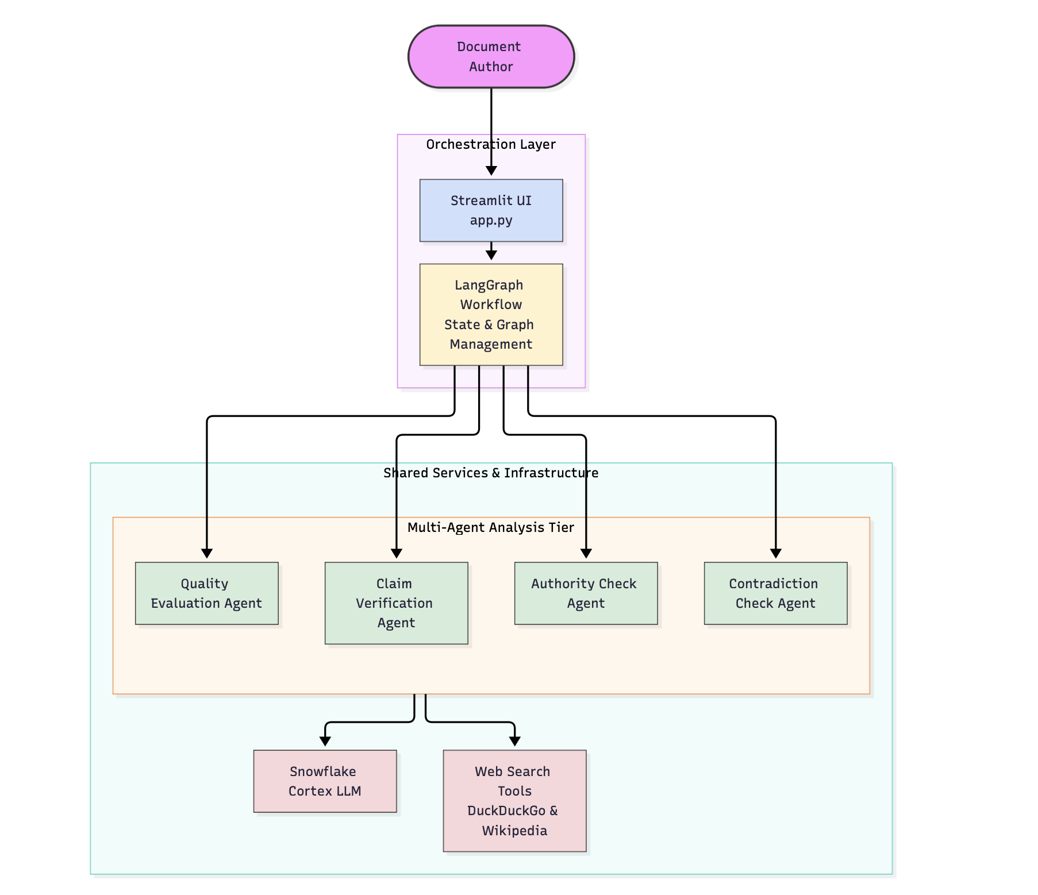
NRTF / JUSTICETREE AI
App Workflow
ATO 2026 • CONCEPT / PROPOSED INTEGRATION 3 / 3

