Slide 1
NC STATE UNIVERSITY
Department of Computer Science
Investigating the Impact of
Technical Debt Remediation on
Code Translation Tasks
A case study on C-to-Rust translation across four LLM-based translators
Neel Ghoshal
M.S. Candidate, Computer Science · nghosha@ncsu.edu
M.S. Thesis Defense · 2026

Slide 2
AGENDA
Roadmap
1
Motivation & Research Question
Why bridge technical debt and code translation
2
Background & Related Work
Existing translation tools and the debt literature
3
Methodology
Pipeline, translators, protocols , comparison procedure
4
Quantitative Results
Aggregate trends, outcome distributions, pairwise comparisons
5
Qualitative Analysis
Case studies, recurring patterns, what the numbers hide
6
Discussion, Limitations & Future Work
Honest reflection on what worked and what did not
Neel Ghoshal · M.S. Thesis Defense · NC State University
2 / 30

Slide 3
PART 1
Motivation & Research Question
Why bridge debt
and translation?
3 / 30

Slide 4
MOTIVATION
Two well-studied fields that have not met
C to Rust Translation
Technical Debt
Migrating legacy C reduces memory-safety vulnerabilities. Rule-based, LLM, and hybrid translators all struggle with non-idiomatic or structurally noisy source code.
Shortcuts, legacy idioms, and suboptimal designs accumulate as debt. Well-studied within a single language but rarely treated as a preprocessing step for translation.
THE GAP
Does resolving technical debt in source C code produce measurably better automated Rust translations?
To our knowledge, no prior study has directly examined this question.
Neel Ghoshal · M.S. Thesis Defense · NC State University
4 / 30

Slide 5
MOTIVATION
Why this matters in practice
MEMORY SAFETY
SCALE
DEBT IS UNIVERSAL
Rust eliminates whole bug classes
Manual rewrites do not scale
Source quality varies widely
Roughly 70% of high-severity CVEs in large C/C++ codebases stem from memory-safety violations that Rust prevents at compile time.
Organizations hold millions of lines of legacy C. Automated translation is the only feasible path; source quality determines whether it succeeds.
Every real-world C codebase carries accumulated debt. If debt affects translation, it has implications for every migration effort in the field.
This thesis asks whether source-level debt directly affects a downstream axis: automated translation quality.
Neel Ghoshal · M.S. Thesis Defense · NC State University
5 / 30

Slide 6
RESEARCH QUESTION
What this thesis sets out to do
RQ
Does technical debt remediation in C source code measurably affect the quality of its automated translation to Rust, and if so, how does that effect vary across modern LLM-based translators?
THREE CONTRIBUTIONS
01
02
03
Problem Formulation
Comparison Procedure
Empirical Evidence
Frame debt remediation as a function-level before-and-after experiment evaluated across four LLM translators.
Fully specified Clippy comparison: 19-category lint taxonomy, LOC-normalized rates, stub protocol.
Case study on GRASS GIS: 35 remediated issues, 280 translated Rust artifacts, model-dependent findings.
Neel Ghoshal · M.S. Thesis Defense · NC State University
6 / 30

Slide 7
PART 2
Background & Related Work
Where this work
sits in the literature
7 / 30

Slide 8
BACKGROUND
Three families of C-to-Rust translation
RULE-BASED
What it does. Syntactic translation producing functionally equivalent Rust.
Trade-off. Relies heavily on unsafe; mirrors C structure closely. (Emre et al. 2021, Ling et al. 2022)
C2Rust, CRustS
LLM-ASSISTED
What it does. Staged translation with static-analysis hints and feedback-based repair.
Trade-off. More idiomatic Rust, but sensitive to input structure and prompting. (Zhou et al. 2025, Nitin et al. 2025)
SACTOR, C2SaferRust
PROJECT-LEVEL
What it does. Skeleton-guided framework combining rule-based scaffolding with LLM-driven module translation.
Trade-off. Scales beyond single functions but adds orchestration complexity. (Wang et al. 2025)
EvoC2Rust
Neel Ghoshal · M.S. Thesis Defense · NC State University
8 / 30

Slide 9
BACKGROUND
Technical debt: what the literature tells us
1992
The metaphor
2016
Taxonomy and management
Introduced 'technical debt' to describe the long-term cost of short-term shortcuts. Interest payments accumulate until the principal is repaid.
Systematic mapping of debt types: design, code, documentation, test, architecture. Code smells and static-analysis violations are practical indicators correlating with reduced maintainability.
Cunningham
Alves et al.
2022
Requirements-level debt
Our work
Debt as a translation input
Systematic review confirming that static-analysis violations are valid and measurable debt proxies that predict future defect proneness.
Treat remediation as a preprocessing step and measure its effect on downstream Rust translation quality. This connection has not previously been studied.
Melo et al.
Neel Ghoshal · M.S. Thesis Defense · NC State University
9 / 30

Slide 10
PART 3
Methodology
How the experiment
was designed
10 / 30

Slide 11
METHOD
A four-stage evaluation pipeline
STAGE 1
STAGE 2
STAGE 3
STAGE 4
Identify
Remediate
Translate
Evaluate
SonarQube static analysis on the C source
Resolve a curated via refactoring code at function level
Generate Rust before & after with 4 LLM translators
Compare with Clippy under a fixed procedure
DATASET · GRASS GIS · g.mapset module + gis library
~15K
767
35
280
lines of C analyzed
SonarQube issues surfaced
issues remediated
translated Rust artifacts
Neel Ghoshal · M.S. Thesis Defense · NC State University
11 / 30

Slide 12
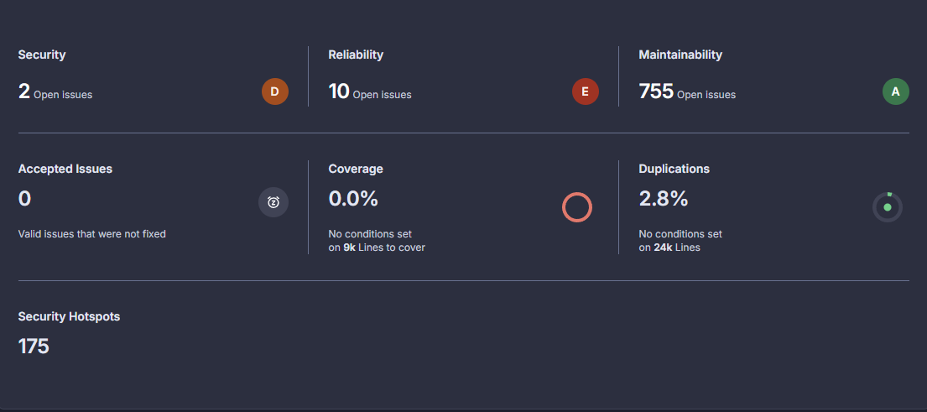
METHOD · STAGE 1
What SonarQube found in GRASS GIS
SCOPING DECISIONS
Module focus. g.mapset + gis library.
Pruning. 75 unused .c files removed from scope.
Severity levels. Blocker, High, Medium, Low, Info.
Selection criterion. Prioritized fixes most likely to affect code structure, since structural changes propagate through translation.
Maintainability dominates (~98%). Reliability and security are minor fractions.
Neel Ghoshal · M.S. Thesis Defense · NC State University
12 / 30

Slide 13
METHOD · STAGE 2
Types of remediation applied (35 issues)
DOCUMENTATION
8
UNUSED CODE
7
THREAD SAFETY
6
Missing comments on public/exported functions
Unnecessary assignments, dead variables, late initialisation
strtok to strtok_r, ctime to ctime_r, localtime to localtime_r
MUTABILITY
5
COMPLEXITY
5
OTHER
4
const-correctness, scope tightening, const-qualified params
Decomposing high-cognitive-complexity functions into helpers
Miscellaneous reliability and maintainability fixes
All fixes preserve program behavior. Committed to a forked GRASS repository for reproducibility.
Neel Ghoshal · M.S. Thesis Defense · NC State University
13 / 30

Slide 14
METHOD · STAGE 3
Four translators in two safety regimes
ChatGPT 5.2
EVALUATION WITH CLIPPY
Unsafe Rust
FFI-style extern C blocks
Density-normalized: warnings per 100 LOC
19-category taxonomy: 8 internal, 11 external quality
Fixed threshold: ±1.00 warnings / 100 LOC per category
Four outcomes: improvement, regression, cross-quality trade-off, quality-equivalent
Stub protocol: minimal stubs let each function compile without altering translation logic.
DeepSeek V3
Unsafe Rust
FFI-style extern C blocks
Claude Sonnet 4.6
Safe Rust
Idiomatic, ownership-aware
Gemini 3.1 Pro
Safe Rust
Idiomatic, ownership-aware
Identical prompt structure across all 35 cases. Variation between before/after reflects source-level change, not translator noise.
Neel Ghoshal · M.S. Thesis Defense · NC State University
14 / 30

Slide 15
METHOD · STUB PROTOCOL
Making per-function comparison reproducible
Why stubs are necessary
Each translated function is analyzed in isolation. Stubs stand in for external GRASS symbols, libc, and message macros, applied identically to both sides of every pair so any change in Clippy output is attributable to the translation, not the scaffolding.
Add only what is needed
Translation logic from the LLM output is never altered.
Real bodies for string ops
strlen, strcpy, strcmp use actual pointer-traversal loops so pointer-related lints fire correctly.
Match translation style
Safe Rust stubs for safe translations; unsafe extern C for FFI-style.
Neel Ghoshal · M.S. Thesis Defense · NC State University
15 / 30

Slide 16
METHOD · COMPARISON
Six deterministic steps per pair
1
Run Clippy
2
Estimate LOC
3
Map to category
Record kind (warning / hard error), lint name, and line number for every issue in each translation.
max(line referred to by Clippy) + 10. Robust to whitespace; derived entirely from Clippy output.
19-category taxonomy: 18 from published Clippy study + Build configuration. Tag each as internal or external quality.
4
Normalize rate
5
Classify pair
6
Report
R = 100 · W / L per category and overall. Hard errors tracked as raw counts, separately.
Threshold ±1.00 / 100 LOC: net improvement, net regression, cross-quality trade-off, or quality-equivalent.
Five-section CSV: summary, internal vs external, per-category, classification, per-lint deltas.
Neel Ghoshal · M.S. Thesis Defense · NC State University
16 / 30

Slide 17
PART 4
Quantitative Results
What the
numbers say
17 / 30

Slide 18
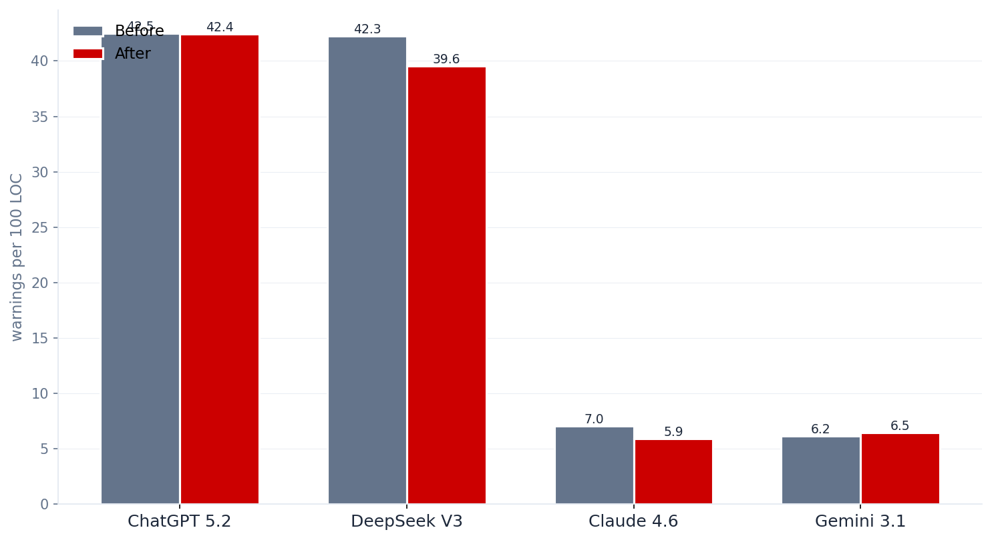
RESULTS · HEADLINE
LOC-weighted Clippy warning rates: before vs. after
TWO REGIMES
42
Unsafe-style (ChatGPT, DeepSeek) near 42 warnings / 100 LOC.
7
Safe-style (Claude, Gemini) near 6 to 7 warnings / 100 LOC.
Interpret remediation lift within regime, not across.
Neel Ghoshal · M.S. Thesis Defense · NC State University
18 / 30

Slide 19
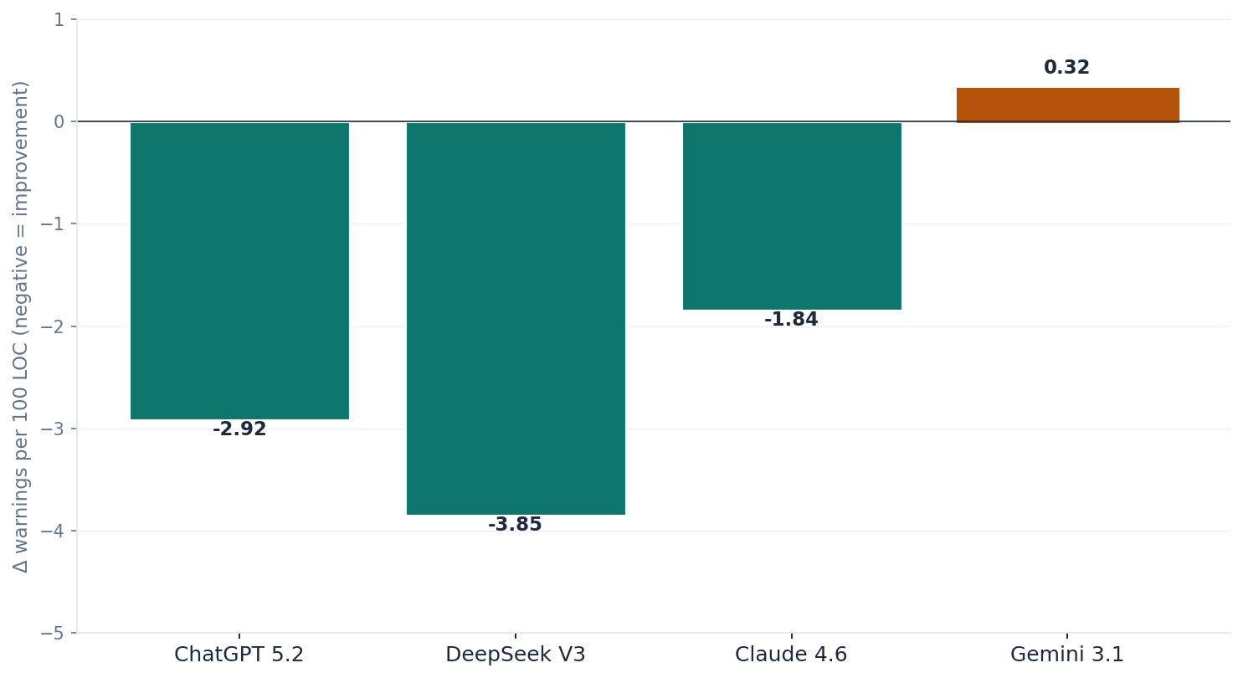
RESULTS · CASE-AVERAGE
Mean change in warning rate per model
READING THE CHART
DeepSeek V3 largest mean lift (−3.85).
ChatGPT & Claude also improve on average.
Gemini 3.1 Pro essentially unresponsive (+0.32).
Effect of remediation is strongly model-dependent.
Neel Ghoshal · M.S. Thesis Defense · NC State University
19 / 30

Slide 20
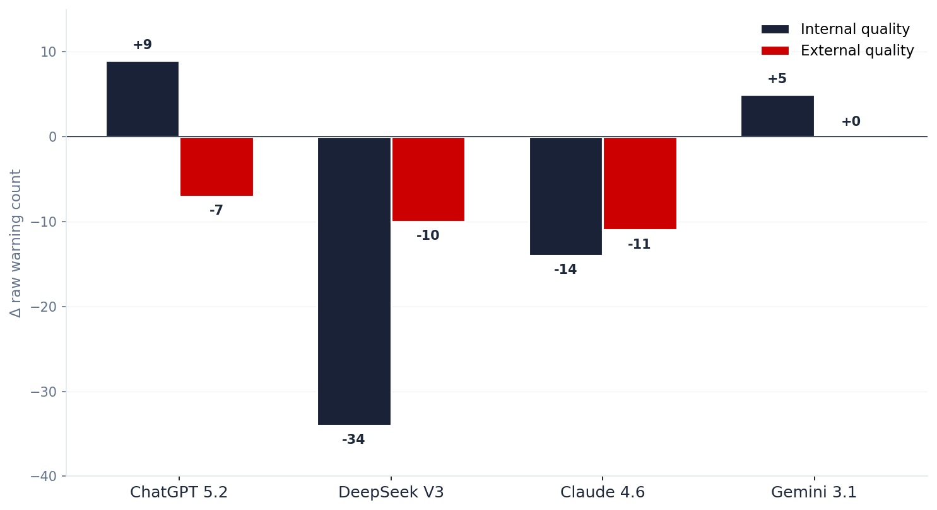
RESULTS · QUALITY SPLIT
Internal vs external quality changes by model
WHY THIS MATTERS
Aggregate delta rate can hide a cross-quality trade-off.
ChatGPT
External −7 (safer) but internal +9 (docs regress).
DeepSeek
Both internal and external decline (−34 / −10).
Claude
Both decline (−14 / −11) from a lower baseline.
Neel Ghoshal · M.S. Thesis Defense · NC State University
20 / 30

Slide 21
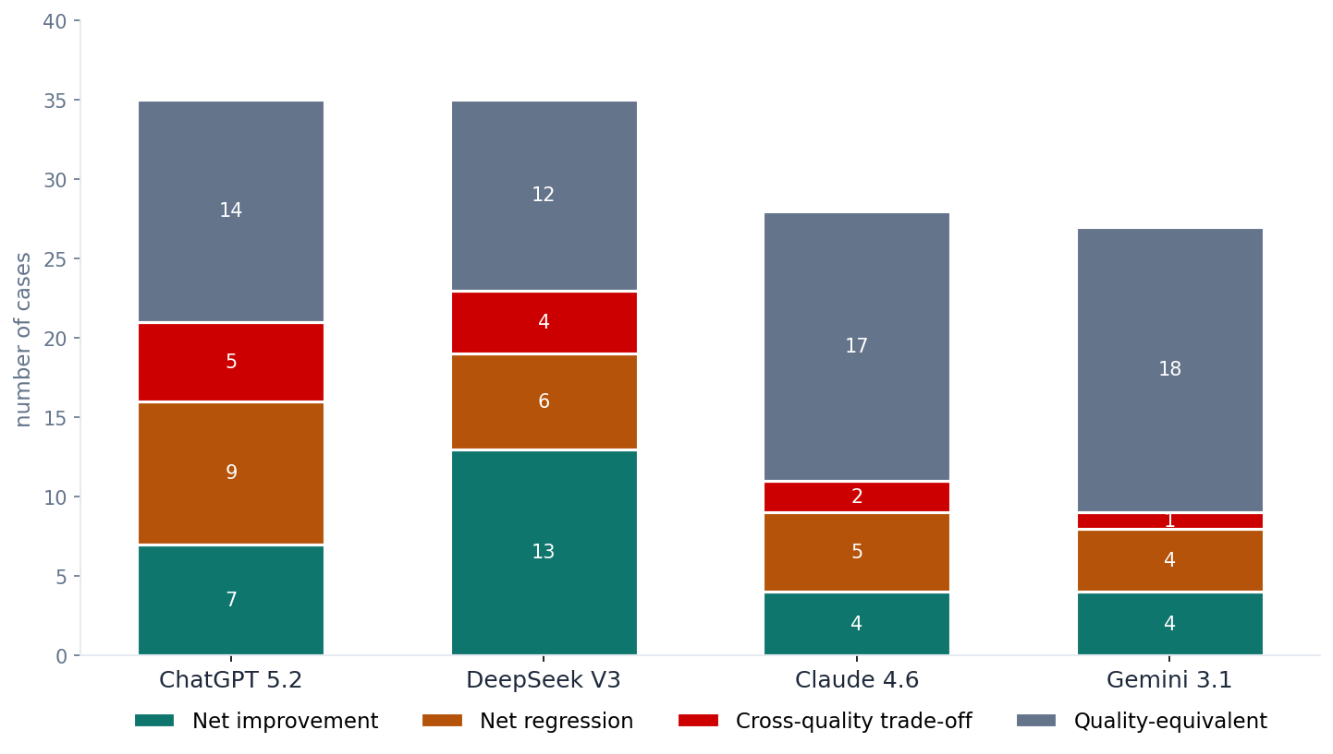
RESULTS · OUTCOMES
Distribution of pair-level classifications
KEY OBSERVATION
The largest bucket for every model is quality-equivalent.
For a sizable fraction of SonarQube findings, the C-level fix does not perturb what Clippy sees in the Rust output.
DeepSeek: 13 improvements vs. 6 regressions, the strongest profile.
Neel Ghoshal · M.S. Thesis Defense · NC State University
21 / 30

Slide 22
RESULTS · LINT-LEVEL
Which Clippy lints actually respond to remediation
unsafe_op_in_unsafe_fn
-31
✓
RESPONDS TO REMEDIATION
unused_assignments
-23
unsafe_op_in_unsafe_fn
unused_assignments
unused_variables
Safety-pressure and unused-code lints respond when source becomes cleaner.
unused_variables
-22
collapsible_match
-11
dead_code
-9
unused_imports
+2
✗
DOES NOT, OR REGRESSES
unexpected_cfgs
+2
missing_safety_doc
(+25, ChatGPT)
Target-language convention lints have no C equivalent; a C-level fix cannot directly induce them.
too_many_arguments
+3
missing_safety_doc
+25
-30
-20
-10
0
10
20
30
aggregate delta count · negative values indicate improvement
Neel Ghoshal · M.S. Thesis Defense · NC State University
22 / 30

Slide 23
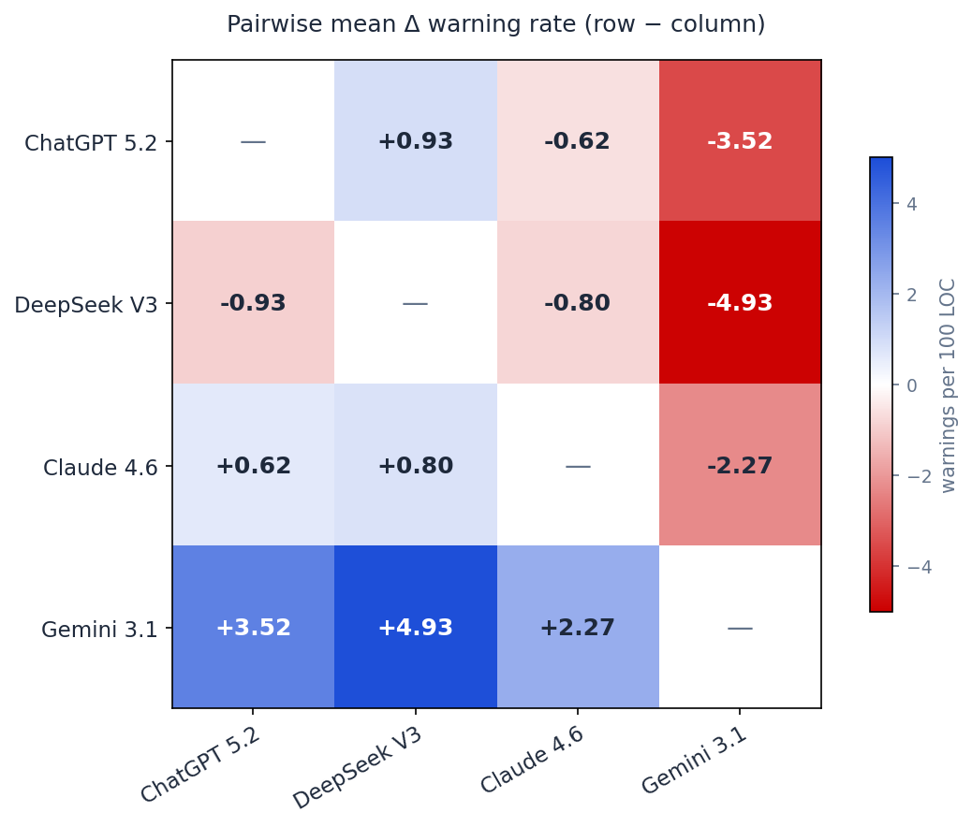
RESULTS · PAIRWISE
Head-to-head model comparison
WITHIN-REGIME READING
ChatGPT vs DeepSeek (both unsafe)
DeepSeek leads on mean rate (−0.93).
Claude vs Gemini (both safe)
Claude leads on lift (−2.27).
Takeaway. Benefiting more from remediation and ending cleaner are related but distinct outcomes. Pairwise dominance is weak in both pairs.
Neel Ghoshal · M.S. Thesis Defense · NC State University
23 / 30

Slide 24
PART 5
Qualitative Analysis
What the numbers
do not show
24 / 30

Slide 25
QUALITATIVE
Four recurring themes behind the numbers
A
Thread-safety swaps are quality-equivalent at the function level
Replacing strtok/localtime with _r variants reliably adds one memory-safety warning but otherwise leaves Clippy unchanged. The improvement is real at the program level but invisible to function-level analysis.
B
Helper extraction dilutes density but raises raw counts
Decomposing a complex function multiplies unsafe_op_in_unsafe_fn across smaller pieces. Raw count rises; rate per 100 LOC falls. Which metric to trust depends on the use case.
C
Documentation fixes upstream do not propagate downstream
C comments do nothing for Rust's missing_safety_doc, which requires Safety blocks on pub unsafe fns. LLMs emits more such fns after remediation, driving the +25 regression.
D
Mutability tightening sometimes induces new hard errors
A few after-translations introduced extern C blocks without the unsafe keyword, or forward declarations without bodies. These are translator-induced regressions, not properties of the fix itself.
Neel Ghoshal · M.S. Thesis Defense · NC State University
25 / 30

Slide 26
QUALITATIVE · CASE STUDY
Same fix, same model, opposite outcome
Remediation: strtok to strtok_r (thread safety)
This category appears in both directions of the win/loss distribution, showing that debt category label alone is a poor predictor of translation outcome.
Instance 1: net improvement
Instance 2: net regression
ChatGPT 5.2
ChatGPT 5.2
Rate change: −2.6 / 100 LOC
Rate change: +3.1 / 100 LOC
WHY
WHY
After the fix, the surrounding function was small enough that ChatGPT emitted one contiguous unsafe block instead of three nested ones. unsafe_op_in_unsafe_fn dropped from 4 to 1.
The strtok_r signature required an extra char** state parameter. ChatGPT emitted a new pub unsafe fn wrapping it, triggering missing_safety_doc (+1) and private_interfaces (+1).
The structure of the surrounding code matters more than the debt category label.
Neel Ghoshal · M.S. Thesis Defense · NC State University
26 / 30

Slide 27
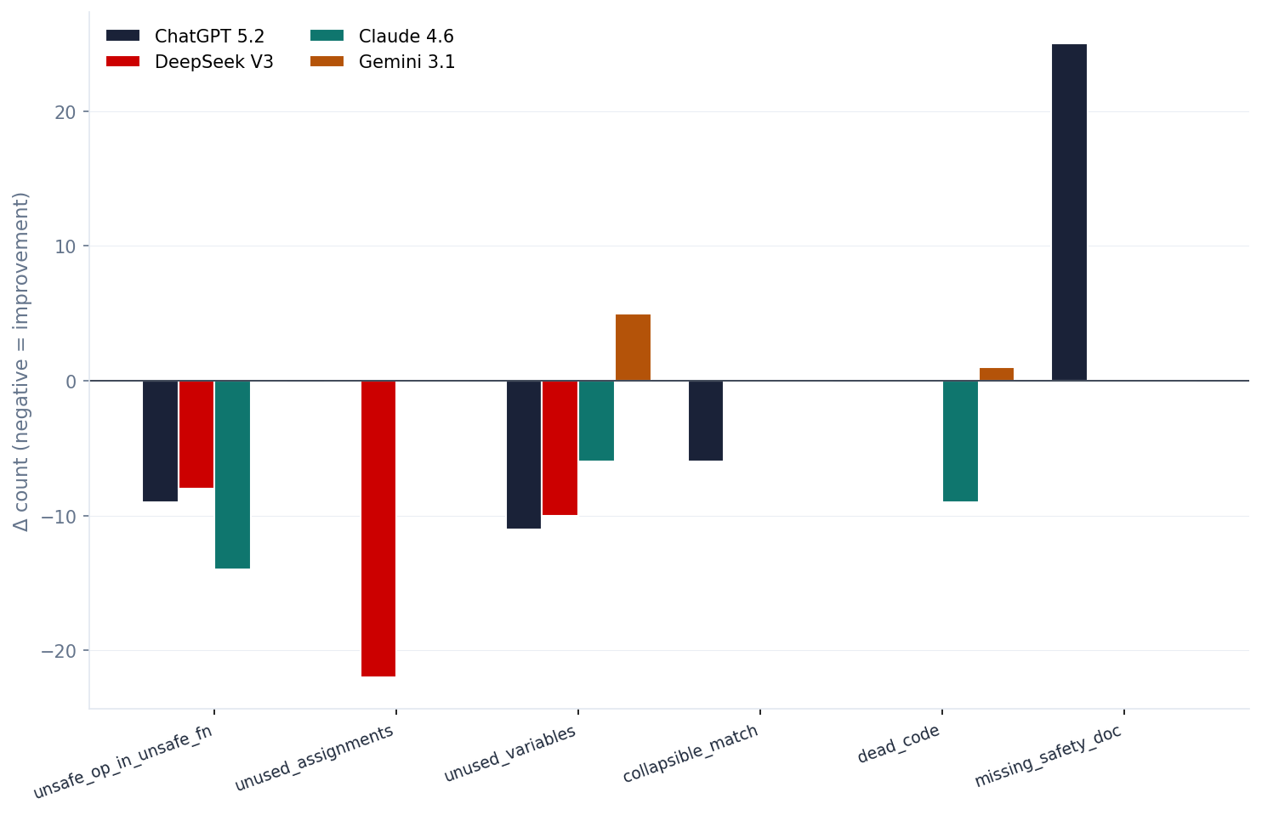
QUALITATIVE · MODEL TRAITS
Each translator has a distinctive lint signature
MODEL FINGERPRINTS
ChatGPT 5.2. Improves unused and collapsible code. Regresses safety docs (+25).
DeepSeek V3. Massive gain on unused_assignments (−22). Verbose FFI output gives more headroom.
Claude 4.6. Largest single drop in unsafe_op_in_unsafe_fn (−14). Tight idiomatic style.
Gemini 3.1 Pro. Small movements. Tends to leak unused_variables after remediation.
Neel Ghoshal · M.S. Thesis Defense · NC State University
27 / 30

Slide 28
PART 6
Discussion, Limitations & Future Work
Study Reflection
28 / 30

Slide 29
DISCUSSION
What worked, what did not, and what surprised us
✓
WORKED WELL
△
DID NOT WORK AS HOPED
!
SURPRISED US
Stub protocol kept comparisons paired and reproducible.
Many SonarQube issues were structurally too minor to perturb translation.
missing_safety_doc going up by +25 after remediation.
Internal / external split made cross-quality trade-offs visible.
Some Gemini outputs were so brief that remediation had no room to act.
Same strtok_r fix producing improvement in one case, regression in another.
A few after-translations introduced hard errors unrelated to the fix.
LOC normalization removed function-size confounds.
Quality-equivalent dominating the outcome distribution for every model.
Neel Ghoshal · M.S. Thesis Defense · NC State University
29 / 30

Slide 30
CONCLUSION
What this thesis contributes, and where it goes next
Source-level technical debt remediation does influence translated Rust quality, but the effect is strongly model-dependent and confined largely to safety-pressure and unused-code lints.
FIVE TAKEAWAYS
FUTURE WORK
Remediation can substantially affect Rust lint outcomes, but direction is not uniform across translators.
Scale & statistics
Larger samples; replace the fixed threshold with a calibrated statistical test.
Safety-pressure and unused-code lints respond; target-language convention lints do not.
Cross-quality trade-offs exist: external quality can improve while internal regresses.
Project-level eval
Repository-level evaluation so Clippy reasons over cross-function behavior.
DeepSeek V3 shows the strongest and most consistent remediation lift.
Pairwise dominance is weak; the effect depends on model and specific code instance.
Thank you
nghosha@ncsu.edu
30 / 30

