Slide 1
MC2 Route Dataset and Model Comparison
A Preliminary Research in Driving Speed Prediction under Nissan’s New Navigation System
PI: Professor Yi Lu Murphey
Neel Khakhar
Notes:
@add axis for plots
@add diagram for LSTM
@add Mixed data info
@comparison observation slides Mar 30

Slide 2
A1 and A3 Datasets
Attribute set Attribute unit Sampling Rate
Vehicle speed kmph 50Hz
Accelerator pedal operation % 10Hz
Steering Angle deg 10Hz
Longitudinal Acceleration G 50Hz
Traversal Acceleration G 50Hz
Average Speed Data 0 kmph n/a
Average speed Data 1 kmph n/a
Dis_to_average_speed_data_0 m n/a
Dis_to_average_speed_data_1 m n/a
Attribute set 1(A1)
Attribute set 3(A3)

Slide 3





LSTM Exp 1 model architecture
Output layer
$$y(t+h)$$
FC layer (128 units)
Flatten
LSTM layer (5 units; relu)
LSTM
LSTM
LSTM
LSTM
LSTM
Input layer
$$X\left(t−w+1\right)$$
$$X\left(t−w+2\right)$$
…
$$X\left(t−1\right)$$
$$X\left(t\right)$$

Slide 4
LSTM Exp 4 model architecture
Output layer
$$y(t+h)$$
FC layer (128 units)
Flatten
LSTM layer (50 units; relu)
LSTM
LSTM
…
LSTM
LSTM
Input layer
$$X\left(t−w+1\right)$$
$$X\left(t−w+2\right)$$
…
$$X\left(t−1\right)$$
$$X\left(t\right)$$

Slide 5
ALSTM32
Dense(1)
Dense(64)
Flatten
Attention
LSTM(32)
Dense(128)

Slide 6
ALSTM50
Dense(1)
Dense(64)
Flatten
Attention
LSTM(50)
Dense(128)

Slide 7
Objective
For each of K/L/M/N drivers we have below 4 variations of models:
Training dataset (Driver A/G/O/Mix)
Model trained
Attribute set
Horizon
Objective: To determine the best model for K/L/M/N Drivers. Can be found by answering below questions.
What dataset among Driver A/G/O/Mix is best for K/L/M/N drivers ?
What model among MLP/LSTM-1/LSTM-4/ALSTM-32/ALSTM-50 is best for K/L/M/N drivers ?
What attribute set A1/A3 is best for K/L/M/N drivers ?

Slide 8
Methodology
For each Horizon find Best, 2nd Best and 3rd Best performing model.
Avg of RMSE across K/L/M/N Drivers is the judgement metric.
Hence for each Horizon:
To observe these values we will utilize plots and finally conclude with data tables
For all plots
Driver A ( ), Driver G ( ), Driver O ( ), Mix( )
A1 set ( ), A3 set ( )
Horizon (s) |  | Model | Dataset | Attribute Set
1 | Best | -- | -- | --
1 | 2nd | -- | -- | --
1 | 3rd | -- | -- | --

Slide 9
Average K/L/M/N RMSE Lower Horizons Comparison

Slide 10
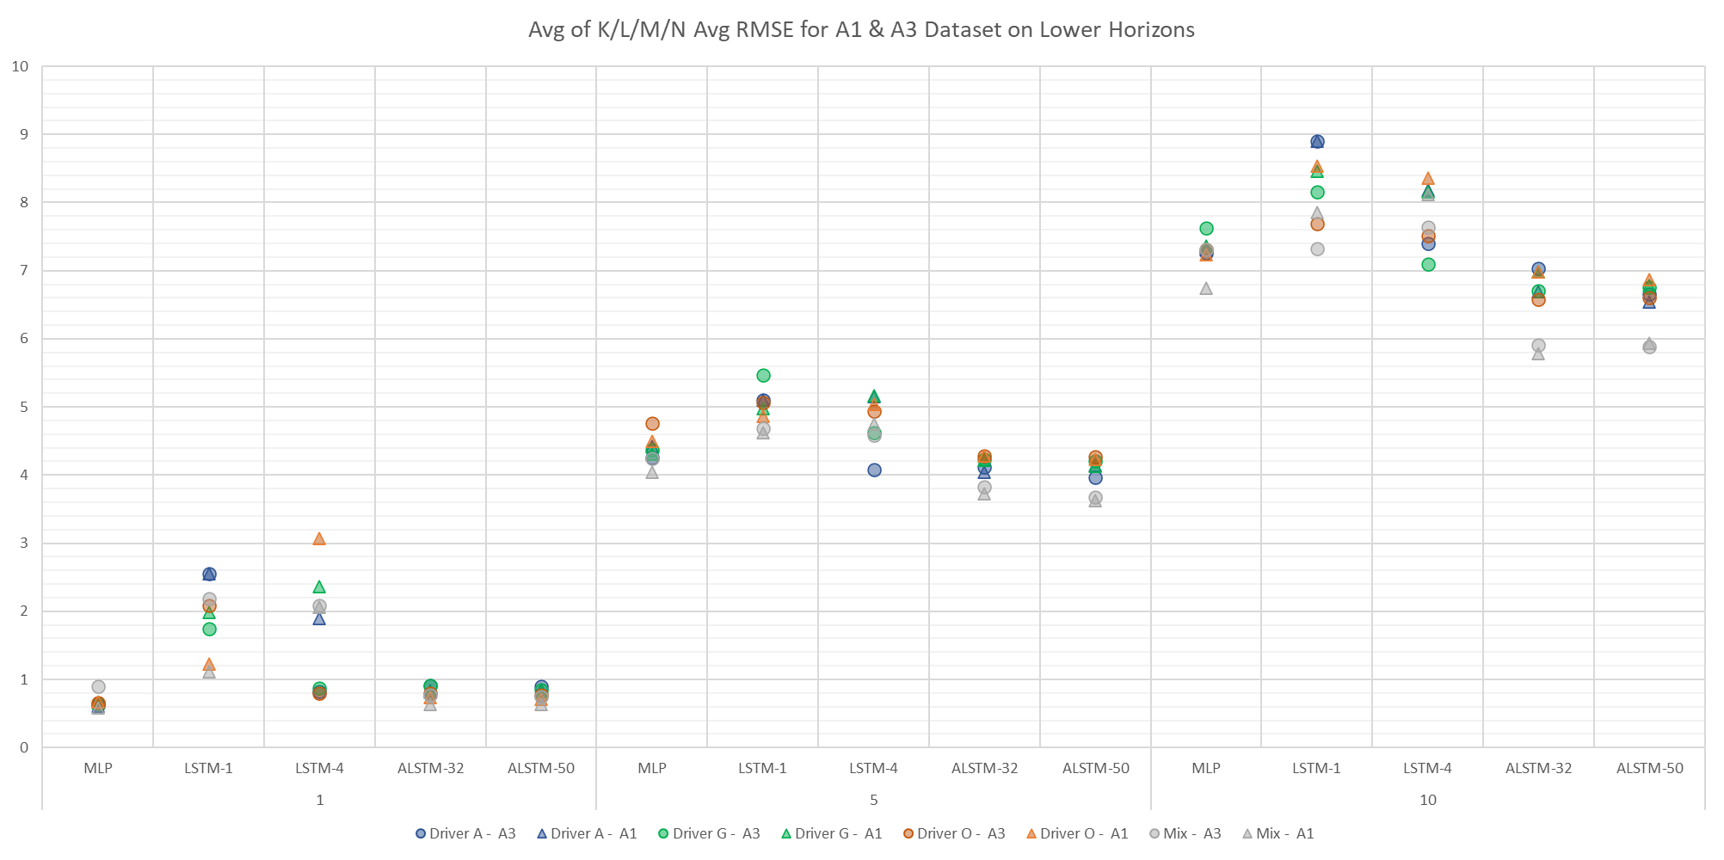
Performance on Lower Horizons for K/L/M/N Average RMSE

Slide 11
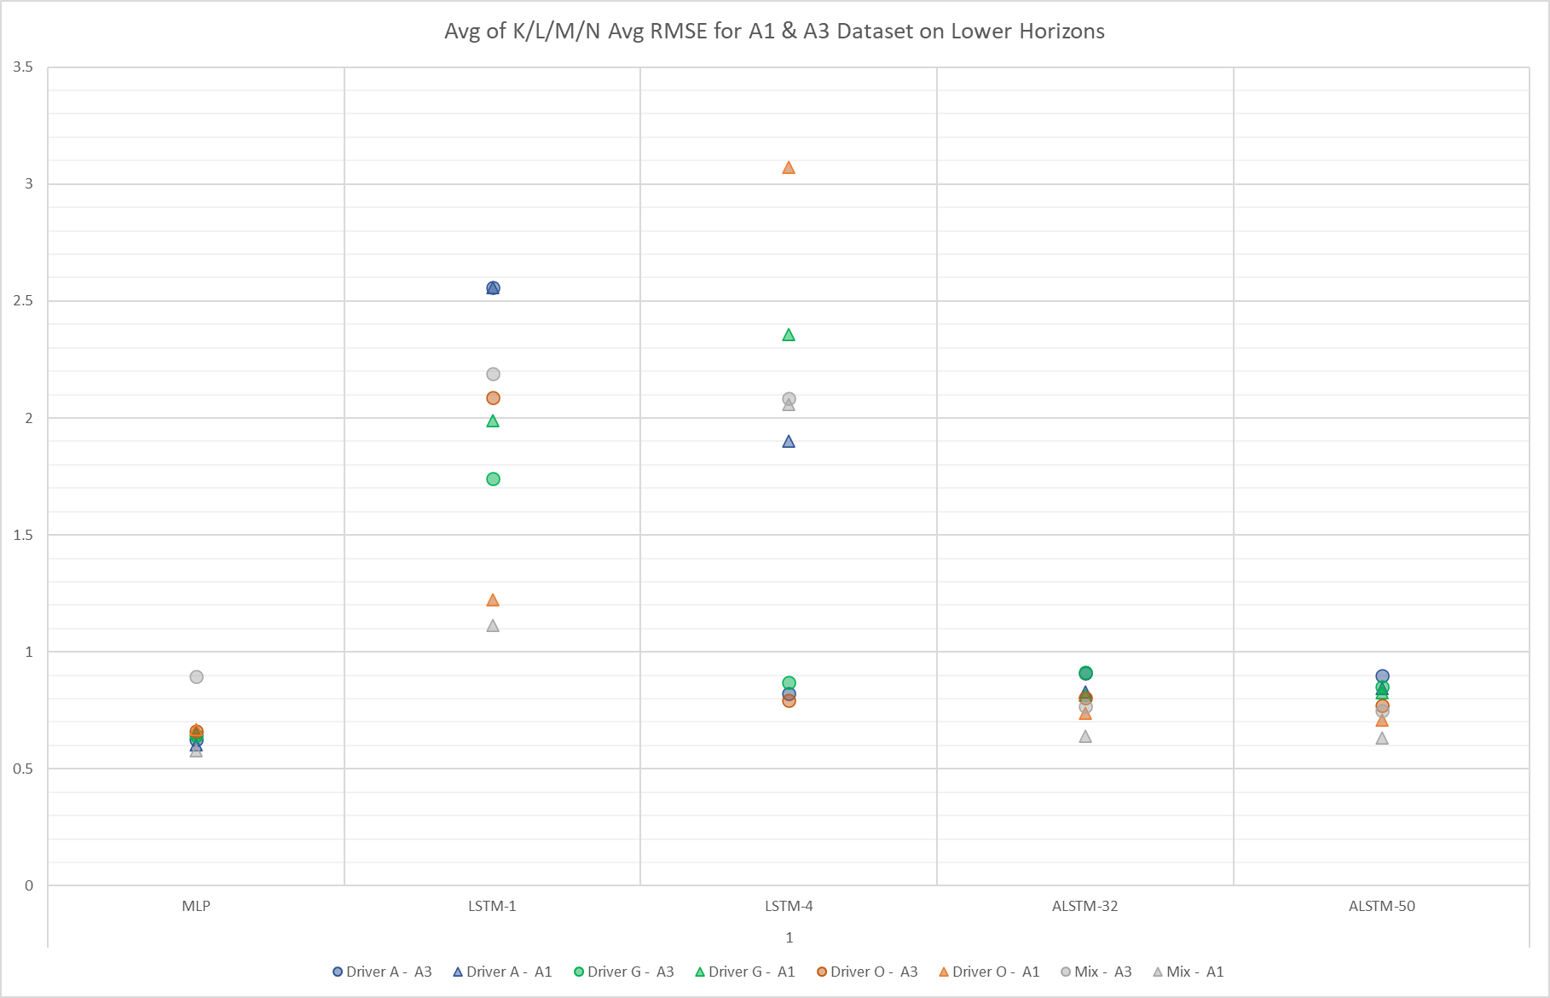
Performance on Lower Horizon for K/L/M/N Average RMSE (1s)
Horizon (s) |  | Model | Dataset | Attribute Set
1 | Best | MLP | Mix | A1
1 | 2nd | MLP | Driver A | A1
1 | 3rd | MLP | Driver A | A3
2
3
1

Slide 12
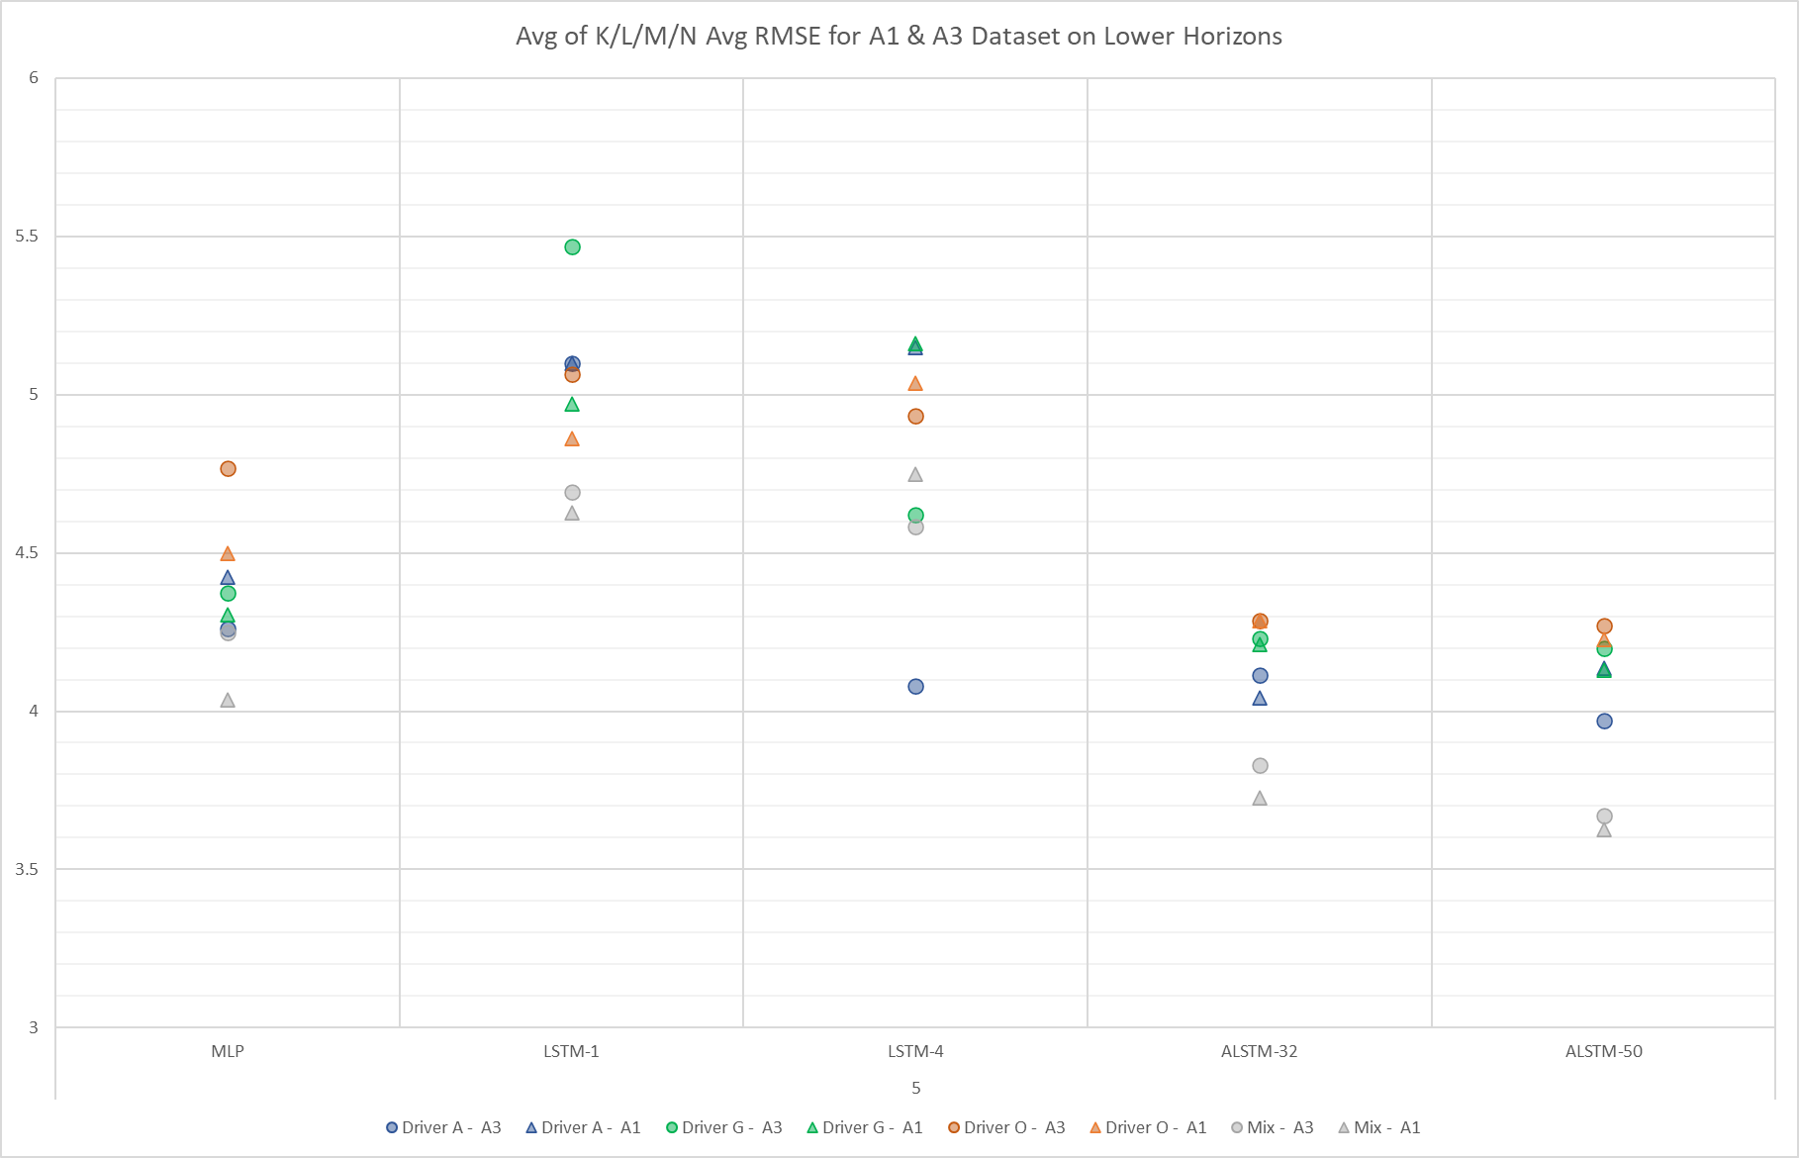
Performance on Lower Horizon for K/L/M/N Average RMSE (5s)
Horizon (s) |  | Model | Dataset | Attribute Set
5 | Best | ALSTM-50 | Mix | A1
5 | 2nd | ALSTM-50 | Mix | A3
5 | 3rd | ALSTM-32 | Mix | A1
3
2
1

Slide 13
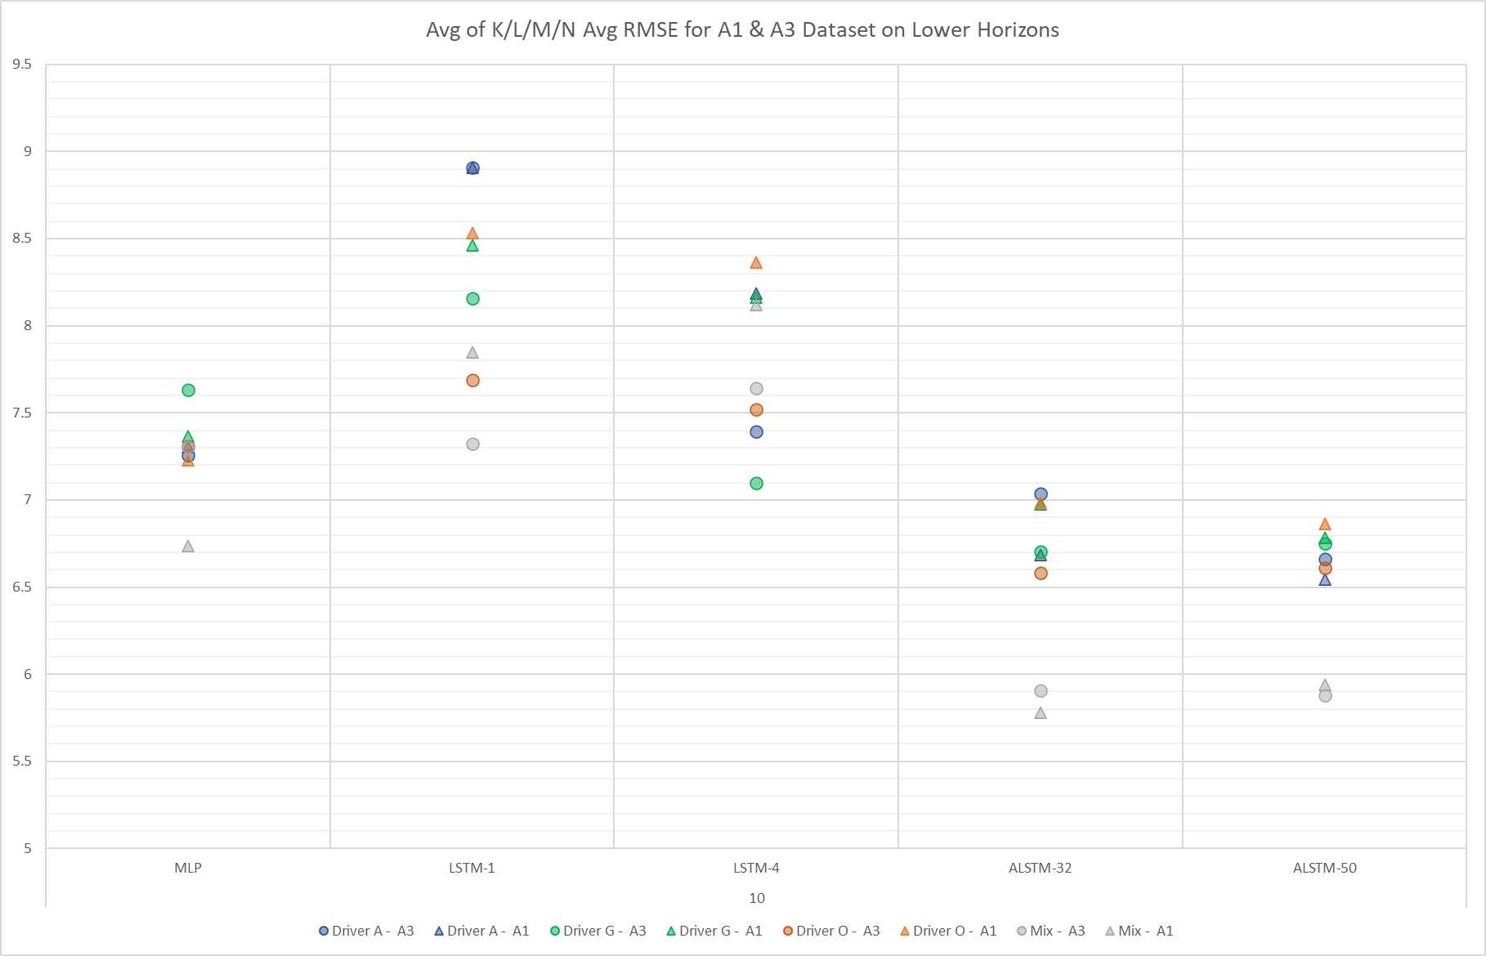
Performance on Lower Horizon for K/L/M/N Average RMSE (10s)
Horizon (s) |  | Model | Dataset | Attribute Set
10 | Best | ALSTM-32 | Mix | A1
10 | 2nd | ALSTM-50 | Mix | A3
10 | 3rd | ALSTM-32 | Mix | A3
3
1
2

Slide 14
Data Table and top models
Horizon |  | Model | Dataset | Attribute Set
1 | Best | MLP | Mix | A1
1 | 2nd | MLP | Driver A | A1
1 | 3rd | MLP | Driver A | A3
5 | Best | ALSTM-50 | Mix | A1
5 | 2nd | ALSTM-50 | Mix | A3
5 | 3rd | ALSTM-32 | Mix | A1
10 | Best | ALSTM-32 | Mix | A1
10 | 2nd | ALSTM-50 | Mix | A3
10 | 3rd | ALSTM-32 | Mix | A3
 |  | Driver A | Driver A | Driver G | Driver G | Driver O | Driver O | Mix | Mix
Horizon | Model | A3 | A1 | A3 | A1 | A3 | A1 | A3 | A1
1 | MLP | 0.63 | 0.60 | 0.65 | 0.66 | 0.66 | 0.67 | 0.90 | 0.58
1 | LSTM-1 | 2.56 | 2.56 | 1.74 | 1.99 | 2.09 | 1.22 | 2.19 | 1.11
1 | LSTM-4 | 0.82 | 1.90 | 0.87 | 2.36 | 0.79 | 3.07 | 2.09 | 2.06
1 | ALSTM-32 | 0.91 | 0.83 | 0.91 | 0.82 | 0.80 | 0.74 | 0.77 | 0.64
1 | ALSTM-50 | 0.90 | 0.85 | 0.85 | 0.83 | 0.77 | 0.71 | 0.75 | 0.63
5 | MLP | 4.26 | 4.43 | 4.37 | 4.31 | 4.77 | 4.50 | 4.25 | 4.04
5 | LSTM-1 | 5.10 | 5.10 | 5.47 | 4.97 | 5.06 | 4.86 | 4.69 | 4.63
5 | LSTM-4 | 4.08 | 5.15 | 4.62 | 5.16 | 4.93 | 5.04 | 4.58 | 4.75
5 | ALSTM-32 | 4.12 | 4.04 | 4.23 | 4.21 | 4.29 | 4.29 | 3.83 | 3.73
5 | ALSTM-50 | 3.97 | 4.14 | 4.20 | 4.13 | 4.27 | 4.23 | 3.67 | 3.63
10 | MLP | 7.26 | 7.31 | 7.63 | 7.37 | 7.31 | 7.23 | 7.31 | 6.74
10 | LSTM-1 | 8.91 | 8.91 | 8.16 | 8.46 | 7.69 | 8.53 | 7.32 | 7.85
10 | LSTM-4 | 7.40 | 8.19 | 7.10 | 8.16 | 7.52 | 8.37 | 7.64 | 8.12
10 | ALSTM-32 | 7.04 | 6.69 | 6.71 | 6.98 | 6.58 | 6.99 | 5.91 | 5.78
10 | ALSTM-50 | 6.66 | 6.54 | 6.75 | 6.79 | 6.61 | 6.87 | 5.88 | 5.94

Slide 15
Average K/L/M/N RMSE Medium Horizons Comparison

Slide 16
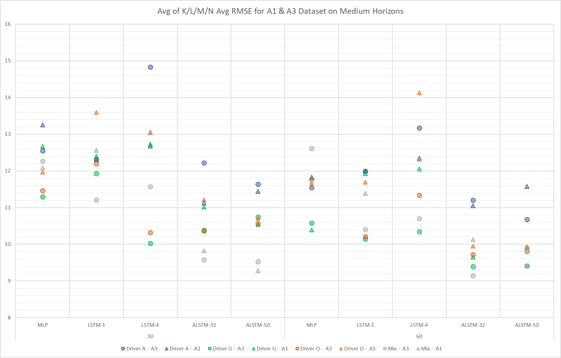
Performance on Medium Horizons for K/L/M/N Average RMSE

Slide 17
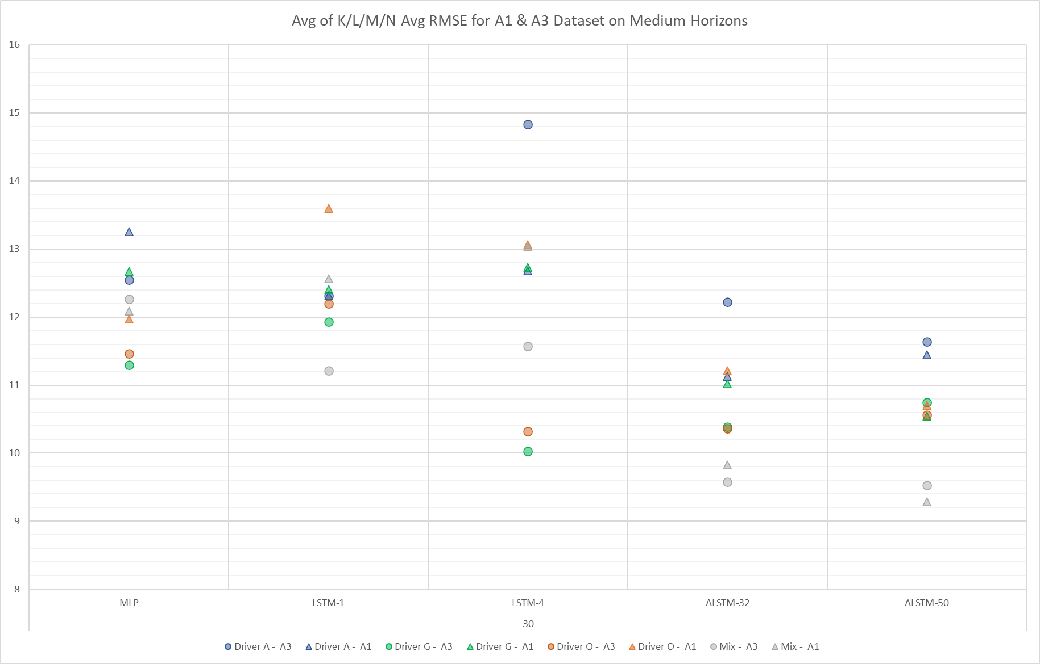
Performance on Medium Horizon for K/L/M/N Average RMSE (30s)
Horizon (s) |  | Model | Dataset | Attribute Set
30 | Best | ASLTM-50 | Mix | A1
30 | 2nd | ALSTM-50 | Mix | A3
30 | 3rd | ALSTM-32 | Mix | A3
3
2
1

Slide 18
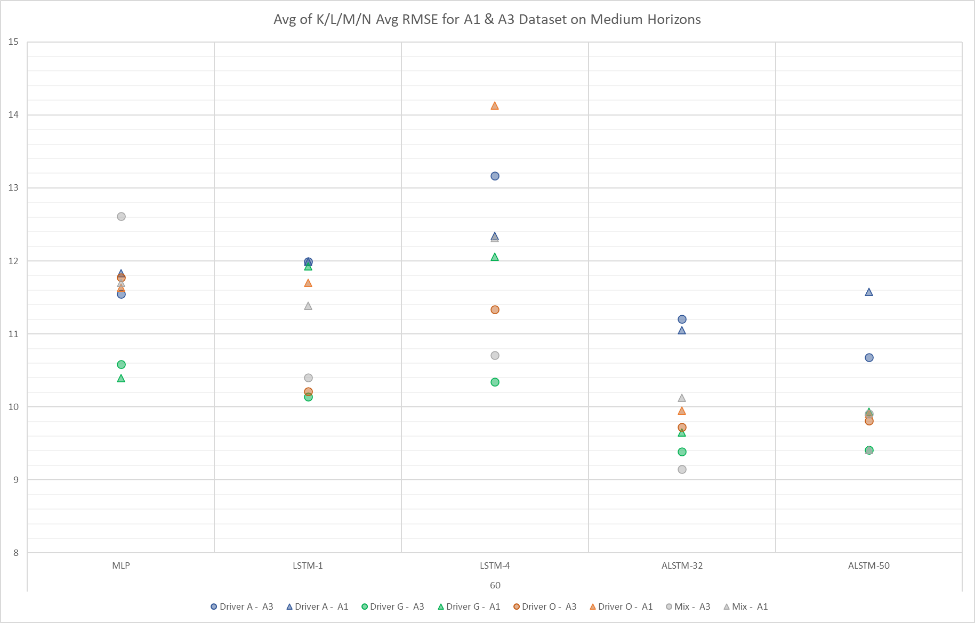
Performance on Medium Horizon for K/L/M/N Average RMSE (60s)
Horizon (s) |  | Model | Dataset | Attribute Set
60 | Best | ALSTM-32 | Mix | A3
60 | 2nd | ALSTM-32 | Driver G | A3
60 | 3rd | ALSTM-50 | Driver G/ Mix | A3/A1
2
3
1

Slide 19
Data Table and top models
Horizon |  | Model | Dataset | Attribute Set
30 | Best | ASLTM-50 | Mix | A1
30 | 2nd | ALSTM-50 | Mix | A3
30 | 3rd | ALSTM-32 | Mix | A3
60 | Best | ALSTM-32 | Mix | A3
60 | 2nd | ALSTM-32 | Driver G | A3
60 | 3rd | ALSTM-32 | Driver G/ Mix | A3/A1
 |  | Driver A | Driver A | Driver G | Driver G | Driver O | Driver O | Mix | Mix
Horizon | Model | A3 | A1 | A3 | A1 | A3 | A1 | A3 | A1
30 | MLP | 12.54 | 13.25 | 11.30 | 12.67 | 11.46 | 11.97 | 12.27 | 12.09
30 | LSTM-1 | 12.31 | 12.31 | 11.93 | 12.41 | 12.19 | 13.60 | 11.21 | 12.57
30 | LSTM-4 | 14.83 | 12.68 | 10.03 | 12.73 | 10.32 | 13.07 | 11.57 | 13.04
30 | ALSTM-32 | 12.23 | 11.13 | 10.39 | 11.02 | 10.37 | 11.22 | 9.58 | 9.83
30 | ALSTM-50 | 11.64 | 11.45 | 10.75 | 10.55 | 10.56 | 10.70 | 9.53 | 9.29
60 | MLP | 11.55 | 11.83 | 10.58 | 10.40 | 11.78 | 11.63 | 12.61 | 11.70
60 | LSTM-1 | 12.00 | 12.00 | 10.14 | 11.93 | 10.21 | 11.70 | 10.40 | 11.39
60 | LSTM-4 | 13.17 | 12.35 | 10.34 | 12.06 | 11.34 | 14.13 | 10.71 | 12.32
60 | ALSTM-32 | 11.21 | 11.06 | 9.39 | 9.66 | 9.72 | 9.95 | 9.15 | 10.13
60 | ALSTM-50 | 10.68 | 11.58 | 9.41 | 9.93 | 9.81 | 9.91 | 9.91 | 9.41

Slide 20
Average K/L/M/N RMSE Longer Horizons Comparison

Slide 21
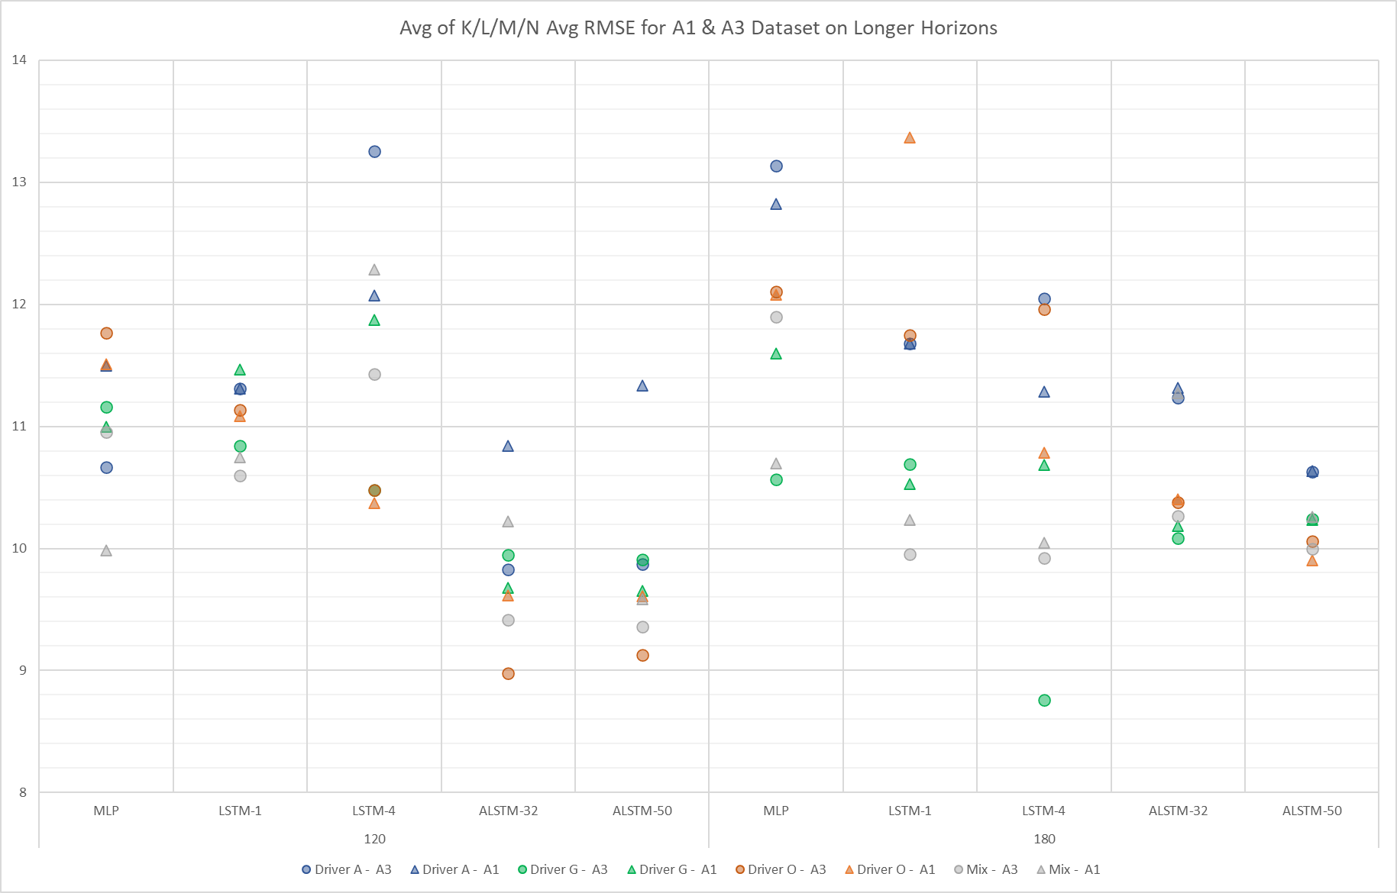
Performance on Longer Horizons for K/L/M/N Average RMSE

Slide 22
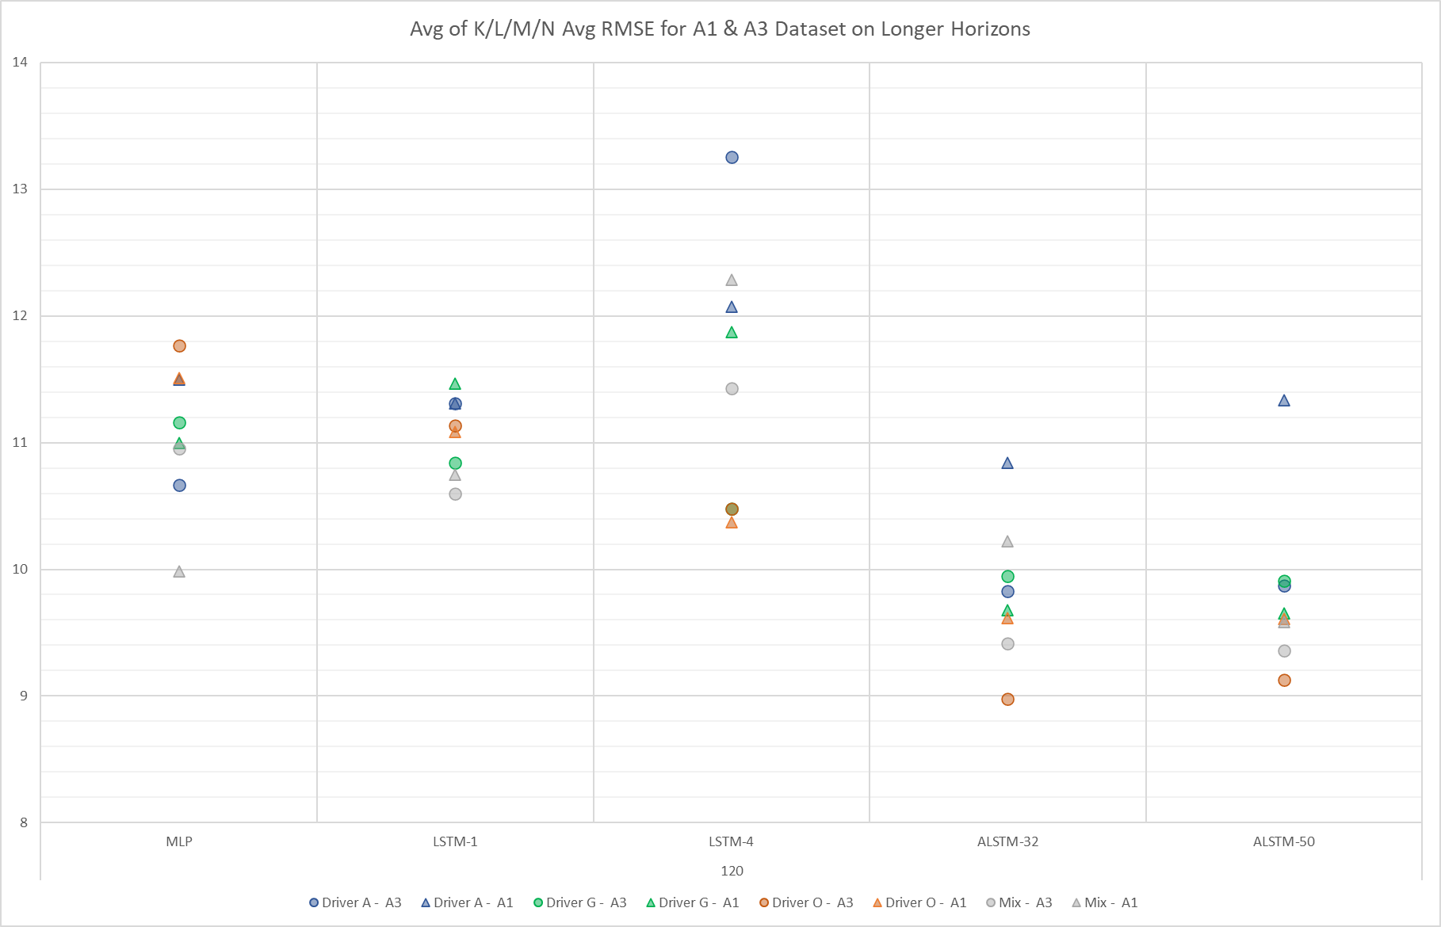
Performance on Longer Horizon for K/L/M/N Average RMSE (30s)
Horizon (s) |  | Model | Dataset | Attribute Set
120 | Best | ALSTM-32 | Driver O | A3
120 | 2nd | ALSTM-50 | Driver O | A3
120 | 3rd | ALSTM-50 | Mix | A3
3
2
1

Slide 23
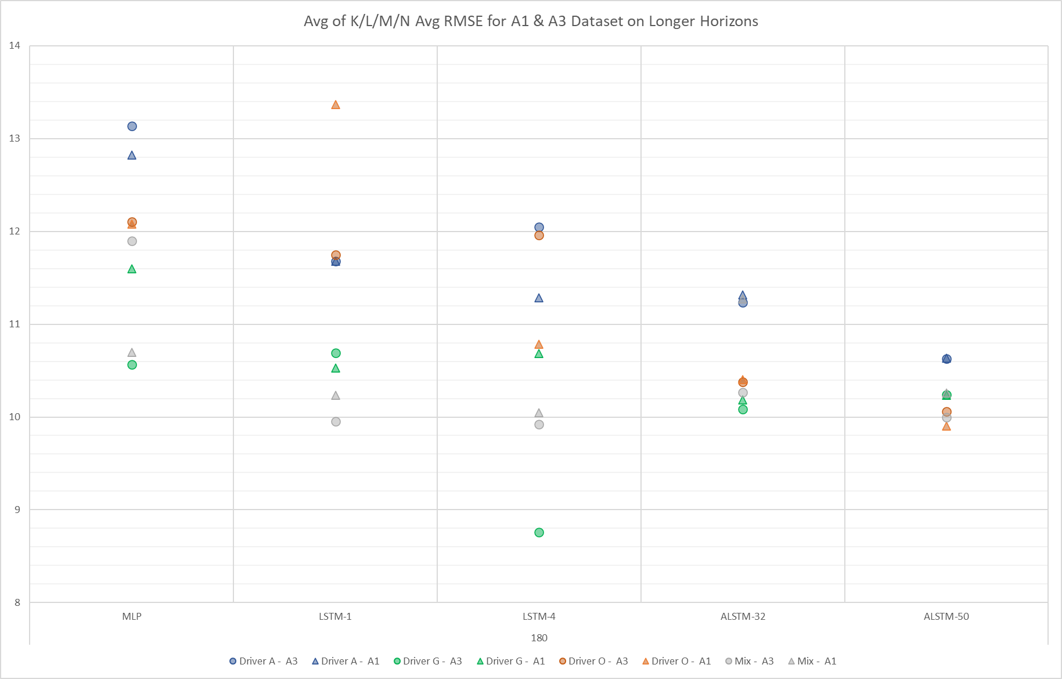
Performance on Longer Horizon for K/L/M/N Average RMSE (60s)
Horizon (s) |  | Model | Dataset | Attribute Set
180 | Best | LSTM-4 | Driver G | A3
180 | 2nd | ALSTM-50 | Driver O | A1
180 | 3rd | LSTM-4 | Mix | A3
3
2
1

Slide 24
Data Table and top models
Horizon |  | Model | Dataset | Attribute Set
120 | Best | ALSTM-32 | Driver O | A3
120 | 2nd | ALSTM-50 | Driver O | A3
120 | 3rd | ALSTM-50 | Mix | A3
180 | Best | LSTM-4 | Driver G | A3
180 | 2nd | ALSTM-50 | Driver O | A1
180 | 3rd | LSTM-4 | Mix | A3
 |  | Driver A | Driver A | Driver G | Driver G | Driver O | Driver O | Mix | Mix
Horizon | Model | A3 | A1 | A3 | A1 | A3 | A1 | A3 | A1
120 | MLP | 10.67 | 11.50 | 11.16 | 11.00 | 11.77 | 11.51 | 10.95 | 9.98
120 | LSTM-1 | 11.31 | 11.31 | 10.84 | 11.47 | 11.13 | 11.09 | 10.60 | 10.75
120 | LSTM-4 | 13.25 | 12.07 | 10.48 | 11.88 | 10.48 | 10.37 | 11.43 | 12.28
120 | ALSTM-32 | 9.83 | 10.84 | 9.95 | 9.68 | 8.98 | 9.61 | 9.42 | 10.22
120 | ALSTM-50 | 9.87 | 11.33 | 9.91 | 9.66 | 9.13 | 9.61 | 9.36 | 9.59
180 | MLP | 13.14 | 12.83 | 10.57 | 11.60 | 12.10 | 12.08 | 11.90 | 10.70
180 | LSTM-1 | 11.68 | 11.68 | 10.69 | 10.53 | 11.75 | 13.37 | 9.95 | 10.24
180 | LSTM-4 | 12.05 | 11.28 | 8.76 | 10.68 | 11.96 | 10.78 | 9.92 | 10.05
180 | ALSTM-32 | 11.23 | 11.32 | 10.09 | 10.18 | 10.38 | 10.41 | 10.27 | 11.27
180 | ALSTM-50 | 10.63 | 10.64 | 10.24 | 10.24 | 10.06 | 9.90 | 10.00 | 10.26

Slide 25
Concluding tables
Horizon (s) |  | Model | Dataset | Attribute Set | RMSE
1 | Best | MLP | Mix | A1 | 0.58
1 | 2nd | MLP | Driver A | A1 | 0.6
1 | 3rd | MLP | Driver A | A3 | 0.63
5 | Best | ALSTM-50 | Mix | A1 | 3.63
5 | 2nd | ALSTM-50 | Mix | A3 | 3.67
5 | 3rd | ALSTM-32 | Mix | A1 | 3.73
10 | Best | ALSTM-32 | Mix | A1 | 5.78
10 | 2nd | ALSTM-50 | Mix | A3 | 5.88
10 | 3rd | ALSTM-32 | Mix | A3 | 5.91
30 | Best | ASLTM-50 | Mix | A1 | 9.29
30 | 2nd | ALSTM-50 | Mix | A3 | 9.53
30 | 3rd | ALSTM-32 | Mix | A3 | 9.58
60 | Best | ALSTM-32 | Mix | A3 | 9.15
60 | 2nd | ALSTM-32 | Driver G | A3 | 9.39
60 | 3rd | ALSTM-50 | Driver G/Mix | A3/A1 | 9.41
120 | Best | ALSTM-32 | Driver O | A3 | 8.98
120 | 2nd | ALSTM-50 | Driver O | A3 | 9.13
120 | 3rd | ALSTM-50 | Mix | A3 | 9.36
180 | Best | LSTM-4 | Driver G | A3 | 8.76
180 | 2nd | ALSTM-50 | Driver O | A1 | 9.9
180 | 3rd | LSTM-4 | Mix | A3 | 9.92
Model | # occurrences in top model
MLP | 3
LSTM-4 | 2
ALSTM-32 | 7
ALSTM-50 | 9
Attribute Set | # occurrences in top model
A1 | 8
A3 | 14
(5 in <30s horizon)
(10 in >=30s horizon)
Dataset | # occurrences in top model
Driver A | 2
Driver G | 3
Driver O | 3
Mix | 14
(7 in <30s horizon)
Hence:
- ALSTM-50 is overall best performing architecture
- A3 attribute set is overall best performing, however lower horizons perform better with A1
- Mix dataset is overall best performing, however individual driver performances perform better at longer horizons

Slide 26
Previously internally presented

Slide 27
A1 dataset with Average K/L/M/N RMSE Training data comparison

Slide 28
All model average performance for K/L/M/N average RMSE
Mix dataset best for 1-5-10 second Horizons

Slide 29
All model average performance for K/L/M/N average RMSE
Mix dataset best for 30-180 second Horizons
Driver G dataset best for 60 second and Driver O dataset for 120 second Horizons

Slide 30
A3 dataset with Average K/L/M/N RMSE Training data comparison

Slide 31
All model average performance for K/L/M/N average RMSE
Mix dataset best for 5-10 second Horizons
Driver G is best for 1 second Horizon

Slide 32
All model average performance for K/L/M/N average RMSE
Mix dataset best for 30 second Horizon
Driver G dataset best for 60-180 second and Driver O dataset for 120 second Horizons

Slide 33
Methodology
What model among MLP/LSTM-1/LSTM-4/ALSTM-32/ALSTM-50 is best for K/L/M/N drivers ?
- To answer this we need to compress (average of..) ‘Training Dataset’ variations to a single point (Average of RMSE collected from Driver A-G-O-Mix)
Plot entities:
- K/L/M/N Average RMSE on y-axis
- Horizons on x-axis
- Series of Model results

Slide 34
A1 dataset with Average K/L/M/N RMSE Model comparison

Slide 35
All training datasets average performance for K/L/M/N average RMSE
MLP is best for 1 second Horizons
ALSTM-50 is best for 5-10 second Horizons

Slide 36
All training datasets average performance for K/L/M/N average RMSE
ALSTM-32 is best for 60 second Horizon
ALSTM-50 is best for 30-120-180 second Horizons

Slide 37
A3 dataset with Average K/L/M/N RMSE Training data comparison

Slide 38
All training datasets average performance for K/L/M/N average RMSE
MLP is best for 1 second Horizons
ALSTM-50 is best for 5-10 second Horizons

Slide 39
All training datasets average performance for K/L/M/N average RMSE
ALSTM-50 is best for 30-180 second Horizons
ALSTM-32 is best for 60-120 second Horizons

Slide 40
A1 All-in-one Models and Training datasets Sample

Slide 41
Model and Training Dataset comparison for Long Horizons

Slide 42
A1 dataset with Average K/L/M/N RMSE Model comparison

Slide 43
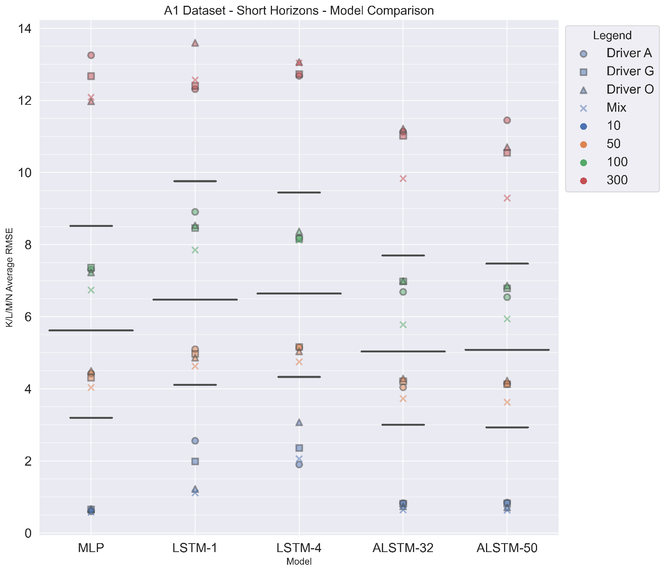
A1 Dataset model comparison on K/L/M/N Average RMSE for shorter horizons
Conclusion:
ALSTM50 is best for shorter horizons with A1 dataset
4 best RMSE for each horizon; 3 from ALSTM50, 1 from MLP

Slide 44
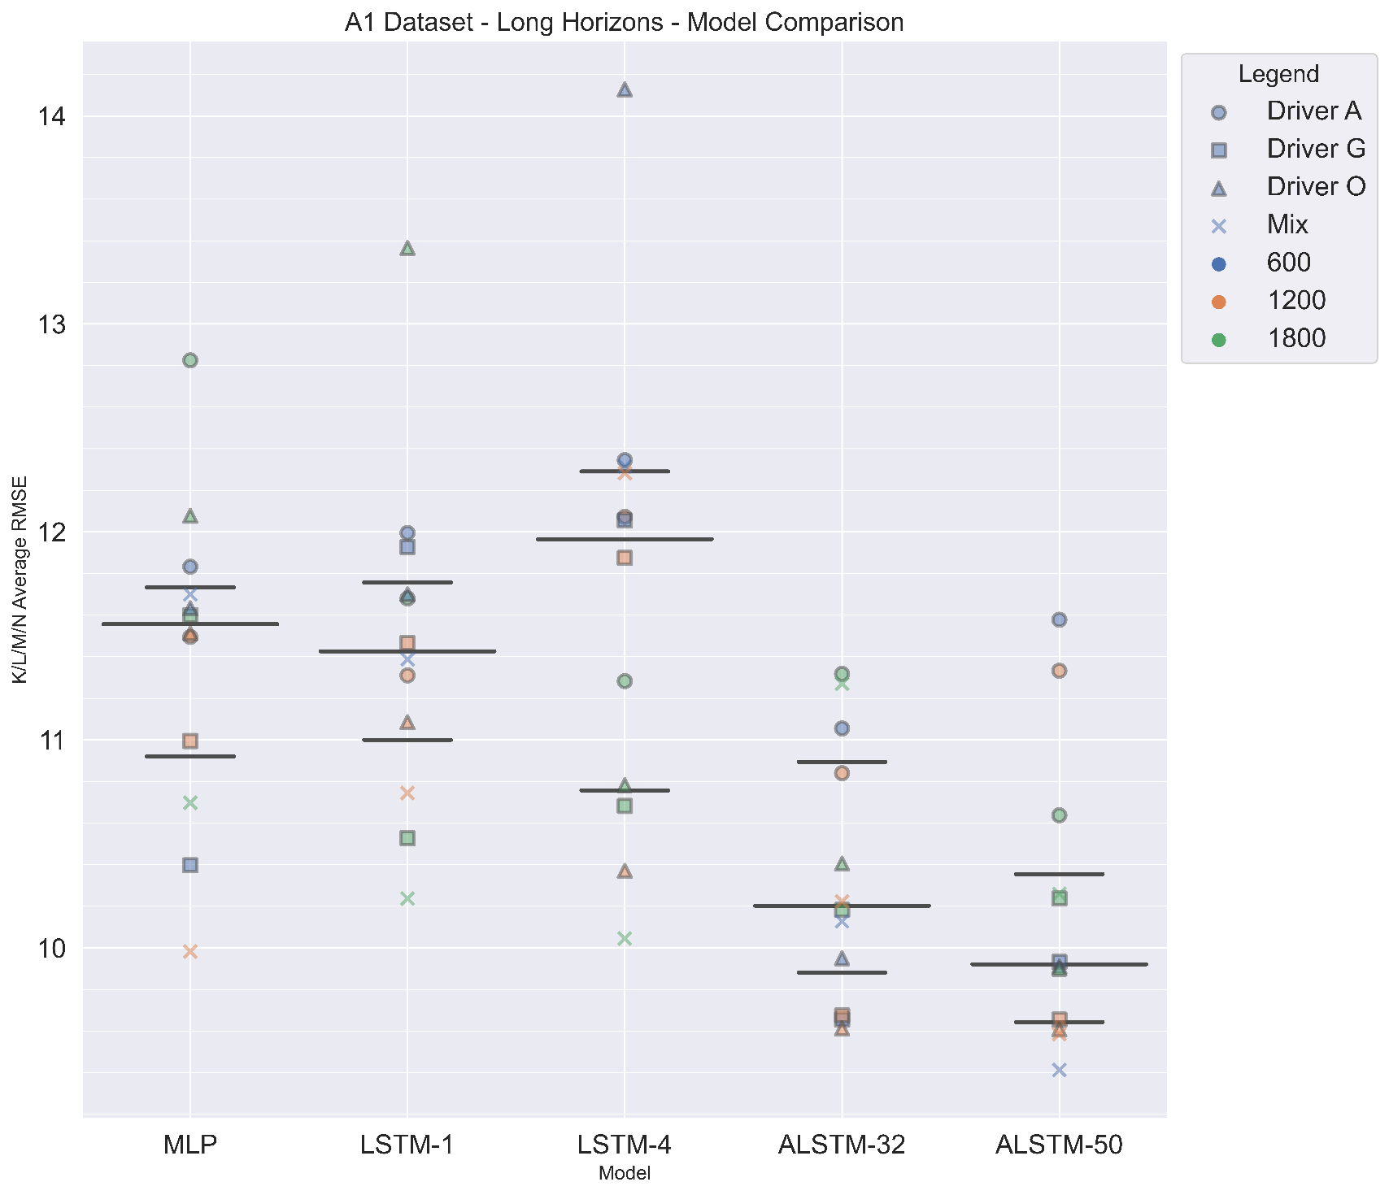
A1 Dataset model comparison on K/L/M/N Average RMSE for longer horizons
Conclusion:
ALSTM50 is best for longer horizons with A1 dataset
4 best RMSE for each horizon; 4 from ALSTM50

Slide 45
A3 dataset with Average K/L/M/N RMSE Model comparison

Slide 46
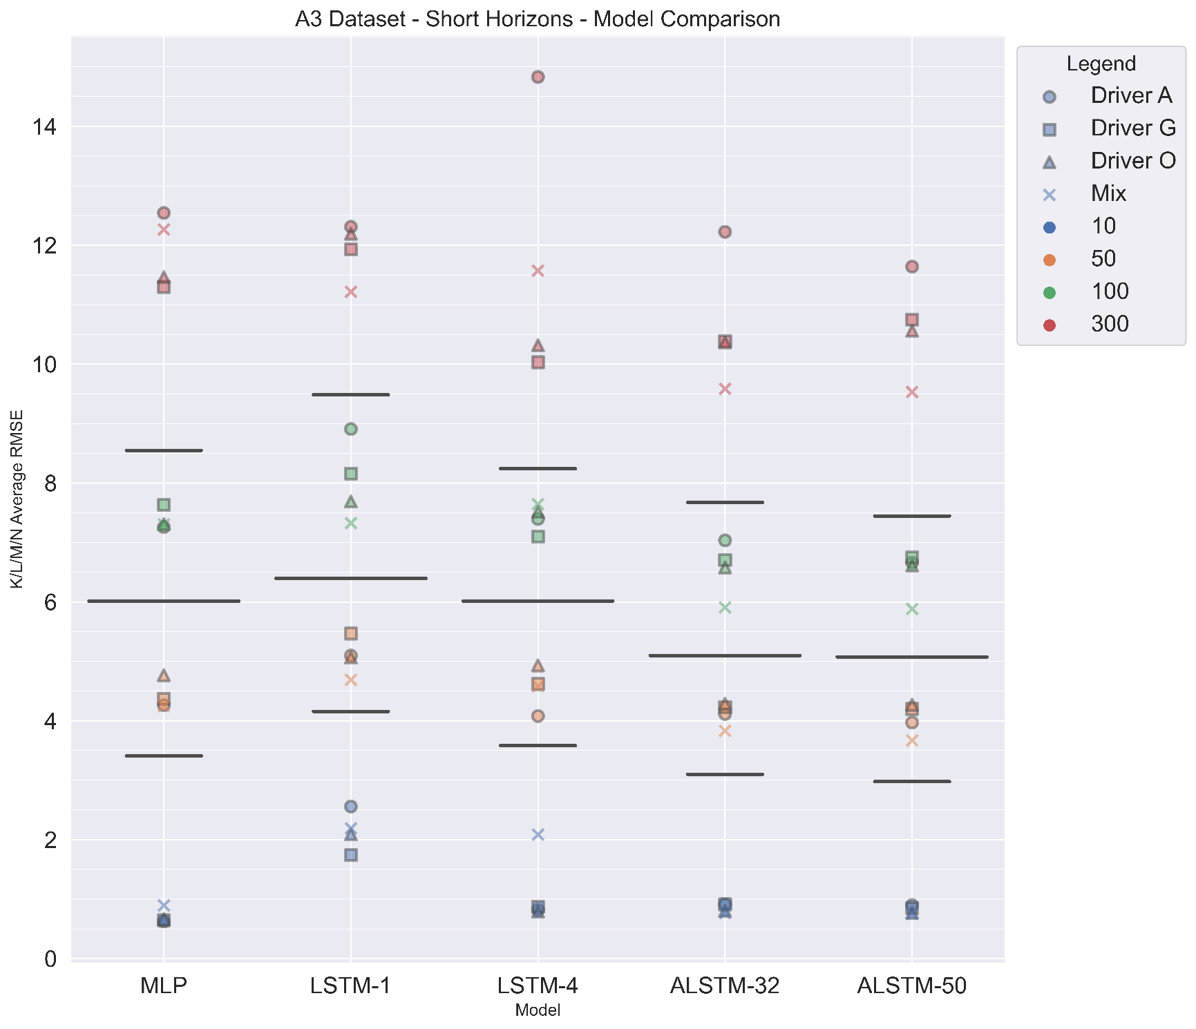
A3 Dataset model comparison on K/L/M/N Average RMSE for shorter horizons
Conclusion:
ALSTM50 is best for shorter horizons with A3 dataset
4 best RMSE for each horizon; 3 from ALSTM50, 1 from MLP

Slide 47
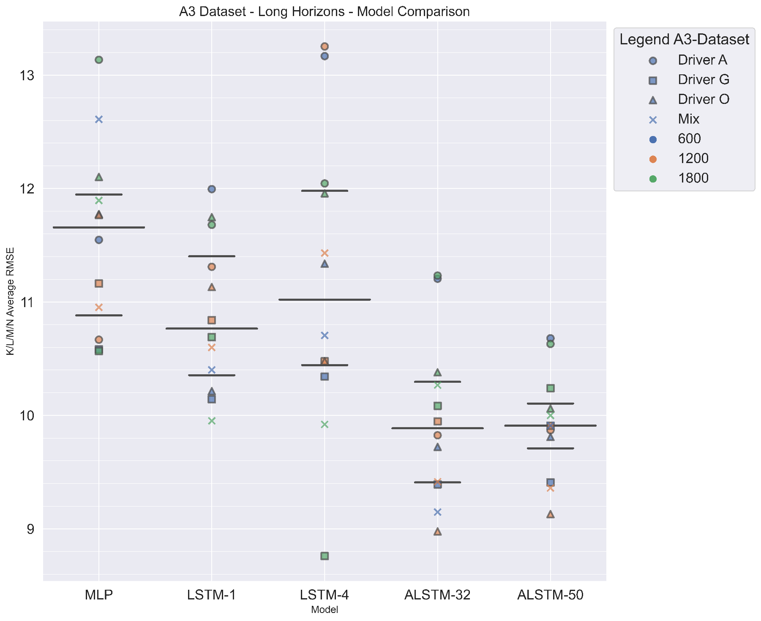
A3 Dataset model comparison on K/L/M/N Average RMSE for longer horizons
Conclusion:
ALSTM50 is best for longer horizons with A3 dataset
4 best RMSE for each horizon; 3 from ALSTM50, 1 from LSTM-4

Slide 48
Dataset comparison with Average K/L/M/N RMSE all Models

Slide 49
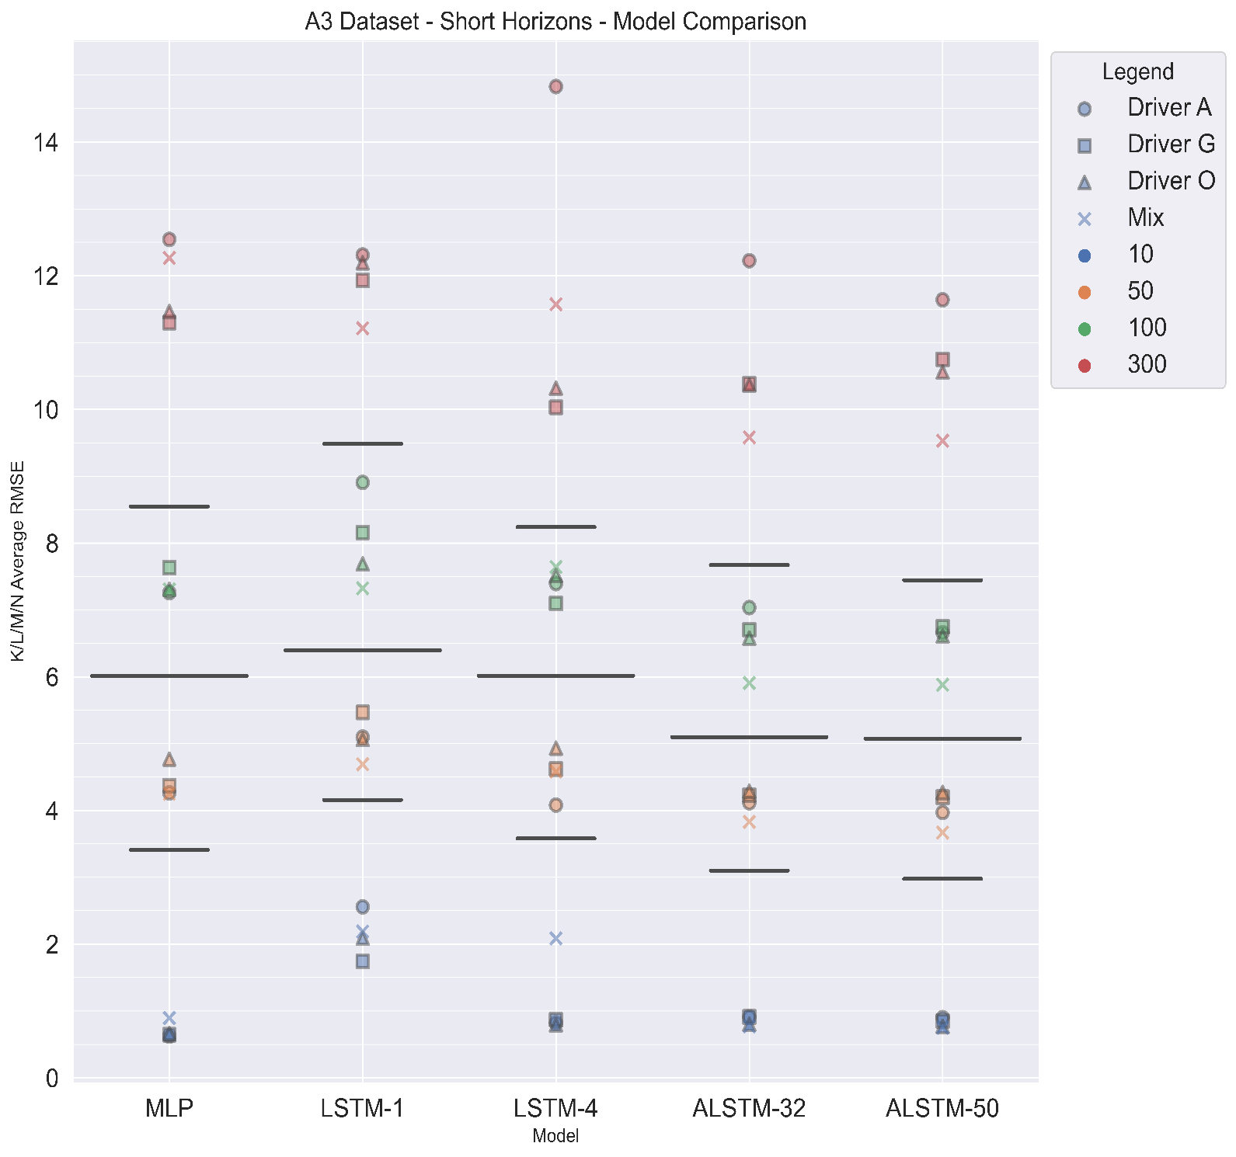
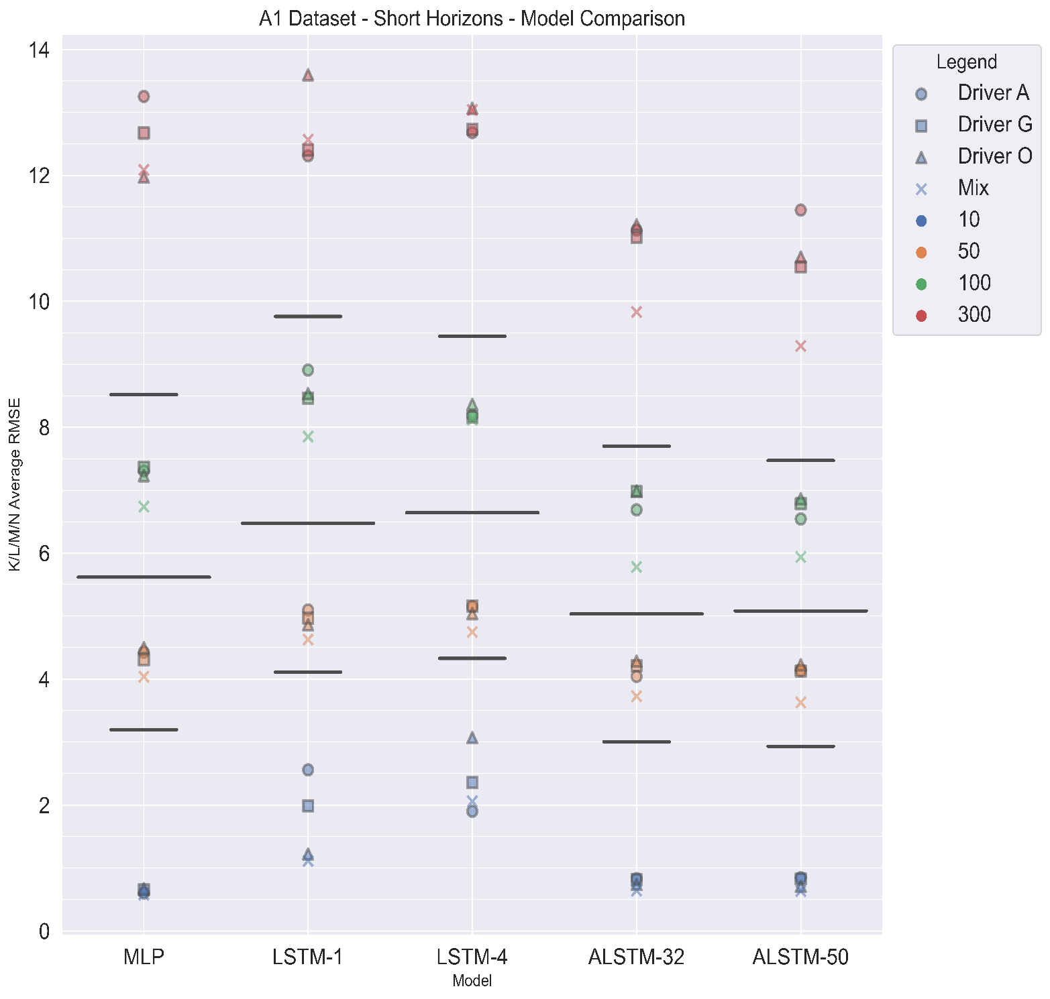
Dataset model comparison on K/L/M/N Average RMSE for short horizons
1/5 models show better performance with A3, 3 show little change, 1/5 shows better with A1
-Both datasets perform similar for short horizon
3/5 models show better performance with A3, 1 shows little change, 1 shows better with A1
-A3 dataset is better for longer horizon

Slide 50

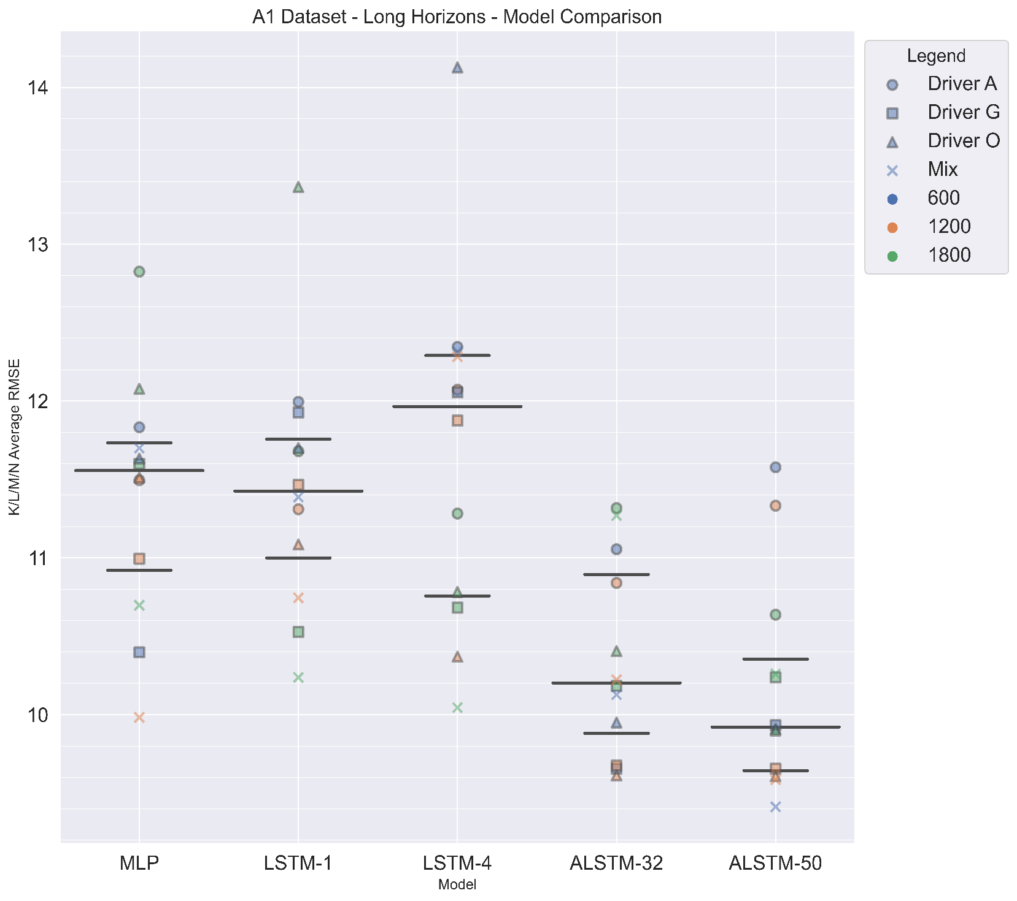
Dataset model comparison on K/L/M/N Average RMSE for longer horizons
3/5 models show better performance with A3, 1 shows little change, 1 shows better with A1
-A3 dataset is better for longer horizon

