Slide 1
DBMS Project – Group 7
Group Members:
Neel Paresh Solanki
Vimal Shantibhai Lakhani
Pratham Milankumar Doshi
Rakshit Khanna

Slide 2
TASK DISTRIBUTION
MEMBERS | TASKS
NEEL SOLANKI | 1,2
RAKSHIT KHANNA | 3,6
PRATHAM DOSHI | 4
VIMAL LAKHANI | 5,6

Slide 3
Task 1
Focus: Creating address table, Talend job design, Oracle DB setup
Tools: Oracle SQL Developer, Talend, SQL
Lead: Neel

Slide 4
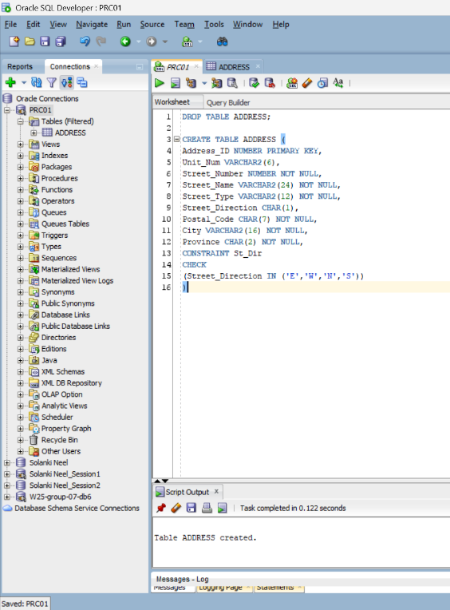
Creating Address Table
CREATE TABLE Address(
Address_ID NUMBER PRIMARY KEY,
Unit_Num VARCHAR2(6),
Street_Number NUMBER NOT NULL,
Street_Name VARCHAR2(24) NOT NULL,
Street_Type VARCHAR2(12) NOT NULL,
Street_Direction CHAR(1),
Postal_Code CHAR(7) NOT NULL,
City VARCHAR2(16) NOT NULL,
Province CHAR(2) NOT NULL,
CONSTRAINT St_Dir CHECK (Street_Direction IN ('E', 'W', 'N', 'S'))
);

Slide 5
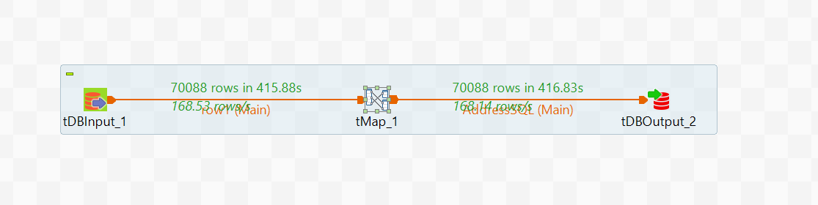
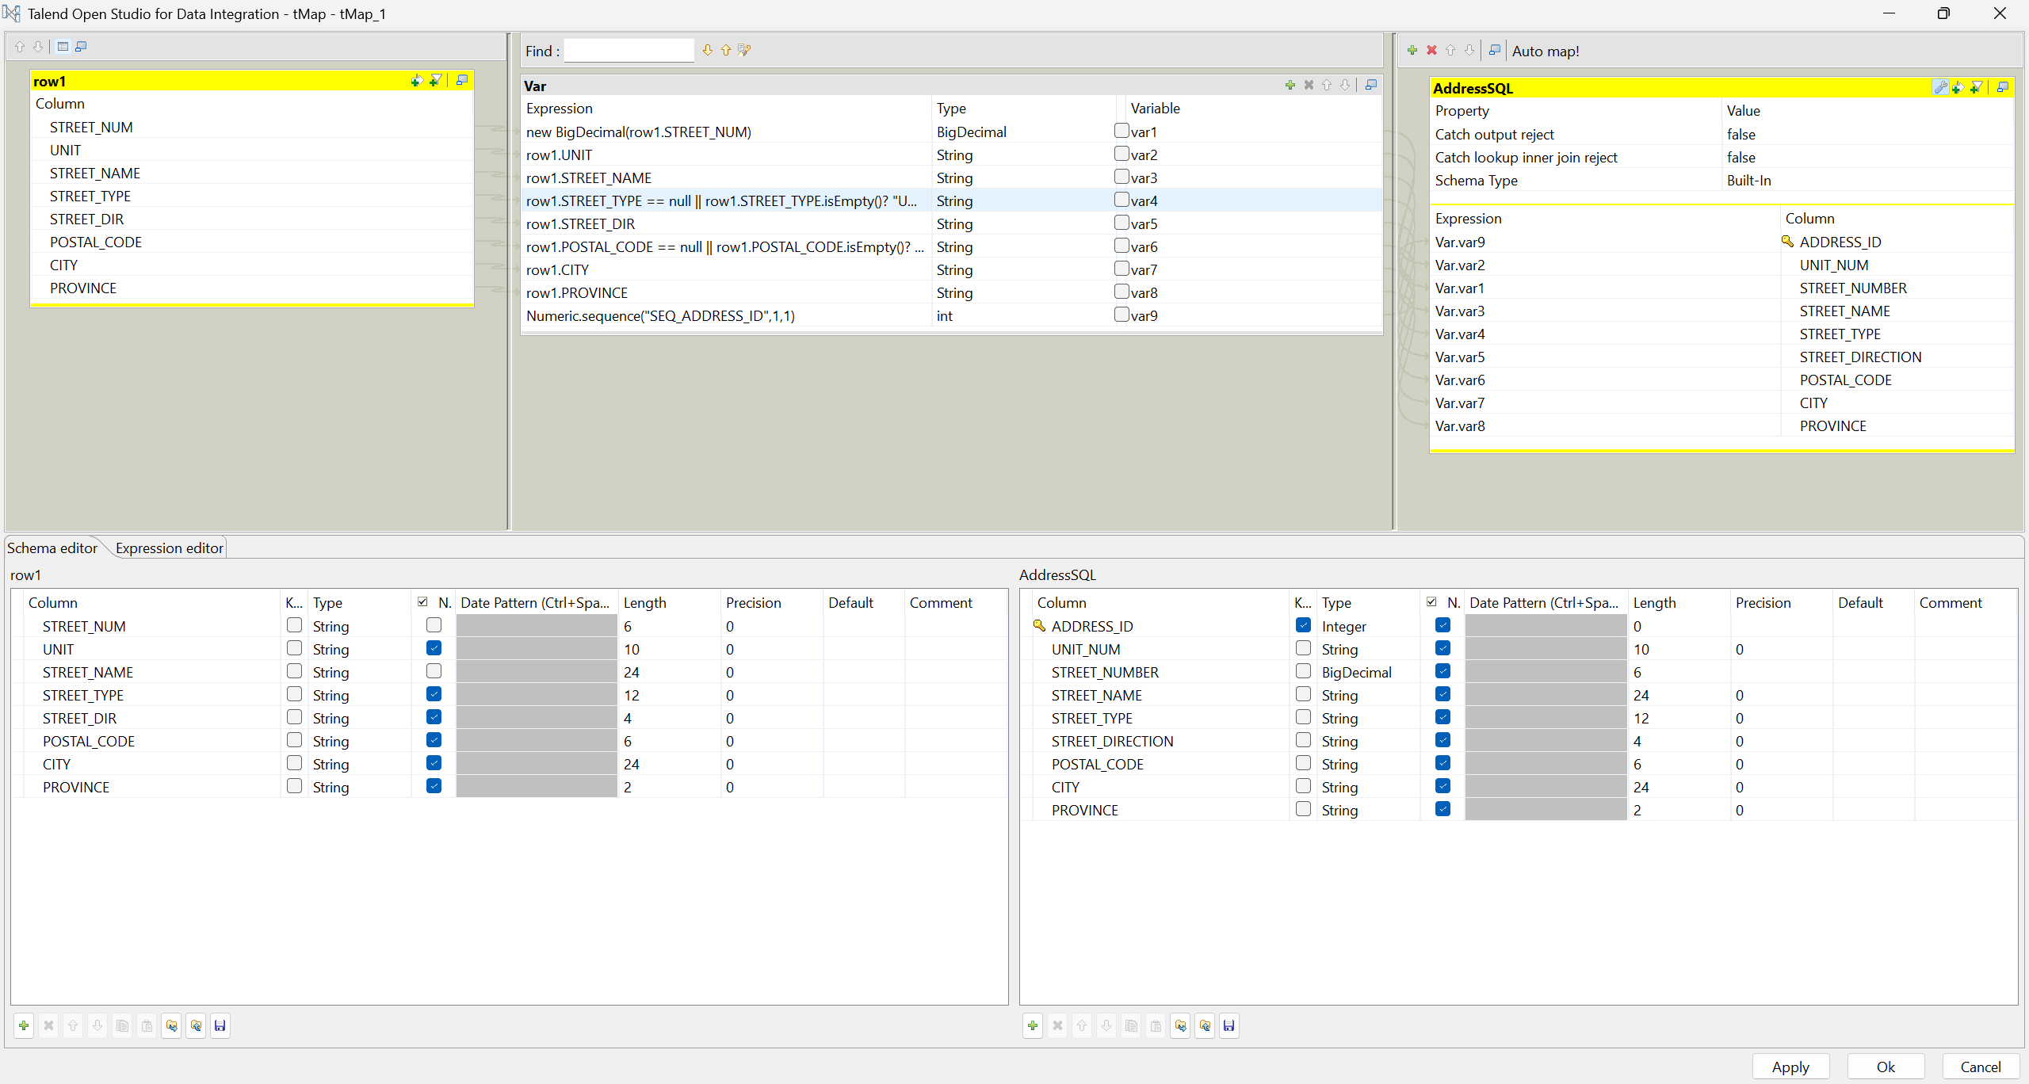
Connection on Talend

Slide 6
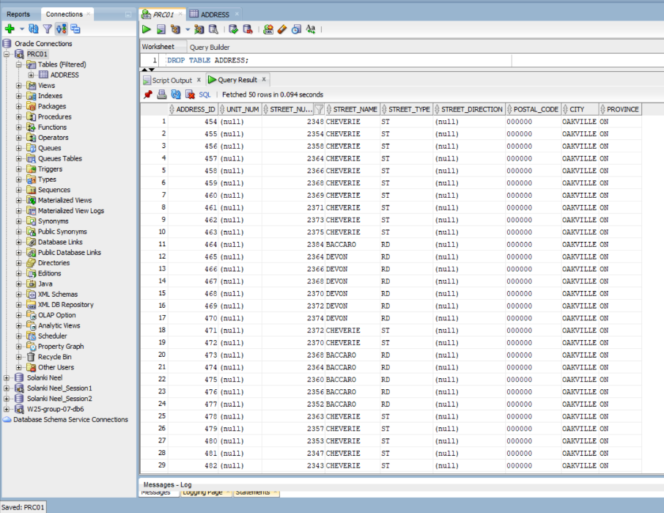
Address table with all values inserted

Slide 7
Task-2
Focus: CSV validation, ETL processing, foreign key constraints
Tools: Talend, Oracle SQL Developer
Lead: Neel

Slide 8
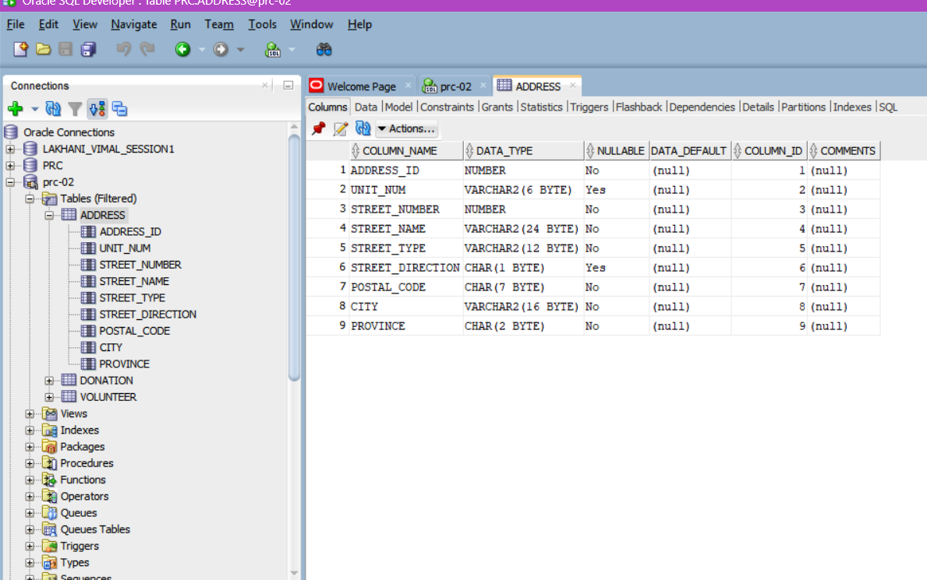
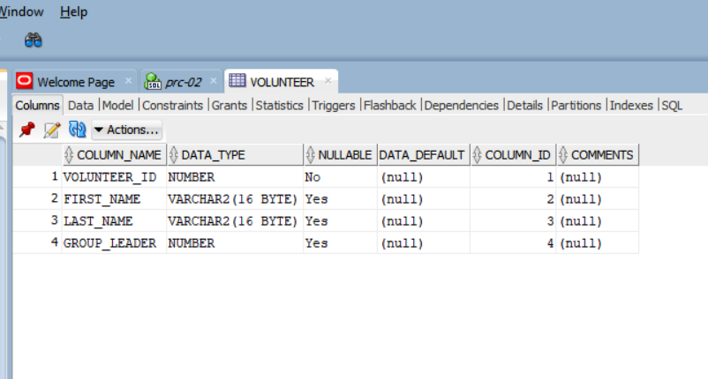
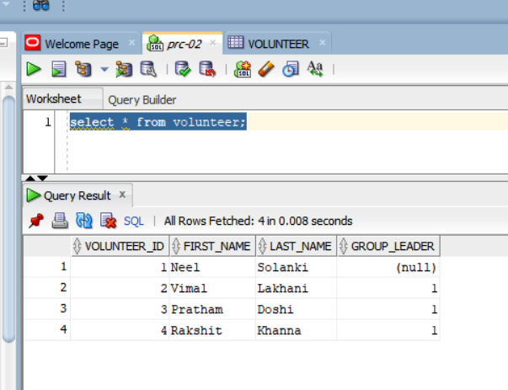
Creation of tables

Slide 9
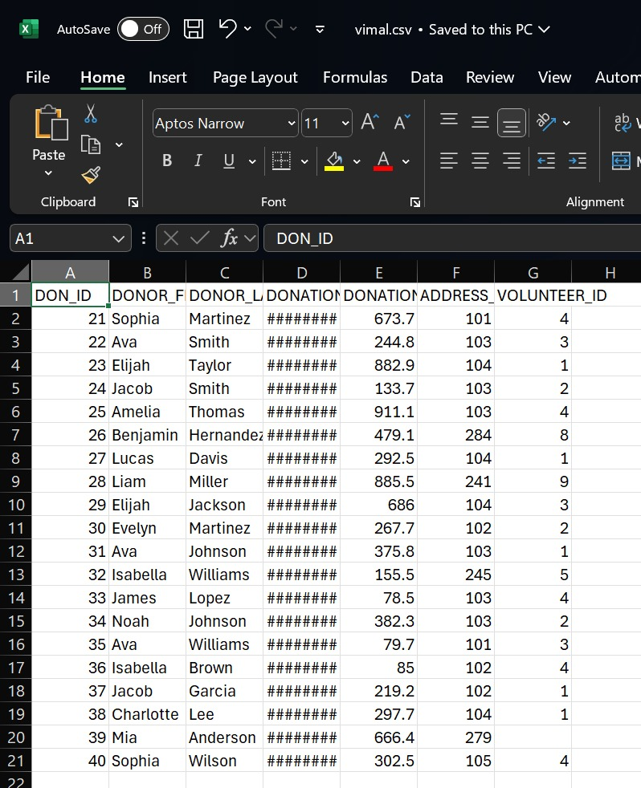
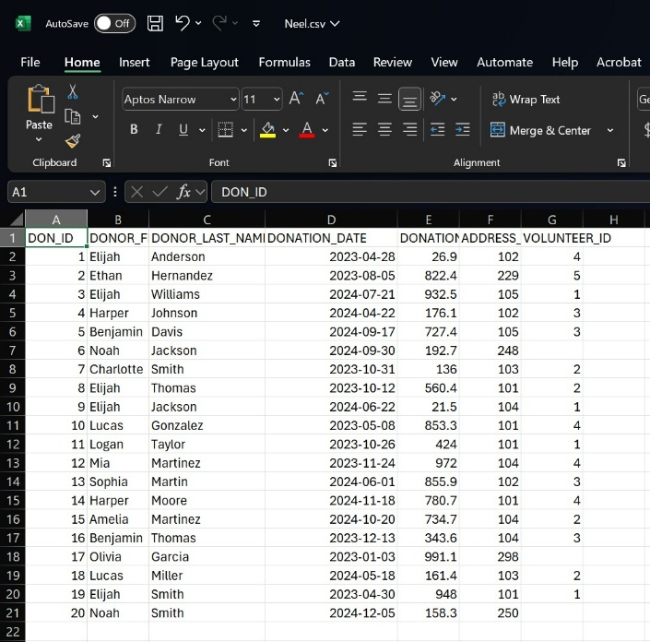
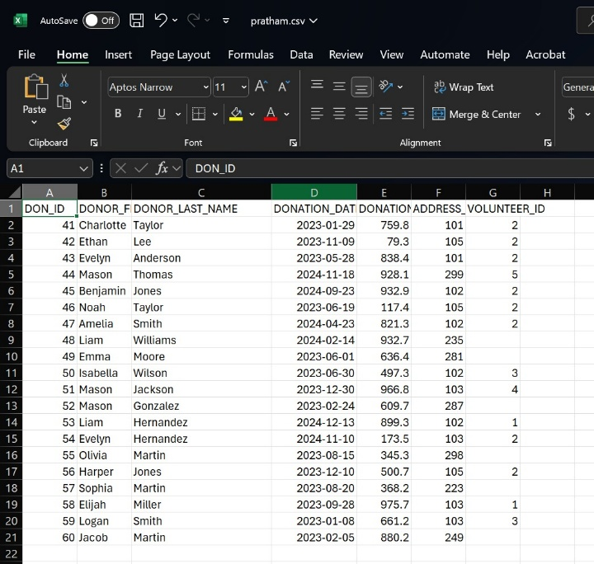
CSV files (with valid & invalid data)
Vimal.csv
Neel.csv
Pratham.csv

Slide 10
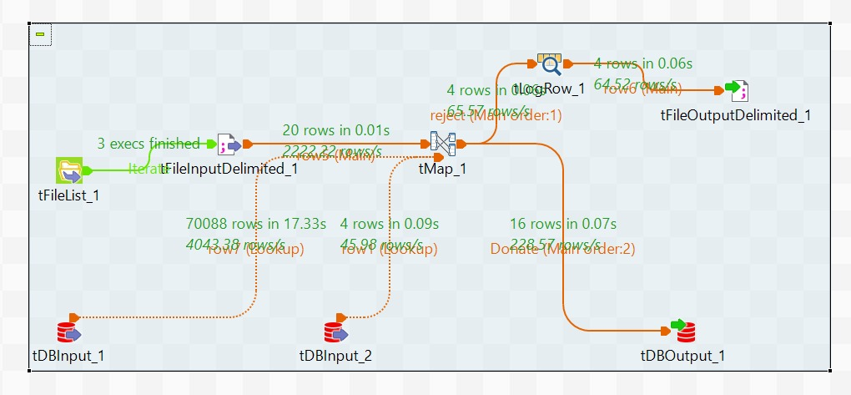
Talend Process
tMap:
Performs lookup operations using reference data from tDBInput_1 (ADDRESS) and tDBInput_2 (VOLUNTEER).
Validates foreign key relationships, specifically Address_ID and Volunteer_ID.
Routes records with valid foreign keys to the database output flow, while directing invalid records to a designated reject flow.

Slide 11
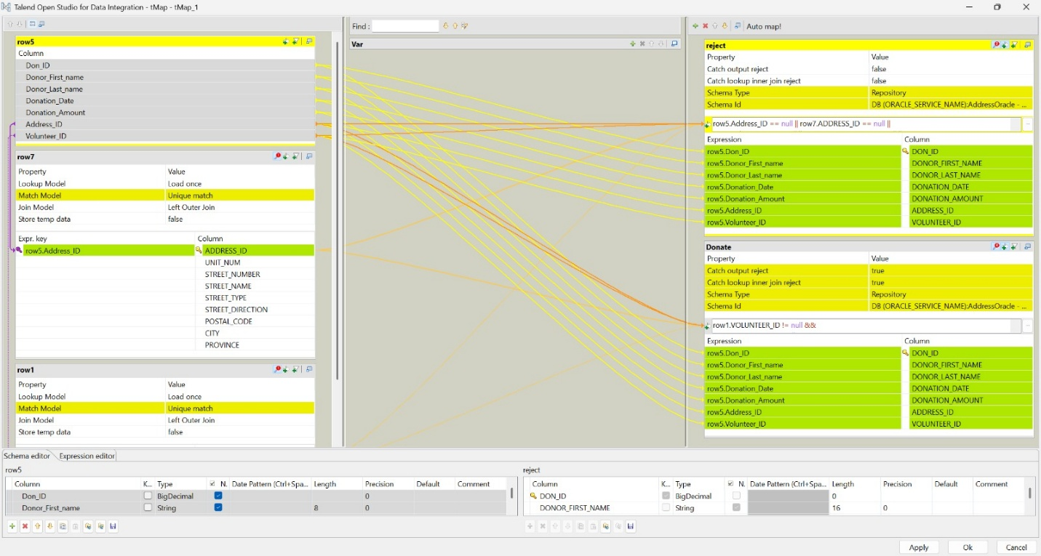
tMap Configuration

Slide 12
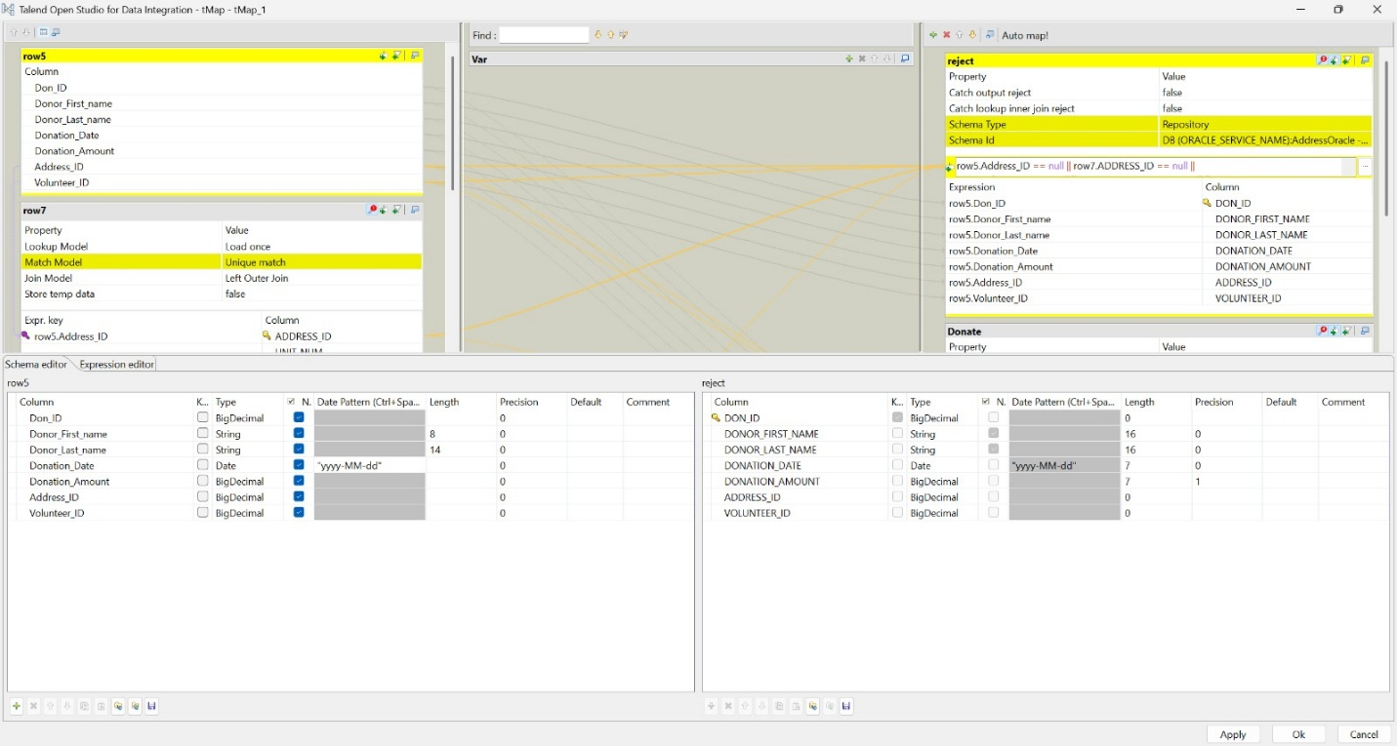
tMap Configuration

Slide 13
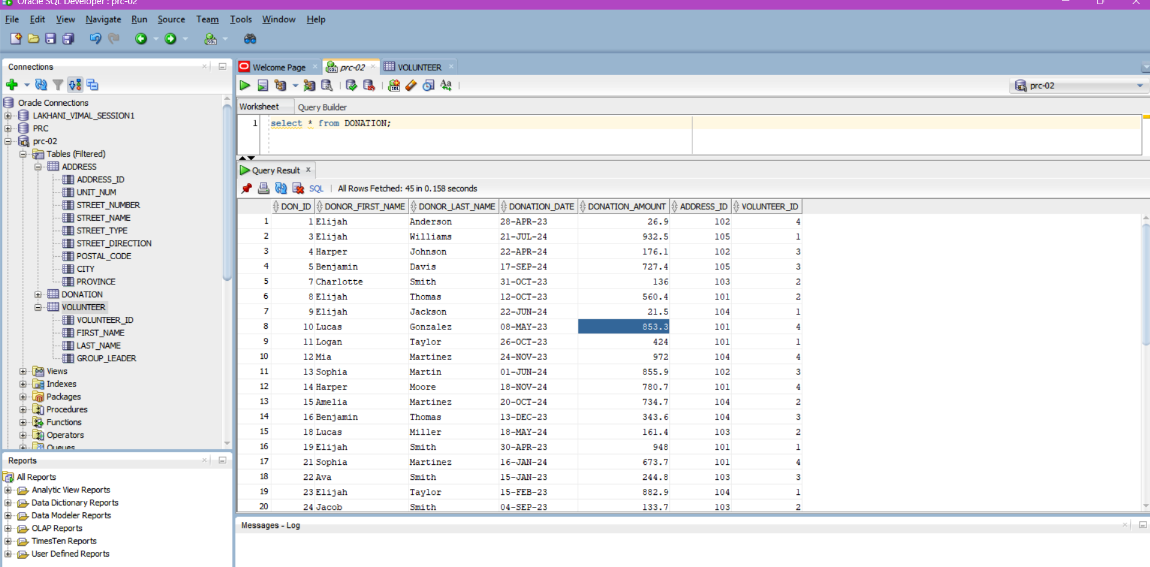
Output

Slide 14
Task 3
Focus: Data Mart creation using Star Schema
Tools: Oracle SQL Developer
Lead: Rakshit

Slide 15
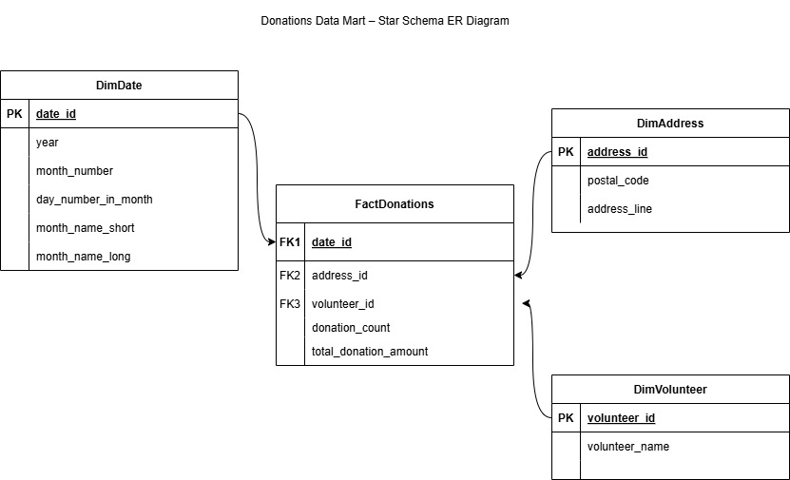
ER diagram

Slide 16
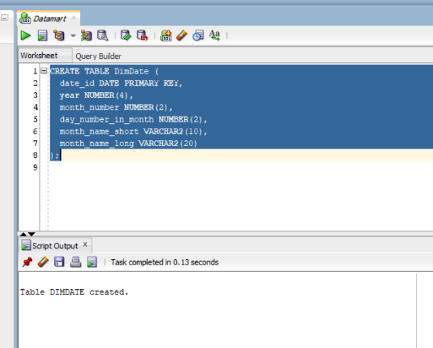
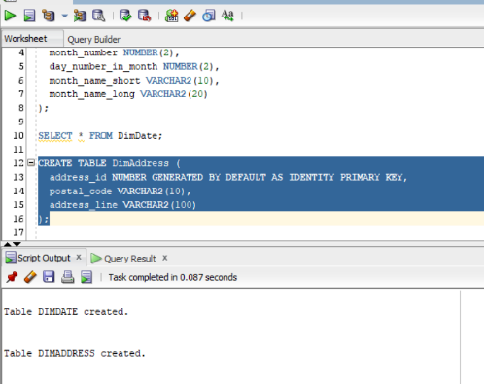
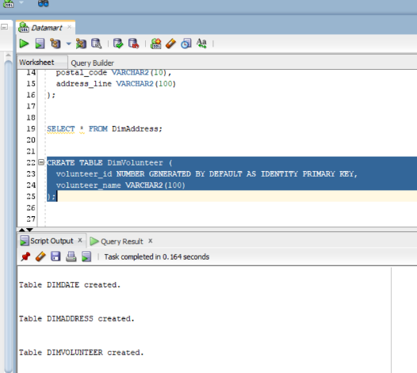
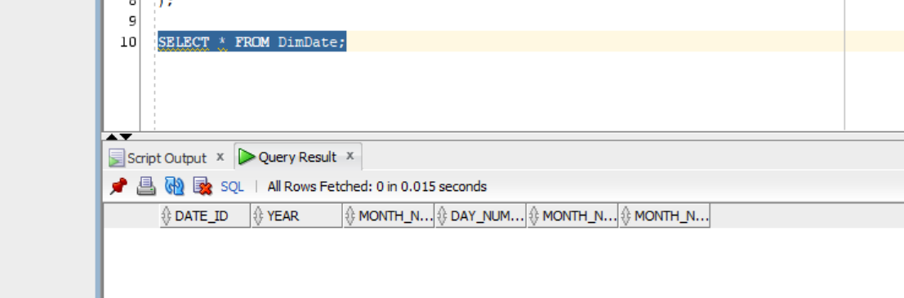
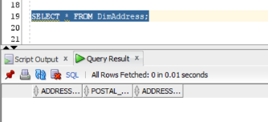
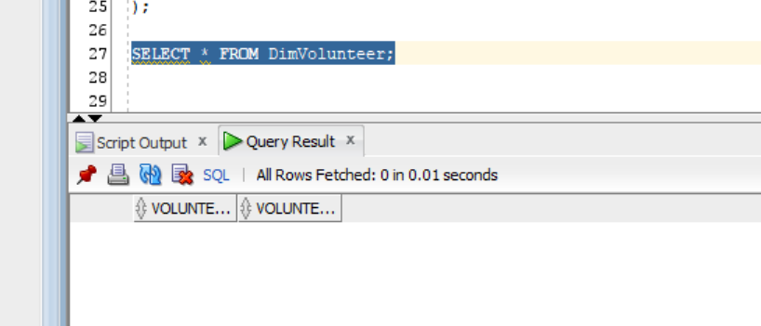
Creating Dimention tables for Datamart

Slide 17
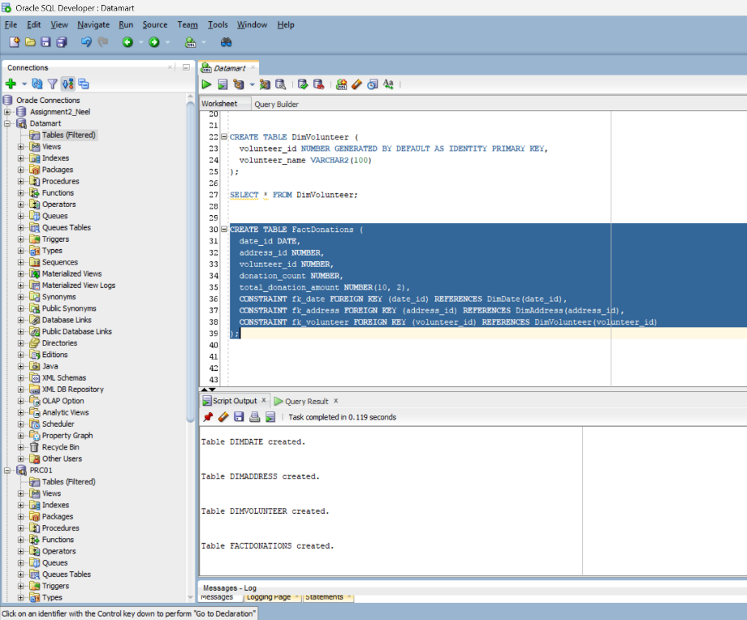
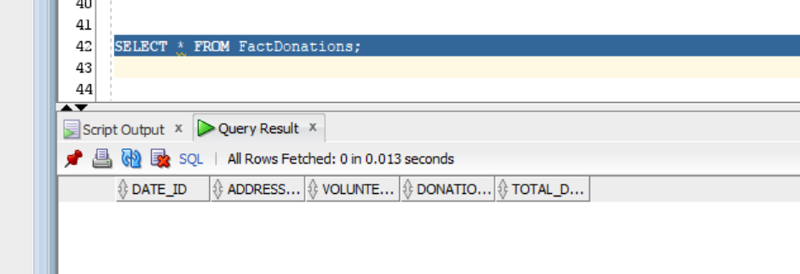
Creating Facts table

Slide 18
Task 4
Inserting data into the datamart tables
Lead: Pratham

Slide 19
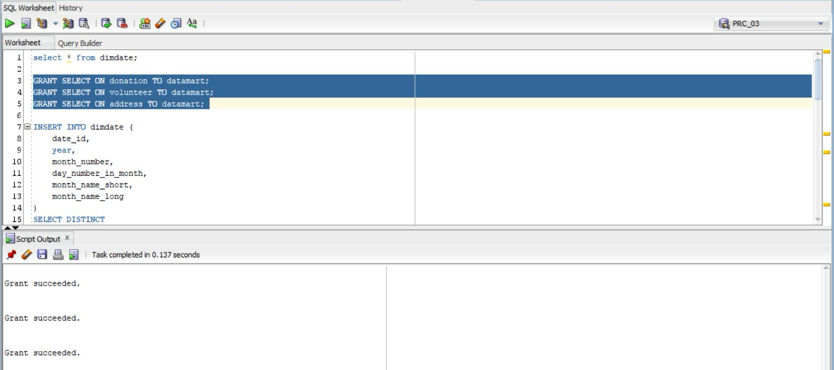
Giving permission to datamart

Slide 20
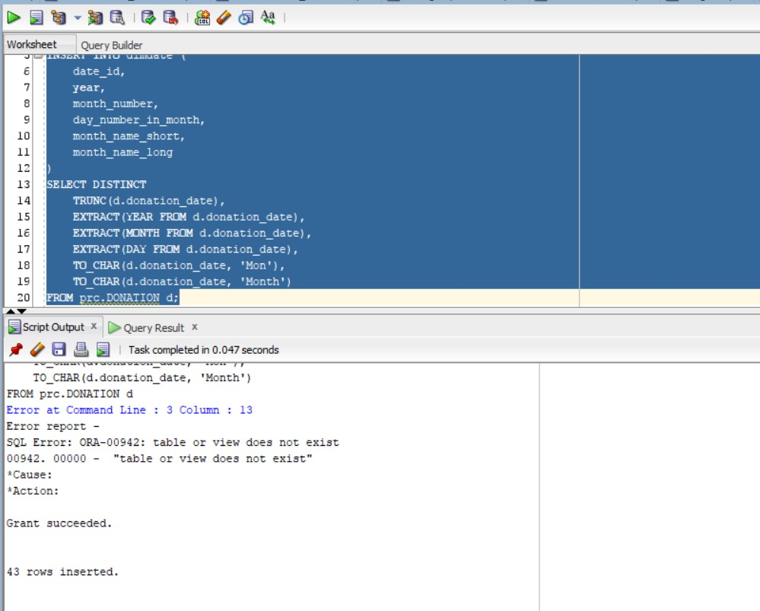
Inserting Data into DimDate
Extracting day, month, and year from date to insert into the dimdate table

Slide 21
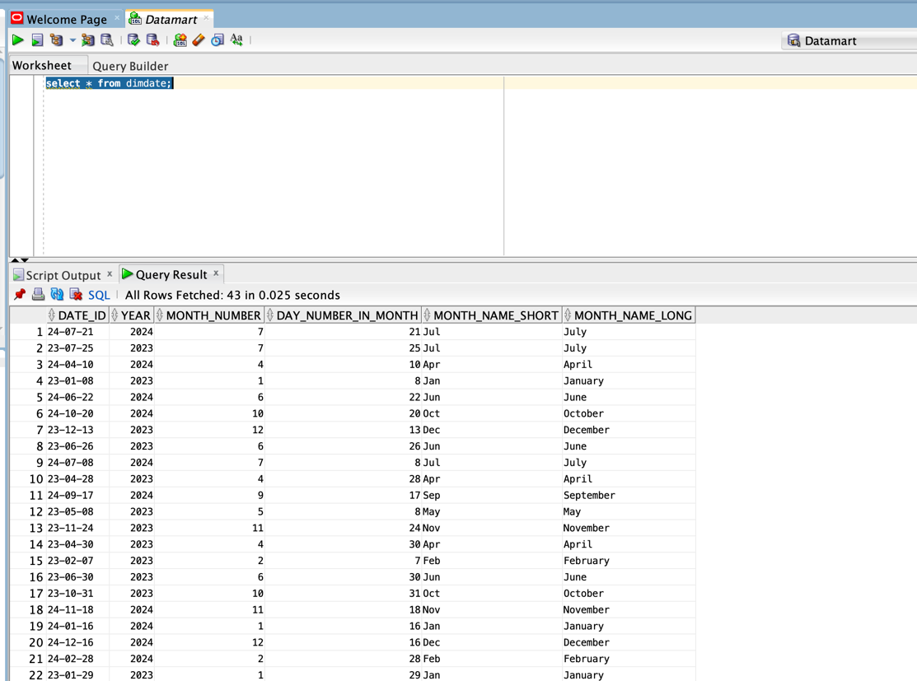
Dimdate table output

Slide 22
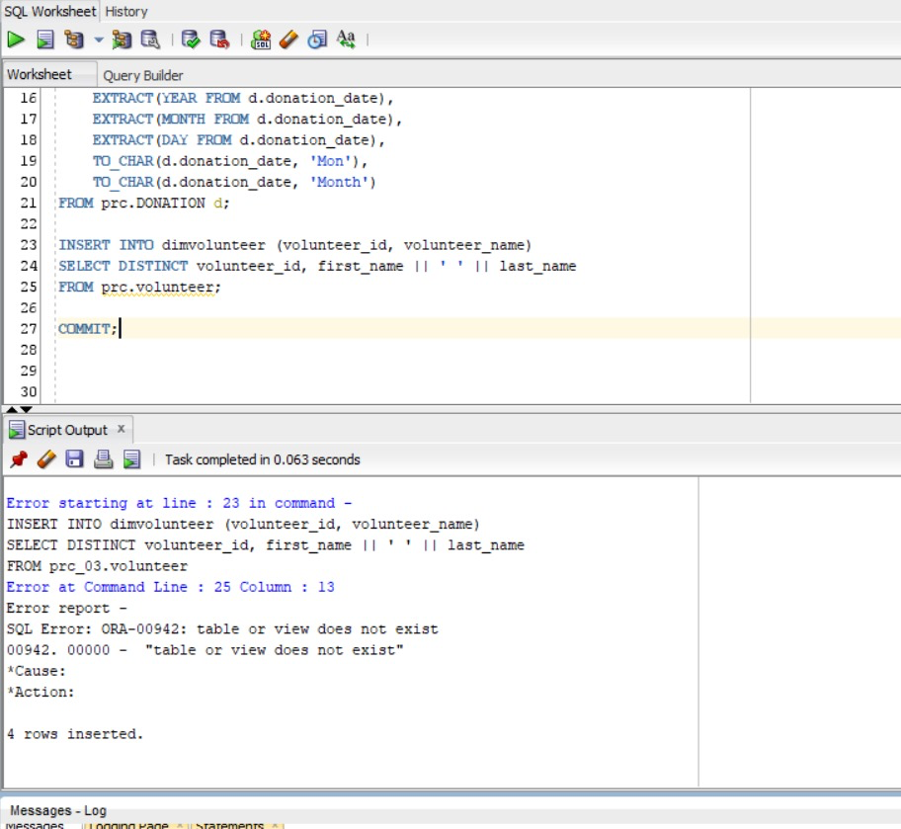
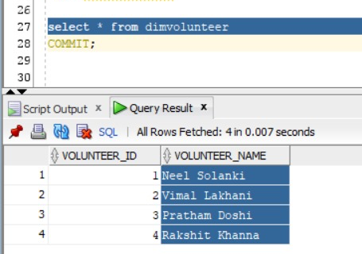
Inserting data into dimvolunteer table
INSERT INTO dimvolunteer (volunteer_id, volunteer_name)
SELECT DISTINCT volunteer_id, first_name || ' ' || last_name
FROM prc.volunteer;
Concatenates the first name and last name
Output:

Slide 23
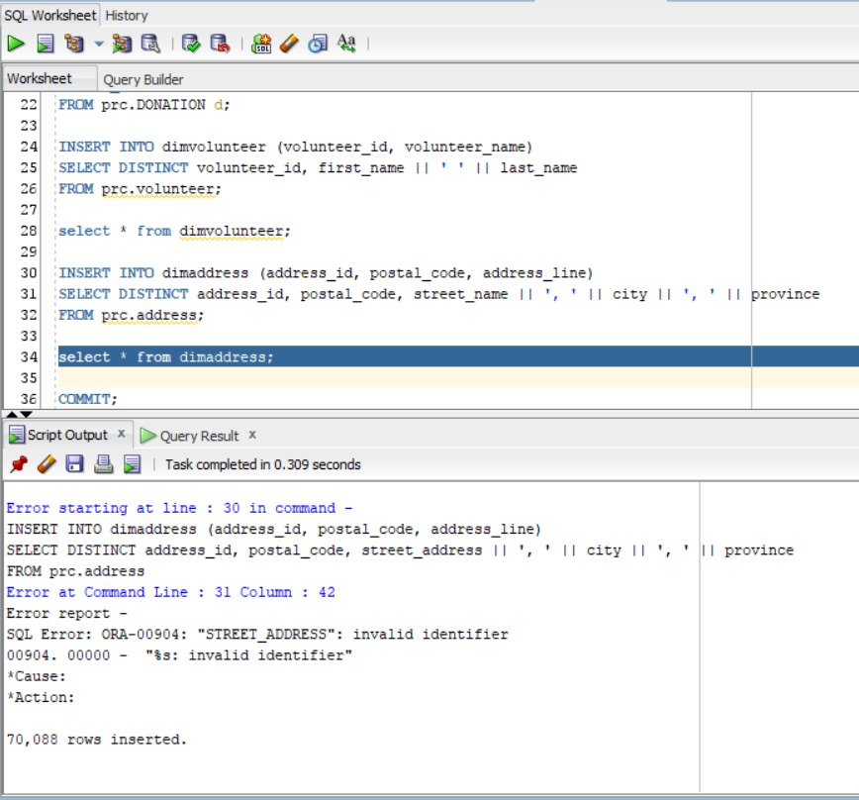
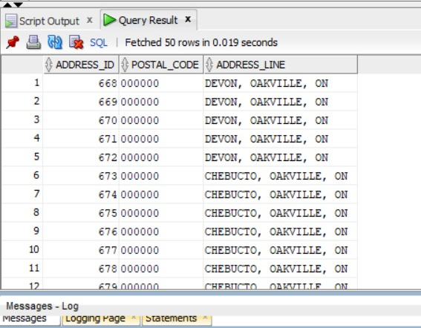
Inserting data into dimaddress table
Output:

Slide 24
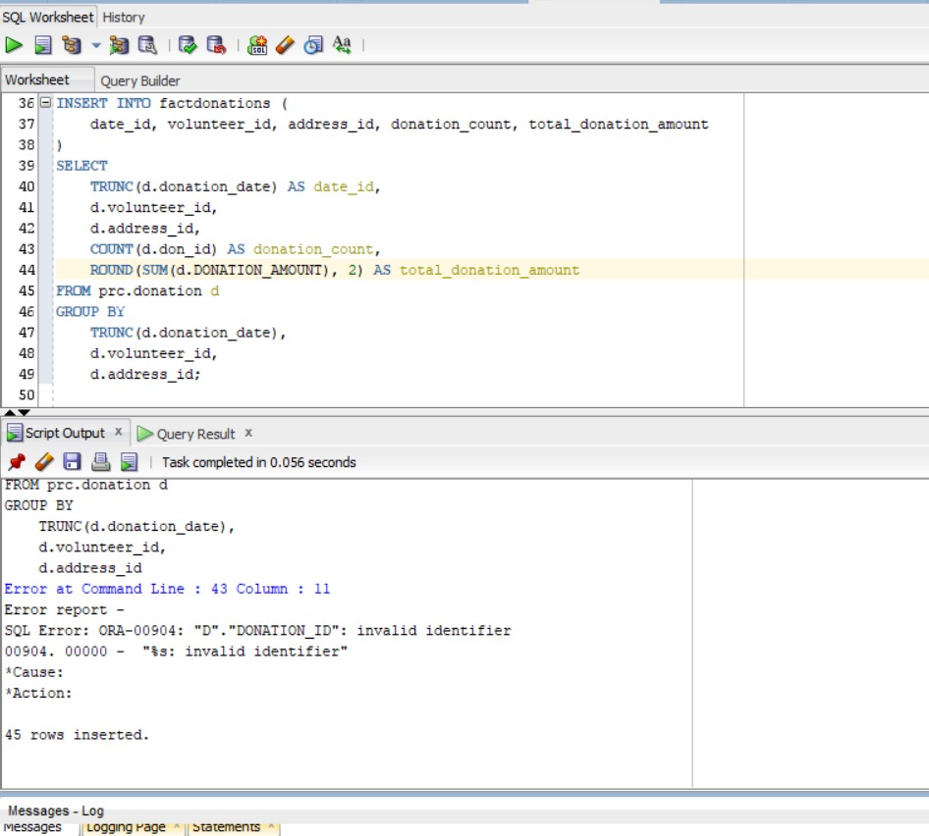
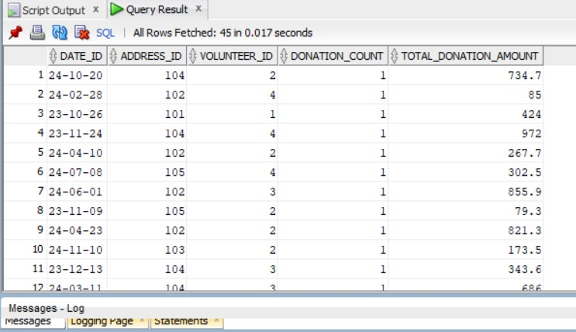
Inserting data into factdonation table
Output:

Slide 25
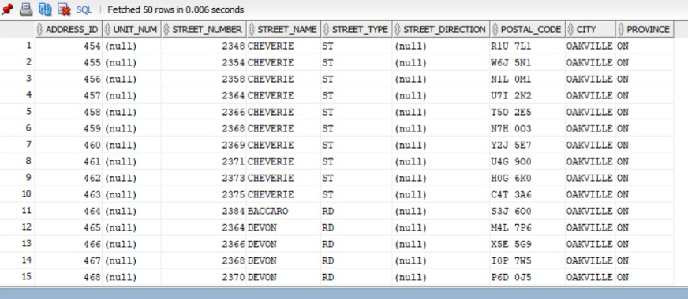
Fixing the postal codes

Slide 26
Task 5
Creating views
Lead: Vimal

Slide 27
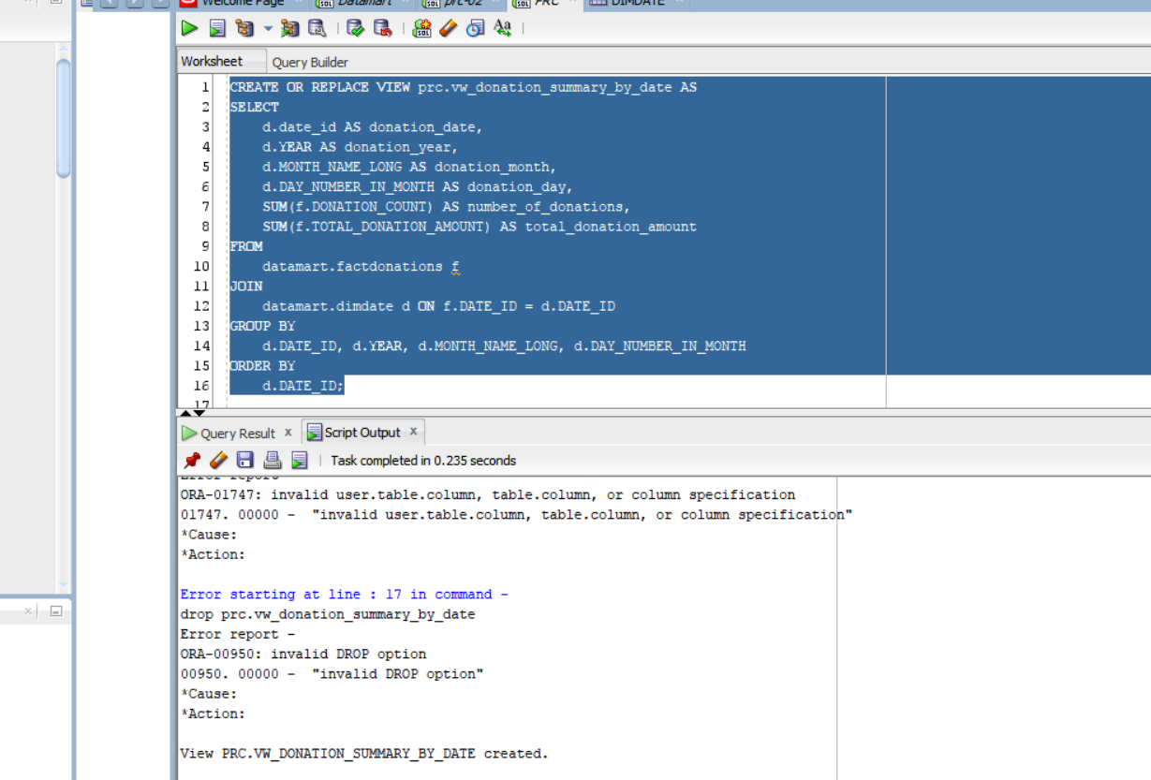
View for donation by date

Slide 28
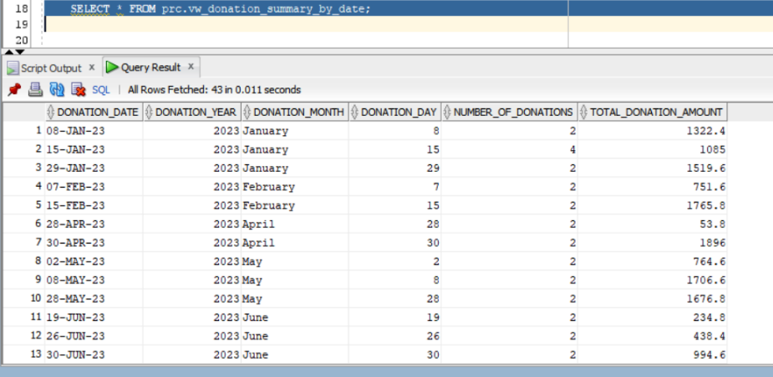
donation_summary_by_date output

Slide 29
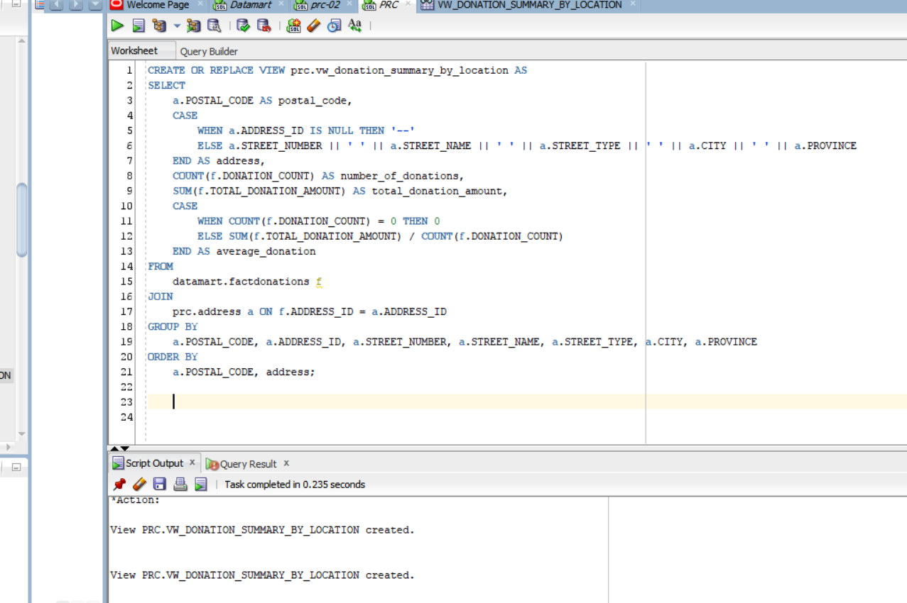
View for donation by location

Slide 30
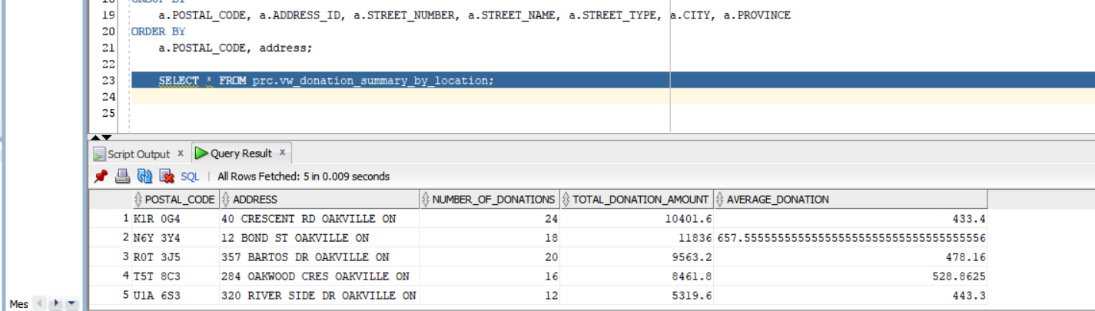
donation_summary_by_location output

Slide 31
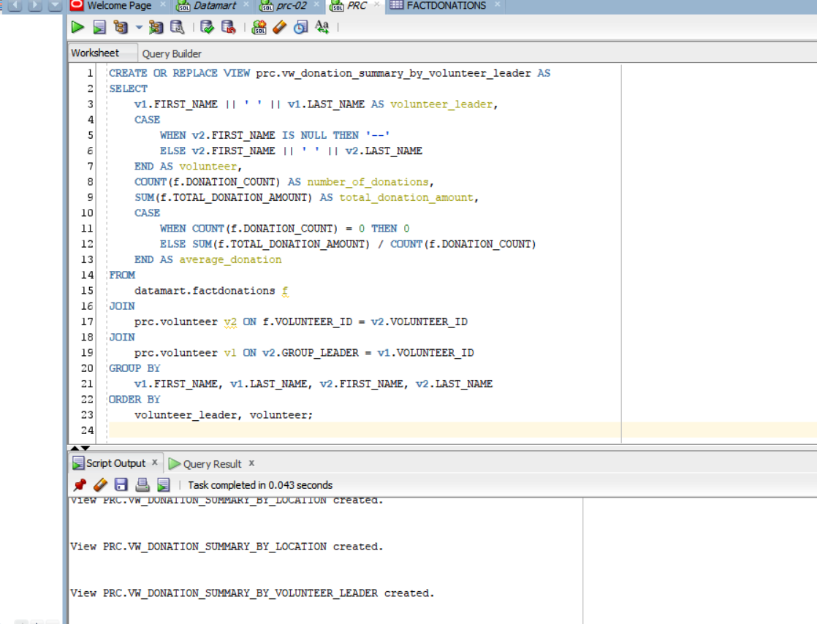
View for donation by volunteer

Slide 32
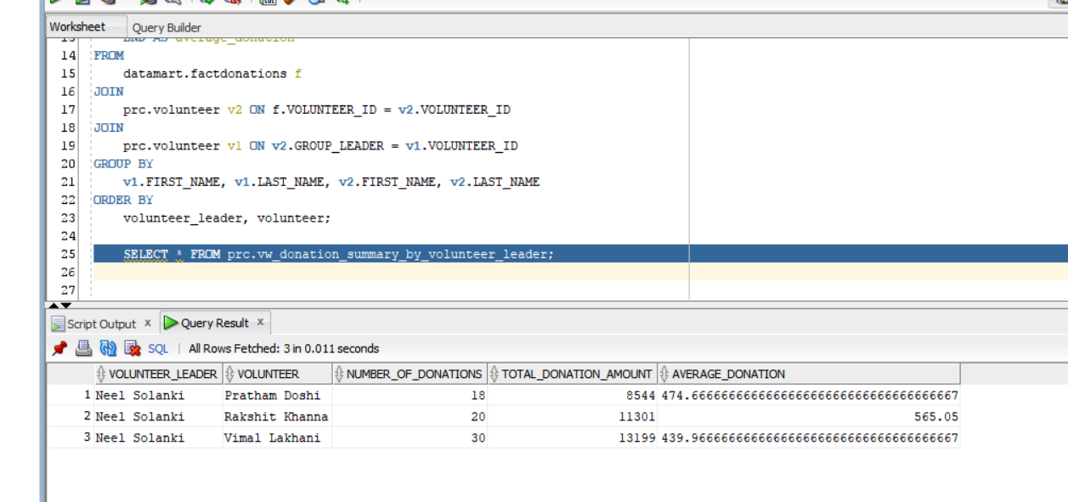
donation_summary_by_volunteer_leader

Slide 33
TASK 6
Create a user named DMLUser and give the user permissions to implement all DML on address, donation, and volunteer tables
Create a user named Dashboard and give the user read permissions on the views
Lead - Vimal

Slide 34
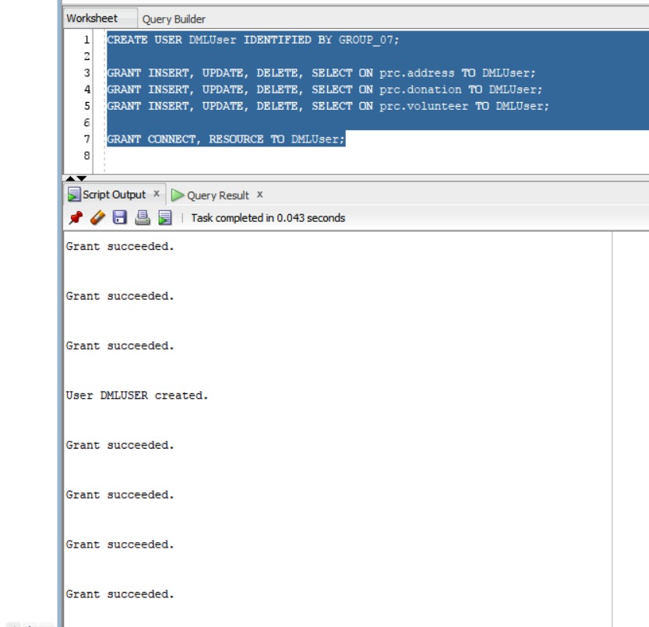
Creating the DMLUser Account
Query :
CREATE USER DMLUser IDENTIFIED BY GROUP_07;
Granting DML Privileges to DMLUser :
GRANT INSERT, UPDATE, DELETE, SELECT ON prc.address TO DMLUser;
GRANT INSERT, UPDATE, DELETE, SELECT ON prc.donation TO DMLUser;
GRANT INSERT, UPDATE, DELETE, SELECT ON prc.volunteer TO DMLUser;
Assigning Additional Roles to DMLUser
GRANT CONNECT, RESOURCE TO DMLUser;

Slide 35
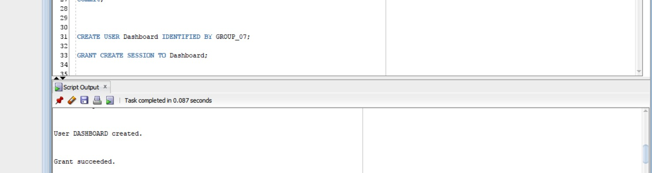
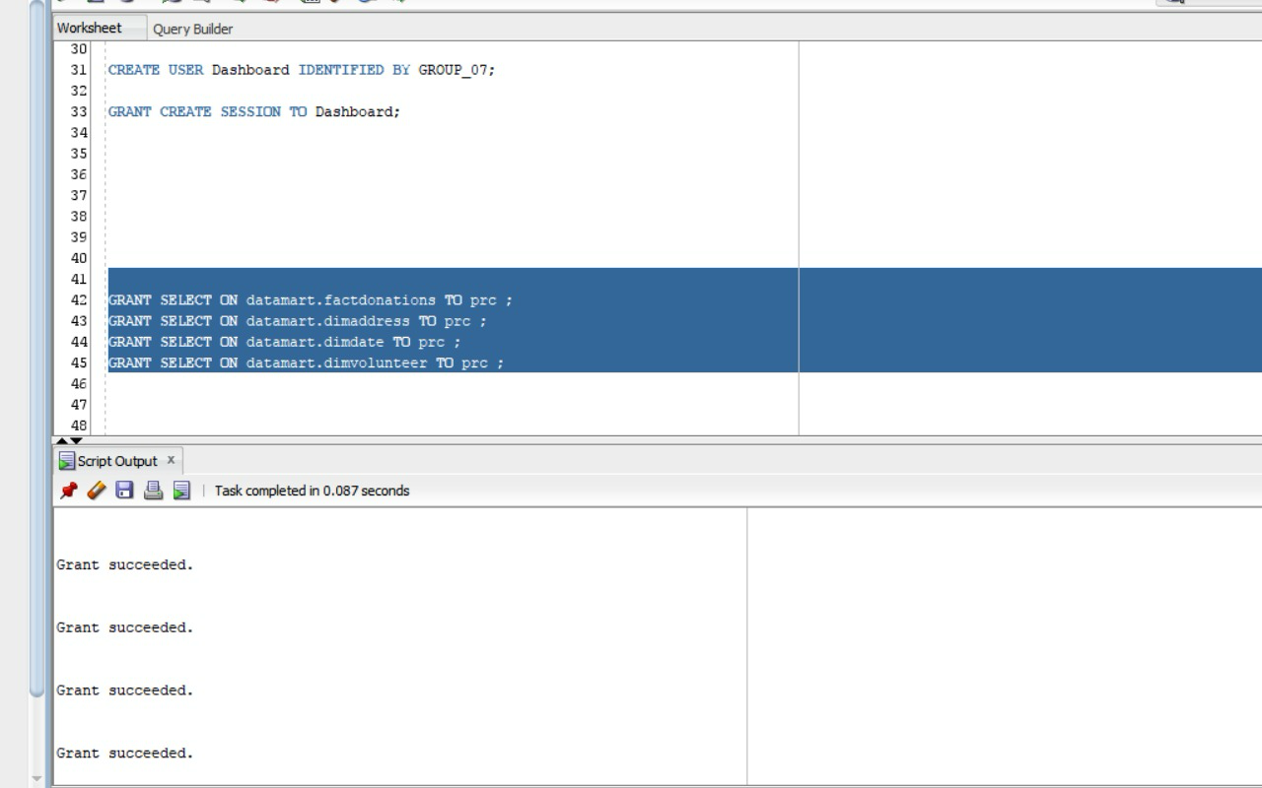
DASHBOARD CREATION
CREATE USER Dashboard IDENTIFIED BY GROUP_07;
GRANT CREATE SESSION TO Dashboard;
GRANT SELECT ON datamart.factdonations TO prc;
GRANT SELECT ON datamart.dimaddress TO prc;
GRANT SELECT ON datamart.dimdate TO prc;
GRANT SELECT ON datamart.dimvolunteer TO prc

Slide 36
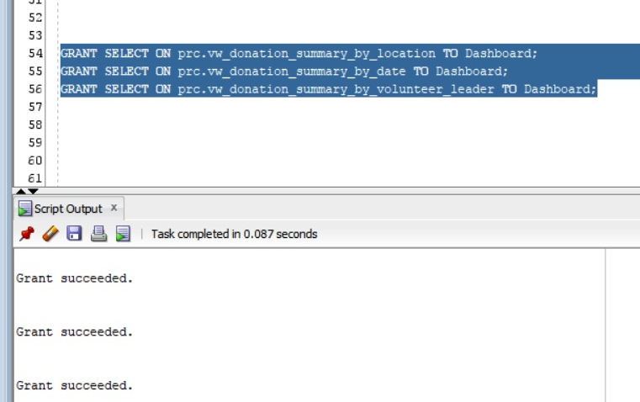
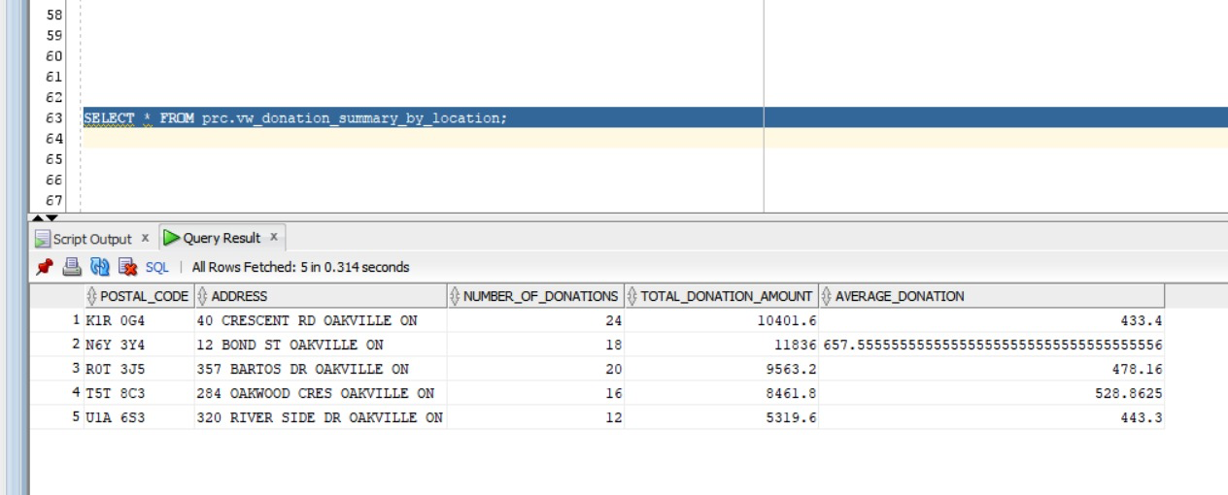
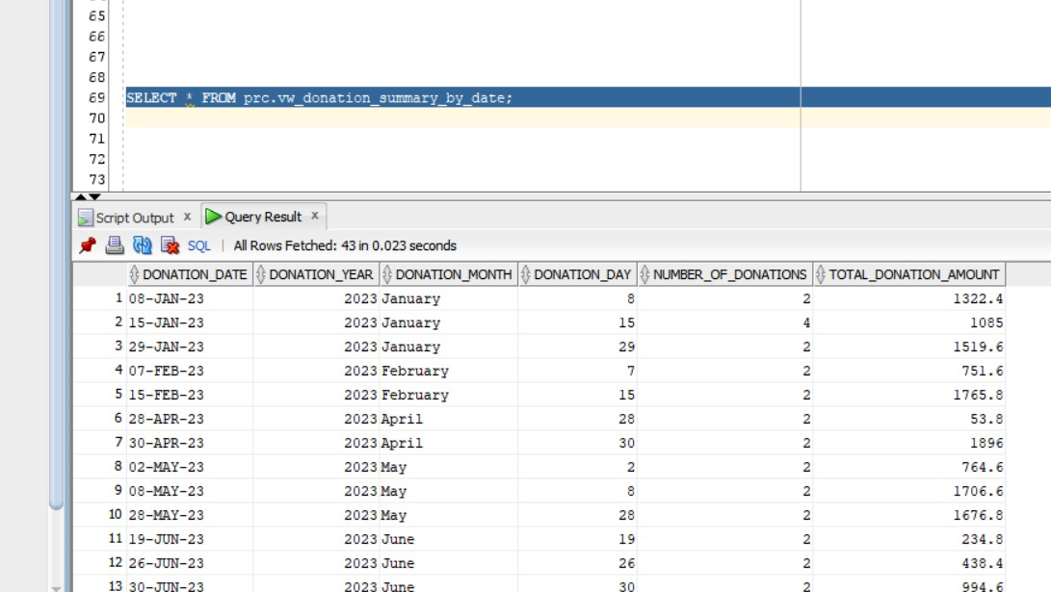
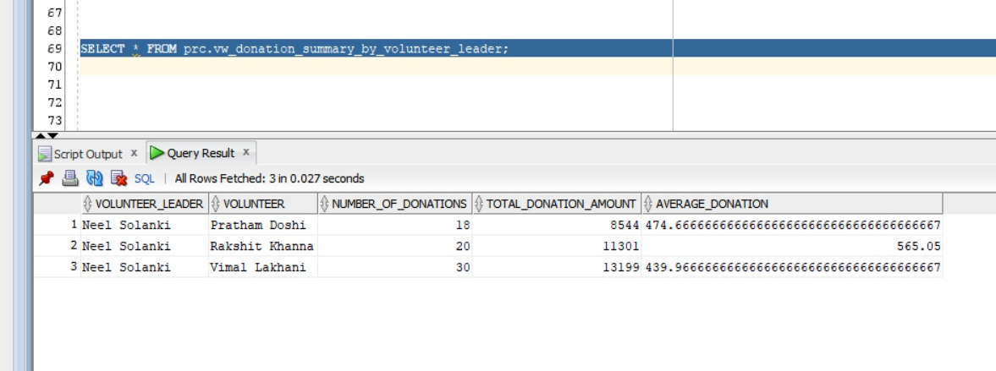
GRANTING ACCESS
GRANT SELECT ON prc.vw_donation_summary_by_location TO Dashboard;
GRANT SELECT ON prc.vw_donation_summary_by_date TO Dashboard;
GRANT SELECT ON prc.vw_donation_summary_by_volunteer_leader TO Dashboard;
SELECT * FROM prc.vw_donation_summary_by_location;
SELECT * FROM prc.vw_donation_summary_by_date;
SELECT * FROM prc.vw_donation_summary_by_volunteer_leader;

Slide 37
THANK YOU FOR YOUR TIME!

