Slide 1

Real-Time Chat
Group 2 Members.
Nathan
Aaftab
Neel
Amar

Slide 2


Agenda
Introduction
What is Socket.io?
Implementation of Library.
How it Works?
Features
Advantages / Disadvantages
Live server
Real world use
Demo code App Screenshot

Slide 3

Introduction
Hey, We worked on Real-time chat app which is live chatting on the server side. Where user write a message in a room for the people and everyone whoever is in that room can respond and read that.
For the Real-time chat app, everyone is concerned how it works and this presentation and demo app will clear that concept.
Real-time chat works through server and client-side script and to connect this through Socket.io.
Socket.io is connection between server and client side and work as bridge for chat.

Slide 4
Socket.Io
Socket.io is Library that enables low-latency, bidirectional and event-based communication between a client and Server.
It built on top of the WebSocket protocol and provides additional guarantees like fallback to HTTP long-poilling or automatic reconnection.
WebSocket is communication protocol which provides a full-duplex and low-latency channel between the server and the browser.

Slide 5
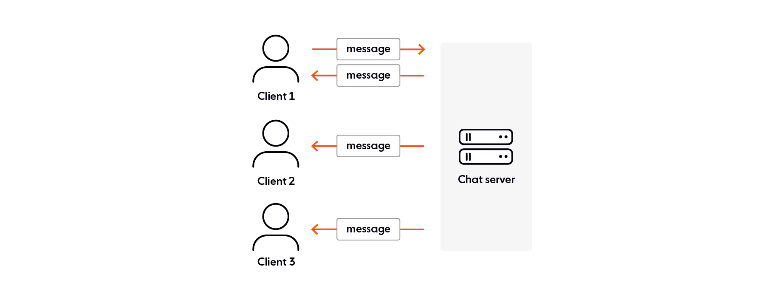
WebSocket Action

Slide 6

Socket.io server implementation
JavaScript
Java
Phython
Golang

Slide 7

Client-side implementation
Javascript
Java
C++
Swift
Dart
Phython
.Net
Rust
Kotlin

Slide 8
Socket.io
Connects with WebSocket and stays connected so you can send and receive multiple requests
Is reliable because it will use WebSocket, but then fall back on HTTP long-polling if issues occur
Is scalable to multiple servers

Slide 9
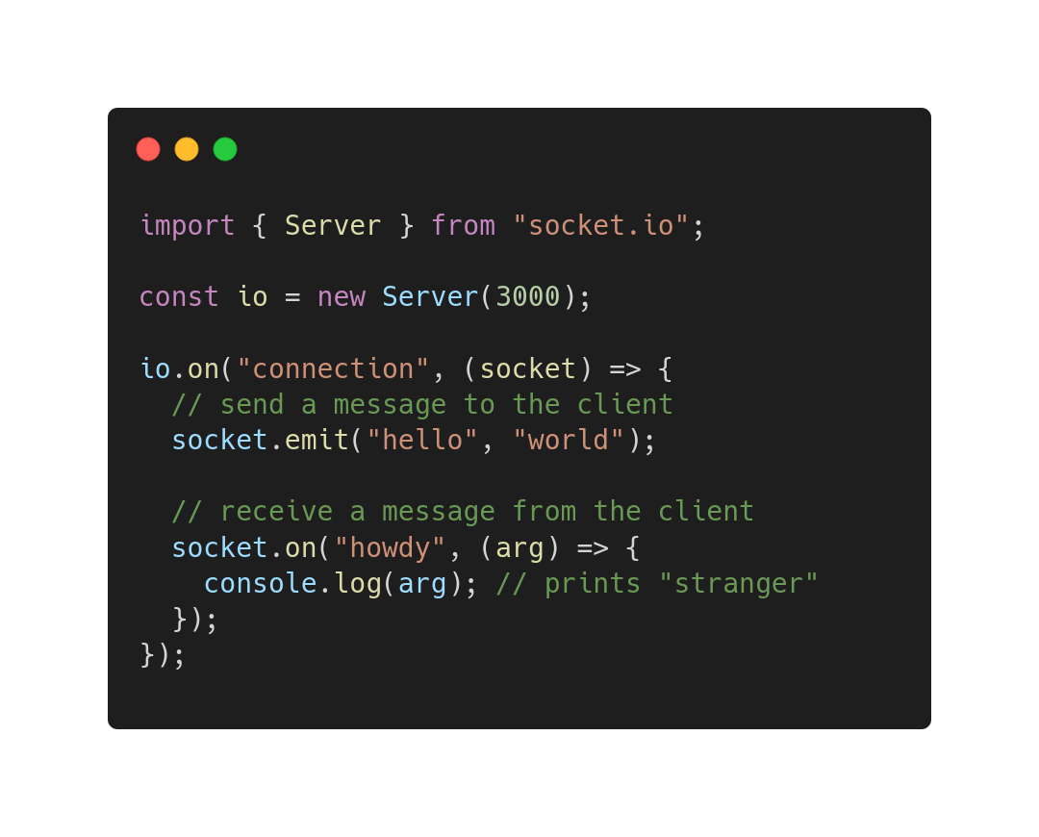
How it works (server)
Server Code
Import Socket.io
Server uses port 3000
Sends a message
Receives a message

Slide 10
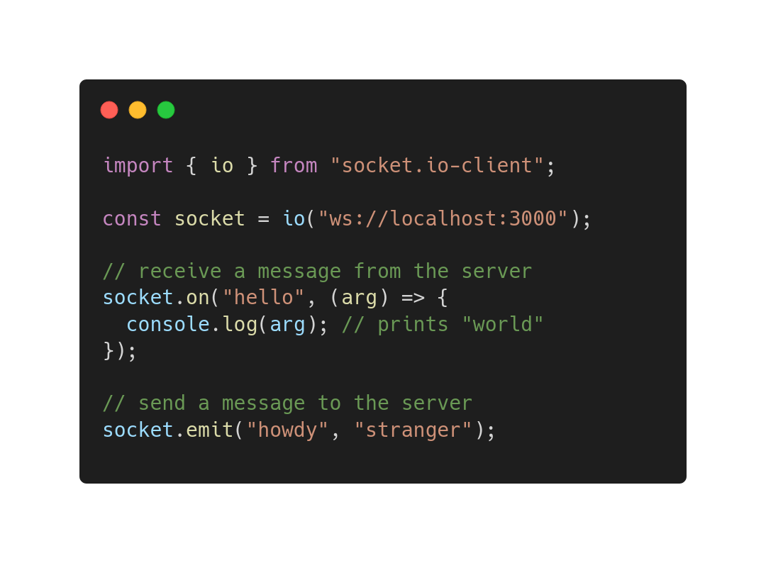
How it works (client)
Client
Import socket.io
Declare connection
Receive messages
Send messages

Slide 11
Features
HTTP Long –Polling Fallback
Automatic Reconnection
Packet Buffering
Acknowledgements
Broadcasting
Multiplexing

Slide 12

Advantages
Socket.io uses WebSocket, but Socket.io supports more browsers
Socket.io is easier to use as it has tools to simplify using WebSockets
Socket.io falls back on Http long-polling if browser doesn’t support WebSockets
Has a community that is active for support and new functionality

Slide 13
Disadvantages
WebSocket can run faster than Socket.io because it has less overhead, usually imperceptible difference though
1
WebSocket makes you have to write everything yourself, which is great if you have very specific business needs
2
Is lightweight, you only implement what you need to use. Whereas Socket.io you have code that you may not require
3

Slide 14
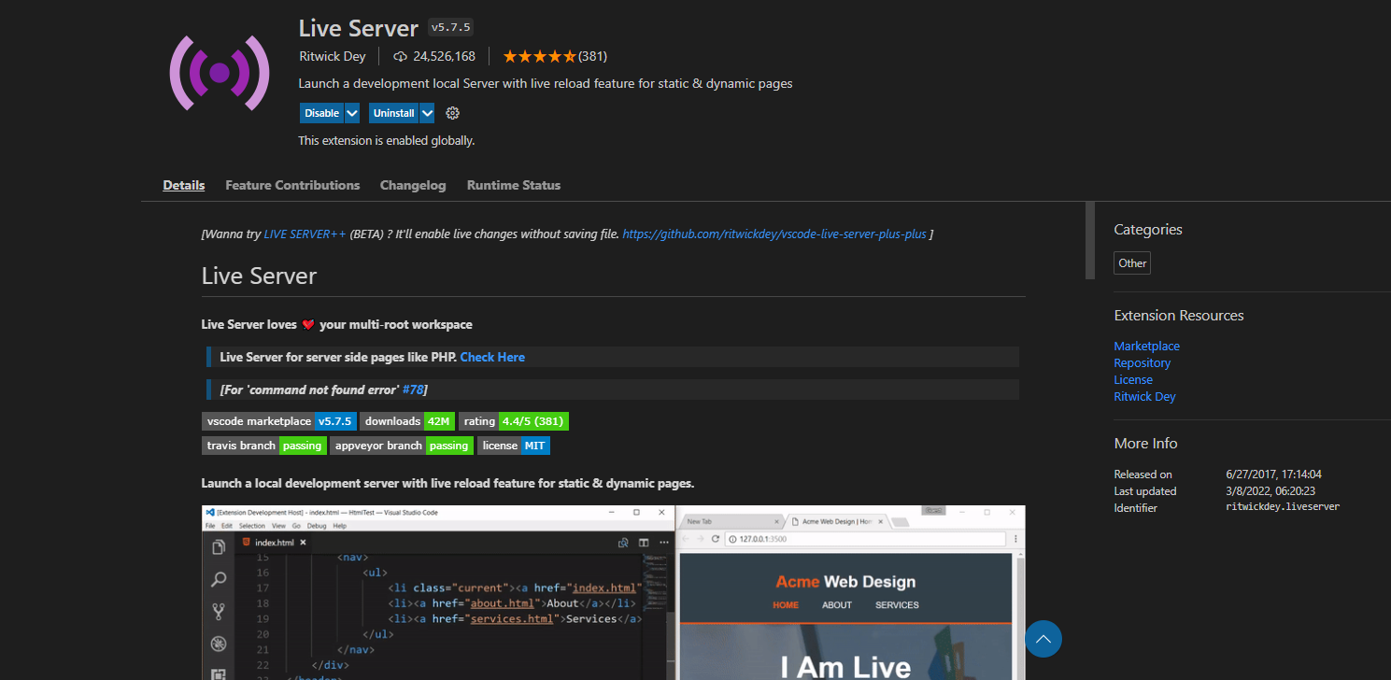
Live Server
Very popular (+24 million installs)
Easy to use
(install and hit “go live)
Supports any browser

Slide 15
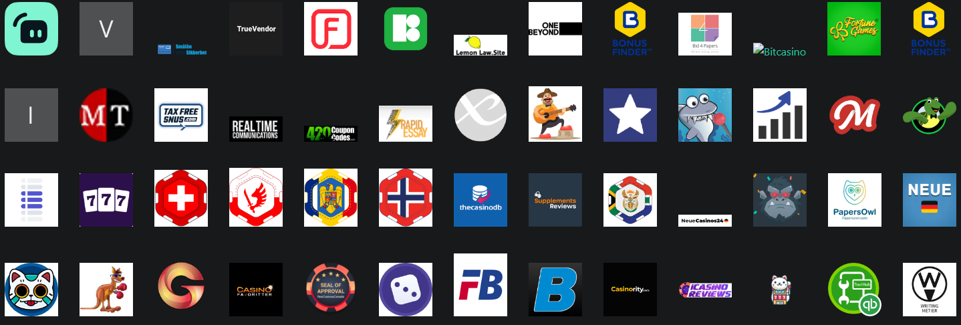
Real World Uses
Very popular with gaming websites, financial, legal offices, etc

Slide 16

Demo Code
App

Slide 17
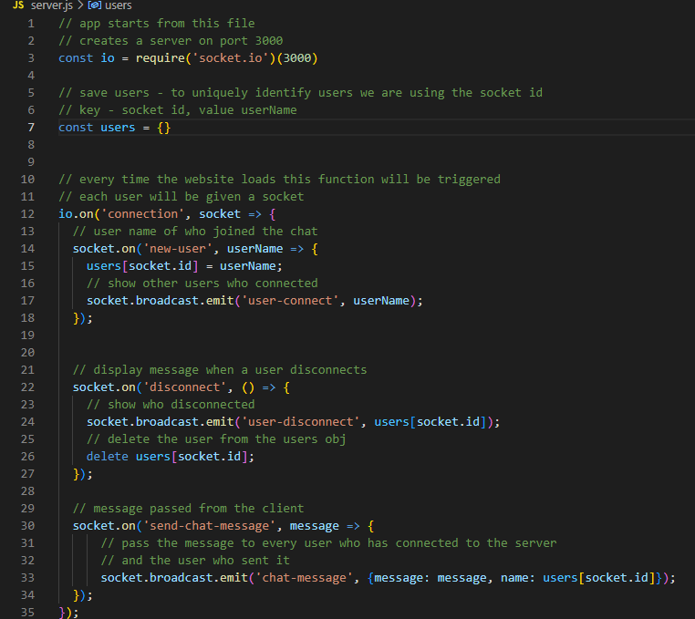
Server

Slide 18
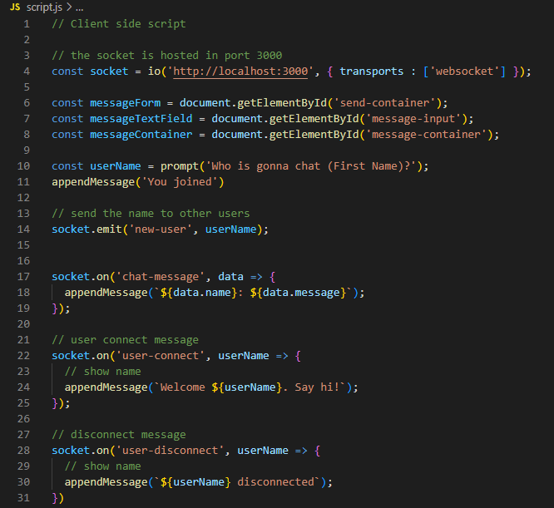
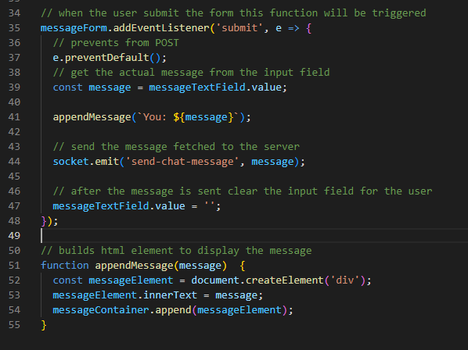
Client

Slide 19
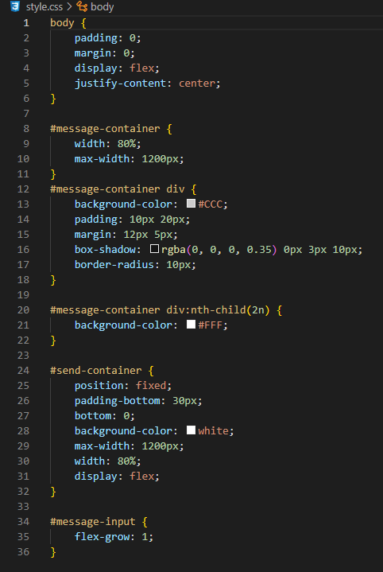
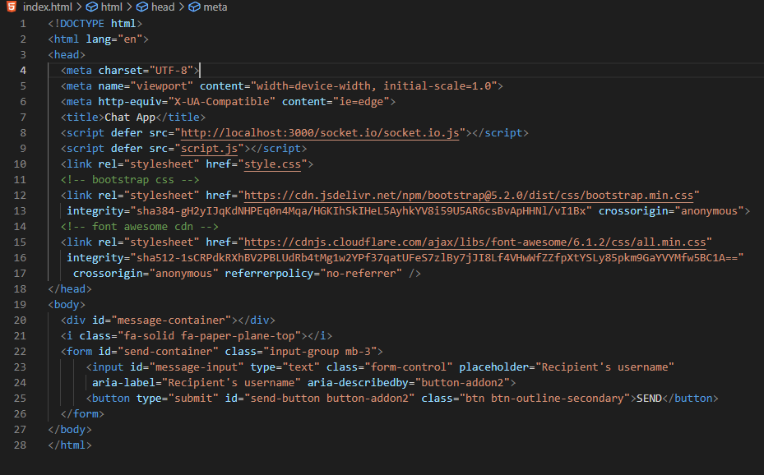
Html and Css

Slide 20
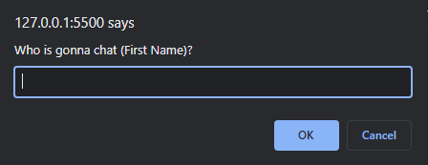
Connecting to the server

Slide 21
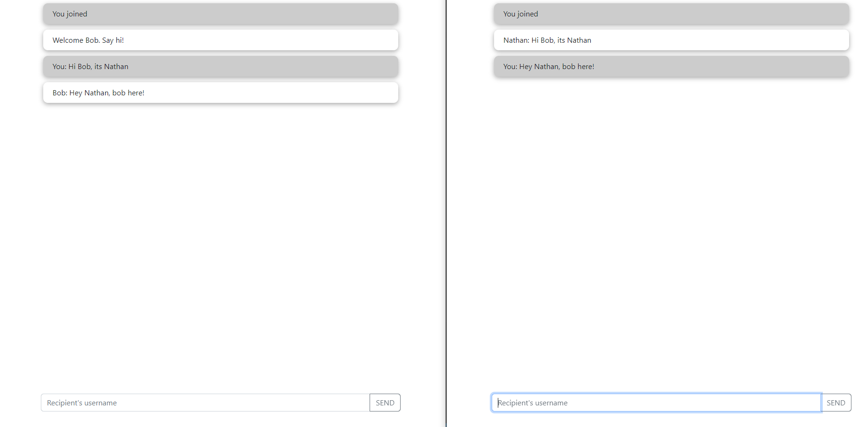
Sending and Receiving Messages

Slide 22
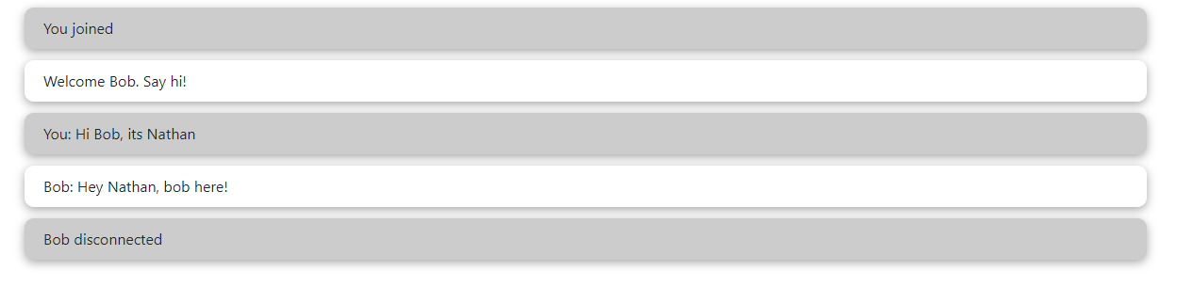
Disconnect

Slide 23
References
https://stackoverflow.com/questions/10112178/differences-between-socket-io-and-websockets
https://socket.io/
https://marketplace.visualstudio.com/items?itemName=ritwickdey.LiveServer
https://www.youtube.com/watch?v=ZKEqqIO7n-k&t=429s

Slide 24
Thank you

