Slide 1

Heart Disease Risk Prediction using XGBoost
Model Performance and Application Demo
Notes:
Today, I’m excited to walk you through our project on Heart Disease Risk Prediction using XGBoost.
Cardiovascular disease remains one of the leading causes of mortality globally. Early detection is often the key to survival, but traditional diagnostic methods can be time-consuming and expensive.
My goal was to leverage machine learning to help medical professionals make faster, data-driven decisions.
In this presentation, I’ll take you through the performance of the XGBoost model, which we chose for its efficiency and accuracy.

Slide 2
Project Objectives
Clinical Goals:
Enhance early detection capabilities to identify high-risk patients before critical events occur, enabling personalized preventative treatment plans.
Business Goals:
Reduce long-term healthcare costs associated with late-stage cardiovascular interventions and optimize hospital resource allocation through automated risk stratification.

Slide 3
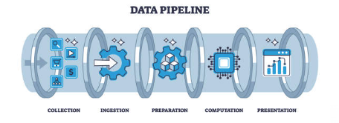
Key Input Variables
Key Input Variables
  Demographics: Age, Sex
  Vitals: Resting Blood Pressure, Cholesterol
  Test Results: Max Heart Rate, ST Depression, Fluoroscopy vessels
  History: Chest Pain Type, Exercise Angina

Slide 4
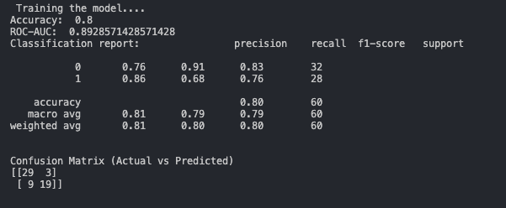
High-Performing Model for Heart Disease Detection
Diagnostic Power (ROC AUC): 89%
  This indicates Excellent discrimination, showing the model is highly effective at ranking patients who have the disease above those who don't.
Overall Accuracy: 80%
  The model correctly classifies the outcome for 8 out of every 10 patients.
Notes:
"Let’s start by looking at the results. I evaluated our model using two primary metrics: ROC AUC and Overall Accuracy.
First, looking at the Diagnostic Power, we achieved an ROC AUC score of 89%.
In the medical field, this is a critical metric because it doesn’t just tell us if the model is right or wrong;
It tells us how good the model is at distinguishing between a sick patient and a healthy one.
An 89% score indicates excellent discrimination, meaning if you gave the model a random positive patient and a random negative patient,
It is highly likely to rank the positive patient higher.
Secondly, our Overall Accuracy is 80%. This means that for every 10 patients that walk through the door,
the model correctly identifies the health outcome for 8 of them. While no model is perfect,
this provides a very strong baseline for a diagnostic support tool.

Slide 5
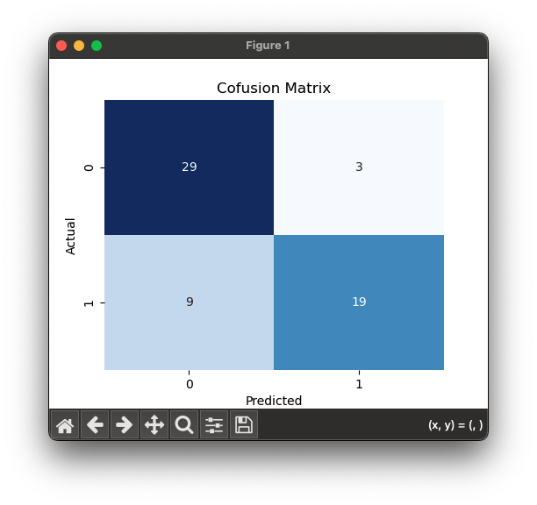
Analyzing Prediction Accuracy
True Negatives (Top-Left): 29 cases correctly identified as "No Disease."
False Positives (Top-Right): 3 cases incorrectly identified as "Disease."
False Negatives (Bottom-Left): 9 cases incorrectly identified as "No Disease."
True Positives (Bottom-Right): 19 cases correctly identified as "Disease."
Notes:
To understand where that 80% accuracy comes from, we have to look at the Confusion Matrix. This breaks down our predictions into four categories.
True Negatives (Top-Left): We correctly identified 29 healthy patients. This is great; we aren't raising false alarms for them.
True Positives (Bottom-Right): We correctly caught the disease in 19 patients. These are the people who can now get treatment because of the model.
However, in medicine, we care deeply about the errors.
False Positives (Top-Right): We have 3 cases where we predicted disease. While stressful for the patient, this is usually acceptable as a 'better safe than sorry' approach.
False Negatives (Bottom-Left): This is the most critical quadrant. We missed 9 cases. These are patients who have heart disease but were classified as healthy. Moving forward, our primary goal in refining this model would be to lower this number, perhaps by adjusting our decision threshold to be more sensitive, ensuring we catch as many positive cases as possible."

Slide 6
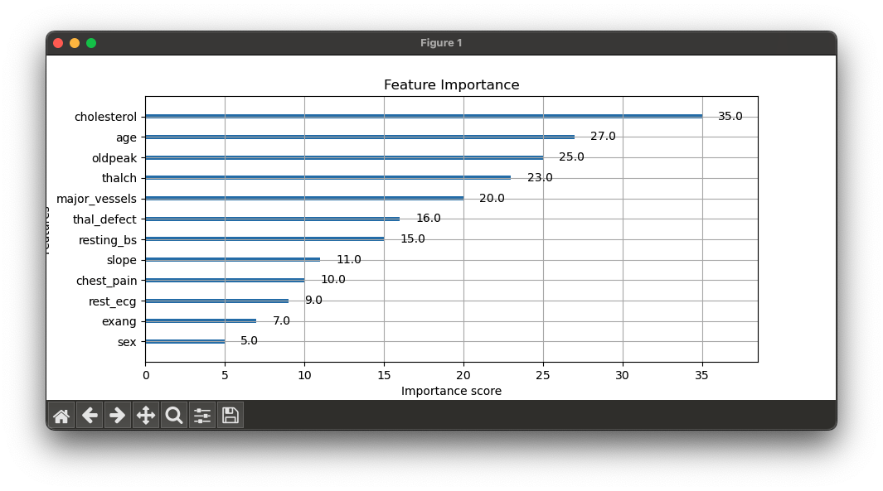
Top 5 Features that Drives the Prediction?
Cholesterol (serum cholesterol)
Age (Patient Age)
Old Peak (ST depression induced by exercise relative to rest)
Thalch (maximum heart rate achieved)
Major Vessel (number of major vessels (0-3) colored by fluoroscopy)
Notes:
One of the reasons we chose XGBoost is that it allows us to see why decisions are being made. We analyzed feature importance to ensure the model wasn't learning from noise, but rather from medically relevant data.
Here are the top 5 factors driving our predictions:
Cholesterol: As expected, serum cholesterol levels are a massive indicator of heart health.
Age: Risk naturally increases as we get older, and the model picked up on this heavily.
Old Peak: This refers to ST depression induced by exercise. It’s a specific ECG reading that indicates how the heart handles stress. The fact that the model prioritizes this shows it is picking up on nuanced clinical signals.
Thalch: This is the maximum heart rate achieved. A lower-than-expected max heart rate during stress can be a warning sign.
Major Vessels: The number of major vessels colored by fluoroscopy. Essentially, more blockage visible usually correlates with higher risk.

Slide 7
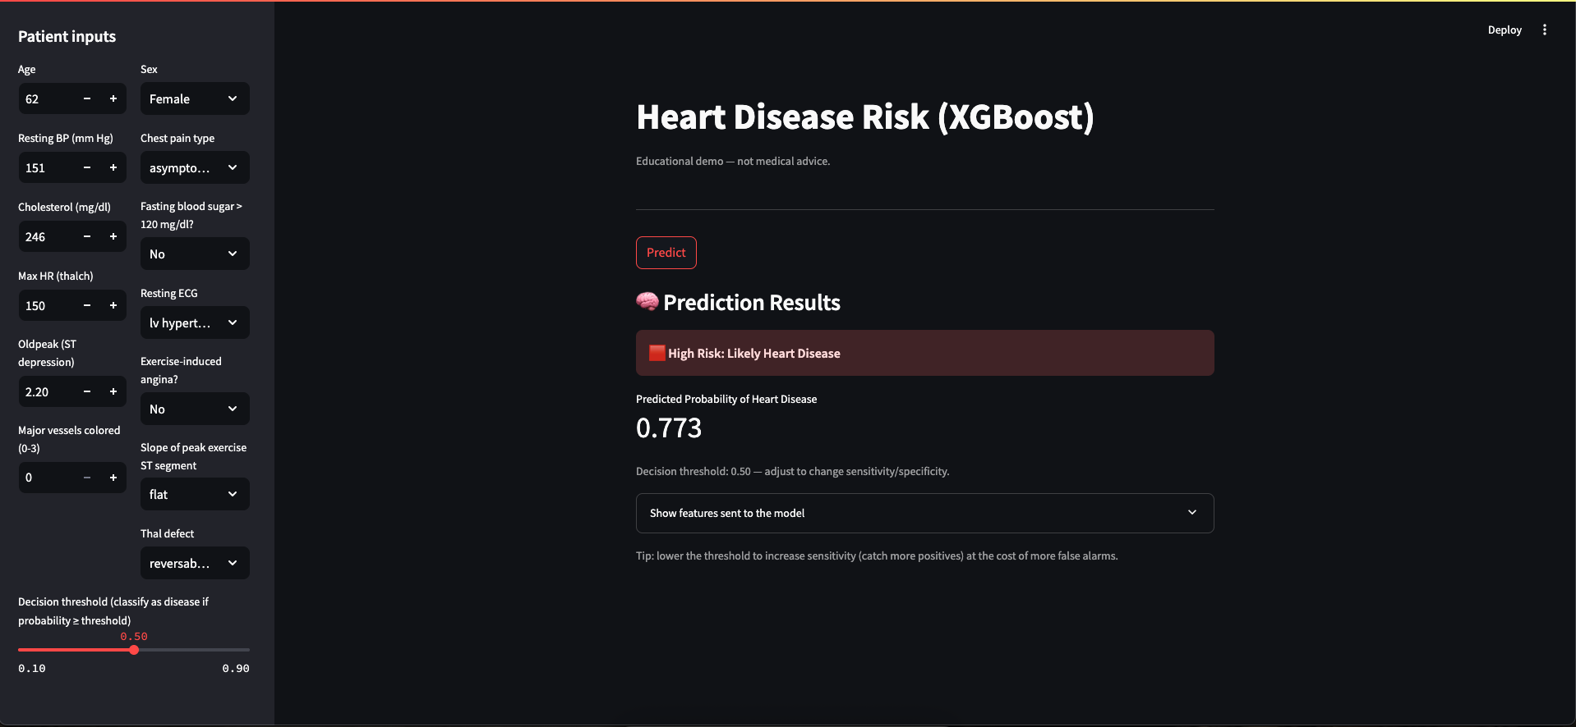
Interactive Prediction Tool (Built with Streamlit)
Notes:
"A model is only useful if people can actually use it. We didn't want this code to just sit in a notebook, so we built an Interactive Prediction Tool using Streamlit.
Streamlit allowed us to rapidly prototype a user-friendly interface. It bridges the gap between the complex XGBoost algorithm and the end-user,
whether that be a doctor, a nurse, or even a patient doing a preliminary self-check. It transforms raw data inputs into an immediate risk assessment."

Slide 8
How the Tool Works
Patient Inputs (Left Side):
Users can input or select values for all model features (e.g., Age, Sex, Cholesterol, Resting BP).
Decision Threshold (Left Side):
A slider allows the user to adjust the classification threshold
Prediction Results (Center):
After pressing "Predict," the result is displayed.
Shows the final "Low Risk" or "High Risk" classification.
Displays the exact "Predicted Probability of Heart Disease" (e.g., 0.773).
Also shows the specific feature values that were sent to the model.
A disease is indicated if the resulting probability exceeds this set threshold.
Notes:
On the left-hand sidebar, you have all the input parameters corresponding to the features we discussed
Age, Sex, Chest Pain Type, Cholesterol levels, and Max Heart Rate. We used sliders and dropdowns to make data entry quick and minimize errors.
Once the medical professional enters the patient's vitals, they simply hit the 'Predict' button.
The model runs the inference in real-time on the backend and displays the result instantly in the main window,
highlighting whether the patient is at 'High Risk' or 'Low Risk' along with the probability confidence.
This creates a seamless workflow where a doctor can get a second opinion from the AI in a matter of seconds."

Slide 9
Future Impact
Moving beyond simple prediction, this technology lays the groundwork for the following systems.
Proactive Medicine: Shifting from reactive treatment to preventative care.
Remote Monitoring: Integrating with wearables to monitor high-risk patients 24/7.
Resource Optimization: AI triage systems to prioritize critical cases in emergency rooms.

Slide 10
Conclusion
The XGBoost model demonstrates strong diagnostic potential (89% AUC). While accuracy is solid, future iterations will focus on minimizing False Negatives to ensure patient safety in clinical deployment.

