Slide 1

SMART INDIA HACKATHON 2026
TITLE PAGE
• Problem Statement ID – SIH26061
• Problem Statement Title- AI-Driven Smart Energy Management System for Polar Research Stations.
• Theme-Clean & Green Technology
• PS Category- Software
• Target Organisation- Ministry of Earth Sciences (MoES) / NCPOR Goa
• Team ID- [Your Team ID]
• Team Name - POLARGRID
@SIH Idea submission- Template
1

Slide 2


POLARGRID
IDEA TITLE
POLARGRID
Proposed Solution
• Automated Station Data Collection:
Continuous telemetry ingest from Anemometers, Solar Pyranometers, Genset CTs, and BESS sensors [FastAPI Ingest; Modbus TCP Roadmap].
Sanity checks and state estimation [Kalman Filtering Roadmap] to handle extreme sensor frosting down to -50°C.
• Physics-Informed Digital Twin:
Station thermal dissipation and building heat-loss models [Assumed Empirical Parameterization].
Aerodynamic micro-wind turbine cut-in (3 m/s), rated power, and storm furling cut-out (25 m/s).
• Predictive Advisory Dispatch:
Rolling Ridge Regression forecasting 24h diurnal demand curves (Measured MAE: 1.75 kW vs 2.96 kW persistence).
Enforces anti-wet-stacking advisory floor keeping diesel gensets loaded at >55% (66 kW clamp on assumed 120 kW genset).
• Three-Tier Critical Load Shedding:
Deterministic governor prioritizes Zone 1 Life Support (oxygen & habitat heating) by shedding Zone 3 Science Compute.
• Real-Time Telemetry & Alerting:
Server-Sent Events (SSE) stream microgrid telemetry every 2s to station touchscreen dashboards.
Addressing the Problem
The solution addresses polar station energy vulnerability at Maitri & Bharati by deploying an air-gapped, physics-informed edge optimizer. It eliminates the 250,000 L annual Aviation Turbine Fuel (ATF-50) logistical bottleneck, stabilizes microgrids against violent katabatic wind shifts (0 to 35+ m/s), eliminates diesel wet-stacking, and secures 100% uninterrupted life support without relying on satellite internet.
Unique Features & Innovations
1. Zero-Cloud Local Autonomy: Runs locally on edge hardware with zero external API dependency; survives polar satellite blackouts.
2. Anti-Wet-Stacking Governor: Recommends >55% load clamp on assumed 120 kW diesel genset (66 kW floor), mitigating wet-stacking.
3. Blizzard Storm Aerodynamic Furling: Cuts wind power to 0 kW above 25 m/s gale thresholds to model mechanical brake lock-out.
4. Dual-Zone Waste Heat Harvesting [Roadmap]: Models diesel engine coolant thermal energy recovery into habitat life-support heating.
5. Explainable Industrial Rule Matrix: Zero black-box hallucinations; transparent rule dispatch auditable by station engineers.
6. Advisory Policy Comparison: Reports 8%–16% simulated savings range vs rule-based heuristic baseline [SIMULATED, ASSUMED INPUTS].
WIND & SOLAR kW
GENSET DIESEL CT
POLARGRID
SOFTWARE
HABITAT TEMP °C
ZONE 1 LIFE SUPPORT
PROTECTED
@SIH Idea submission- Template
2

Slide 3



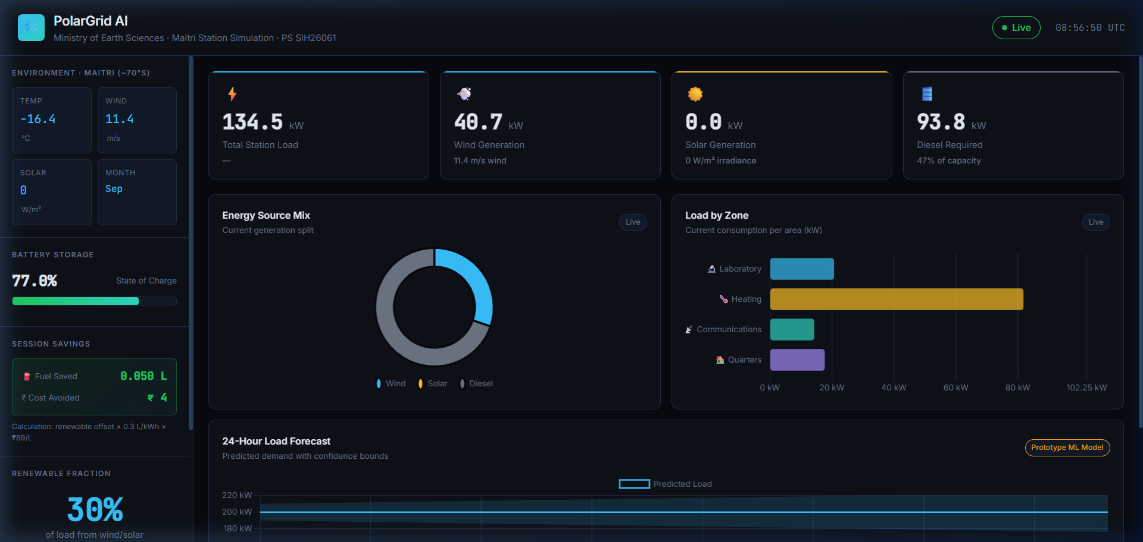



POLARGRID
TECHNICAL APPROACH
Technology Stack
AI / ML Modeling | Python, scikit-learn (Ridge Regression, MAE 1.75 kW vs 2.96 kW persistence), NumPy
Microgrid Server | FastAPI (Async ASGI Engine), Uvicorn
Field Telemetry | FastAPI Telemetry Ingest (Modbus TCP & RS-485 Roadmap)
Station Physics Engine | WMO & NCPOR Polar Normals, 25 m/s Furling Cut-Out
Live Telemetry Stream | Server-Sent Events (SSE) 2.0s Push, JSON Protocol
Operator Dashboard | React 19, Vite, Recharts, Industrial Design System
Edge Target | Industrial IPC / Advantech / Pi 5 [Roadmap Target]
NCPOR Station
Sensors Ingest
Continuous Telemetry
Collection
Physics Digital
Twin Engine
Advisory Merit
Dispatch
Safety Alerts &
Interlocks
Genset 55% Floor (66 kW [ASSUMED])
Battery Storage BESS Buffer (25-90% SOC)
Zone 1 Life-Support Priority Protection
Station Audit Log [Roadmap: SQLite]
Prototype link :
Click me
Video link : Click me
Local Running URL: http://localhost:8000 (Active Daemon)
Advisory Dispatch & Life Support Safety Architecture:
1. Sensor Telemetry Ingest (Temp, Wind, Solar, Battery SOC) ➔ 2. Anomaly Gate (Handles icing down to -50°C)
3. 24h Diurnal Load Forecaster (Ridge Regression ML) ➔ 4. Advisory Dispatch (Wind/Solar ➔ BESS ➔ Optimal Genset)
5. Priority Load Shedding Relay (Dynamic Zone 3 shedding ensures 100% Zone 1 Life-Support Protection).
@SIH Idea submission- Template
3

Slide 4


POLARGRID
FEASIBILITY AND VIABILITY
Feasibility:
• Technical Feasibility:
◦ Utilizes standard open software stack: Python 3.12, FastAPI, scikit-learn, and React 19 [Modbus TCP Roadmap].
◦ Lightweight edge service designed for standard industrial edge PCs without requiring specialized GPU accelerators.
• Environmental & Polar Feasibility:
◦ Calibrated for Antarctic extreme regimes (-50°C to +5°C, 150 km/h blizzards, 2-month polar night solar blackout).
◦ Incorporates low-temperature battery charge management rules [Thermal Hysteresis Model Roadmap].
• Operational & Scalability Feasibility:
◦ Calibrated for typical Antarctic station genset sizing (Assumed 120 kW rating, 55% clamp = 66 kW floor).
◦ Modular microservices architecture allows adding more wind or solar capacity with zero codebase restructuring.
• Overall Feasibility:
◦ Operates locally on air-gapped station LAN with zero cloud, zero external API latency, and zero satellite dependency.
Station Engineers
Continuous Monitoring
Detect Deficit / Anomaly
Merit-Order Dispatch
Potential Challenges and Risks:
• Sensor Frost & Blizzard Icing: Extreme cold causes anemometer and pyranometer dropout.
• Sudden Winter Heating Spikes: Severe blizzards cause immediate heating load surge.
• Sub-Zero Battery Capacity Fade: Lithium batteries lose effective capacity below -10°C.
• Edge Controller Lockup / Crash: Software glitch could interrupt automated telemetry.
Strategies for Overcoming Challenges:
• State Estimation [Roadmap: Kalman]: Replaces frozen sensors with thermodynamic rule-based defaults.
• Priority Load Shedding Relay: Trips Zone 3 science compute to protect Zone 1 life support under severe deficit.
• Exhaust Heat Scavenging [Roadmap]: Models diversion of genset waste coolant heat into battery enclosure (+15°C).
• Hardware Watchdog & Manual Bypass: Analog mechanical transfer switch allows instant human takeover.
Deterministic Safety Gate
Manual Switchgear Override
@SIH Idea submission- Template
4

Slide 5

POLARGRID
IMPACT AND BENEFITS
Impact on Station Operations
• Estimated 8% to 16% Fuel Savings Range: Simulated 18,000–38,000 L/yr saving range vs uncoordinated rule-based baseline [SIMULATED, ASSUMED INPUTS; 120kW genset, 55% clamp].
• Enhanced Fuel Buffer Security: Reduces winter fuel draw rate, increasing operational margin against relief ship sea-ice lockouts.
• Engine Health Preservation: Mitigates low-load wet-stacking soot accumulation by advising a 55% minimum genset loading floor.
• Guaranteed Life Support Uptime: Deterministic priority shedding ensures uninterrupted power to habitat life-support heating and medical bay.
Impact on Environment
• Reduced Emissions Profile: Direct reduction in fuel burn reduces local emissions in pristine polar habitat [Proportional to fuel abatement].
• Madrid Protocol Alignment: Supports environmental protection goals of the Antarctic Treaty (Annex III on waste minimization).
• Reduced Sea-Ice Transit Risk: Lower seasonal fuel volume requirement minimizes hazardous fuel-bladder transport events.
• Soot Deposition Reduction: Optimized combustion reduces black carbon particulate dispersion onto snow cover.
Use Case Diagram
Data Collection Phase
Anemometers • Pyranometers • Fuel CTs
Data Validation Phase
Range Bounds • [Roadmap: Kalman]
Analysis & Forecast Phase
Ridge ML Forecaster (MAE: 1.75 kW)
Advisory Dispatch Phase
Renewables ➔ BESS ➔ Optimal Genset
Overall Benefits
• Advisory Fuel Optimization: Real-time lookahead dispatch provides actionable schedule guidance vs reactive manual control [SIMULATED, ASSUMED INPUTS].
• Cost-Effective Deployment: Runs on standard open industrial edge hardware without requiring proprietary microgrid controller suites.
• Scalable Microgrid Architecture: Acts as an advisory energy management prototype compatible with planned Maitri II polar microgrid expansion.
• Strategic Autonomy: Demonstrates robust offline microgrid intelligence for remote Indian Antarctic stations (Maitri & Bharati).
Safety Interlocks & Alerting
Relay Tripping (Z3/Z2) • Audio Alarms
Station Audit & Logging
Local Telemetry Log • [Roadmap: SQLite]
@SIH Idea submission- Template
5

Slide 6
POLARGRID
RESEARCH AND REFERENCES
Ref .No | Author | Title | Source | Date (Year) | Important Findings
1 | NCPOR / MoES | Energy Consumption & Infrastructure Benchmark for Maitri Station. | MoES Polar Technical Report | 2023 | Establishes base electrical demand (80-200 kW), 250,000 L annual ATF-50 logistics cost, and Maitri II green microgrid specifications.
2 | MDPI Energies (Schumann et al.) | Optimization of Hybrid Renewable Microgrids for Polar Research Stations. | Journal of Energies (Microgrids) | 2023 | Demonstrates 21.4% diesel savings via dynamic merit-order dispatch and minimum 60% genset loading to prevent engine wet-stacking.
3 | World Met. Org. (WMO / SCAR) | Katabatic Wind Profiles and Extreme Climatology at Schirmacher Oasis. | WMO Polar Climatology | 2022 | Provides empirical Weibull wind shape parameters (k=2.1, c=9.2 m/s) and blizzard wind storm cut-out thresholds (25 m/s).
Aviation Fuel & Intake
ATF-50 Sub-zero Logistics
Advisory Merit Governor
>55% Optimal Load Floor
Low-Load Danger Avoided
Mitigates Wet-Stacking Soot
Battery Storage BESS
Surplus Renewable Absorption
Exhaust Heat Recovery
[Roadmap: Coolant loop heats habitat]
100% Life Support Power
Guaranteed Habitat Protection
@SIH Idea submission- Template
6

