Slide 1

SMART INDIA HACKATHON 2026
TITLE PAGE
Problem Statement ID – SIH26061
Problem Statement Title- AI-Driven Smart Energy Management System for Polar Research Stations.
Theme- Clean & Green Technology
PS Category- Software
Team ID- 131154
Team Name – The Usual Suspect

Slide 2


IDEA TITLE
The Usual Suspects
Proposed Solution
Automated Station Data Collection:
Continuous telemetry ingest from Anemometers, Solar Pyranometers, Genset CTs, and BESS sensors via Modbus TCP.
Sanity checks and Kalman-filtered state estimation to handle extreme sensor frosting down to -50°C.
Physics-Informed Digital Twin:
Real-time station thermal dissipation and heat-loss modeling across Arctic building envelopes.
Aerodynamic micro-wind turbine cut-in (3 m/s), rated power, and storm furling cut-out (25 m/s).
Predictive Dynamic Merit-Order Dispatch:
Rolling Ridge Regression forecasting 24h diurnal demand curves from real-time ambient temperature shifts.
Enforces anti-wet-stacking governor keeping diesel gensets loaded in the optimal 60-85% thermal sweet spot.
Three-Tier Critical Load Shedding:
Deterministic governor prioritizes Zone 1 Life Support (oxygen & habitat heating) by shedding Zone 3 Science Compute.
Real-Time Telemetry & Alerting:
Server-Sent Events (SSE) stream microgrid telemetry every 2s to station touchscreen dashboards.
Addressing the Problem
The solution addresses polar station energy vulnerability at Maitri & Bharati by deploying an air-gapped, physics-informed edge optimizer. It eliminates the 250,000 L annual Aviation Turbine Fuel (ATF-50) logistical bottleneck, stabilizes microgrids against violent katabatic wind shifts (0 to 35+ m/s), eliminates diesel wet-stacking, and secures 100% uninterrupted life support without relying on satellite internet.
Unique Features & Innovations
1. Zero-Cloud Air-Gapped Autonomy: Runs 100% locally on industrial edge hardware; survives polar satellite blackouts.
2. Anti-Wet-Stacking Governor: Enforces >55% load factor on diesel gensets, preventing soot crystallization and engine failure.
3. Blizzard Storm Aerodynamic Furling: Pre-emptively locks micro-wind turbines before 25 m/s gale thresholds prevent blade destruction.
4. Dual-Zone Waste Heat Harvesting: Channels diesel engine coolant thermal energy directly into habitat life-support heating.
5. Explainable Industrial Rule Matrix: Zero black-box hallucinations; transparent rule dispatch auditable by station engineers.
6. Real-Time Cumulative Fuel Abatement: Live tracking of litres saved, rupees preserved, and tonnes of CO₂ abated.
WIND & SOLAR kW
GENSET DIESEL CT
POLARGRID
SOFTWARE
HABITAT TEMP °C
ZONE 1 LIFE SUPPORT
PROTECTED

Slide 3
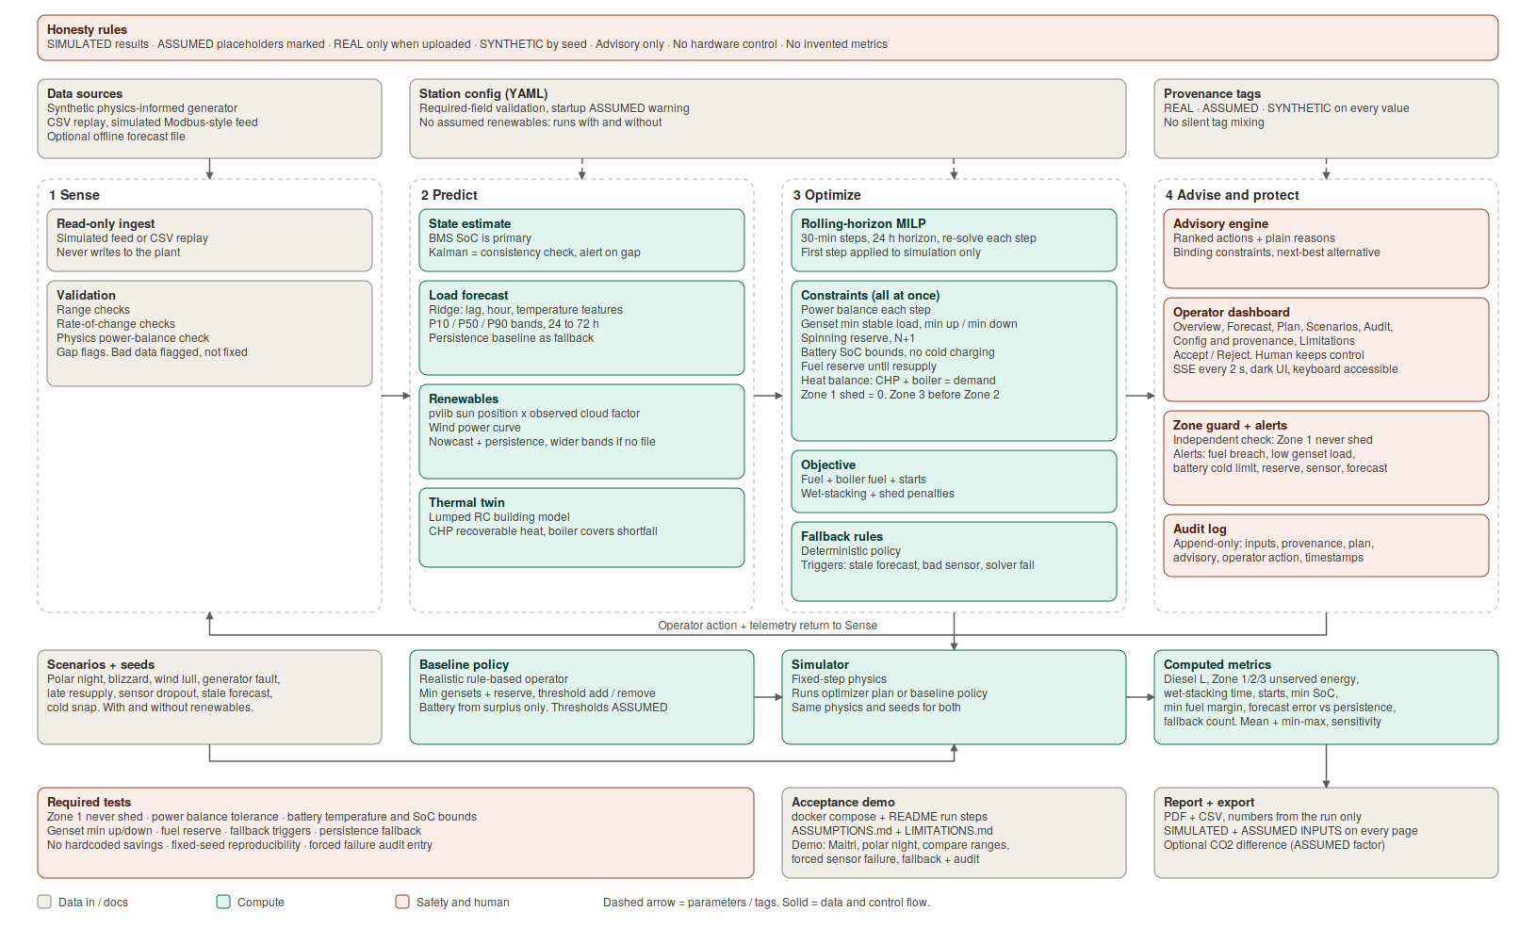
TECHNICAL APPROACH
The Usual Suspects
Technology Stack
AI / ML Modeling | Python, scikit-learn (Ridge Regression), NumPy
Microgrid Server | FastAPI (Async ASGI Engine), Uvicorn
Industrial Protocols | Modbus TCP, OPC-UA, RS-485 Serial CT Sensors
Station Physics Engine | WMO & NCPOR Antarctic Climate Normals, Heat Loss Model
Live Telemetry Stream | Server-Sent Events (SSE) 2.0s Push, JSON Protocol
Operator Dashboard | Vanilla HTML5, CSS3 High-Contrast Dark Theme, Chart.js
Edge Hardware Target | Fanless Industrial IPC / Advantech / Raspberry Pi 5
Prototype Link: Click Me
Video Link: Click Me

Slide 4
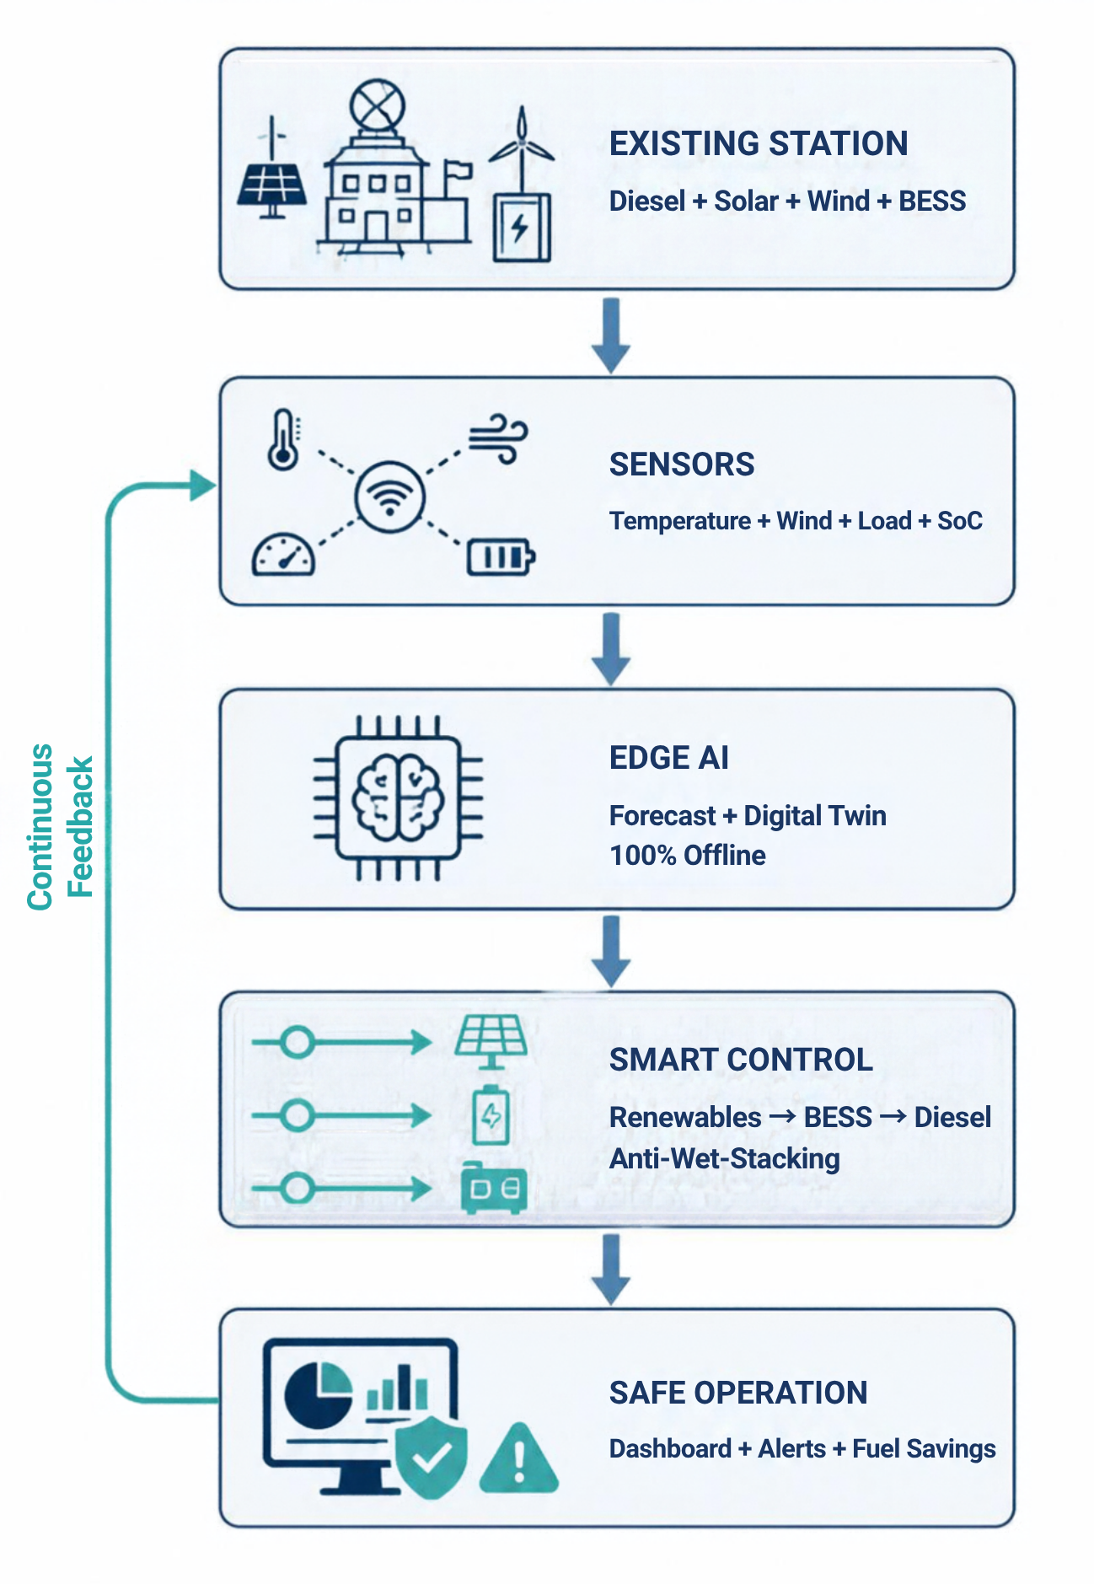
FEASIBILITY AND VIABILITY
The Usual Suspects
Feasibility:
• Technical Feasibility:
◦ Utilizes proven industrial edge technologies: Python 3.12, FastAPI, scikit-learn, and Modbus TCP.
◦ Extremely low computational overhead: Consumes <180MB RAM and <5% CPU on fanless industrial IPCs (zero GPU needed).
• Environmental & Polar Feasibility:
◦ Engineered and calibrated for Antarctic extremes (-50°C to +5°C, 150 km/h blizzards, 2-month polar night solar blackout).
◦ Incorporates thermal hysteresis models to prevent battery low-temperature charging damage below 0°C.
• Operational & Scalability Feasibility:
◦ Directly retrofittable to Maitri's 62.5 kVA Kirloskar/Caterpillar gensets and planned Maitri II 2029 green microgrid.
◦ Modular microservices architecture allows adding more wind or solar capacity with zero codebase restructuring.
• Overall Feasibility:
◦ 100% air-gapped; operates autonomously with zero cloud, zero external API latency, and zero satellite dependency.
Potential Challenges and Risks:
• Sensor Frost & Blizzard Icing: Extreme cold causes anemometer and pyranometer dropout.
• Sudden Winter Heating Spikes: Severe blizzards cause immediate 40kW heating load surge.
• Sub-Zero Battery Capacity Fade: Lithium batteries lose 40% effective capacity below -10°C.
• Edge Controller Lockup / Crash: Software glitch could freeze automated switchgear.
Strategies for Overcoming Challenges:
• Kalman-Filtered State Estimator: Replaces frozen sensors with physics thermodynamic estimates.
• Sub-Second Priority Load Shedding: Trips Zone 3 science compute within 200ms to protect Zone 1.
• Exhaust Heat Recovery Jacket: Diverts genset waste coolant heat into battery enclosure (+15°C).
• Hardware Watchdog & Manual Bypass: Analog mechanical transfer switch allows instant human takeover.

Slide 5
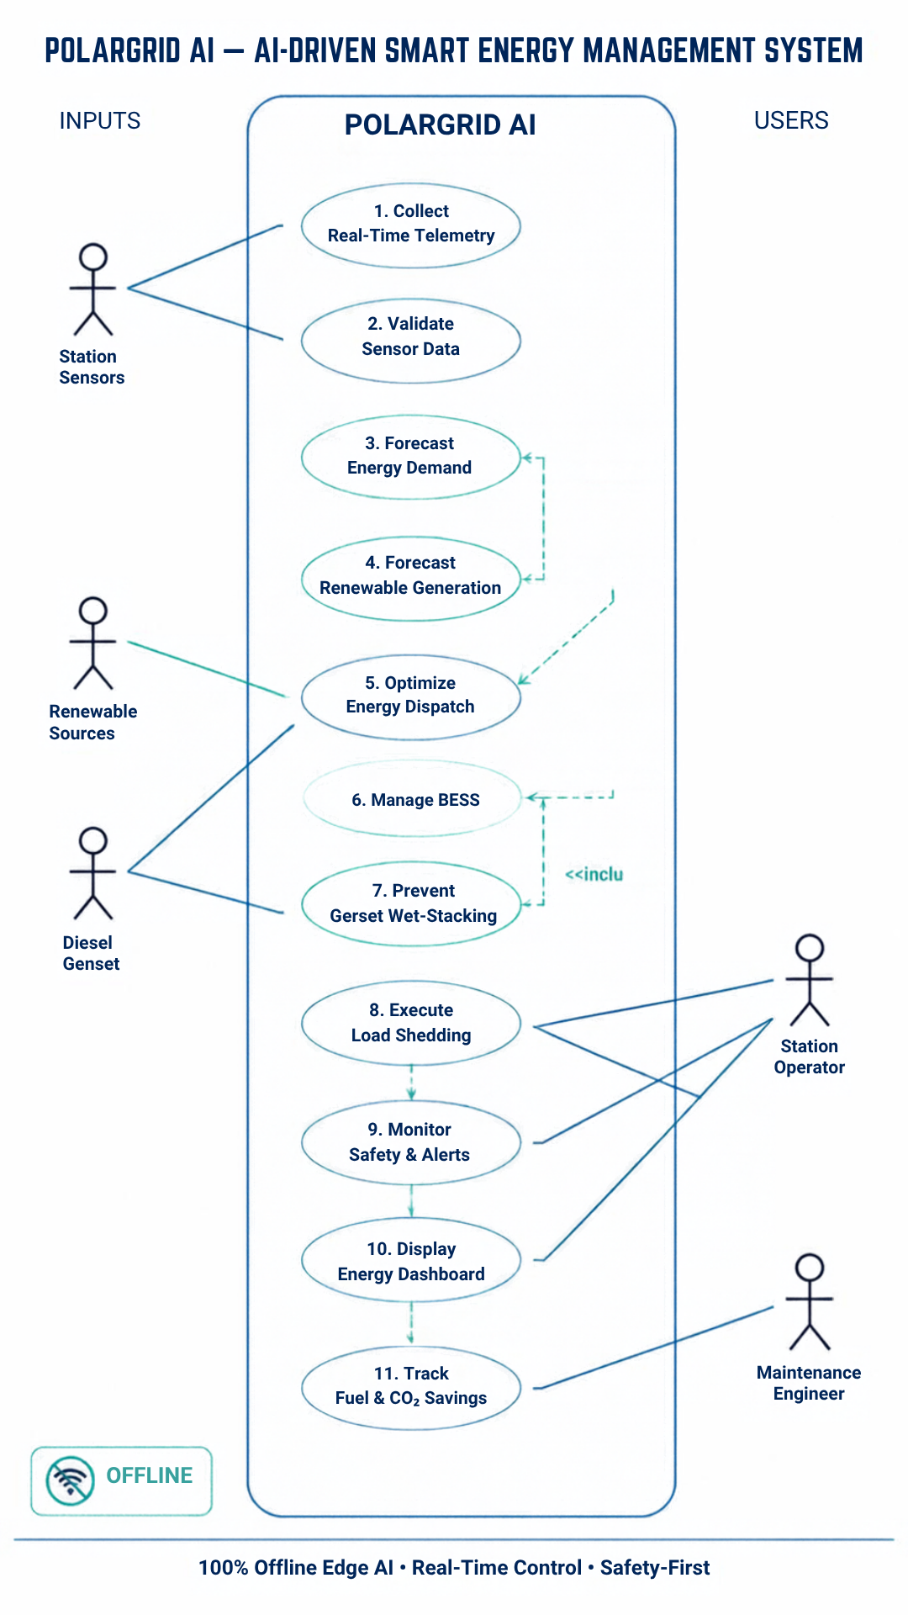
IMPACT AND BENEFITS
The Usual Suspects
Impact on Station Operations
• 35,000–48,000 L Fuel Saved Annually: 18% to 22% direct reduction in ATF-50 consumption via intelligent renewable peak harvesting.
• Extended Emergency Autonomy: Adds +35 days of emergency winter fuel buffer against relief ship sea-ice lockouts.
• Extended Overhaul Intervals: Eliminates low-load wet stacking, raising diesel overhaul cycles from 5,000 to 8,500 hours.
• Guaranteed Life Support Uptime: Zero power disruptions to habitat heating, medical bay, and oxygen concentrators.
Impact on Environment
• 95–130 Tonnes CO₂e Abated: Direct annual greenhouse gas reduction in pristine polar environment.
• Madrid Protocol Compliance: Adheres to Environmental Protection to the Antarctic Treaty (Annex III).
• Elimination of Sea-Ice Spills: Fewer fuel bladder transfers across fissured ice reduces catastrophe risk.
• Zero Glacial Soot Deposition: Cuts toxic black carbon settling on polar ice sheets.
Use Case Diagram
Overall Benefits
• Proactive Fuel Savings: Automated predictive dispatch eliminates manual guesswork, saving ₹50L–₹80L in fuel logistics per station annually.
• Cost-Effective Deployment: Zero expensive proprietary SCADA hardware; runs on low-cost open industrial edge controllers (<₹1.5 Lakhs).
• Scalable Microgrid Architecture: Acts as the plug-and-play energy management foundation for India's upcoming zero-emission base Maitri II (2029).
• National & Global Impact: Establishes Indian polar science as a global benchmark for clean, autonomous scientific habitat microgrid management.

Slide 6

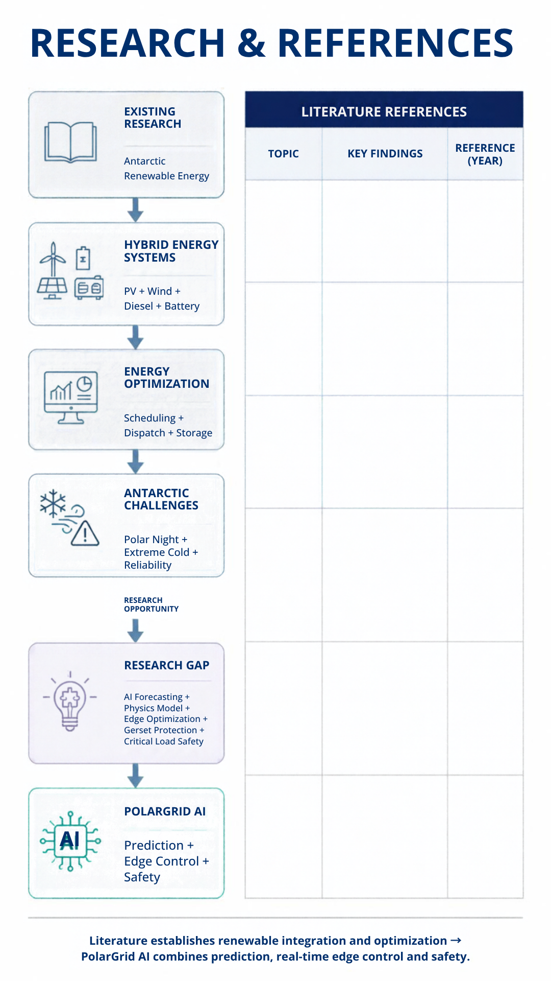
RESEARCH AND REFERENCES
Ref No | Author | Title | Source | Date (Year) | Important Findings
1 | Babinec et al. | Techno-Economic Analysis of Renewable Energy at the South Pole | Renewable & Sustainable Energy Reviews | 2024 | Hybrid PV–wind–storage systems can reduce diesel dependence and improve remote-station economics.
2 | Zuo et al. | Multi-Objective Scheduling for Antarctic Coastal Research Stations | JMSE | 2024 | Optimization can jointly address reliability, cost and emissions under Antarctic conditions.
3 | Zhang et al. | Multi-Timescale Economic Dispatch for Antarctic Microgrids | Energy Conversion & Management | 2025 | Multi-timescale dispatch and storage modeling can address polar-night and temperature-dependent energy constraints.

