Slide 1

EMPLOYEE PROMOTION PREDICTION
Bhuvaneswari Neela

Slide 2

Abstract
Finding and preparing qualified individuals for promotion, particularly at the manager level and below, is a problem that the majority of organisations and huge multinational corporations are facing. Currently the process they are using is:
They first identify a set of employees based on recommendations/ past performance.
Selected employees go through the separate training and evaluation program.
These programs are based on the required skill of each individual.
At the end of the project, based on various factors such as training & performance, will predict whether employee would get a promotion or not

Slide 3
Importing all the Required Libraries
We Imported Numpy, Pandas, Matplot, and Seaborn for Data Analysis and Visualizations.
We imported ipywidgets, for Exploratory Data Analysis.
We Imported Sklearn for Machine Learning Modelling
Used Decision Tree algorithm

Slide 4
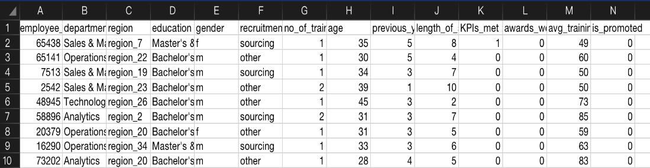
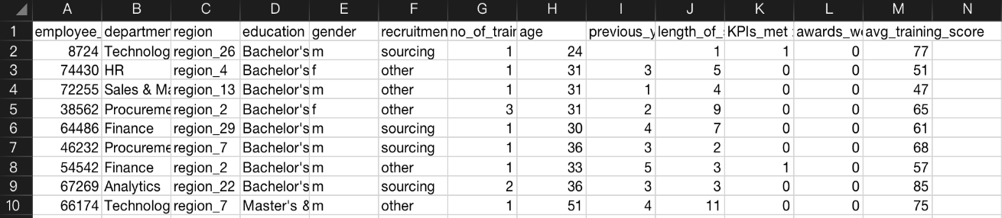
DATASETS
Training dataset:
Testing dataset:

Slide 5

Graphical Representation of Various Categories
&
Findings

Slide 6
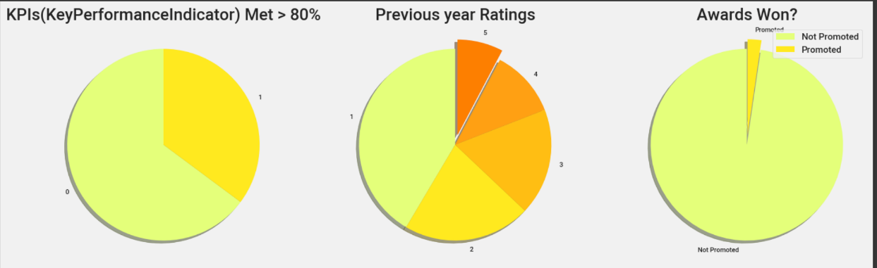
This Pie-chart is about,
KPIs(Key Performance Indicator) who met more than 80%
The rate of Employee rankings of previous year.
Awards won by the Promoted and Not-Promoted employees.

Slide 7
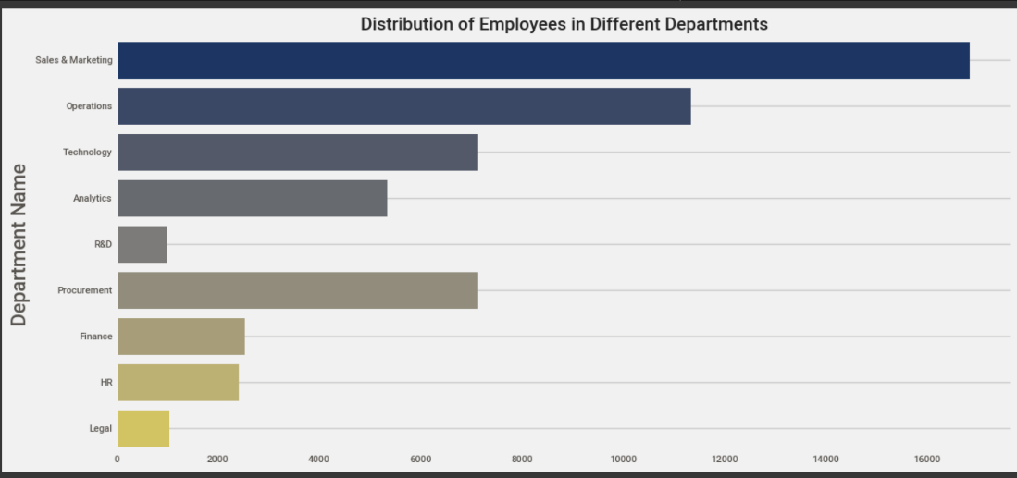
This Bar-graph indicates the Department names and count of employees.
Most of the Employees are from Sales & Marketing Department

Slide 8
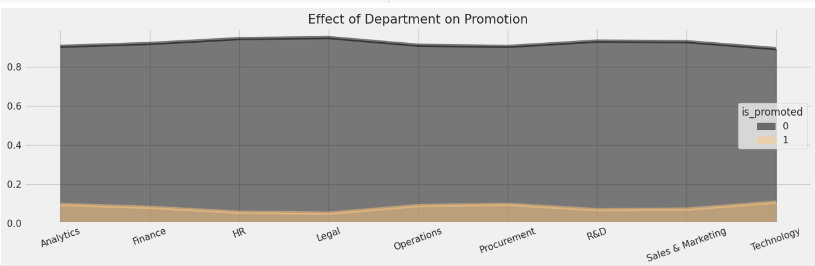
Distribution on effect of Department on Promotion Employees from Procurement & Technology department are mostly likely are getting promoted

Slide 9
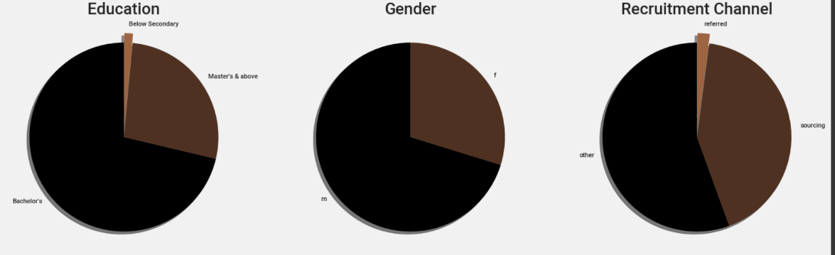
Categories within the Employees
For better understanding we distinguished the employees and divided into three categories:
Education
Gender
Recruitment

Slide 10
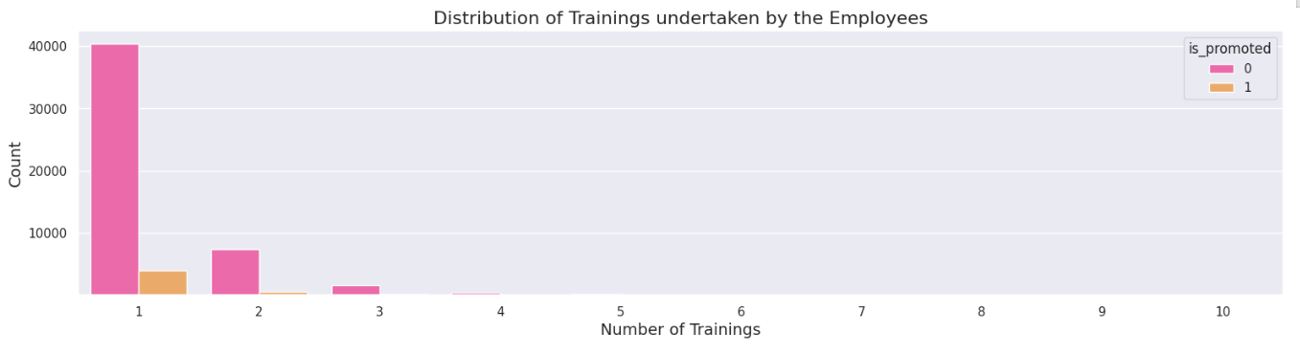
Distribution of Trainings taken by employees

Slide 11
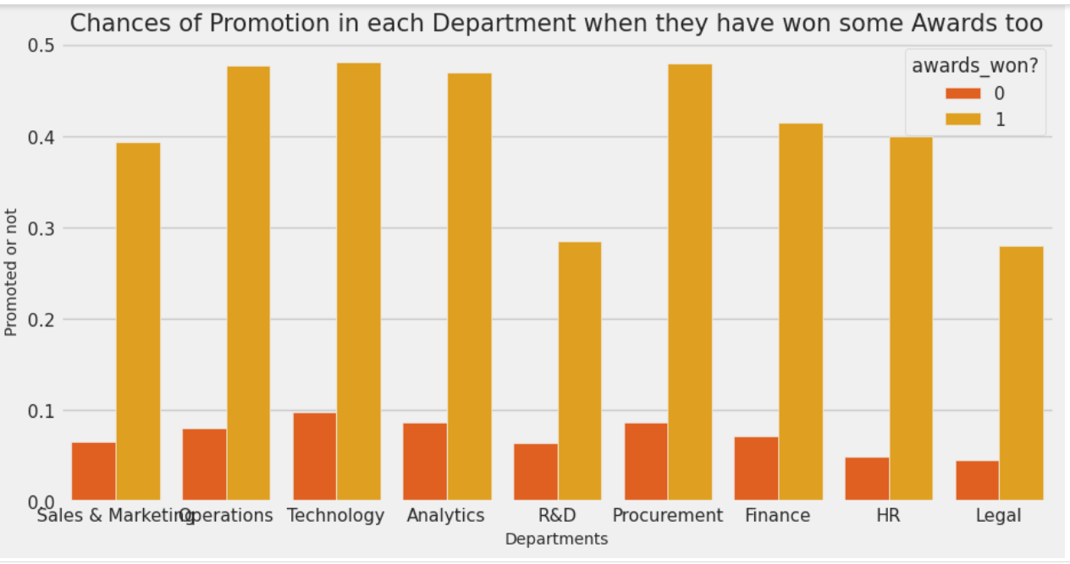
Chances of Promotion in each Department with Awards
Here we consider the Probability of Promotions among the employees in all departments.

Slide 12
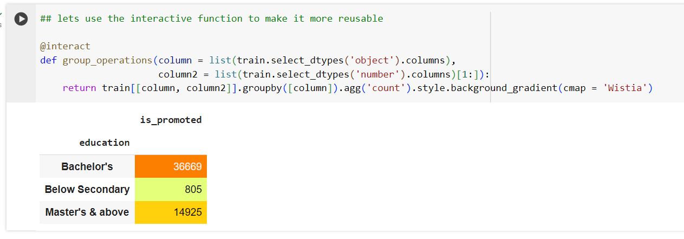
Findings :
Employees who done their bachelors are most likely are getting promoted

Slide 13
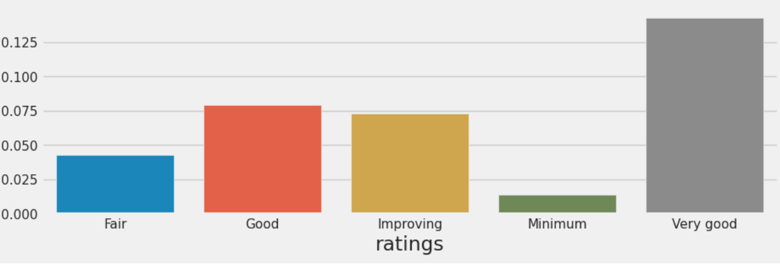
Employees with 'Very good' rating (5) are most likely to be promoted.

Slide 14
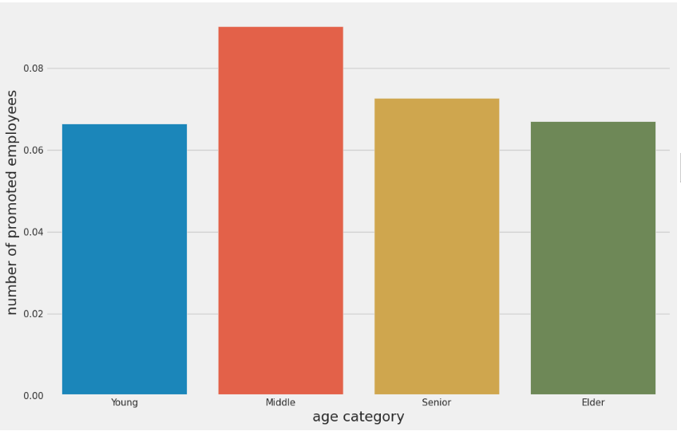
An employee aged between 25 and 40 years are likely to be promoted

Slide 15
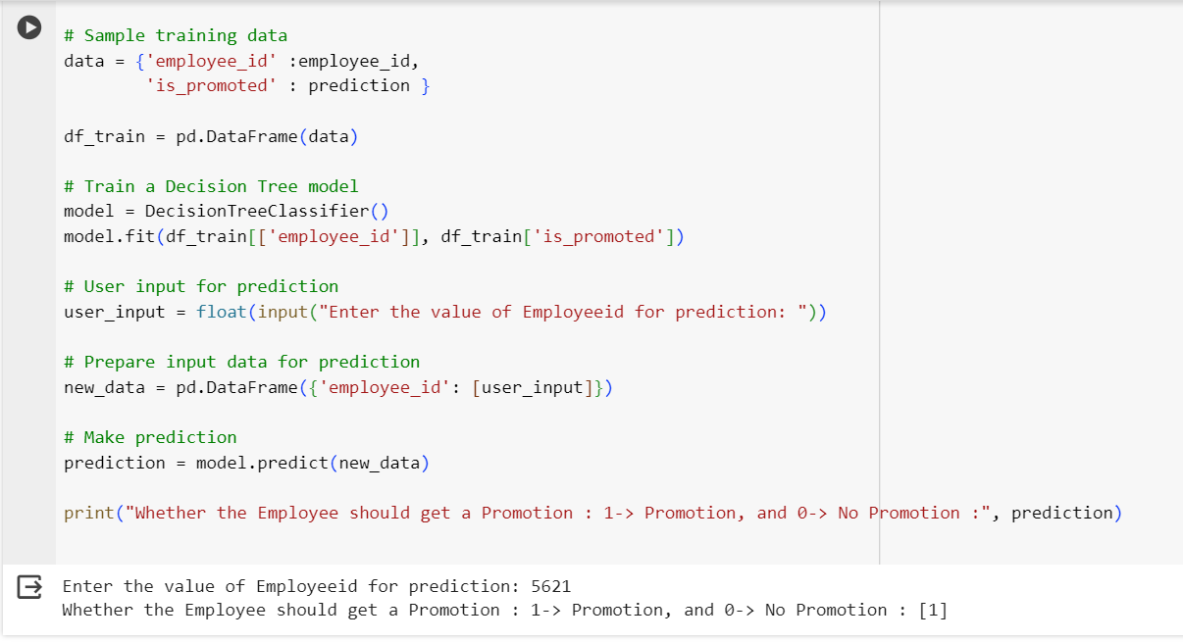
Output 1:

Slide 16
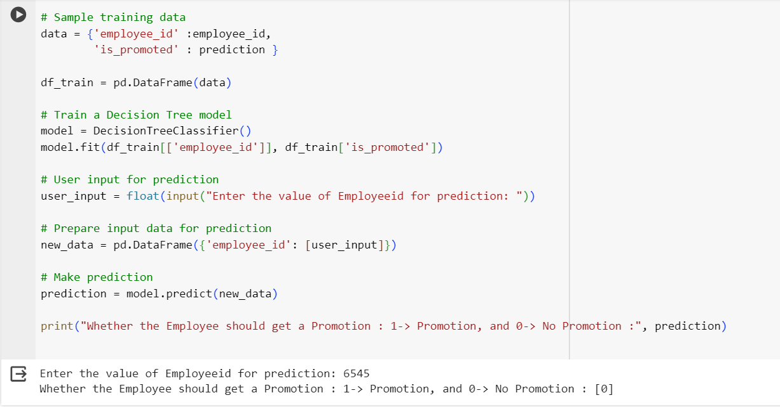
Output 2:

Slide 17
Conclusion:
The goal of this project was to create a supervised machine learning classification model for promotion determination. information was utilized to forecast which employees were eligible for promotion. Knowing which staff are qualified for advancement is critical for any firm. Furthermore, the larger the organization, the more time and work it takes to manually identify people qualified for advancement. As a result, developing a model that identifies prospects for potential advancement is quite beneficial. The following prediction models was created is ‘The Decision Tree’. The findings show that there was no bias and that the features of the recruitment channel and department did not play important roles in promotion. The algorithms were able to perform well despite the relatively minimal data. More data would result in better-optimized solutions. Thus, machine learning model can reduce the amount of time spent on decision making, enhancing productivity.

Slide 18
Thank You

