Slide 1

DDCA GROUP PROJECT · TEAM 07
Digital Door Access
System Using
Combination Logic
A combinational-logic based electronic lock that verifies an access code and grants entry without any mechanical key.
TEAM MEMBERS
Manideep · Aarush · Hansika · Neelagreeva · Swarajith

Slide 2

INTRODUCTION
What is a Digital Door Access System?
An electronic lock that replaces a conventional mechanical key with a secret access code entered on a keypad or switch bank.
The heart of the system is a combinational logic circuit — it has no memory of past inputs; the output depends only on the code present at that instant.
Input → Logic → Action
Each bit of the entered code is compared against a pre-set reference code using logic gates such NOT Gate & AND Gate, and the results are combined with an AND gate.
Keypad code → gate-level comparison → relay-driven unlock
If — and only if — every bit matches, the circuit produces a single "Access Granted" signal that drives the door-unlocking mechanism.
No microcontroller required for the core comparison — pure digital logic gates do the job.
DDCA · TEAM 7 · DIGITAL DOOR ACCESS SYSTEM
02

Slide 3



PROBLEM STATEMENT
Why Move Away from Mechanical Locks?
Keys Get Lost or Copied
No Access Control
Slow to Reconfigure
Physical keys can be misplaced, stolen, or duplicated without the owner's knowledge, creating a lasting security gap.
A mechanical lock cannot restrict entry to specific people or times — anyone holding the key can enter, anytime.
Changing who can enter means changing the physical lock or re-cutting keys — costly and inconvenient.
Motivation:
Design a low-cost, reliable access-control circuit — built entirely from basic digital logic gates — that grants entry only when the correct code is presented.
DDCA · TEAM 7 · DIGITAL DOOR ACCESS SYSTEM
03

Slide 4



OBJECTIVES
Project Objectives
01
02
Design the comparison logic
Use only basic logic gates
Build a combinational circuit that checks an entered code against a fixed reference code, bit by bit.
Implement the comparator using XNOR, AND, OR and NOT gates — no microcontroller in the core logic.
03
04
Drive a real unlocking action
Verify with a truth table
Use the match output to energise a relay/solenoid that physically unlocks the door.
Simulate and test every input combination to confirm the circuit only unlocks for the correct code.
DDCA · TEAM 7 · DIGITAL DOOR ACCESS SYSTEM
04

Slide 5
SYSTEM DESIGN
System Block Diagram
Relay / Solenoid
→ Door Unlocks
Green LED
Stays Lit
Yes
Keypad /
Switch Input
Combinational
Comparator Logic
Code
Match?
Buzzer + Red LED
→ Access Denied
No
The comparator continuously checks the entered bits; a single AND-combined "match" signal decides which path the system takes.
DDCA · TEAM 7 · DIGITAL DOOR ACCESS SYSTEM
05

Slide 6

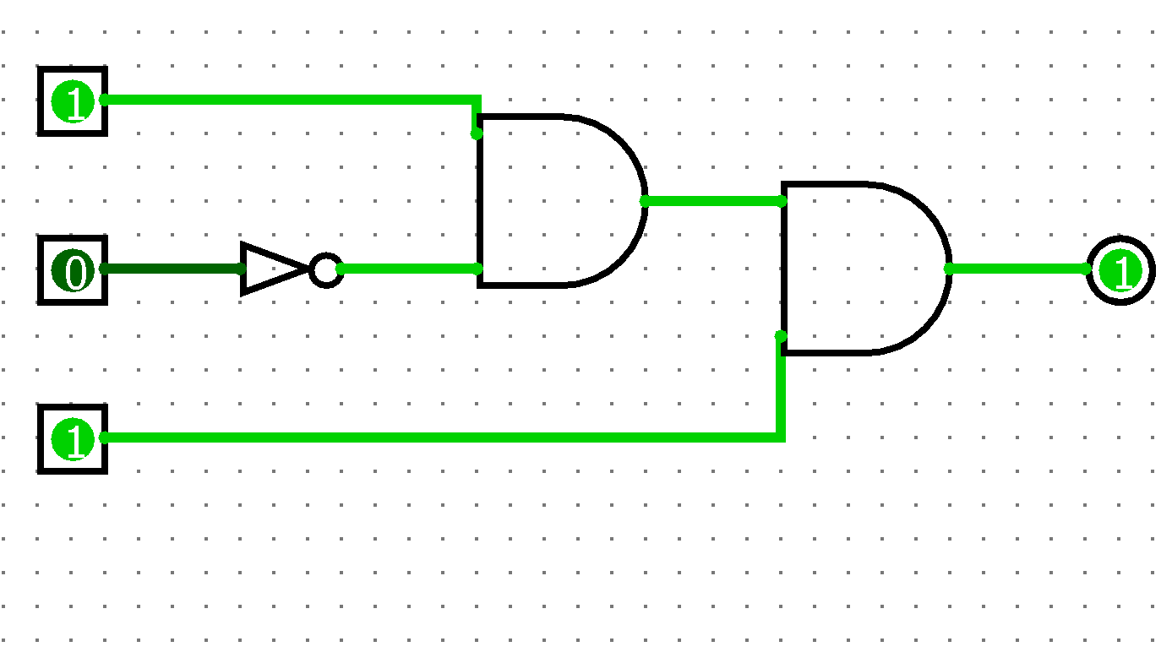

LOGIC DESIGN
Combinational Logic & Truth Table
Sample Truth Table (3-bit code, reference = 1 0 1)
A | B | C | Y (Unlock)
0 | 0 | 0 | 0
0 | 1 | 1 | 0
1 | 0 | 0 | 0
1 | 0 | 1 | 1
1 | 1 | 1 | 0
Bit-wise Comparison
Each entered bit (A, B, C) is compared to the corresponding reference bit using an XNOR gate — it outputs 1 only when the two bits are equal.
The three XNOR outputs are combined with an AND gate so the final output Y is 1 only when all bits match.
Only the exact match 1-0-1 pulls the output high — every other combination keeps the door locked.
Here now, we only use AND Gate and NOT Gate for simple construction.
DDCA · TEAM 7 · DIGITAL DOOR ACCESS SYSTEM
06

Slide 7

OPERATION
Working Flowchart
Start
Purely Combinational
User enters code
on keypad
There is no clock or memory element — the decision is made instantly and continuously from the present input state alone. As soon as the correct code is removed, the output returns low.
Gates compare
each bit to reference
Buzzer sounds +
red LED — access denied
AND output
= 1 ?
Relay energised —
door unlocks + green LED
YES
NO
End
DDCA · TEAM 7 · DIGITAL DOOR ACCESS SYSTEM
08

Slide 8
IMPLEMENTATION
Components Used
Component | IC / Part | Function
Switches / Keypad | SPDT toggles or 4×3 matrix | Enter the access code as logic 0/1 inputs
AND Gate | 74LS08 | Combines all bit-comparisons into one match signal
Relay / Solenoid | 5V/12V relay module | Physically unlocks the door mechanism
Indicator LEDs | Green / Red LED | Shows access granted or denied
Power Supply | 5V regulated (7805) | Powers all logic ICs and the relay driver
DDCA · TEAM 7 · DIGITAL DOOR ACCESS SYSTEM
09

Slide 9






APPLICATIONS
Where This System Can Be Used
Homes
Offices
Storerooms
Keyless entry for front doors and gates
Restricting entry to authorised staff only
Protecting inventory & equipment areas
Labs
Server Rooms
Lockers & Safes
Controlling access to sensitive lab equipment
Guarding critical IT infrastructure
Personal or shared secure storage
DDCA · TEAM 7 · DIGITAL DOOR ACCESS SYSTEM
10

Slide 10


EVALUATION
Advantages & Limitations
Advantages
Limitations
No physical key to lose, copy, or pick
Fixed code — changing it needs rewiring, not reprogramming
Instant response — no processing delay
No memory of failed attempts (purely combinational)
Simple, low-cost design using standard ICs
No built-in lockout after repeated wrong codes
Access code changed easily by rewiring reference bits
Lower security than microcontroller / biometric systems
Low power consumption, easy to maintain
Wiring complexity grows with longer access codes
DDCA · TEAM 7 · DIGITAL DOOR ACCESS SYSTEM
11

Slide 11

CONCLUSION
A Practical Case for
Combinational Logic
This project shows that a functional, real-world security device can be built from nothing more than AND, OR and NOT gates — no microcontroller needed for the core decision-making.
The design was verified with a truth table covering every input combination, confirming the door unlocks only for the correct code, meeting the project's objectives of a low-cost, reliable, gate-level access-control system.
FUTURE SCOPE
Add sequential logic for lockout after failed attempts
Integrate a microcontroller + keypad matrix for reprogrammable codes
Extend with biometric or RFID / IoT-based access control
Team 07 · Manideep · Aarush · Hansika · Neelagreeva · Swarajith

