Slide 1
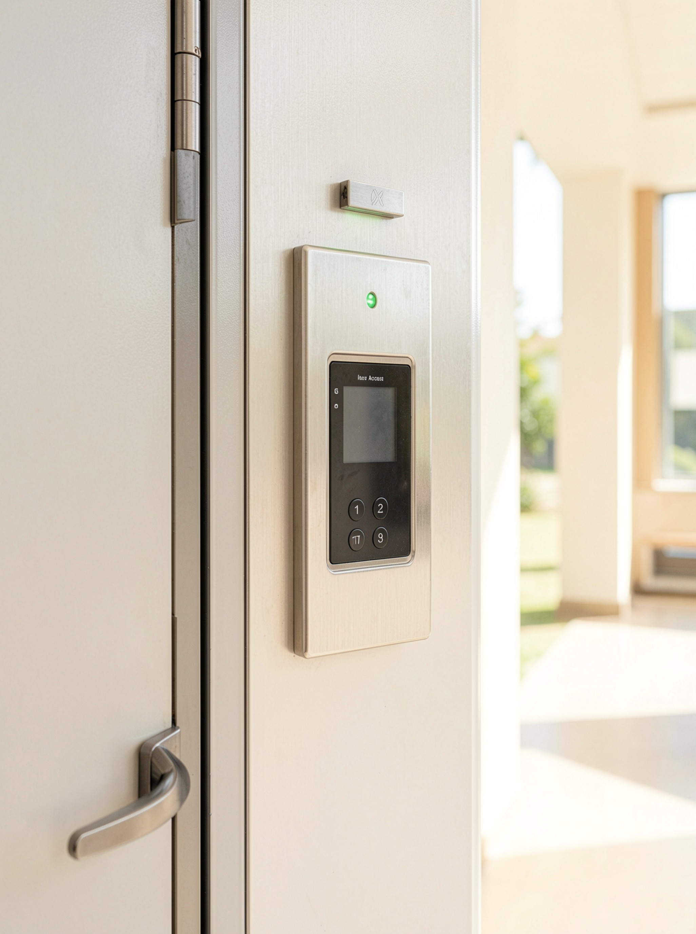
DIGITAL LOGIC PROJECT
Digital Door
Access System
Using Combination Logic
Presented by Team - 07
Manideep – 2620030560 · Aarush – 2620030563
Neelagreeva – 2620030564 · Swarajith – 2620030583
Hansika – 2620030551 · Section: 11
01 / 08

Slide 2
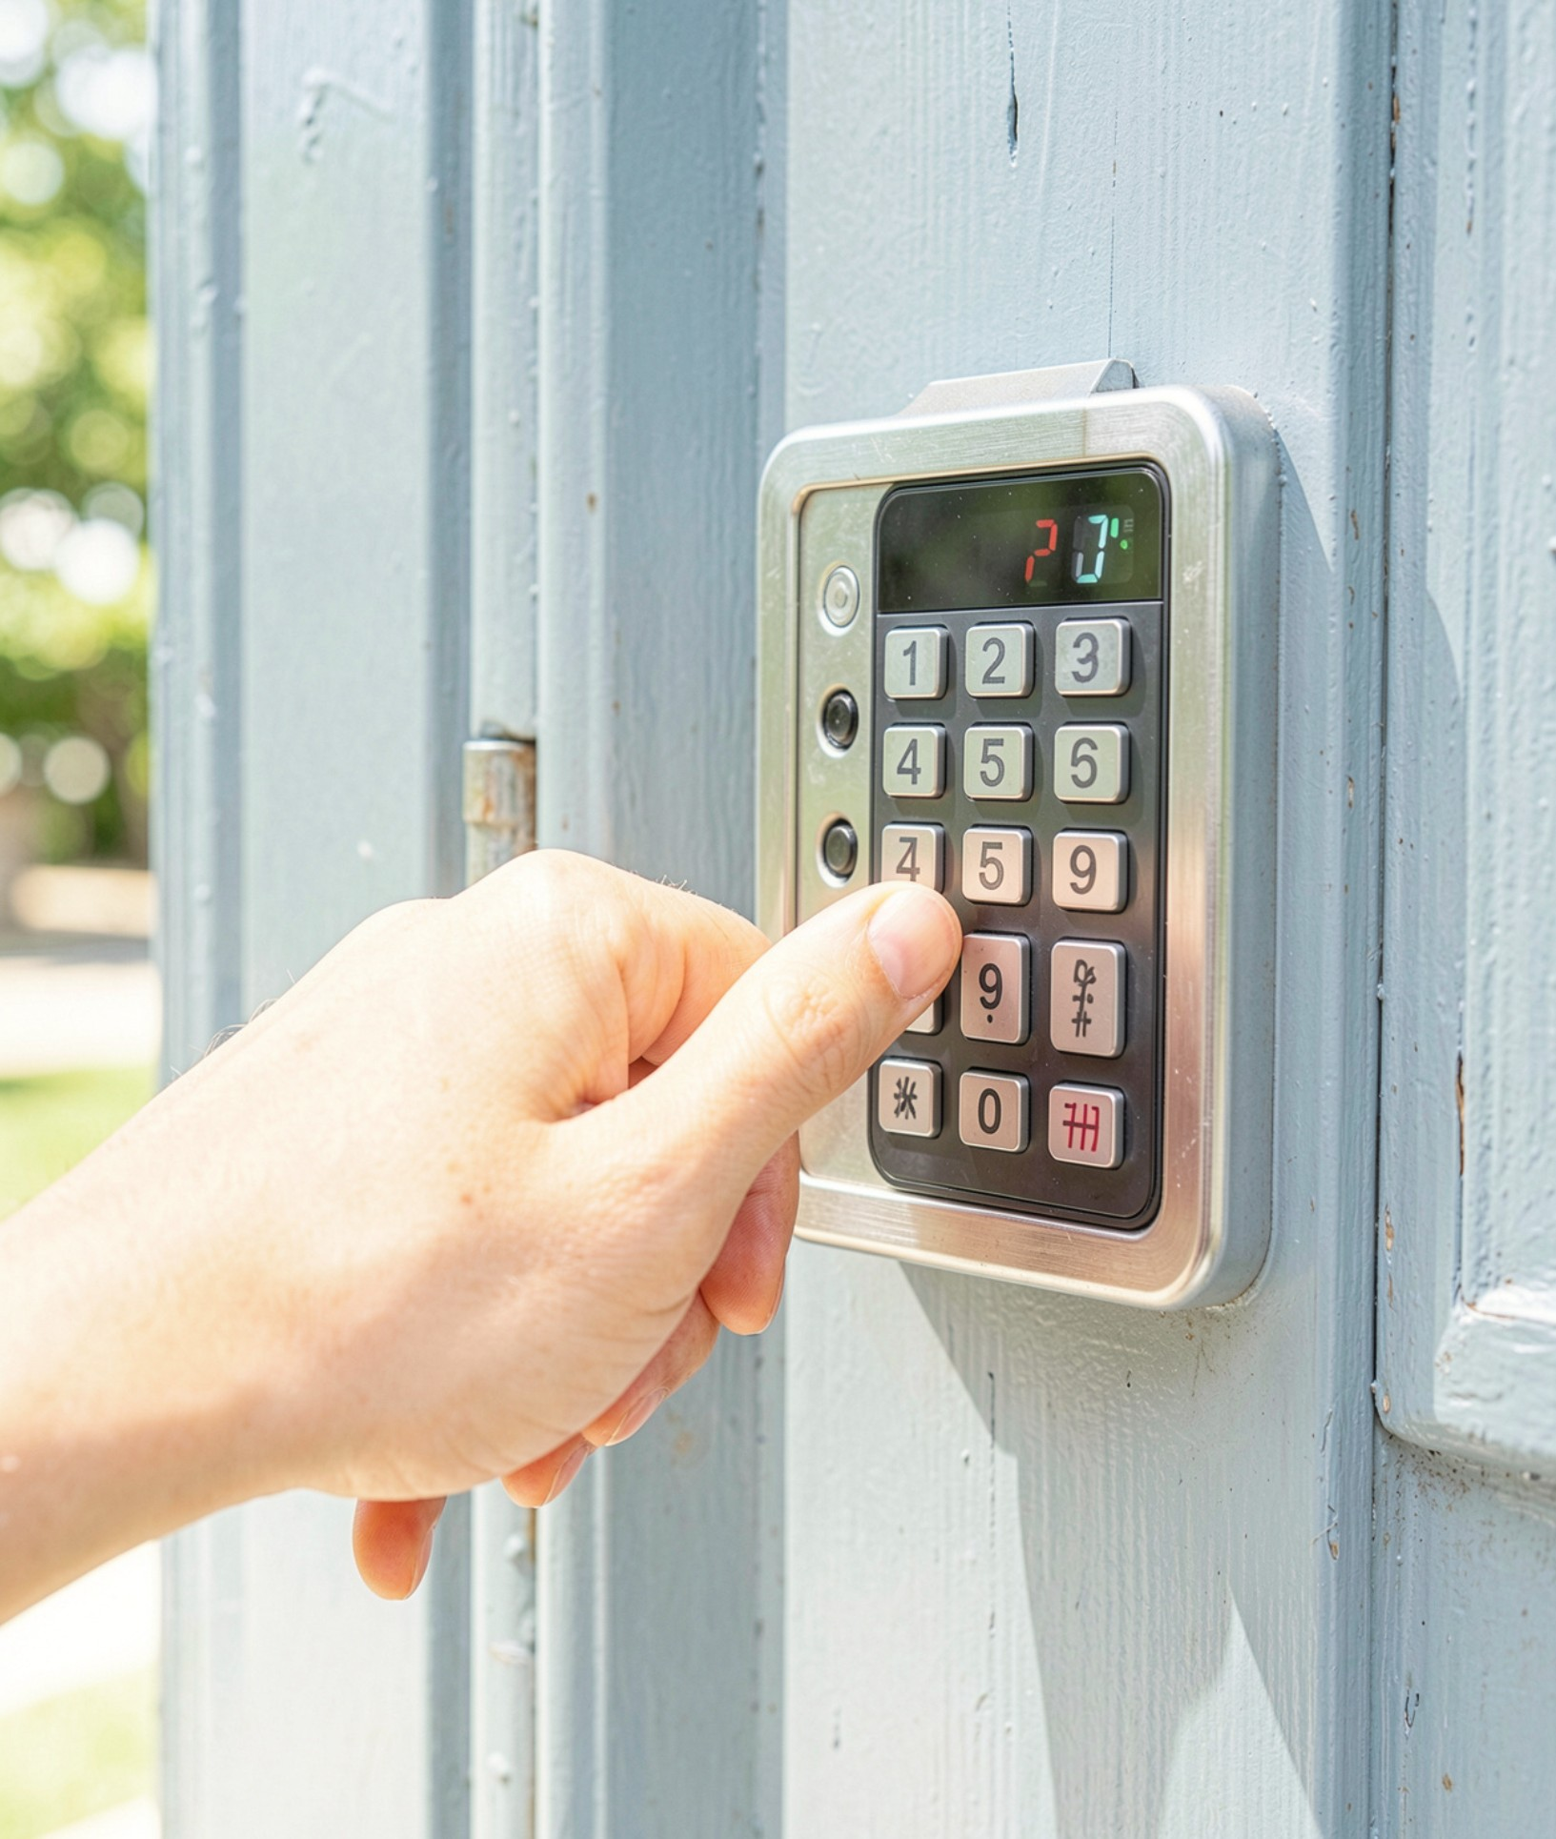



Introduction and objective
DIGITAL LOGIC PROJECT
Team - 07
The problem
Conventional keys can be lost, copied, or shared without visibility.
INTRODUCTION
The idea
A digital door access system takes an entered code and decides, using logic gates, whether to unlock.
The approach
Build the decision circuit from basic gates, simulate it in Logisim and verify it with a truth table.
Access control
Objective: design and simulate a combinational logic circuit that unlocks the door only for the valid input code (A = 1, B = 0, C = 1) and rejects every other combination.
02 / 08

Slide 3
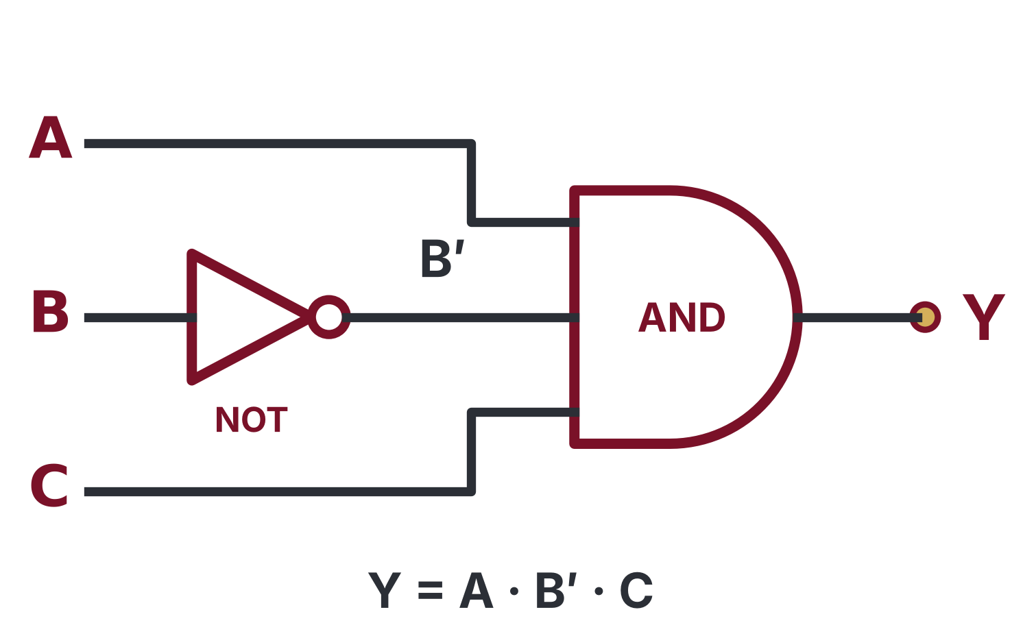
Theory and logic circuit
THEORY
Team - 07
1
AND gate: the output is 1 only when all of its inputs are 1.
LOGIC GATES
2
NOT gate: inverts its input, so 0 becomes 1 and 1 becomes 0.
3
B goes through a NOT gate, then A, NOT B and C enter a 3-input AND gate.
4
Y = A · B′ · C, so the door unlocks only for A = 1, B = 0, C = 1.
Gates & Boolean logic
Combinational logic: the output depends only on the present inputs, with no memory.
03 / 08

Slide 4
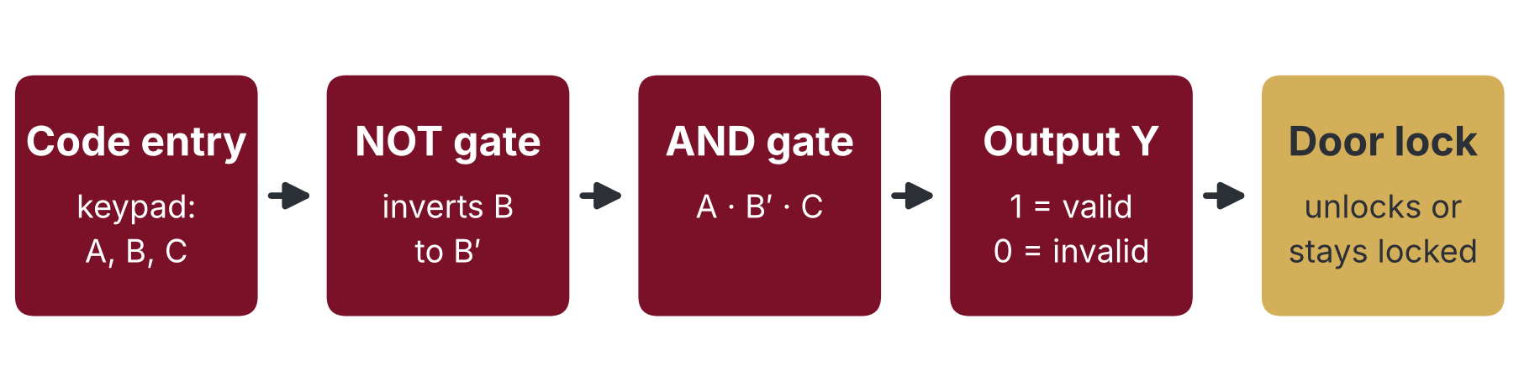
How the access system works
OPERATION
Team - 07
SYSTEM FLOW
Valid code entered
Any other code
A = 1, B = 0, C = 1: the NOT gate makes B′ = 1, so all three AND inputs are 1.
Y = 1 and the door unlocks.
At least one AND input is 0, so Y = 0 and the door stays locked.
The A = B = C = 0 test in Logisim is one such case.
Input to output
Combinational design: the decision follows the inputs instantly and stores no state.
04 / 08

Slide 5
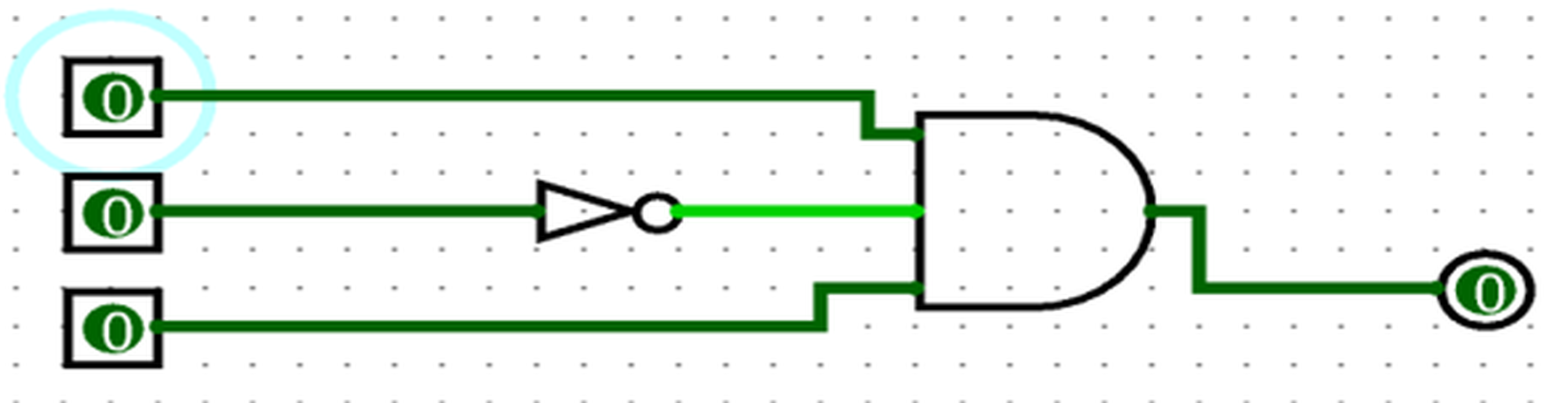
Circuit design in Logisim
LOGISIM
Team - 07
CIRCUIT DESIGN
Components used
Working of the circuit
Three input pins (A, B, C), a NOT gate on B, a 3-input AND gate and one output pin Y.
Bright green wires carry logic 1; dark green wires carry logic 0.
B is inverted, so the AND gate receives A, B′ and C.
Y = 1 only when A = 1, B = 0 and C = 1; that output unlocks the door.
Built in Logisim
Logisim shows every wire’s logic level live, so the design can be tested one input pattern at a time.
05 / 08

Slide 6
Simulation results
SIMULATION
Team - 07
A | B | C | B′ | Y
0 | 0 | 0 | 1 | 0
0 | 0 | 1 | 1 | 0
0 | 1 | 0 | 0 | 0
0 | 1 | 1 | 0 | 0
1 | 0 | 0 | 1 | 0
1 | 0 | 1 | 1 | 1
1 | 1 | 0 | 0 | 0
1 | 1 | 1 | 0 | 0
RESULTS
Logisim run: A = B = C = 0 gives Y = 0 (access denied).
What the simulation shows
With A = B = C = 0, the NOT gate makes B′ = 1, but A and C are 0, so Y = 0.
Of the 8 input combinations, only A = 1, B = 0, C = 1 gives Y = 1.
Case shown in the Logisim screenshot
The only valid code (Y = 1)
Result: the simulation matches the truth table; only code 101 unlocks the door.
Truth table
06 / 08

Slide 7
Conclusion and applications
DIGITAL LOGIC PROJECT
Team - 07
01
02
03
CONCLUSION
Outcome
Applications
Improvements
Outcome and scope
A 3-input access circuit was designed and simulated in Logisim.
Output Y = 1 only for A = 1, B = 0, C = 1.
The other seven input combinations are denied.
Home and office door locks
Keypad and digital-code entry panels
Lockers, safes and restricted rooms
Extend to a longer 4-bit or 8-bit access code.
Add flip-flops to count wrong attempts and raise an alarm.
Drive a real lock through a microcontroller or FPGA.
Result: a simple, testable combinational design that shows how basic gates make a door-access decision.
07 / 08

Slide 8
DIGITAL LOGIC PROJECT
Thank You
Presented by Team - 07
Manideep · Aarush · Neelagreeva · Swarajith · Hansika
GitHub link - https://github.com/Neelagreeva/DDCA-Digital-Door-Access-System-by-Team---07
08 / 08

