Slide 1
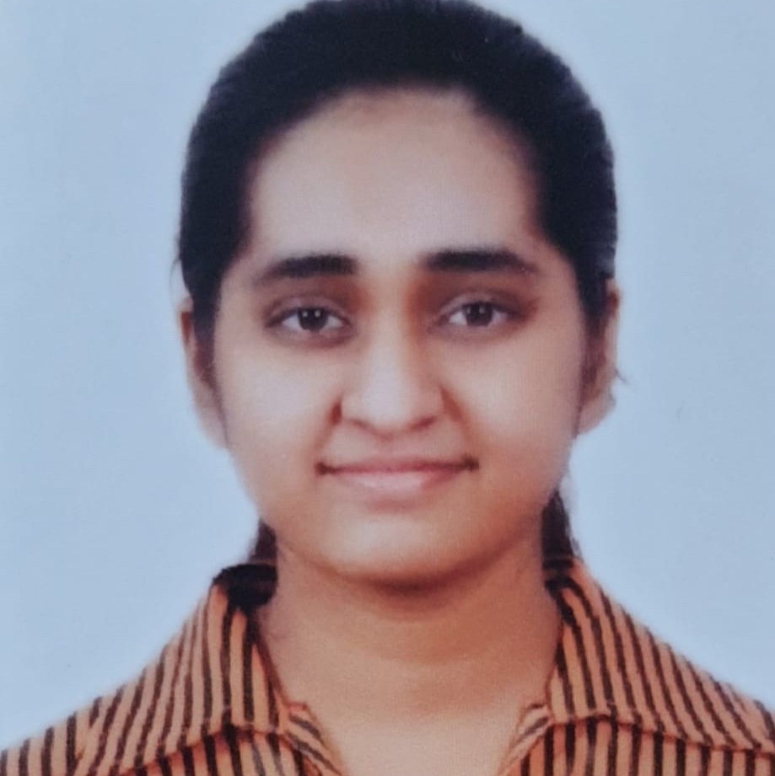

Neelam S Kurhade
Senior Analyst/Software Engineer
Bachelor of Engineering
EXTC : 2018 - 2022
Skills
Mumbai
Java 8 /J2EE | Java Basics, OOPS, Generics, Collections, Arrays, Loops, Lambda Exp, Stream API Junit, Mockito.
Spring core | IOC & Dependency Injection, Autowiring
Spring REST | REST controllers, Implementation of GET, POST, PUT & DELETE, Exception Handling, Testing Services
Spring Boot Microservices | Spring Boot Starters, annotations
Spring Cloud | Eureka server and discovery client
Angular | Components, Services, Modules, Routing, Forms & Validation
Database | MongoDB
UI Tech | HTML 5 & CSS 3,JavaScript, Angular
Tools | Git, Postman, Maven, IDE
neelam.sitaram-kurhade@capgemini.com
+91 8779808133
A5
Full Stack Developer
Proficient in creating microservices using spring boot, Eureka server and API Gateway.
Proficient in creating Single page Web Application in Angular with Angular forms, angular routing
Proficient in unit testing using Junit and Mockito
Proficient in creating databases using MongoDB.
Used Git as distributed version control system to push and commit codes.
Basic understanding of the cloud services provided by Amazon Web Services (AWS).
Course Management System
Completed end to end case study of Course Management System using Spring boot , mongo DB database and unit testing using Junit and Mockito. Used Angular in creating the user interface.
Check out my work on GitHub

