Slide 1
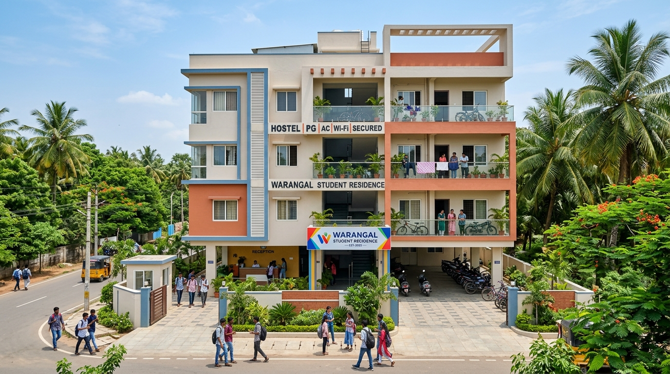
FULL STACK DEVELOPMENT (FSD) LAB PROJECT
NEARSTAY
One App. Every Room Nearby.
A real-time full stack web platform connecting students with verified hostels & PGs with live room availability, transparent pricing & zero brokerage.
PROJECT CONTRIBUTORS
1. Neelam Jashwanth (Roll No: 24CSB0A49)
2. Venu Gopala Dasari (Roll No: 24CSB0A84)
Department of Computer Science & Engineering (CSE)

Slide 2
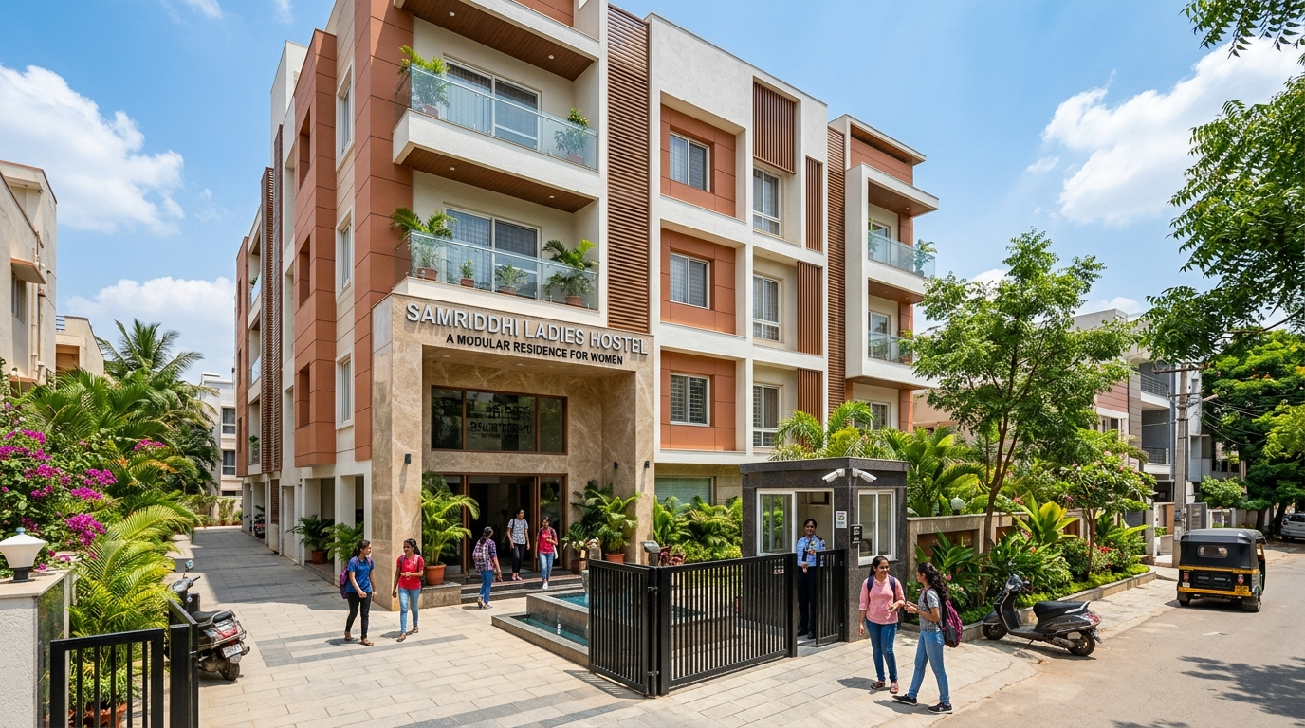
CURRENT REALITY
The Problem: Why Student Accommodation Hunting is Broken
1. Blind & Exhausting Offline Search
New college students walk 10-15 km in hot sun checking hostels one-by-one with zero real-time visibility into whether rooms are actually vacant.
2. Exploitation by Unregistered Brokers
Local offline agents charge 50% to 100% of the first month’s rent as heavy brokerage commission without offering any legal safety guarantee.
3. Outdated Classifieds & Fake Photos
Traditional classifieds (OLX, Facebook groups) feature dead phone numbers, misleading old pictures, and uninspected food mess claims.

Slide 3
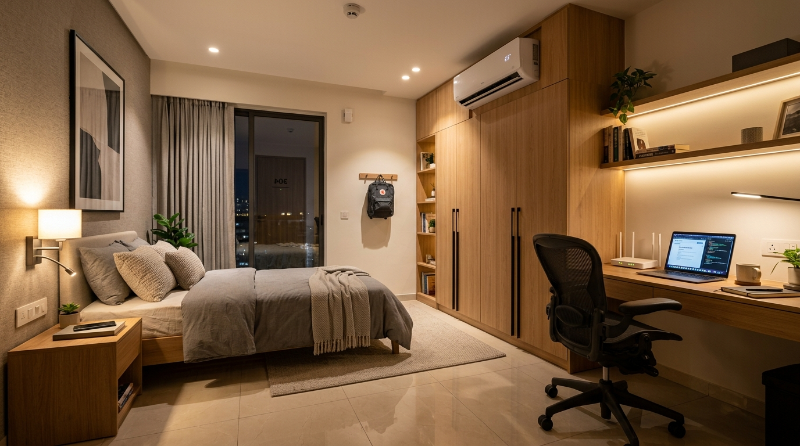
OUR INNOVATION
The Solution: How NearStay Solves This
⚡ Live Room-Level Availability Matrix
Students can view floor-wise vacant rooms in real-time (Green = Available, Dark = Occupied) and pick their exact room before visiting.
🛡️ 100% Zero-Brokerage Direct Model
Direct connection between students and verified property wardens with ₹0 platform commission or hidden middleman charges.
🍛 Inspected Weekly Food Mess Schedules
Clear 7-day breakfast, lunch, and dinner menus verified on-ground to eliminate food disputes and ensure hygiene.

Slide 4
ENGINEERING STACK
Full Stack System Architecture
1. FRONTEND UI
2. BACKEND & LOGIC
3. DATABASE LAYER
4. HOSTING & CLOUD
HTML5 · CSS3 · ES6+ JS
Node.js · Firebase Compat
Google Cloud Firestore
Firebase Edge CDN
• Modular Semantic Layout
• Custom CSS Design System
• Dark / Light Theme Engine
• Interactive Photo Carousels
• Client-side State Cache
• Student & Warden Auth
• Dynamic Pricing Engine
• Coupon Validation Logic
• Real-Time Event Sync
• Responsive Webhooks
• NoSQL Document Store
• `onSnapshot` Live Listeners
• Atomic Room State Locks
• Sub-second Latency Sync
• Offline Cache Fallback
• Global Edge Delivery
• 256-bit SSL Security
• 99.9% Uptime Guarantee
• Instant CI/CD Deploy
• Zero Server Maintenance

Slide 5
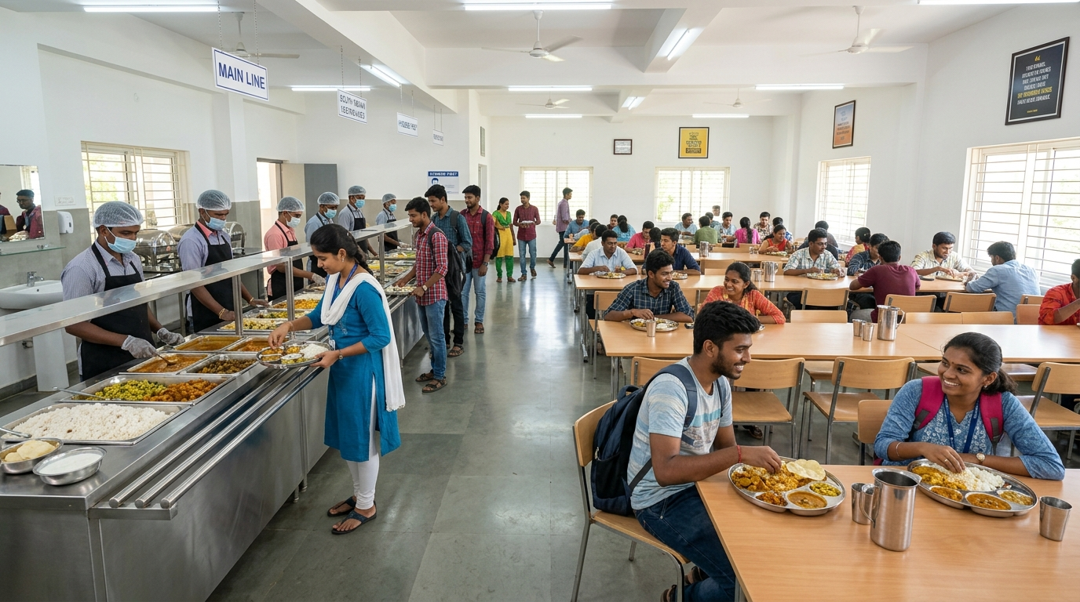

LIVE FUNCTIONALITIES
Core System Modules & Key Features
FEATURE HIGHLIGHTS
• Smart Search & Campus Filtering (NIT Warangal, Kazipet, Subedari, Sharing type, Budget).
• Interactive Live Room Matrix (Floor-wise room selector with real-time occupancy updates).
• Verified Weekly Food Mess Schedule (7-day breakfast, lunch, dinner & special meals).
• Digital Booking Confirmation Pass (Unique Ref ID, Reception QR verification, Warden Call).

Slide 6
PROJECT MILESTONES
Implementation Roadmap & Current Progress
PHASE 1 : COMPLETED
PHASE 2 : IN PROGRESS
PHASE 3 : PLANNED
Frontend & UI Experience
Real-Time Database & Logic
Deployment & Mobile App
• Modern responsive interface
• Multi-photo card carousel
• Detail lightbox modal & tabs
• Dark/Light theme toggle
• Wishlist local storage
• Cloud Firestore collections
• Real-time `onSnapshot` sync
• Dynamic pricing & coupon logic
• Digital booking pass with QR
• Role-based authentication
• SMS/WhatsApp Warden Alerts
• Integrated UPI Token Gateway
• React Native mobile app
• AI-based roommate matching
• Production Cloud Edge Deploy

Slide 7
IMPACT & ROAD AHEAD
Project Impact & Future Vision
REAL-WORLD VALUE IMPACT
FUTURE SCOPE & EXPANSION
• Drastically reduces accommodation hunting time from 3-4 days to under 5 minutes.
• 100% Zero-Brokerage model eliminates high commissions for students & parents.
• Live room matrix prevents traveling to hostels that are already full.
• On-ground verified meal menus & safety badges provide peace of mind.
• Native Android & iOS Mobile Apps using React Native / Flutter.
• AI-Powered Roommate Compatibility matching based on course & habits.
• Direct Online Token Payments via UPI & Razorpay gateway integration.
• Expansion from Warangal to major educational hubs like Hyderabad & Kota.

