Slide 1
Project Presentation:
Gender Classification Using Fingerprints
Deepak Neelam – jqp841
Emilio Martinez III – emx062

Slide 2
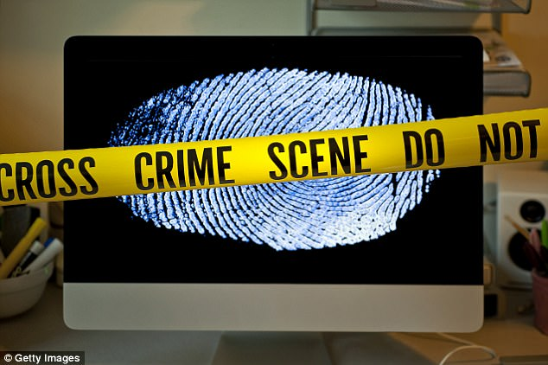
Introduction
Gender Classification is an indispensable Human activity since many social interactions are based on gender.
It represents a key role in various applications like Human-Computer interplay, Indexing and Inspections depends on the context.
Typically in an automatic gender identification problem, features are extracted from a collection of images fitting male and female items and used to train a two class classification model.
Various face based classification methods has shown good accuracy. But they are time consuming for gender classification.
Fingerprint Classification plays a fundamental role in fingerprint identification systems. As it reduces the time spent in identifying an individual.

Slide 3
Related Works
Different fingerprint identification and classification studies were performed and conducted. Based on Deep Neural Networks, CNN models.
Models based on CNN are robust with technical advancement in image classification.
But the past studies either dealt with images of a fixed size and type without using filters to remove noise or techniques to improve image quality or they used complex techniques.
In order to find high precise consequences to increase the rate of gender classification, various powerful features are also required.

Slide 4
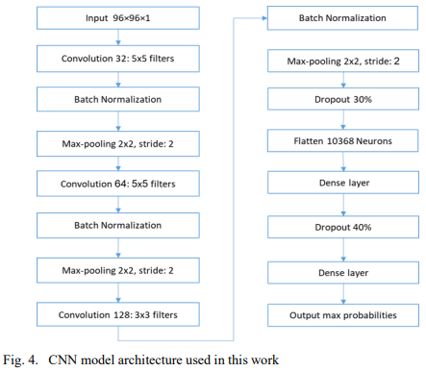
Proposed Architecture
A CNN is a Multi-Layered Perceptron network (MLP) with a specific topology comprising more than one hidden layer.
CNN preserves spatial information utilizing filter kernels.
Without explicit normalization, this network automatically extracts various features from raw input information from its internal layers.
In this work, CNN has exploited its unique ability to create a model for classifying SOCOF images into several classes.
Without explicit normalization, this network automatically extracts various features from raw input information from its internal layers.

Slide 5
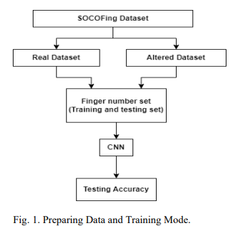
Contribution
In this project, a fundamental CNN for fingerprint classification has been applied. As they are effective in image processing related works.
Firstly, Fingerprint Image augmentation and preposing.
Removing the noise from images using wiener filter.
Improving image contrast by applying multilevel histogram techniques.
Image
(if applicable)

Slide 6
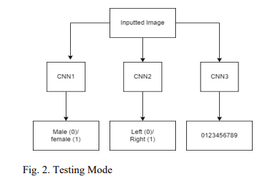
Contribution
Secondly, CNN is applied to identify finger prints based on gender, classify them based on identifying individual fingerprint(finger name).
This could be especially useful in cases where traditional fingerprint analysis methods may be difficult or inconclusive.

Slide 7
Preliminary Research
Since out project was taking advantage of neural networks to solve the problem, the more common problem of digit recognition was also attempted to further solidify our foundational understanding. Two separate programs were made using the mnist data set. The links below show the two implementations.
Network 1
https://colab.research.google.com/drive/15ZitIBNixZL8xgdT2ktzaJkn2ONSJF3?usp=sharing
Network_2
https://colab.research.google.com/drive/1rIIlG61I2Ih3FeHxpbuFjLxBwhk74W4G?usp=sharing

Slide 8
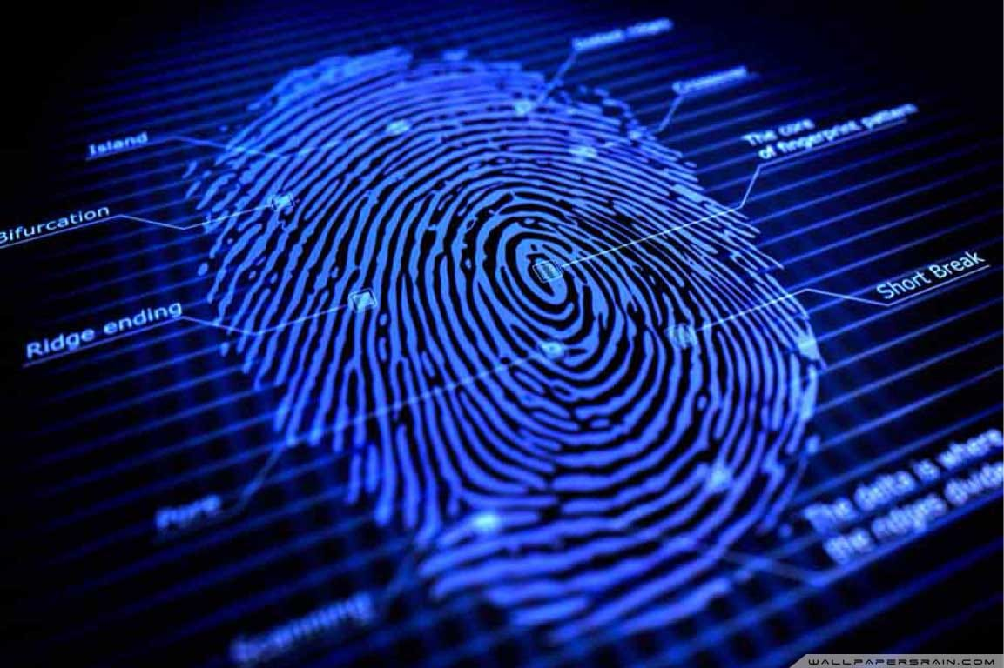
Data
Sokoto Conventry’s Fingerprint Dataset(SOCOFing)
It is a biometric fingerprint database designed for academic research purposes.
The effective learning technique in addressing fingerprint classification is Transfer learning technique.
This dataset contains fingerprint images from 600 African subjects.

Slide 9
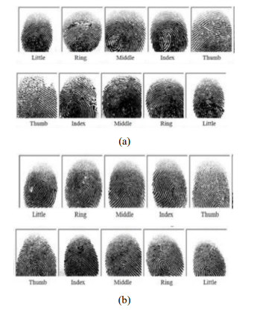
SOCOFing Dataset
This dataset consists of a total of 6000 real fingerprint images, gathered from 600 individuals with unique features including in terms of gender type, hand type and finger name.
This is a sample of ten real fingerprints of one person (a) is a male subject's left and right-hand fingerprints, and (b) is a female subject's left and right- hand fingerprints

Slide 10
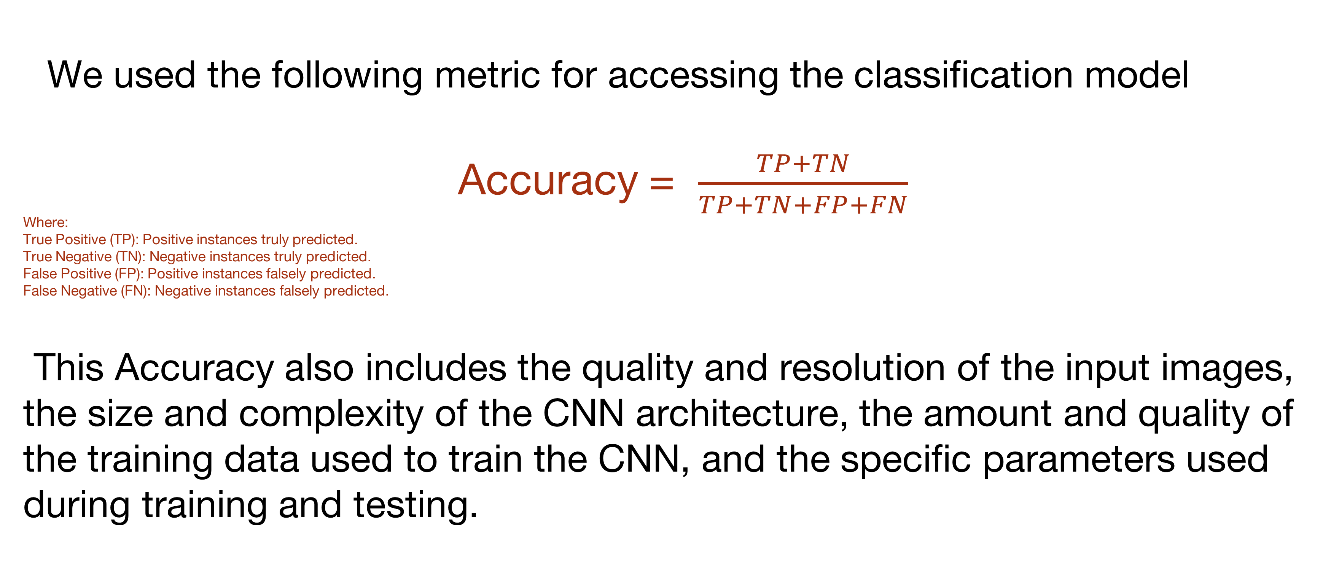
Metrics
We used the following metric for accessing the classification model
Accuracy = $\frac{TP+TN}{TP+TN+FP+FN}$
Where:
True Positive (TP): Positive instances truly predicted.
True Negative (TN): Negative instances truly predicted.
False Positive (FP): Positive instances falsely predicted.
False Negative (FN): Negative instances falsely predicted.
This Accuracy also includes the quality and resolution of the input images, the size and complexity of the CNN architecture, the amount and quality of the training data used to train the CNN, and the specific parameters used during training and testing.

Slide 11
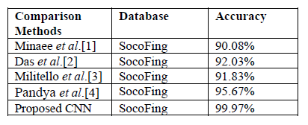
Results
70% of the dataset is used for the training part learning of CNNs, and 30% of the dataset is used to test CNNs.
The overall highest accuracy of subjects’ fingers classification is 98.5%.
Four thousand seven hundred fifty-nine male subjects and One thousand one hundred and nighty-nine female subjects were accurately classified,
Image
(if applicable)

Slide 12
Results
Preliminary Results:
Obtained an Accuracy of 67.3% with the dummy dataset which is used for model development.
Actual Result:
Obtained an Accuracy of 98.5% with the SOCOFing dataset.

Slide 13
Results
Problems Encountered:
The left hand's ring finger has the worst classification of all the fingers.
The left little and left middle prints were misclassified by the model as the left ring prints, leading to their suspicion.
Except for the left thumbprint, all ten prints categories had the wrong label for the right middle print.
Reason:
This may have been due to the multiple finger directions that were exhibited during the collection procedure prior to the scanner searches.

Slide 14
References
[1] S. Minaee, E. Azimi, and A. Abdolrashidi, “FingerNet: pushing the limits of fingerprint recognition using convolutional neural network,” Jul. 2019, [Online]. Available: http://arxiv.org/abs 1907.12956.
[2] R. Das, E. Piciucco, E. Maiorana, and P. Campisi, “Convolutional neural network for finger-vein-based biometric identification,” IEEE Transactions on Information Forensics and Security, vol. 14, no. 2, pp. 360–373, 2018, doi: 10.1109/TIFS.2018.2850320.
[3] C. Militello, L. Rundo, S. Vitabile, and V. Conti, “Fingerprint classification based on deep learning approaches: experimental findings and comparisons,” Symmetry, vol. 13, no. 5, p. 750, Apr. 2021, doi: 10.3390/sym13050750. [4] B. Pandya, G. Cosma, A. A. Alani, A. Taherkhani, V. Bharadi, and T. M. McGinnity, “Fingerprint classification using a deep convolutional neural network,” in 2018 4th International Conference on Information Management, ICIM 2018, pp. 86–91, doi: 10.1109/INFOMAN.2018.8392815.

Slide 15
Thank You

