Slide 1
Experimental Analysis of Adversarial Robustness in
Variational Hybrid Quantum-Classical Machine
Learning Models Under NISQ Noise
Master's Thesis Defense
Jitendra Neelam
[Committee / Department] · [Defense Date]
Notes:
[~20 sec]
Good [morning/afternoon]. Thank you all for being here. My thesis asks a specific question: when a quantum machine learning model runs on noisy hardware, does that noise make it more vulnerable to adversarial attacks, or less? I'll walk through what I found.

Slide 2
MOTIVATION
Does NISQ noise help or hurt adversarial robustness in quantum classifiers?
• Variational hybrid models are the leading near-term quantum machine learning architecture, but they must run on noisy intermediate-scale quantum (NISQ) hardware.
• Adversarial robustness has been studied in classical deep learning for a decade. Whether the same vulnerability transfers to noisy quantum models is still unresolved.
• Noise as a double-edged sword: it can degrade accuracy outright, or act like an implicit defense against gradient-based attacks. The literature has only just started testing this rigorously.
• This thesis: 3 noise channels, 2 attacks (FGSM, PGD), 2 mitigation techniques, a matched classical baseline, 8 seeds, and paired statistics, a combination no prior study was found to test together.
Introduction
2
Notes:
[~60 sec]
Variational hybrid models are the leading near-term approach to quantum machine learning, but they have to run on NISQ hardware: noisy, intermediate-scale quantum devices. Every gate and every measurement on that hardware carries error. Separately, classical deep learning has spent the last decade studying adversarial robustness, how easily a small, deliberate perturbation to an input can flip a model's prediction. Once quantum models get proposed for real classification tasks, it's fair to ask whether they inherit that same vulnerability, or whether noise changes the picture. The literature calls noise a double-edged sword. It can act like a defense, or it can just make everything worse, and nobody had tested it carefully across more than one noise type, with a fair classical comparison and real statistics. That's the gap this thesis targets: three noise channels, two attacks, two mitigation techniques, a matched classical baseline, eight seeds, and paired statistical tests, all in one study.

Slide 3
BACKGROUND
A variational quantum classifier: data in, a trained circuit, a prediction out
Feature map
Encodes 4 classical
features into 4 qubits
(ZZFeatureMap)
Ansatz
Trainable rotations +
entangling gates
(RealAmplitudes)
Measurement
Reads out a Pauli-Z
expectation value
Classical head
Linear(1→1) + sigmoid
→ predicted class
• A parameterized quantum circuit plays the role a classical layer would: its rotation angles are the trainable weights.
• Gradients come from Qiskit's parameter-shift rule, the same differentiation path used later by the FGSM/PGD attacks.
• This thesis's VQC: 4 qubits, 22 trainable parameters (20 ansatz weights + 2 classical head), trained on an exact, noiseless statevector simulator.
Background
3
Notes:
[~70 sec]
For anyone not working with quantum circuits day to day, here's the short version. A variational quantum classifier has three parts. First, a feature map encodes your classical data, in my case four numbers, into the state of four qubits. Second, a trainable ansatz applies rotations and entangling gates to those qubits; the rotation angles are exactly analogous to the weights in a classical neural network, and they get tuned by gradient descent the same way. Third, you measure the circuit. I use a single Pauli-Z expectation value, and that number feeds into one small classical output layer that makes the final prediction. My circuit has four qubits and twenty-two trainable parameters total, and it's trained on an exact, noiseless simulator. Noise only gets introduced later, at test time.

Slide 4
BACKGROUND
Every NISQ circuit runs through imperfect gates and imperfect measurement
Depolarizing noise
After a gate, the qubit state is replaced by a fully mixed (random) state with some probability. Models imperfect gate operations.
Phase damping
Decoherence that destroys quantum phase information without flipping outcomes: pure dephasing, no bit-flip.
Readout error
The final measurement misreports the true outcome with some probability, a classical bit-flip on the measured result.
• All three are simulated independently via Qiskit Aer, at four severity levels (optimistic to stress-test), applied only at inference time on fixed, noiselessly-trained checkpoints.
Background
4
Notes:
[~60 sec]
There isn't one kind of noise on NISQ hardware. There are several distinct physical mechanisms, and I test three of them independently. Depolarizing noise comes from imperfect gates: after a gate fires, there's some probability the qubit's state just gets replaced with a random one. Phase damping is decoherence; it destroys the quantum phase information in the state without flipping any measurement outcomes. And readout error is simpler: it's just a chance that the final measurement reports the wrong bit. I simulate all three through Qiskit Aer, at four severity levels each, and this part matters: I only add noise at inference time, on top of models that were trained without any noise at all.

Slide 5
RESEARCH QUESTIONS
One main question, five sub-questions
Main RQ: How does NISQ hardware noise affect the adversarial robustness of variational hybrid quantum-classical machine learning models?
(a)
Which noise type (depolarizing, phase damping, or readout) matters most?
(b)
How does increasing noise intensity affect adversarial attack success?
(c)
What is the relationship between clean accuracy and robustness under noise?
(d)
Can inference-time mitigation (ZNE, readout calibration) improve robustness?
(e)
How does the hybrid model compare to a matched classical baseline?
Research Questions
5
Notes:
[~50 sec]
The whole thesis is organized around one main question and five sub-questions. The main question: how does NISQ noise affect the adversarial robustness of a hybrid quantum-classical model? The five sub-questions break that down. Which noise type matters most. How attack success changes as noise gets stronger. Whether clean accuracy and robustness under noise actually track each other. Whether standard mitigation techniques (zero-noise extrapolation and readout calibration) can recover any lost robustness. And finally, how the whole hybrid setup stacks up against a properly matched classical baseline. Every result I show you maps back to one of these.

Slide 6
METHOD
Binary MNIST (0 vs. 1), reduced to 4 features: deliberately easy
• 14,780 samples (digits 0/1), 80/20 stratified split, class balance preserved (~53.3% class 1).
• MinMaxScaler → PCA to 4 components (54.8% of variance) → StandardScaler, all fit on the training split only.
• One feature per qubit, matching the VQC's 4-qubit design.
• A near-saturated classical ceiling gives a stable reference point: any later degradation is attributable to noise or attack, not to task difficulty.
53.3%
Majority-class floor
99.66% / 99.90%
Logistic regression / SVM ceiling on the same 4 features
Method · Dataset
6
Notes:
[~45 sec]
The task is binary MNIST, just the digits zero and one, reduced from 784 raw pixels down to four principal components, one feature per qubit. That's almost fifteen thousand samples, an eighty-twenty train-test split. I picked an easy task on purpose: a plain logistic regression on these same four features gets 99.66% accuracy, and an SVM gets 99.9%. That near-perfect classical ceiling means any degradation I see later under noise or attack is coming from the noise or the attack, not from the task itself being hard.

Slide 7
METHOD
Matched architectures: comparable parameter budgets, identical data
Variational Quantum Classifier
• ZZFeatureMap (reps=2) + RealAmplitudes ansatz (reps=4, linear entanglement)
• Single-qubit Pauli-Z observable → Linear(1→1) head
• 22 trainable parameters (20 ansatz + 2 classical)
• Trained on an exact statevector simulator (noiseless)
• Adam, lr=0.05, 8 seeds (42–49)
Classical Baseline
• Linear(4→8) → ReLU → Linear(8→1)
• BCEWithLogitsLoss, sigmoid output
• 49 trainable parameters
• Same PCA features, same split, same per-split scaling
• Adam, lr=0.01, 30 epochs, 8 seeds (42–49)
Parameter counts are the same order of magnitude, so a later accuracy or robustness gap cannot be explained away as a capacity mismatch.
Method · Architecture
7
Notes:
[~55 sec]
Here are the two models side by side. The quantum classifier uses a ZZFeatureMap plus a RealAmplitudes ansatz, twenty-two trainable parameters, trained on an exact statevector simulator. The classical baseline is a small feedforward network: four inputs, eight hidden units, one output, forty-nine parameters total. I deliberately sized the classical network so its parameter count is the same order of magnitude as the quantum model's. That way, when I compare them later, nobody can argue the gap is just because one model had more capacity than the other. Same data, same split, same preprocessing, comparable budget. The only real difference is quantum versus classical.

Slide 8
METHOD
Three channels, four severity levels, one shared protocol
Level | Depolarizing (p₁/p₂) | Phase damping (γ) | Readout (p)
L1 (optimistic) | 0.0005 / 0.005 | 0.005 | 0.01
L2 (device-realistic) | 0.001 / 0.01 | 0.01 | 0.02
L3 (pessimistic) | 0.005 / 0.03 | 0.03 | 0.05
L4 (stress-test) | 0.01 / 0.05 | 0.05 | 0.10
• Levels bracket optimistic-to-pessimistic conditions at comparable orders of magnitude across channels, so the RQ(a) comparison is not confounded by one channel being set harsher than the others.
• Applied at inference only, on the fixed, noiselessly-trained checkpoints. Noise never touches training.
Method · Noise
8
Notes:
[~50 sec]
For each of the three noise channels, I swept four severity levels, from optimistic to what I call a stress test. The table shows the actual error probabilities used: depolarizing has both a single-qubit and two-qubit error rate, phase damping has a damping rate, readout has a flip probability. I kept these at comparable orders of magnitude across all three channels specifically so that when I compare which noise type matters most later, that comparison isn't just an artifact of me setting one channel harsher than the others. And again, this all happens at inference time, on checkpoints that were trained with zero noise.

Slide 9
METHOD
FGSM as the primary attack; PGD added when FGSM proved insufficient
• FGSM (Fast Gradient Sign Method): one step in the sign of the loss gradient, clipped to an ε-radius L∞ ball. Swept ε ∈ {0, 0.02, 0.05, 0.1, 0.15, 0.2, 0.3}.
• PGD (Projected Gradient Descent): 7 iterative steps, re-projected onto the same ε-ball each time: a stronger attack. Swept ε ∈ {0, 0.05, 0.1, 0.2, 0.3}.
• Attack-transfer design: adversarial examples are generated once against the clean, noiseless model, then evaluated under each noise condition at inference, the same design used in the closest prior work.
• Generated with the Adversarial Robustness Toolbox (ART); gradients flow through the quantum layer via the parameter-shift rule.
500 / 50
Stratified subsample size: FGSM sweep / PGD sweep (per seed)
8
Seeds per condition (42–49)
Method · Attacks
9
Notes:
[~55 sec]
For adversarial attacks, I used FGSM as the primary method. That's a single step in the direction of the loss gradient, capped at some perturbation budget epsilon. I added PGD as a stronger, iterative attack once it became clear FGSM alone didn't tell the whole story. More on that in a few slides. Both attacks were generated against the clean, noiseless model, and then those same fixed adversarial examples were evaluated under each noise condition: what's called an attack-transfer design, matching how the closest prior work sets this up. Everything runs through the Adversarial Robustness Toolbox, and gradients flow through the quantum circuit using Qiskit's parameter-shift rule.

Slide 10
METHOD
Two mitigation techniques, tested against robustness specifically
• Readout calibration: invert a 16×16 measurement confusion matrix (Moore-Penrose pseudo-inverse) to correct observed bitstring counts.
• Zero-noise extrapolation (ZNE): fold circuits at scale factors {1, 3, 5}, then linearly (Richardson) extrapolate back to the zero-noise limit.
STATISTICAL APPROACH
• Paired comparisons: Wilcoxon signed-rank test (primary) + paired t-test (secondary check), effect size as paired Cohen's d.
• Multiple comparisons: Benjamini-Hochberg FDR correction within each family of related tests.
• Trend and correlation questions: per-seed Spearman correlation, avoiding pseudo-replication across the noise grid.
• All statistics run across the full 8-seed design (42–49), validated by a 14-test unit suite.
Method · Mitigation & Statistics
10
Notes:
[~55 sec]
I tested two standard mitigation techniques. Readout calibration inverts a measurement confusion matrix to correct for readout error. Zero-noise extrapolation deliberately amplifies the circuit's noise at several scale factors, then extrapolates back to what the zero-noise answer would have been. On the statistics side, every comparison in this thesis uses a paired Wilcoxon signed-rank test as the primary test, with a paired t-test as a secondary check, Cohen's d for effect size, and Benjamini-Hochberg correction wherever I'm running multiple related comparisons. All of it runs across eight seeds, and the whole statistics module is backed by its own unit tests.

Slide 11
PHASE 0 · DIAGNOSING A TRAINING FAILURE
The VQC first trained to just 58% accuracy, barely above chance
• Majority-class floor: 53.3%. The same 4 features reach 99.66% under a plain logistic regression.
• Training loss stuck near ln(2) ≈ 0.693, exactly what random guessing produces.
• Every research question in this thesis assumes a VQC that has actually learned something. This could not be tuned away quietly. It had to be understood first.
~58%
Initial VQC test accuracy
53.3%
Majority-class floor
99.66%
Logistic regression, same features
Phase 0
11
Notes:
[~45 sec]
Before I could trust any of the noise or attack results, I had to deal with something more basic. My first working version of this quantum classifier only reached about 58% test accuracy, barely above the 53% you'd get by just guessing the majority class every time. And remember, the same four features get 99.66% under a plain logistic regression. Every single research question in this thesis assumes a model that's actually learned something, so this wasn't something I could just tune away quietly. I had to understand it first.

Slide 12
PHASE 0 · DIAGNOSING A TRAINING FAILURE
Four explanations ruled out; a genuine circuit expressivity ceiling remained
• Ruled out, in order: broken gradient flow, frozen optimizer parameters, mini-batch noise, and observable width, each tested with a falsifiable check, cheapest first.
• Key diagnostic: the architecture overfit a tiny 40-point subset cleanly (97.5% accuracy) but could not learn a diverse ~9,459-point training set: a capacity limit, not a broken model.
THE FIX
• Doubled ansatz depth (reps 2→4, 12→20 weights): raised the ceiling from ~58% to ~62–64%: a real, transferring improvement, but with diminishing returns. It moved the ceiling; it did not remove it.
Treated as a real, citable finding: a bounded trainability limit in a shallow, non-data-reuploading circuit, not an implementation bug.
Phase 0
12
Notes:
[~70 sec]
I worked through this as an ordered set of falsifiable checks, cheapest first. I ruled out broken gradients, a frozen optimizer, mini-batch noise, and observable width. None of those explained it. The most useful test was a tiny-subset check: the architecture could overfit forty hand-picked points to 97.5% accuracy, but it couldn't learn a more diverse set of just two hundred points, let alone the full training set. That told me this wasn't a bug. It was a real capacity limit in the circuit. The fix that actually worked was doubling the ansatz depth, which raised the ceiling from about 58% to the low sixties. It didn't remove the ceiling, but it moved it, and it held up when I checked it on the full dataset, unlike an earlier learning-rate fix that looked promising at small scale and then completely failed to transfer. I'm reporting this as a real finding: a genuine, bounded trainability limit in a shallow quantum circuit, not an implementation bug.

Slide 13
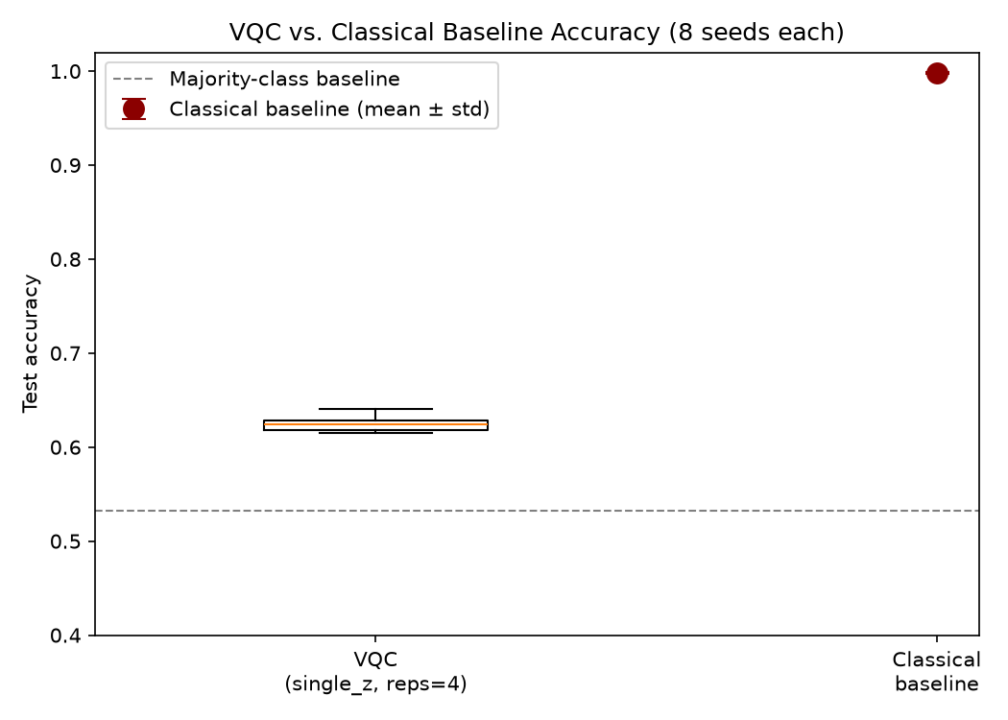
RESULTS · RQ(E): HYBRID VS. CLASSICAL
The VQC reaches 62.46% accuracy against a 99.83% classical ceiling
• 8 seeds each: VQC 62.46% ± 0.85pt; classical 99.83% ± 0.09pt: a 37.4-point gap.
• No overlap between the two seed distributions.
d = 43.7
Paired Cohen's d
p < 0.001
Wilcoxon signed-rank, 8 seeds
Results · RQ(e)
13
Notes:
[~50 sec]
So here's where that ceiling lands. Across eight seeds, the quantum classifier averages 62.46% test accuracy. The classical baseline, on identical data, averages 99.83%. That's a 37-point gap, and it's not close, and there's zero overlap between the two seed distributions. The effect size here is enormous, Cohen's d of 43.7, and it's significant at the smallest p-value you can even get with eight paired seeds. This accuracy gap is the baseline every other comparison in this thesis gets measured against.

Slide 14
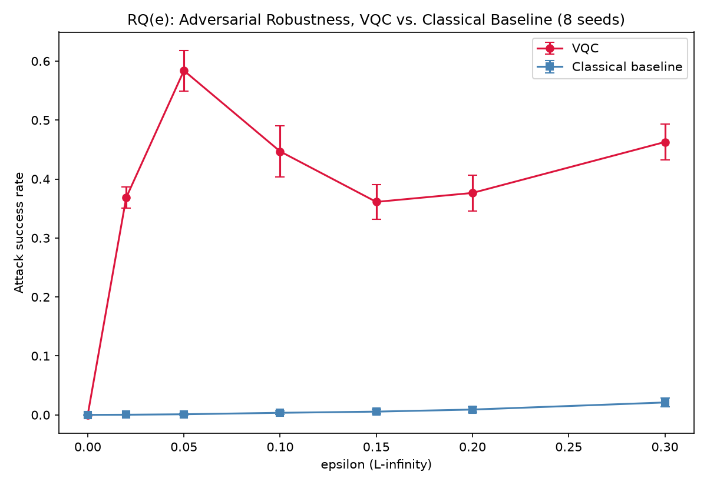
RESULTS · RQ(E): HYBRID VS. CLASSICAL
The classical baseline is also much harder to attack: this is not a tradeoff
• FGSM attack success: 36–58% (VQC) vs. under 3% (classical), across all nonzero ε.
• PGD, the stronger attack: up to 95.7% (VQC) vs. under 1% (classical).
d = −9.9 to −20.3
FGSM, per-ε (FDR-corrected)
d = −10.2 to −25.5
PGD, per-ε
The VQC loses on accuracy and on robustness: two independent disadvantages, not one traded for the other.
Results · RQ(e)
14
Notes:
[~60 sec]
But the research question isn't just about accuracy. It's about robustness. And here the story gets worse for the quantum model, not better. Under FGSM, its attack success rate runs 36 to 58%, while the classical model stays under 3% across every epsilon tested. Under the stronger PGD attack, the quantum model's attack success reaches as high as 95.7%, while the classical model still stays under 1%. The effect sizes here are large in both directions: negative ten to negative twenty for FGSM, negative ten to negative twenty-five for PGD. The important framing here: this is not a tradeoff where the quantum model gives up accuracy to gain robustness. It loses on both axes, independently.

Slide 15
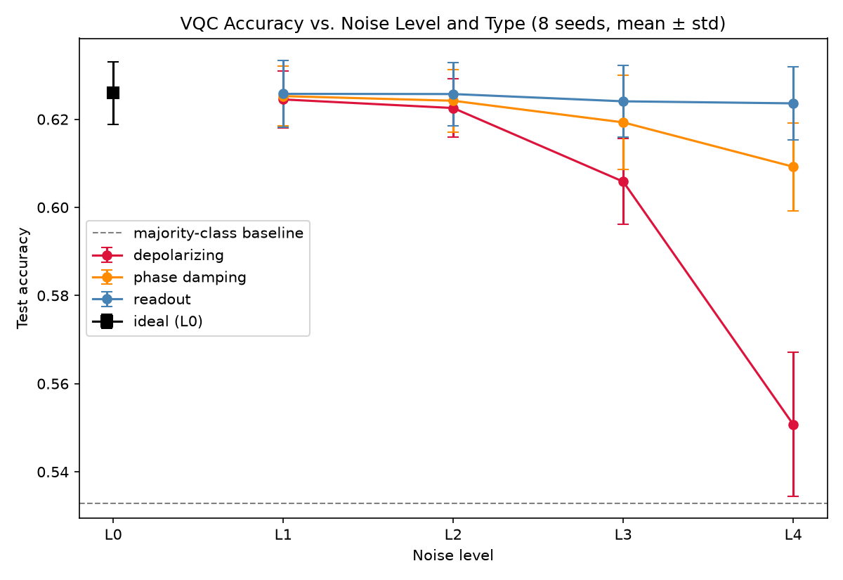
RESULTS · RQ(A): WHICH NOISE TYPE MATTERS MOST
Depolarizing noise dominates; phase damping is moderate; readout barely registers
• At the strongest level (L4): 55.1% (depolarizing) vs. 60.9% (phase damping) vs. 62.4% (readout).
• Depolarizing also disproportionately damages recall (71.3%→49.7% at L4): a systematic shift in the decision function, not shot noise.
d > 2.5, all pairs
All three pairwise comparisons
FDR p < 0.001
All three pairwise comparisons
Results · RQ(a)
15
Notes:
[~55 sec]
Now, which noise type actually matters. At the strongest severity level, depolarizing noise drags accuracy down to about 55%, phase damping to about 61%, and readout barely moves it at all: 62.4%, essentially unchanged from the noiseless baseline. All three pairwise differences are large and statistically significant. And it's not just about accuracy: depolarizing noise specifically wrecks the model's recall, dropping it over twenty points at the worst level, while precision barely moves. That's a systematic shift in how the model makes decisions, not just random noise.

Slide 16
RESULTS · RQ(B) & RQ(C)
Noise intensity tracks accuracy tightly, but not attack success, and accuracy does not predict robustness
RQ(b): NOISE INTENSITY vs. OUTCOME
• Clean accuracy: strong, consistent monotonic decline: Spearman r = −0.95 (depolarizing), −0.84 (phase damping), −0.39 (readout), all significant.
• Attack success (averaged across ε): only weak, borderline significance for depolarizing (r = 0.23, p = 0.041 t-test; p = 0.078 Wilcoxon). No detectable trend for the other two channels.
RQ(c): ACCURACY vs. ROBUSTNESS
• Per-seed Spearman correlation between clean-under-noise accuracy and accuracy-under-attack, across all 14 noise conditions.
r = 0.27
Mean per-seed correlation
p = 0.14
Not significant, n = 8
A genuine null result, not an absence of testing.
Results · RQ(b), RQ(c)
16
Notes:
[~65 sec]
Two related questions here. First, does increasing noise intensity produce a consistent trend? For clean accuracy, yes: a strong, clearly monotonic decline, especially for depolarizing noise. For attack success rate, averaged across all the epsilon values, the trend is much weaker, only borderline significant for depolarizing, and not significant at all for the other two channels. That weak average is actually a clue, and I'll come back to why in a couple of slides. Second question: does a noise condition that preserves clean accuracy also preserve robustness under attack? I tested this directly with a per-seed correlation across all fourteen noise conditions, and the answer is no detectable relationship: r of 0.27, not significant. That's a real, honestly-reported null result, not something I just didn't have the seeds to test properly.

Slide 17
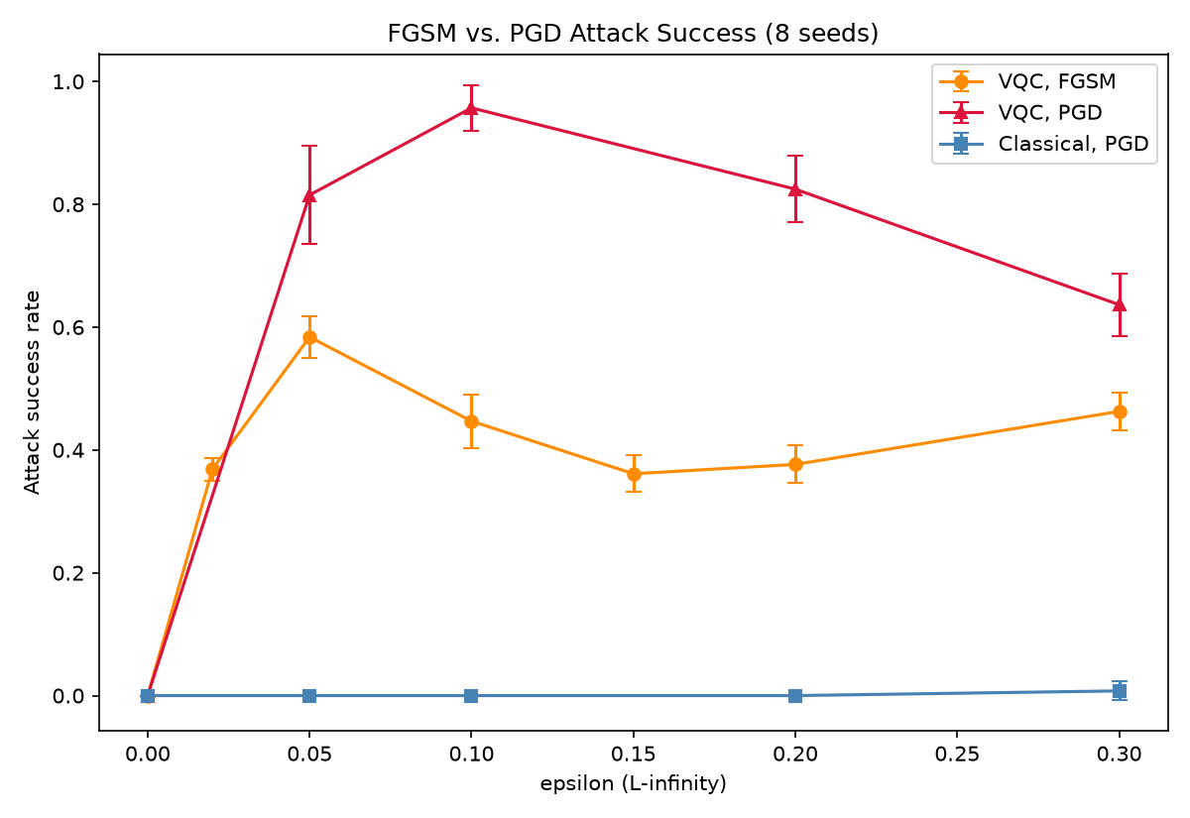
RESULTS · ATTACK METHODOLOGY
FGSM understated the VQC's vulnerability by nearly 40 percentage points
• FGSM: peak attack success 58.4% at ε = 0.05.
• PGD (stronger, iterative): 95.7% at the nearby ε = 0.1.
• The classical baseline stays under 1% attack success under PGD through ε = 0.2.
d = 2.6 to 10.3
FGSM vs. PGD, matched ε, VQC
FDR p = 0.0078
All four matched ε (min. achievable, n=8)
Results · Attack Methodology
17
Notes:
[~65 sec]
This is probably the most important methodological result in the thesis. FGSM's attack success against the quantum model peaks at 58.4%, at epsilon 0.05. If I'd stopped there, I would have reported that this model's worst-case vulnerability tops out around 58%. But when I ran PGD, the stronger, iterative attack, at a nearby epsilon, attack success jumped to 95.7%. That's a nearly 40-point gap between what the weaker attack suggested and what the model is actually vulnerable to. The difference is statistically solid: Cohen's d from 2.6 to over 10, significant at every matched epsilon. Meanwhile the classical baseline barely notices PGD at all. The lesson: reporting adversarial robustness with only a single-step attack can be seriously misleading, and that's a caution for this field generally, not just for this thesis.

Slide 18
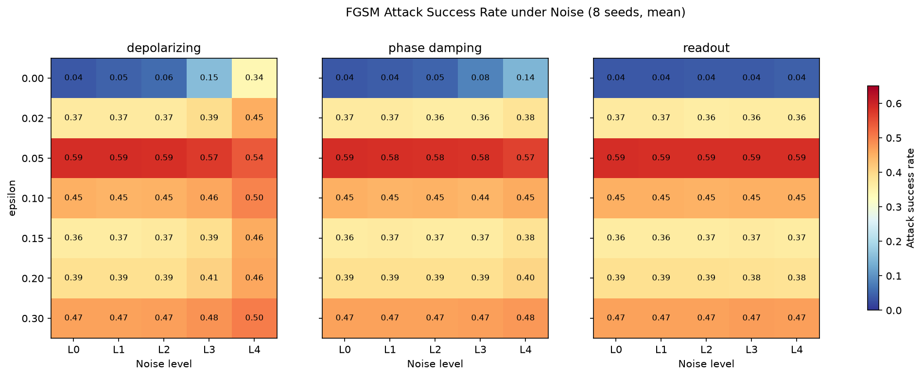
RESULTS · MAIN RESEARCH QUESTION
Depolarizing noise raises attack success, except at the model's single most vulnerable point
• 6 of 7 epsilon rows climb with noise level (e.g. +8.6pt at ε=0.02). Only ε = 0.05, the noiseless model's peak vulnerability, falls by 4.8pt (58.8%→54.0%).
Results · Main RQ
18
Notes:
[~75 sec]
This is the central finding of the whole thesis. I composed noise and attack together. I took the FGSM examples and ran them through the model under each of the fourteen noise conditions. Look at the heatmap. In the depolarizing panel, six of the seven epsilon rows get worse, meaning attack success goes up, as noise increases. But one row does the opposite: at epsilon 0.05, which is exactly where the noiseless model was already most vulnerable, more depolarizing noise actually suppresses the attack, dropping success from 58.8% down to 54%. So noise isn't uniformly good or bad for robustness here; it depends on how hard the attacker is pushing. This connects directly to the closest related paper, published in Entropy in 2026, which found a similar dual effect but across different datasets at one fixed model. What I'm finding is the same duality, but within a single model, as a function of attack strength instead.

Slide 19
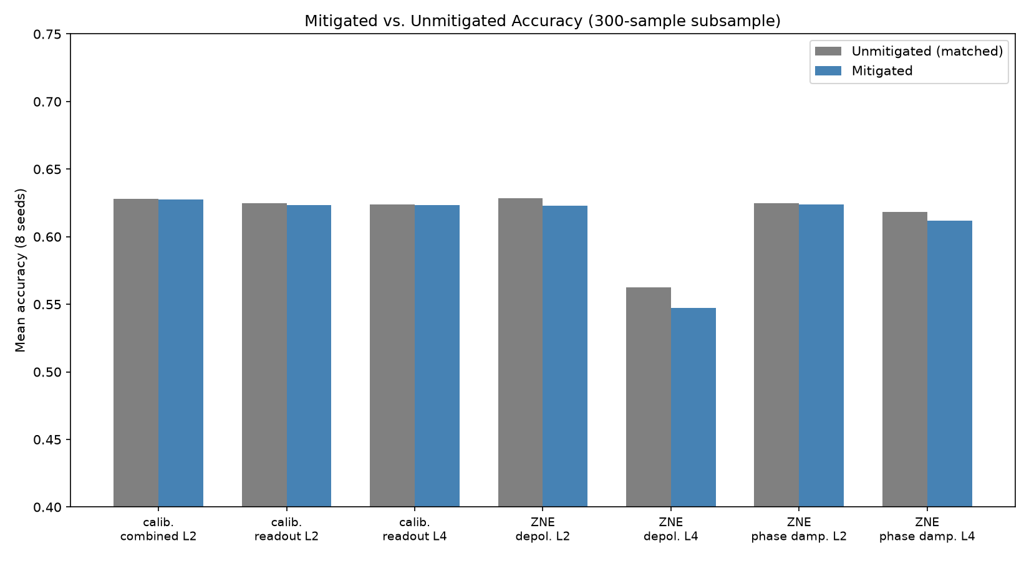
RESULTS · RQ(D): DOES MITIGATION HELP
Neither mitigation technique improved robustness, in any of 7 tested conditions
• Readout calibration: 3 conditions tested. Zero-noise extrapolation: 4 conditions tested. Point estimates are small and, if anything, slightly negative.
• Two plausible mechanisms: readout calibration has almost nothing to correct (readout barely affects accuracy); linear ZNE likely mismatches depolarizing noise's near-exponential decay.
FDR p ≥ 0.73
All 7 conditions
Results · RQ(d)
19
Notes:
[~60 sec]
I tested two standard mitigation techniques, readout calibration and zero-noise extrapolation, against seven different noise conditions. In every single one, the improvement was not statistically significant: all the corrected p-values are at least 0.73, nowhere close to significant. If anything, the point estimates trend slightly negative. I have two candidate explanations. Readout calibration doesn't have much to fix in the first place, since readout barely touches this model's accuracy to begin with. And linear zero-noise extrapolation likely doesn't match how depolarizing noise actually decays, which behaves closer to exponential than linear at these levels. Both techniques were validated correct in isolation before I used them, so this is a real null result, not a broken implementation.

Slide 20
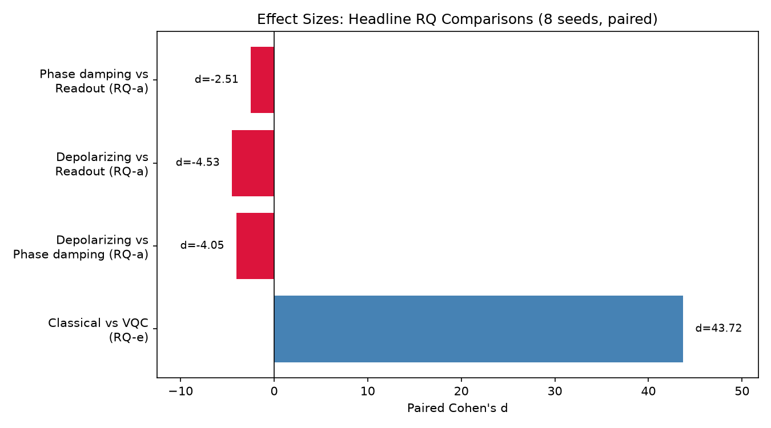
DISCUSSION
Two findings shape how this result should be read
• 1. Noise's effect on attack success depends on attack strength. The closest prior work (Entropy, 2026) found depolarizing noise's effect on attack success to be non-monotonic across four datasets, at a fixed model. This thesis finds the same duality within one model and dataset, as a function of ε instead.
• 2. Clean accuracy and robustness under noise are partially independent. RQ(c)'s null result (r = 0.27, n.s.) means a noise condition that looks harmless on an accuracy dashboard can still be meaningfully changing how easy the model is to attack, or the reverse.
Discussion
20
Notes:
[~75 sec]
Two findings really shape how I think this thesis should be read. First, the epsilon-dependent dual effect of depolarizing noise. This sharpens what the Entropy 2026 paper found across datasets into something more specific: within one model, the same noise channel can either help or hurt robustness, depending entirely on how strong the attack is. That's a less comfortable conclusion for anyone hoping to treat NISQ noise as a free, general-purpose defense. Second, the null correlation between clean accuracy and robustness under noise. Practically, that means you can't just watch an accuracy dashboard and assume it tells you anything about adversarial exposure. A noise condition can look almost harmless on accuracy while still changing how easy the model is to attack, or the reverse. Both findings push toward the same conclusion: robustness needs to be measured directly, not inferred from other numbers.

Slide 21
LIMITATIONS
What this scope does not cover
• Single dataset, 4 qubits: binary MNIST reduced to 4 PCA features. Results are conditional on this circuit family, encoding, and task difficulty.
• Simulated, not physical, noise: all conditions ran through Qiskit Aer at illustrative, order-of-magnitude severity levels, not a named hardware backend.
• Subsampled evaluation for the more expensive sweeps: 500 points (FGSM, noise×attack), 300 (mitigation), 50 (PGD), versus the full 2,956-point test set used for the noise-only sweep.
• No adaptive noise-aware attacker: adversarial examples were generated against the clean model and transferred to noisy conditions. Whether an attacker that knew the noise level in advance could recover the “lost” attack success at ε = 0.05 is untested: the single most consequential open question this thesis leaves.
• 8 seeds: sufficient for a valid paired Wilcoxon test, but limited power for small effects, most relevant to RQ(c)'s null result.
Limitations
21
Notes:
[~60 sec]
I want to be direct about what this thesis doesn't cover. It's a single dataset, a four-qubit circuit, a deliberately easy binary task, and results are conditional on that scope. All the noise is simulated through Qiskit Aer, not measured on real hardware. Several of the more expensive sweeps ran on subsamples rather than the full test set, for compute-budget reasons. And probably the most consequential limitation: the adversarial examples were generated against the clean model and transferred to noisy conditions. I did not build an attacker that adapts to a known noise level. Whether that dual-effect suppression at epsilon 0.05 would survive against a smarter, noise-aware attacker is genuinely an open question. And with eight seeds, I have enough power for the paired tests I ran, but not enough to rule out small effects, which mostly affects how much weight to put on the RQ(c) null result.

Slide 22
CONCLUSION
Noise's effect on robustness is conditional, not a single verdict
• Depolarizing noise dominates the other two channels, and its effect on attack success flips sign specifically at the model's most vulnerable epsilon.
• Clean accuracy and robustness under noise behave as partially independent properties, not one tracking the other.
• Neither tested mitigation technique recovered any of the lost robustness.
• The hybrid model has a double disadvantage against a matched classical baseline at this scale, not a tradeoff.
FUTURE WORK
• Test an adaptive, noise-aware attacker against the ε = 0.05 suppression effect.
• Validate on physical NISQ hardware; test a deeper or data-reuploading VQC to separate architecture effects from under-training.
Conclusion & Future Work
22
Notes:
[~60 sec]
So, to close. NISQ noise's effect on adversarial robustness is not one thing; it depends on which noise channel you're looking at, and for the dominant channel, depolarizing noise, it even depends on how strong the attack is. Clean accuracy and robustness under noise behave as separate properties, not one predicting the other. The mitigation techniques I tested didn't recover any robustness. And the hybrid quantum-classical model loses to a matched classical baseline on both accuracy and robustness, not a tradeoff but a double disadvantage, at least at this scale. For future work, the most valuable next step is testing an adaptive, noise-aware attacker against that epsilon 0.05 effect. Beyond that: validating on real hardware, and testing a deeper or data-reuploading circuit to see whether closing the accuracy gap also closes the robustness gap.

Slide 23
Thank you
Questions?
Notes:
[~10 sec]
Thank you. I'm happy to take questions.

Slide 24
Backup Slides
Not part of the timed talk: held in reserve for questions.
Notes:
Divider slide. Skip past this during the timed talk; jump here only if a question calls for one of the slides behind it.

Slide 25
BACKUP · ANTICIPATED QUESTION: WHY NOT...
Three alternative designs considered, and why each was set aside
• An adaptive, noise-aware attacker (differentiating through the noisy, shot-based forward pass directly, instead of transferring a fixed attack) would answer a related but different question. It requires differentiating through a stochastic simulation: a substantially larger undertaking than the parameter-shift differentiation used here, and out of scope for this timeline.
• Real quantum hardware instead of Qiskit Aer simulation would strengthen external validity, but queue time and cost make an 8-seed × multi-noise-level × multi-epsilon grid unrealistic within the time available.
• Amplitude encoding instead of the angle-style ZZFeatureMap was considered, since the SoK literature found encoding choice changes the accuracy/robustness tradeoff substantially. Angle encoding was kept because it matches the qubit-efficient design in the approved proposal, and because amplitude encoding's noise sensitivity would confound the noise-channel comparison (RQ a) with an encoding effect this thesis isn't trying to measure.
Backup
25
Notes:
[Use only if asked]
Three things I considered and deliberately didn't do. An adaptive attacker that knows the noise level in advance. That's a real follow-up question, but differentiating through a stochastic, shot-based simulation is a much bigger undertaking than what parameter-shift gives me for free, and it didn't fit this timeline. Real hardware instead of simulation would be great for external validity, but an eight-seed, multi-level, multi-epsilon grid on real queue time and cost just isn't realistic right now. And amplitude encoding instead of angle encoding. I kept angle encoding because switching would have confounded the noise-channel comparison with an encoding effect I'm not trying to measure here; that's a separate study.

Slide 26
BACKUP · ANTICIPATED QUESTION: RIGOR & REPRODUCIBILITY
Two bugs caught and fixed during development
• An early classical baseline was trained on the wrong task: the full 10-class, raw-pixel MNIST problem instead of the binary, 4-PCA-feature task, and reached just 12% accuracy. Caught before it was used for any comparison, fully replaced by the matched baseline in Section 3.3, and archived rather than silently deleted.
• A weight-initialization bug in TorchConnector: the framework drew initial ansatz weights from PyTorch's global RNG, not from the seed passed to the model, so two “same-seed” model instances actually started from different initial weights. Fixed by drawing weights from a local, seed-scoped NumPy generator; a regression test now confirms two same-seed instantiations produce bit-identical output.
Both are logged in the project's archive and git history rather than quietly corrected: the multi-seed statistics in this thesis only mean something if seed-to-seed variance is real training stochasticity, not accidental non-determinism.
Backup
26
Notes:
[Use only if asked]
Two concrete bugs, for anyone asking how much I trust my own pipeline. First, an early classical baseline was accidentally trained on the wrong task entirely, full ten-class MNIST instead of the binary task, and got 12% accuracy. I caught it before it touched any real comparison and rebuilt it properly. Second, and more subtle: the library I used to bridge Qiskit and PyTorch was drawing initial weights from PyTorch's global random state instead of the seed I was passing in, which meant two runs with the 'same seed' weren't actually starting from the same place. I fixed that by seeding the weight initialization directly, and I have a regression test that confirms two same-seed runs now produce identical results. That matters because the entire eight-seed statistical design depends on seed-to-seed variance being real.

