Slide 1
Decoding the
2026 TN Elections
TAMIL
NADU
A 3-Question Data Story
ASSEMBLY
ELECTIONS
Q1
Q2
Q6
🗺
🔄
📊
234
Seats
Geographic
Story
The Flip
Story
Margin of
Victory
Who dominated which region?
Which 47 seats changed hands?
Dominant wins or knife-edge?
Source: Power BI Dashboard · TN_report.pbix | RPC Assignment

Slide 2
Q1 · THE GEOGRAPHIC STORY — Meet the 6 Regions
Tamil Nadu's 234 constituencies are grouped into 6 distinct regions — each with its own political character and alliance strongholds.
25 seats
Chennai Metro
48 seats
North TN
Urban, high DMK cadre density
Competitive — highest flip rate 2026
38 seats
Central TN
45 seats
Kongu (West)
DMK incumbency + welfare converts
AIADMK-BJP-TVK three-way contest
39 seats
Delta
39 seats
South TN
Agricultural belt, margin-thin races
AIADMK pockets, caste-driven voting

Slide 3
Q1 · GEOGRAPHIC STORY — DMK Alliance Seats by Region: 2021 vs 2026
🔴 North TN
+6 seats — highest gain any region
🟡 Central TN
+3 seats — welfare scheme effect
🔵 Kongu (West)
+2 seats — TVK split AIADMK vote
🟢 South TN
–2 seats — AIADMK held pockets
Key takeaway: North TN was the decisive battleground — 6 new DMK seats came from AIADMK territory here.

Slide 4
Q1 · THE OTHER SIDE — AIADMK's Regional Retreat
North TN
-6 seats
Worst loss — urban belt gone
Central TN
-3 seats
Welfare schemes eroded base
South TN
-2 seats
Partial hold — best retention
Post-BJP split, AIADMK lost 15 seats net. North TN (-6) was the critical wound — these are seats the alliance will need to rebuild for 2031.

Slide 5
Q2
THE FLIP STORY
47 constituencies changed hands between 2021 and 2026.
The Sankey on the next slide shows exactly where those seats went — and the pattern reveals something bigger than just numbers.
30
17
142
35
AIADMK→DMK
DMK→Others
DMK retained
AIADMK retained

Slide 6
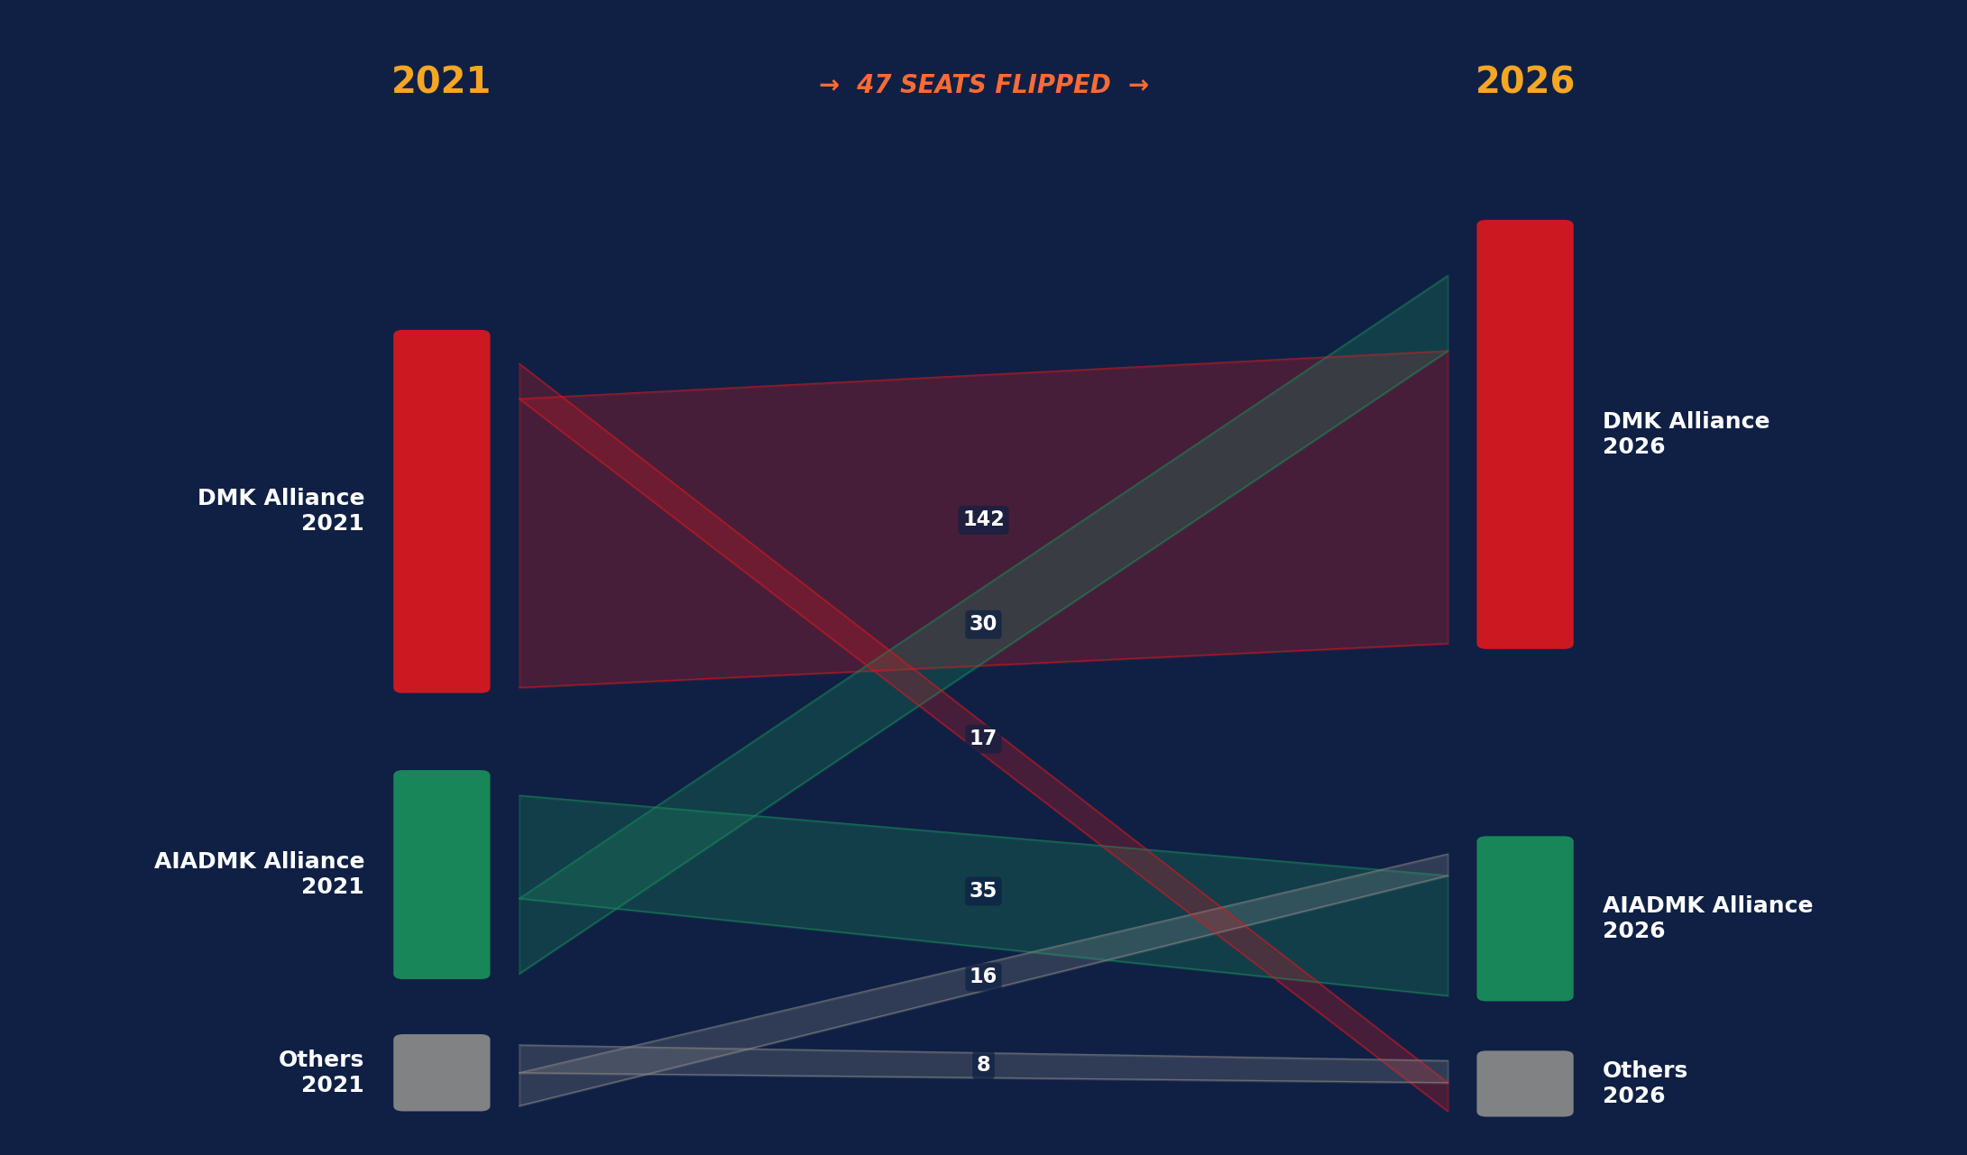
Q2 · SANKEY FLOW — Where Did Each Party's 2021 Seats Go in 2026?
DMK held 142
89% seat retention — incumbency at its strongest
30 AIADMK→DMK
The decisive flip — mostly North TN & urban belts
17 DMK→Others
TVK & regional parties gained from DMK's outer fringe
35 AIADMK retained
Core south & Kongu pockets — still reliable green belt

Slide 7
Q2 · FLIP STORY — Which Regions Had the Most Seat Changes?
Key Findings
→ North TN = 17 flips total (36% of all flip activity)
→ Kongu West saw equal bi-directional flips — 3-way TVK contest is new variable
→ South TN had fewest flips — most stable region in 2026
→ 0 constituencies flipped from DMK→AIADMK (net flow was one-directional)
→ The Sankey confirms: flips were asymmetric — AIADMK bled seats, didn't gain any

Slide 8
Q6
MARGIN OF
VICTORY
A majority of seats doesn't tell you HOW those seats were won.
The margin data reveals two very different Tamil Nadus — constituencies with overwhelming mandates, and seats hanging by threads.
+3.2%
38
30
Avg margin change
2021 → 2026
Won with
>50% vote share
Won with
<35% vote share

Slide 9
Q6 · MARGIN STORY — Vote Share Distribution: Winners 2026
How did winners win? (2026)
Average Margin Change by Region (2021 vs 2026)

Slide 10
Q6 · THE INSIGHT — Two Tamil Nadus
💪
⚡
Tamil Nadu #1
Dominant Mandate
Tamil Nadu #2
Knife-Edge Results
38 seats (16% of assembly)
30 seats (13% of assembly)
▸ Winner took >50% of valid votes
▸ Winner took <35% — 65%+ voted against
▸ Concentrated in Chennai Metro, Central TN
▸ Multi-cornered contests with TVK splitting votes
▸ Strong DMK cadre + welfare scheme reach
▸ Mostly Kongu & Delta constituencies
▸ Average margin: 20–25%
▸ Average margin: 3–8%
▸ These seats signal deep structural trust
▸ Seats that could easily flip again in 2031

Slide 11
THE CONNECTED STORY — How Q1, Q2 & Q6 Tell One Narrative
These three questions are not separate analyses — they're one story told in sequence:
Q1
Q2
Q6
Set the scene
Show the drama
Add the depth
North TN & Central TN were DMK's key battlegrounds — regional dominance was the foundation.
→
→
47 flips — 30 from AIADMK — happened exactly in those battleground regions. The Sankey proves the direction.
Many of those flipped seats were won narrowly (<35%). The mandate is real, but fragile in 30 constituencies.
Bottom line: DMK's regional strength (Q1) enabled the seat flips (Q2) — but the margins (Q6) reveal governance pressure points for the 2026–2031 term.

Slide 12
RPC
Assignment
Three questions.
One coherent story.
Tamil Nadu 2026
Elections
The geographic story set the battlefield (Q1).
The flip story revealed who won it (Q2).
The margin data shows how durably they hold it (Q6).
Q1 + Q2 + Q6
Data source: TN_report.pbix (Power BI)
Visualisation built with PptxGenJS

