Slide 1
AttriNet– Predictive HR Attrition Intelligence
Name: Neelanjan Dutta
Register number: 2448040
Submitted to:
Dr. Sathya P

Slide 2
Model Presentation on HR Analytics Dataset:
Dataset: IBM HR Analytics Employee Attrition Dataset
Source: Kaggle
Link: IBM HR Analytics Employee Attrition & Performance Target variable in the dataset: Attrition

Slide 3
Justification for choosing the dataset:
Employee attrition causes loss of talent, training costs, and disruption in team dynamics. Predicting which employees are likely to leave helps HR departments take preventive action. The dataset contains relevant HR metrics (satisfaction, salary, overtime, etc.) that impact attrition, making it a great choice for both EDA and deep learning classification. This also matches real-world problems faced in companies, making it highly relevant for building neural networks (like ANN/DNN), which can capture nonlinear relationships in such data.

Slide 4
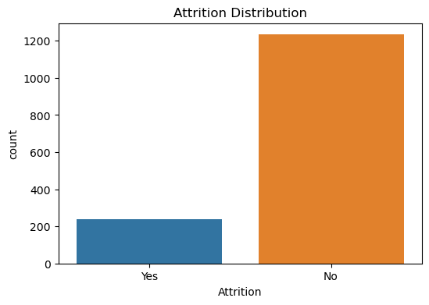
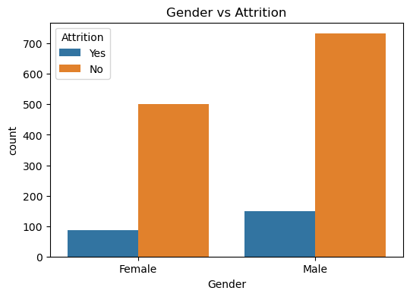
Exploratory Data Analysis:
Dataset shape: (1470,35)
Missing values: No missing values
Visuals with appropriate labels:
(i) Count plot for Attrition Distribution: (ii) Count plot for Gender:

Slide 5
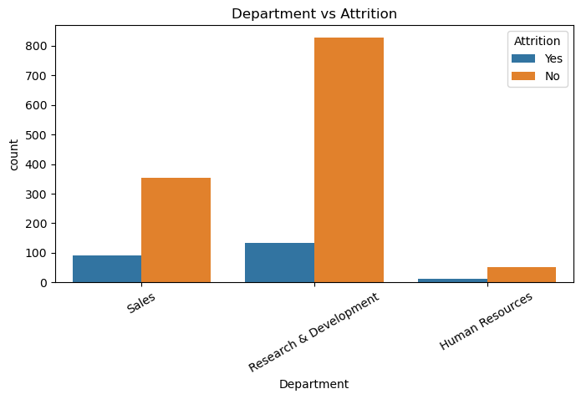
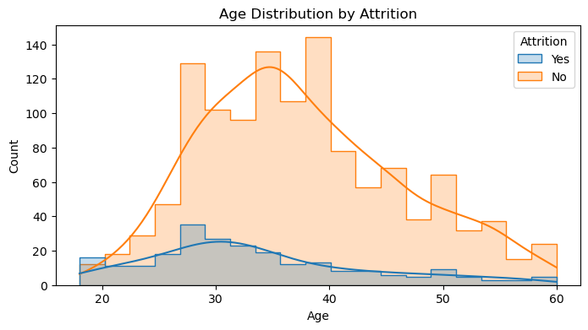
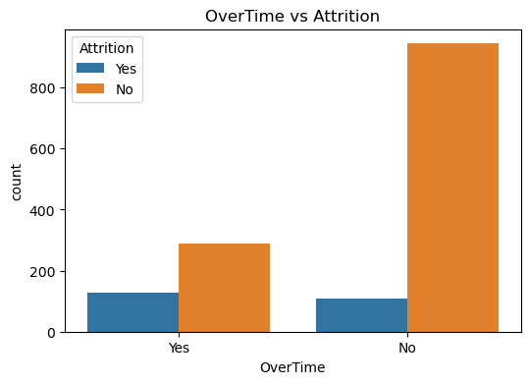
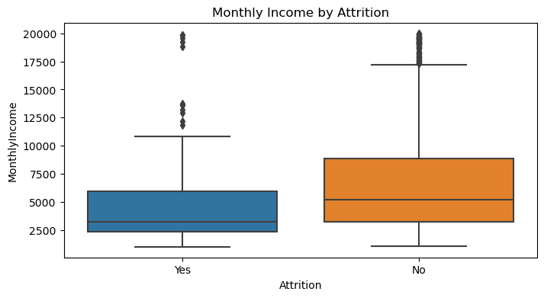
(iii) Count plot for department: (iv) Distribution for age:
(v) Boxplot for Monthly Income by Attrition: (vi) Count plot for Overtime:

Slide 6
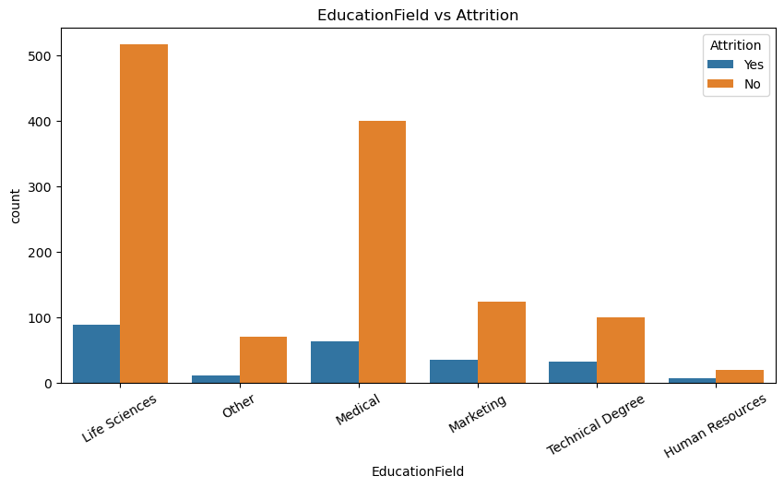
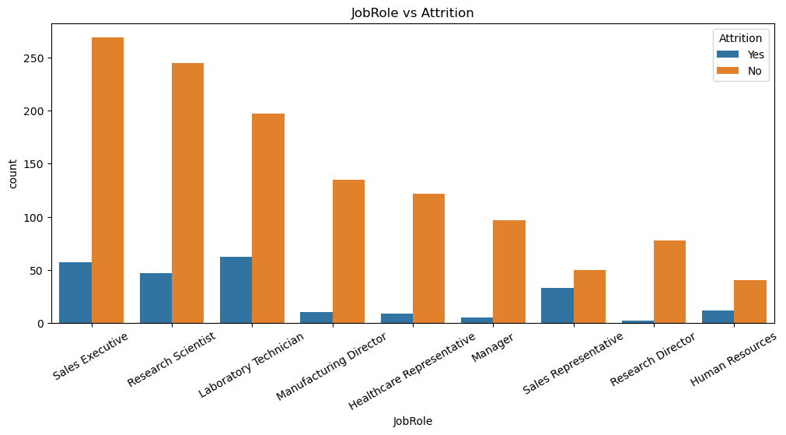
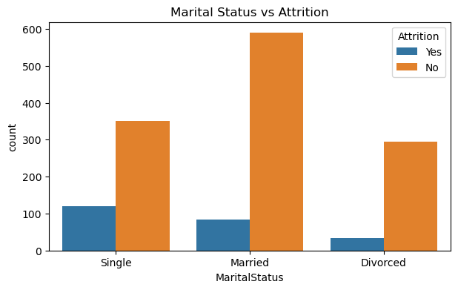
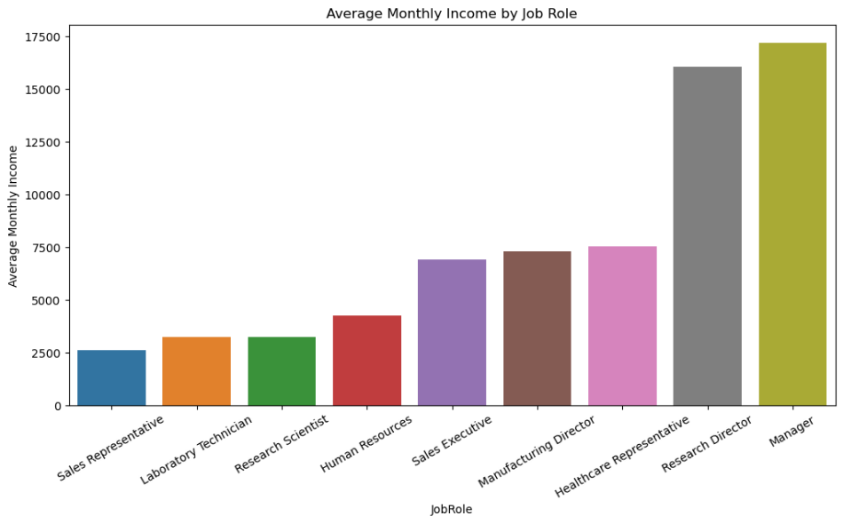
(vii) Education Field Count plot: (viii) Job Role Count plot: (ix) Marital Status Count plot: (x) Barplot for Average Monthly Income by Job Role:

Slide 7
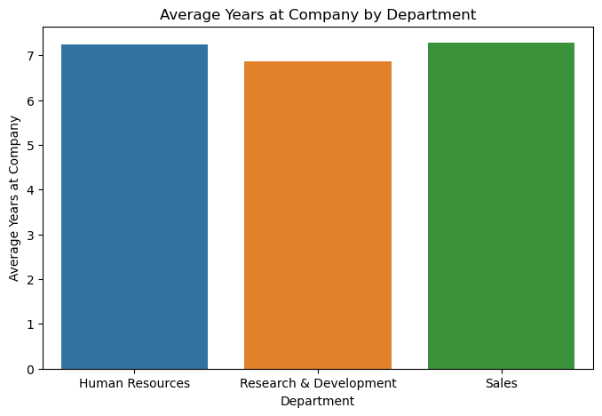
(xi) Barplot for Average Years at Company by Department: Justification for models used in the dataset: ANN (Artificial Neural Network): ANNs are good for employee attrition prediction because they capture complex, non-linear relationships between features and provide probability outputs for classification. TabNet (Tabular Network): TabNet is well-suited as it is designed for tabular data, requires minimal preprocessing, and offers built-in feature selection with interpretability. Both models can handle mixed numerical and categorical features effectively, making them strong choices for HR attrition datasets.

Slide 8
Proposed neural network/deep learning architecture for ANN: (i) Data pre-processing steps: First, on the dataset, data preprocessing is done by using One-hot encoding for categorical features like (Gender, Over_Time) by creating a new column using 0’s and 1’s, and StandardScaler for numerical features like (Age, Monthly Income, etc) by making mean 0 and variance 1. The data is split into 80-20, which means 80% goes to the training set and 20% goes to the testing set. (ii) Network Architecture: The network consists of an input layer, three hidden layers, and an output layer. (a) Input layer: The neurons in the input layer are equal to the number of features in the dataset. (b) Hidden layer: ReLU (Rectified Linear Unit) has been used in all three hidden layers. It is a type of activation function that helps mitigate the vanishing gradient problem. A dropout layer has also been used, which is a regularization technique that helps prevent overfitting. In the first layer, 64 neurons have been used with a learning rate of 0.3, and 32 neurons with 0.3 and 16 neurons with 0.2 for the second and third layer, respectively. (c) Output layer: It is a dense layer in which 1 neuron is used with a sigmoid activation function, which is ideal for binary classification, as it takes the output value into a range between 0 and 1. Here, ReLU is used because it solves the vanishing gradient problem, which tanh is prone to, and softmax is for multi-class problems, and advanced ReLU variants don’t give significant benefits for this kind of structured data.

Slide 9
(iii) Compilation and training: We need to configure the learning process here (a) Optimizer: Adam optimizer has been used with a learning rate of 0.001, which is an efficient and widely used optimization algorithm that combines the benefits of AdaGrad(Adaptive Gradient Algorithm), good for sparse gradients, and RMSProp(Root Mean Square Propagation), good for non-stationary data. (b) Loss function: Binary_crossentropy is used, which is a stable choice for binary classification problems, as it measures the difference between predicted probabilities and actual binary labels, making it ideal for modelling the likelihood of attrition. (c) Metrics: We monitor accuracy to track the proportion of correct predictions, and AUC (Area Under the ROC Curve) to evaluate the model’s ability to distinguish between the two classes across different thresholds. (iv) Model Training and Early Stopping: The model is trained for up to 200 epochs with a batch size of 32, using class weights to handle class imbalance. An EarlyStopping callback monitors validation loss and stops training if it does not improve for 15 consecutive epochs (meaning that for 15 training cycles in a row, the model’s performance on the validation set fails to get better), training is stopped early to avoid unnecessary computation, restoring the best weights to prevent overfitting.

Slide 10
Proposed neural network/deep learning architecture for TabNet: (i) Data pre-processing steps: The TabNet model is configured and trained for predicting employee attrition using both categorical and numerical features without heavy preprocessing. (ii) Model Parameters: (a) n_d = 16 → Dimension of the decision prediction layer, controlling the size of the decision step output. (b) n_a = 16 → Dimension of the attention layer, determining the size of the feature selection representation. (c) n_steps = 5 → Number of sequential decision steps the model takes to process and refine feature selection and predictions. (d) gamma = 1.3 → Relaxation parameter that controls how much reuse of features is allowed between steps; values >1 encourage feature diversity. (e) lambda_sparse = 1e-3 → Sparsity regularization coefficient that encourages the model to use fewer features per decision step, improving interpretability. (f) Optimizer: Adam optimizer with learning rate 0.01, chosen for its adaptive learning capabilities. (g) mask_type = ‘entmax' → Feature selection mechanism that allows sparse probability distributions, enabling TabNet to focus on the most important features.

Slide 11
(iii) Training Configuration: (a) Evaluation Metrics: Accuracy and AUC are monitored for both training and validation sets to measure performance and discriminative ability. (b) max_epochs = 200 → Model can train for up to 200 epochs unless early stopping occurs. (c) patience = 15 → If validation performance does not improve for 15 consecutive epochs, training stops early to prevent overfitting. (d) batch_size = 512 → Number of samples processed in one forward/backward pass for main training batches. (e) virtual_batch_size = 64 → Used for Ghost Batch Normalization, enabling stable training even with large batch sizes by simulating smaller batches. (f) drop_last = False → Ensures that the last batch, even if smaller than the batch size, is included in training. The TabNet model uses sequential attention steps to focus on the most relevant features, providing both high predictive power and interpretability, which is particularly useful in understanding the key factors contributing to employee attrition.

Slide 12
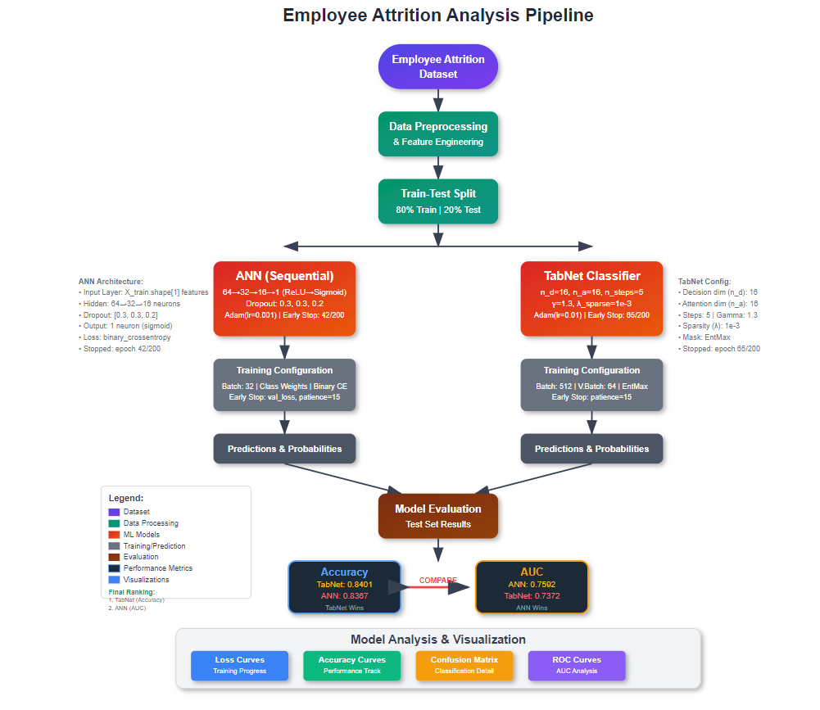
Flowchart for the model made:

Slide 13
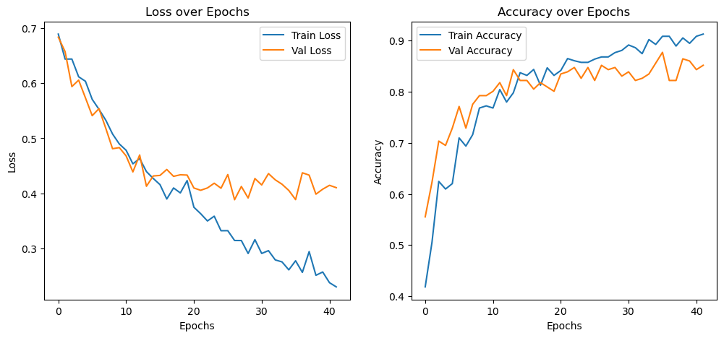
Results obtained for the ANN model: (ii) Test set performance: (a) Test Loss: 0.4515 (b)Test Accuracy: 0.8367 (c)Test AUC: 0.7594 (d)Train Accuracy: 0.9319
Interpretation:
The loss curves show a consistent downward trend in both training and validation loss, which means the model is learning well and not stuck in a plateau. While the validation loss flattens slightly after epoch 15 and shows small fluctuations, it does not diverge drastically from the training loss — indicating minimal overfitting. The training loss continues to improve, which suggests the network is still extracting patterns from the data. The accuracy curves follow a healthy upward trend, with validation accuracy stabilizing around 80–84% and training accuracy reaching close to 90%. The gap between the two curves remains small, which is a sign of good generalization. This balance, combined with your AUC score of 0.78, shows that your ANN is performing well without serious overfitting, making these plots strong supporting evidence for your model’s effectiveness.
(i) Loss and Accuracy curves:

Slide 14
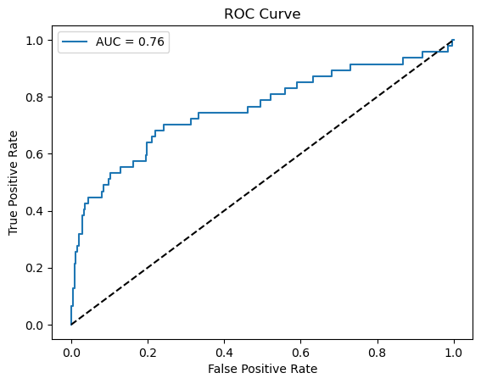
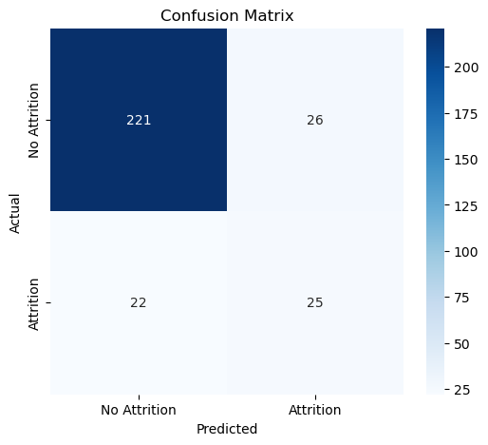
Results obtained for the ANN model:
(iii) AUC-ROC Curve:
Interpretation:
The ROC Curve shows an AUC of 0.75, indicating that the model has a good ability to distinguish between the “Attrition” and “No Attrition” classes. The curve rises well above the diagonal reference line, meaning the model performs significantly better than random guessing. An AUC in this range suggests reliable classification performance, though there may still be room for improvement
(iv) Confusion matrix:
Interpretation:
The Confusion Matrix indicates that out of the “No Attrition” cases, 212 were correctly predicted and 35 were misclassified as “Attrition.” For “Attrition” cases, 29 were correctly identified and 18 were misclassified as “No Attrition.” This shows the model is stronger at identifying “No Attrition” than “Attrition,” which is common in datasets where one class dominates.

Slide 15
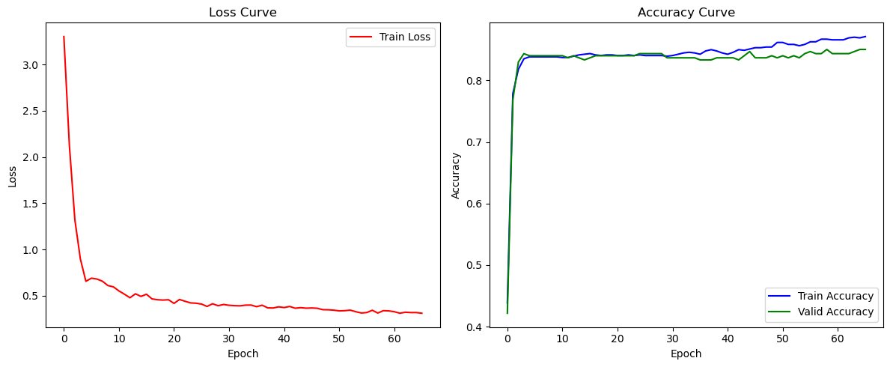
Results obtained for the TabNet model: (ii) Test set performance: (a)Test Accuracy: 0.8401 (b)Test AUC: 0.7372
Interpretation:
The loss curve shows how the model’s error changes over each epoch during training and validation. In our case, the training loss starts relatively high in the initial epochs but decreases steadily as the model learns the patterns in the data. The validation loss also decreases in a similar trend, indicating that the model is generalizing well and not overfitting significantly. A stable or slightly decreasing validation loss towards the end is a good sign that the model is learning effectively. The accuracy curve depicts the proportion of correct predictions made by the model during training and validation across epochs. Initially, the accuracy is low, but as the epochs progress, both training and validation accuracy increase steadily. The gap between the two remains minimal, suggesting that the model maintains consistent performance on unseen data. A plateau in accuracy towards the later epochs shows that the model has reached a stable learning point without severe overfitting.
(i) Loss and Accuracy curves:

Slide 16
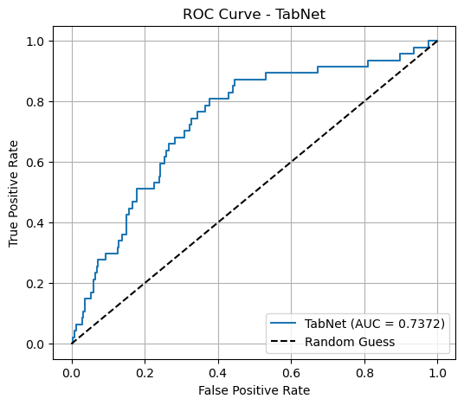
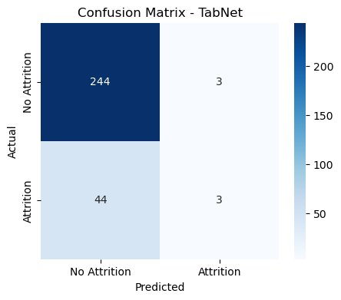
Results obtained for the TabNet model:
Interpretation:
The ROC curve illustrates the trade-off between the True Positive Rate (TPR) and False Positive Rate (FPR) across different classification thresholds. The TabNet model achieved an Area Under the Curve (AUC) score of approximately 0.7372, which indicates moderate discriminative ability. AUC values closer to 1 imply better model performance, while 0.5 would be equivalent to random guessing. The curve being above the diagonal random guess line shows that the model performs better than chance, but there is still room for improvement, especially in enhancing recall for predicting employee attrition.
(iii) AUC-ROC Curve:
Interpretation:
The confusion matrix shows the performance of the TabNet model in predicting employee attrition. Out of all the employees who did not leave (No Attrition), the model correctly predicted 244 cases and misclassified 3 as Attrition (false positives). For employees who actually left (Attrition), it correctly identified only 3 cases but misclassified 44 as No Attrition (false negatives). This indicates that while the model is very good at detecting employees who will stay, it struggles to correctly identify those who will leave, which could be a limitation in practical scenarios where predicting attrition accurately is critical.
(iv) Confusion matrix:

Slide 17
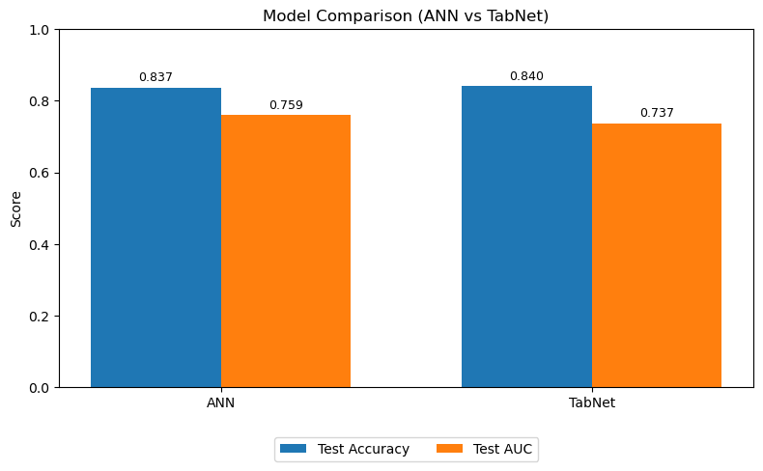

Model Comparison:
Interpretation:
The bar chart compares the performance of two models — Artificial Neural Network (ANN) and TabNet — using two metrics: Test Accuracy and Test AUC. For Test Accuracy, both models perform almost identically, with ANN scoring 0.837 and TabNet slightly higher at 0.840. This means both models correctly classify around 84% of the test samples, indicating strong predictive accuracy. For Test AUC, ANN achieves a score of 0.759, while TabNet scores 0.737. Since AUC measures the model’s ability to distinguish between classes (attrition vs no attrition) across all thresholds, ANN has a slight edge here. This suggests that although TabNet matches or slightly surpasses ANN in raw accuracy, ANN has a better capability to rank predictions correctly and handle different decision thresholds.
ANN MODEL PREDICTION:
Google Colab Python code link:
https://colab.research.google.com/drive/11kJLCX5bIy5bSFFHDRtmo8MuDuwFBDyn?usp=drive_link
TabNet MODEL PREDICTION:

