Slide 1
MACHINE LEARNING
PROJECT WORK

Slide 2
TABLE OF CONTENT
Id | Table of Content | Location
1 | Data Files | E-Learning
2 | Project files and python notebook | GitHub Repository
3 | Detailed Project Report | GitHub Repository
4 | Detailed Documentation with Readme file | GitHub Repository
5 | Other Files: Embeddings, Images | GitHub Repository
6 | Dataset description | Page 4
7 | Embedding Models | Page 6
8 | Accuracy Comparison | Page 7
9 | Precision Comparison | Page 9
10 | Recall Comparison | Page 11
11 | F1 Score Comparison | Page 13
12 | Conclusion | Page 15

Slide 3
PROJECT FILES, REPORT AND DOCUMENTATION
GITHUB LINK: https://github.com/Neelansh01/ML-Project-Work
In the project repository:
Project files with classes implemented for all the Classifier and Pretrained models.
Project Report.
Documentation (steps/sequence to go through the project files and notebooks and the result files).
Dataset Analysis.
Visualizations.
Complete comparison of different classifiers across various derived embeddings.
Critical Findings.
Conclusions

Slide 4
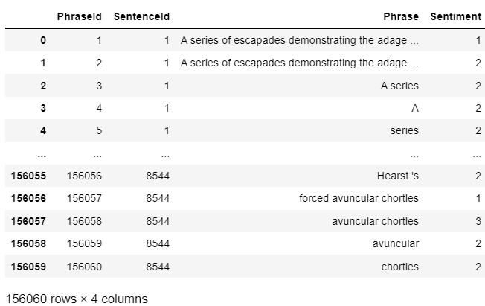
DATASET INTRODUCTION
Features: {PhraseId, SentenceId, Phrase, Sentiment}
Rows: 156060
Columns: 4
Rows utilized: 10000
(for the sake of enabling computation for all the
models like GBDT which take a lot of time.)
Output Classes: 5

Slide 5
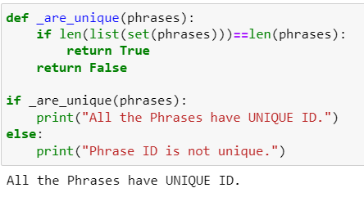
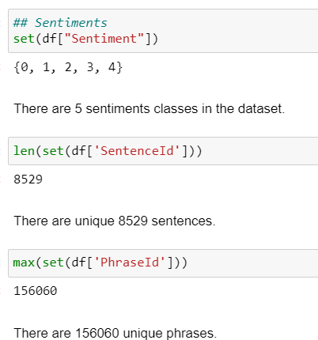
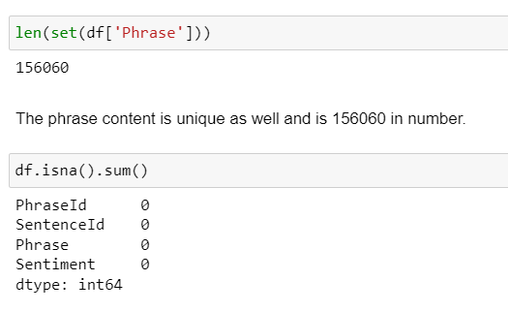
DATASET INTRODUCTION

Slide 6
EMBEDDING MODELS
Embedding models are used to convert the phrases to corresponding mathematical representation.
The pretrained models which find the embeddings use different algorithms/structure of Neural Network to map input text to the output embeddings.
The models used in this project are:
BERT: https://huggingface.co/sentence-transformers/bert-base-nli-mean-tokens
SBERT: https://huggingface.co/sentence-transformers/all-MiniLM-L6-v2
MPNET: https://huggingface.co/sentence-transformers/all-mpnet-base-v2
We will be comparing these 3 models over randomly shuffled data of similar type over same sample size across these three models.

Slide 7
ACCURACY COMPARISON
ALGORITHM | BERT (100%) | SBERT (100%) | MPNET (100%) | AVERAGE (100%) | RANKING
SVC (Support Vector Classifier) | 70.2 | 68.7 | 69.9 | 69.6 | 1
ANN (Multi Layer Perceptron) | 69.1 | 67.5 | 69.1 | 68.5 | 2
Logistic Regression | 68.2 | 65.6 | 68.4 | 67.4 | 3
KNN (K Nearest Neighbour) | 68.6 | 65.5 | 67 | 67 | 4
Gradient Boosted Decision Tree | 68.5 | 65 | 66.1 | 66.5 | 5
Decision Tree | 62.7 | 54.5 | 56.4 | 57.9 | 6
Naïve Bayes | 54.2 | 56 | 58.2 | 56.1 | 7

Slide 8
ACCURACY COMPARISON REPORT
SVC and ANN performed better on average for different sets of parameters.
SVC gave the maximum accuracy across the three embedding models
Decision Tree did not perform well over the word embeddings in average.
Naïve Bayes performed the worst out of all the models.
Logistic Regression, KNN and GBDT gave almost same metrics while tuning the hyper-parameters.

Slide 9
AVERAGE PRECISION(5 Classes) - COMPARISON
ALGORITHM | BERT (100%) | SBERT (100%) | MPNET (100%) | AVERAGE (100%) | RANKING
SVC (Support Vector Classifier) | 63.7 | 61.9 | 62.7 | 62.7 | 1
Logistic Regression | 68.3 | 57.1 | 61.2 | 62 .2 | 2
ANN (Multi Layer Perceptron) | 60.6 | 57.1 | 61 | 59.6 | 3
Gradient Boosted Decision Tree | 58 | 53 | 57.8 | 56.3 | 4
KNN (K Nearest Neighbour) | 56.4 | 53.5 | 55.7 | 55.2 | 5
Naïve Bayes | 42 | 41.2 | 43.2 | 42.1 | 6
Decision Tree | 43.3 | 35.8 | 33.5 | 37.5 | 7

Slide 10
PRECISION COMPARISON REPORT
SVC and Logistic Regression performed on the basis of average precision of the 5 sentiment classes.
SVC gave the maximum average precision across the three embedding models.
Precision for decision tree was the lowest.
Naïve Bayes and Decision Tree resulted in lower precision compared to other models.
ANN, GBDT and KNN performed in best first order for predicting true positives.

Slide 11
AVERAGE RECALL (5 Classes) - COMPARISON
ALGORITHM | BERT (100%) | SBERT (100%) | MPNET (100%) | AVERAGE (100%) | RANKING
Logistic Regression | 56.7 | 53.6 | 59.1 | 56.5 | 1
Naïve Bayes | 54 | 47.7 | 50.3 | 50.7 | 2
ANN (Multi Layer Perceptron) | 51 | 48.4 | 50.6 | 50 | 3
KNN (K Nearest Neighbour) | 49.7 | 46.8 | 46.9 | 47.8 | 4
SVC (Support Vector Classifier) | 46.7 | 43.2 | 45.2 | 45 | 5
Gradient Boosted Decision Tree | 46.3 | 46.8 | 39.4 | 44.2 | 6
Decision Tree | 42.4 | 35.5 | 33.3 | 37.1 | 7

Slide 12
RECALL COMPARISON REPORT
Logistic Regression has maximum recall.
Naïve Bayes and ANN performed well on the basis of average recall of the 5 sentiment classes.
Recall for decision tree is the lowest.
KNN, SVC and GDBT performed in best first order for predicting the outputs.
Neural Network is best suited for text embeddings.

Slide 13
AVERAGE F1 SCORE(5 Classes) - COMPARISON
ALGORITHM | BERT (100%) | SBERT (100%) | MPNET (100%) | AVERAGE (100%) | RANKING
ANN (Multi Layer Perceptron) | 53.6 | 50.5 | 53.5 | 52.5 | 1
KNN (K Nearest Neighbour) | 51.9 | 49.2 | 49.7 | 50.3 | 2
Logistic Regression | 52.3 | 45.9 | 51.3 | 49.8 | 3
SVC (Support Vector Classifier) | 50.5 | 47.2 | 49.3 | 49 | 4
Gradient Boosted Decision Tree | 49.7 | 49.2 | 43.2 | 47.4 | 5
Naïve Bayes | 43.7 | 42.5 | 44.5 | 43.6 | 6
Decision Tree | 42.8 | 35.6 | 33.4 | 37.2 | 7

Slide 14
F1 SCORE COMPARISON REPORT
ANN performed with maximum F1 score across 3 data samples averaged over 3 embedding models.
KNN and Logistic Regression performed well on the basis of average F1 Score of the 5 sentiment classes.
F1 Score for decision tree was the lowest.
Naïve Bayes and Decision Tree resulted in lower F1 Score compared to other models.
Logistic Regression, SVC and GBDT performed in best first order for predicting true positives.

Slide 15
CONCLUSION
Embedding models differences on the basis of F1 Score:
BERT performed the best in almost all the cases.
MPNET gave better score than SBERT with a small difference for some models.
Probabilistic models and Decision Trees did not qualify as a good text sentiment classifier for the sample in analysis. As the sample contains simple phrases, so this can be generalized over other datasets.
Considering F1 Score as the base metric for across-embedding-model comparison:
Best model for text classification is ANN.
KNN, Logistic Regression and SVC performed better after ANN.
GBDT performed on the lower side.
Naïve Bayes and Decision Tree gave minimum F1 Score.

