Slide 1
MACHINE LEARNING
PROJECT WORK

Slide 2
TABLE OF CONTENT
Id | Table of Content | Location
1 | Data Files | E-Learning
2 | Project files and python notebook | GitHub Repository
3 | Detailed Project Report | GitHub Repository
4 | Detailed Documentation with Readme file | GitHub Repository
5 | Other Files: Embeddings, Images | GitHub Repository
6 | Dataset | Page 4
7 | F1 Score | Page 7
8 | Precision and Recall | Page 8

Slide 3
PROJECT FILES, REPORT AND DOCUMENTATION
GITHUB LINK: https://github.com/Neelansh01/ML-Project-Work
In the project repository:
Project files with classes implemented for all the Classifier and Pretrained models.
Project Report.
Documentation (steps/sequence to go through the project files and notebooks and the result files).
Dataset Analysis.
Visualizations.
Complete comparison of different classifiers across various derived embeddings.
Critical Findings.
Conclusions

Slide 4
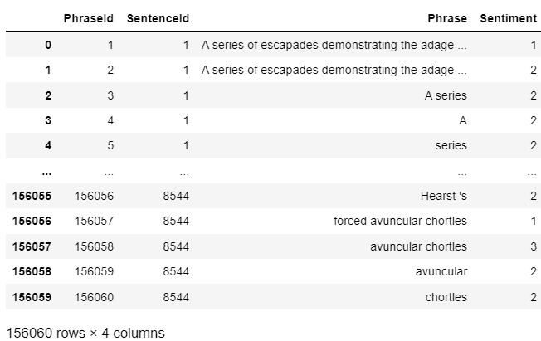
DATASET INTRODUCTION
Features: {PhraseId, SentenceId, Phrase, Sentiment}
Rows: 156060
Columns: 4
Rows utilized: 10000
(for the sake of enabling computation for all the
models like GBDT which take a lot of time.)
Output Classes: 5

Slide 5
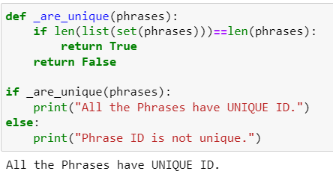
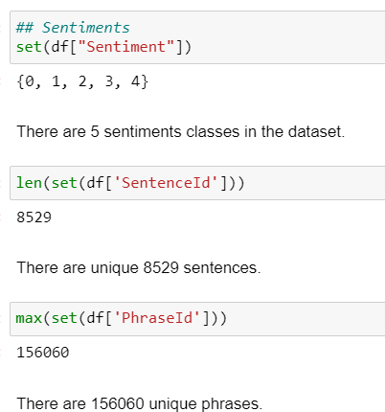
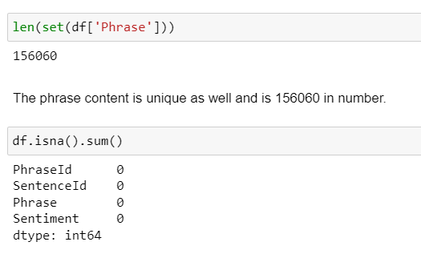
DATASET INTRODUCTION

Slide 6
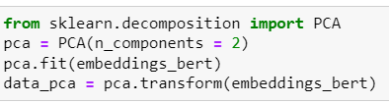
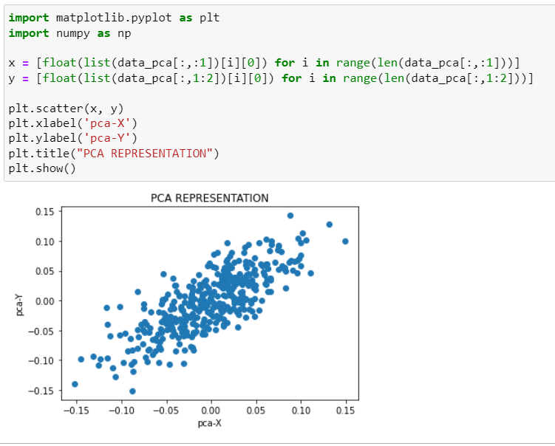
PHRASES PLOTTING IN 2-D USING PCA

Slide 7
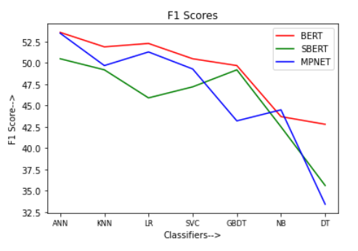
F1 Score

Slide 8
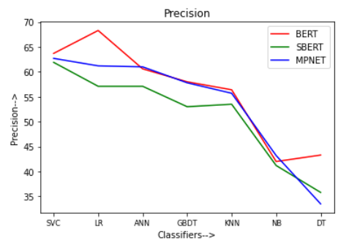
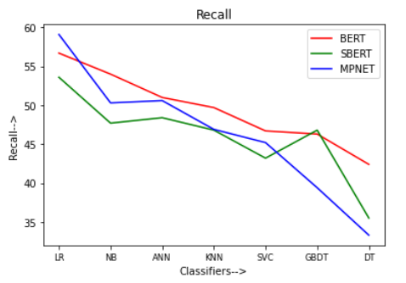
Precision and Recall

